Slide 1

Middleware Framework
Component
Data Subscriber
Component Operation
Executor Code
[Business Logic]
Data Publisher
Component Scheduling Queue
Operation Deadline Monitor
Timers
&
State Variables
Server
Client
Network QoS Arbiter

Slide 2
Middleware Framework
Component
Data Subscriber
Component Operation
Executor Code
[Business Logic]
Data Publisher
Component Operation Scheduling Queue
Component Operation Deadline Monitor
Timers
&
State Variables
Server
Client

Slide 3
Node 4
Network
Node 2
Node 2
Node 3
Node 4
Node 1
Node 2
Component
Component
Component
Component
Component
Component
Component
Node 3
Component

Slide 4

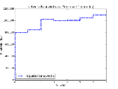
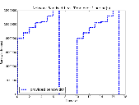
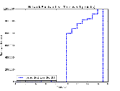
Routing Node
Flow 1:
High Priority
From Source 1
To Sink 1
Flow 2:
Low Priority
From Source 2
To Sink 2
High Priority Queue
Low Priority Queue
Network
Interface
IN
OUT
Node 1
Node 2
`
Source 1
Sink 1
Node 3
Node 4
Source 2
Sink 2

Slide 5
Flow 1:
High Priority
From Source 1 to Sink 1
Flow 2:
Low Priority
From Source 2 to Sink 2
Node 1
Node 2
`
Source 1
Sink 1
Routing Node
High Priority Queue
Low Priority Queue
Node 3
Node 4
Source 2
Sink 2

Slide 6
Application Data Communication Channel
Out-of-Band Communication Channel
Node 1
Node 2
Sink 1
Source 1
Sink 2
Source 2
Node 3
Node 4
Source 3
Source 4

Slide 7
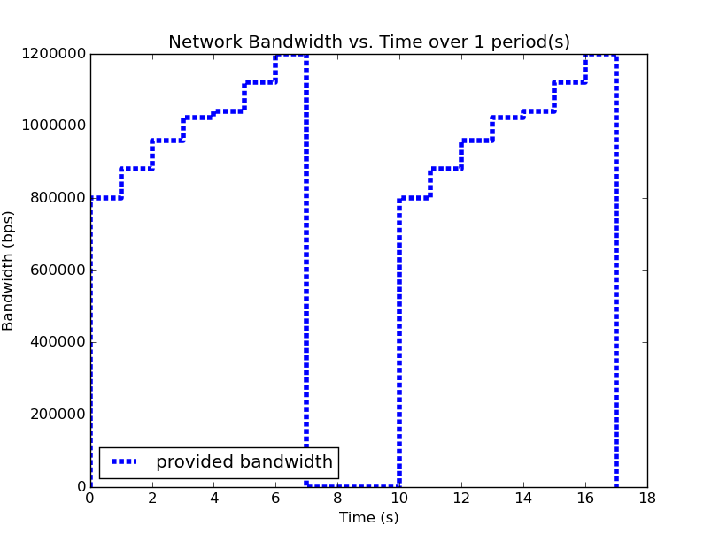
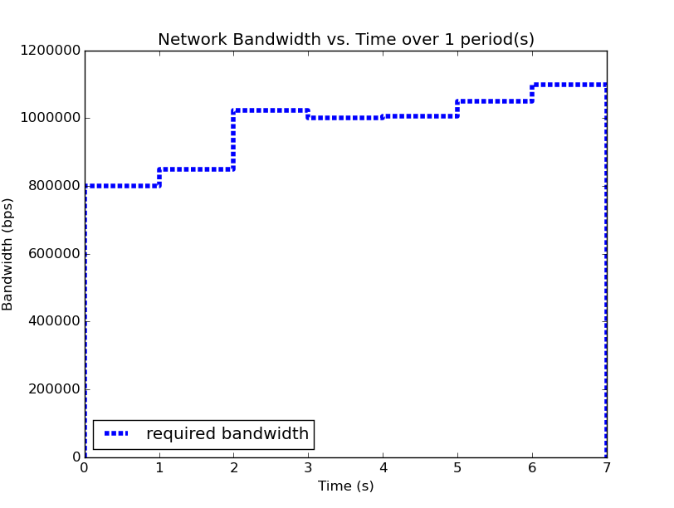
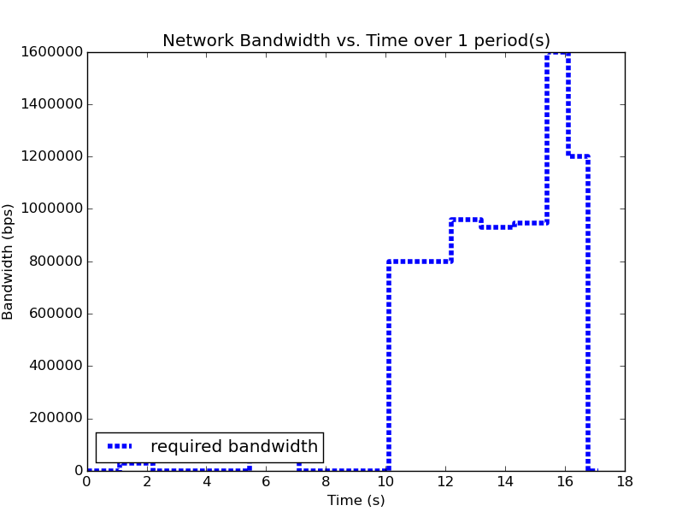
Node 1
Node 2
Node 3
Node 4

Slide 8
Traffic produced by the application is received by the Linux TC in the Kernel and filtered into QDISCs where it awaits transmission.
Enqueue
Dequeue
Root:
Network Interface
Enqueue:
Traffic leaving on the network interface filters down the tree until it reaches a leaf QDISC, where it is enqueued
Dequeue:
A packet at the front of a QDISC is dequeued and enqueued into the QDISC’s parent QDISC. If the parent is the root, it is transmitted.
Priority QDISC
Filter
This filter separates traffic into two classes:
Application Traffic
Other Network Traffic
High Priority
Low Priority
Delay
QDISC
FIFO
QDISC
Traffic Shaping QDISC
Filter
This filter separates traffic into two classes:
High Priority
Low Priority
High Priority
Low Priority
FIFO
QDISC
FIFO
QDISC

Slide 9
The arrival time between packets on node 2 is the inter-arrival time (IAT)
Data
Time
Node 1
Node 2
Constant Delay:
IAT does not change, so bandwidth measured at the receiver does not change
IAT
Constant Delay
Increasing Delay:
IAT increases, so bandwidth measured at the receiver decreases
Increasing Delay
Decreasing Delay
Decreasing Delay:
IAT decreases, so bandwidth measured at the receiver increases

Slide 10
Priority
Handler
High Priority
Network Traffic
Filter
Medium Priority
Shaper
Non Application
Network Traffic:
Outbound traffic destined for the network interface is first filtered into three queues. Application traffic is filtered by priority into the high and medium priority queues, where it will be shaped and delayed according to the link profile. Non application traffic is sent to the lowest priority queue and not shaped.
Delay
Network
Interface

