Slide 1
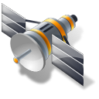
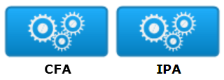
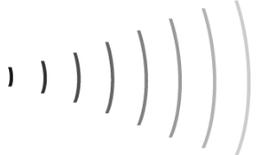

Software Bundle on each satellite
Sat 3
Sat 2
Application | Software Components | Partition
Cluster Flight Application (CFA) | Orbital Maintenance | Temporal Partition 1
 | Trajectory Planning | System
 | Module Proxy | System
 | Command Proxy | System
Image Processing Application (IPA) | Image Processing Component (4 on each) | Temporal Partitions 2 & 3
Ground Network
Sat 1
Cluster Leader
System Entity | Simulation/Emulation
Network | Dummynet
Physical Dynamics | Orbiter Space Flight Simulator
Satellite Hardware | IBX N270
DESIGN-TIME MODELING
RUN-TIME DEPLOYMENT/MANAGEMENT

