Slide 1
SURE Project Meeting 2015-01-16 Network QoS Research and Applications to SURE
William Emfinger
emfinger@isis.vanderbilt.edu
2015/01/16

Slide 2
Outline
Background
(min,+) calculus
Network Calculus
Completed Work:
Theory
Implementation
Continuing Work
Application to SURE

Slide 3

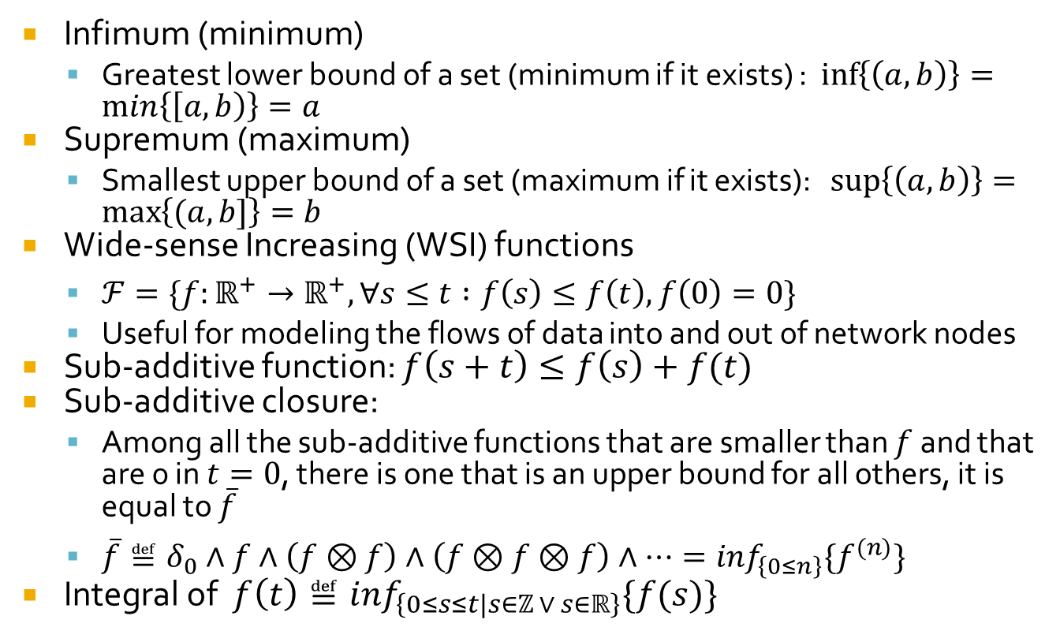
Background: (min,+) calculus $$(ℝ∪\left\{+∞\right\},∧,+)$$
Infimum (minimum)
Greatest lower bound of a set (minimum if it exists) : $\inf\left\{\left(a,b\right)\right\}=\min\left\{\left[a,b\right)\right\}=a$
Supremum (maximum)
Smallest upper bound of a set (maximum if it exists): $\sup\left\{\left(a,b\right)\right\}=\max\left\{(a,b]\right\}=b$
Wide-sense Increasing (WSI) functions
$ℱ=\{f:ℝ^{+}→ℝ^{+}, ∀s≤t :f\left(s\right)≤f\left(t\right),f\left(0\right)=0\}$
Useful for modeling the flows of data into and out of network nodes
Sub-additive function: $f\left(s+t\right)≤f\left(s\right)+f(t)$
Sub-additive closure:
Among all the sub-additive functions that are smaller than $f$ and that are 0 in $t=0$, there is one that is an upper bound for all others, it is equal to $\overline{f}$
$\overline{f}≝δ_{0}∧f∧\left(f⊗f\right)∧\left(f⊗f⊗f\right)∧⋯=\inf_{\left\{0≤n\right\}}\{f^{(n)}\}$
Integral of $f\left(t\right)≝\inf_{\left\{0≤s≤t|s∈ℤ ∨ s∈ℝ\right\}}\{f(s)\}$
Notes:
If a function is concave with f(0)=0, then it is sub-additive
Subadditivity is required for defining meaningful constraints

Slide 4
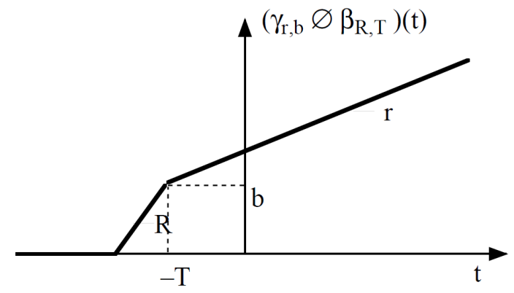
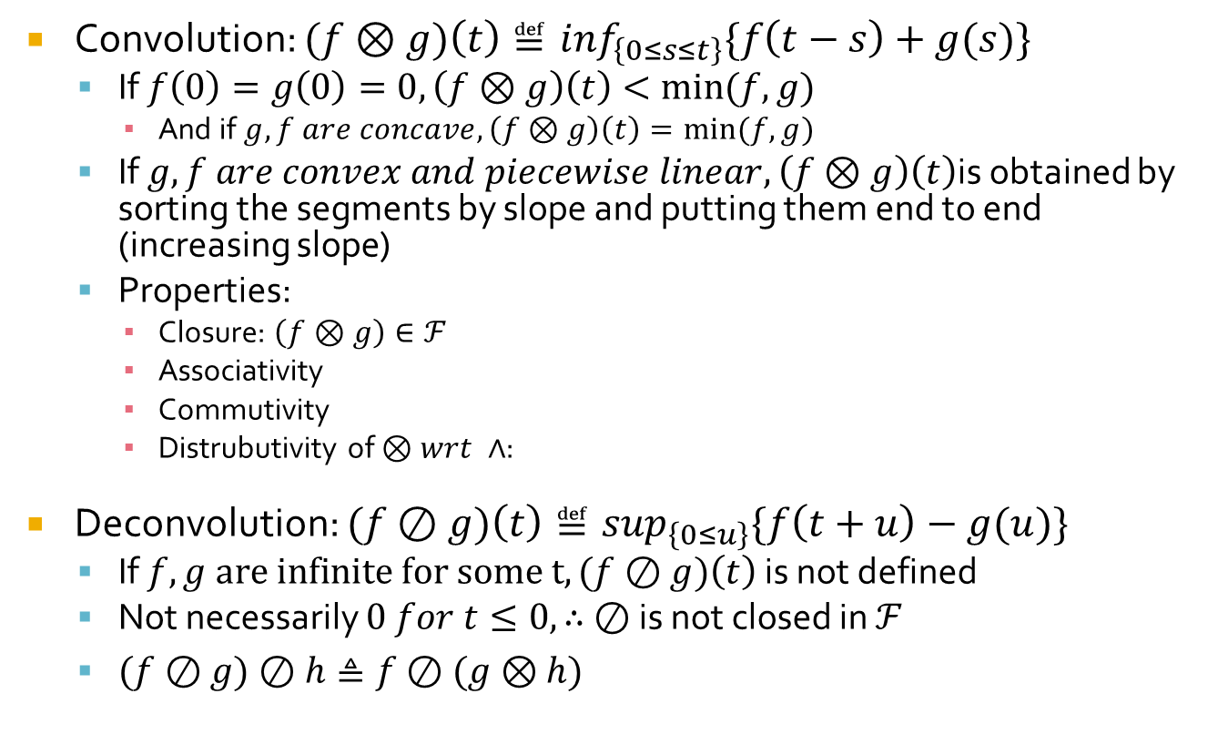
Background: (min,+) calculus $$(ℝ∪\left\{+∞\right\},∧,+)$$
Convolution: $(f⊗g)\left(t\right)≝\inf_{\left\{0≤s≤t\right\}}\{f\left(t−s\right)+g(s)\}$
If $f\left(0\right)=g\left(0\right)=0, \left(f⊗g\right)\left(t\right)<min⁡(f,g)$
And if $g,f are concave,\left(f⊗g\right)\left(t\right)=min⁡(f,g)$
If $g,f are convex and piecewise linear,\left(f⊗g\right)\left(t\right)$is obtained by sorting the segments by slope and putting them end to end (increasing slope)
Properties:
Closure: $\left(f⊗g\right)∈ℱ$
Associativity
Commutivity
Distrubutivity of $⊗wrt ∧$:
Deconvolution: $(f⊘g)\left(t\right)≝\sup_{\left\{0≤u\right\}}\{f\left(t+u\right)−g(u)\}$
If $f,g are infinite for some t,(f⊘g)\left(t\right)$ is not defined
Not necessarily $0 for t≤0, ∴ ⊘$ is not closed in $ℱ$
$(f⊘g)⊘h≜f⊘(g⊗h)$

Slide 5
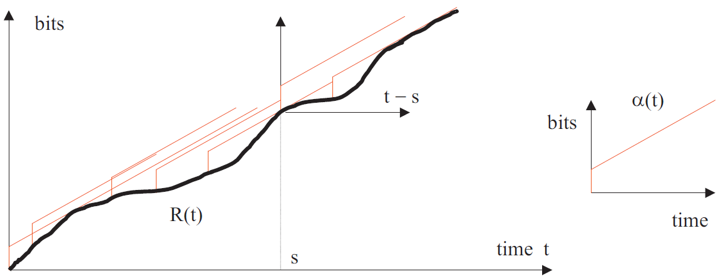

Background: Network Calculus
Arrival Curve
Arrival function for data flow $R(t)$ = number of bits seen on the flow during time interval $[0,t]$.
WSI function $α$ constrains the flow iff $∀s≤t:R\left(t\right)−R\left(s\right)≤α(t−s)$
Equivalently $R≤R⊗α$
Therefore $α$ is called the $arrival curve$ of the flow
Example: Leaky Bucket arrival curve $α(t)=b+rt$

Slide 6
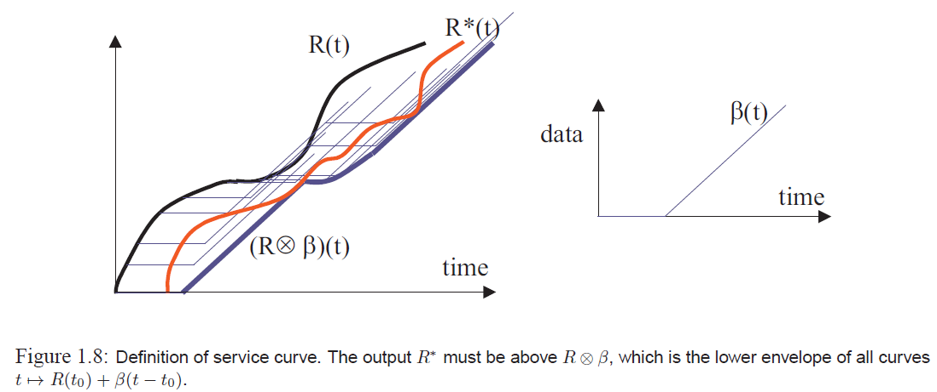
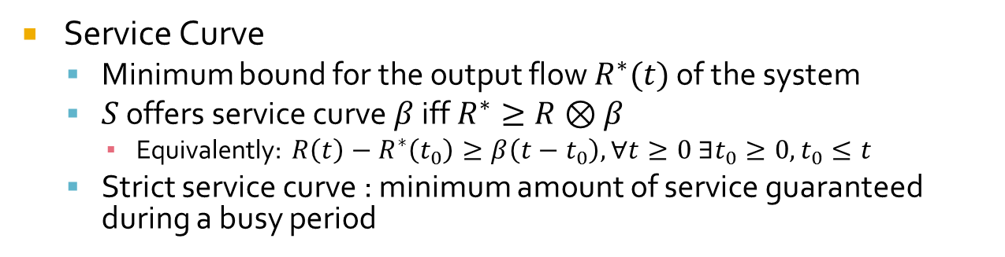
Background: Network Calculus
Service Curve
Minimum bound for the output flow $R^{∗}(t)$ of the system
$S$ offers service curve $β$ iff $R^{∗}≥R⊗β$
Equivalently: $R\left(t\right)−R^{∗}\left(t_{0}\right)≥β\left(t−t_{0}\right),∀t≥0 ∃t_{0}≥0, t_{0}≤t$
Strict service curve : minimum amount of service guaranteed during a busy period

Slide 7
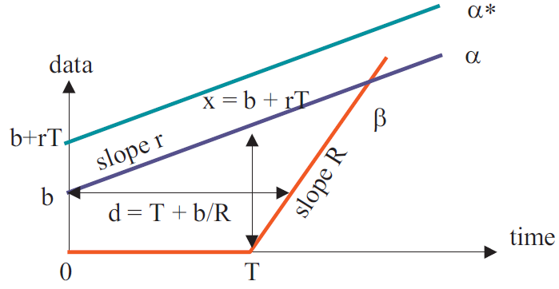
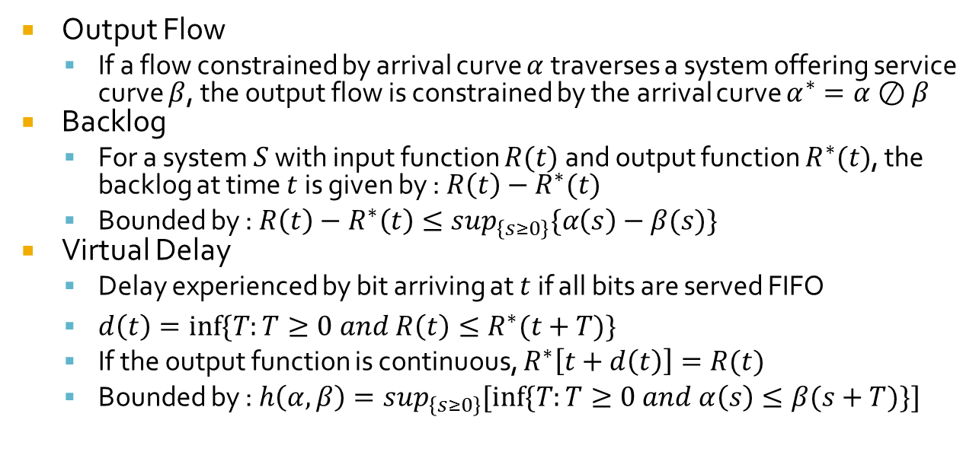
Background: Network Calculus
Output Flow
If a flow constrained by arrival curve $α$ traverses a system offering service curve $β$, the output flow is constrained by the arrival curve $α^{∗}=α⊘β$
Backlog
For a system $S$ with input function $R(t)$ and output function $R^{∗}(t)$, the backlog at time $t$ is given by : $R\left(t\right)−R^{∗}(t)$
Bounded by : $R\left(t\right)−R^{∗}\left(t\right)≤\sup_{\left\{s≥0\right\}}\{α\left(s\right)−β(s)\}$
Virtual Delay
Delay experienced by bit arriving at $t$ if all bits are served FIFO
$d\left(t\right)=inf⁡\{T:T≥0 and R\left(t\right)≤R^{∗}(t+T)\}$
If the output function is continuous, $R^{∗}\left[t+d\left(t\right)\right]=R(t)$
Bounded by : $h\left(α,β\right)=\sup_{\left\{s≥0\right\}}[inf⁡\{T:T≥0 and α\left(s\right)≤β(s+T)\}]$
Notes:
Backlog = amount of bits inside the system (in the buffers)
Continuous means no batch departure
Bounds are tight if $α$ is a good function (i.e. WSI, sub-additive, & $α\left(0\right)=0$) and $β\left(0\right)=0$, $β$ is WSI
Tight means $α$* is the minimum arrival curve for R*

Slide 8
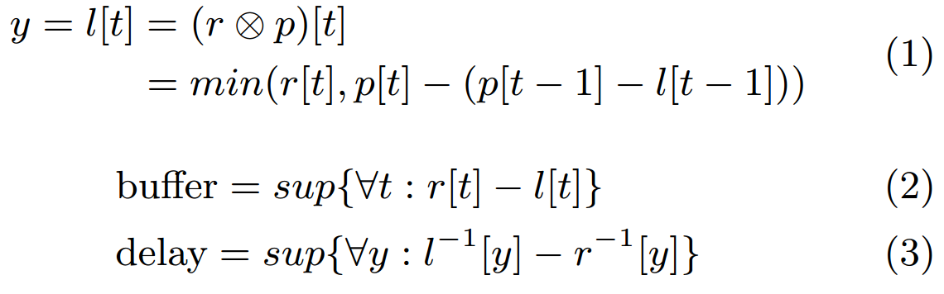
Network QoS Analysis (1/3)
Application and System network profiles specified as data-rate as a function of time; time-integration gives data as a function of time for each profile
Composition based on (min,+) concepts from Network Calculus given the following data vs. time profiles:
Application data generation profile: r[t]
System capacity profile: p[t]
Convolution of r[t] and p[t] produces the link transmitted data profile: l[t]
Take-away: with this profile specification, we can perform easy calculations to predict required buffer size and delay experienced

Slide 9
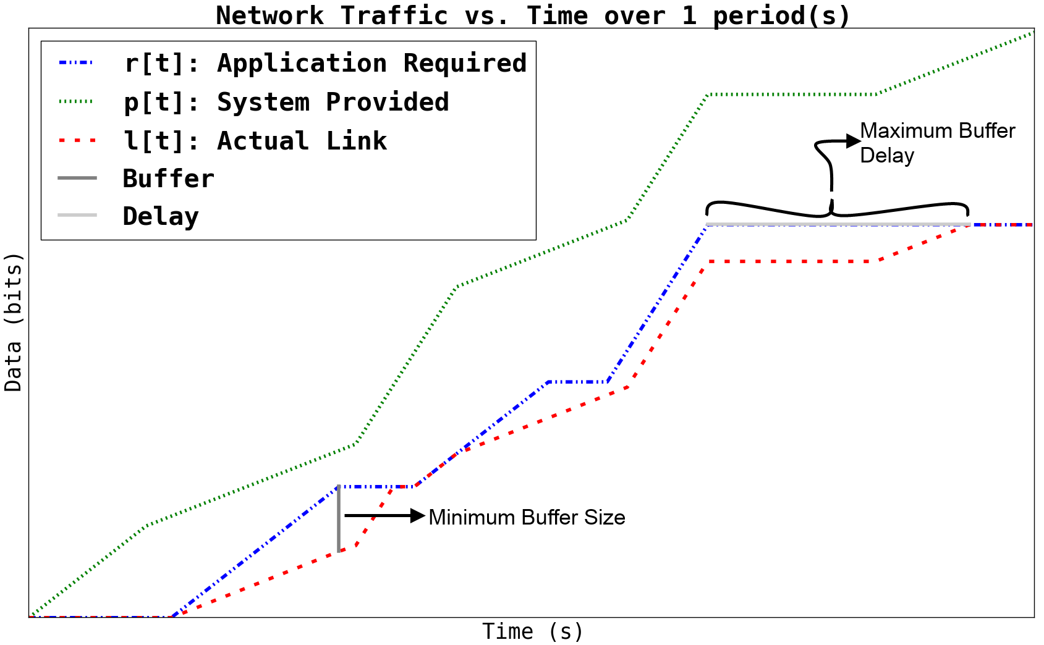
Network QoS Analysis (2/3)

Slide 10
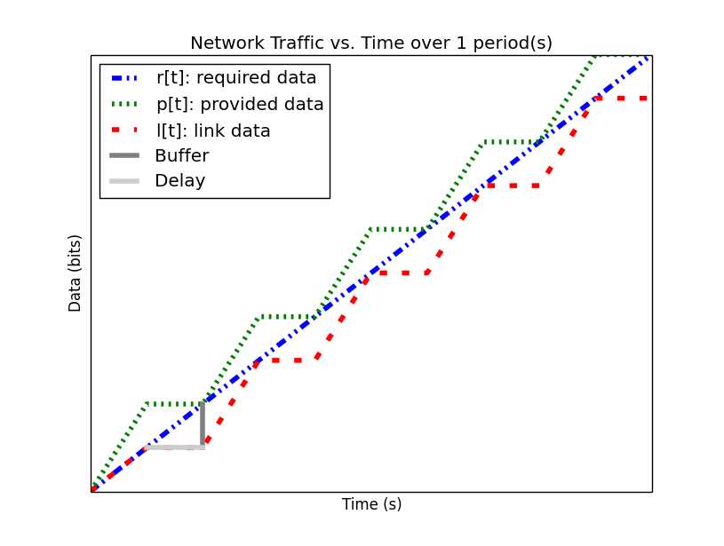
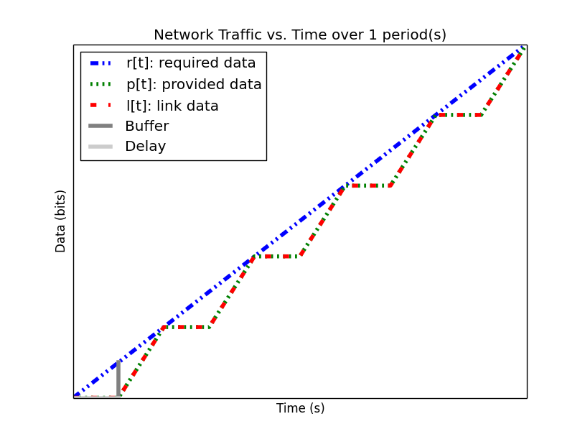
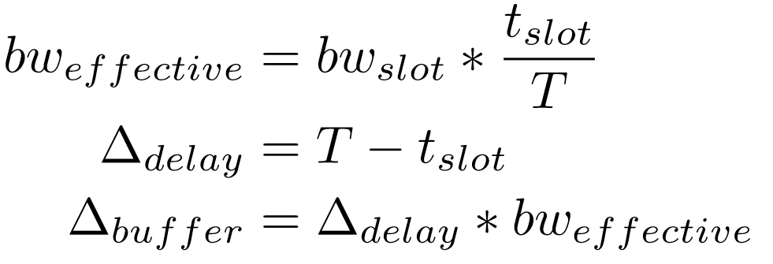
Network QoS Analysis (3/3)
System descriptions so far have been abstract:
Simply bandwidth as a function of time
How does the inclusion of the network medium channel access protocol affect the results?
Explicitly model TDMA profile and integrate it into the system profile
We can determine formulas which remove the need to explicitly model TDMA

Slide 11
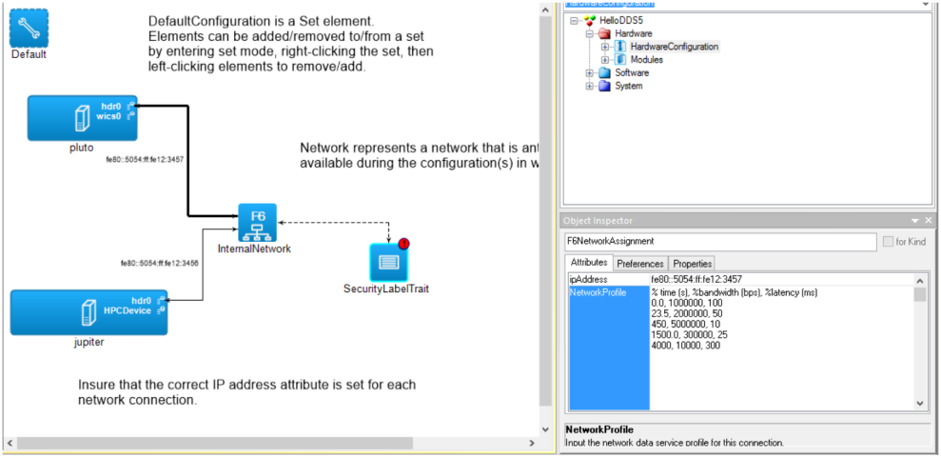
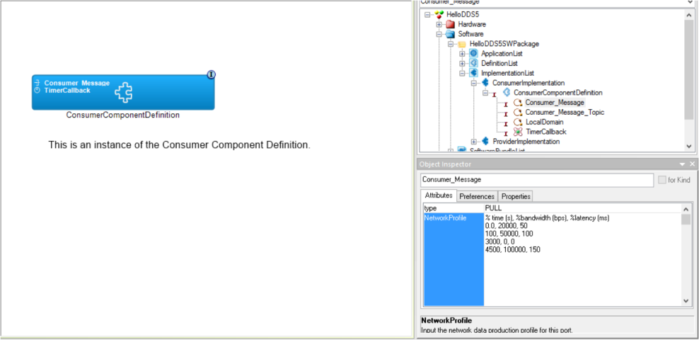
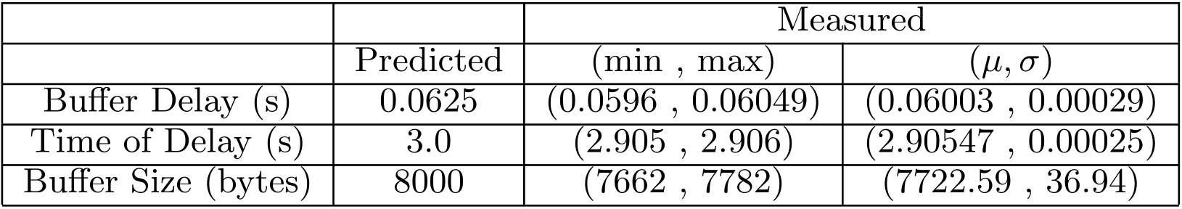
Implementation of Theory
Network QoS analysis algorithms and tools integrated into a modeling toolsuite (GME/F6ML)
Allows developers to input application/system network profiles and perform design-time analysis of their applications on the system
Experimental applications which generate network traffic according to the supplied network profile
Measurements used to validate the theoretical buffer and delay results
Run on system with traffic shaping to enforce the system network profiles

Slide 12
Integration into a middleware stack: DREMS
Every port of every component has measurement and enforcement code auto-generated into it
Uses as input the port’s data profile from the modeling tools
Measures the traffic going out of the port
Enforces that the traffic does not exceed the supplied profile
Every node in the system has a network manager process (Node Communications Resource Manager)
Ensures that at all times, the traffic flowing out of the node onto the network conforms to the provided system profile

Slide 13
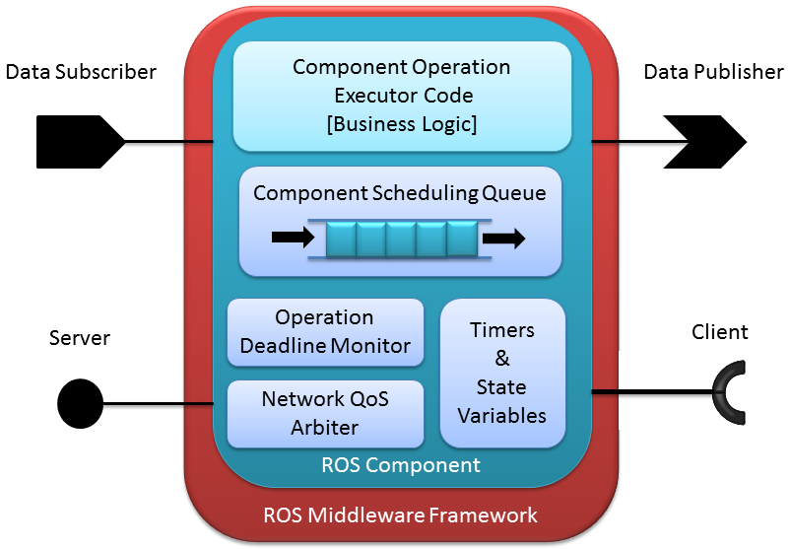
ROSMOD : Work in Progress (1/2)
Robot Operating System
Lightweight middleware providing
Publish/subscribe
Point-to-point (RMI)
Timers
ROSMOD:
Component model add-on for ROS with support for:
Composition of component-based applications
Analysis of network QoS and business logic timing

Slide 14
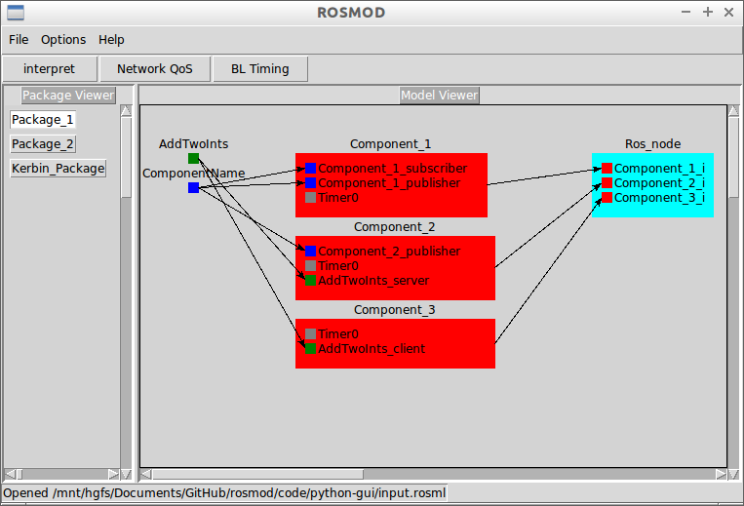
ROSMOD: Work in Progress (2/2)
Textual specification language for ROSMOD: ROSML
Allows the specification of
ROS Services (w/ clients & servers)
ROS Messages (w/ pub/sub)
ROS Timers
ROSMOD Component Definitions
ROS Nodes (processes)
ROSMOD Component Instances
Templates allow for the generation of component code from ROSML specification
ROSMOD Graphical Editor
Allows developers to view/edit ROSML models and generate executable component application code

Slide 15
ROSMOD: Adding Network QoS Analysis
Continuing our work from DREMS:
Building a component model from the ground up with our Network QoS analysis built-in
Run-Time measurement of network resource utilization per component
Run-Time arbitration of network resources between components
Run-Time enforcement of application network profiles
Integrating our network analysis paradigm into the modeling language and the toolsuite

Slide 16
Continuing and Future Work
Theory:
Extension to other types of networks, heterogeneous networks
Extension to allow multiple traffic priorities
Extension to routed networks & dynamic networks
Extension to adaptive systems
Generation of profiles from business-logic code generation
Implementation:
Integration with ROS component implementation
Run-Time Arbitration
Run-Time Measurement
Run-Time Anomaly detection
Integration into ROSMOD environment and ROSML

Slide 17
Application to SURE
These network models represent normal application behavior during run-time
Deviation from these parameters constitutes an anomaly
If we can analyze these anomalies, we can classify them and their security threat
Integration with application business logic modeling will produce more precise network models for the applications
Run-time measurement and arbitration of the network resources
Allows us to detect the anomalies
Constrain the application(s) based on the threat
We can isolate application(s) from the network
We can isolate node(s) from the network
We can throttle the application network resources (variably)
We can throttle the node network resources (variably)

Slide 18
Questions?

