Slide 1
Network Performance Analysis and Management for Cyber-Physical Systems and their Applications
William Emfinger
Vanderbilt University/ISIS
The DARPA System F6, AFRL RESOS, and AFRL SURE Projects supported this work. Any opinions, ﬁndings, and conclusions or recommendations expressed in this material are those of the authors and do not reﬂect the views of DARPA or AFRL.
Notes:
Better explanations of how it is a single period and the first period
Formally prove the 2 period predicate
Business logic is complicated
Timeline is difficult
Improve the math : make it based on a period possibly or make it more explicit and concise? Idk just make it better

Slide 2
Outline
Introduction
Related Work
Results:
Design-Time Network Performance Analysis of Distributed CPS Applications
Precise Network Performance Prediction
Comparison with Network Calculus
Analysis of Periodic Systems
Analysis of TDMA Scheduling
Compositional Analysis
Delay Analysis
Analysis of Statically Routed Networks
Run-Time Network Performance Monitoring and Management for Distributed CPS Applications
Measurement, Detection, and Enforcement
DDoS Detection
Conclusions and Future Work
Publications
Notes:
Mention admittance test

Slide 3

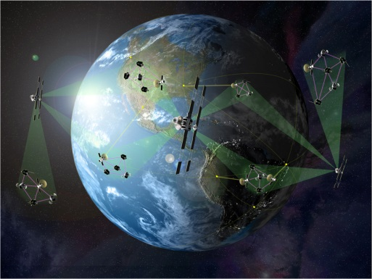

Introduction
Cyber-Physical Systems (CPS):
According to NIST: CPS are smart systems that include co-engineered interacting networks of physical and computational components
Embedded computers, sensing/actuation software, tightly coupled physical system
Communications network (wireless) acts as backbone for cooperation between nodes
Network resources provided as a service to users
Network resource availability affected by both application load and system’s environment
Bandwidth (bits/sec)
Buffering delay and transmission delay
Availability of network resources
Some systems may have deterministic, time-varying network characteristics or application network load (or both)
Design-time analysis is critical for applications which require tight and/or real-time guarantees
Use the analysis to perform test for admission into the system
Image Credit: DARPA
Notes:
Mention IoT thingies; focus on satellites because of challenging features
Mention why this is a special class inside of CPS:
managed remotely,
costly to operate,
need assurances (difficult to replace/repair)
Not a general purpose system/application

Slide 4
Related Work
Current research and techniques for predicting system performance and managing resources

Slide 5
Network Analysis through Simulation / Emulation
Discrete Event-based Simulation
Relevant events stepped through sequentially
Model state changes only at simulated time steps
Scaling Issues
OMNET++ [A. Varga, 2008]
Simulates network traffic passing through the network layers
NS-2 [D. Mahrenholz, 2004]
Single-threaded
Allows both simulation and emulation
Accuracy issues [G. Lucio, 2003]
Emulation
Use real system or testbed
Shape network traffic to enforce proper bandwidth/delay based on models of network
Dummynet [L. Rizzo, 1997, 2010]
Uses Linux’s underlying network traffic shaping and policing tools
Runs on system nodes or specific network emulation nodes
OpenFlow [O. S. Consortium, 2009]
Runs on compatible network hardware (e.g. a smart switch)
Acts on traffic as it flows through the switch
Simulation and Emulation are both widely used for system analysis and performance prediction, but may not capture relevant behavior
Cannot provide the types of performance guarantees described in the previous section
Notes:
Mention emulab when talking about emulation
Wireless emulation possibly difficult, not possible with many widely-used tools
Some labs do
Open Systems Interconnection Model (OSI):
Physical (DSL, USB)
Electrical and physical specs
Data Link (PPP, IEEE 802.2)
Node to Node
MAC
Physical error detection
Network (IPv4/6)
Routing
fragmentation
Transport (TCP,UDP)
reliability
Session (RPC)
Presentation (ASCII, JPEG)
Application (HTTP,FTP)
-----
Capturing system behavior from simulation/emulation is difficult: worst-case or edge-case behavior may not be represented

Slide 6
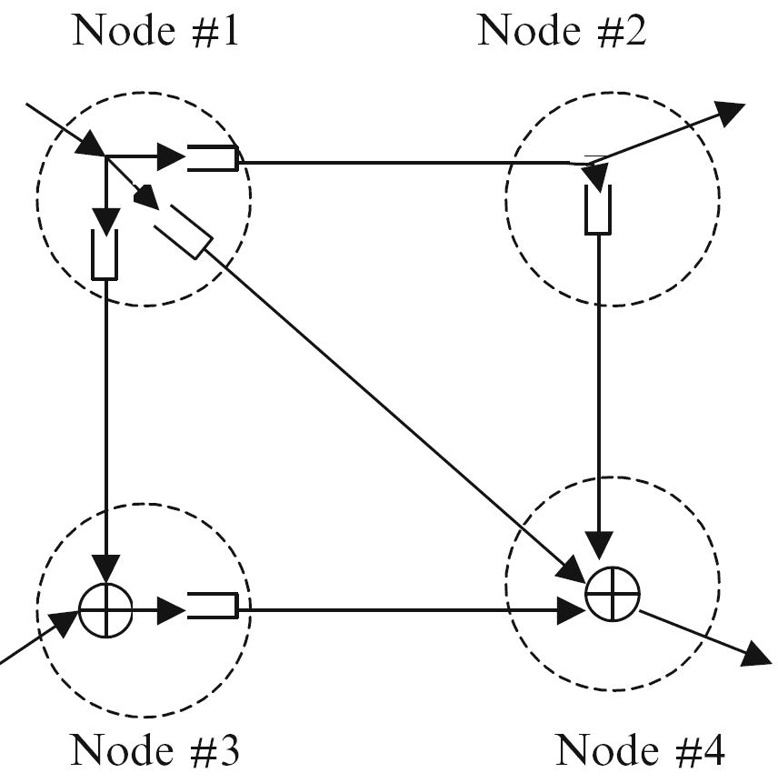
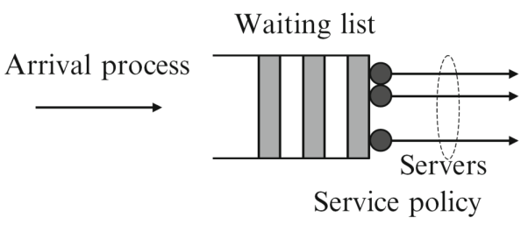
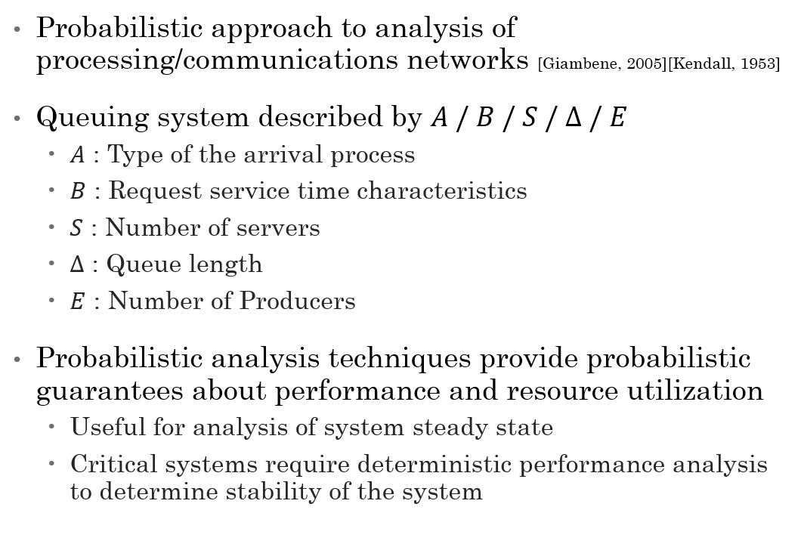
Queuing Theory
Probabilistic approach to analysis of processing/communications networks [Giambene, 2005][Kendall, 1953]
Queuing system described by $A / B / S / Δ / E$
$A$ : Type of the arrival process
$B$ : Request service time characteristics
$S$ : Number of servers
$Δ$ : Queue length
$E$ : Number of Producers
Probabilistic analysis techniques provide probabilistic guarantees about performance and resource utilization
Useful for analysis of system steady state
Critical systems require deterministic performance analysis to determine stability of the system
Notes:
Weak for non-steady state

Slide 7
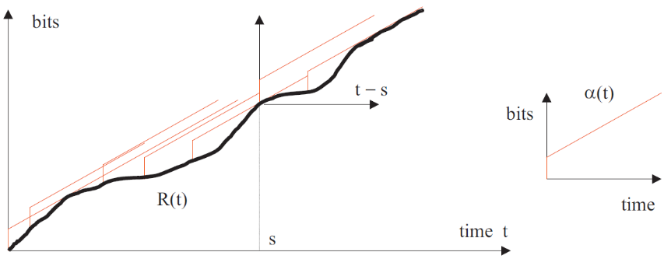
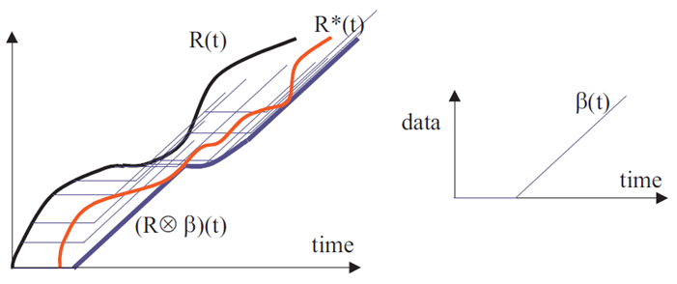
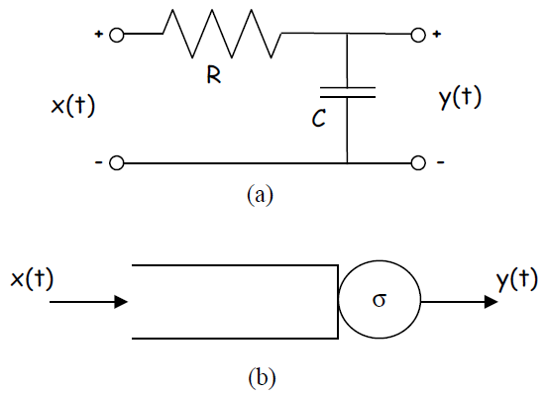
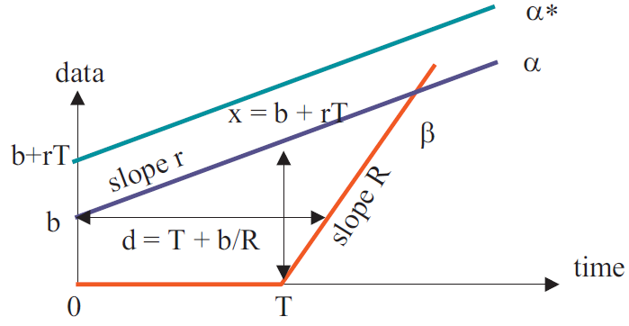
Deterministic Network Analysis : Network Calculus [Le Boudec, 2001][Cruz, 1991]
Based on (min,+)-calculus
Abstracts network traffic and computing nodes as arrival curves and traffic shaping service curves
Analytically predicts worst-case buffer requirements and application buffering delay
Applies system-theory concepts to computer network analysis
Input function (data input flow) convolved with a system function (shaper) to produce the output function (data output flow)
Allows the calculation of deterministic performance bounds on
Buffering delay
Buffer backlog

Slide 8
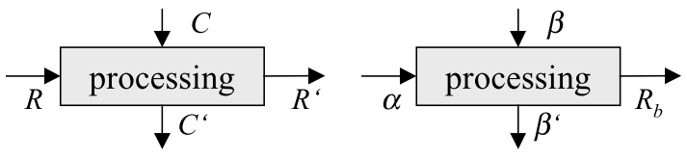
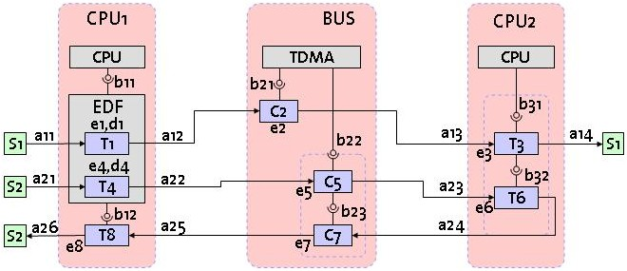
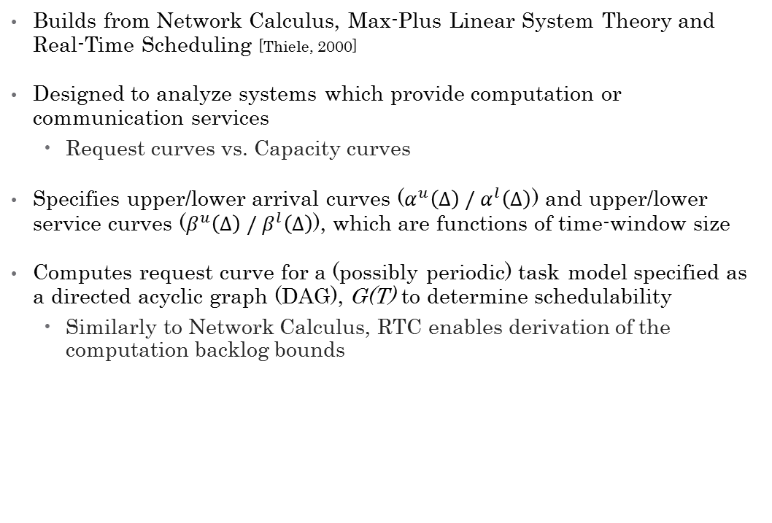
Real-Time Calculus
Builds from Network Calculus, Max-Plus Linear System Theory and Real-Time Scheduling [Thiele, 2000]
Designed to analyze systems which provide computation or communication services
Request curves vs. Capacity curves
Specifies upper/lower arrival curves ($α^{u}\left(Δ\right) / α^{l}\left(Δ\right)$) and upper/lower service curves ($β^{u}\left(Δ\right) / β^{l}\left(Δ\right)$), which are functions of time-window size
Computes request curve for a (possibly periodic) task model specified as a directed acyclic graph (DAG), G(T) to determine schedulability
Similarly to Network Calculus, RTC enables derivation of the computation backlog bounds
Notes:
Talk about the fig in the top, explain capacity and demand as it flows through the network
GPS: generalized processor sharing
EDF : earliest deadline first
FP : fixed priority
BS: best effort?
The graph’s vertices represent subtasks and each have their own associated
Required computation time e(u)
relative deadline d(u) specifying that the task must be completed d(u) units of time after its triggering
Two vertices in G(T) may be connected by a directed edge (u;v)
which has an associated parameter p(u;v) specifies the minimum time that must elapse after the triggering of u before v can be triggered
P(T) is the period of task T
Most researchers are still using QT, but many want more precise descriptions of application traffic and performance

Slide 9
Results
New techniques for increasing the precision of system analysis and resource management

Slide 10
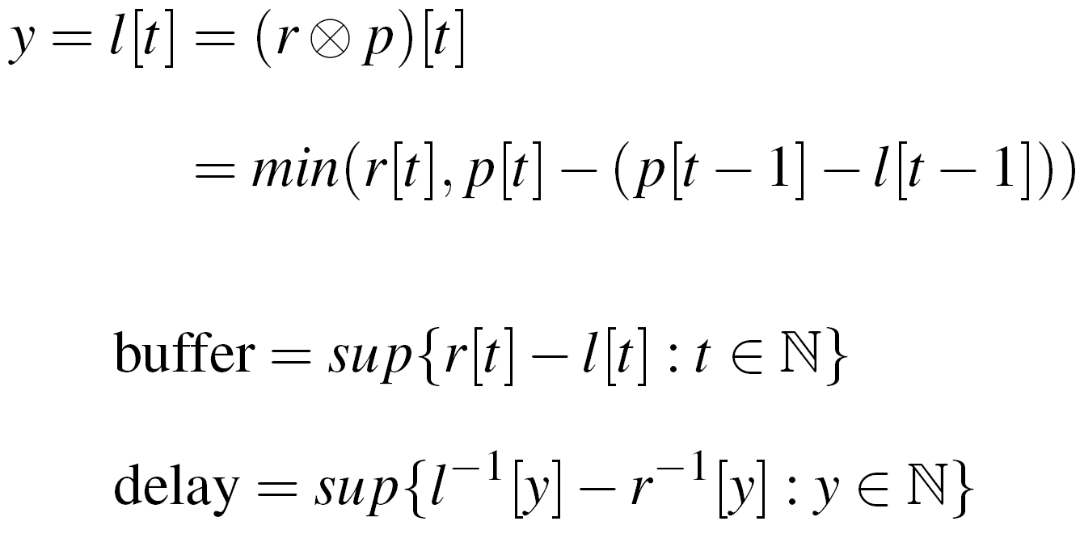
Network Performance Analysis for CPS Applications
To address the issues described above, we have developed a network modeling paradigm similar to Network Calculus’ arrival curves and service curves, called Precise Network Performance Prediction (PNP²)
In contrast to Network Calculus, we precisely model the network traffic as a function of time, i.e. bits produced or serviced as functions of time
Math/Algorithms are functionally the same
Convolve the application data profile with the system network service profile to obtain transmitted data profile
Given :
r[t] : application data profile
p[t] : system link capacity profile
We compute :
l[t] : the link transmitted data profile
Minimum buffer required
Maximum buffering delay

Slide 11
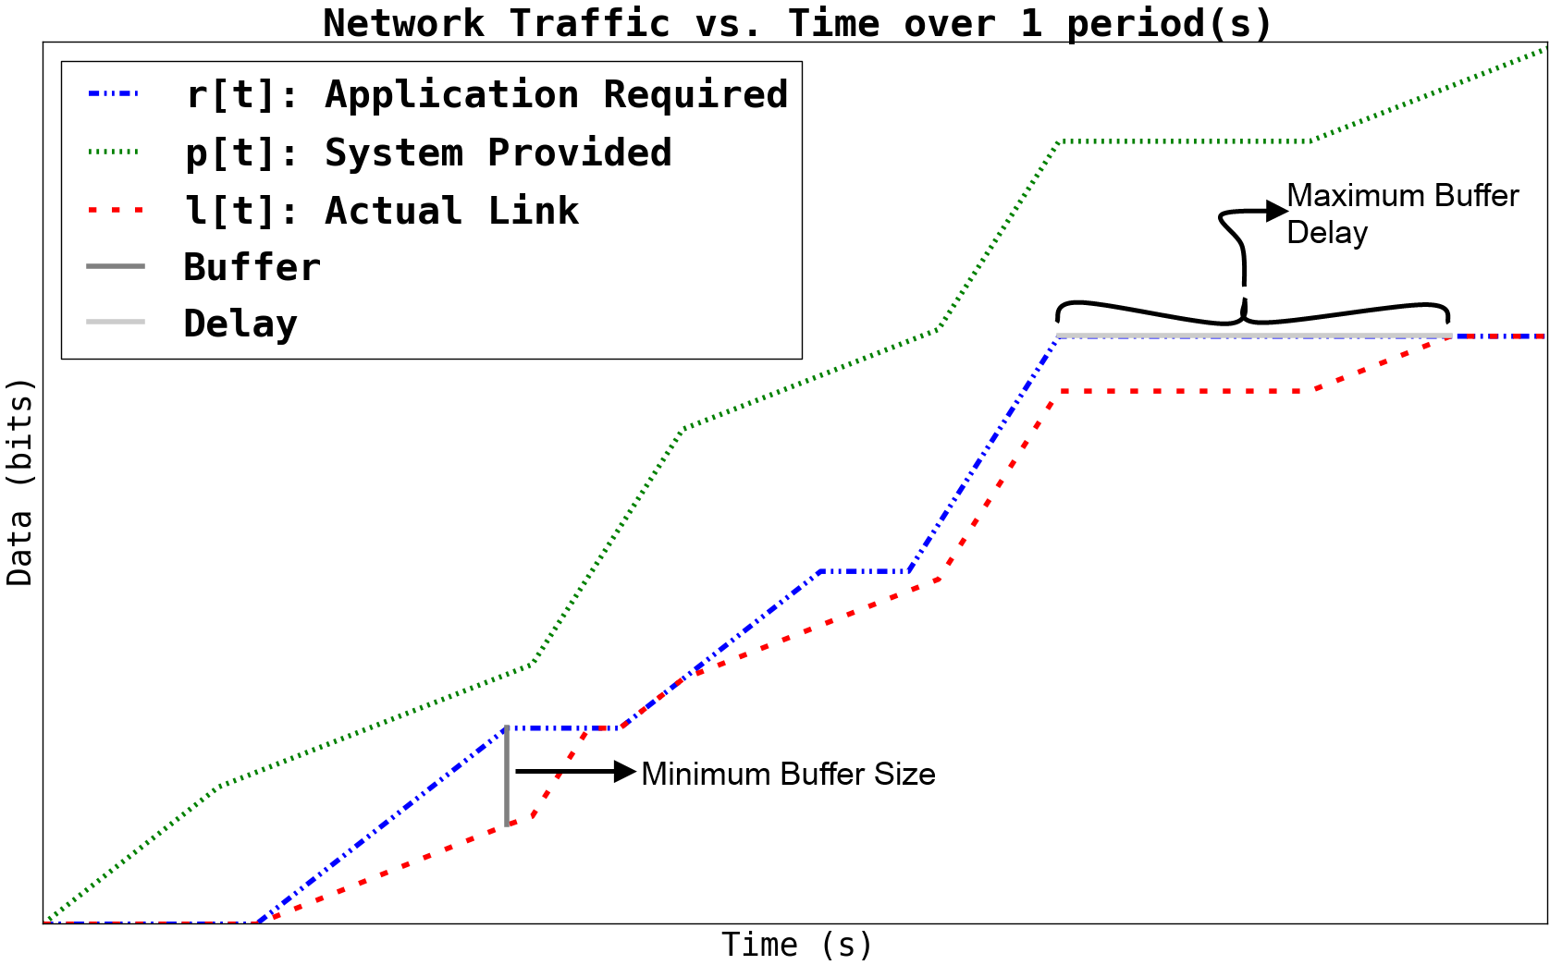
Network Performance Analysis for CPS Applications
Notes:
Reference my paper here; say it’s been implemented & measured with experiments

Slide 12
PNP² Accuracy and Comparison with NC
Validated the accuracy of PNP² predictions using custom network traffic generation code and a network testbed
Used Dummynet to perform traffic shaping and link emulation
Integrated Network Calculus model into PNP² tool, allows analysis of PNP² model using NC’s semantics
Enables direct, easy comparison between analysis techniques
Network Calculus defines arrival curves and service curves as functions of time-window size, therefore it cannot precisely analyze systems where the applications’ data production is tightly coupled with the service capacity of the system
i.e. applications know a prioi when the system will have high network capacity and are designed to send their data at that time

Slide 13
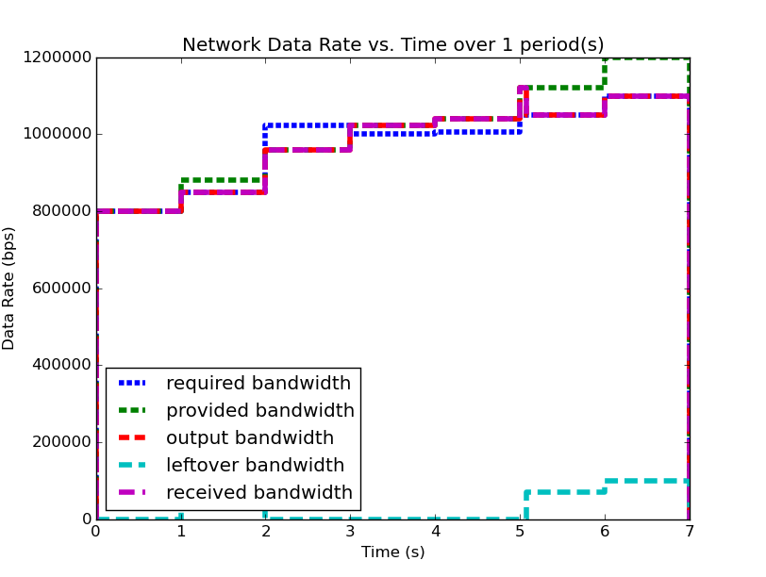
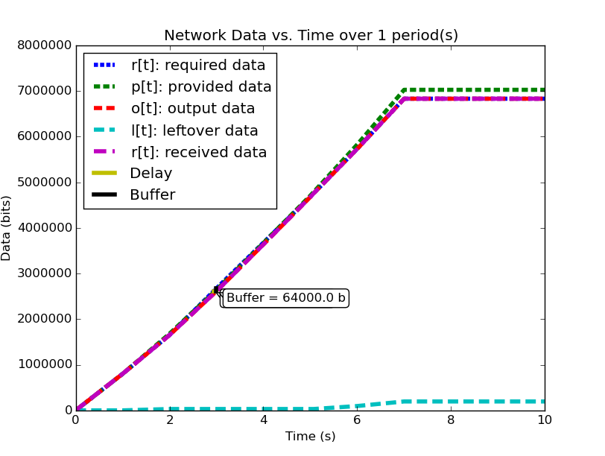
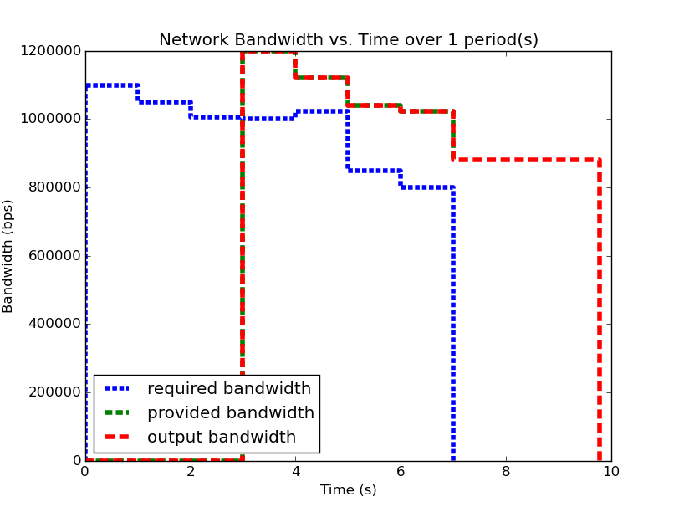
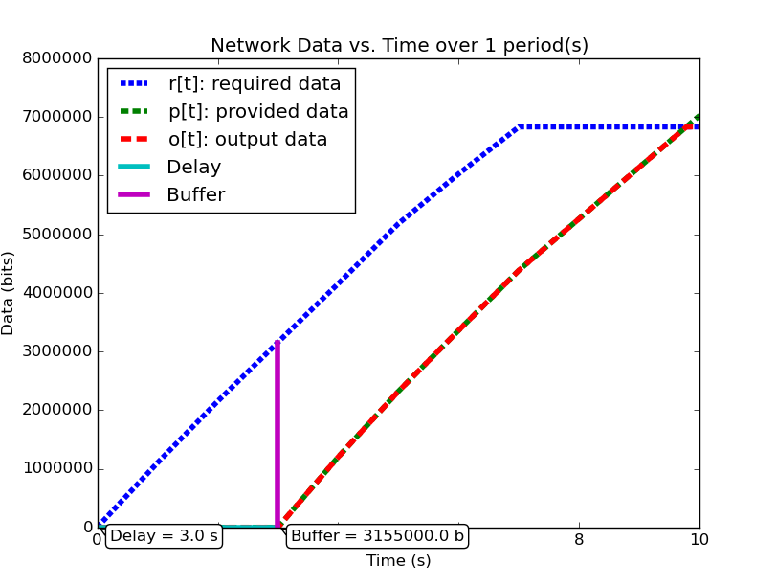
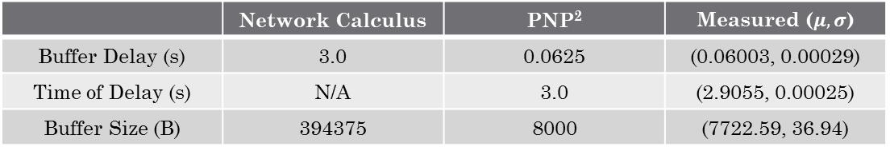
PNP²
NC
 | Network Calculus | PNP² | Measured ($μ, σ$)
Buffer Delay (s) | 3.0 | 0.0625 | (0.06003, 0.00029)
Time of Delay (s) | N/A | 3.0 | (2.9055, 0.00025)
Buffer Size (B) | 394375 | 8000 | (7722.59, 36.94)
Notes:
Talk about how the results are analyzed, i.e. why they are different and what that means
Time of delay can’t be calculated for NC because it loses the connection between data and time

Slide 14
Analysis of Periodic Systems (1/5) : Overview
Many systems exhibit some form of periodicity, where a system is periodic if the data production, service, or consumption (p/s/r) rate is a periodic function of time
Time-integral of periodic data rates is the cumulative data (p/s/r) rate in the system. These cumulative functions are called repeating functions.
We wish to analyze the behavior of the system, specifically by looking at the system’s outputs
If we show that the system’s outputs exhibit periodicity, we can show that the system has no unbounded buffer growth
We will examine two periodic systems and analyze how their behavior changes over the course of two periods.

Slide 15
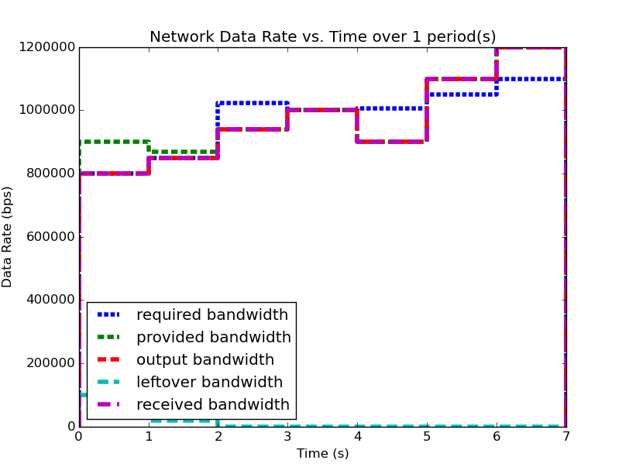
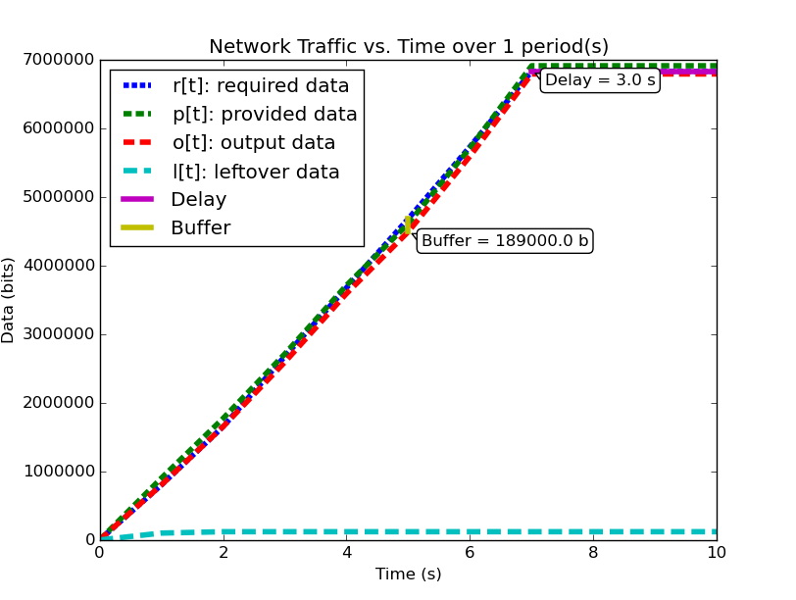
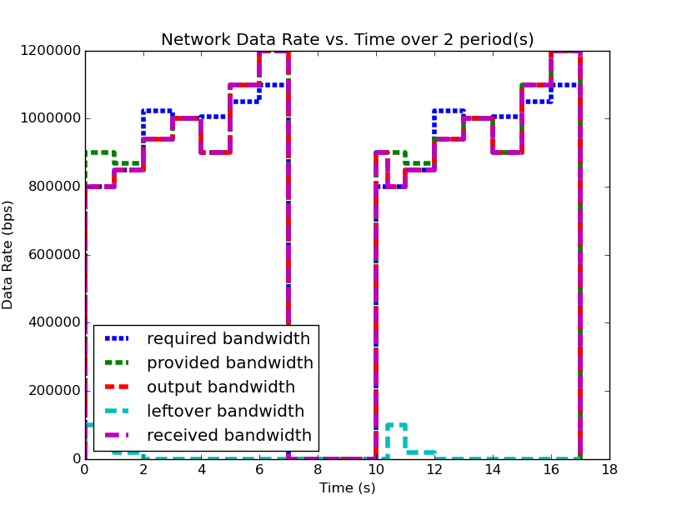
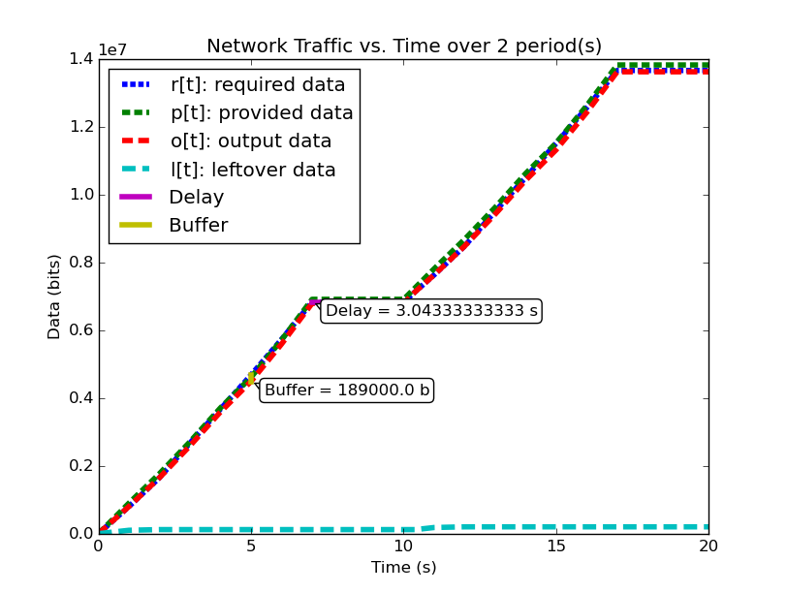
Analysis of Periodic Systems (2/5) : System 1

Slide 16
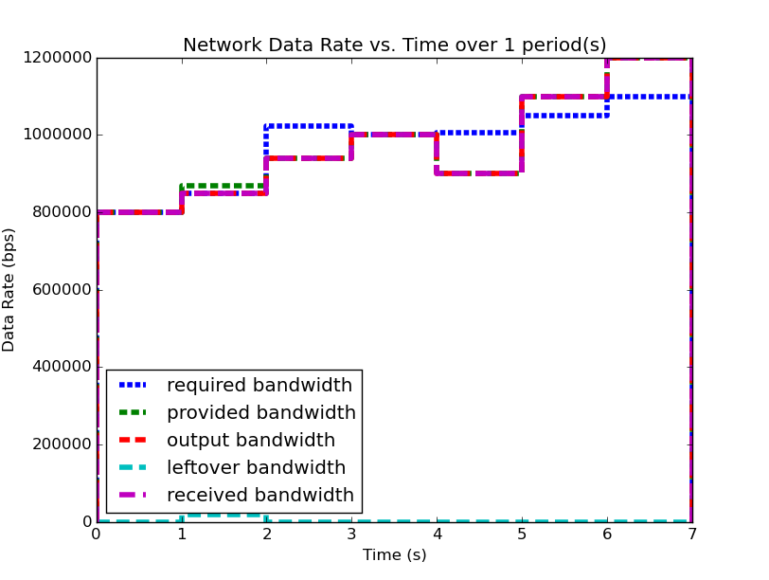
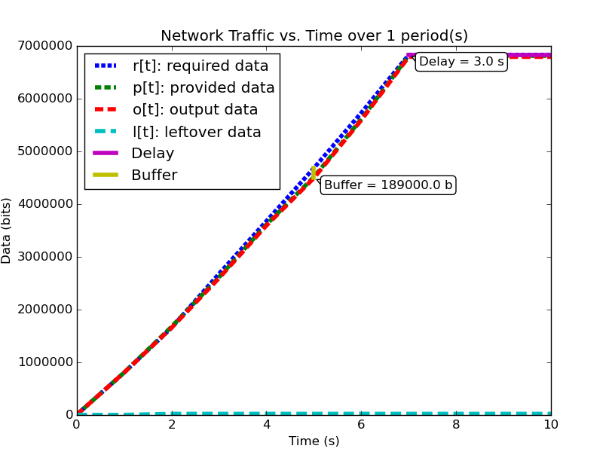
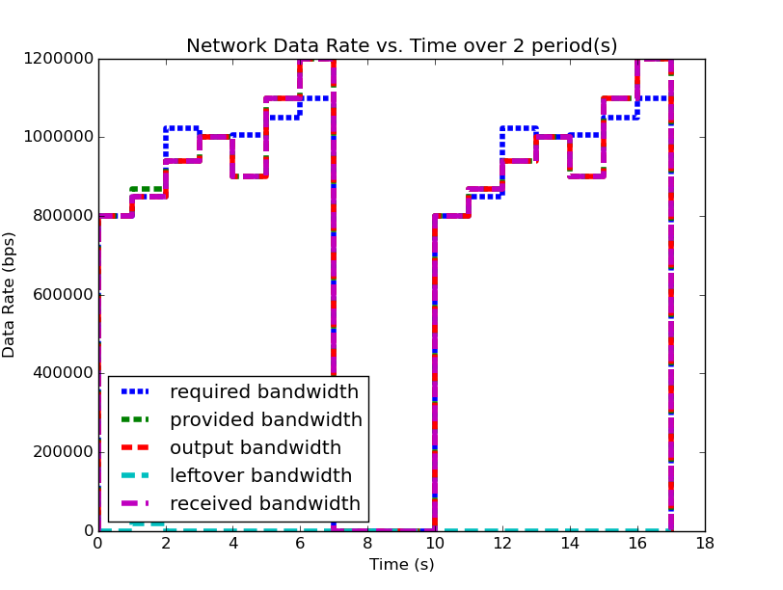
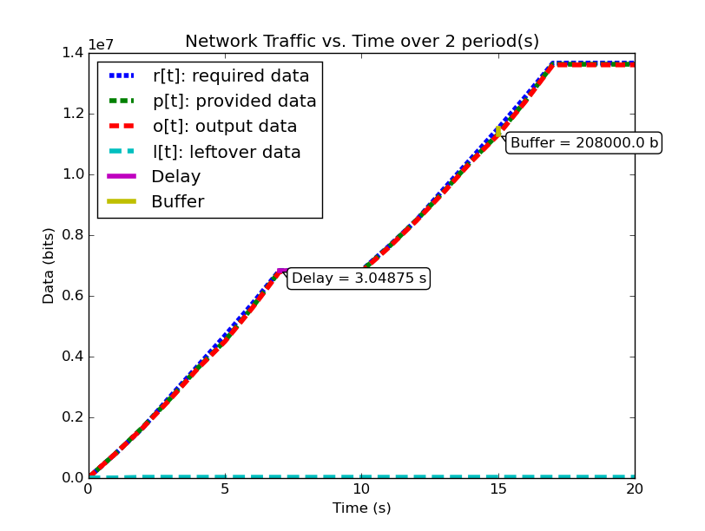
Analysis of Periodic Systems (3/5): System 2

Slide 17
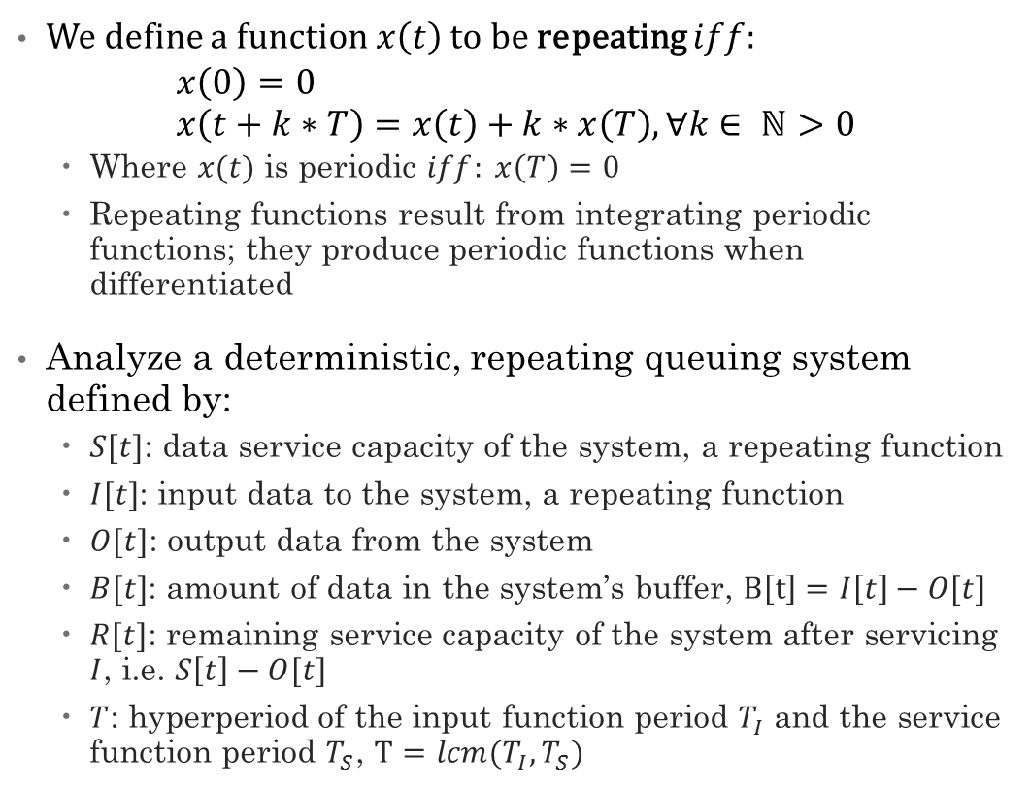
Analysis of Periodic Systems (4/5): Formal Definitions
We define a function $x\left(t\right)$ to be repeating $iff$:
$$x\left(0\right)=0 \\ x\left(t+k∗T\right)=x\left(t\right)+k∗x\left(T\right), ∀k∈ ℕ>0$$
Where $x(t)$ is periodic $iff: x\left(T\right)=0$
Repeating functions result from integrating periodic functions; they produce periodic functions when differentiated
Analyze a deterministic, repeating queuing system defined by:
$S[t]$: data service capacity of the system, a repeating function
$I[t]$: input data to the system, a repeating function
$O[t]$: output data from the system
$B[t]$: amount of data in the system’s buffer, $B\left[t\right]=I\left[t\right]−O[t]$
$R[t]$: remaining service capacity of the system after servicing $I$, i.e. $S\left[t\right]−O[t]$
$T$: hyperperiod of the input function period $T_{I}$ and the service function period $T_{S}$, $T=lcm(T_{I},T_{S})$

Slide 18
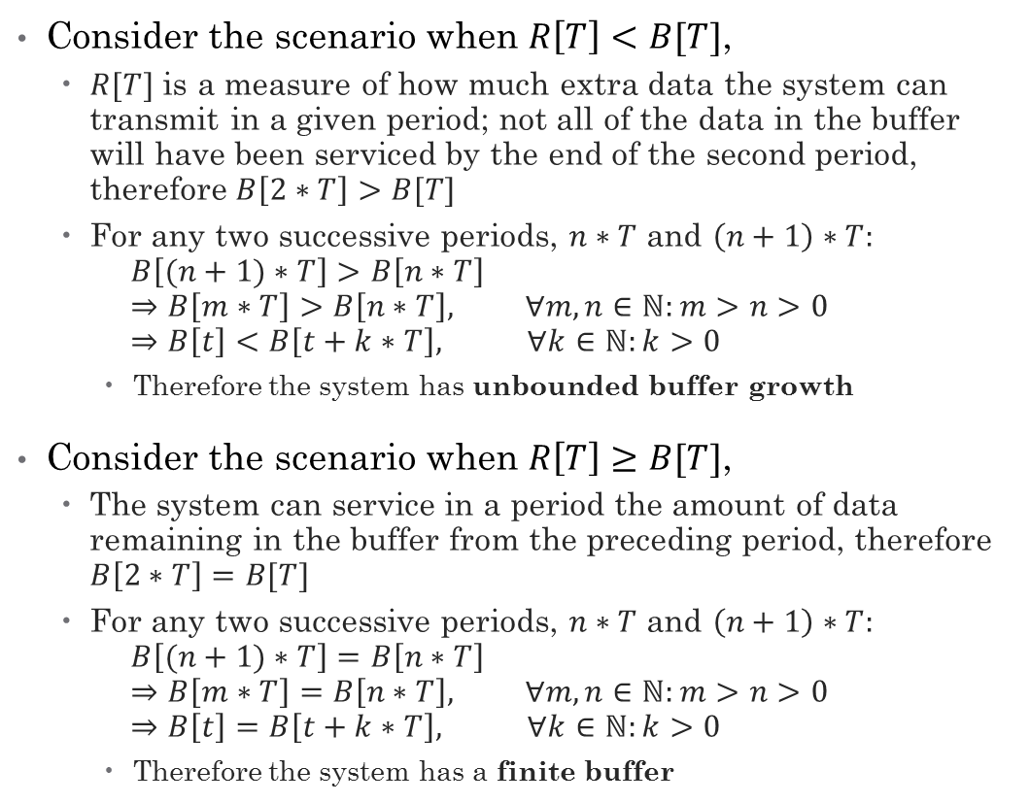
Analysis of Periodic Systems (5/5): Stability Analysis
Consider the scenario when $R\left[T\right]<B[T]$,
$R[T]$ is a measure of how much extra data the system can transmit in a given period; not all of the data in the buffer will have been serviced by the end of the second period, therefore $B\left[2∗T\right]>B[T]$
For any two successive periods, $n∗T$ and $\left(n+1\right)∗T:$ $B\left[(n+1)∗T\right]>B\left[n∗T\right]$ $⇒B\left[m∗T\right]>B\left[n∗T\right], ∀m,n∈ℕ:m>n>0$ $⇒B\left[t\right]<B\left[t+k∗T\right], ∀k∈ℕ:k>0$
Therefore the system has unbounded buffer growth
Consider the scenario when $R\left[T\right]≥B[T]$,
The system can service in a period the amount of data remaining in the buffer from the preceding period, therefore $B\left[2∗T\right]=B[T]$
For any two successive periods, $n∗T$ and $\left(n+1\right)∗T:$ $B\left[(n+1)∗T\right]=B\left[n∗T\right]$ $⇒B\left[m∗T\right]=B\left[n∗T\right], ∀m,n∈ℕ:m>n>0$ $⇒B\left[t\right]=B\left[t+k∗T\right], ∀k∈ℕ:k>0$
Therefore the system has a finite buffer
Notes:
the remaining capacity of the system at the end of the hyperperiod is less than the amount of data in the buffer at the end of the period
In addition to the period’s required traffic

Slide 19
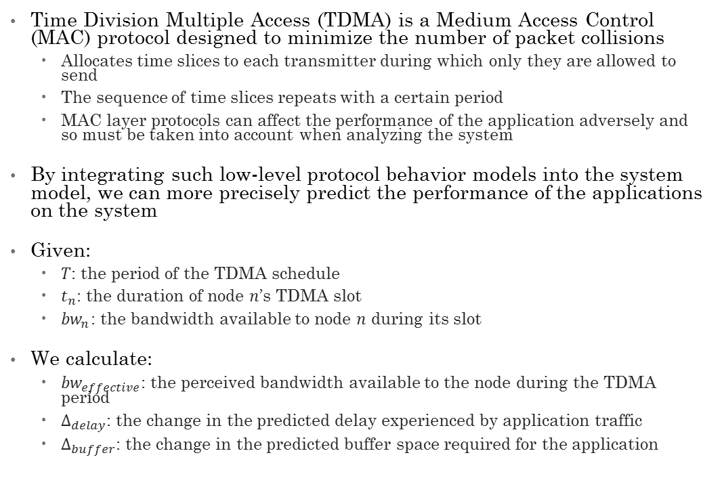
PNP² Analysis of TDMA
Time Division Multiple Access (TDMA) is a Medium Access Control (MAC) protocol designed to minimize the number of packet collisions
Allocates time slices to each transmitter during which only they are allowed to send
The sequence of time slices repeats with a certain period
MAC layer protocols can affect the performance of the application adversely and so must be taken into account when analyzing the system
By integrating such low-level protocol behavior models into the system model, we can more precisely predict the performance of the applications on the system
Given:
$T$: the period of the TDMA schedule
$t_{n}$: the duration of node $n$’s TDMA slot
${bw}_{n}$: the bandwidth available to node $n$ during its slot
We calculate:
${bw}_{effective}$: the perceived bandwidth available to the node during the TDMA period
$Δ_{delay}$: the change in the predicted delay experienced by application traffic
$Δ_{buffer}$: the change in the predicted buffer space required for the application

Slide 20
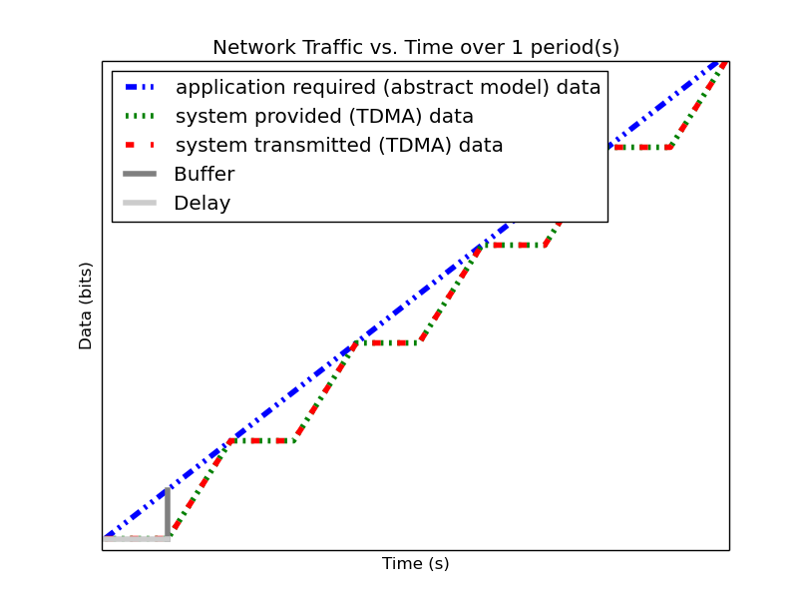
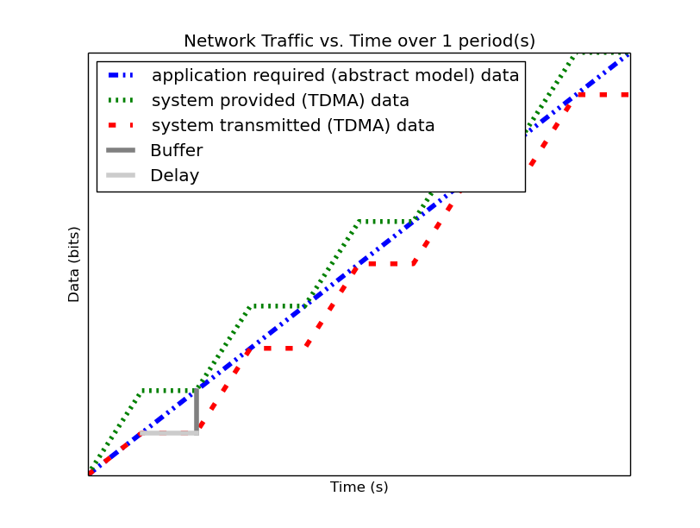
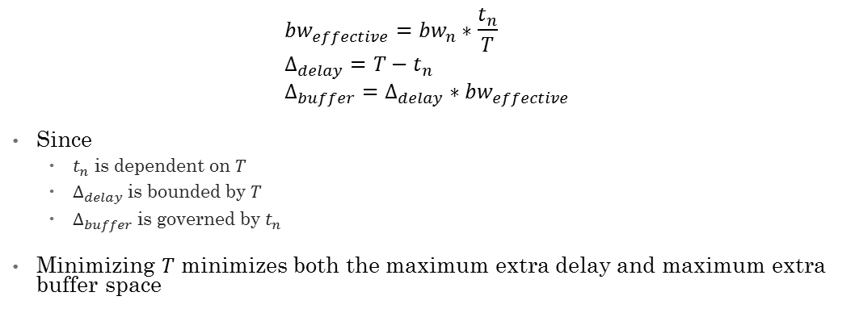
PNP² Analysis of TDMA
$${bw}_{effective}={bw}_{n}∗\frac{t_{n}}{T} \\ Δ_{delay}=T−t_{n} \\ Δ_{buffer}=Δ_{delay}∗{bw}_{effective}$$
Since
$t_{n}$ is dependent on $T$
$Δ_{delay}$ is bounded by $T$
$Δ_{buffer}$ is governed by $t_{n}$
Minimizing $T$ minimizes both the maximum extra delay and maximum extra buffer space
Notes:
These formulas remove the need to explicitly incorporate TDMA into the system model when modeling/analyzing the system

Slide 21
PNP² Compositional Analysis
Goal: allow applications to be analyzed separately, derive performance prediction for each application
Compositionality: when a system’s properties can be derived from the properties of its components and how they are interconnected
Composability: when components’ properties do not change when it is composed with other components
Must define the way applications’ profiles share their node’s resources and formalize mathematically the sharing of the resources

Slide 22
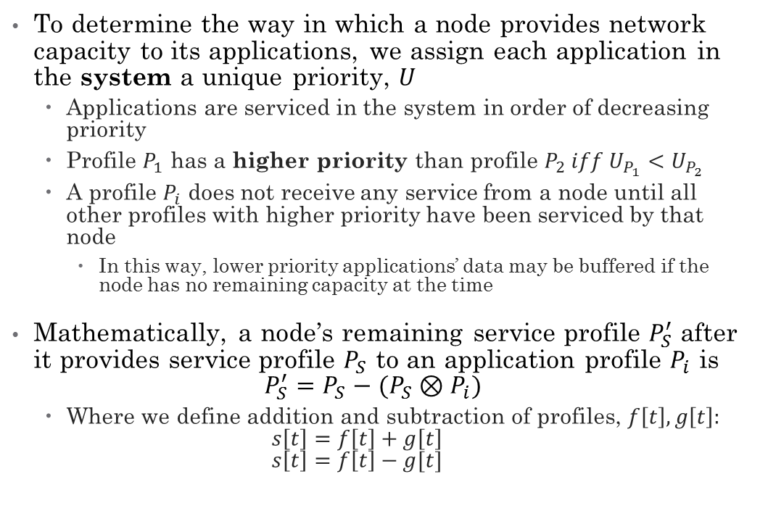
PNP² Compositional Analysis
To determine the way in which a node provides network capacity to its applications, we assign each application in the system a unique priority, $U$
Applications are serviced in the system in order of decreasing priority
Profile $P_{1}$ has a higher priority than profile $P_{2} iff U_{P_{1}}<U_{P_{2}}$
A profile $P_{i}$ does not receive any service from a node until all other profiles with higher priority have been serviced by that node
In this way, lower priority applications’ data may be buffered if the node has no remaining capacity at the time
Mathematically, a node’s remaining service profile $P_{S}^{′}$ after it provides service profile $P_{S}$ to an application profile $P_{i}$ is $P_{S}^{′}=P_{S}−(P_{S}⊗P_{i})$
Where we define addition and subtraction of profiles, $f\left[t\right],g\left[t\right]:$ $s\left[t\right]=f\left[t\right]+g\left[t\right]$ $s\left[t\right]=f\left[t\right]−g[t]$
Notes:
Mention how this priority relation can be implemented in real networks using DSCP or TC

Slide 23
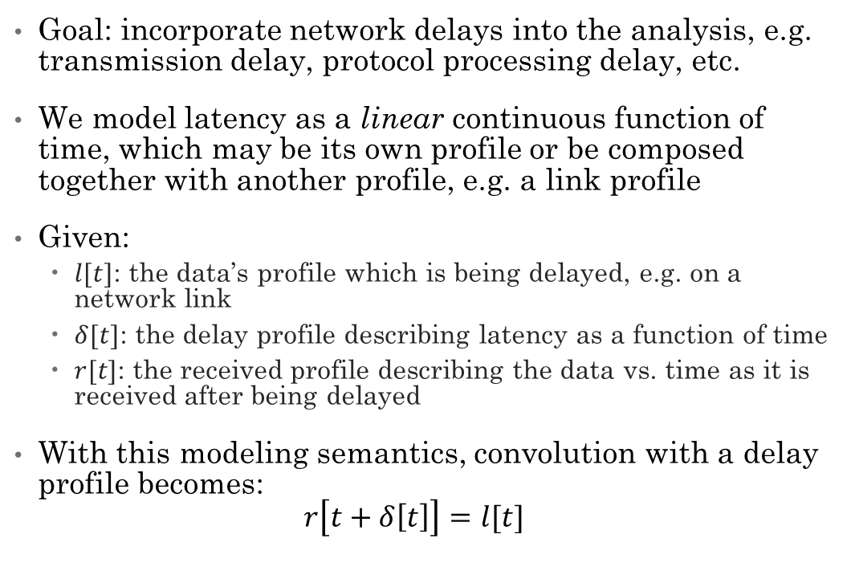
PNP² Delay Analysis
Goal: incorporate network delays into the analysis, e.g. transmission delay, protocol processing delay, etc.
We model latency as a linear continuous function of time, which may be its own profile or be composed together with another profile, e.g. a link profile
Given:
$l[t]$: the data’s profile which is being delayed, e.g. on a network link
$δ[t]$: the delay profile describing latency as a function of time
$r[t]$: the received profile describing the data vs. time as it is received after being delayed
With this modeling semantics, convolution with a delay profile becomes: $r\left[t+δ\left[t\right]\right]=l[t]$

Slide 24
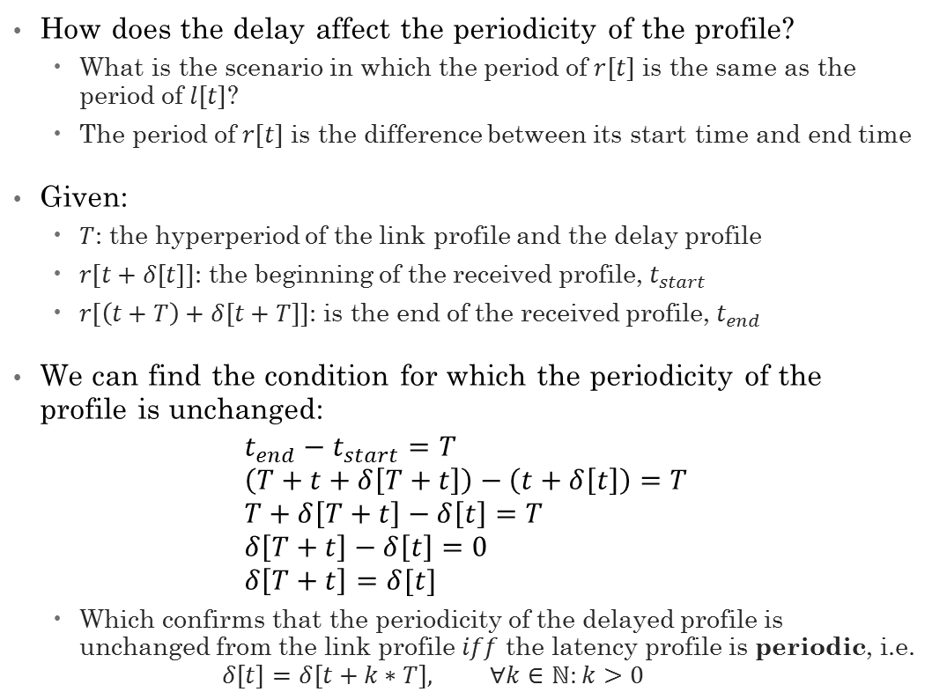
PNP² Delay Analysis
How does the delay affect the periodicity of the profile?
What is the scenario in which the period of $r[t]$ is the same as the period of $l[t]$?
The period of $r[t]$ is the difference between its start time and end time
Given:
$T$: the hyperperiod of the link profile and the delay profile
$r[t+δ\left[t\right]]$: the beginning of the received profile, $t_{start}$
$r[\left(t+T\right)+δ[t+T]]$: is the end of the received profile, $t_{end}$
We can find the condition for which the periodicity of the profile is unchanged:
$$t_{end}−t_{start}=T \\ \left(T+t+δ\left[T+t\right]\right)−\left(t+δ\left[t\right]\right)=T \\ T+δ\left[T+t\right]−δ\left[t\right]=T \\ δ\left[T+t\right]−δ\left[t\right]=0 \\ δ\left[T+t\right]=δ[t]$$
Which confirms that the periodicity of the delayed profile is unchanged from the link profile $iff$ the latency profile is periodic, i.e. $δ\left[t\right]=δ\left[t+k∗T\right], ∀k∈ℕ:k>0$

Slide 25
PNP² Analysis of Statically Routed Networks

Slide 26
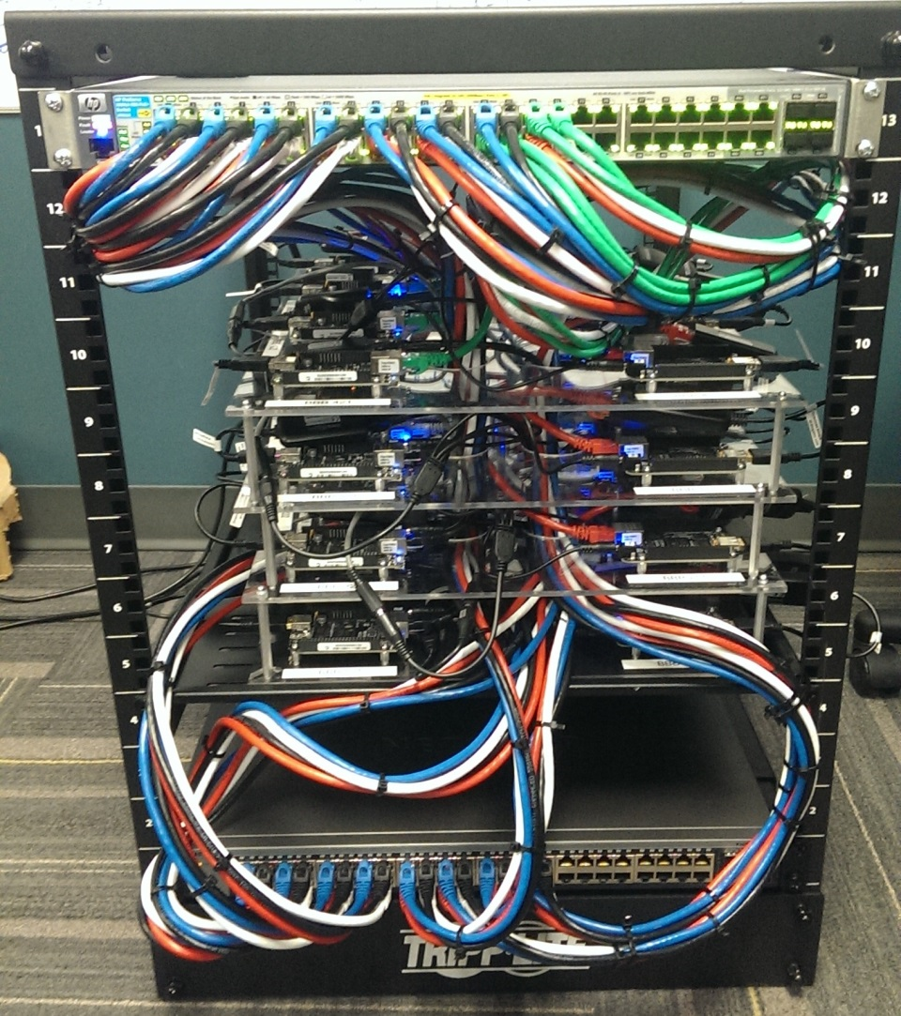
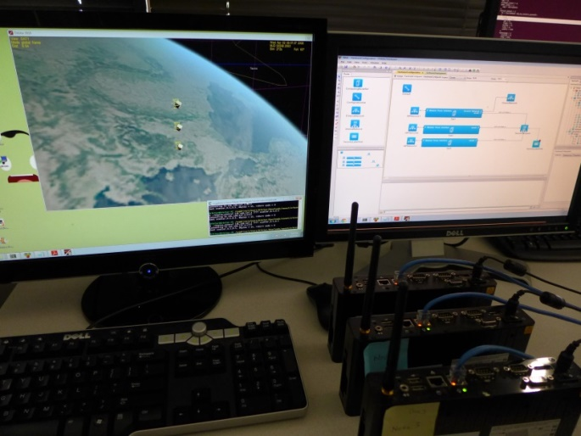
PNP² Network Applications Testbed
Used for the deployment of PNP² tests
Have experimentally validated PNP² analysis results using our testbed
Will be useful in developing and testing new research in networked cyber-physical systems

Slide 27
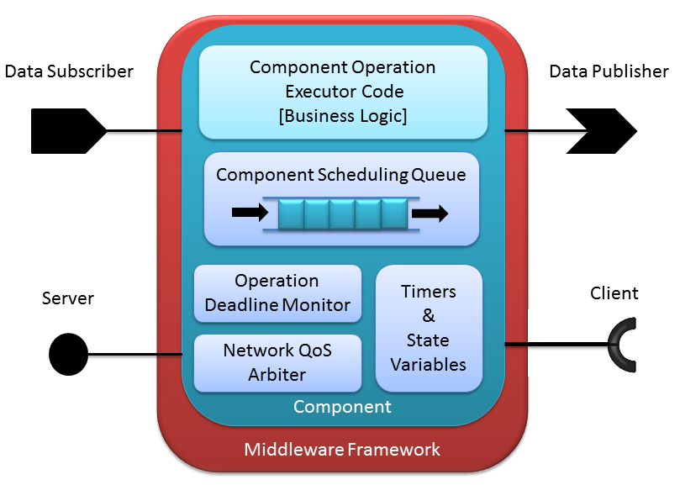
Generation of Application Network Profiles from Business Logic Models (1/3)
Component-based Software Engineering Overview
A component is the smallest deployable part of an application, containing
Timers & State Variables
External interfaces (input and output ports), their associated input callbacks or output handles
A single thread which sequentially processes to completion pending component operations
Components can be only triggered by
Timer expiry
Callback invocation for data arriving on an input port
An application consists of a group of single-threaded components which cooperate together and are deployed as a unit
Applications are complex and difficult to analyze
By using component-based software design and developing models based on the components, we can make analysis tractable
Notes:
Don’t get into depth about CPN or anything

Slide 28
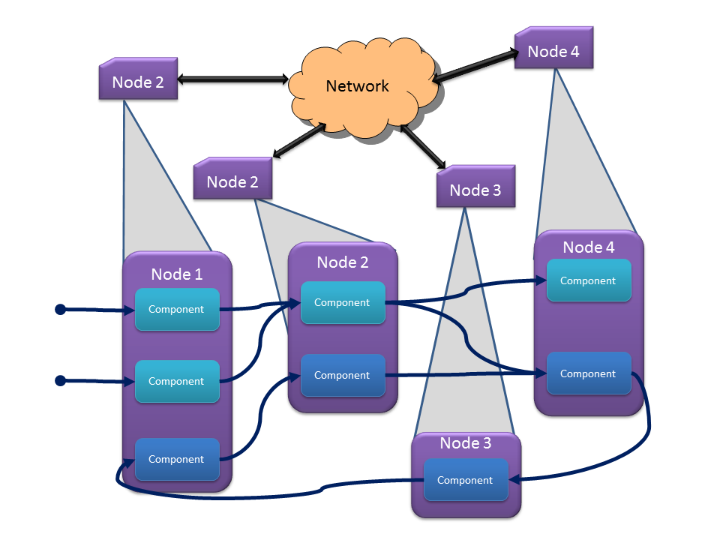
Generation of Application Network Profiles from Business Logic Models (2/3)
Notes:
2 component-based applications (shades of blue) split across 4 nodes in a cluster
Apps communicate with each other
All port traffic flows on the network

Slide 29
Generation of Application Network Profiles from Business Logic Models (3/3)
Proposed Contributions
We will develop an add-on to our currently existing modeling language for application business logic which captures the network resources required during each part of the business logic model.
We will develop a compositional technique for generating the network resource requirement profile for an application from the combined business logic models of that application's components. This is required because the business logic models describe the behavior of the callback associated with a component port, but does not describe the timing of the invocations of that callback.
We will develop test applications for our testbed which adhere to the business logic models and allow us to measure the accuracy and precision of the predictions using these generated profiles.
Notes:
Don’t get into depth about CPN or anything

Slide 30
Analysis of Statically Routed Networks
Challenges
Proposed Contributions
Most realistic networks require some form of message routing
Not all nodes have a direct communications link to each other
Due to e.g. obstructions, local interference, etc.
Routing allows for more flexibility with respect to system deployment and connectivity
Routing can be either pre-defined at deployment time (static) or configured dynamically at run-time
We consider a case of routing in ad-hoc networks:
one or more nodes can route messages for other nodes
We will extend our network resource modeling and analysis techniques to support networks in which system nodes can act as routers for packets in the network.
We will show experimentally the validity of the analysis results using our testbed and test applications.

Slide 31
Comparison of PNP² to Network Calculus
By showing that the main concepts of Network Calculus, e.g. compositionality, hold for PNP², we show the capability for similar systems-theory based analysis approaches
We will mathematically analyze the differences between the proposed technique and Network Calculus, showing that compositionality (i.e. concatenation of nodes in NC) applies to our analysis techniques
We will analyze network flow composition to formalize operations for flow aggregation

Slide 32
Network Application Fault/Anomaly Classification
We will use our testbed to run distributed network tests to classify certain types of anomalies, e.g. DDoS attacks from compromised applications within the cluster.
Cluster is a managed system; we have full control over all layers on each node, but not the applications
We will use the network resource utilization measurements gained from the tests to derive metrics which allow us to differentiate between classes of behavior, e.g. standard/stable application behavior vs. DDoS behavior.
We will then use the classifications to show that the system can detect these types of attacks, mitigate their propagation, and report the attack to the system's manager.
Notes:
Since/if we know expected behavior, we can detect deviations from expected behavior;
This is a managed system, we have full control over the layers in every node, but not over the applications

Slide 33
Conclusions and Future Work
Certain classes of distributed, real-time, embedded, cyber-physical systems require strict design-time guarantees about resource utilization and performance
Network resources are now critical for distributed CPS
Current simulation or analysis techniques are too conservative at best, too inaccurate at worst
Our proposed work extends previous work to increase the fidelity of the analysis results with respect to the run-time system
The inclusion of temporal/physical dynamics into the analysis is paramount to providing strict performance guarantees
We have described some remaining work in the field and outlined our plans to address it

Slide 34
Publications
W. Emfinger and G. Karsai. Modeling network medium access protocols for network quality of service analysis. In Proceedings of the 18th IEEE Symposium on Real-Time Computing (ISORC), ISORC ’15, pages 44–47, Auckland, New Zealand, 2015. IEEE
W. Emfinger, G. Karsai, A. Dubey, and A. Gokhale. Analysis, verification, and management toolsuite for cyber-physical applications on time-varying networks. In Proceedings of the 4th ACM SIGBED International Workshop on Design, Modeling, and Evaluation of Cyber-Physical Systems, CyPhy ’14, pages 44–47, New York, NY, USA, 2014. ACM
W. Emfinger, P. Kumar, A. Dubey, W. Otte, A. Gokhale, G. Karsai. DREMS: A Toolchain for the Rapid Application Development, Integration, and Deployment of Managed Distributed Real-time Embedded Systems. In Proceedings of the IEEE Real-Time Systems Symposium, RTSS@Work 2013, Vancouver, Canada, 2013. IEEE
Pradhan S., W. Emfinger, A. Dubey, W. Otte, A. Coglio, D. Balasubramanian, A.Gokhale, G. Karsai. Establishing secure interactions across distributed applications in satellite clusters. In Proceedings of the IEEE International Conference on Space Mission Challenges for Information Technology, SMC-IT, 2014, Laurel, MD, USA. IEEE
Balasubramanian, D., W. Emfinger, P. S. Kumar, W. Otte, A. Dubey, and G. Karsai. An application development and deployment platform for satellite clusters. In Proceedings of the Workshop on Spacecraft Flight Software, 2013
Balasubramanian, D., A. Dubey, W. R. Otte, W. Emfinger, P. Kumar, and G. Karsai. A Rapid Testing Framework for a Mobile Cloud Infrastructure. In Proceedings of the IEEE International Symposium on Rapid System Prototyping, RSP, 2014. IEEE
Dubey, A., W. Emfinger, A. Gokhale, G. Karsai, W. R. Otte, J. Parsons, C. Szabo, A. Coglio, E. Smith, and P. Bose. A Software Platform for Fractionated Spacecraft. In Proceedings of the 2012 IEEE Aerospace Conference, Big Sky, Montana, 03/2012. IEEE
Levendovszky, T., A. Dubey, W. R. Otte, D. Balasubramanian, A. Coglio, S. Nyako, W. Emfinger, P. Kumar, A. Gokhale, and G. Karsai. DREMS: A Model-Driven Distributed Secure Information Architecture Platform for Managed Embedded Systems. In IEEE Software, vol. 99: IEEE Computer Society, 2014. IEEE
Submitted, Awaiting Review:
W. Emfinger, P. Kumar, A. Dubey, G. Karsai. Towards Assurances in Self-Adaptive, Dynamic, Distributed Real-time Embedded Systems. In Software Engineering for Self-Adaptive Systems: Assurances, 2015.

Slide 35
References
L. Thiele, S. Chakraborty, and M. Naedele. Real-time calculus for scheduling hard real-time systems. In in ISCAS, pages 101–104, 2000.
A. Varga and R. Hornig. An overview of the omnet++ simulation environment. In Simutools ’08: Proceedings of the 1st international conference on Simulation tools and techniques for communications, networks and systems & workshops, pages 1–10, ICST, Brussels, Belgium, Belgium, 2008. ICST (Institute for Computer Sciences,Social-Informatics and Telecommunications Engineering).
L. Rizzo. Dummynet : a simple approach to the evaluation of network protocols. ACM SIGCOMM Computer Communication Review, 27(1):31–41, 1997.
D. Mahrenholz and S. Ivanov. Real-time network emulation with ns-2. Proceedings- Eighth IEEE International Symposium on Distributed Simulation and Real-Time Applications, DS-RT 2004, pages 29–36, 2004.
J.-Y. Le Boudec and P. Thiran. Network Calculus: A Theory of Deterministic Queuing Systems for the Internet. Springer-Verlag, Berlin, Heidelberg, 2001.
D. G. Kendall. Stochastic Processes Occurring in the Theory of Queues and their Analysis by the Method of the Imbedded Markov Chain. The Annals of Mathematical Statistics, 24(3):338–354, 1953.
Gilberto Flores Lucio, Marcos Paredes-farrera, Emmanuel Jammeh, Martin Fleury, and M. J. Reed. OPNET Modeler and Ns-2: Comparing the Accuracy of Network Simulators for Packet-Level Analysis using a Network Testbed. 3rd WEAS International Conference on Simulation, Modelling and Optimization (ICOSMO), pages 700–707, 2003.
G. Giambene. Queuing Theory and Telecommunications Networks and Applications. 2005.
R. L. Cruz. A calculus for network delay–I: Network elements in isolation. IEEE Transactions on Information Theory, 37(1):114–131, 1991.
O. S. Consortium et al. Openflow switch specification version 1.0. 0, 2009.
M. Carbone and L. Rizzo. Dummynet revisited, 2010

Slide 36
Questions?
Thank you for your attention!

