Slide 1
Flight software
Orbital state information
CRM
Updates QoS scheduler logic, utility functions, etc. as needed
Predicted link state information
Target | Link bandwidth | Link delay | Link quality
… | … | …. | ….
… | …. | …. | ….
Target | Link bandwidth | Link delay | Link quality
… | … | …. | ….
… | …. | …. | ….
Messages w/ QoS tags
QoS Scheduler
Accept message?
If yes, then
- Which queue?
- Which position in queue?
Momentary link state information
Queue
Comm.
Device
Queue
Momentary link state information
Comm.
Device
Queue
Momentary link state information
Comm.
Device

Slide 2
CRM
Updates routing tables, filtering rules, etc. as needed
Momentary link state information
Target | Link bandwidth | Link delay | Link quality
… | … | …. | ….
… | …. | …. | ….
UPDATE
USER SPACE
Queue
KERNEL SPACE
Messages w/ QoS tags
ROUTING
Filtering
rules
Queue
Queue
Comm.
Device
Partition 3
Queue
Filtering
rules
Queue
Partition 2
Queue
Comm.
Device
Queue
Filtering
rules
Queue
Partition 1
Queue
Comm.
Device

Slide 3
CRM
Updates routing tables, filtering rules, etc. as needed
Momentary link state information
User
space
Target | Link bandwidth | Link delay | Link quality
… | … | …. | ….
… | …. | …. | ….
UPDATE
Messages w/ QoS tags
Kernel
space
ROUTING
Classifying
Rules
Priority
Queues
Comm.
Device
Partition 3
Classifying
rules
Priority
Queues
Partition 2
Comm.
Device
Classifying
rules
Priority
Queues
Partition 1
Comm.
Device

Slide 4
CRM
Updates routing tables, filtering rules, etc. as needed
Momentary link state information
User
space
Target | Link bandwidth | Link delay | Link quality
… | … | …. | ….
… | …. | …. | ….
Thread making
request
UPDATE
Messages w/ QoS tags
Kernel
space
Path of Kernel Thread
Servicing a message
ROUTING
Classifying
Rules
Priority
Queues
Comm.
Device
Partition 3
Classifying
rules
Priority
Queues
Partition 2
Comm.
Device
Classifying
rules
Priority
Queues
Partition 1
Comm.
Device

Slide 5
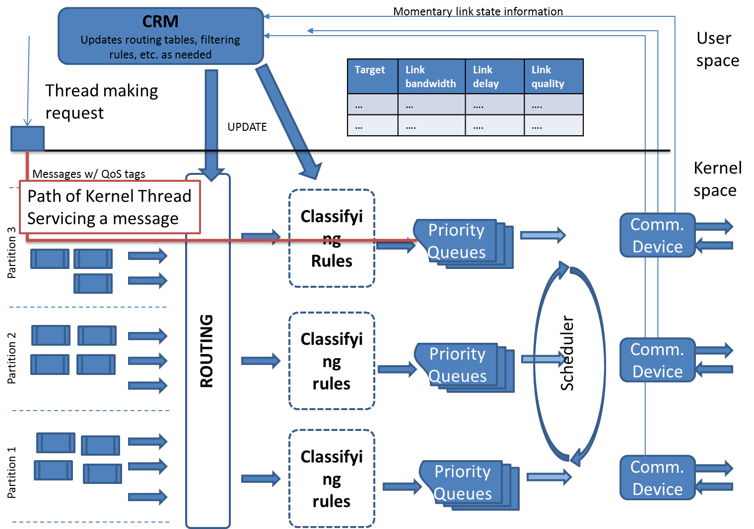
Forwarder
Comm.
Device
Message Forwarding
Ingress

Slide 6
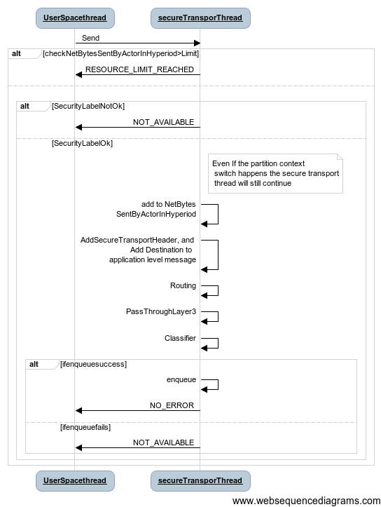
Notes:
UserSpacethread -> secureTransporThread: Send
alt checkNetBytesSentByActorInHyperiod>Limit
secureTransporThread->UserSpacethread : RESOURCE_LIMIT_REACHED
else
alt SecurityLabelNotOk
secureTransporThread->UserSpacethread : NOT_AVAILABLE
else SecurityLabelOk
note right of secureTransporThread: Even If the partition context\n switch happens the secure transport\n thread will still continue
secureTransporThread->secureTransporThread: add to NetBytes\nSentByActorInHyperiod
secureTransporThread->secureTransporThread:AddSecureTransportHeader, and \n Add Destination to \n application level message
secureTransporThread->secureTransporThread:Routing
secureTransporThread->secureTransporThread:PassThroughLayer3
secureTransporThread->secureTransporThread: Classifier
alt ifenqueuesuccess
secureTransporThread->secureTransporThread: enqueue
secureTransporThread->UserSpacethread : NO_ERROR
else ifenqueuefails
secureTransporThread->UserSpacethread : NOT_AVAILABLE
end
end
end

Slide 7
Momentary link state information
Tx
CRM
Updates routing tables, filtering rules, etc. as needed
Target | Link bandwidth | Link delay | Link quality
… | … | …. | ….
… | …. | …. | ….
UPDATE
USER SPACE
KERNEL SPACE
Messages w/ QoS tags
Priority
Queues
ROUTING
Classifying rules
Comm.
Device
Priority
Queues
Classifying rules
Comm.
Device
Priority
Queues
Classifying rules
Comm.
Device

Slide 8
Momentary link state information
Rx
CRM
Updates routing tables, filtering rules, etc. as needed
Target | Link bandwidth | Link delay | Link quality
… | … | …. | ….
… | …. | …. | ….
UPDATE
USER SPACE
KERNEL SPACE
Messages
ROUTING
Comm.
Device
Comm.
Device
Comm.
Device

Slide 9
Momentary link state information
Fwd
CRM
Updates routing tables, filtering rules, etc. as needed
Target | Link bandwidth | Link delay | Link quality
… | … | …. | ….
… | …. | …. | ….
UPDATE
USER SPACE
KERNEL SPACE
Priority
Queues
ROUTING
Classifying rules
Comm.
Device
Comm.
Device
Priority
Queues
Classifying rules
Comm.
Device

Slide 10
CRM
Updates routing tables and classification rules periodically
Momentary link state information
Target | Link bandwidth | Link delay | Link quality
… | … | …. | ….
… | …. | …. | ….
UPDATE
USER SPACE
KERNEL SPACE
SECURE TRANSPORT ENDPOINTS
ROUTING TABLE
Classification rules
Priority
Queues
Comm.
Device
Driver
Classification rules
Priority
Queues
Comm.
Device
Driver

Slide 11
CRM
Updates routing tables and classification rules periodically
Momentary link state information
Target | Link bandwidth | Link delay | Link quality
… | … | …. | ….
… | …. | …. | ….
UPDATE
USER SPACE
KERNEL SPACE
SECURE TRANSPORT ENDPOINTS
ROUTING TABLE
Classification rules
Priority
Queues
Comm.
Device
Driver
Classification rules
Priority
Queues
Comm.
Device
Driver

Slide 12
Controller
Communication Resource Manager
Process
Network Link
Link Quality Sensor
Admission Control and Routing
Module/cluster CRM
Gateway messages
Network Link
Link Quality Sensor

Slide 13
Module 1 (subnet)
A
B
Node
B
A
WIMC Link
C
Cluster Network
C
Module 2 (subnet)
WIMC Link
Module 3 (subnet)
C
D
Ground
Radio
BGAN Link
Ground
Radio
Ground Network
G
F
E

Slide 14
Network
Ground
Cluster1
Module1
Module 2
Cluster 2

