Slide 1

Middleware Framework
Component
Data Subscriber
Component Operation
Executor Code
[Business Logic]
Data Publisher
Component Scheduling Queue
Operation Deadline Monitor
Timers
&
State Variables
Server
Client
Network QoS Arbiter

Slide 2
Node 4
Network
Node 2
Node 2
Node 3
Node 4
Node 1
Node 2
Component
Component
Component
Component
Component
Component
Component
Node 3
Component

Slide 3
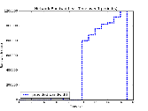

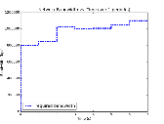
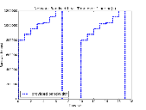
Node 4
Sink 2
Node 1
Node 2
Router
High Priority Queue
Low Priority Queue
Source 1
Sink 1
Node 3
Flow 1:
High Priority
From Source 1
To Sink 1
Flow 2:
Low Priority
From Source 2
To Sink 2
Source 2

