Slide 1

Middleware Framework
Component
Data Subscriber
Component Operation
Executor Code
[Business Logic]
Data Publisher
Component Scheduling Queue
Operation Deadline Monitor
Timers
&
State Variables
Server
Client
Network QoS Arbiter

Slide 2
Node 4
Network
Node 2
Node 2
Node 3
Node 4
Node 1
Node 2
Component
Component
Component
Component
Component
Component
Component
Node 3
Component

Slide 3

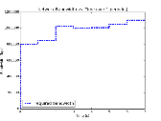
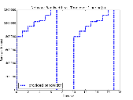
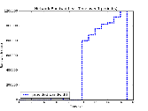
Routing Node
Flow 1:
High Priority
From Source 1
To Sink 1
Flow 2:
Low Priority
From Source 2
To Sink 2
High Priority Queue
Low Priority Queue
Network
Interface
IN
OUT
Node 1
Node 2
`
Source 1
Sink 1
Node 3
Node 4
Source 2
Sink 2

Slide 4
Traffic produced by the application is received by the Linux TC in the Kernel and filtered into QDISCs where it awaits transmission.
Enqueue
Dequeue
Root:
Network Interface
Enqueue:
Traffic leaving on the network interface filters down the tree until it reaches a leaf QDISC, where it is enqueued
Dequeue:
A packet at the front of a QDISC is dequeued and enqueued into the QDISC’s parent QDISC. If the parent is the root, it is transmitted.
Priority QDISC
Filter
This filter separates traffic into two classes:
Application Traffic
Other Network Traffic
High Priority
Low Priority
Delay
QDISC
FIFO
QDISC
Traffic Shaping QDISC
Filter
This filter separates traffic into two classes:
High Priority
Low Priority
High Priority
Low Priority
FIFO
QDISC
FIFO
QDISC

