Slide 1
Collision Detection on the GPU
Mike Donovan
CIS 665
Summer 2009

Slide 2
Overview
Quick Background
CPU Methods
CULLIDE
RCULLIDE
QCULLIDE
CUDA Methods

Slide 3
Background
Need to find collisions for lots of reasons
  Physics engines
  Seeing if a projectile hits an object
  Ray casting
  Game engines
  Etc…

Slide 4
Background
Broad phase:
  Looks at entire scene
  Looks at proxy geometry (bounding shapes)
  Determines if two objects may intersect
  Needs to be very fast

Slide 5
Background
Narrow phase:
  Looks at pairs of objects flagged by broad phase
  Looks at the actual geometry of an object
  Determines if objects are truly intersecting
  Generally slower

Slide 6
Background
Resolution
  Compute forces according to the contact points returned from the narrow phase
  Can be non trivial if there are multiple contact points
  Returns resulting forces to be added to each body

Slide 7
CPU Methods
Brute Force
  Check every object against every other
    N(N-1)/2 tests O(N²)
Sweep and Prune
    Average case: O(N log N)
    Worst case: O(N²)
Spatial Subdivisions
    Average case: O(N log N)
    Worst case: O(N²)

Slide 8
Sweep and Prune
Bounding volume is projected onto x, y, z axis
Determine collision interval for each object [b_{i}, e_{i}]
Two objects who’s collision intervals do not overlap can not collide
O₁
O₂
O₃
Sorting Axis
B1
B3
E1
B2
E3
E2
Notes:
Courtesy Gary Katz

Slide 9

Spatial Subdivisions
5
6
1
2
7
8
3
4
Example
O₁
1
2
3
4
O₄
O₂
O₃
5
6
7
8
Images from pg 699, 700 GPU Gems III
Notes:
Hierarchical grids
Check an object against objects in its or adjacent cells

Slide 10
CULLIDE
Came out of Dinesh’s group at UNC in 2003
Uses graphics hardware to do a broad-narrow phase hybrid
No shader languages

Slide 11

Outline
Overview
Pruning Algorithm
Implementation and Results
Conclusions and Future Work

Slide 12
Outline
Overview
Pruning Algorithm
Implementation and Results
Conclusions and Future Work

Slide 13
Overview
Potentially Colliding Set (PCS) computation
Exact collision tests on the PCS

Slide 14
Algorithm
Object Level
Pruning
Sub-object
Level
Pruning
Exact Tests
GPU based PCS computation
Using CPU

Slide 15
Potentially Colliding Set (PCS)
PCS

Slide 16
Potentially Colliding Set (PCS)
PCS

Slide 17
Outline
Problem Overview
Overview
Pruning Algorithm
Implementation and Results
Conclusions and Future Work

Slide 18
Algorithm
Object Level
Pruning
Sub-object
Level
Pruning
Exact Tests

Slide 19

Visibility Computations
Lemma 1: An object O does not collide with a set of objects S if O is fully visible with respect to S
  Utilize visibility for PCS computation

Slide 20
Collision Detection using Visibility Computations
set S
Object O
Fully Visible

Slide 21
PCS Pruning
Lemma 2: Given n objects
O₁,O₂,…,O_{n} , an object O_{i} does not
belong to PCS if it does not
collide with O₁,…,O_{i-1},O_{i+1},…,O_{n}
Prune objects that do not collide

Slide 22
PCS Pruning
O₁ O₂ … O_{i-1} O_{i} O_{i+1} … O_{n-1} O_{n}
O₁ O₂ … O_{i-1} O_{i} O_{i+1} … O_{n-1} O_{n}
O₁ O₂ … O_{i-1} O_{i} O_{i+1} … O_{n-1} O_{n}

Slide 23
PCS Pruning
O₁ O₂ … O_{i-1} O_{i}

Slide 24
PCS Pruning
O_{i} O_{i+1} … O_{n-1} O_{n}

Slide 25
PCS Computation
Each object tested against all objects but itself
Naive algorithm is O(n²)
Linear time algorithm
  Uses two pass rendering approach
  Conservative solution

Slide 26
PCS Computation: First Pass
Render
O₁ O₂ … O_{i-1} O_{i} O_{i+1} … O_{n-1} O_{n}

Slide 27
PCS Computation: First Pass
Render
O₁
Fully Visible?

Slide 28
PCS Computation: First Pass
Render
O₁ O₂
Yes. Does not collide with
O₁
Fully Visible?

Slide 29
PCS Computation: First Pass
Render
Yes. Does not collide with
O₁,O₂,…,O_{i-1}
O₁ O₂ … O_{i-1} O_{i}
Fully Visible?

Slide 30
PCS Computation: First Pass
Render
O₁ O₂ … O_{i-1} O_{i} O_{i+1} … O_{n-1} O_{n}
Fully Visible?

Slide 31
PCS Computation: Second Pass
Render
O₁ O₂ … O_{i-1} O_{i} O_{i+1} … O_{n-1} O_{n}
O_{n}

Slide 32
PCS Computation: Second Pass
Render
O_{n}
Fully Visible?

Slide 33
PCS Computation: Second Pass
Yes. Does not collide with O_{n}
Render
O_{n-1} O_{n}
Fully Visible?

Slide 34
PCS Computation: Second Pass
Yes. Does not collide with O_{i+1},…,O_{n-1},O_{n}
Render
O_{i} O_{i+1} … O_{n-1} O_{n}
Fully Visible?

Slide 35
PCS Computation: Second Pass
Render
O₁ O₂ … O_{i-1} O_{i} O_{i+1} … O_{n-1} O_{n}
Yes. Does not collide with O₁,…,O_{n-1},O_{n}
Fully Visible?

Slide 36
PCS Computation
Fully Visible
Fully Visible
O₁ O₂ … O_{i-1} O_{i} O_{i+1} … O_{n-1} O_{n}

Slide 37
PCS Computation
O₁ O₂ O₃ … O_{i-1} O_{i} O_{i+1} … O_{n-2} O_{n-1} O_{n}
O₁ O₃ … O_{i-1} O_{i+1} … O_{n-1}

Slide 38
Example
O₁
O₂
O₃
O₄
Scene with 4 objects
O₁and O₂ collide
O₃, O₄ do not collide
Initial PCS = { O₁,O₂,O₃,O₄ }

Slide 39
First Pass
Fully Visible
O₁
O₁
Not Fully Visible
O₂
Fully Visible
O₃
O₃
Fully Visible
O₄
O₄
Order of rendering: O₁ O₄

Slide 40
Second Pass
Not Fully Visible
O₁
Fully Visible
O₂
O₂
Fully Visible
O₃
O₃
Fully Visible
O₄
O₄
Order of rendering: O₄ O₁

Slide 41
After two passes
O₁
O₂
Fully Visible
O₃
Fully Visible
O₄

Slide 42
Potential Colliding Set
O₁
O₂
PCS ={O₁,O₂}

Slide 43
Algorithm
Object Level
Pruning
Sub-object
Level
Pruning
Exact Tests

Slide 44
Overlap Localization
Each object is composed of sub-objects
We are given n objects O₁,…,O_{n}
Compute sub-objects of an object O_{i} that overlap with sub-objects of other objects

Slide 45
Overlap Localization
Our solution
  Test if each sub-object of O_{i} overlaps with sub-objects of O₁,..O_{i-1}
  Test if each sub-object of O_{i} overlaps with sub-objects of O_{i+1},...,O_{n}
Linear time algorithm
Extend the two pass approach

Slide 46

Overlap Localization
PCS
O₁ O₂ … O_{i-1} O_{i} O_{i+1} … O_{n-1} O_{n}
Sub-objects

Slide 47
Overlap Localization: First Pass
Render sub-objects
O₁ O₂ … O_{i-1} O_{i} O_{i+1} … O_{n-1} O_{n}

Slide 48
Overlap Localization: First Pass
Render sub-objects
O₁ O₂ … O_{i-1} O_{i}
Rendered sub-objects

Slide 49
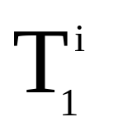
Overlap Localization: First Pass
Render sub-objects
O₁ O₂ … O_{i-1}
Rendered sub-objects
Fully Visible?

Slide 50
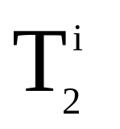
Overlap Localization: First Pass
Render sub-objects
O₁ O₂ … O_{i-1}
Rendered sub-objects
Fully Visible?

Slide 51

Overlap Localization: First Pass
Yes. Does not collides with sub-objects of
O₁,O₂,…,O_{i-1}
Render sub-objects
O₁ O₂ … O_{i-1}
Rendered sub-objects
Fully Visible?

Slide 52
Overlap Localization: First Pass
Render sub-objects
Avoids
self-collisions!
O₁ O₂ … O_{i-1}
Rendered sub-objects
Fully Visible?

Slide 53
Overlap Localization: First Pass
Render sub-objects
O₁ O₂ … O_{i-1} O_{i}
Rendered sub-objects

Slide 54
Overlap Localization: First Pass
O₁ O₂ … O_{i-1} O_{i} O_{i+1} … O_{n-1} O_{n}
Rendered sub-objects

Slide 55
Overlap Localization: Second Pass
Render sub-objects
O₁ O₂ … O_{i-1} O_{i} O_{i+1} … O_{n-1} O_{n}

Slide 56
Overlap Localization
O₁ O₂ … O_{i-1} O_{i} O_{i+1} … O_{n-1} O_{n}
Sub-objects

Slide 57
Potential Colliding Set
O₁
O₂
PCS = {O₁,O₂}

Slide 58
Sub-objects
O₁
O₂
PCS = sub-objects of {O₁,O₂}

Slide 59
First Pass
Rendering order: Sub-objects of O₁ O₂

Slide 60
Fully Visible
First Pass

Slide 61
First Pass
Fully Visible

Slide 62
Fully Visible
First Pass
Fully Visible
Not Fully Visible

Slide 63
Fully Visible
First Pass
Fully Visible
Fully Visible

Slide 64
Fully Visible
First Pass
Fully Visible
Fully Visible

Slide 65
Fully Visible
First Pass
Fully Visible
Fully Visible
Fully Visible

Slide 66
Second Pass
Rendering order: Sub-objects of O₂ O₁

Slide 67
Second Pass
Fully Visible

Slide 68
Second Pass
Fully Visible

Slide 69
Second Pass
Fully Visible

Slide 70
Second Pass
Not Fully Visible
Fully Visible
Fully Visible
Fully Visible

Slide 71
Fully Visible
Second Pass
Fully Visible
Fully Visible
Fully Visible

Slide 72
Fully Visible
After two passes
Fully Visible
Fully Visible

Slide 73
PCS

Slide 74
Algorithm
Object Level
Pruning
Sub-object
level
Pruning
Exact Tests
Exact Overlap
tests using CPU

Slide 75
Visibility Queries
We require a query
  Tests if a primitive is fully visible or not
Current hardware supports occlusion queries
  Test if a primitive is visible or not
Our solution
  Change the sign of depth function

Slide 76
Visibility Queries
Depth function
GEQUAL
LESS
All fragments
Pass
Pass
Fail
Fail
Fail
Fail
Fail
Pass
Pass
Occlusion query
Query not supported
  Examples - HP_Occlusion_test, NV_occlusion_query

Slide 77
Bandwidth Analysis
Read back only integer identifiers
  Independent of screen resolution

Slide 78
Optimizations
First use AABBs as object bounding volume
Use orthographic views for pruning
Prune using original objects

Slide 79
Advantages
No coherence
No assumptions on motion of objects
Works on generic models
A fast pruning algorithm
No frame-buffer readbacks

Slide 80
Limitations
No distance or penetration depth information
Resolution issues
No self-collisions
Culling performance varies with relative configurations

Slide 81
Assumptions
Makes assumptions that their algorithm will get faster as hardware improves.
Luckily they were right

Slide 82
RCULLIDE
An improvement on CULLIDE in 2004
Resolves issue of screen resolution precision

Slide 83
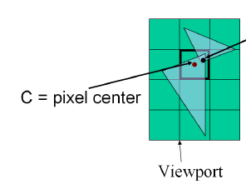
Overview
A main issue with CULLIDE was the fact that it wasn’t reliable
Collisions could easily be missed due to screen resolution

Slide 84
Overview
3 kinds of error associated with visibility based overlap
  Perspective error
    Strange shapes from the transformation
  Sampling error
    Pixel resolution isn’t high enough
  Depth buffer precision error
    If distance between primitives is less than the depth buffer resolution, we will get incorrect results from our visibility query

Slide 85
Reliable Queries
The three errors cause the following:
  A fragment to not be rasterized
  A fragment is generated but not sampled where interference occurs
  A fragment is generated and sampled where the interference occurs but the precision of the buffer is not sufficient

Slide 86
Reliable Queries
Use “fat” triangles
  Generate 2 fragments for each pixel touched by a triangle (no matter how little it is in the pixel)
  For each pixel touched by the triangle, the depth of the 2 fragments must bound the depth of all points of the triangle in that pixel
Causes method to become more conservative (read: slower) but much more accurate

Slide 87
Minkowski Sum
Scary name…easy math
A = { (1, 0), (0, 1), (0, −1)}
B = { (0, 0), (1, 1), (1, −1)}
A + B = { (1, 0), (2, 1), (2, −1), (0, 1), (1, 2), (1, 0), (0, −1), (1, 0), (1, −2)}

Slide 88
Reliable Queries
In practice, we use the Minkowski sum of a bounding cube B and the triangle T
B = max(2dx, 2dy, 2dz) where dx,y,z are pixel dimensions
If uniform supersampling is known to occur on the card, we can reduce the size of B
  We need B to cover at least 1 sampling point for the triangle it bounds

Slide 89
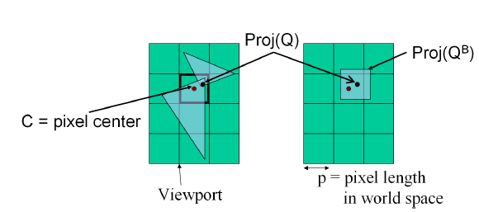
Reliable Queries
Cubes only work for z-axis projections so in practice use a bounding sphere of radius sqrt(3)p/2

Slide 90
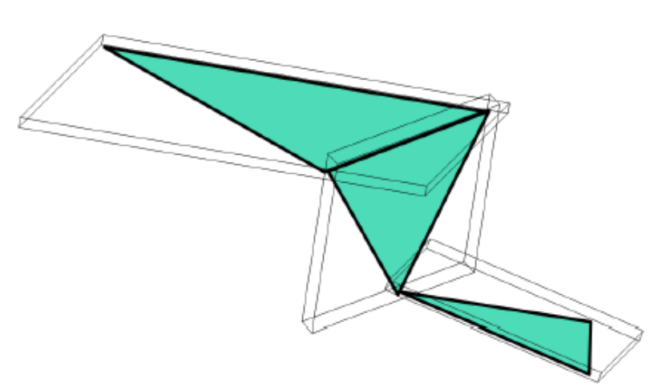
Bounding Offset
So far we’ve just dealt with single triangles but we need whole objects
This is done using a Union of Object-oriented Bounding Boxes(UOBB)

Slide 91
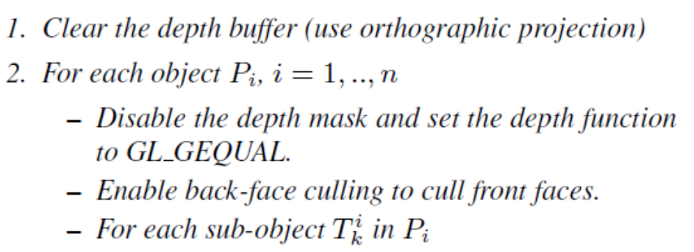
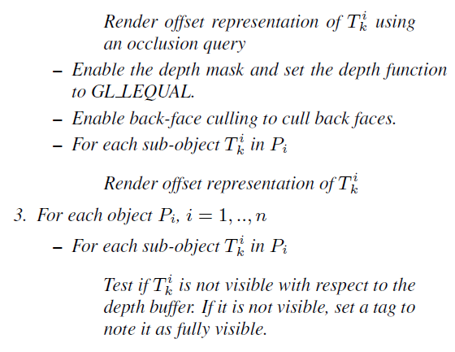
Algorithm

Slide 92
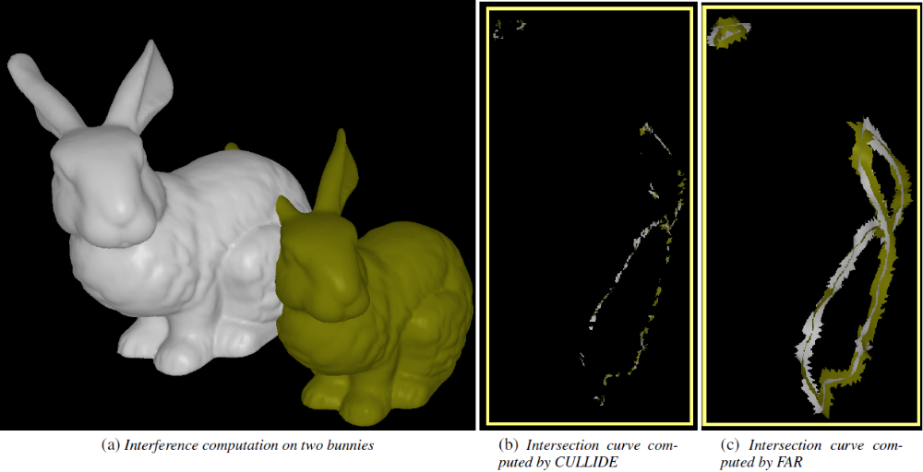
Improvement over CULLIDE

Slide 93
Performance
Still runs faster than CPU implementations
3x slower than CULLIDE due to bounding box rasterization vs triangle rasterization

Slide 94
QCULLIDE
Extends CULLIDE to handle self collisions in complex meshes
All running in real time

Slide 95
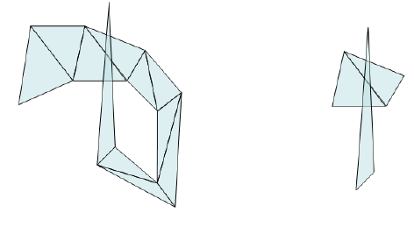
Self Collision Culling
Note that only intersecting triangles that don’t share a vertex or edge are considered colliding

Slide 96
Self Collision Culling
Algorithm
  Include all potentially colliding primitives and PCS where each primitive is a triangle
  Perform the visibility test to see if a triangle is penetrating any other
  If completely visible, the object is not colliding

Slide 97
Q-CULLIDE
Sets
  BFV – Objects fully visible in both passes and are pruned from the PCS
  FFV – Fully visible in only the first pass
  SFV – Fully visible in only the second pass
  NFV – Not fully visible in both passes

Slide 98
Q-CULLIDE
Properties of sets
  FFV and SFV are collision free
    No object in FFV collides with any other in FFV…same for SFV
  If an object is in FFV and is fully visible in the 2nd pass of the algorithm, we can prune it and vice versa

Slide 99
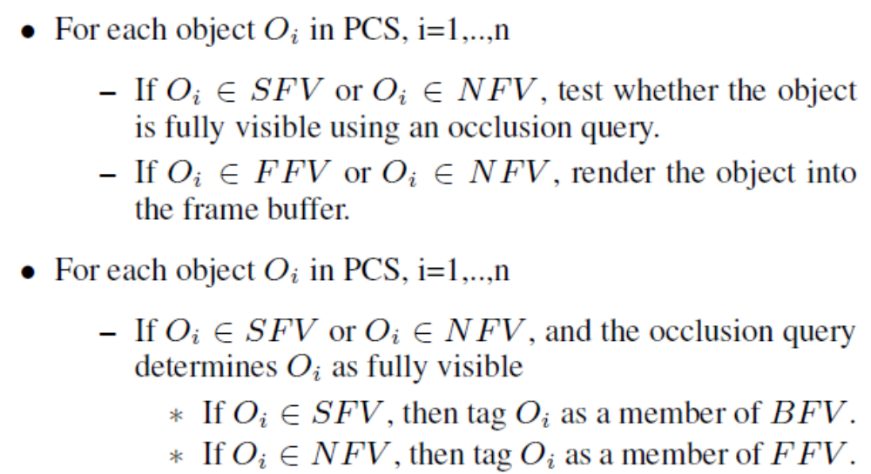
Algorithm

Slide 100
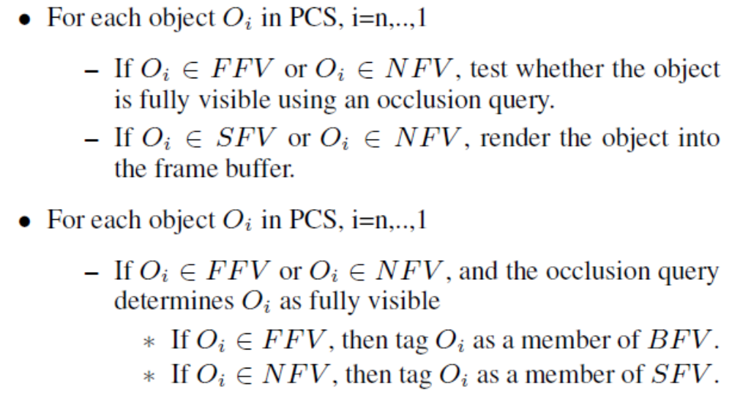
Algorithm

Slide 101
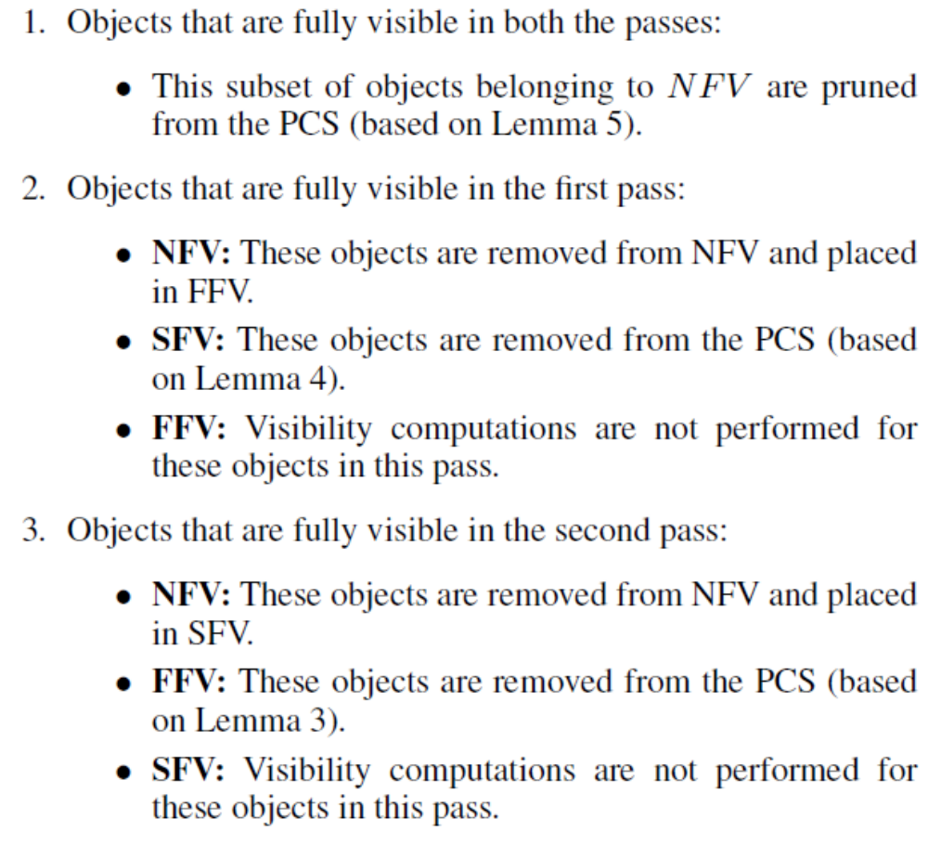
What’s Happening

Slide 102
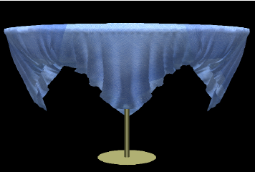
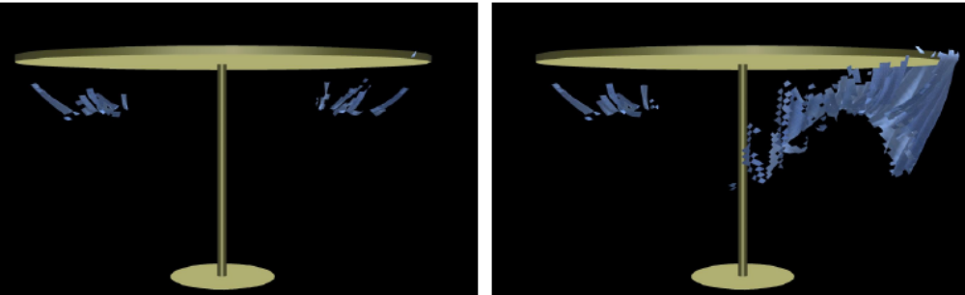
Improvement Over CULLIDE

Slide 103
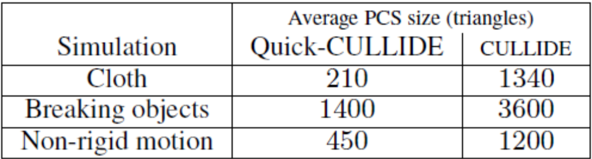
Improvements Over CULLIDE
Sends an order of magnitude less collisions to the CPU than CULLIDE

Slide 104
Spatial Subdivision
Partition space into uniform grid
Grid cell is at least as large as largest object
Each cell contains list of each object whose centroid is in the cell
Collision tests are performed between objects who are in same cell or adjacent cells
Implementation:
Create list of object IDs along with hashing of cell IDs in which they reside
Sort list by cell ID
Traverse swaths of identical cell IDs
Perform collision tests on all objects that share same cell ID
5
6
1
2
7
8
3
4
Example
O₁
1
2
3
4
O₄
O₂
O₃
5
6
7
8
Images from pg 699, 700 GPU Gems III
Notes:
Might want to mention hierarchical grids as a solution to the problem where objects vary greatly in size.

Slide 105
Parallel Spatial Subdivision
Complications:
  Single object can be involved in multiple collision tests
  Need to prevent multiple threads updating the state of an object at the same time
Ways to solve this?

Slide 106
Guaranteed Individual Collision Tests
Prove: No two cells updated in parallel may contain the same object that is being updated
  Constraints
  Each cell is as large as the bounding volume of the largest object
  Each cell processed in parallel must be separated by each other cell by at least one intervening cell
  In 2d this takes _____ number of passes
  In 3d this takes _____ number of passes
4
8

Slide 107
Example of Parallel Spatial Subdivision
O₁
1
2
1
2
O₄
O₂
O₃
3
4
3
4
O₁
1
2
1
2
O₄
O₂
O₃
3
4
3
4

Slide 108
Avoiding Extra Collision Testing
Associate each object a set of control bits to test where its centroid resides
Scale the bounding sphere of each object by sqrt(2) to ensure the grid cell is at least 1.5 times larger than the largest object
1
2
1
2
Case 2
Case 1
3
4
3
4
Notes:
Case 1:
Both cells share both 1 and 3 so we can skip test in cell 3 because it has already been performed by test 1
Case 2:
Overlap different cells of type 3, so their centroids are separated by a distance greater than the diameter of the largest object

Slide 109
Implementing in CUDA
Store list of object IDs, cell IDs in device memory
Build the list of cell IDs from object’s bounding boxes
Sorting list from previous step
Build an index table to traverse the sorted list
Schedule pairs of objects for narrow phase collision detection

Slide 110
Initialization
Cell ID Array
Object ID Array
OBJ 1 Cell ID 1
OBJ 1 Cell ID 2
OBJ 1 Cell ID 3
OBJ 1 Cell ID 4
OBJ 2 Cell ID 1
OBJ 2 Cell ID 2
OBJ 2 Cell ID 3
OBJ 2 Cell ID 4
.
.
.
OBJ 1 ID, Control Bits
OBJ 1 ID, Control Bits
OBJ 1 ID, Control Bits
OBJ 1 ID, Control Bits
OBJ 2 ID, Control Bits
OBJ 2 ID, Control Bits
OBJ 2 ID, Control Bits
OBJ 2 ID, Control Bits
.
.
.

Slide 111
Construct the Cell ID Array
Host Cells (H – Cells)
Contain the centroid of the object
Phantom Cells (P-Cells)
Overlap with bounding volume but do not contain the centroid
H-Cell Hash = (pos.x / CELLSIZE) << XSHIFT) |
(pos.y / CELLSIZE) << YSHIFT) |
(pos.z / CELLSIZE) << ZSHIFT)
P
P
P
P-Cells – Test the 3^{d}-1 cells surrounding the H cell
There can be as many as 2^{d}-1 P cells
P
H
P
P
P
P

Slide 112
Sorting the Cell ID Array
What we want:
  Sorted by Cell ID
  H cells of an ID occur before P cells of an ID
Starting with a partial sort
  H cells are before P cells, but array is not sorted by Cell ID
Solution:
  Radix Sort
  Radix Sort ensures identical cell IDs remain in the same order as before sorting.

Slide 113
Sorting Cell Array
Cell ID Array
Sorted Cell ID Array
010
0
011
1
111
2
101
3
021
4
...
021
n
000
2
011
n
101
3
...
020
0
110
2
100
3
011
4
011
n
001
2
020
0
101
2
011
0
100
2
021
n
010
0
021
4
110
2
021
0
000
2
111
n
010
2
021
n
111
2
Legend
001
2
022
n
011
1
021
0
111
n
Invalid Cell
101
2
011
0
022
n
111
n
011
1
Home Cell
011
2
011
2
100
2
102
n
100
2
Phantom Cell
010
2
011
4
100
3
103
3
Cell ID
103
3
Object ID
Notes:
Students already learned an implementation of RADIX sort in a previous lecture, but there is an excellent detailed overview of this particular radix sort in the GPU Gems 3 chapter (32)

Slide 114
Spatial Subdivision
5
6
1
2
7
8
3
4
Example
O₁
1
2
3
4
Assign to each cell the list of bounding volumes whose objects intersect with the cell
Perform Collision test only if both objects are in the cell and one has a centroid in the cell
O₄
O₂
O₃
5
6
7
8
Images from pg 699, 700 GPU Gems III
Notes:
Might want to mention hierarchical grids as a solution to the problem where objects vary greatly in size.

Slide 115
Create the Collision Cell List
Scan sorted cell ID array for changes of cell ID
  Mark by end of the list of occupants of one cell and beginning of another
Count number of objects each collision cell contains and convert them into offsets using scan
Create entries for each collision cell in new array
  Start
  Number of H occupants
  Number of P occupants

Slide 116
Create Collision Cell List
Sorted Cell ID Array
Cell Index & Size Array
000
2
011
n
101
3
...
2
1 1
4
1 4
10
2 1
...
001
2
020
0
101
2
ID
H P
ID = Cell index in sorted Cell ID Array
H = Number of Home Cell IDs
P = Number of Phantom Cell IDs
010
0
021
4
110
2
010
2
021
n
111
2
011
1
021
0
111
n
011
0
022
n
111
n
011
2
100
2
102
n
011
4
100
3
103
3

Slide 117
Traverse Collision Cell List
Cell Index & Size Array
2
1 1
4
1 4
10
2 1
16
1 1
19
1 1
...
X
p q
T 0
T 1
T 2
T 3
T 4
...
T n
Perform Collision
Test Per Cell
0
1
0
2
1
...
…
Number of Collisions / Thread Array

