Slide 1
UNIVERSITÀ DI PISA
Plant Disease Assistant
Plant disease recognition in field images
Intelligent Systems Course Project
Master's degree in Computer Engineering
A.Y. 2025 / 2026

Slide 2
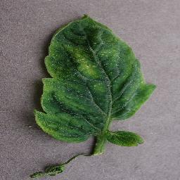
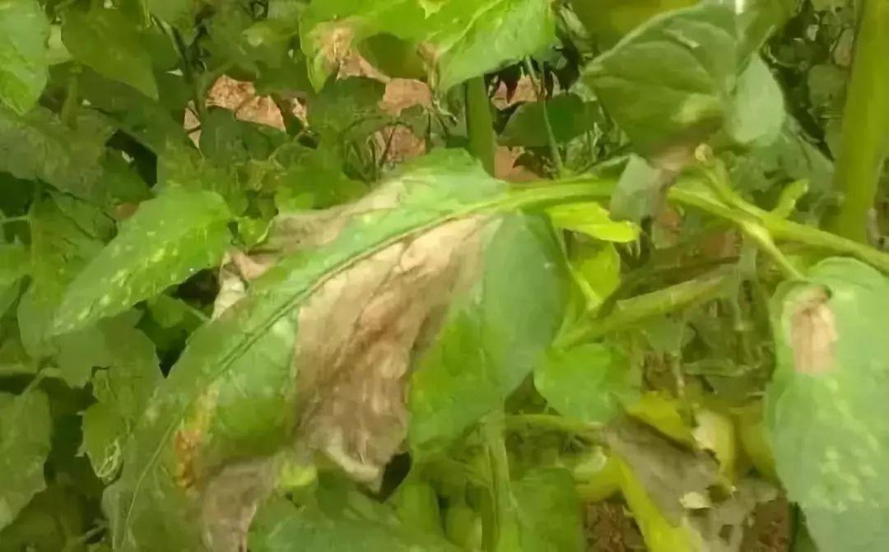
Problem Statement
Disease classification and localization in non-ideal conditions
Ideal images show one clear leaf with good lighting and little background clutter.
Field images add shadows, clutter, occlusion, scale changes and multiple leaves.
We expect classification and localization performance to decrease in non-ideal conditions.
IDEAL CONDITIONS
CLEAR LEAF IMAGE
NON-IDEAL CONDITIONS
FIELD IMAGE
Plant Disease Assistant | Intelligent Systems
2

Slide 3
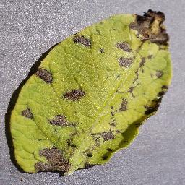
Machine Learning Tasks
INPUT
LEAF IMAGE
1 CLASSIFICATION
2 LOCALIZATION
3 ROBUSTNESS
Identify the crop-disease category shown in the image.
Identify the regions affected by the disease.
Compare performance in controlled and field conditions.
The project combines disease recognition, affected-region localization and condition-based evaluation.
Plant Disease Assistant | Intelligent Systems
3

Slide 4
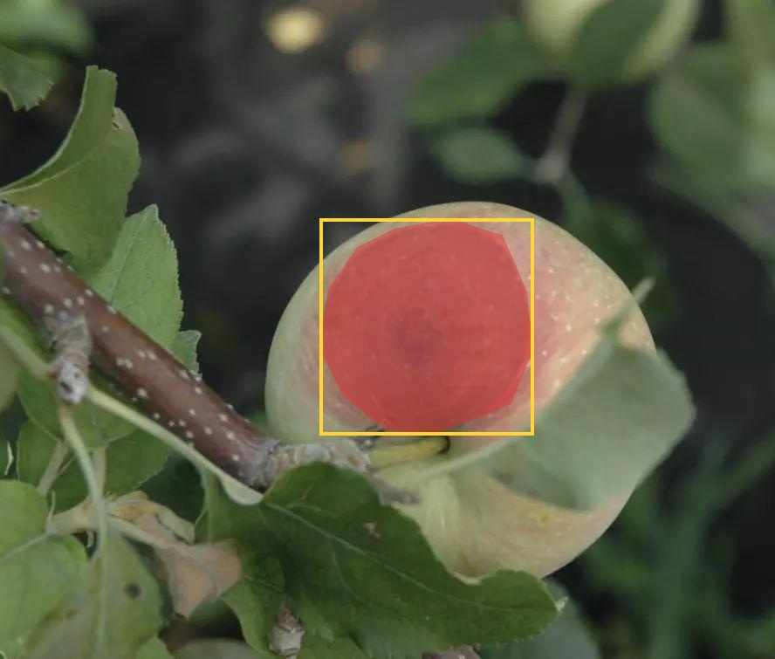
Datasets
Two datasets represent the image conditions considered in the project.
Each dataset has a different role in the evaluation.
PLANTVILLAGE - CONTROLLED IMAGES
Single leaves on simple backgrounds
Purpose: classification in ideal conditions
PLANTSEG - FIELD IMAGES
Leaves photographed in realistic scenes
Purpose: classification and localization in non-ideal conditions
CONDITION COMPARISON
Classifier performance in controlled and field images
LOCALIZATION DATA
PlantSeg masks identify affected regions
Together, the datasets support classification, localization and robustness.
Plant Disease Assistant | Intelligent Systems
4

Slide 5
Models
Classification identifies the disease; localization identifies the affected regions.
TASK / MODELS
PURPOSE
OUTPUT
CLASSIFICATION
EfficientNetB0
MobileNetV2
Recognize crop-disease categories in controlled and field images.
Disease label and prediction confidence.
LOCALIZATION
YOLO11n-seg
Grad-CAM
Identify visible symptoms and the regions used by the classifiers.
Lesion mask and attention heatmap.
Plant Disease Assistant | Intelligent Systems
5

Slide 6
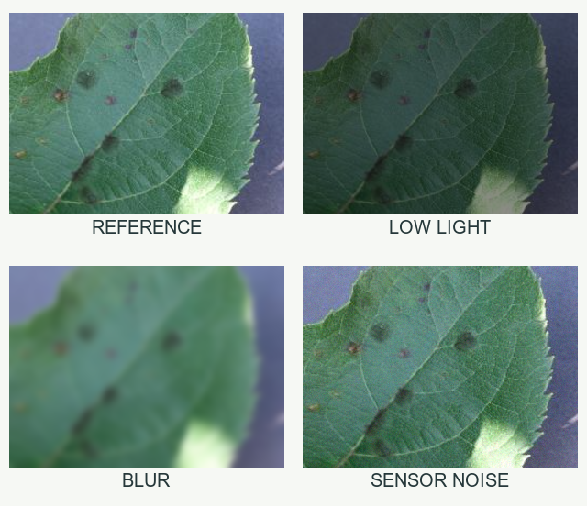
Robustness Checks
Robustness checks cover controlled image changes and natural field conditions.
Each condition is compared with a clear reference image.
CONTROLLED VARIANTS
Low light, blur and sensor noise applied to a reference image
FIELD CONDITIONS
Clutter, shadows, occlusion and variable framing
WHAT WE COMPARE
Accuracy, confidence and prediction consistency
GOAL
Identify the conditions associated with the largest performance drop
Code-generated examples from the same PlantVillage image.
Plant Disease Assistant | Intelligent Systems
6

