Slide 1
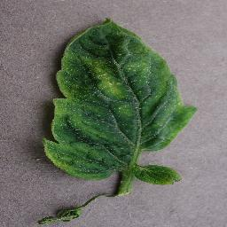
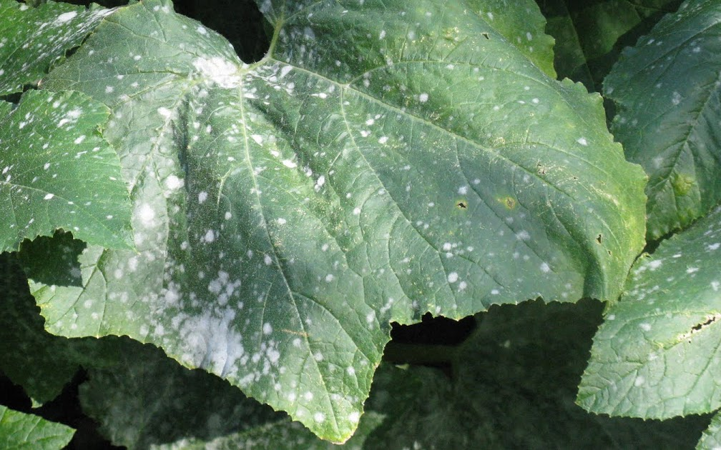
Problem Statement
Plant disease classification under controlled and field conditions
PlantVillage contains single, centered leaves on uniform backgrounds.
Field photographs include clutter, multiple leaves, occlusion, scale changes and variable illumination.
The project evaluates whether models trained on controlled images remain reliable under these changes.
PLANTVILLAGE
CONTROLLED IMAGE
PLANTDOC
FIELD IMAGE
UNIPI
Plant Disease Assistant | Intelligent Systems
1

Slide 2
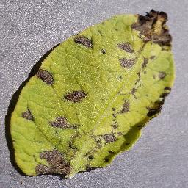
Machine Learning Tasks
INPUT
LEAF IMAGE
1 CLASSIFICATION
2 LOCALIZATION
3 ROBUSTNESS
Predict the crop and disease class with a CNN classifier.
Use YOLO detections and Grad-CAM activation maps to locate relevant image regions.
Measure performance and confidence under synthetic corruptions and field images.
The three tasks are evaluated separately and combined in the final prototype.
UNIPI
Plant Disease Assistant | Intelligent Systems
2

Slide 3
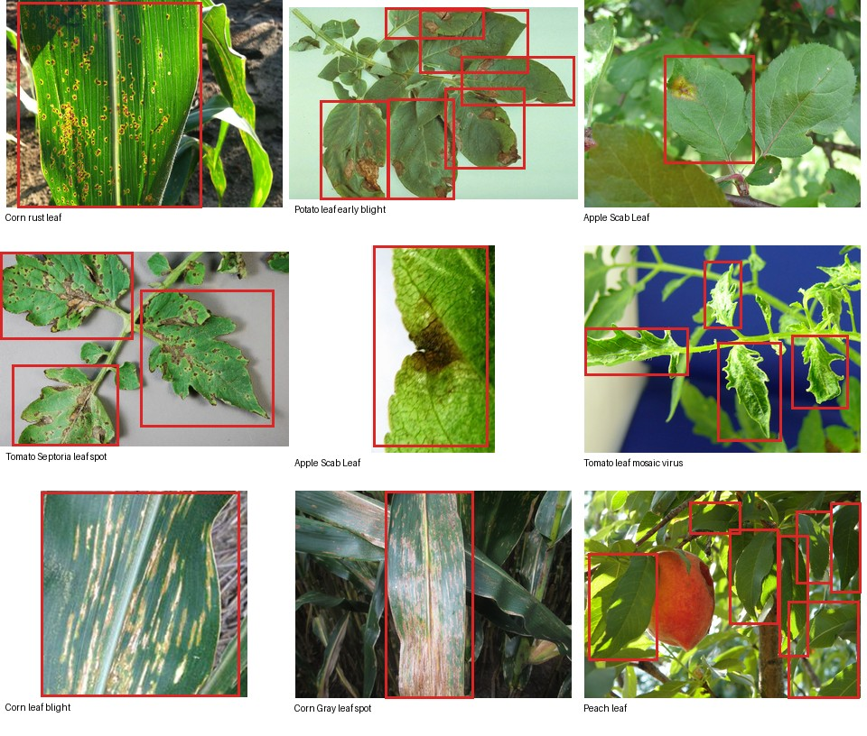
Datasets and Preliminary Analysis
PlantVillage is used for classification; PlantDoc for localization and external evaluation.
The datasets require duplicate removal, bounding-box validation and a shared label taxonomy.
PLANTVILLAGE
54,305 images | 38 classes
Main classifier training
PLANTDOC
2,578 field images | 8,910 boxes
YOLO + field robustness
DATA PREPARATION
Remove cross-split duplicates and repair invalid boxes.
LABEL MAPPING
Evaluate only crop-disease classes shared by both datasets.
PlantDoc boxes often identify whole disease-labelled leaves, not pixel-level lesions.
UNIPI
Plant Disease Assistant | Intelligent Systems
3

Slide 4
Models
The models are selected according to the classification and localization tasks.
MODEL
TRAINING
USE IN THE PROJECT
Baseline CNN
Train from scratch on PlantVillage.
Reference model for classification performance.
EfficientNetB0
MobileNetV2
Initialize with ImageNet weights, then fine-tune on PlantVillage.
Compare macro F1, model size and inference time.
YOLO
Grad-CAM
Train YOLO on PlantDoc boxes; compute Grad-CAM from the classifiers.
Leaf detection and visualization of classifier activation regions.
UNIPI
Plant Disease Assistant | Intelligent Systems
4

Slide 5
Experimental Setup
TRAINING AND MODEL SELECTION: PLANTVILLAGE
TEST SETS
CLEAN
BLUR
LIGHT
JPEG
Macro F1 + recall
confidence + calibration
Robustness evaluation
Data preparation
1. Apply each corruption at several severity levels to the same clean test images.
Remove train/test duplicates and repair invalid PlantDoc boxes.
2. Evaluate taxonomy-matched PlantDoc crops as the real field-domain test.
3. Compare the baseline CNN, EfficientNetB0 and MobileNetV2 under identical shifts.
Record corruption type and severity instead of using a single standard/non-standard label.
Prototype output: disease class, confidence, Grad-CAM map and optional YOLO detections
UNIPI
Plant Disease Assistant | Intelligent Systems
5

