Slide 1

REALTIME WEB APPS
SLAWOMIR.WILUSZ@FINGOWEB.COM - FINGOWEB.COM - PSDORGANIZER.COM - @2017

Slide 2
POLLING
<meta http-equiv="refresh" content="5">
window.location + setTimeout
AJAX
  Short polling
  Long polling
SLAWOMIR.WILUSZ@FINGOWEB.COM - FINGOWEB.COM - PSDORGANIZER.COM - @2017

Slide 3
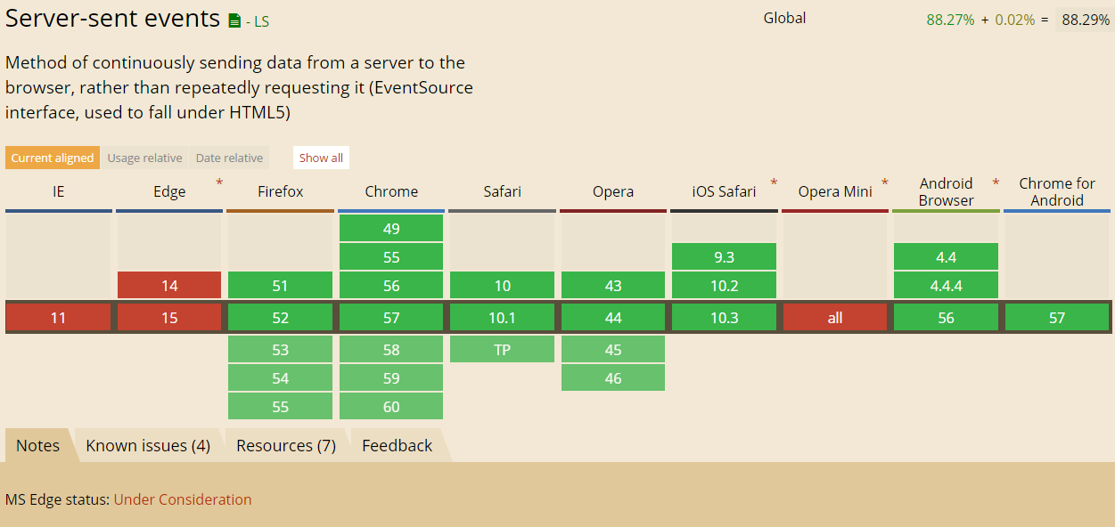
PUSH
server-sent event
SLAWOMIR.WILUSZ@FINGOWEB.COM - FINGOWEB.COM - PSDORGANIZER.COM - @2017

Slide 4
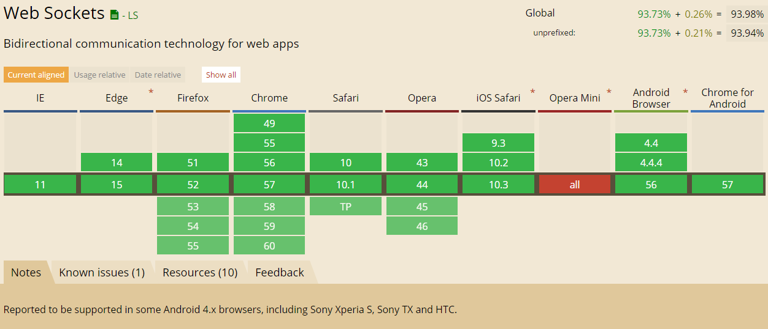
WEBSOCKETS
Advantages of Websockets over SSE:
Real time, two directional communication.
Native support in more browsers
SLAWOMIR.WILUSZ@FINGOWEB.COM - FINGOWEB.COM - PSDORGANIZER.COM - @2017

Slide 5
SERVER-SIDE – IN MEMORY
socket.io
Socket.IO is a JavaScript library for realtime web applications. It enables realtime, bi-directional communication between web clients and servers. It has two parts: a client-side library that runs in the browser, and a server-side library for Node.js. Both components have a nearly identical API.
SLAWOMIR.WILUSZ@FINGOWEB.COM - FINGOWEB.COM - PSDORGANIZER.COM - @2017

Slide 6
SERVER-SIDE – DB CHANGE FEED
Oplog / Binlog
  MongoDB
  MySql
Triggers
  PostgreSQL – LISTEN/NOTIFY
Dedicated solution
  RethinkDB – „changes()”
  CouchDB – „_changes”
SLAWOMIR.WILUSZ@FINGOWEB.COM - FINGOWEB.COM - PSDORGANIZER.COM - @2017

Slide 7
PUTTING THE PIECES TOGETHER
React
NodeJS
FeathersJS +RxJS + Socket.io
RethinkDB
SLAWOMIR.WILUSZ@FINGOWEB.COM - FINGOWEB.COM - PSDORGANIZER.COM - @2017

Slide 8
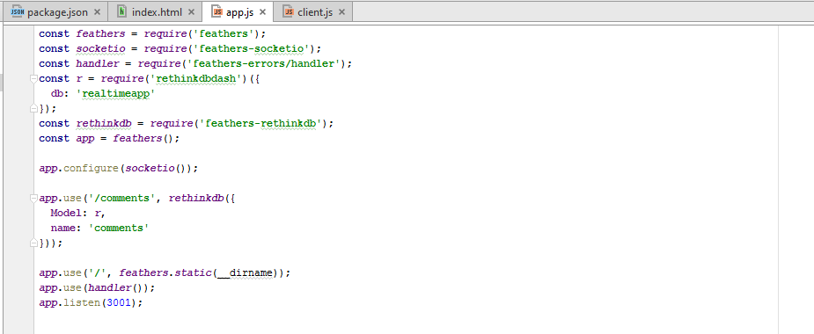
DEMO – SERVER SIDE
SLAWOMIR.WILUSZ@FINGOWEB.COM - FINGOWEB.COM - PSDORGANIZER.COM - @2017

Slide 9
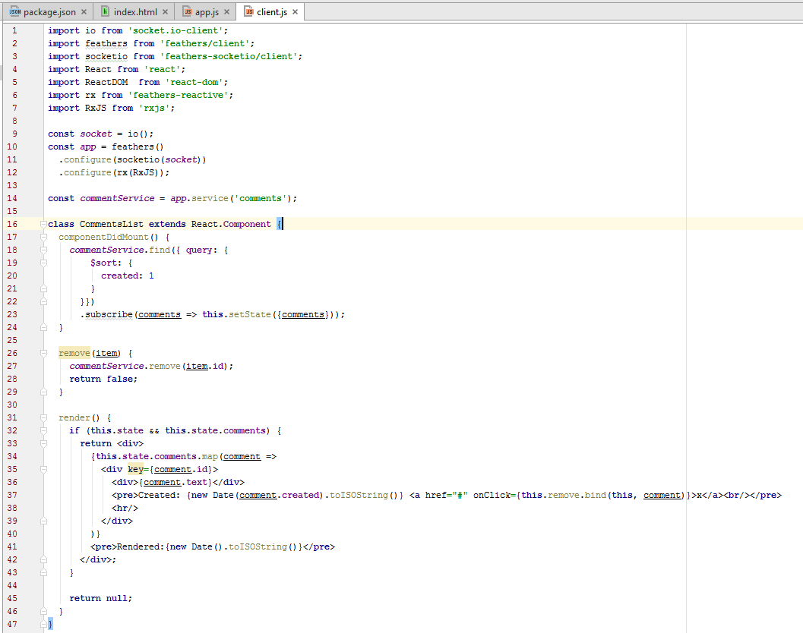
DEMO – CLIENT SIDE
SLAWOMIR.WILUSZ@FINGOWEB.COM - FINGOWEB.COM - PSDORGANIZER.COM - @2017

Slide 10
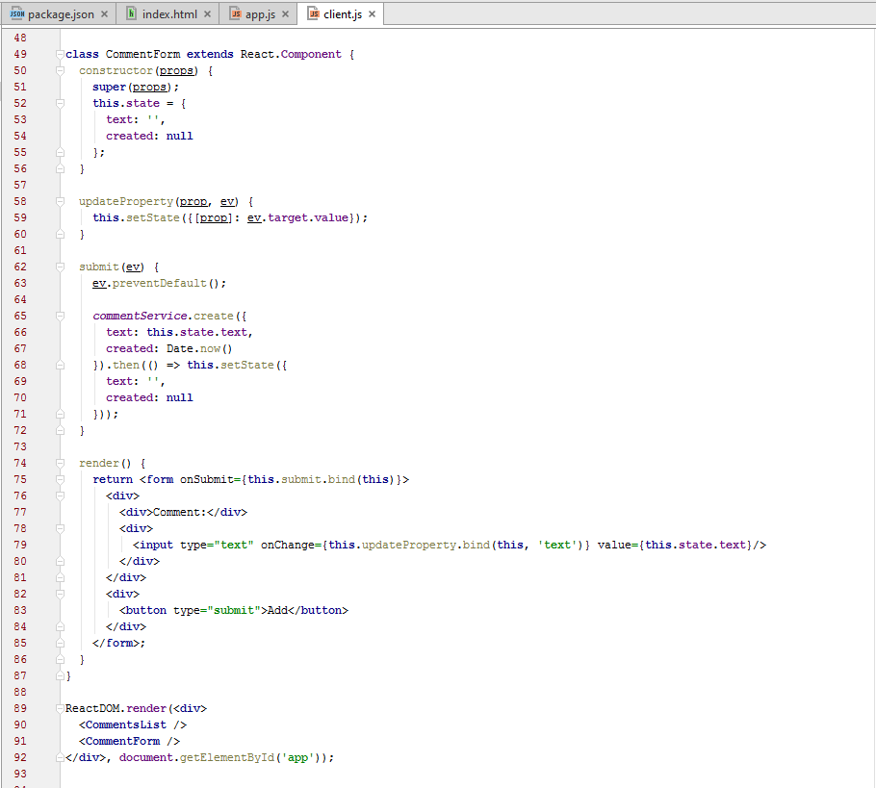
DEMO – CLIENT SIDE 2
SLAWOMIR.WILUSZ@FINGOWEB.COM - FINGOWEB.COM - PSDORGANIZER.COM - @2017

Slide 11
DEMO – PSDORGANIZER.COM
SLAWOMIR.WILUSZ@FINGOWEB.COM - FINGOWEB.COM - PSDORGANIZER.COM - @2017

Slide 12
THE END
THANK YOU
SLAWOMIR.WILUSZ@FINGOWEB.COM - FINGOWEB.COM - PSDORGANIZER.COM - @2017

