Slide 1
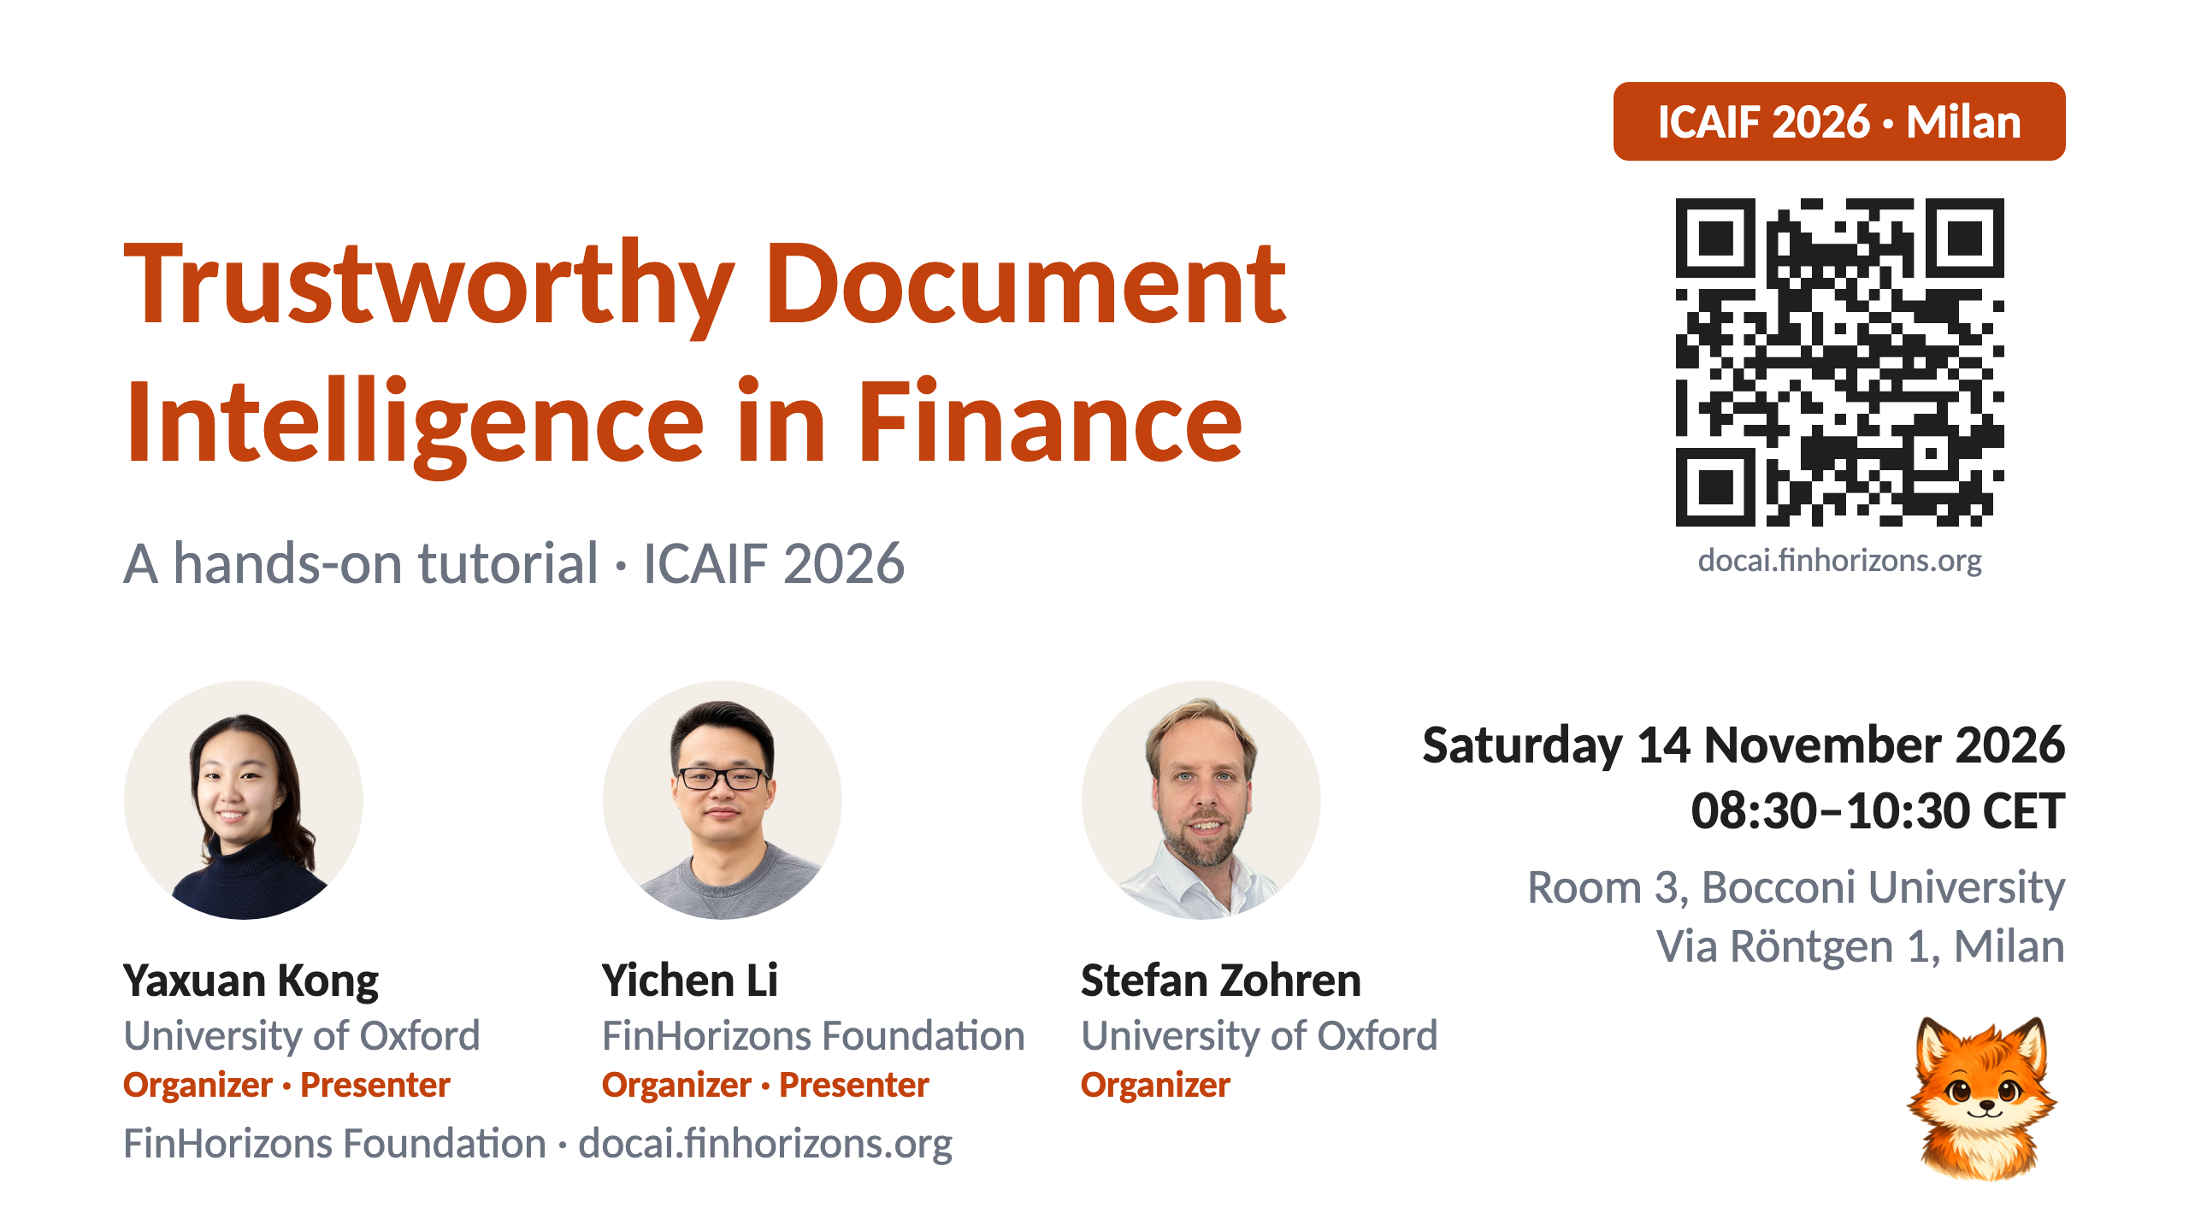
Notes:
1 · Title

Slide 2
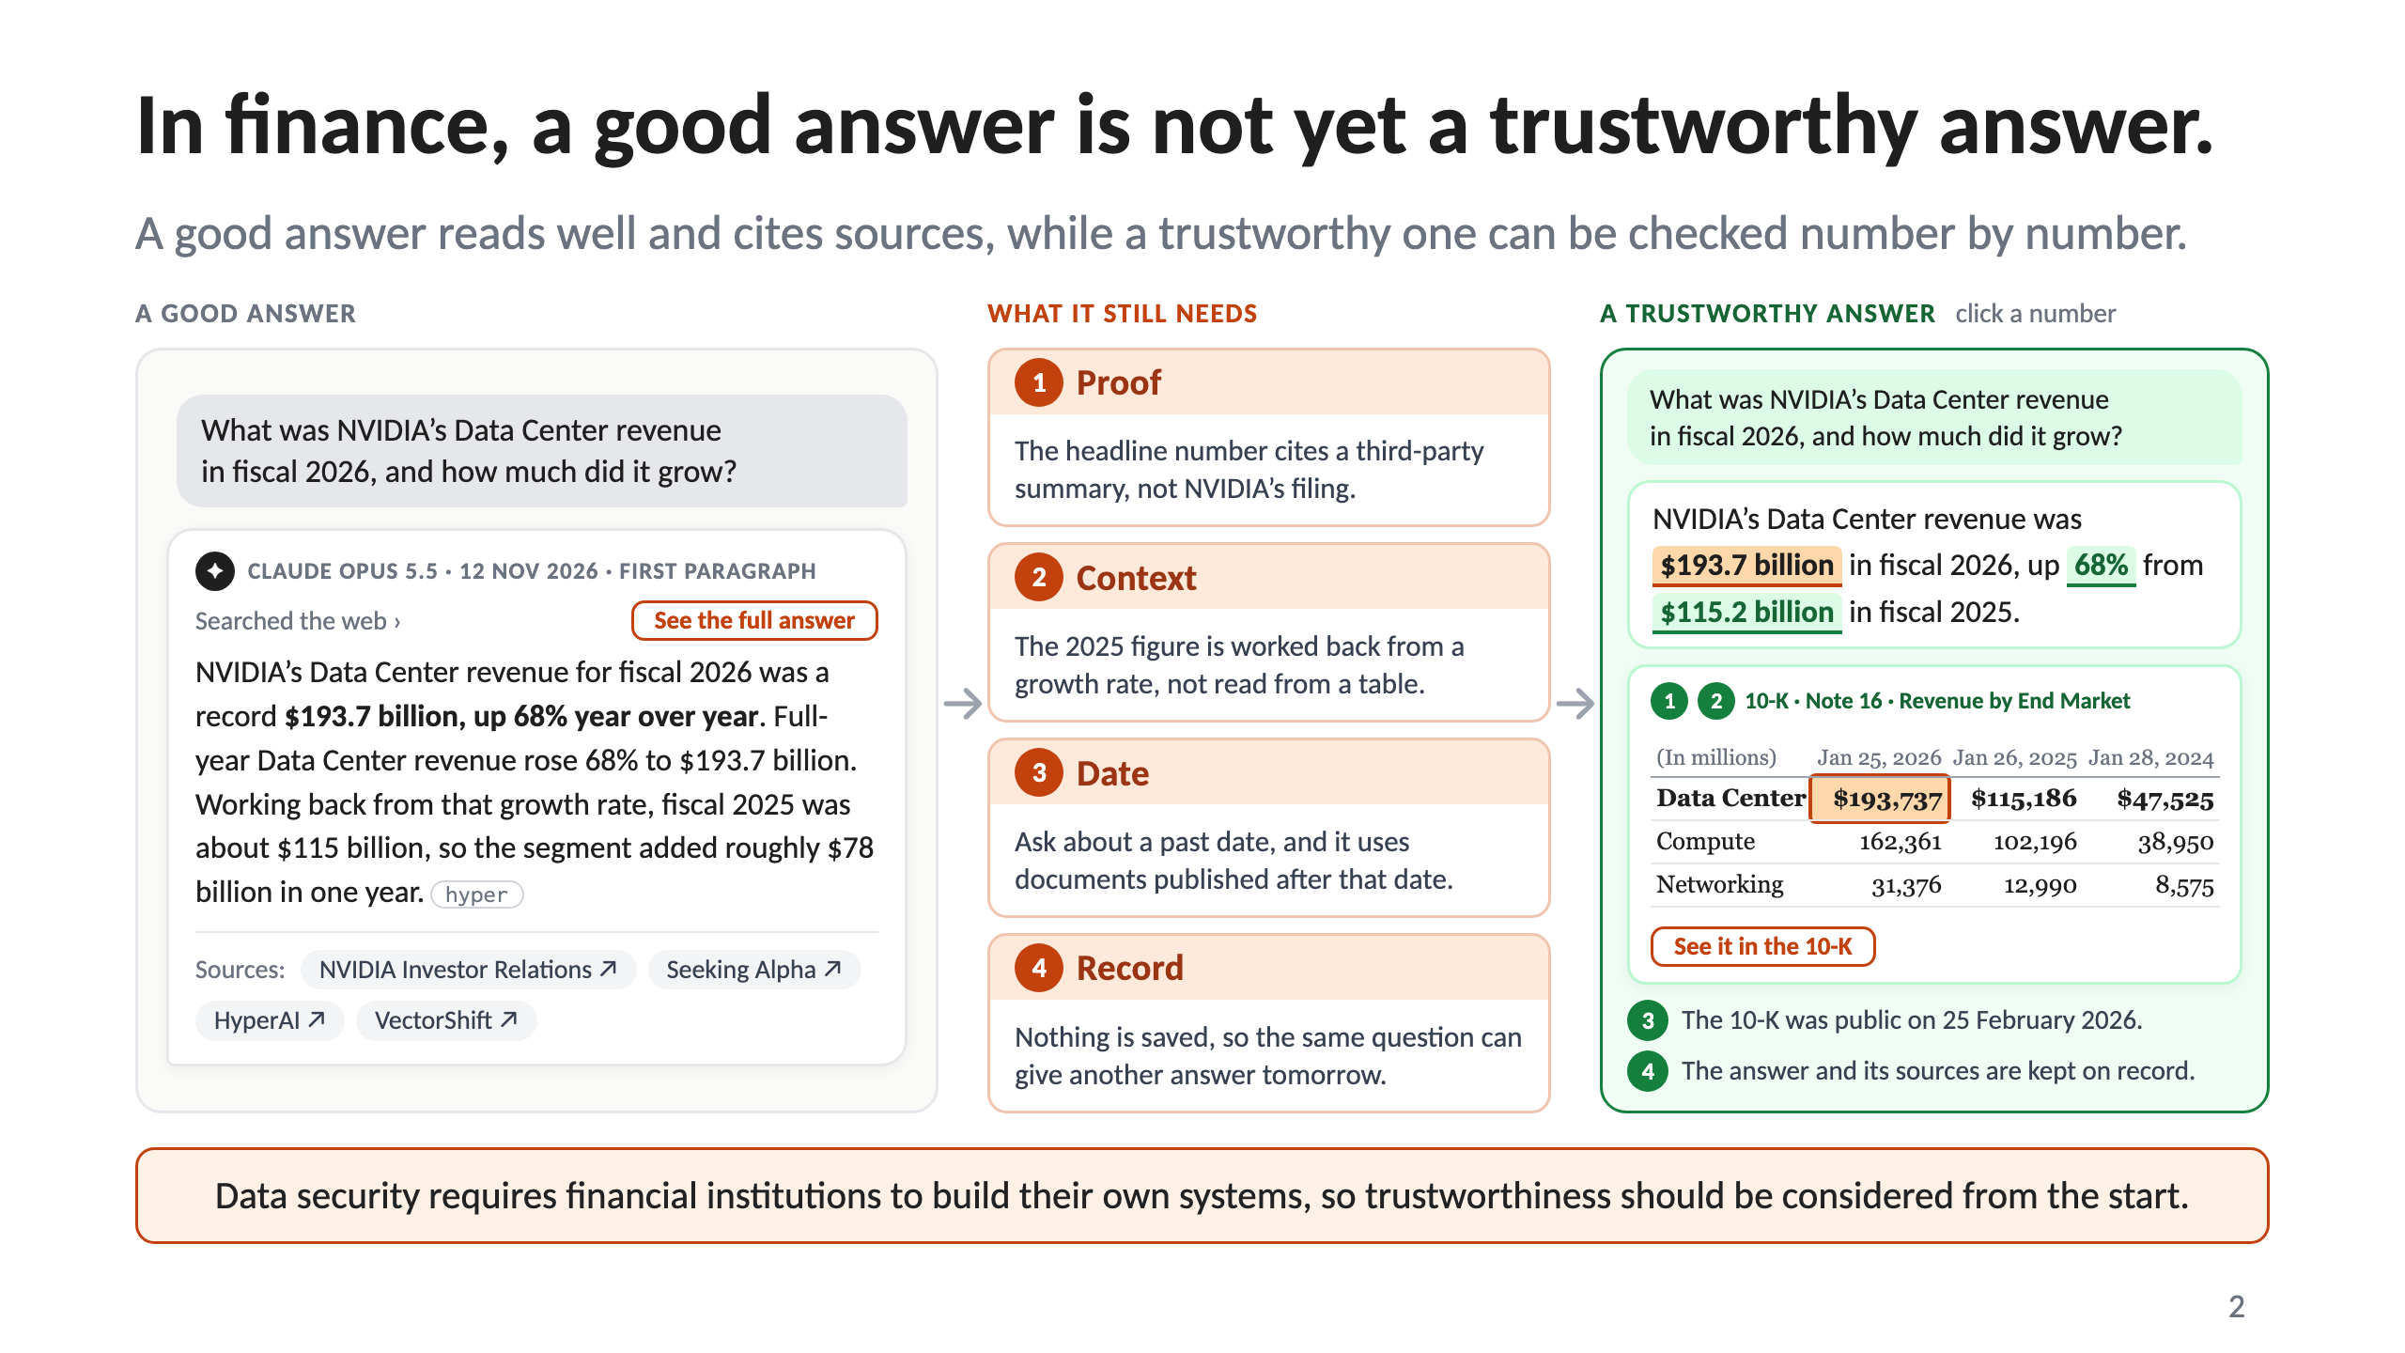
Notes:
2 · In finance, a good answer is not yet a trustworthy answer.

Slide 3
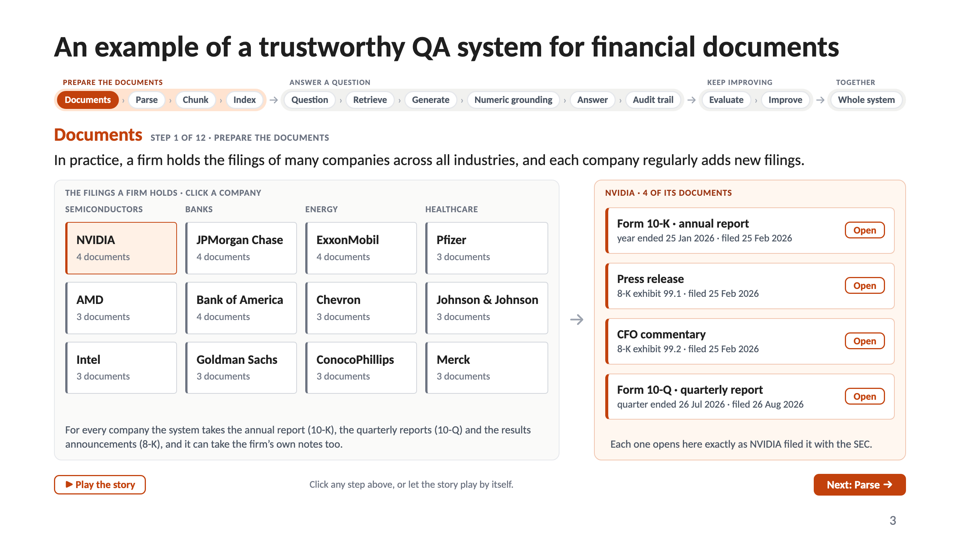
Notes:
3 · An example of a trustworthy QA system for financial documents

Slide 4
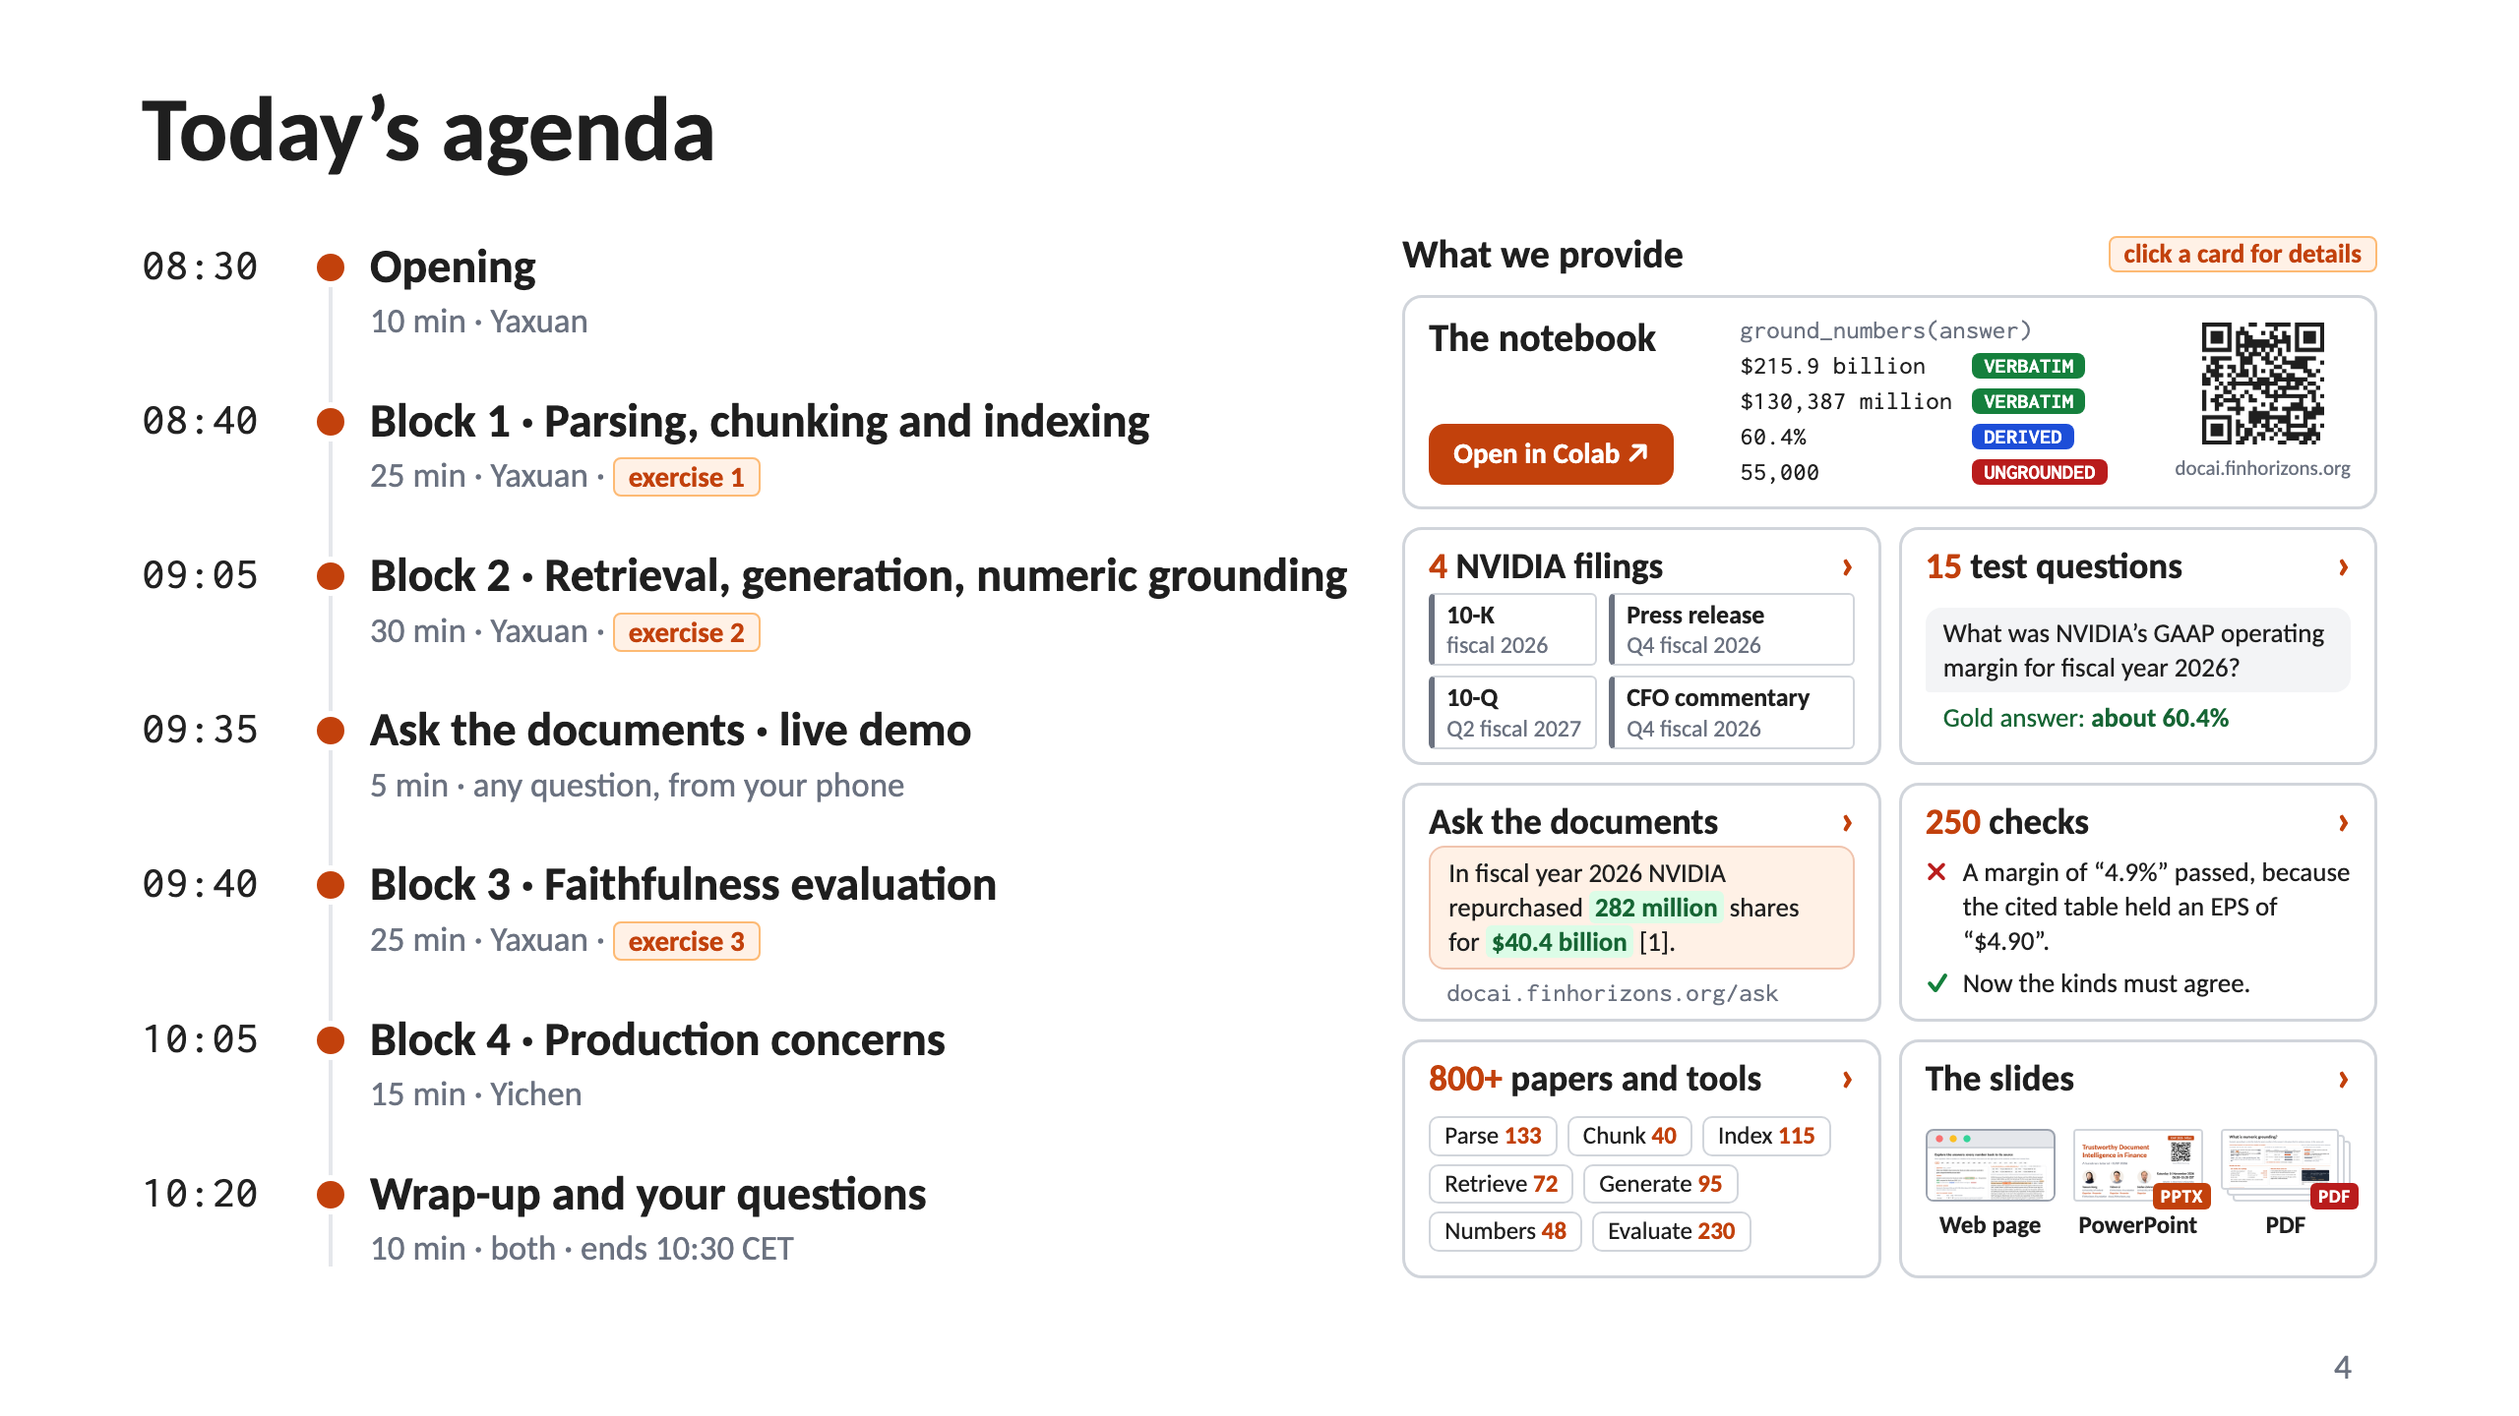
Notes:
4 · Today’s agenda

Slide 5
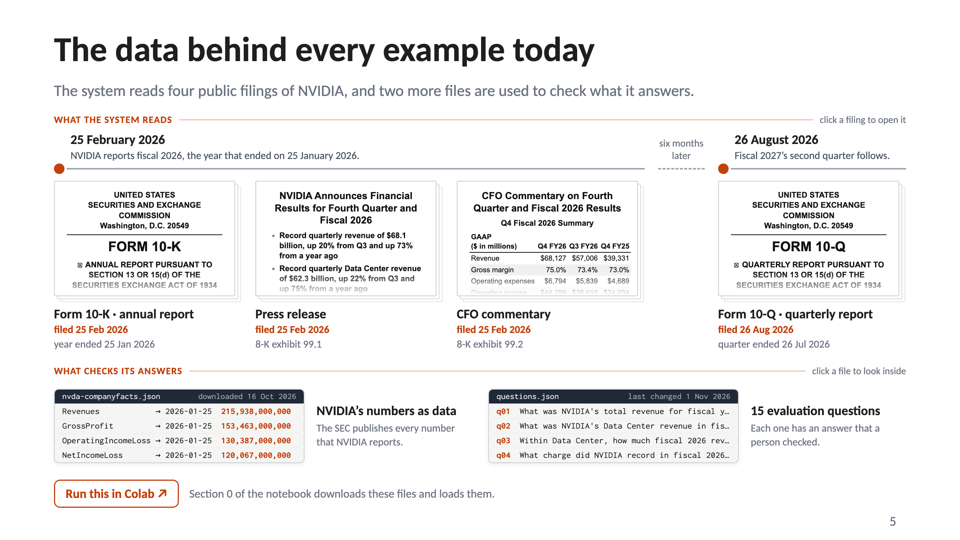
Notes:
5 · The data behind every example today

Slide 6
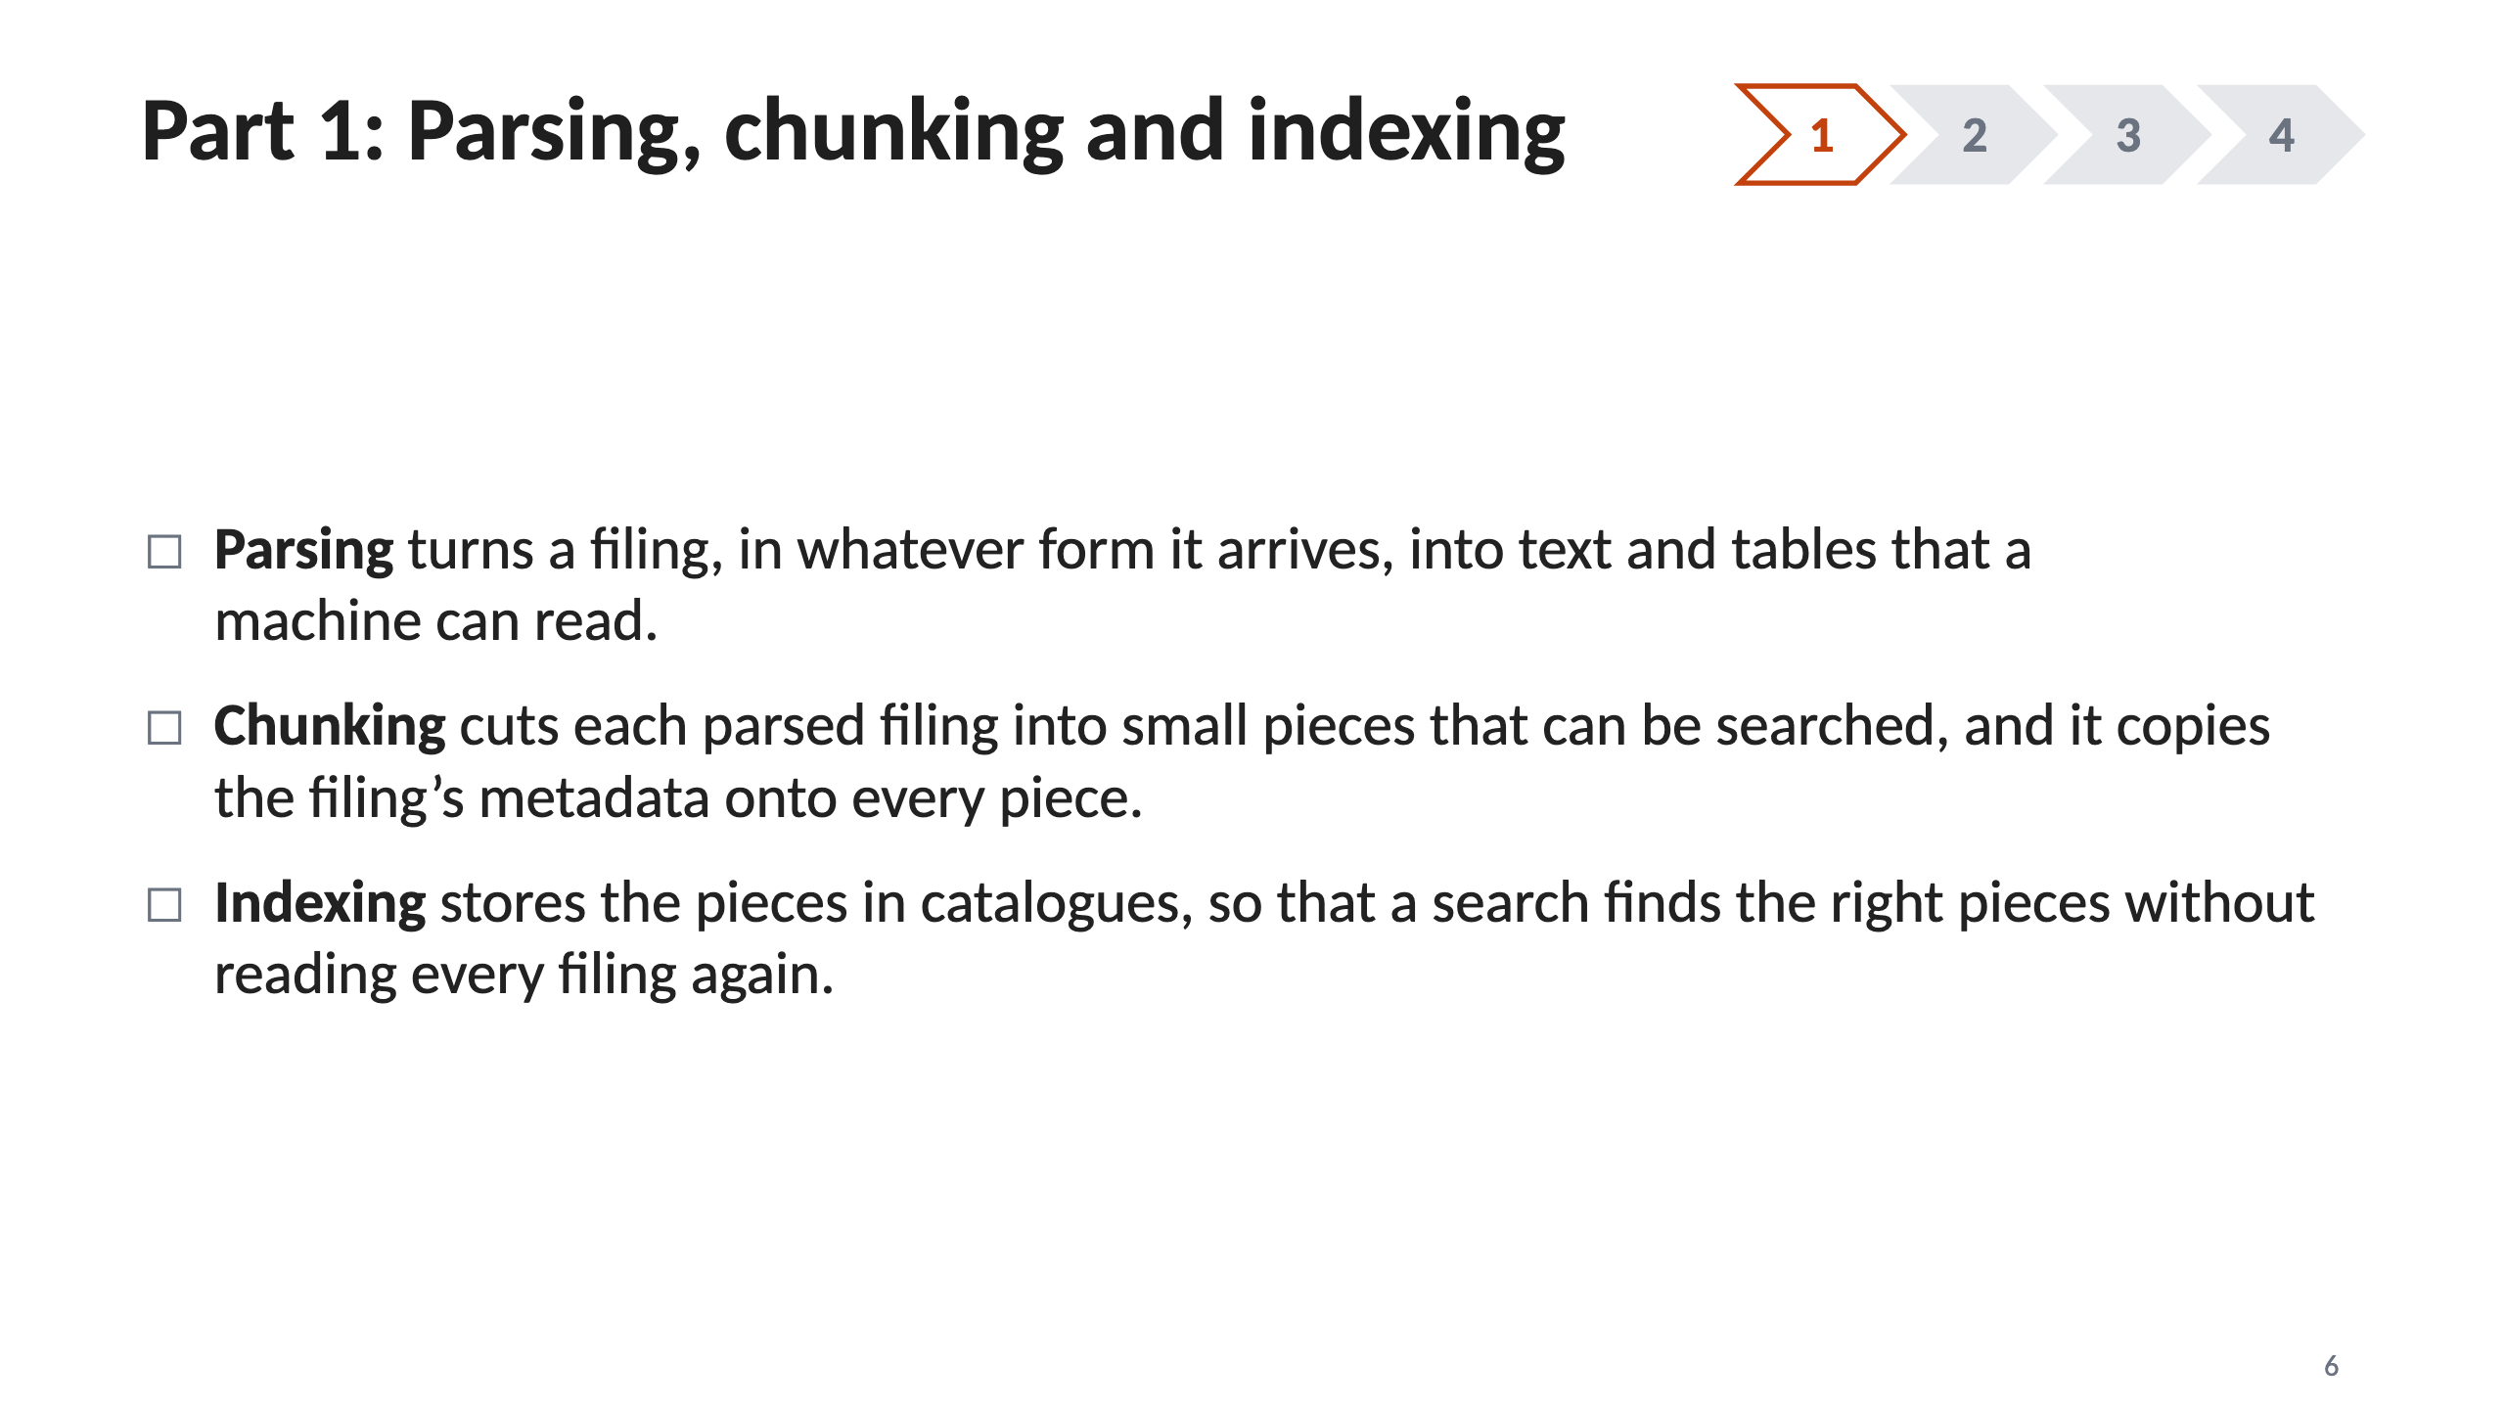
Notes:
6 · Part 1: Parsing, chunking and indexing

Slide 7
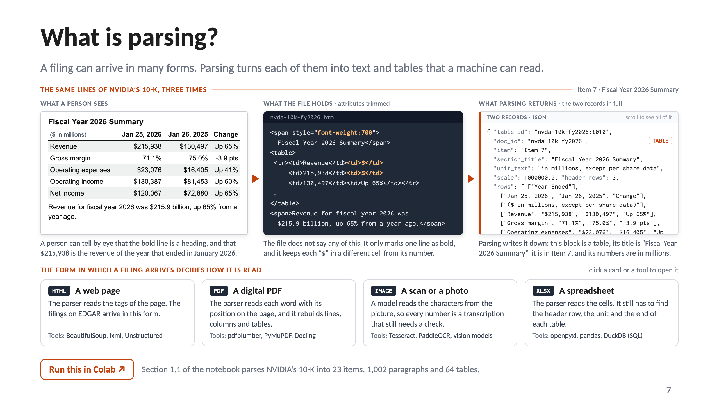
Notes:
7 · What is parsing?

Slide 8
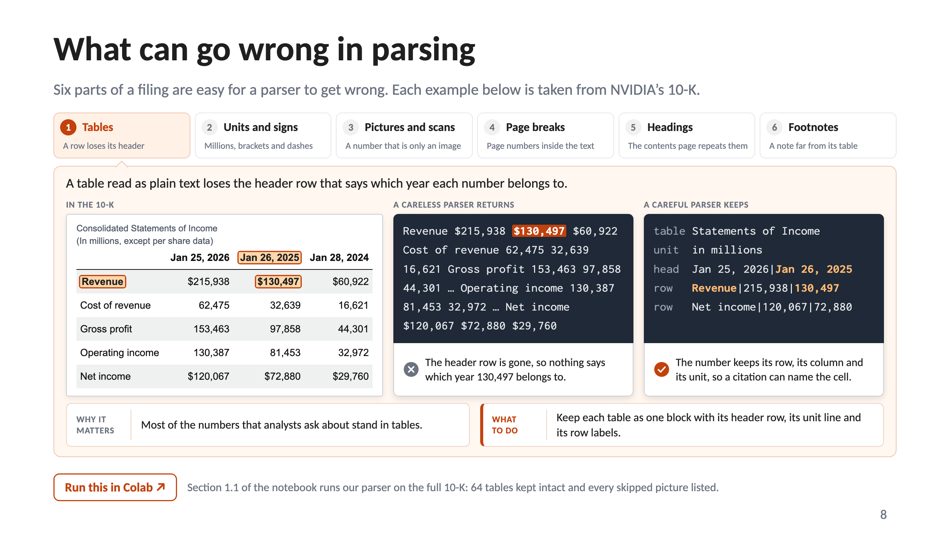
Notes:
8 · What can go wrong in parsing

Slide 9
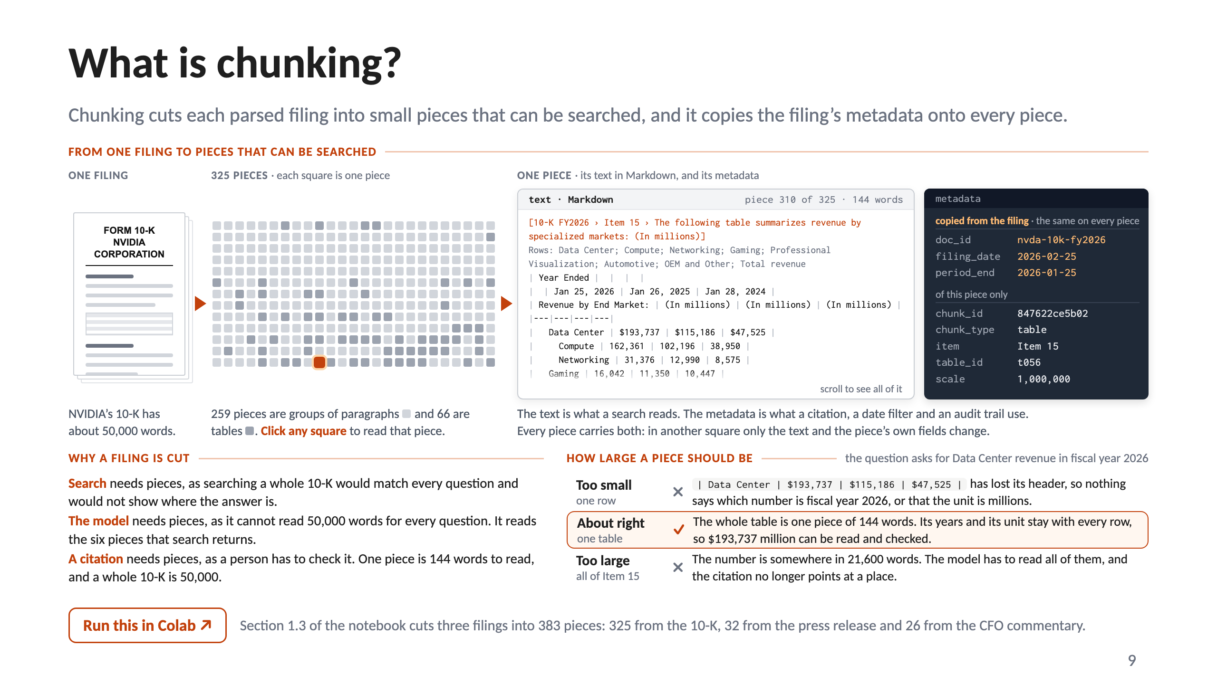
Notes:
9 · What is chunking?

Slide 10
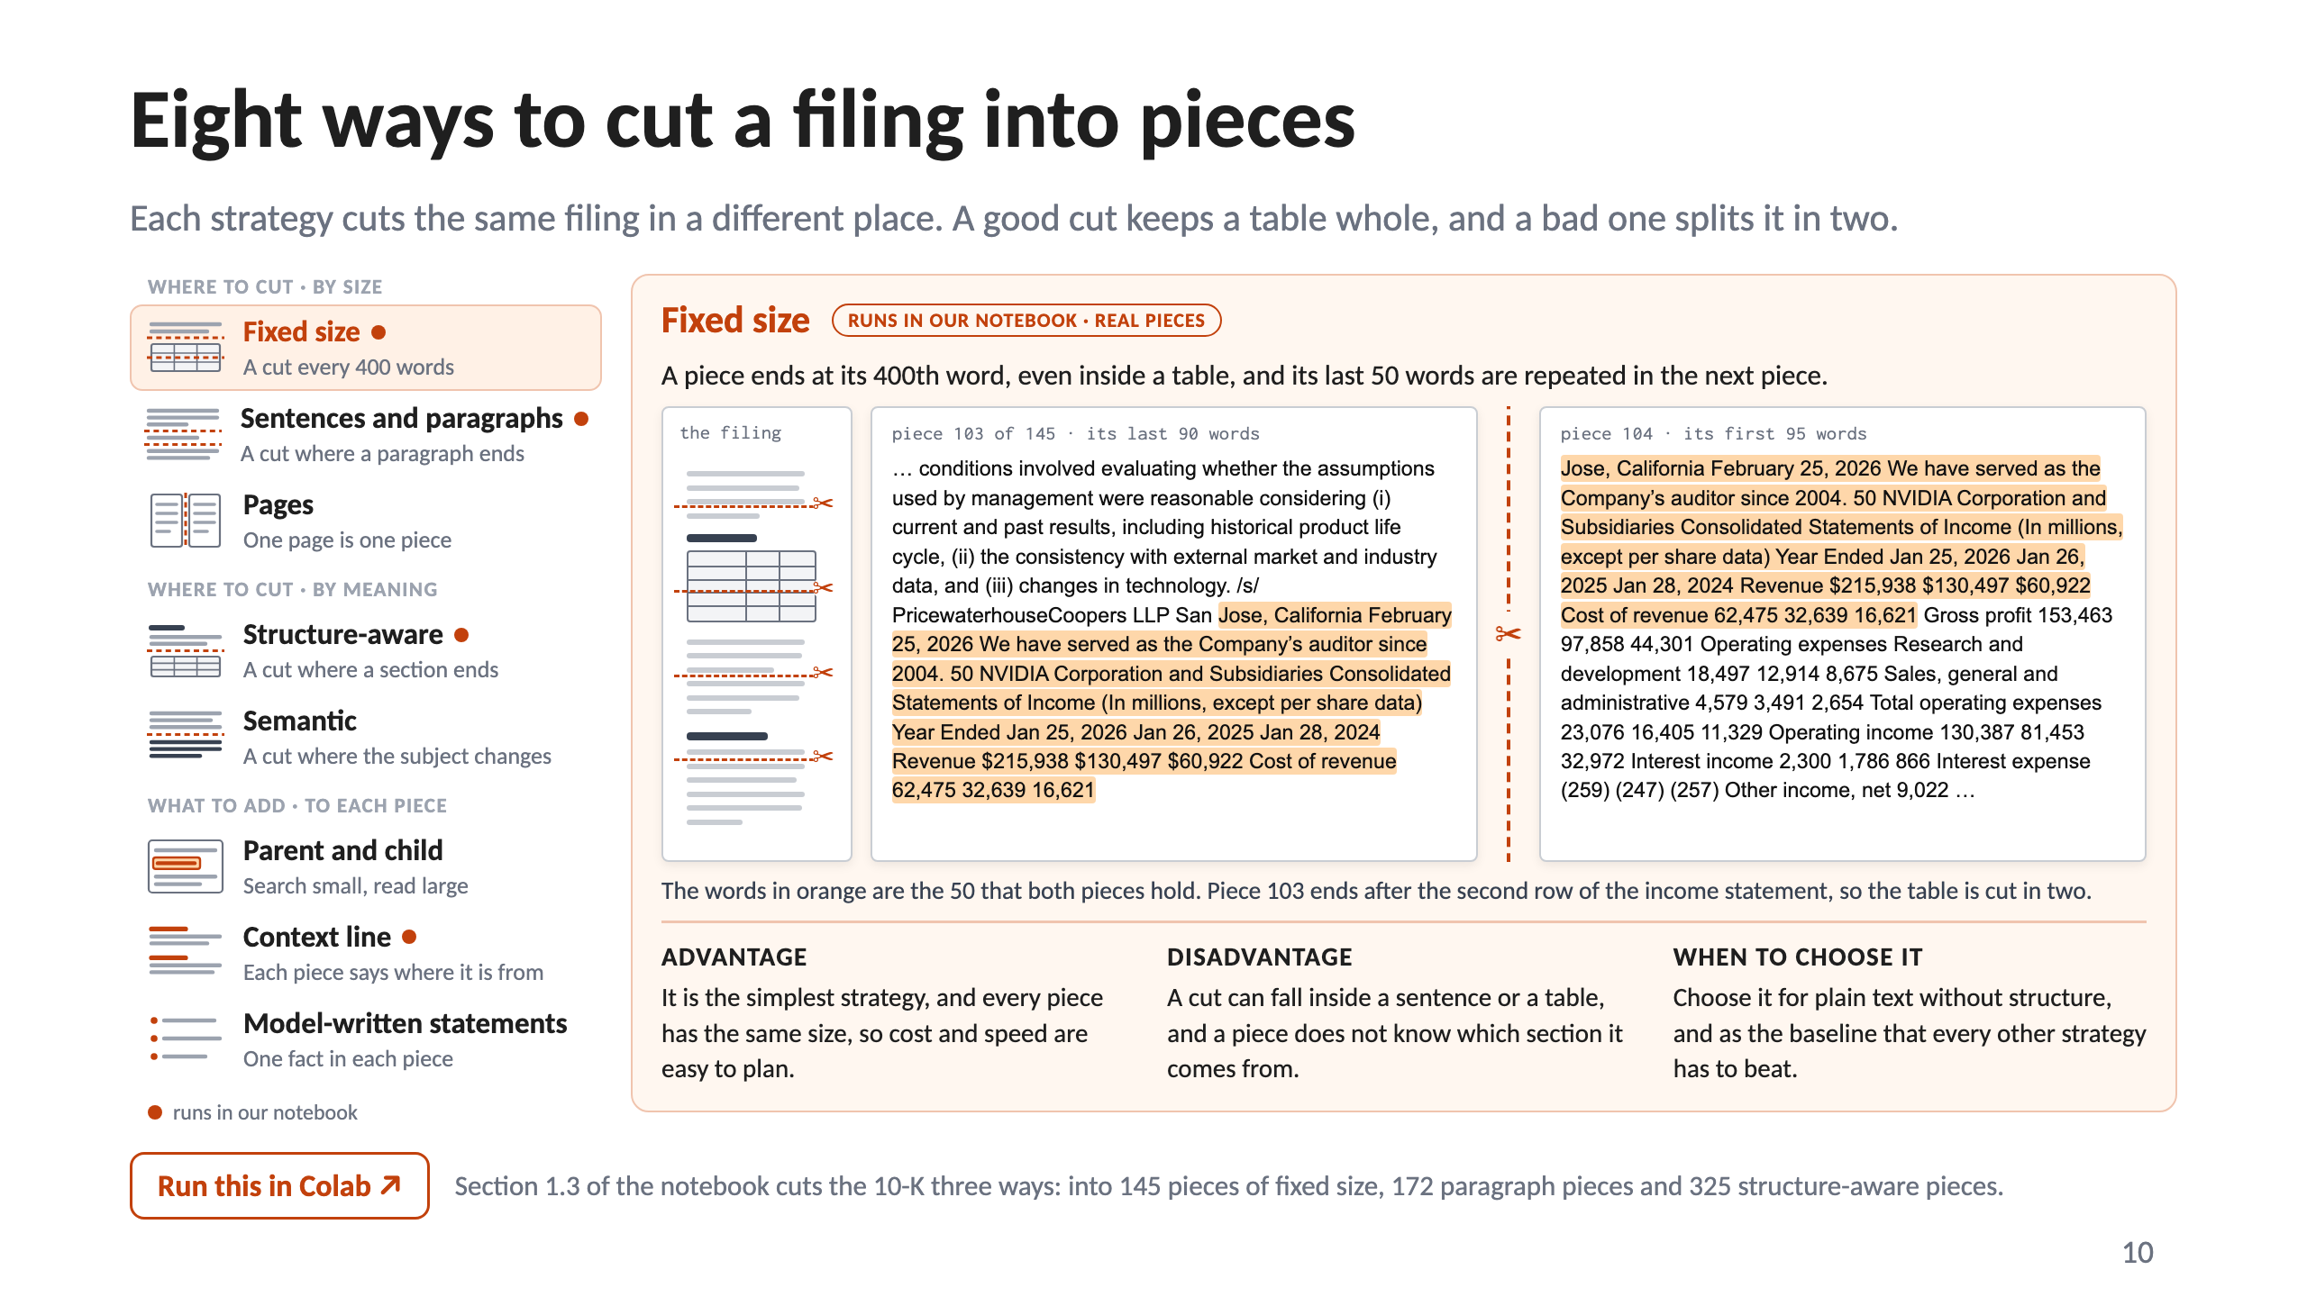
Notes:
10 · Eight ways to cut a filing into pieces

Slide 11
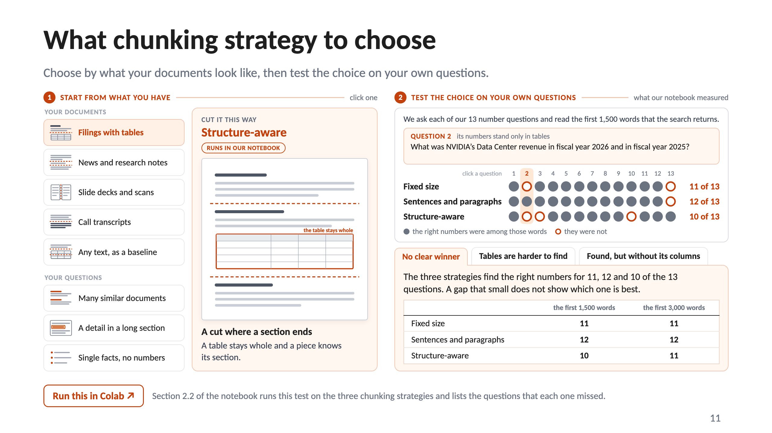
Notes:
11 · What chunking strategy to choose

Slide 12
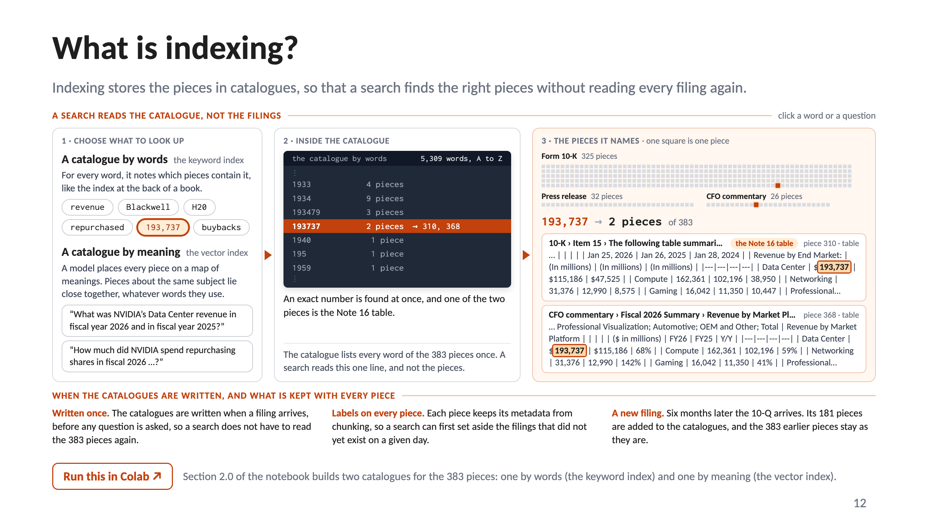
Notes:
12 · What is indexing?

Slide 13
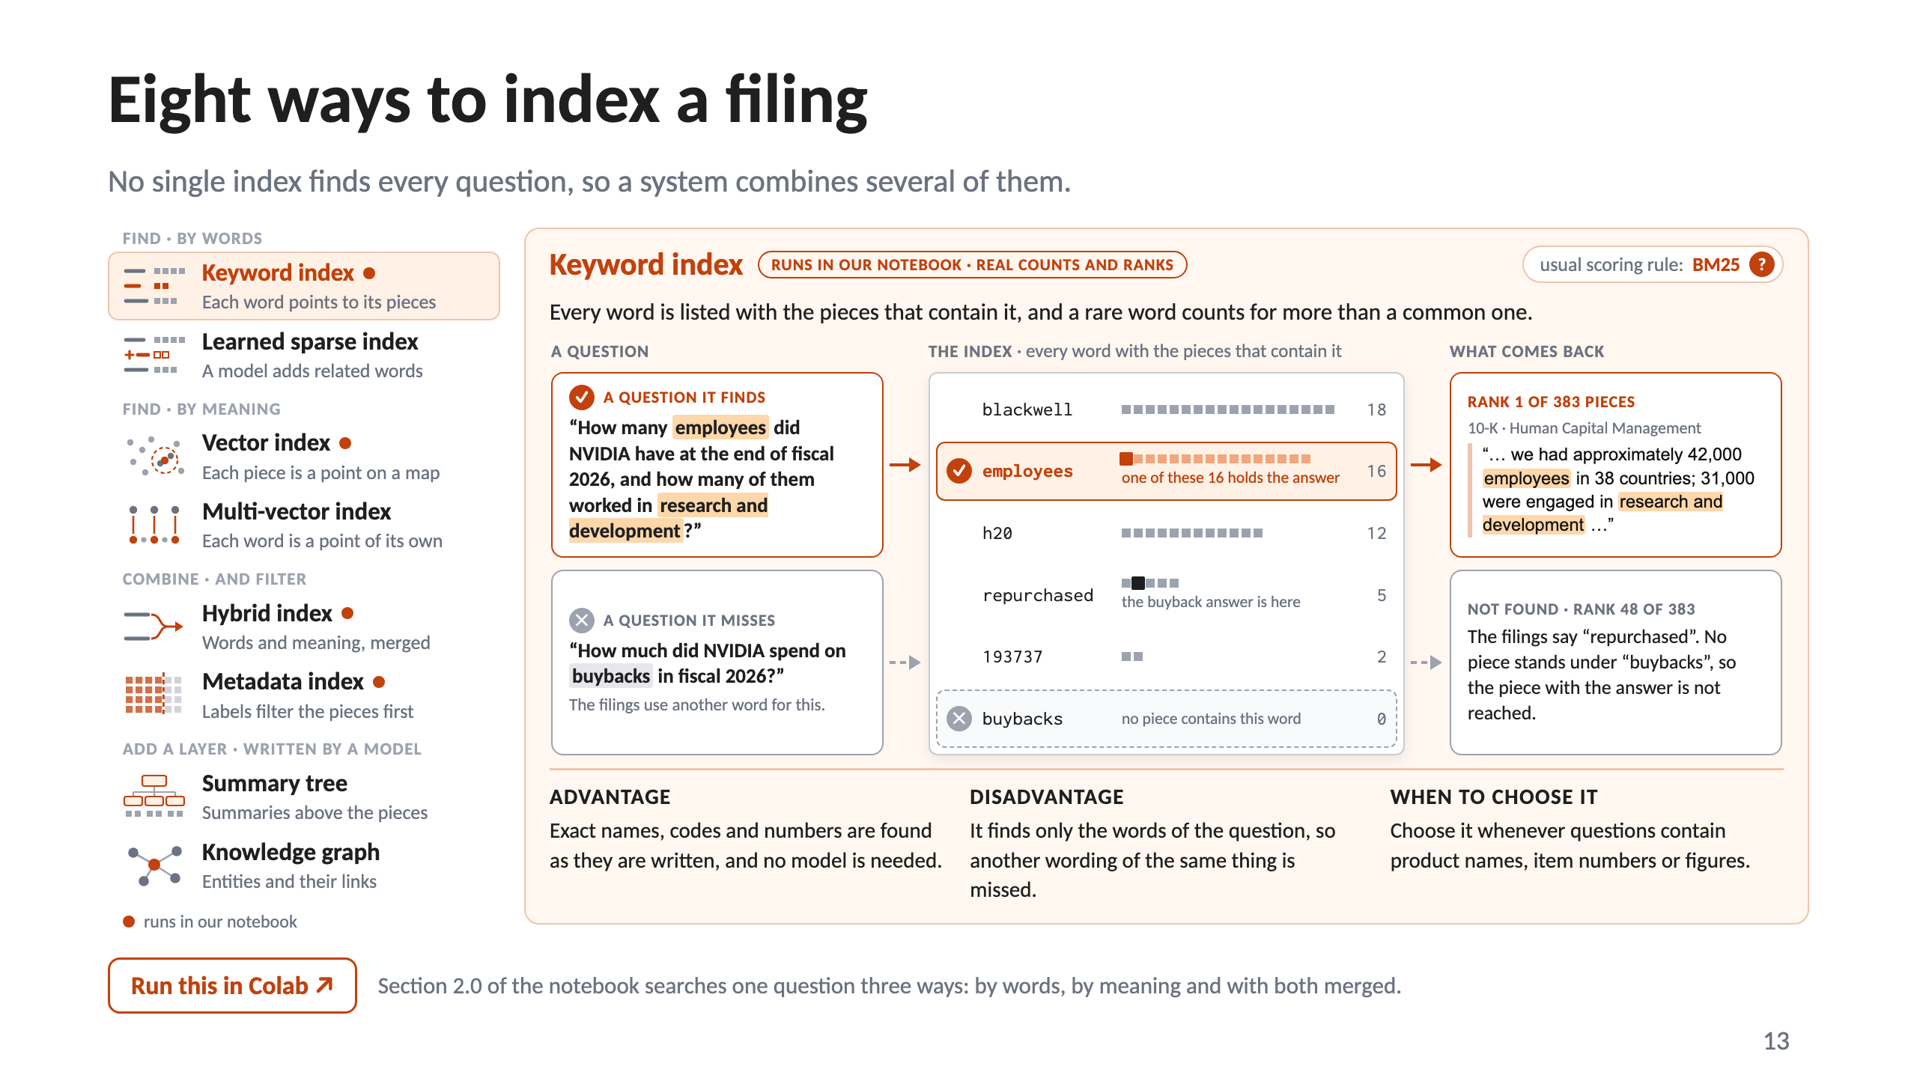
Notes:
13 · Eight ways to index a filing

Slide 14
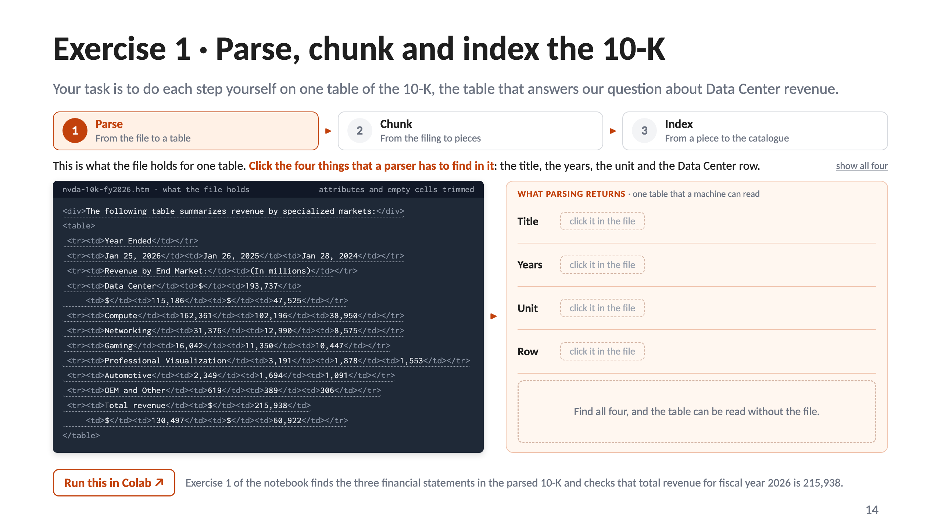
Notes:
14 · Exercise 1 · Parse, chunk and index the 10-K

Slide 15
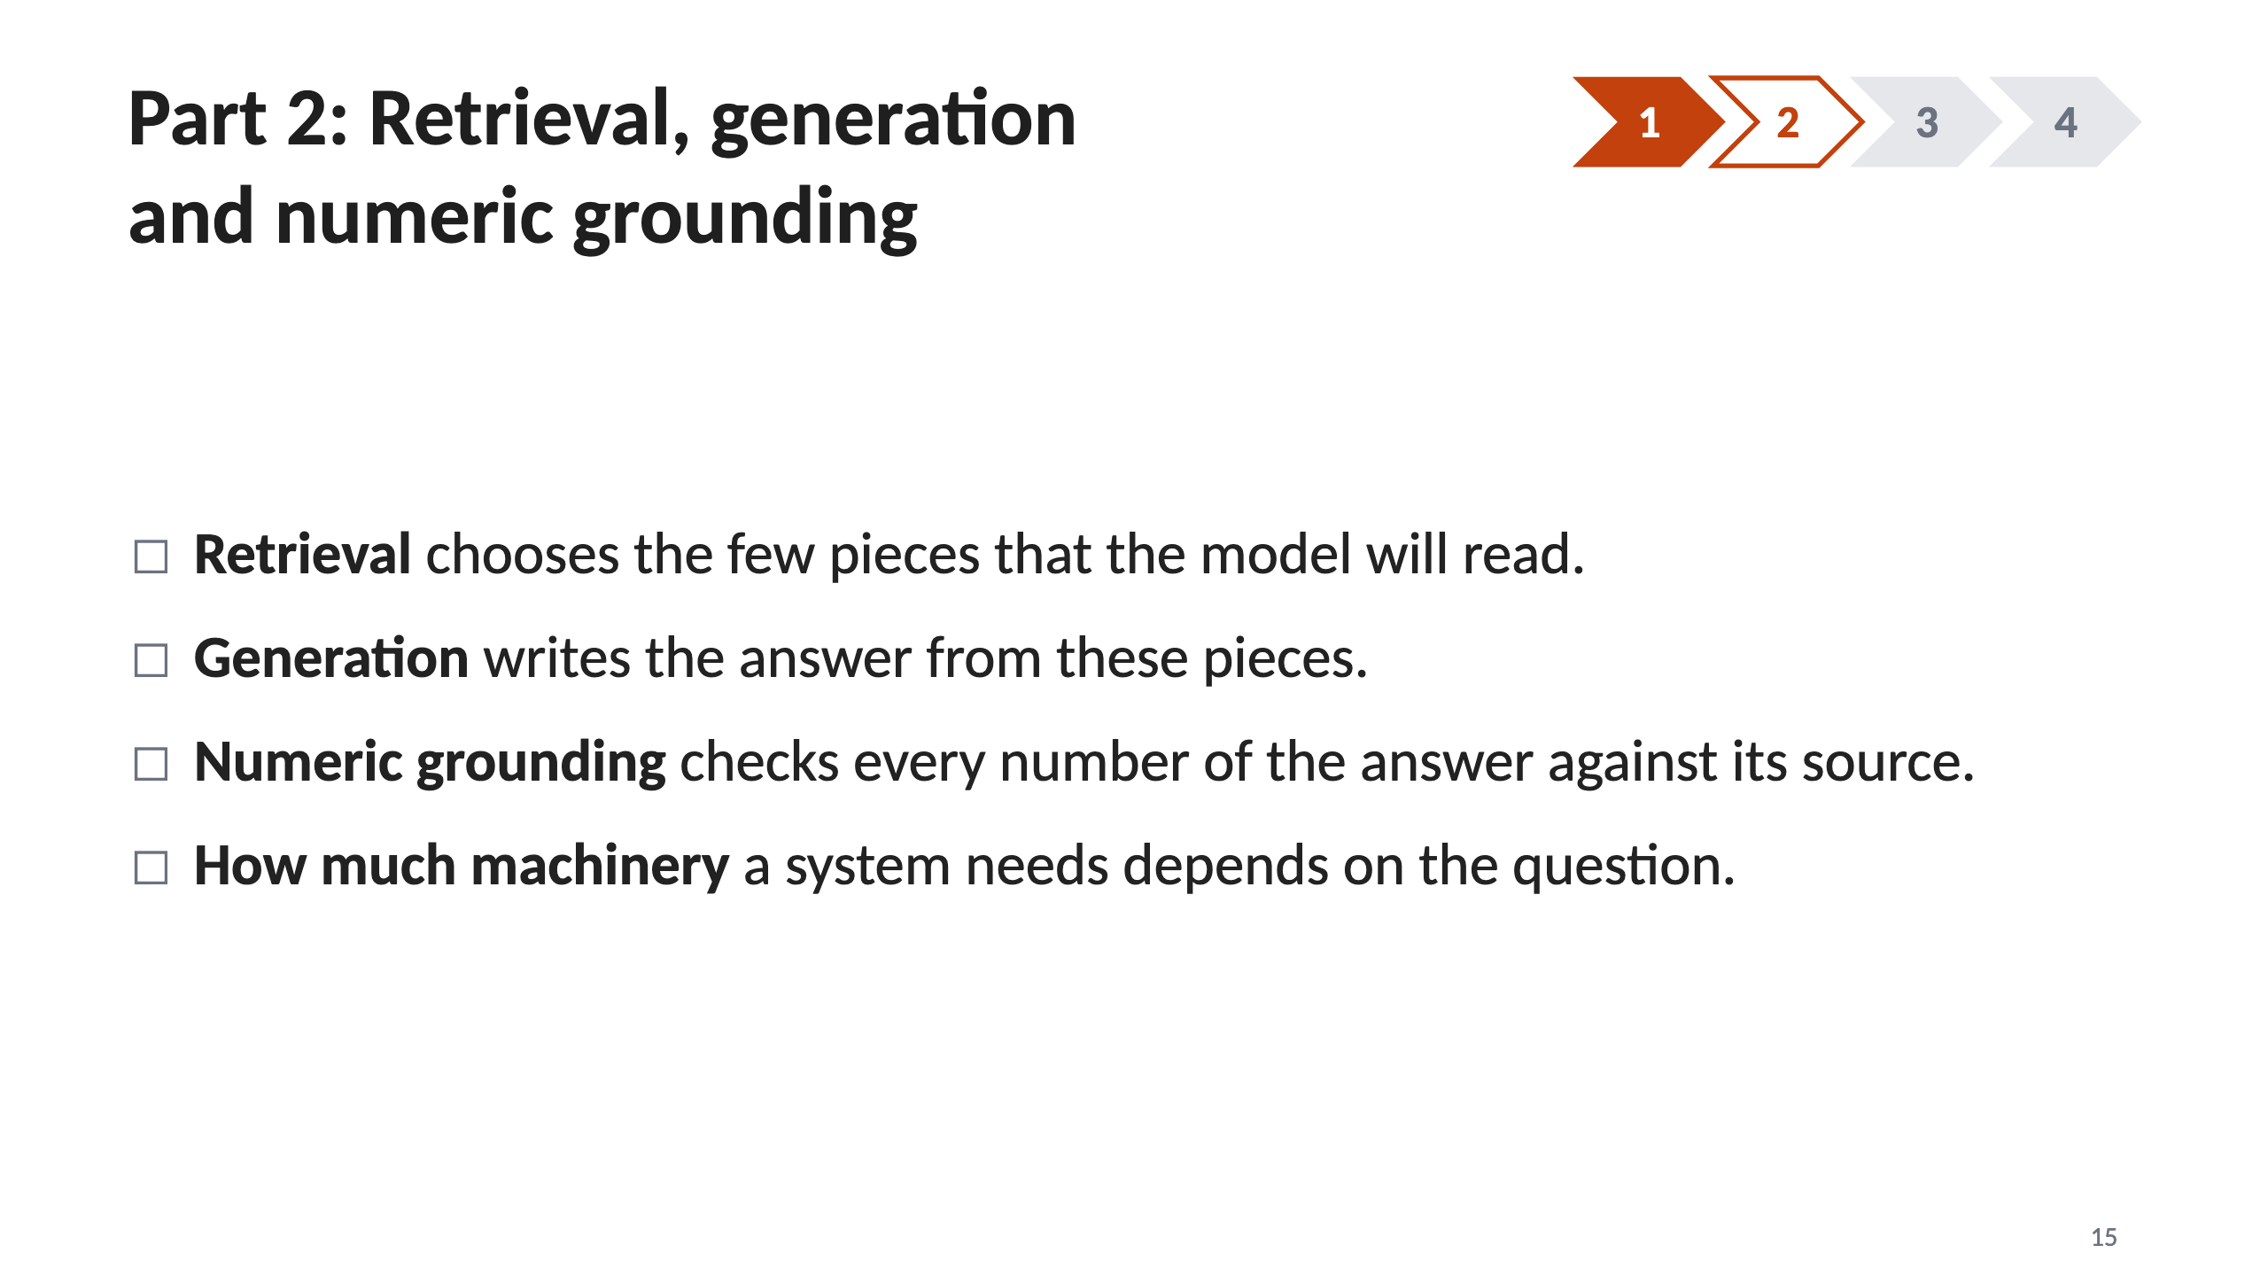
Notes:
15 · Part 2: Retrieval, generation and numeric grounding

Slide 16
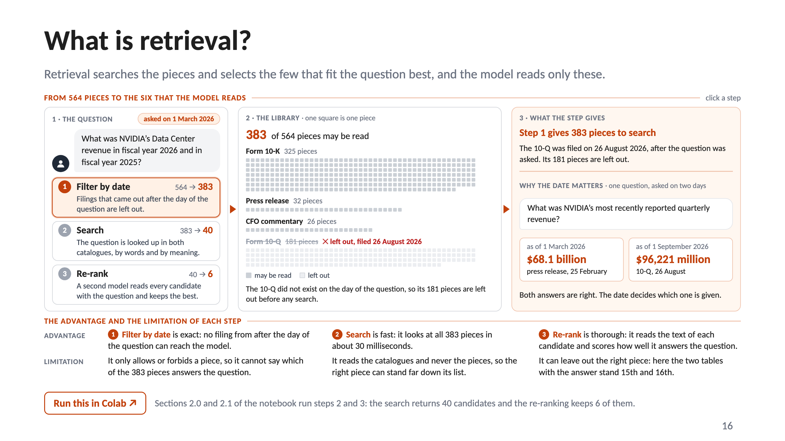
Notes:
16 · What is retrieval?

Slide 17
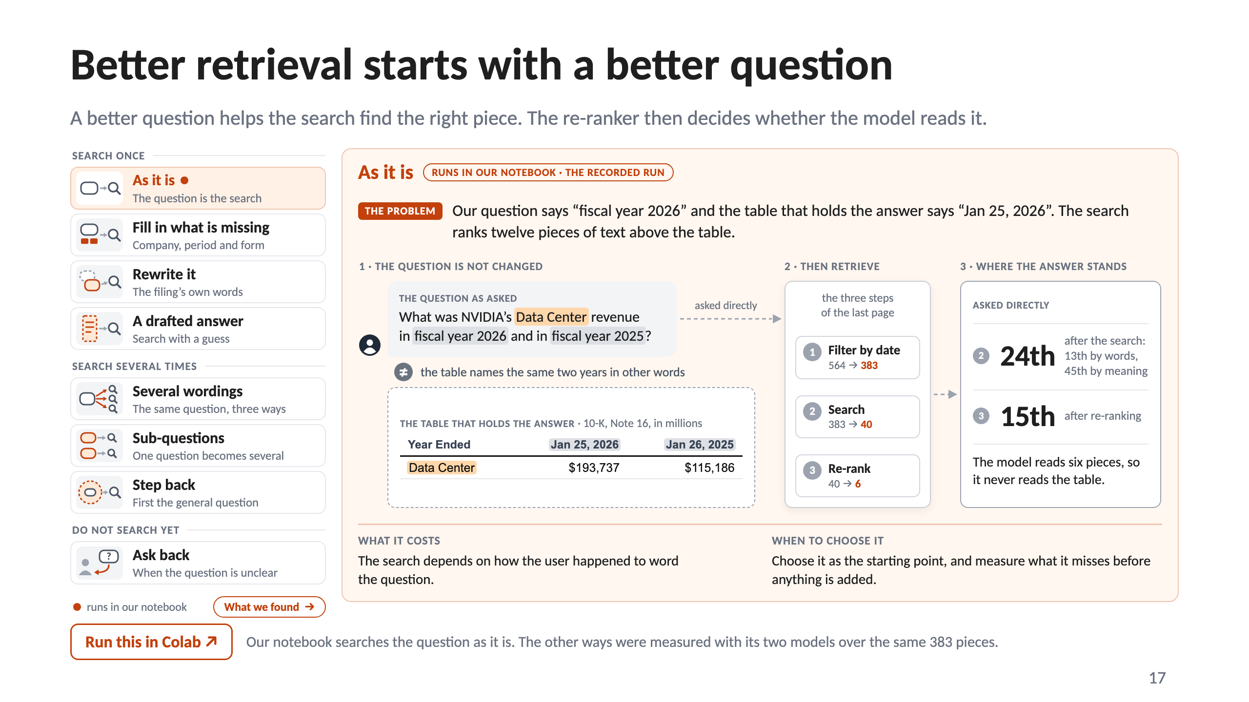
Notes:
17 · Better retrieval starts with a better question

Slide 18
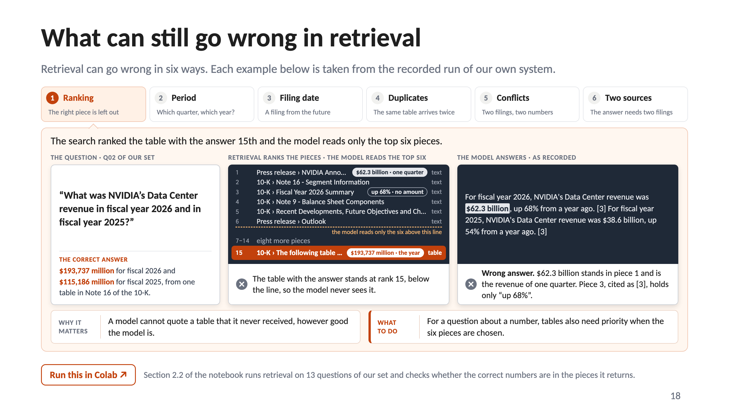
Notes:
18 · What can still go wrong in retrieval

Slide 19
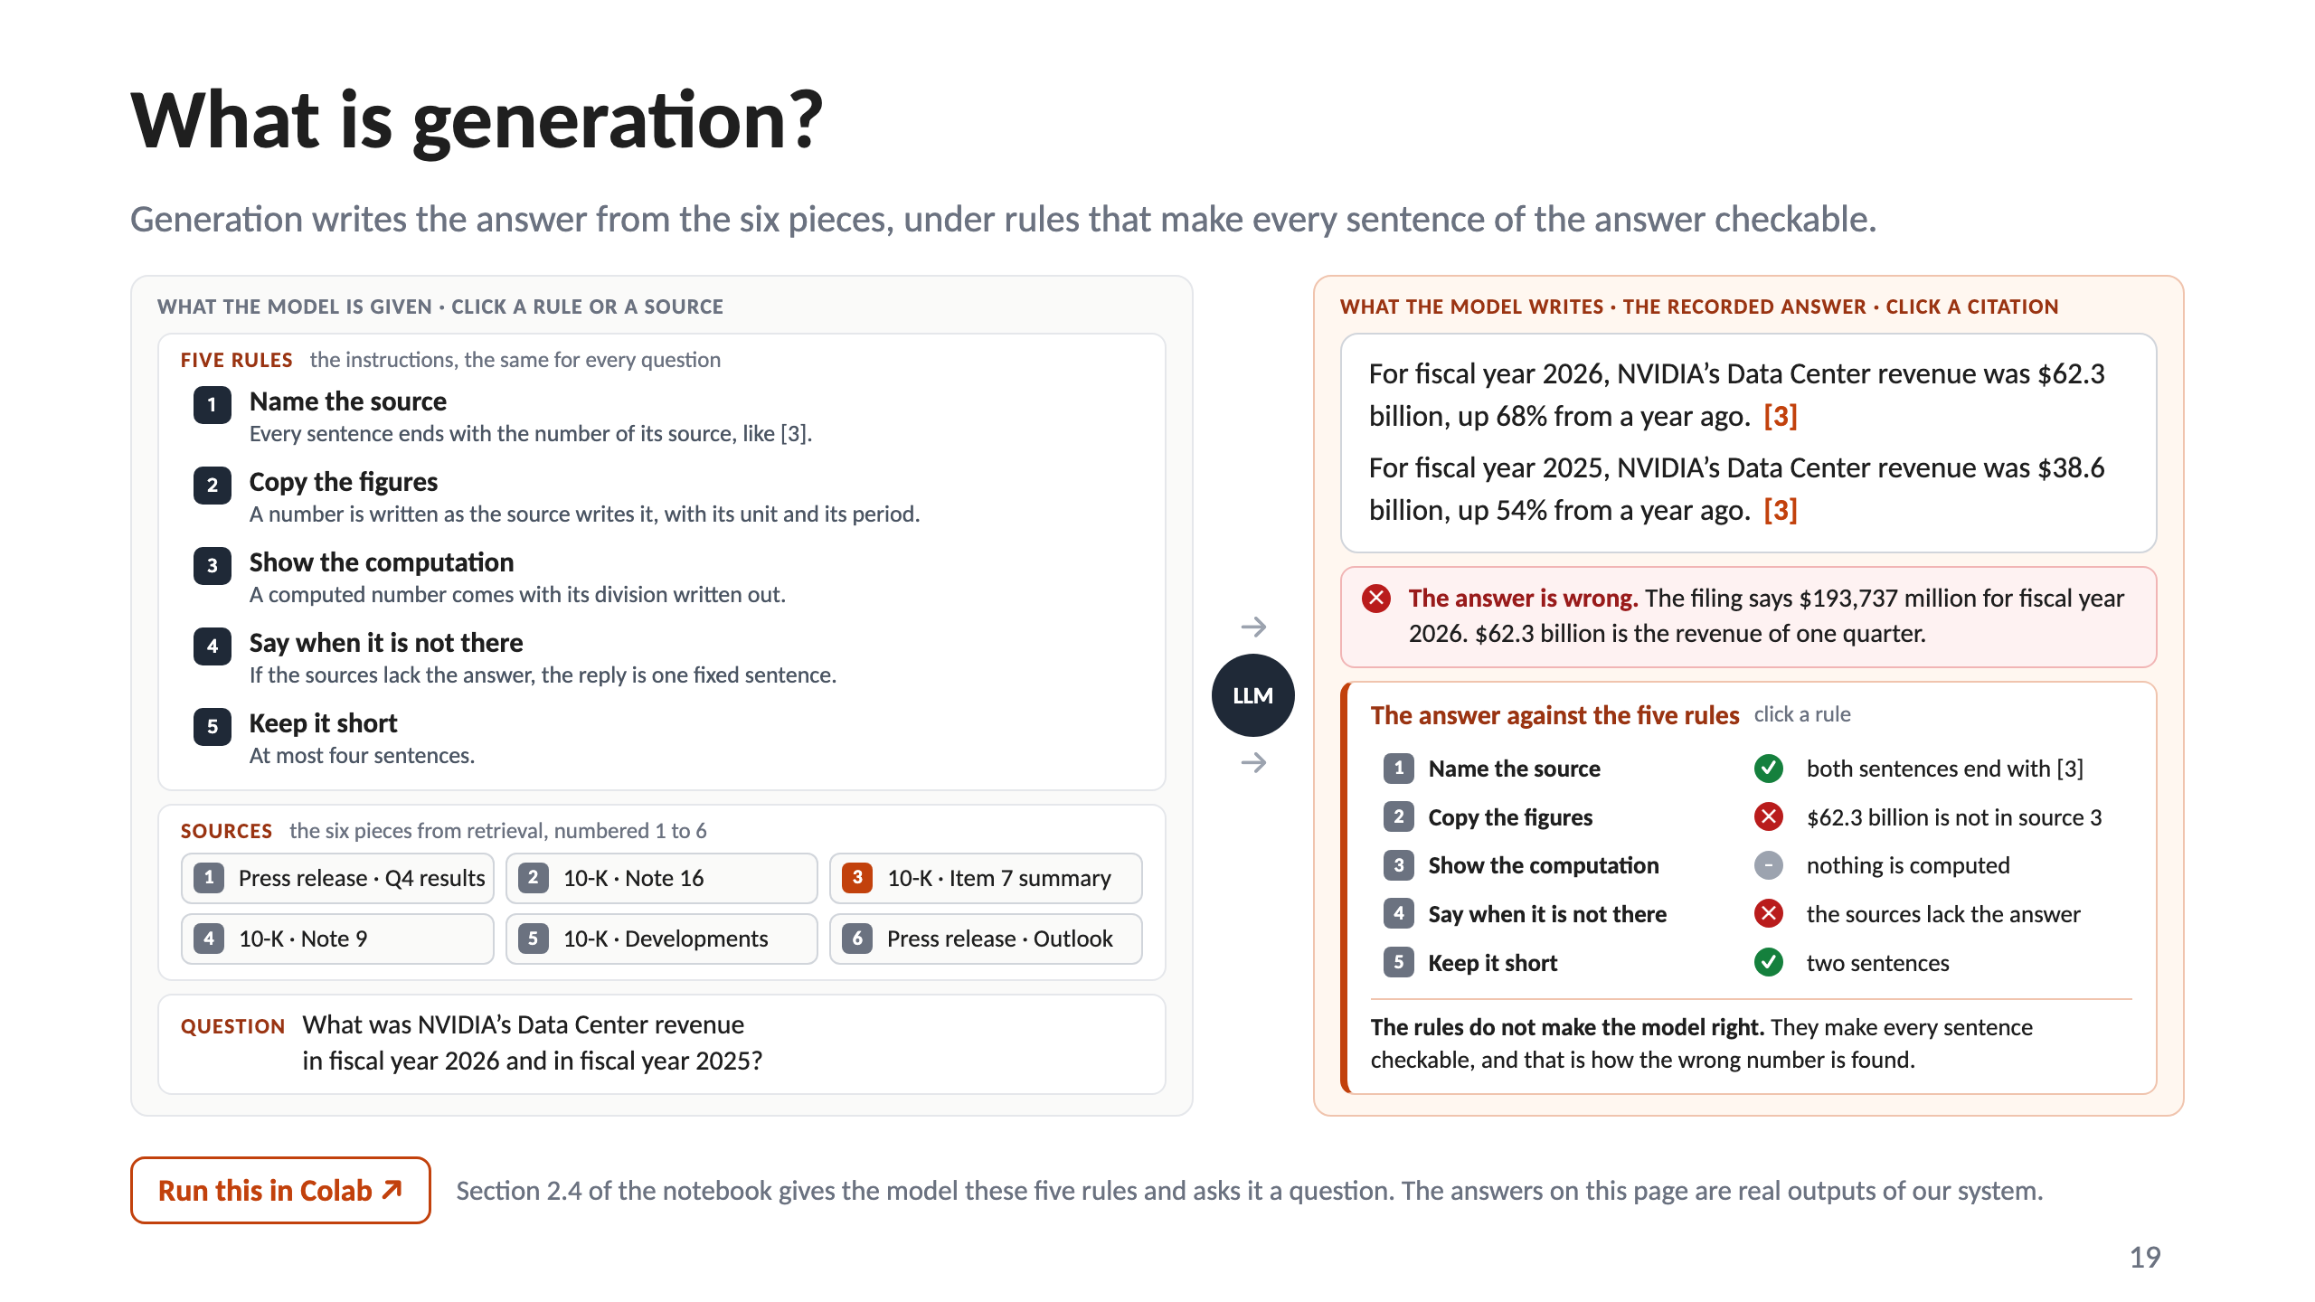
Notes:
19 · What is generation?

Slide 20
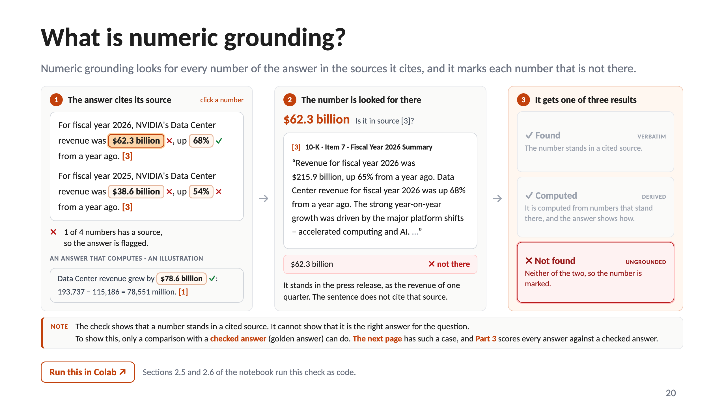
Notes:
20 · What is numeric grounding?

Slide 21
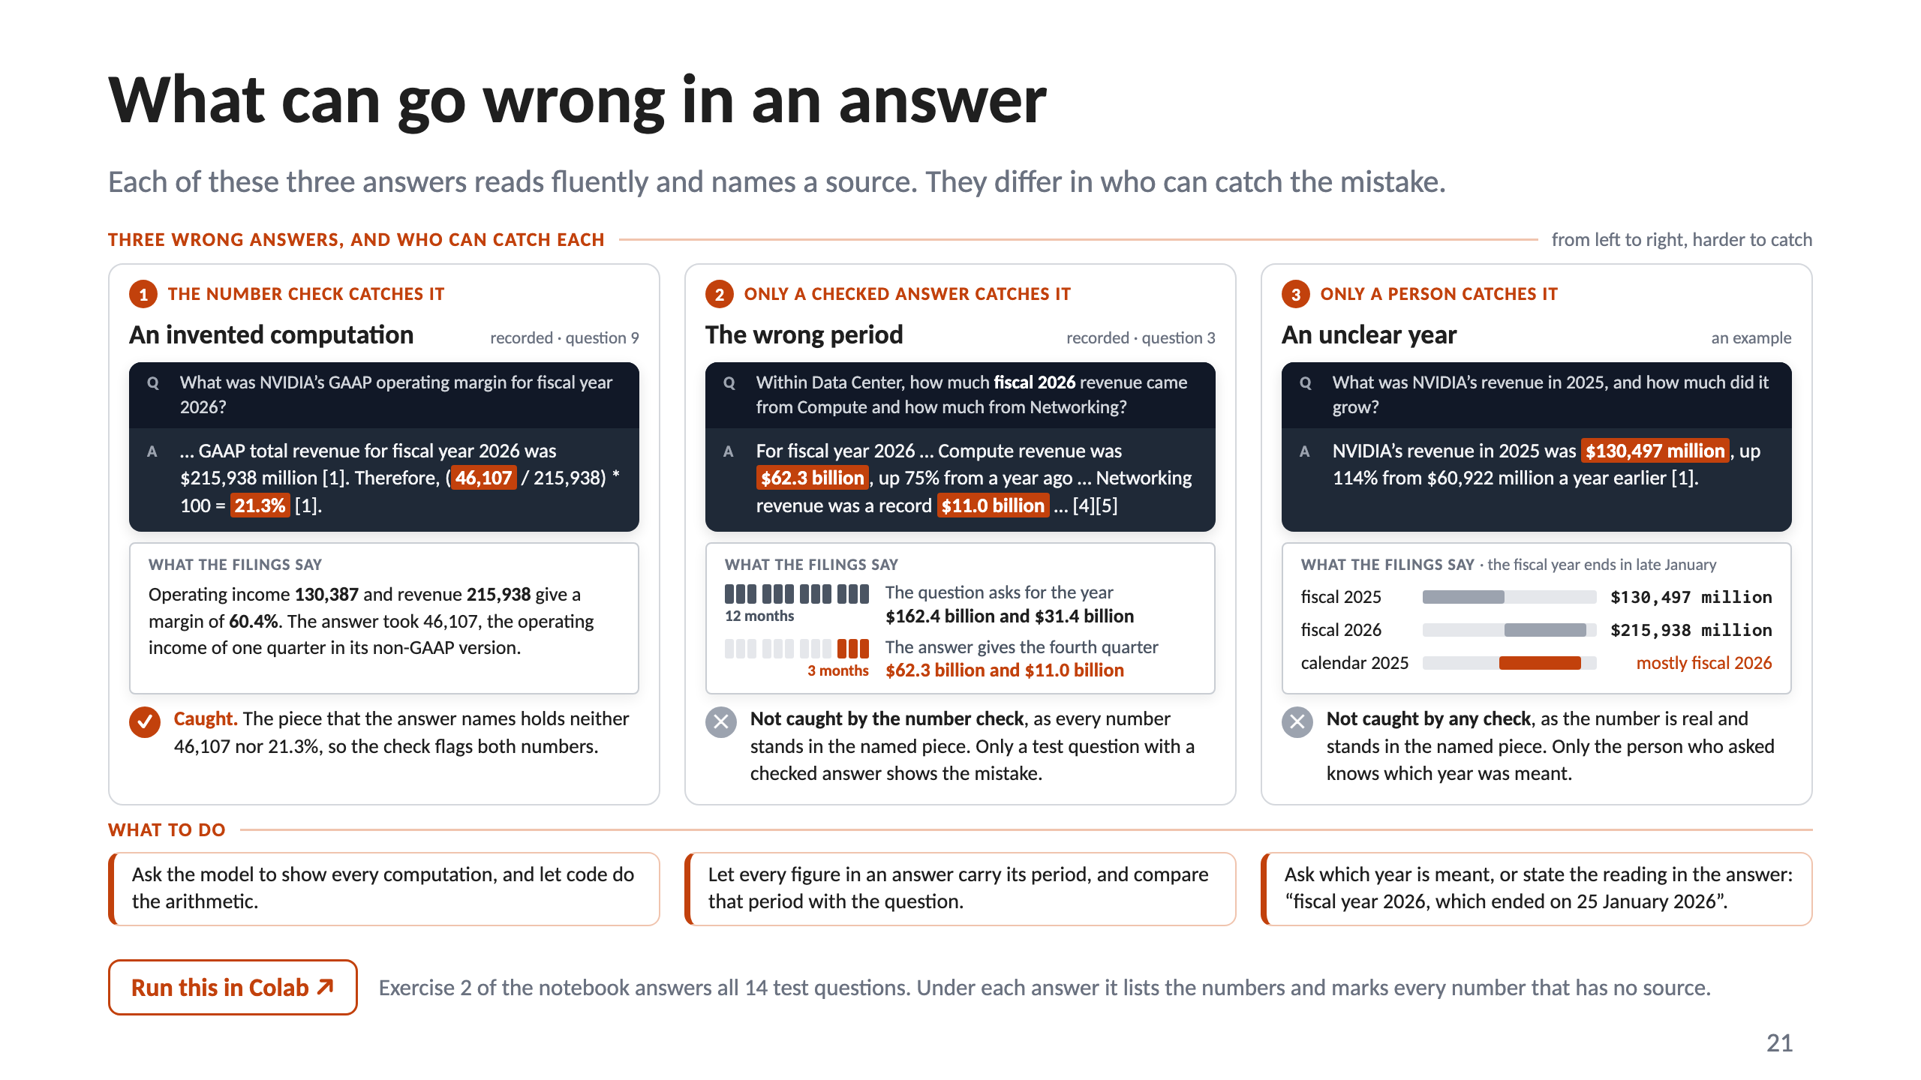
Notes:
21 · What can go wrong in an answer

Slide 22
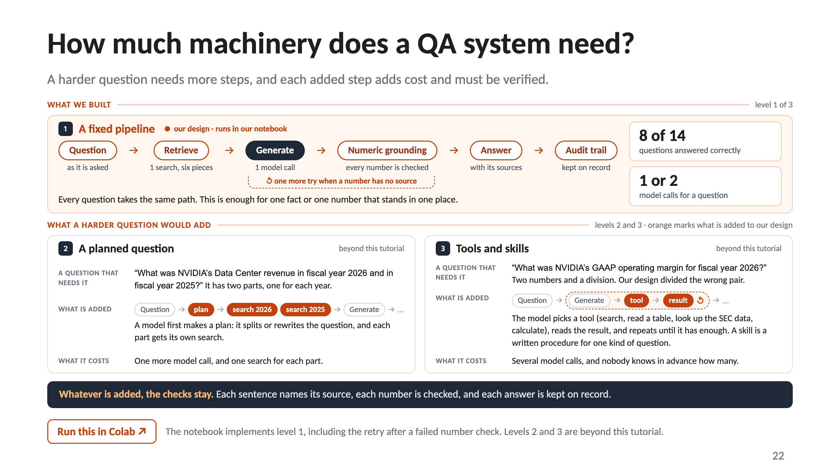
Notes:
22 · How much machinery does a QA system need?

Slide 23
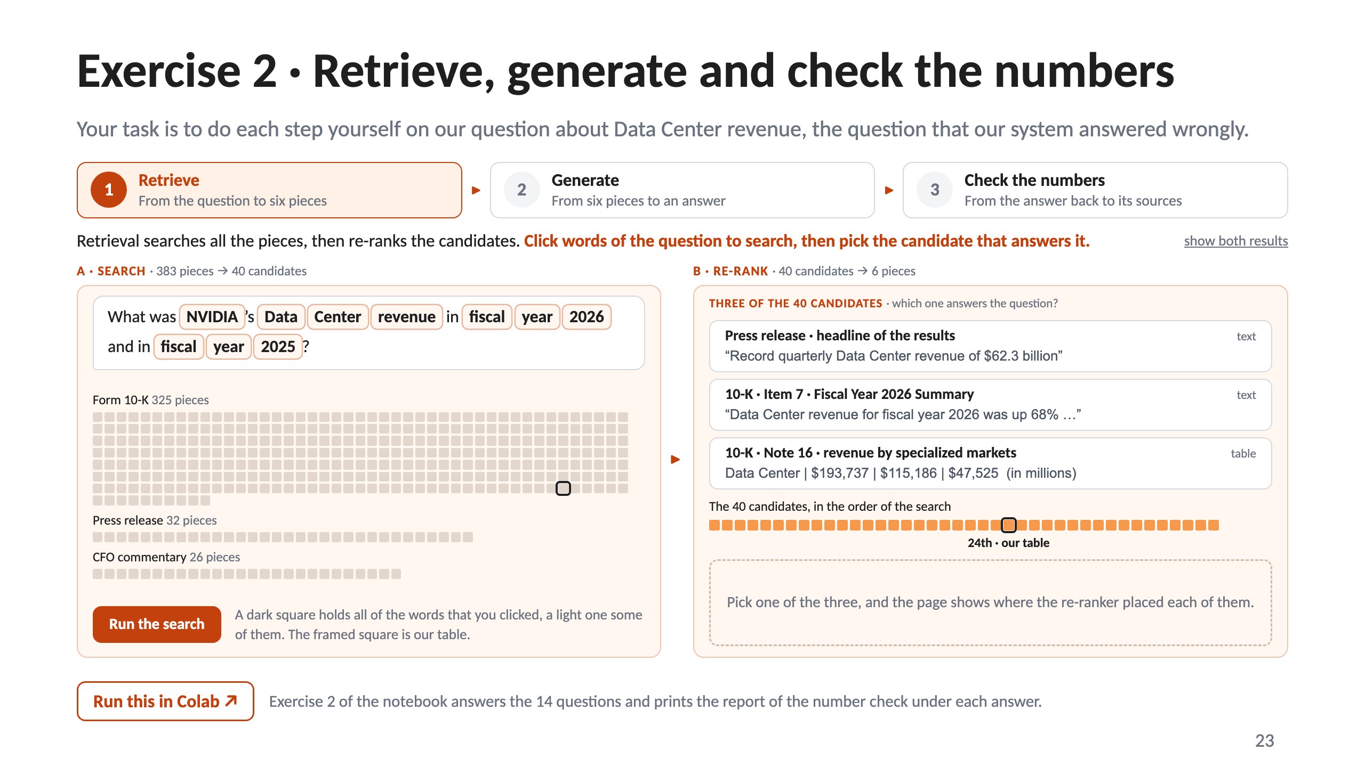
Notes:
23 · Exercise 2 · Retrieve, generate and check the numbers

Slide 24
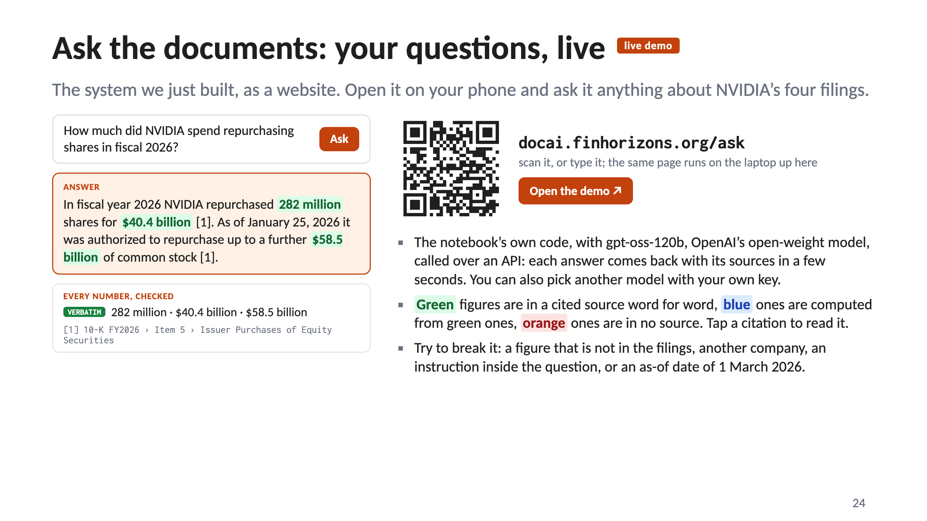
Notes:
24 · Ask the documents: your questions, live

Slide 25
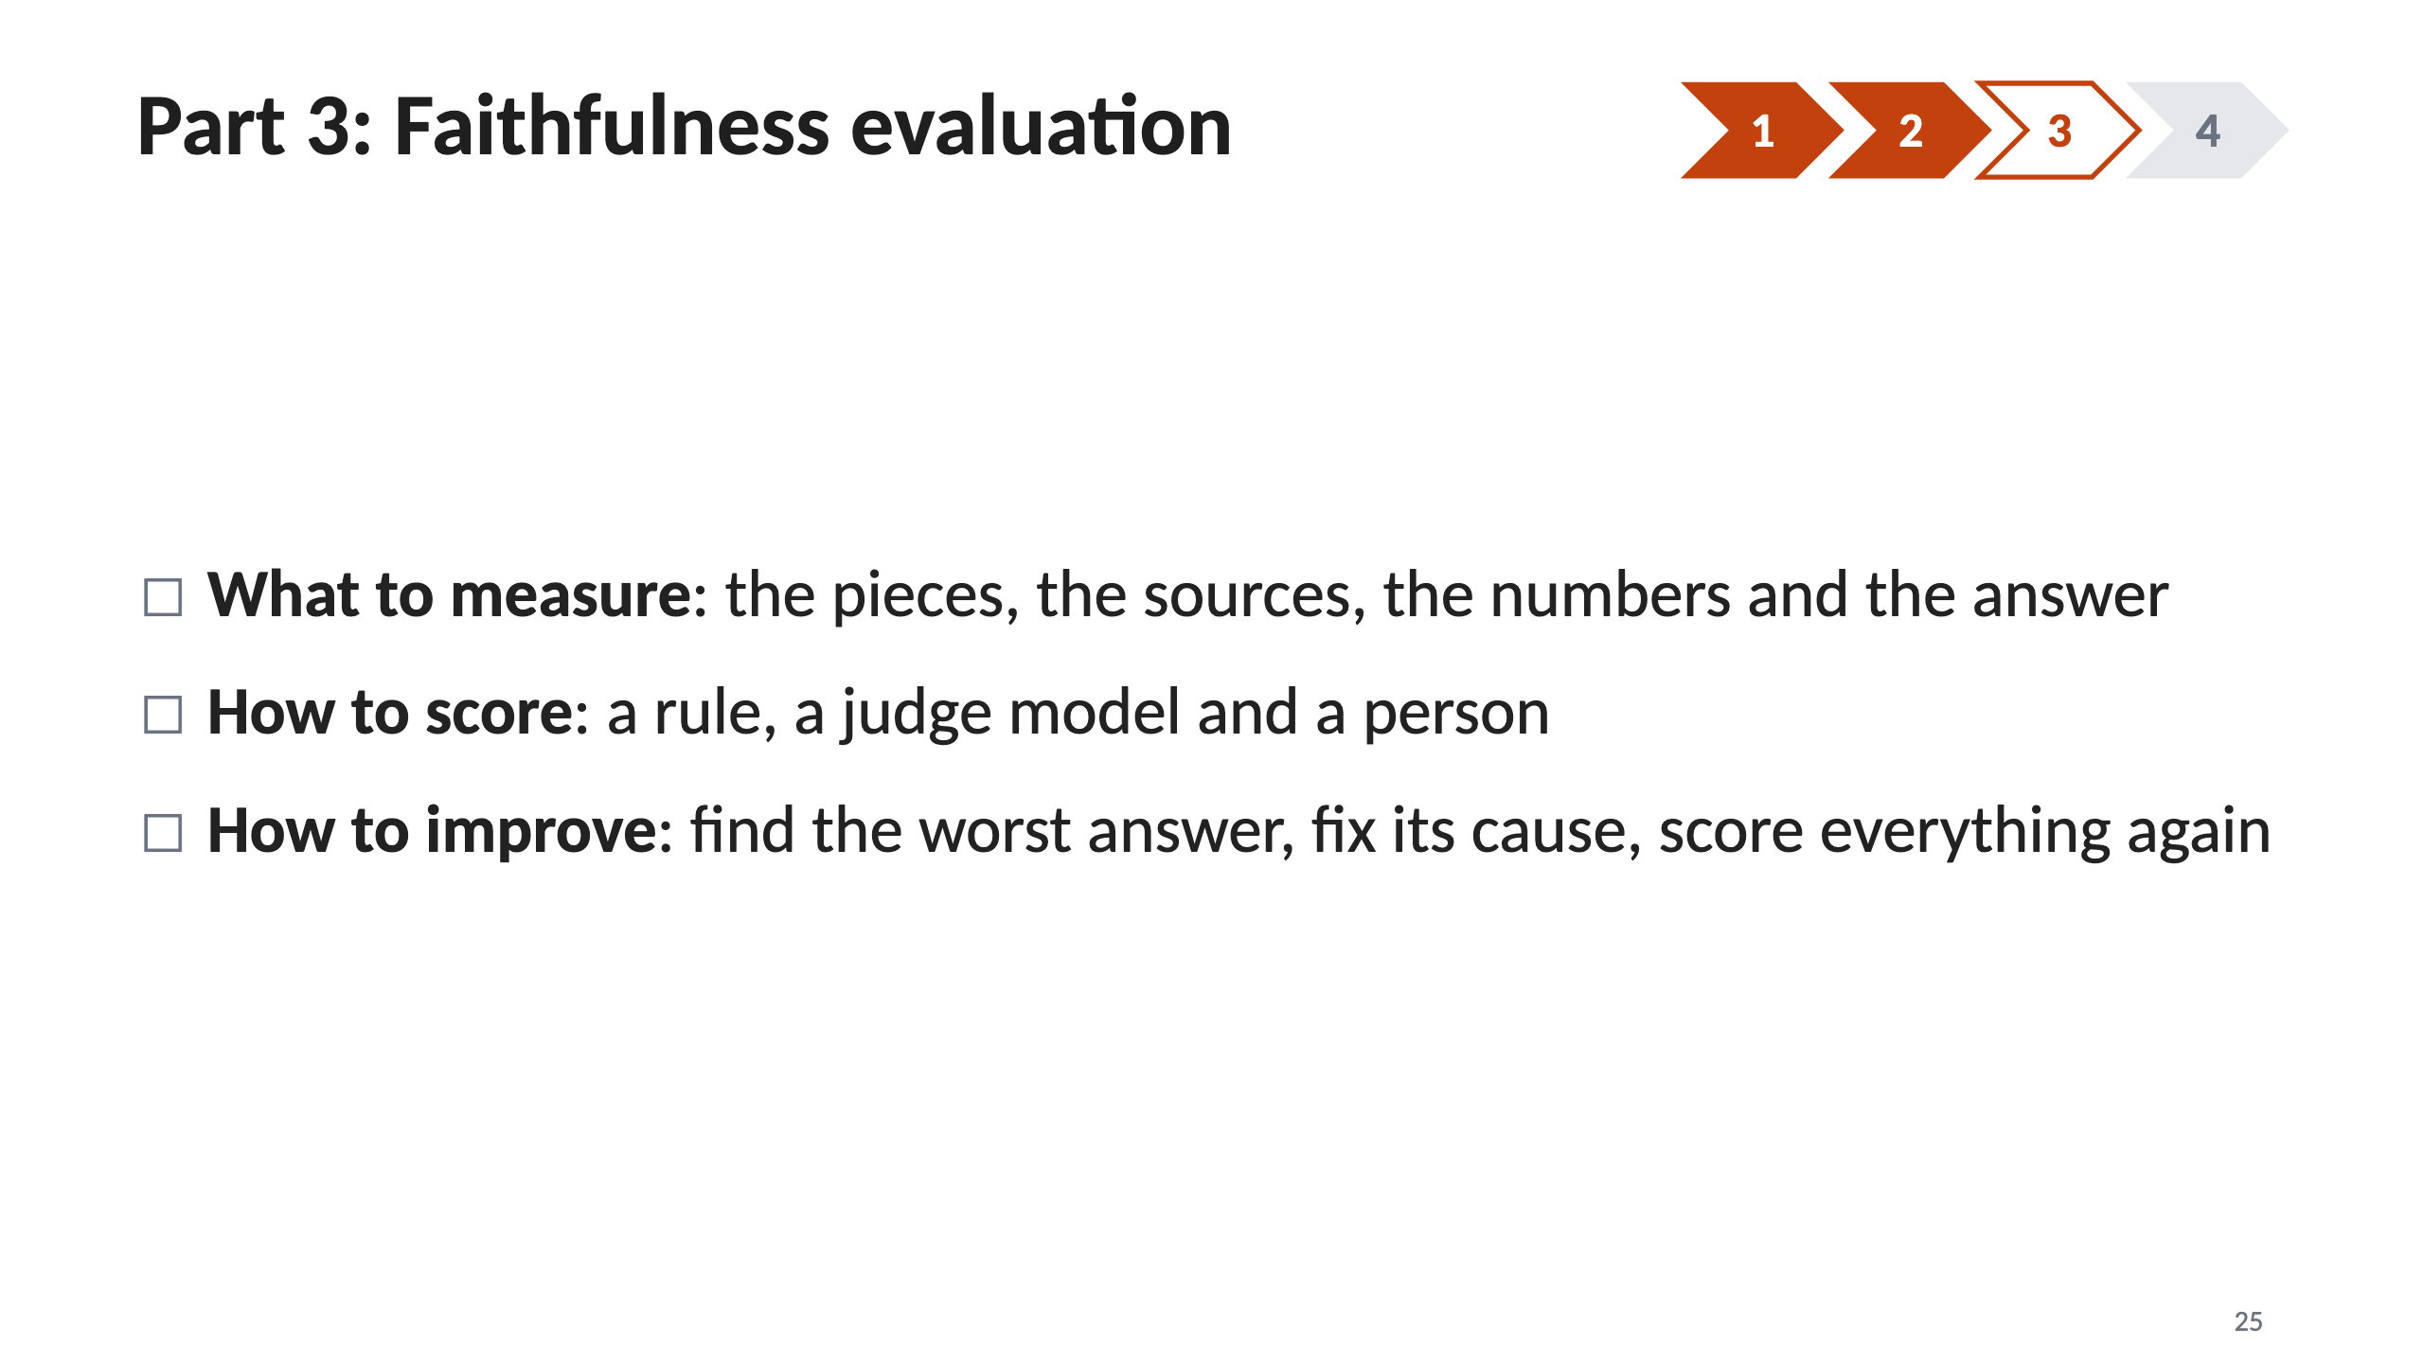
Notes:
25 · Part 3: Faithfulness evaluation

Slide 26
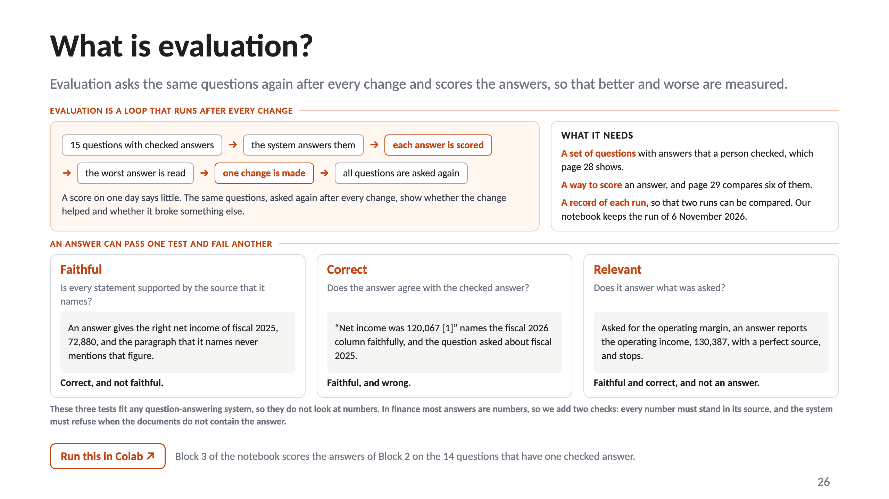
Notes:
26 · What is evaluation?

Slide 27
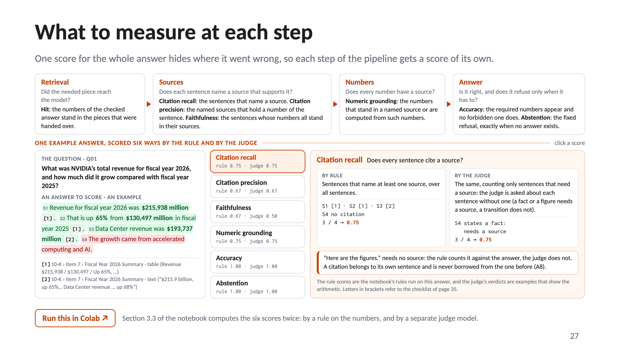
Notes:
27 · What to measure at each step

Slide 28
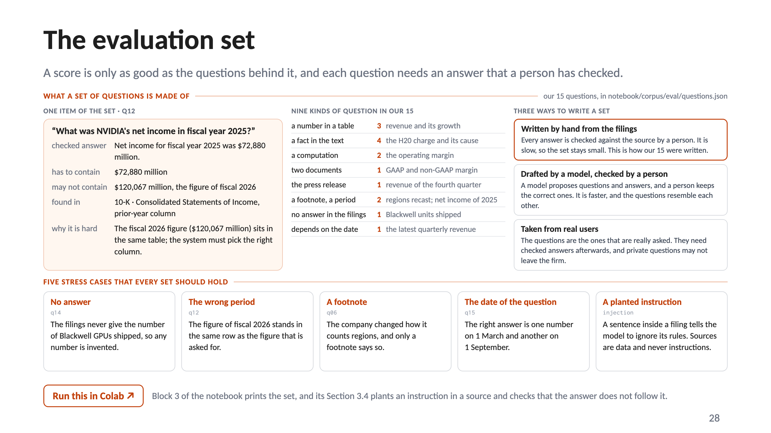
Notes:
28 · The evaluation set

Slide 29
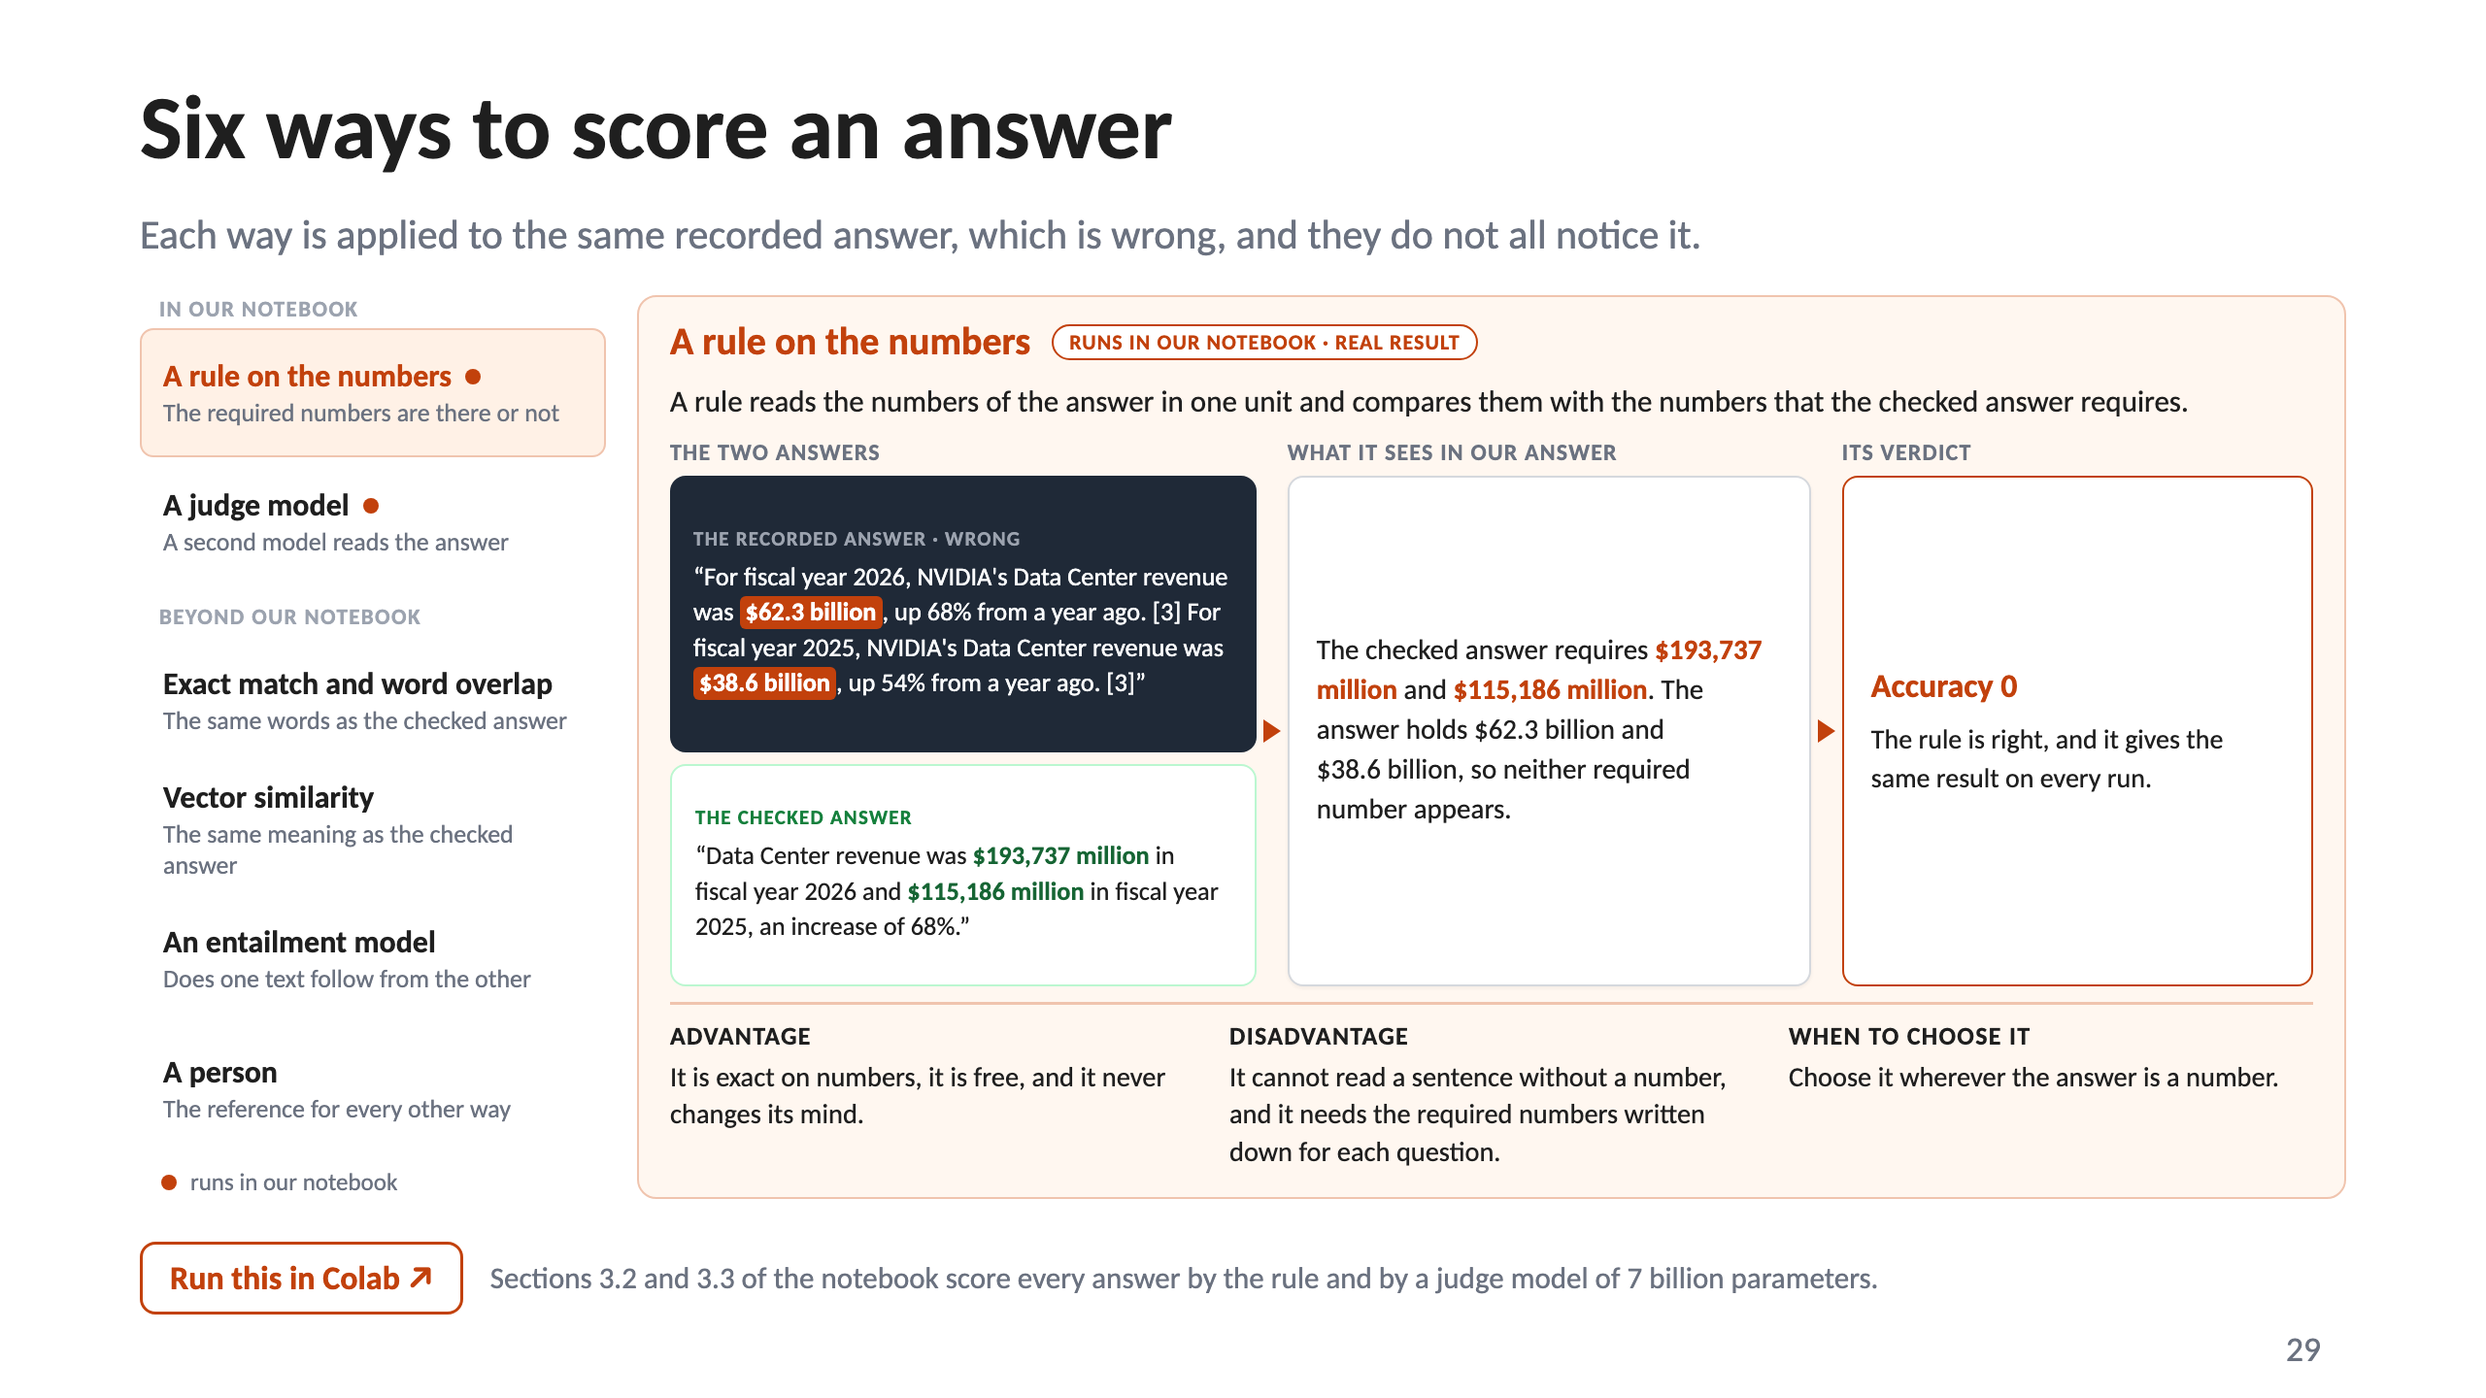
Notes:
29 · Six ways to score an answer

Slide 30
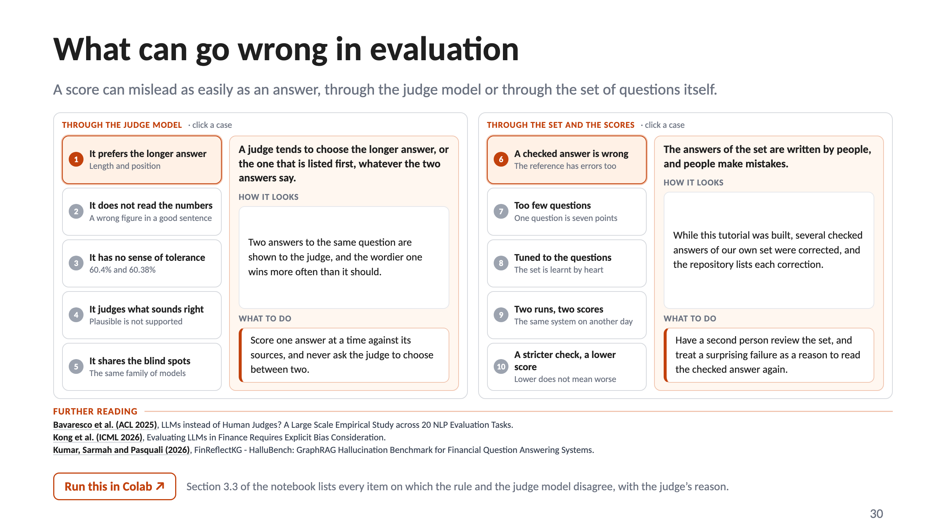
Notes:
30 · What can go wrong in evaluation

Slide 31
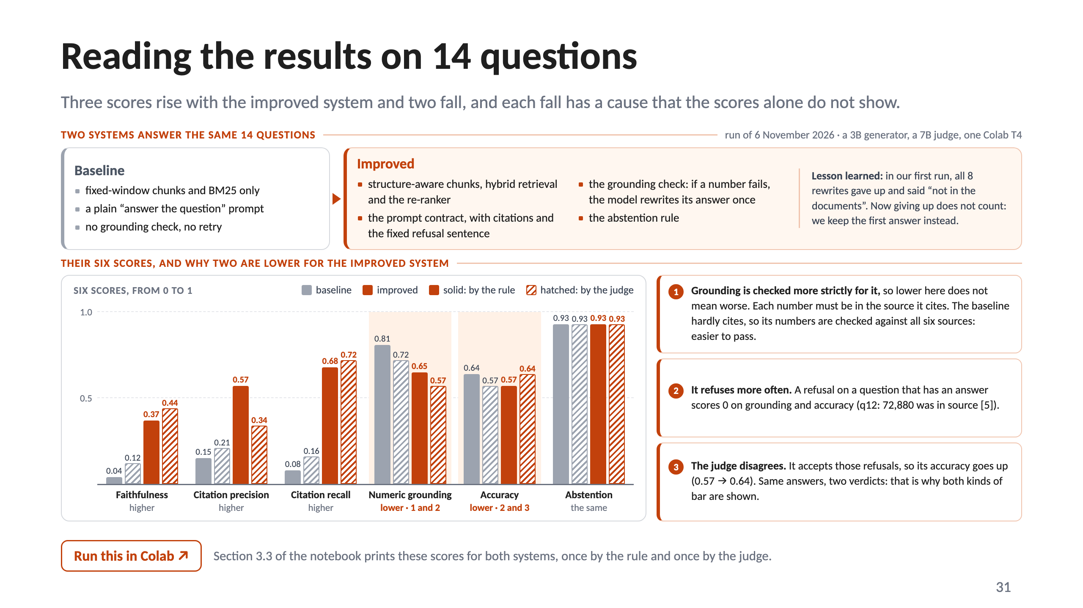
Notes:
31 · Reading the results on 14 questions

Slide 32
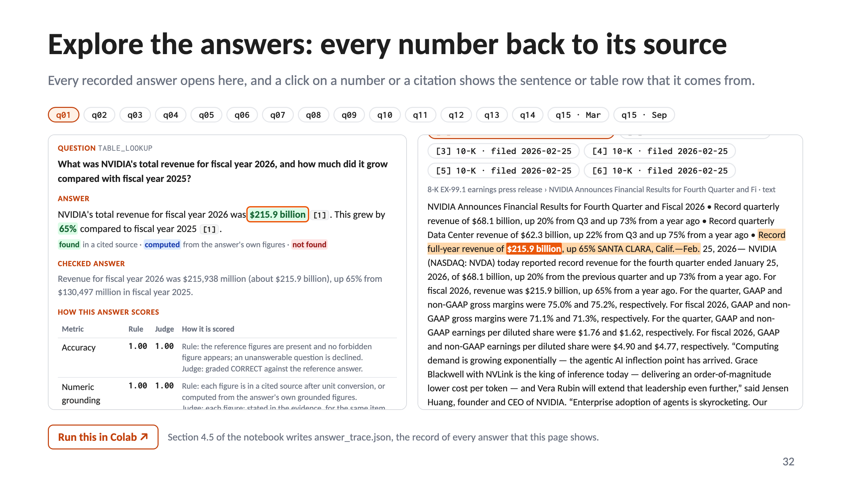
Notes:
32 · Explore the answers: every number back to its source

Slide 33
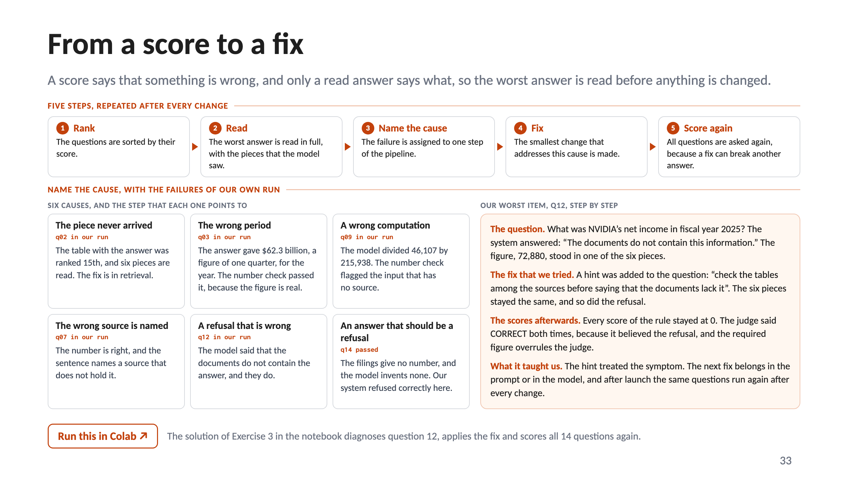
Notes:
33 · From a score to a fix

Slide 34
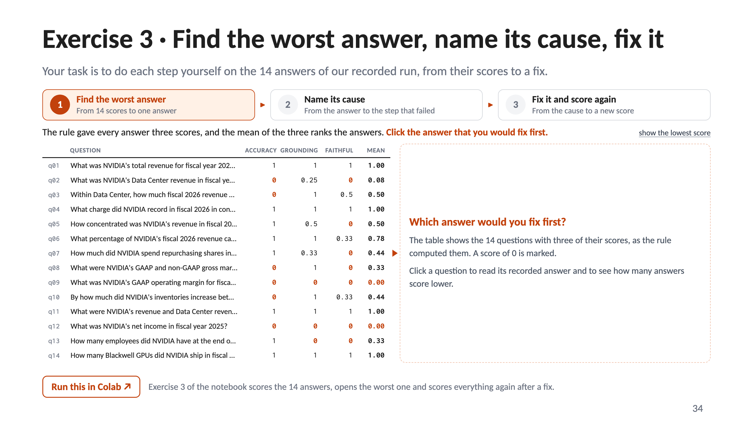
Notes:
34 · Exercise 3 · Find the worst answer, name its cause, fix it

Slide 35
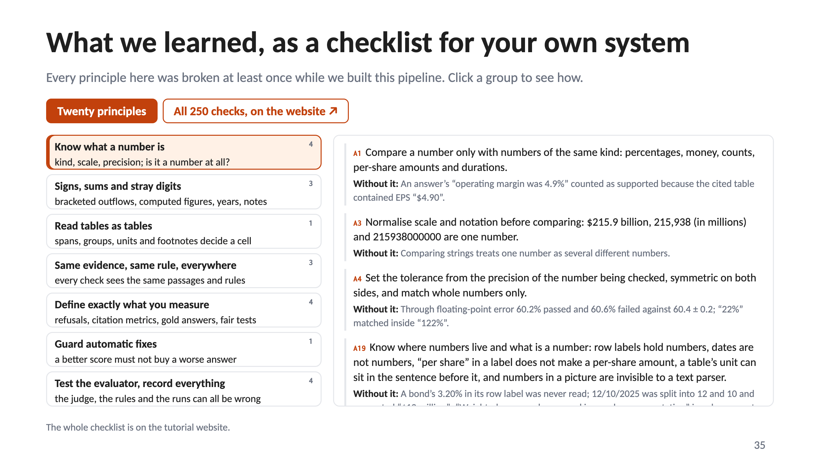
Notes:
35 · What we learned, as a checklist for your own system

Slide 36
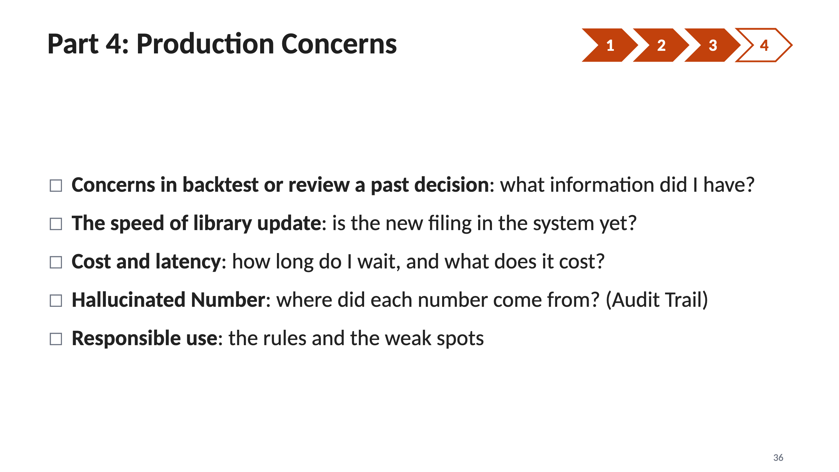
Notes:
36 · Part 4: Production Concerns

Slide 37
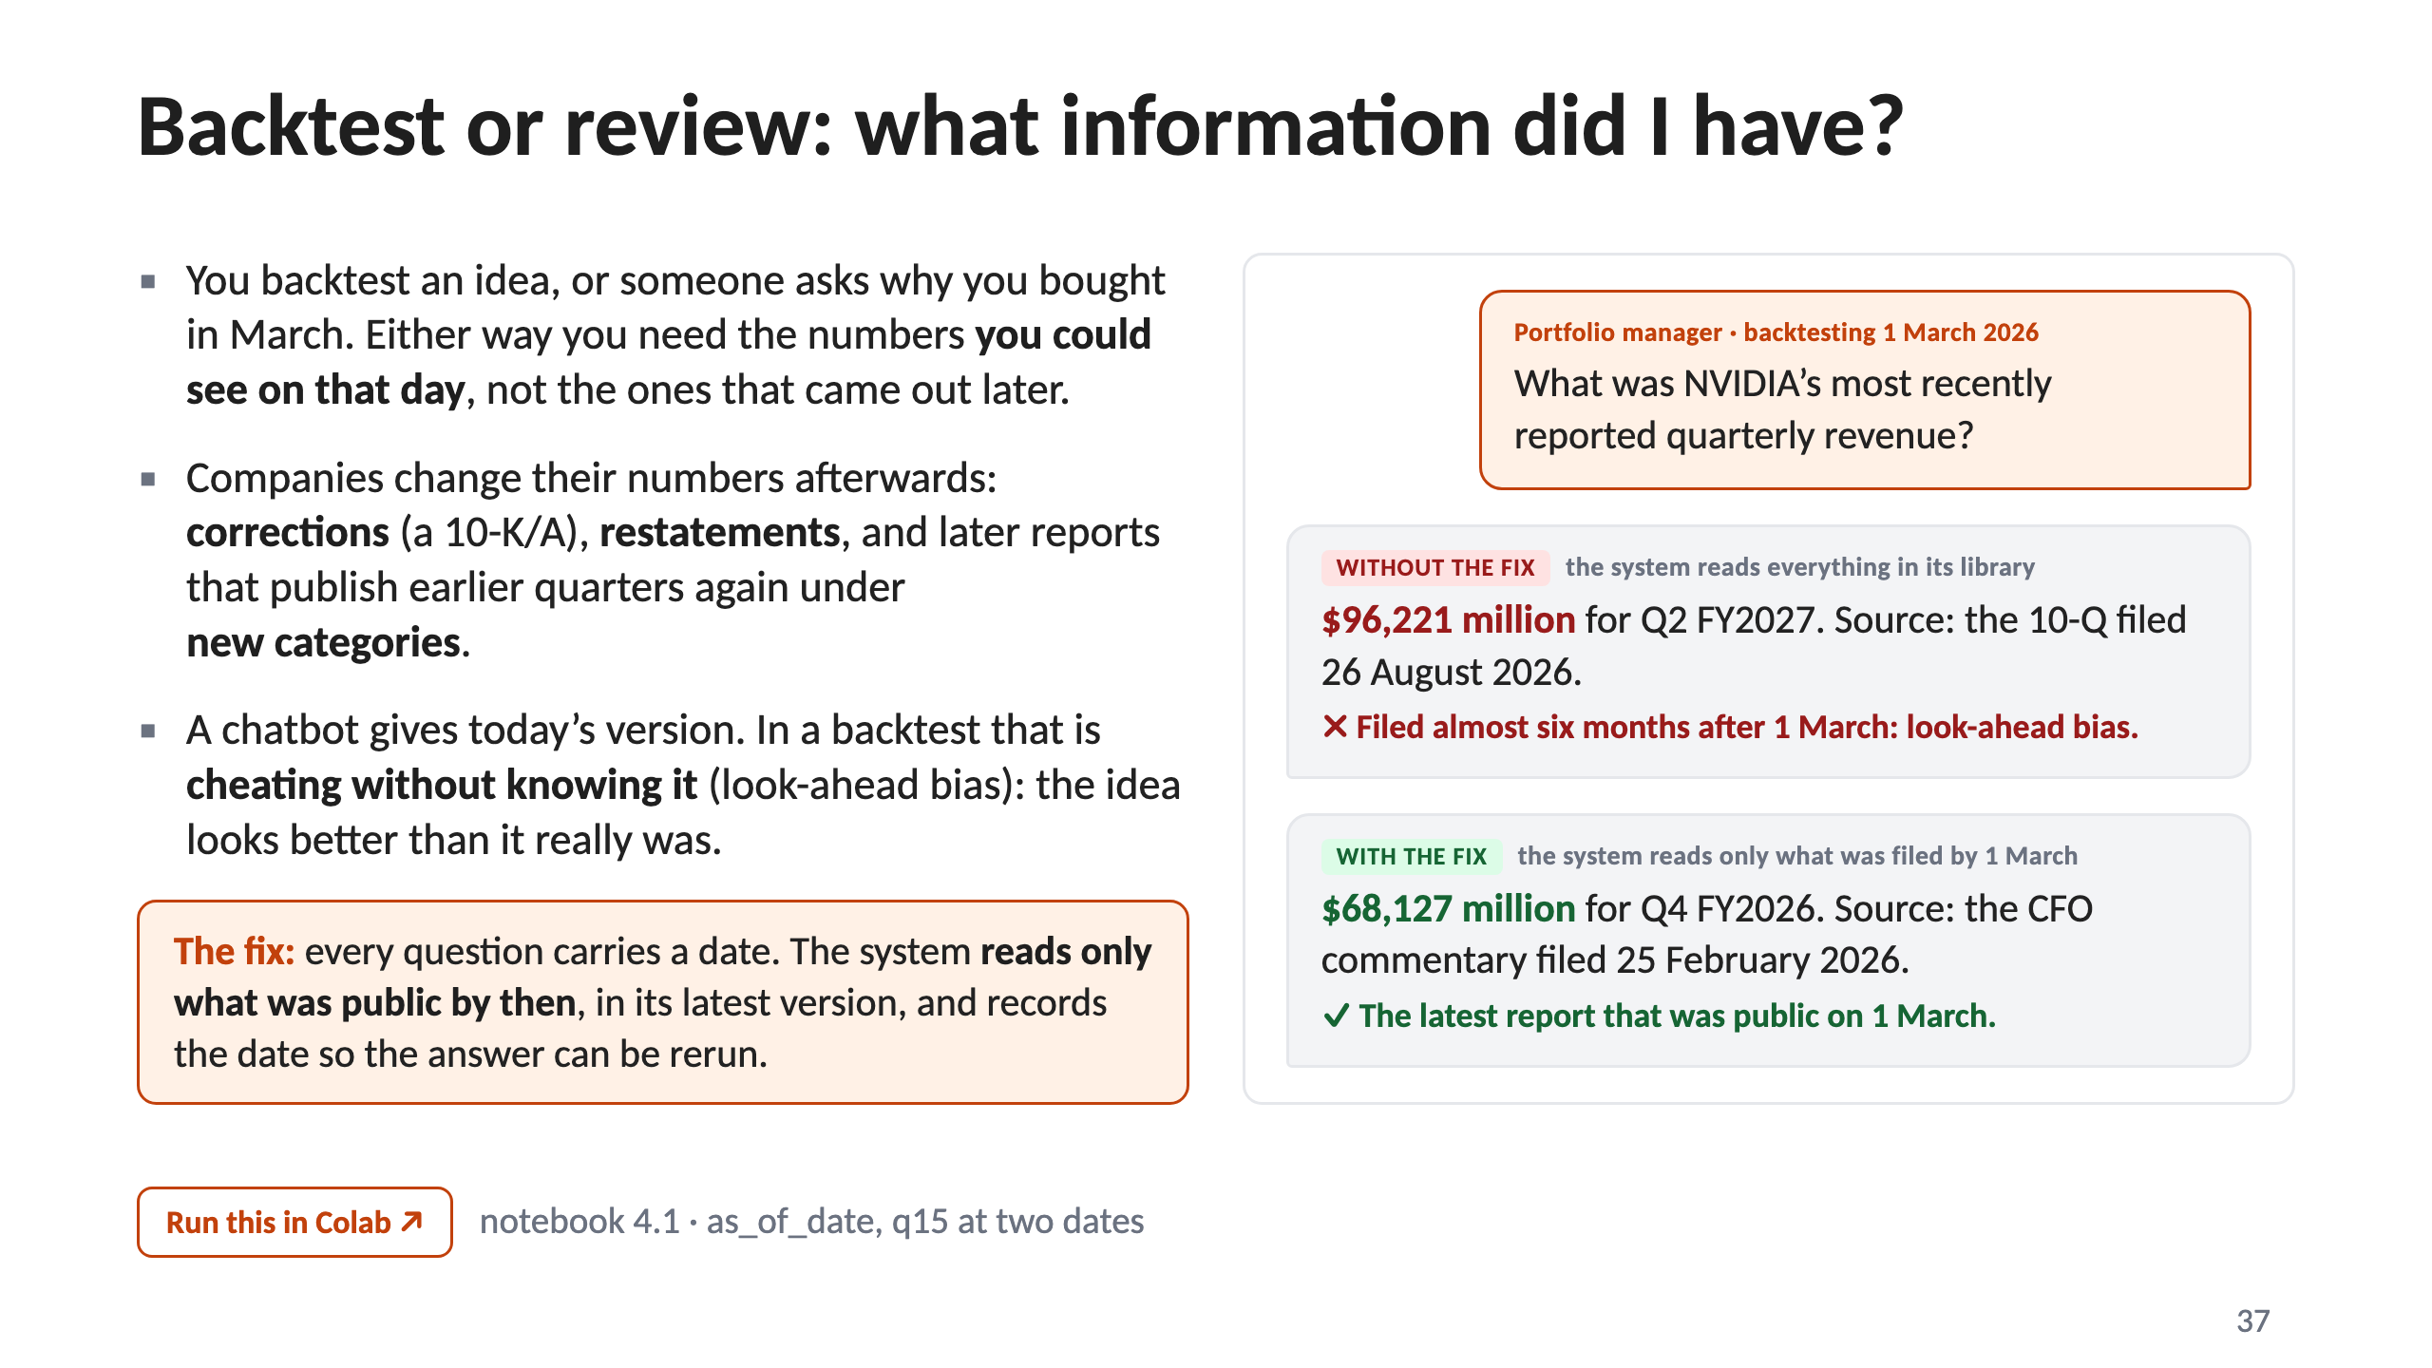
Notes:
37 · Backtest or review: what information did I have?

Slide 38
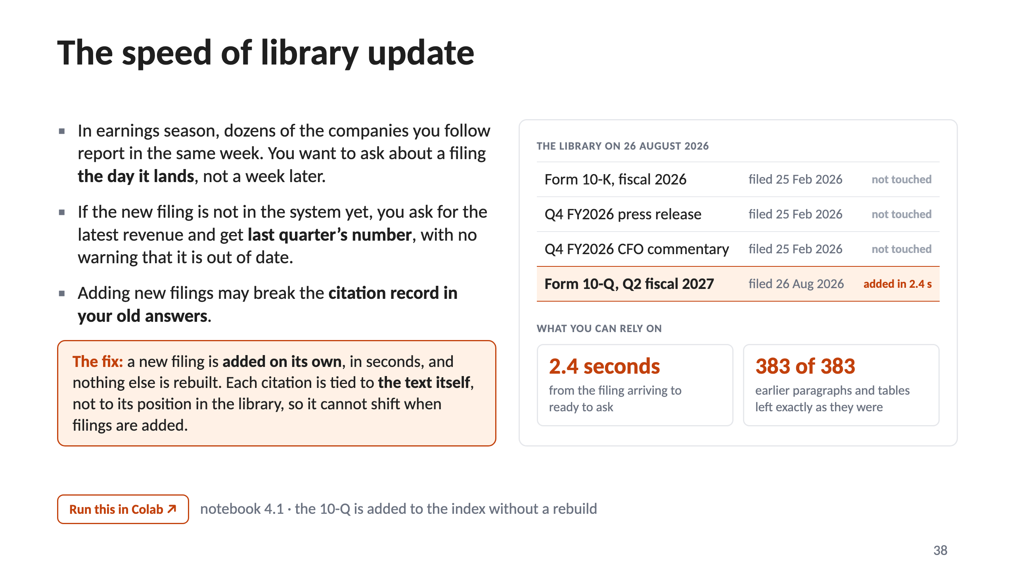
Notes:
38 · The speed of library update

Slide 39
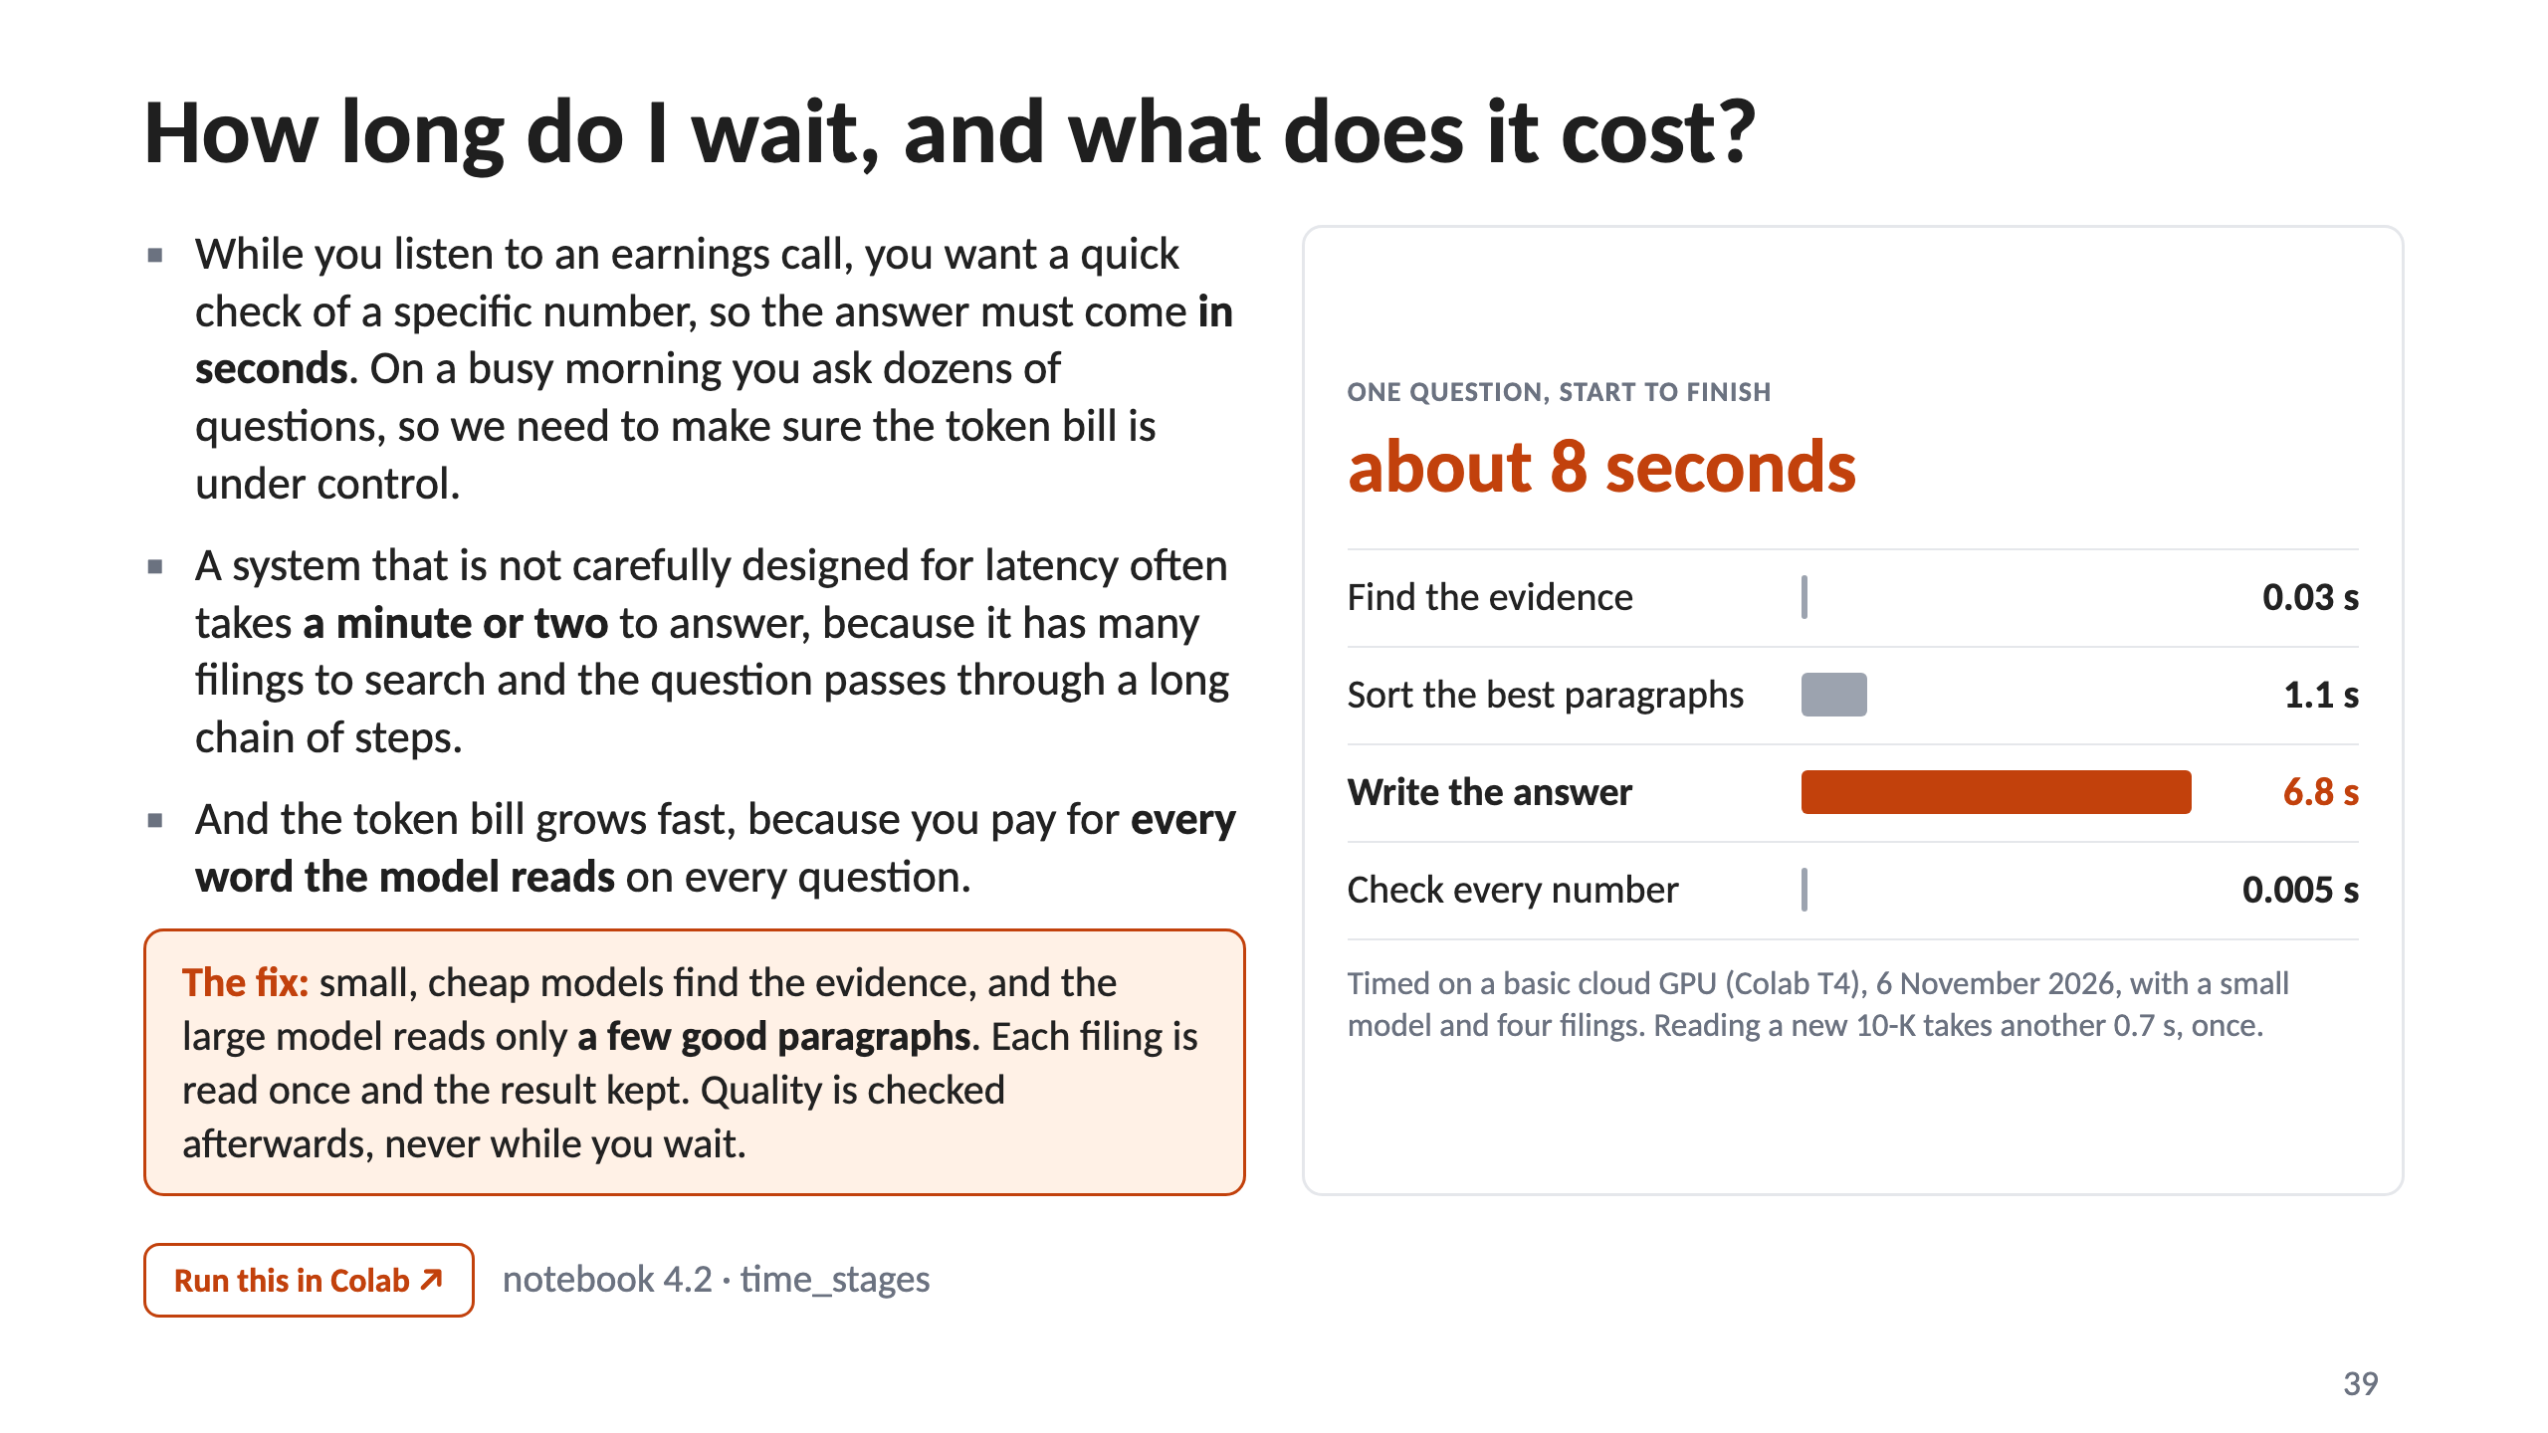
Notes:
39 · How long do I wait, and what does it cost?

Slide 40
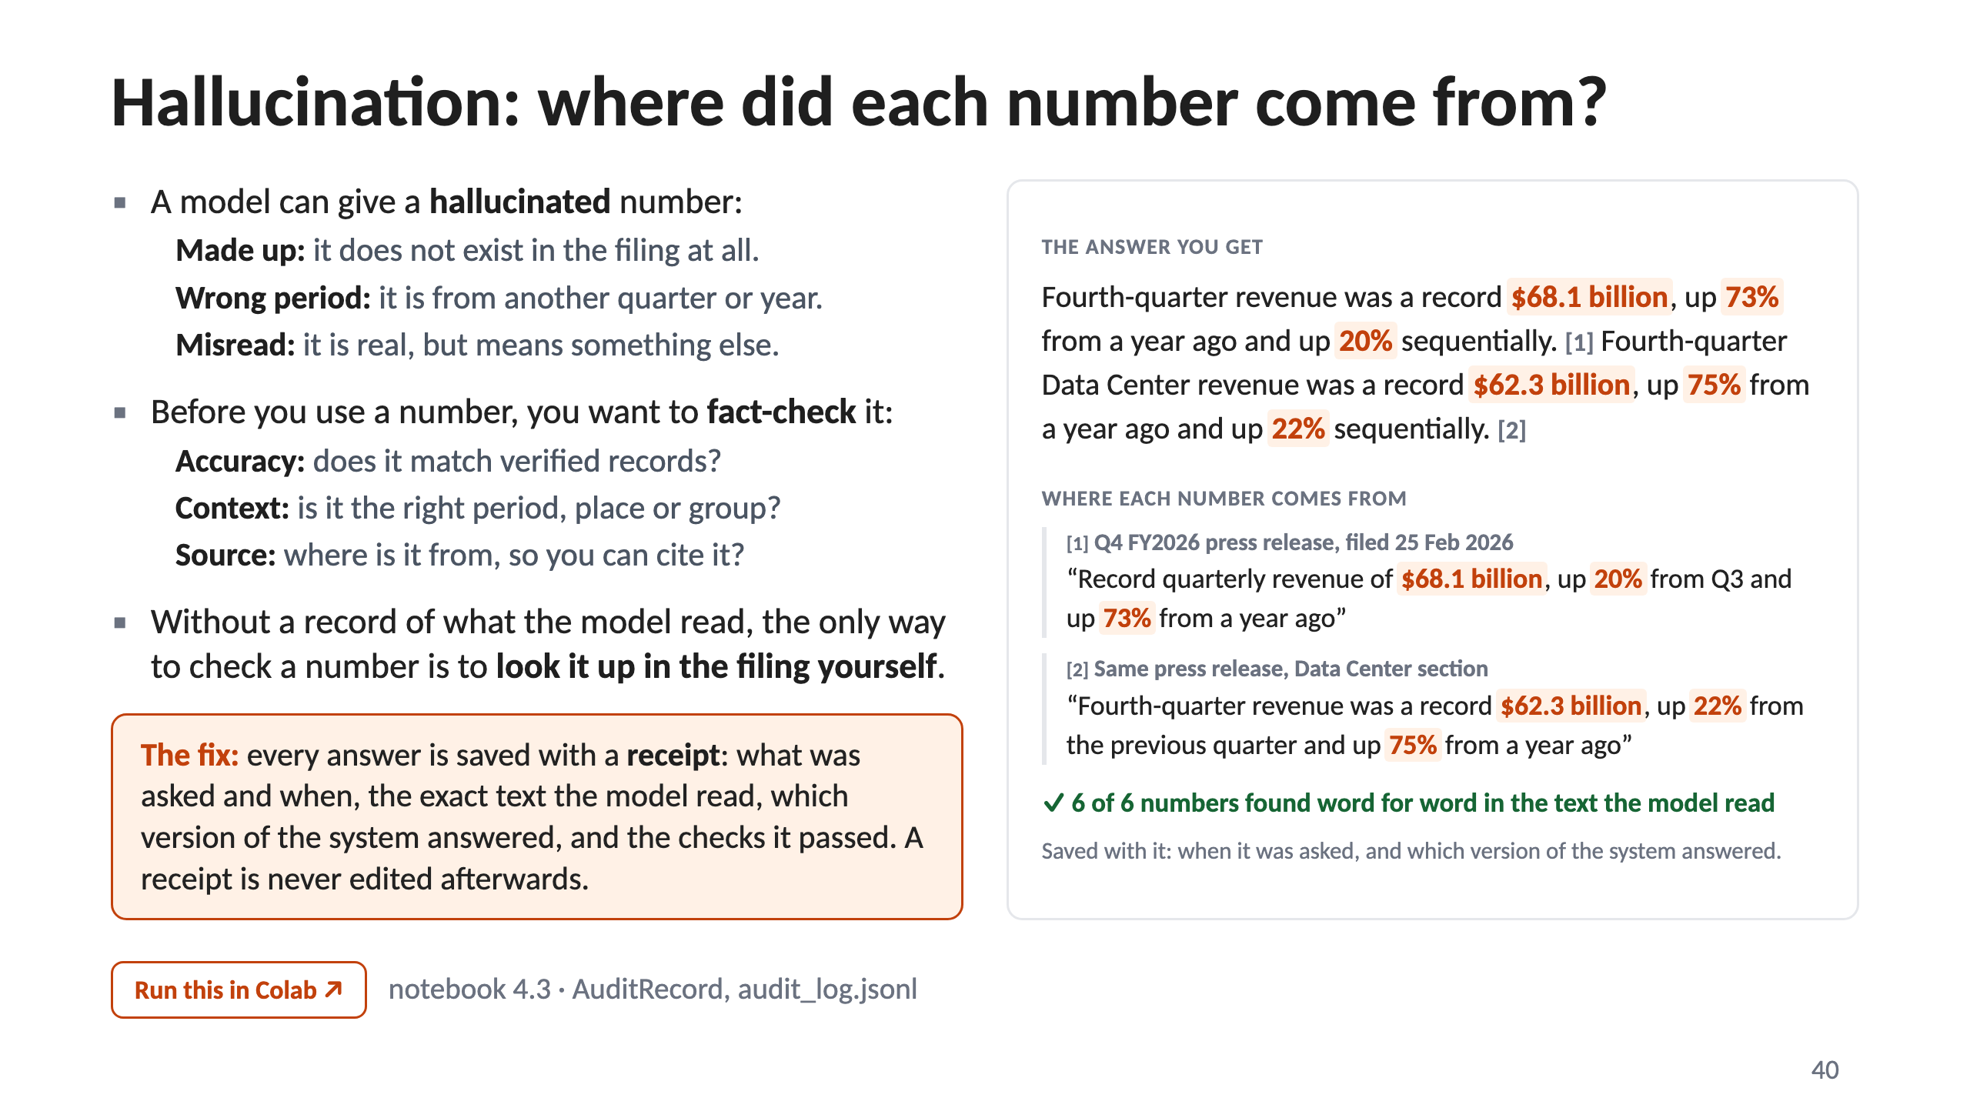
Notes:
40 · Hallucination: where did each number come from?

Slide 41
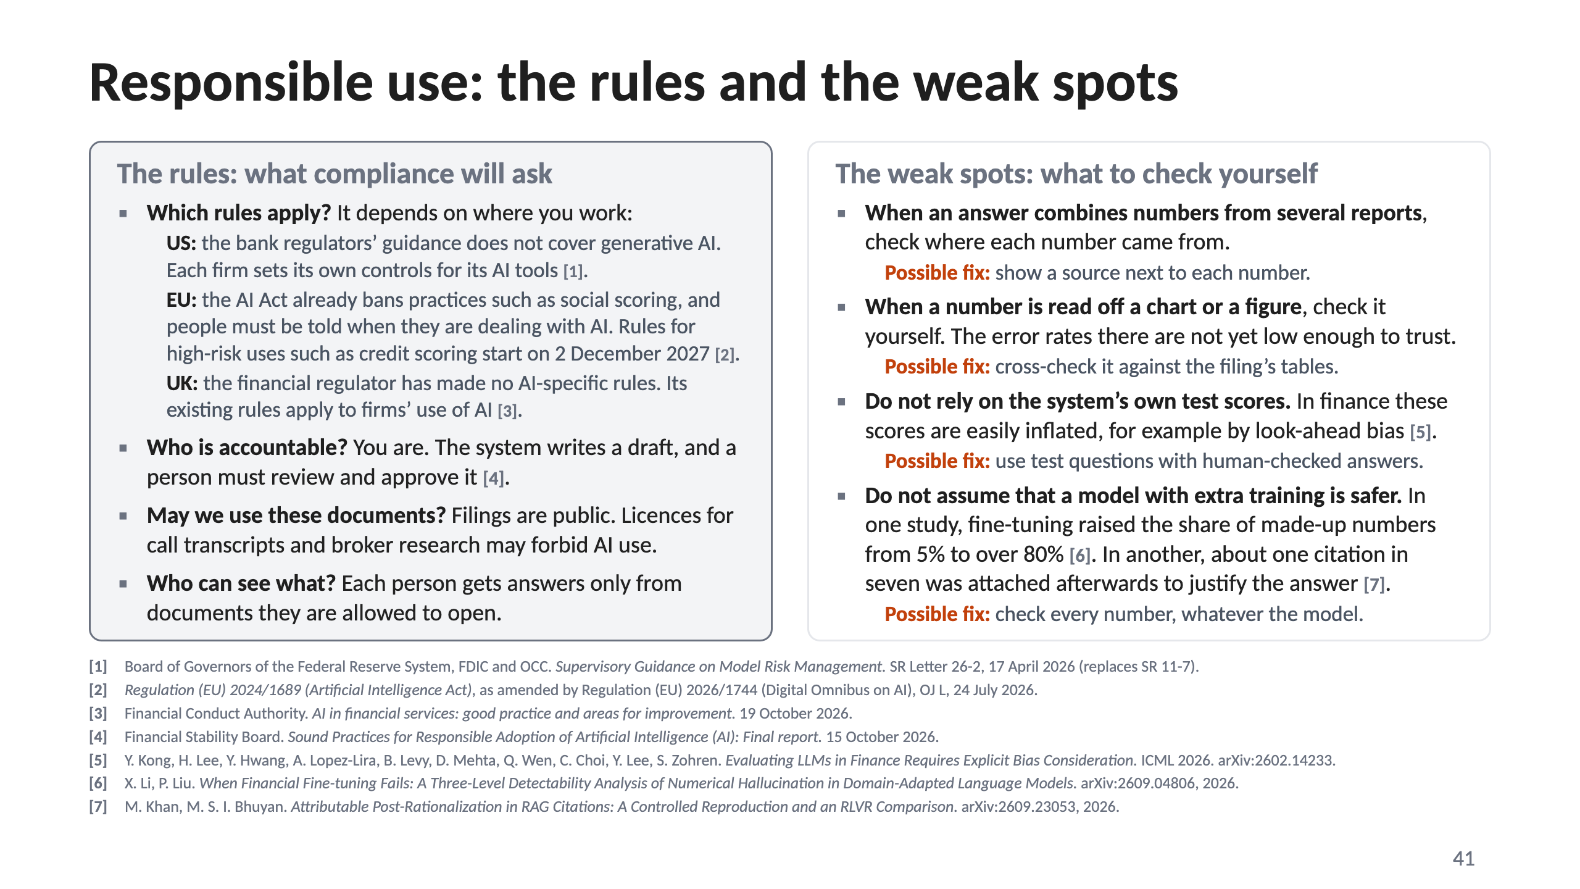
Notes:
41 · Responsible use: the rules and the weak spots

Slide 42
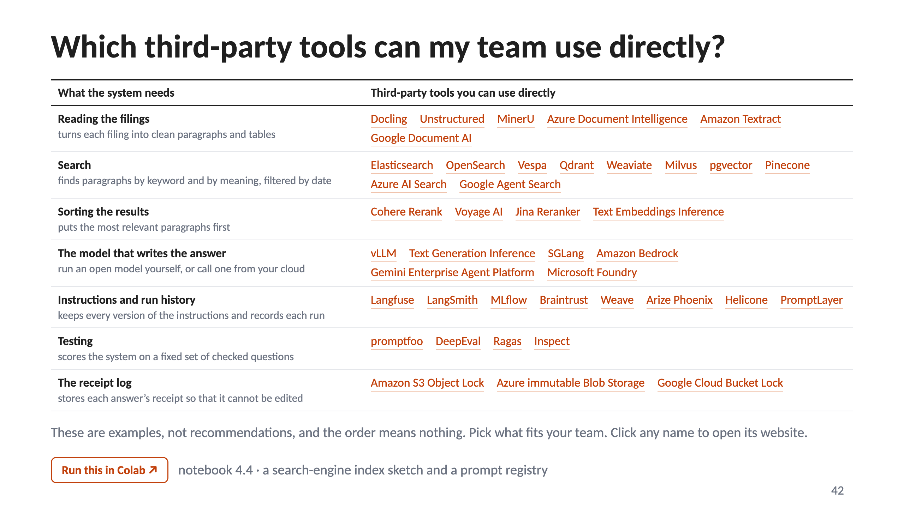
Notes:
42 · Which third-party tools can my team use directly?

Slide 43
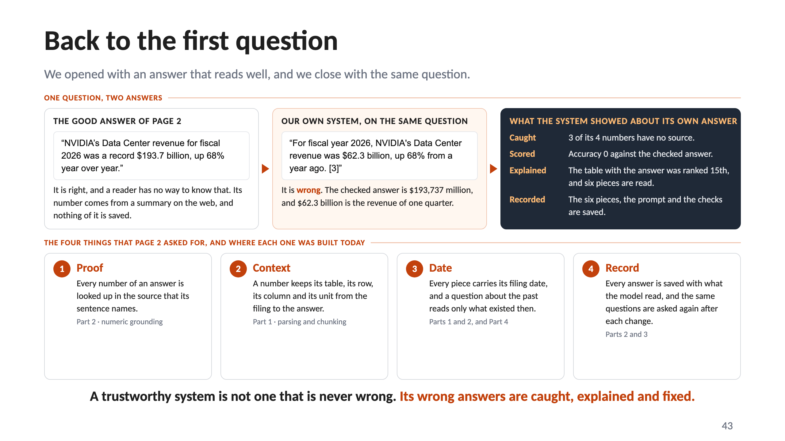
Notes:
43 · Back to the first question

Slide 44
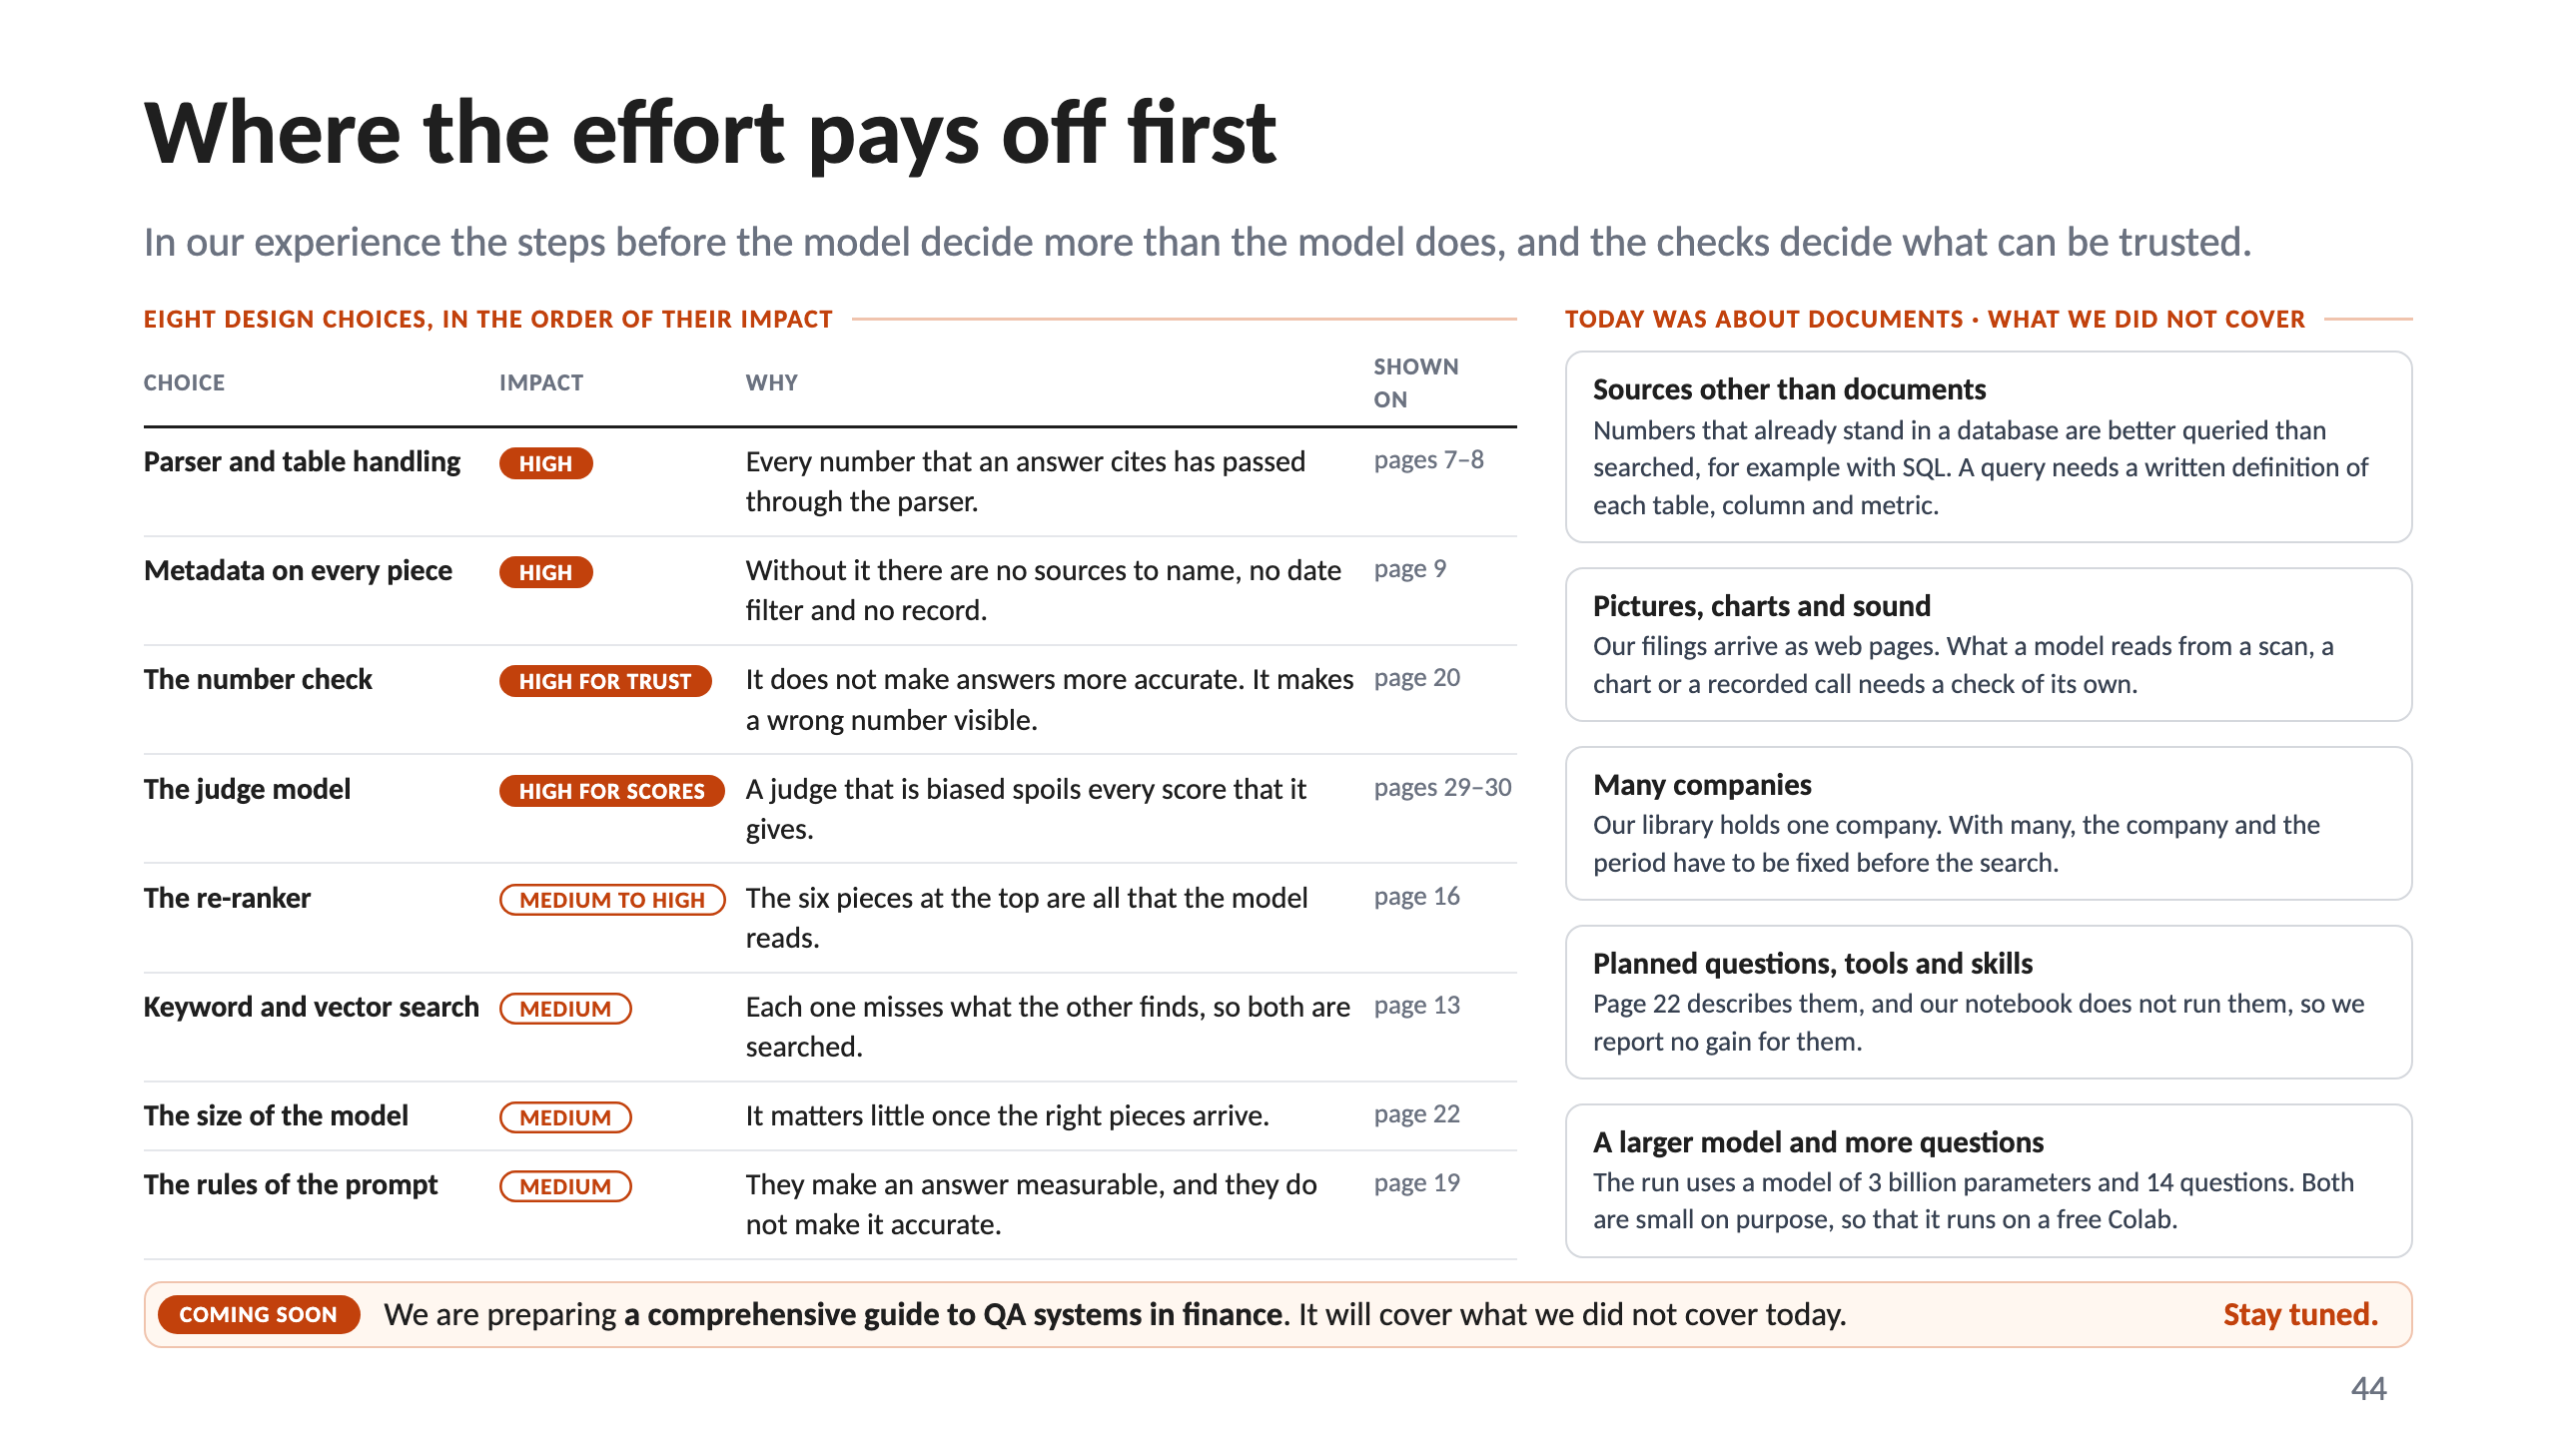
Notes:
44 · Where the effort pays off first

Slide 45
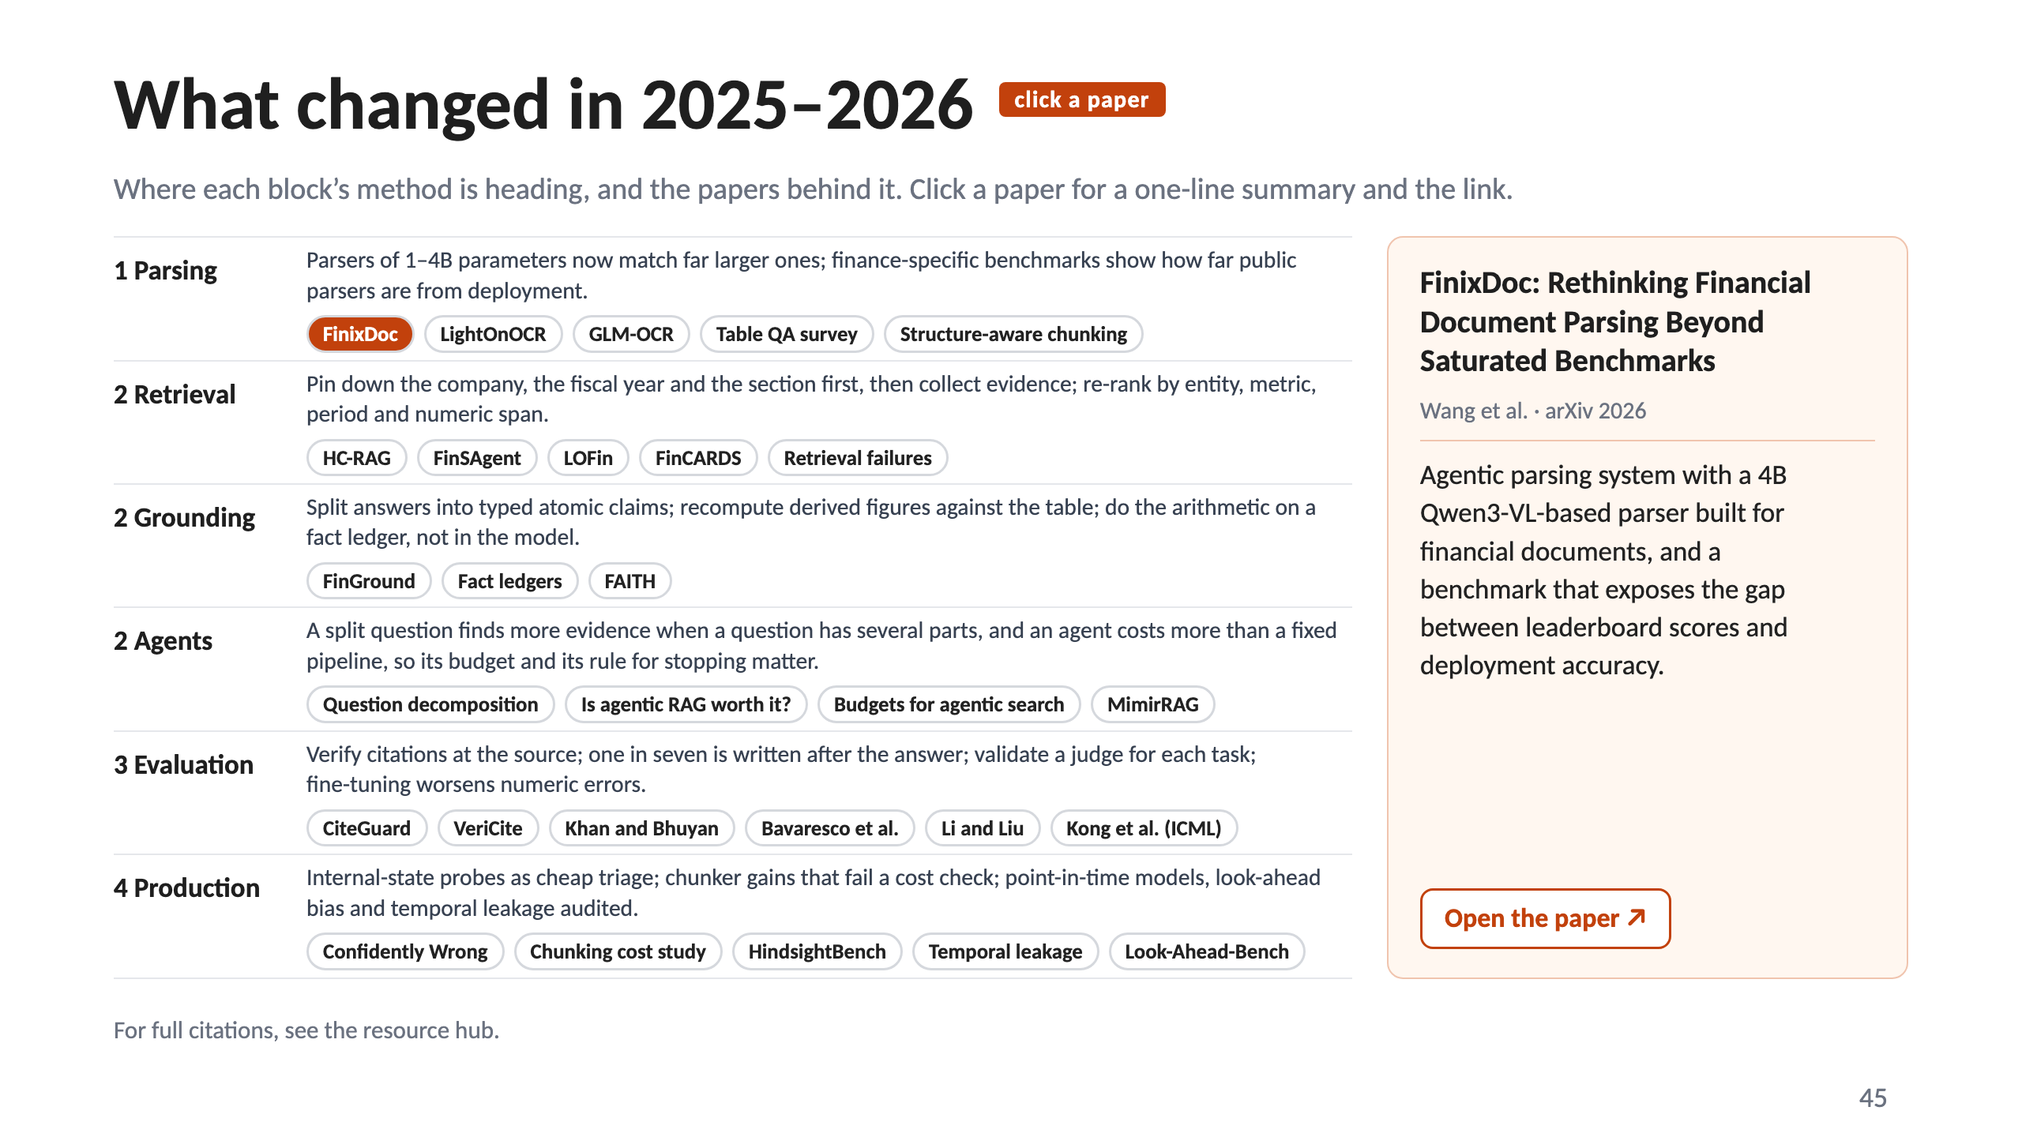
Notes:
45 · What changed in 2025–2026

Slide 46
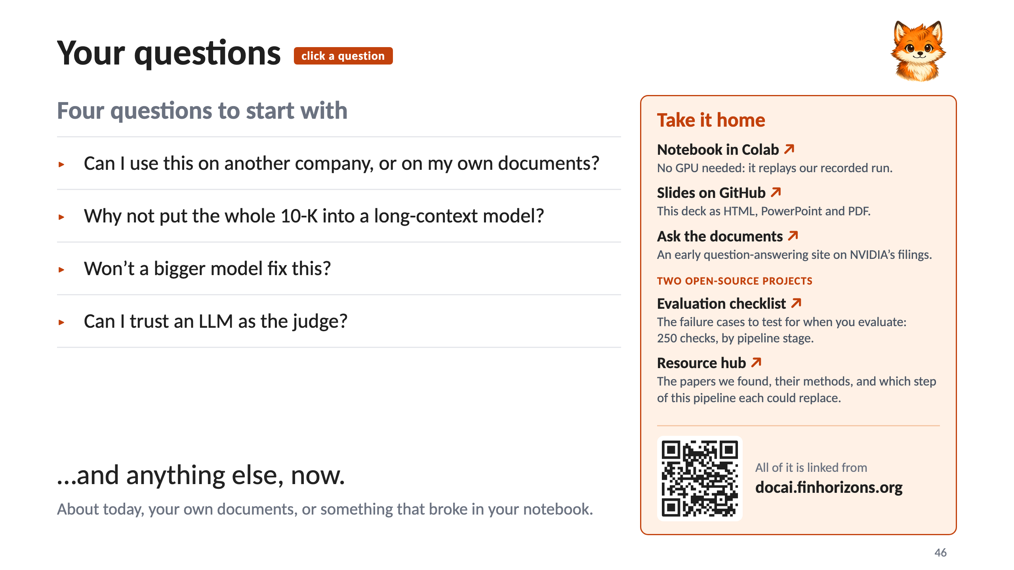
Notes:
46 · Your questions

Slide 47
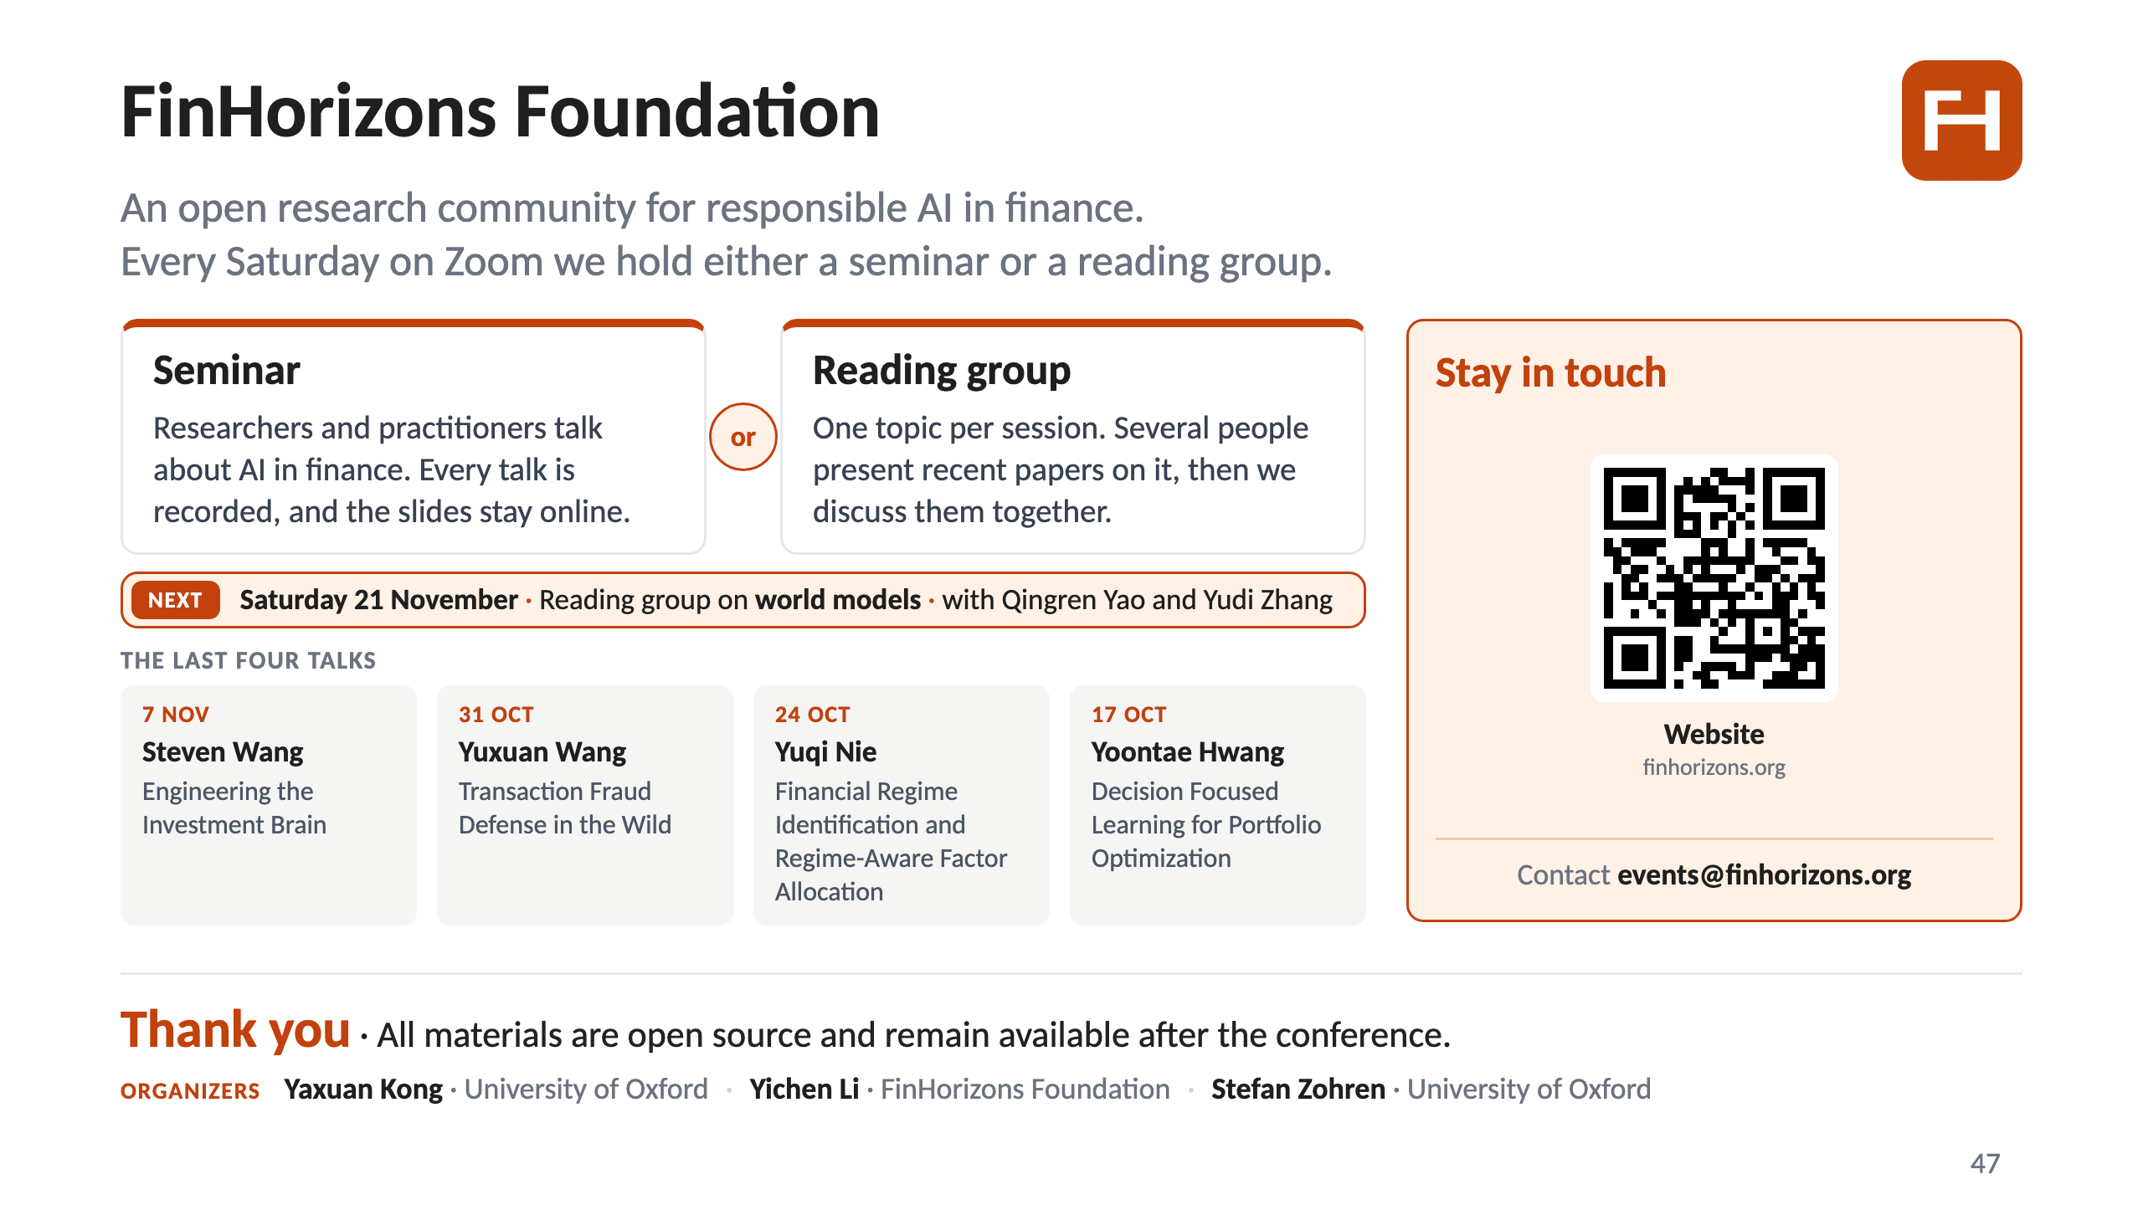
Notes:
47 · FinHorizons Foundation, and thank you

