Slide 1
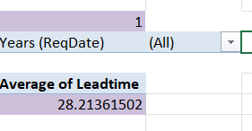
1
The average Leadtime between the Req date and completed date is 28.21361502 days

Slide 2
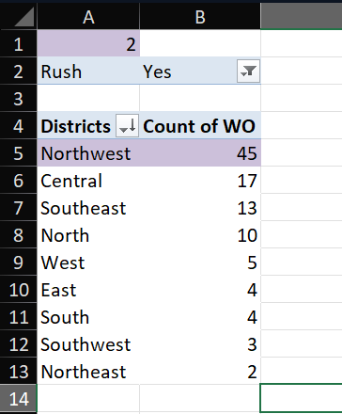
2
Based on the given data,
Northwest has the highest number of rushjobs

Slide 3
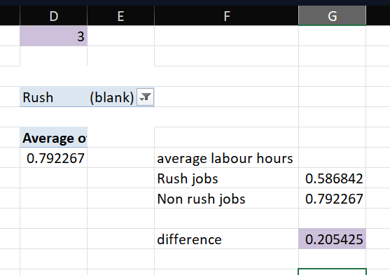
3
Based on the analysis,
1. The difference of average labour hours between Rush jobs and Non rushjobs is 0.2055 hours

Slide 4
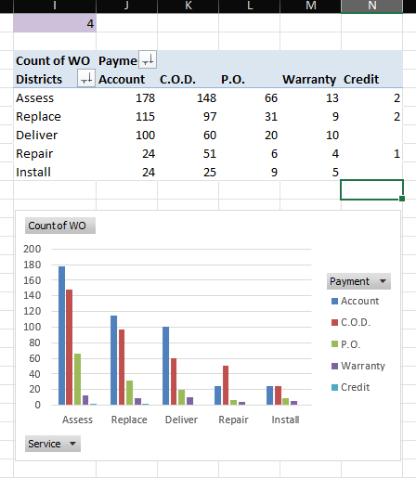
4
Based on the analysis of the given data,
The most used payment mode is “Account”
Irrespective of the Type of service
2. “Account” is usually followed by C.O.D and P.O.

Slide 5
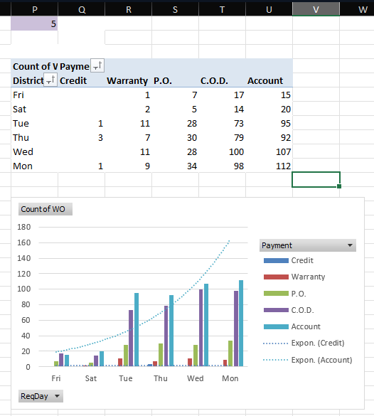
5
Based on the above data,
1.The Payments are maximum during the
Beginning of the week and gradually they
Decrease by the end of it.
2. The payments decline irrespective of the
Type of payment method available

Slide 6
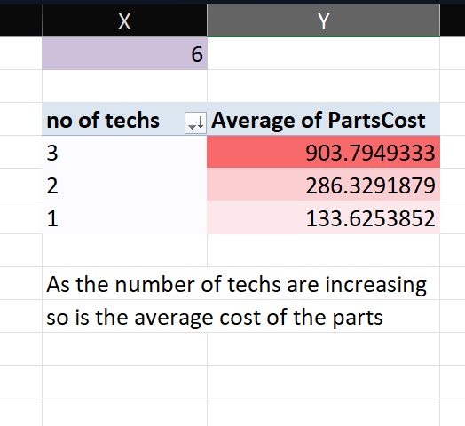
6
Based on the analysis done
As the number of employees increases,
The average cost of each part is also increasing

Slide 7
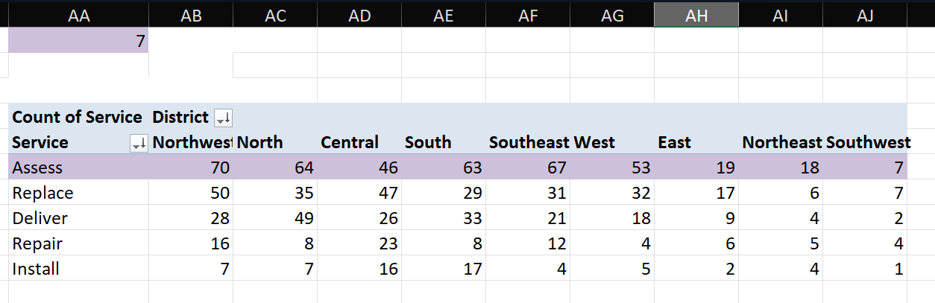
7
By the analysis carried out, we can concur that The most common type of service requested is “Assess”
Across all regions

Slide 8
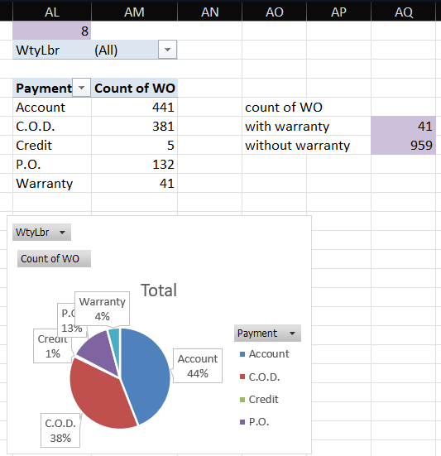
8
Based on the analysis
The distribution of payment types varies wrt.
Labour warranty
The people who have labour warranty are paid
In one mode, while people who don’t have any
Warranty are paid in multiple ways

Slide 9
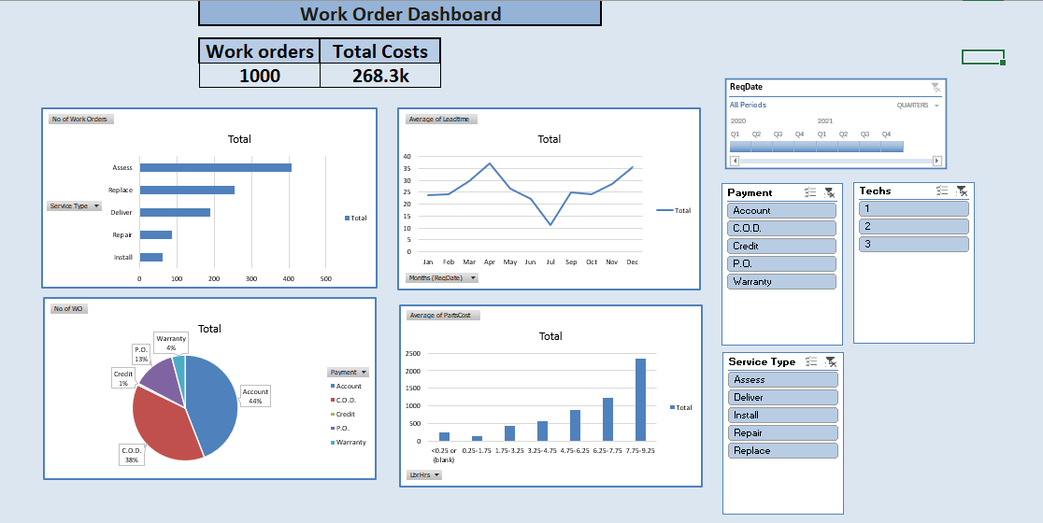
Dashboard

Slide 10
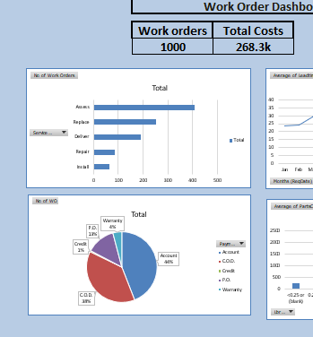

Slide 11
