Slide 1
Pre- & Post- Work Surveys
Purpose: Create and maintain a work environment free from unnecessary radiation exposure by utilizing a Geiger counter to survey work spaces before and after use.
Perform battery test prior to using survey meter.
Survey the areas listed on the “Pre- & Post- Work Survey Checklist” prior to beginning radioactive work.
Complete the checklist indicating positive and negative results as well as remediation action used for decontamination.
Reference the attached photographs for detailed area locations.
Repeat steps 1 - 4 after completion of radioactive work.

Slide 2
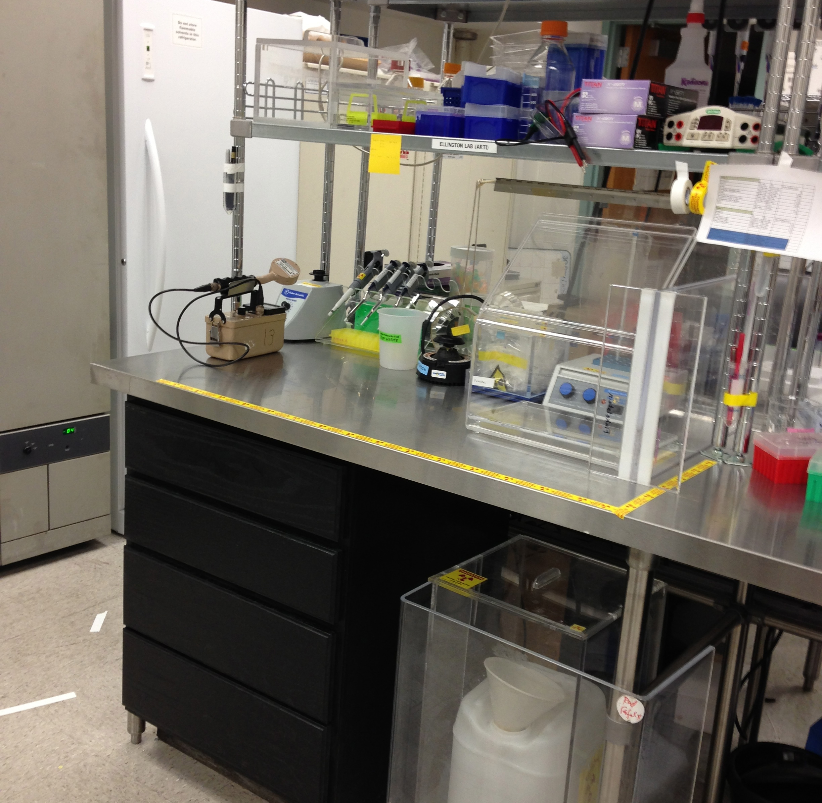
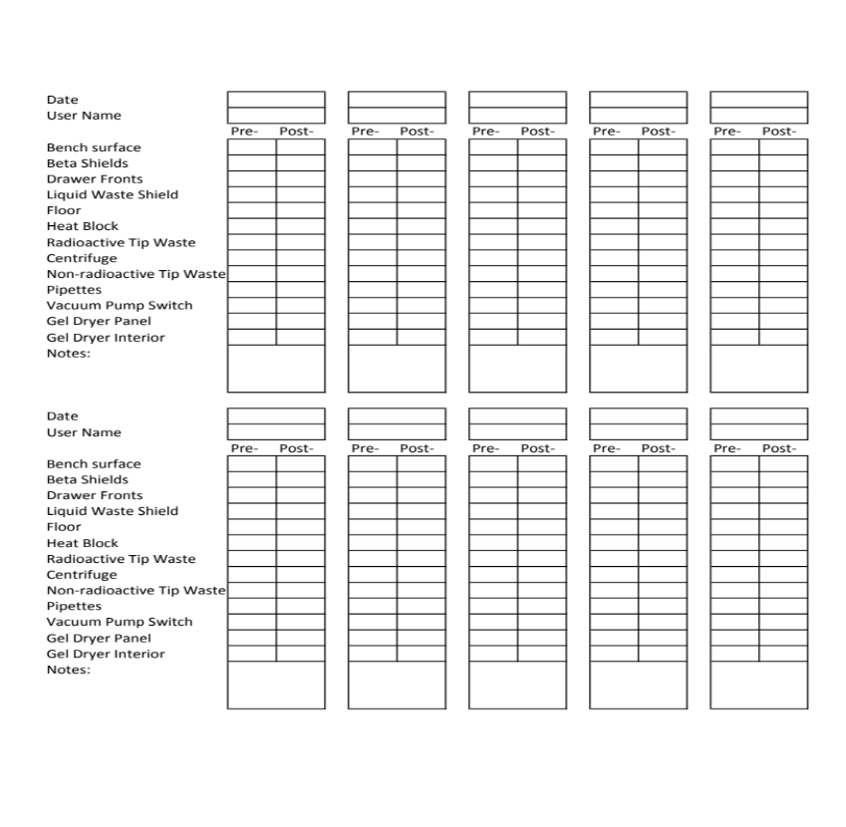
Pre- & Post- Work Surveys
General Work Surface
Daily Survey Checklist
Beta Shields
Bench Surface
Drawer Fronts
Liquid Waste

Slide 3
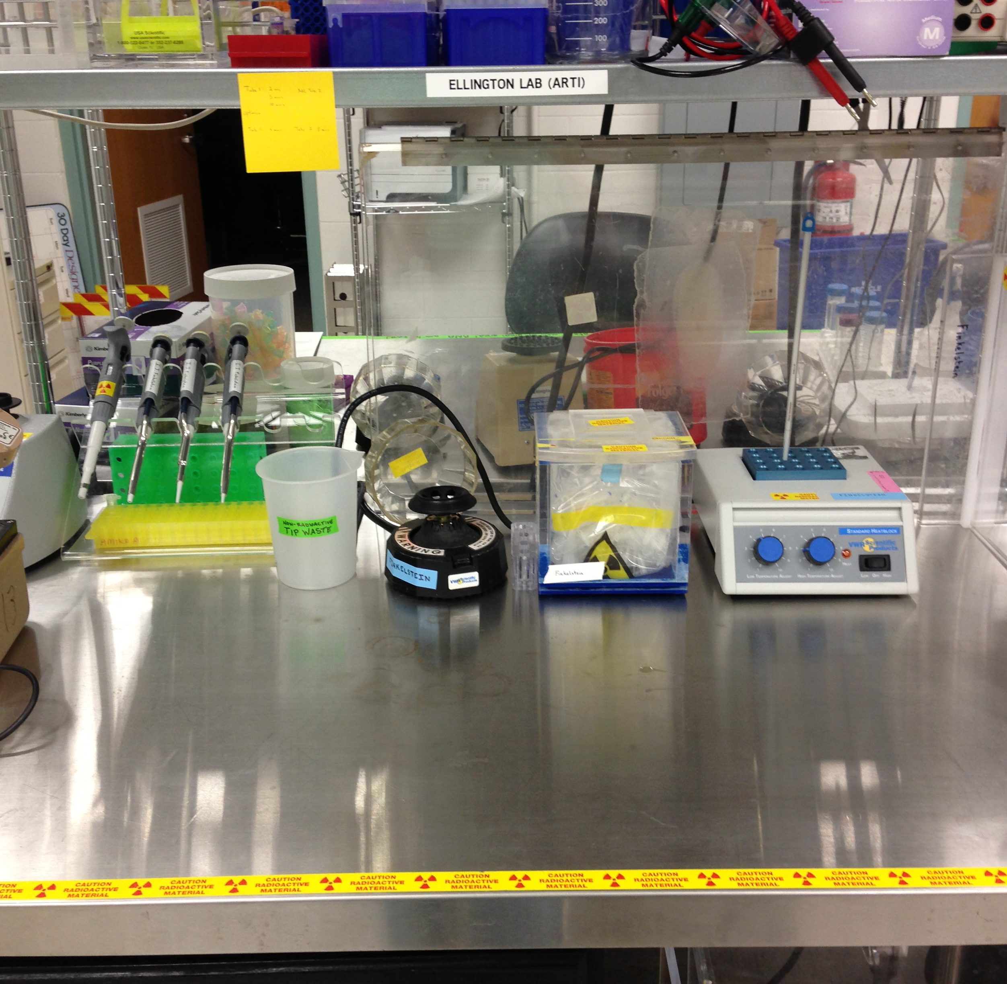
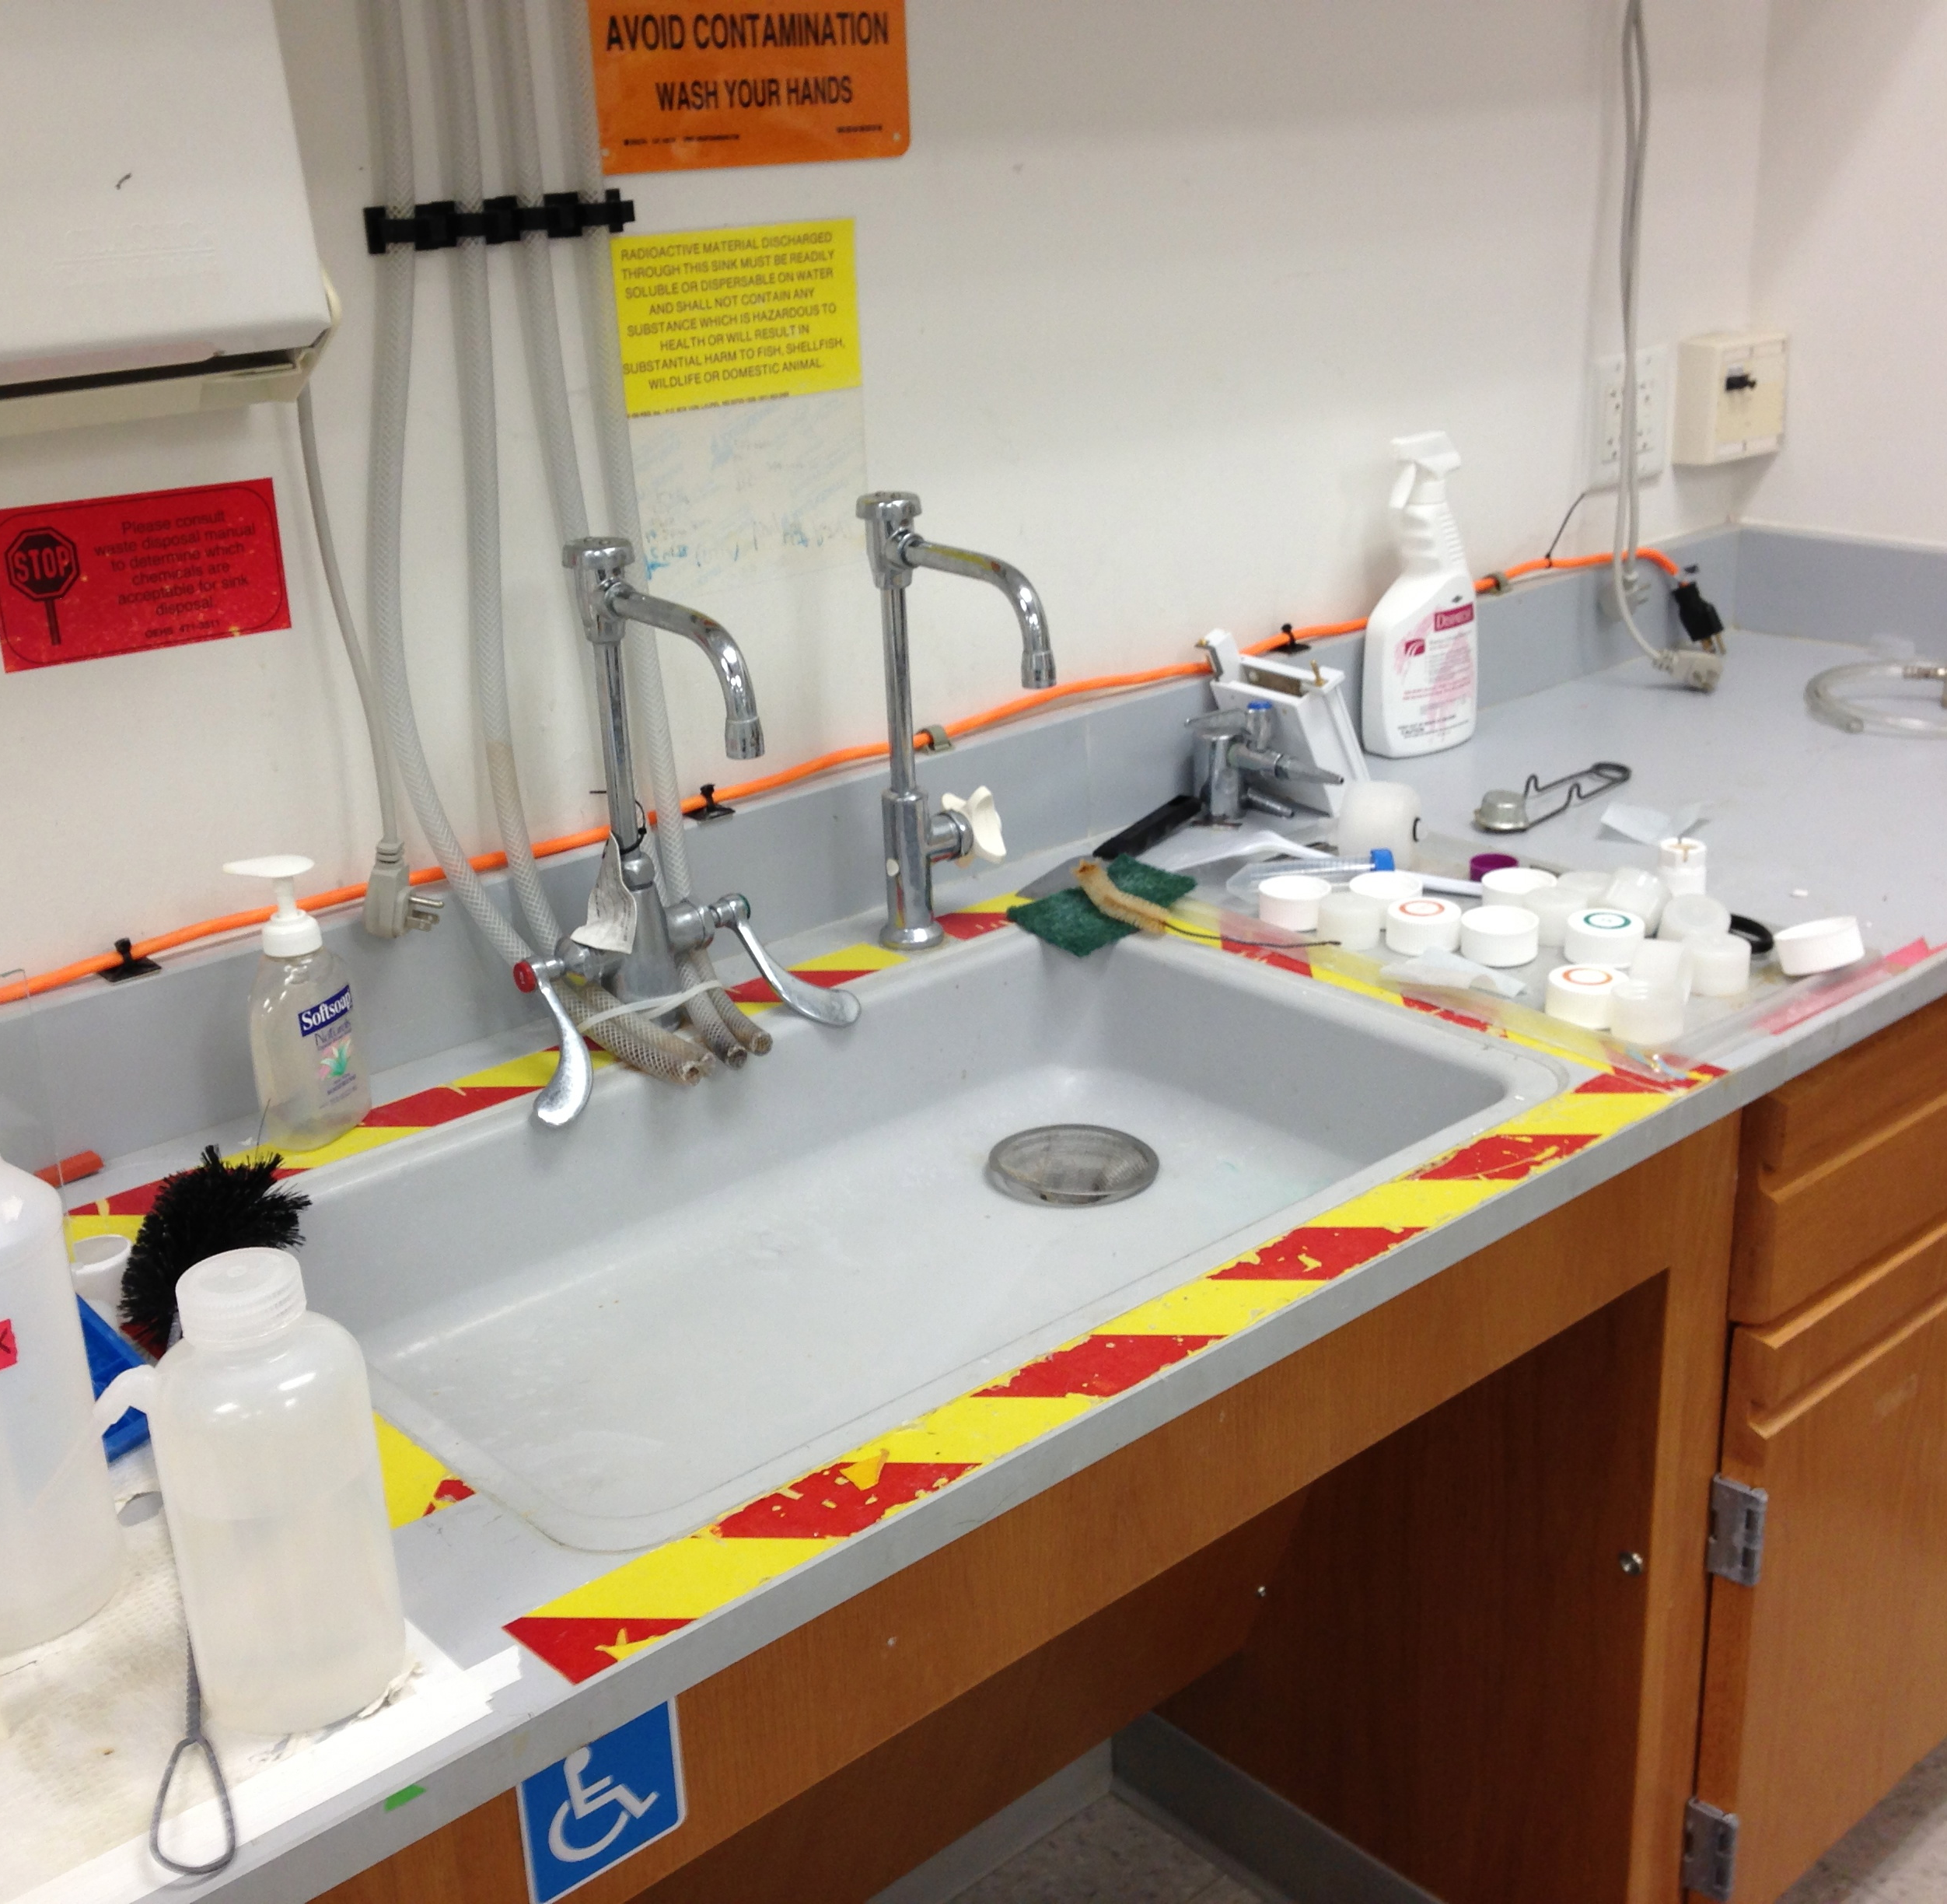
Pre- & Post- Work Surveys
Bench top Equipment
Sink Basin and Faucet Handles
Pipette Tips and Handles
Centrifuge
Heat Block
Basin and Drain
Faucet Handles
Non-Radioactive Tip Waste
Radioactive Tip Waste

Slide 4
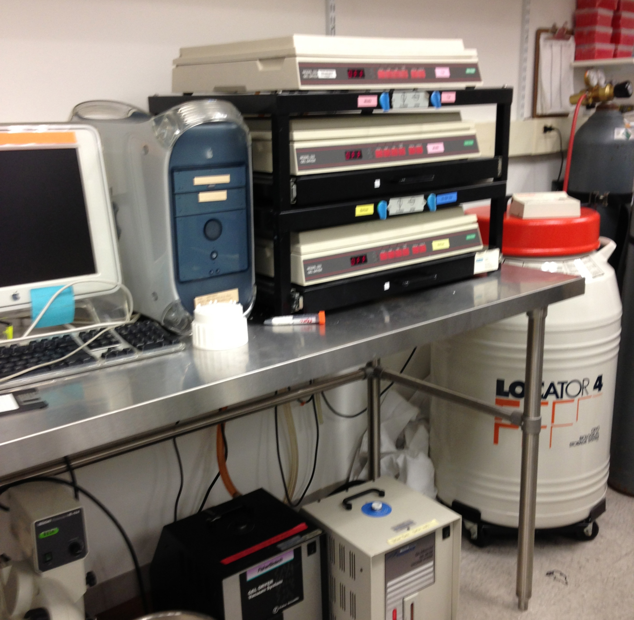
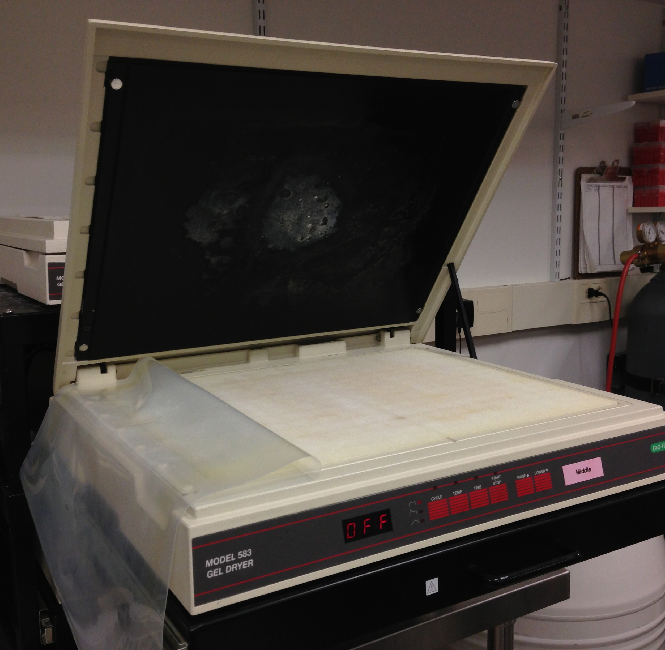
Pre- & Post- Work Surveys
Gel Dryer Area
Interior Gel Dryer
Control Panel
Mat and Cover
Switch

Slide 5
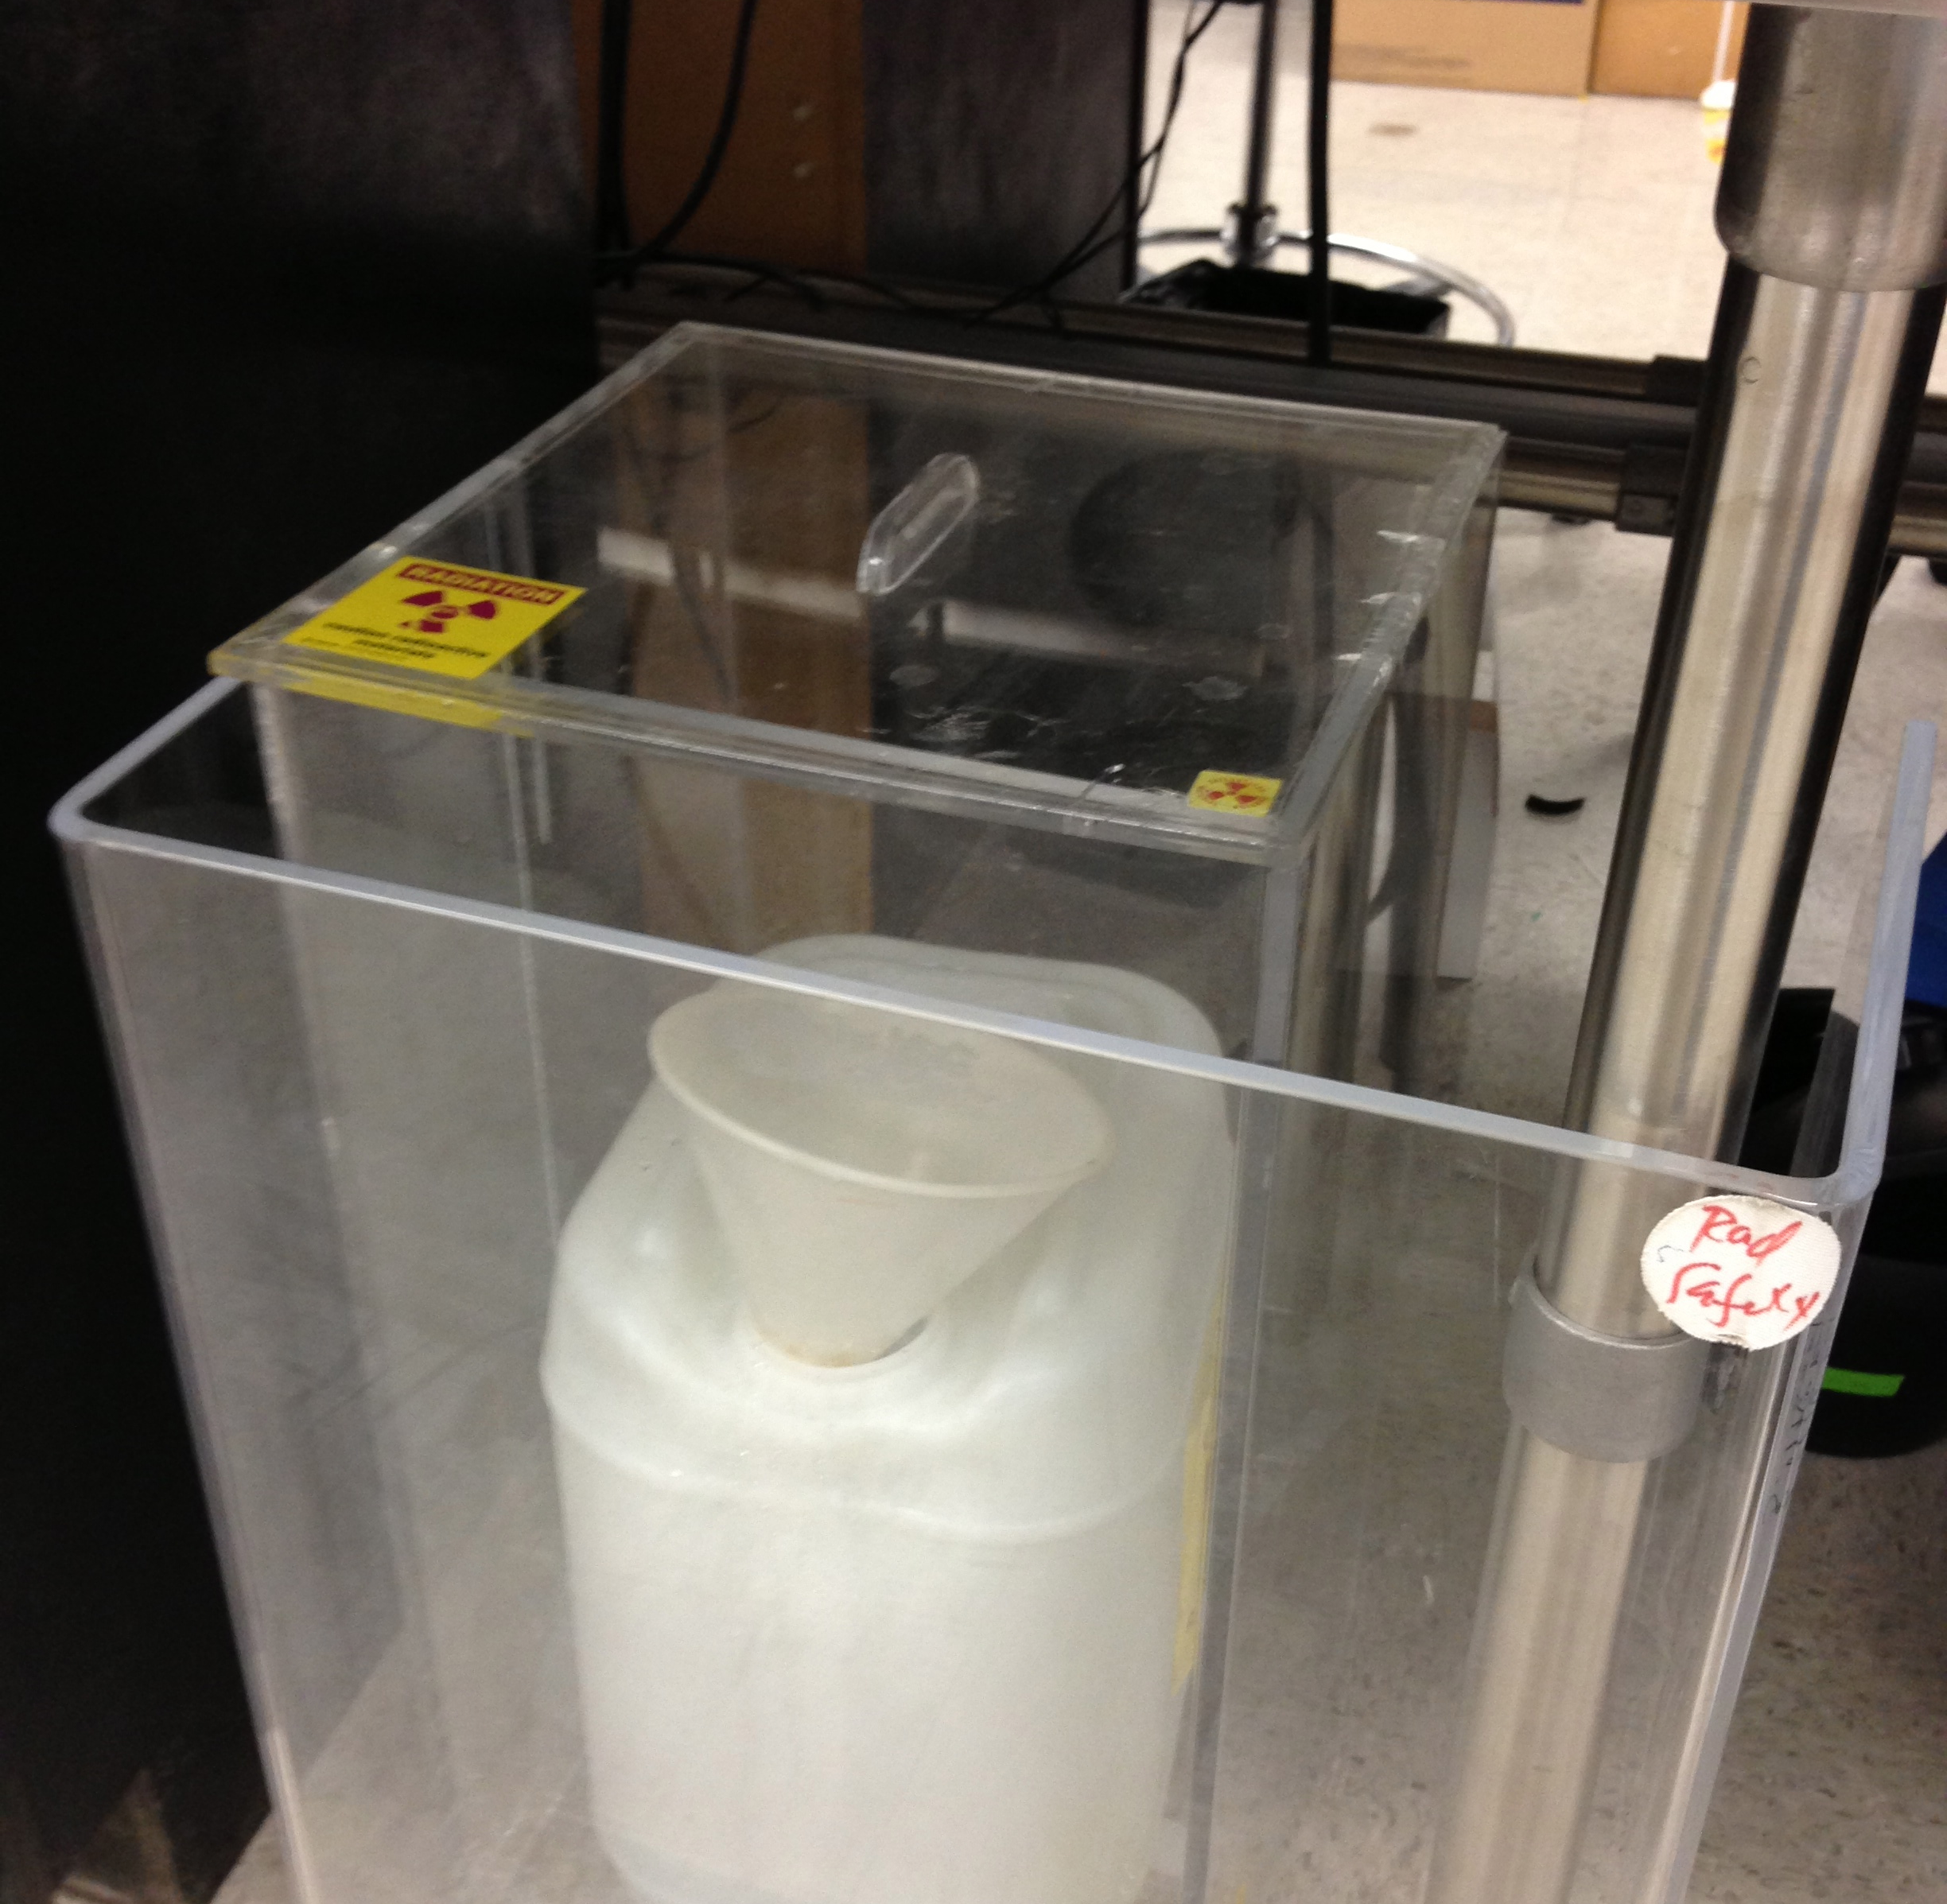
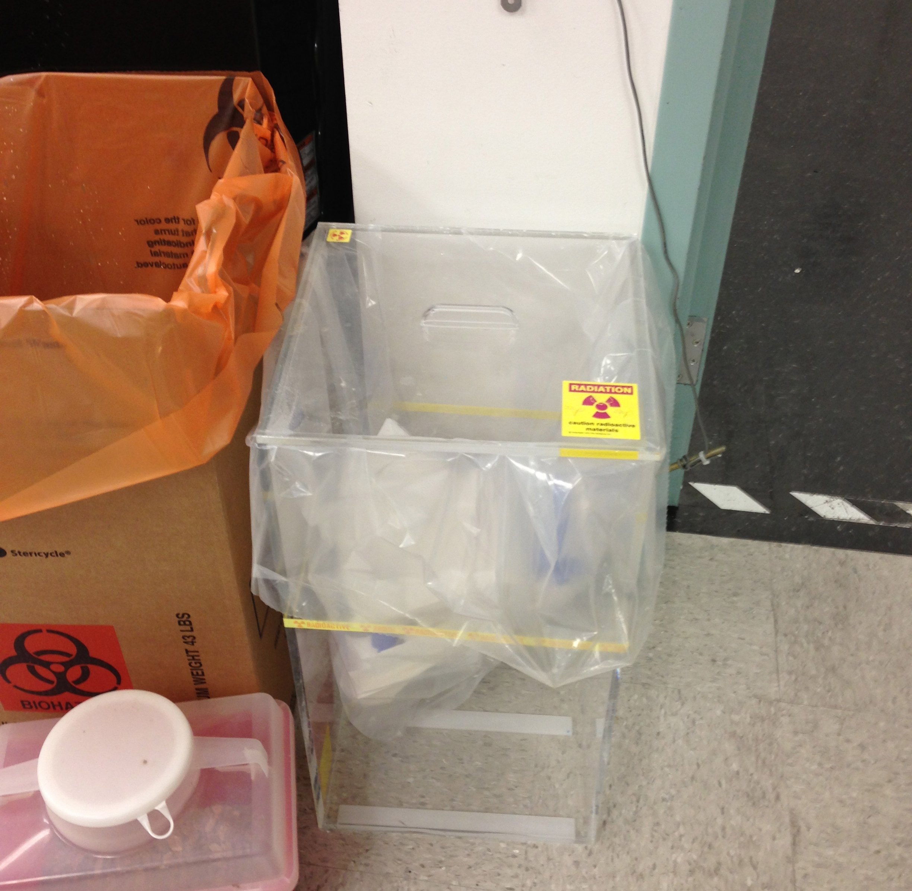
Pre- & Post- Work Surveys
Liquid Waste Storage & Handle
Radioactive Dry Waste & Handle
Handle and Lid
Handle and Lid

Slide 6
Have Questions?
Contact Finkelstein Lab’s Radiation Safety Officer:
Vanessa Landsteiner
Landsteiner@UTexas.edu
MBB 3.422

