Slide 1
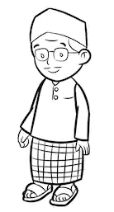



PERSONA
HOW TO USE?
BOOTCAMP ONE | DAY THREE
HCD EXERCISE | DEFINE
CREATE A USER PERSONA
About: Background/Context
Broad Goals: What are aspirations and motivations that represent what the person wants in life?
Specific Needs/Problem: What does he/she want that is relevant to specific problem/opportunity domain?
Specific Behaviours: What are current behaviours and actions relevant to the specific domain?
Specific Motivators: What are specific motivators as a user to engage with a solution?
Specific Pain Points: What are specific pain points as a user engaging with a solution?
Quote: Something the persona would say to summarise their position on the problem
Objective of Exercise
To establish the needs and challenges of a target user/customer. To humanise the user that one can empathise with, and create solutions for.
Tools
Persona
About ‘Persona’
Personas are fictional “characters” we create to represent a pattern/type of user or stakeholder for whom a design or solution has to be developed. The persona is not a generic demographic profile but a summary of needs, behaviours, motivations, and challenges that helps provide us the foundation on which to create a solution.
Name: Real/Fictional
Relevant Demographics: Age, Gender, Income, Family, Occupation
1
2
3
Persona
Identify: Based on the research data, identify if there is a pattern emerging with regards to a particular type of user. This type can be the basis of the persona.
Details
Fill out: The sections under the different questions on the template based on the research collected, and the pattern emerging.
Image
Add: An image of a person who represents the pattern/persona. The image does not need to belong to a person who has participated in the research..
FINANCIAL INNOVATION LAB | BOOTCAMP ONE

Slide 2
BOOTCAMP ONE | DAY THREE
HCD EXERCISE | DEFINE
CREATE A USER PERSONA
Notes
Session Flow
Sharing the Objective | 2 Min
Facilitators to share the objective of the session/exercise.
Walkthrough - Example | 5 Min
Facilitators to walk through 1-2 examples of the tool in use.
Walkthrough - ‘How To?’ | 5 Min
Facilitators to walk through the ‘How to?’ of the tool as per instructions on the toolsheet.
Clarifications | 3 Min
Facilitators to clarify doubts from participants.
Exercise | 30 Min
Participants to use tool with guidance from the facilitation team. A recommended flow could be -
Considering Persona - 5 Min
Building Persona - 20 Min
Refining Persona - 5 Min
Points to Consider
The numbering provided in the How To? is a recommended path. Startups may still choose to fill the template as per their convenience.
Personas should not be confused with a generic demographic or segment profile. The personas have depth by being able to call out user needs, behaviours, motivations and pain points specifically.
Persona is not a 1:1 match to a research respondent. Ideally a demographic, need based, behavioural pattern of users is brought alive as a representative persona.
When the persona is completed, one should feel like there is enough insight into the user, and the constraints are informative enough to come up with innovative and yet rooted ideas.
Personas can be built for various types of target users, and also for various types of influencers depending on their stake in the problem or opportunity.
Tools
Personas
Material
Template, Chart Paper, Post-Its, Pens/ Sketch Pens
Time
45 Minutes
FINANCIAL INNOVATION LAB | BOOTCAMP ONE

Slide 3
TOOL: PERSONA
About: Background/Context
Broad Goals: What are aspirations and motivations that represent what the person wants in life?
Specific Needs/Problem: What does he/she want that is relevant to specific problem/opportunity domain?
Specific Behaviours: What are current behaviours and actions relevant to the specific problem/opportunity domain?
Specific Motivators: What are specific motivators as a user to engage with a solution?
Specific Pain Points: What are specific pain points as a user engaging with a solution?
Quote: Something the persona would say to summarise their position on the problem, and write it as a quote
Name:
Relevant Demographics:
Age:
Gender:
Income:
Family:
Occupation:
FINANCIAL INNOVATION LAB | BOOTCAMP ONE

Slide 4
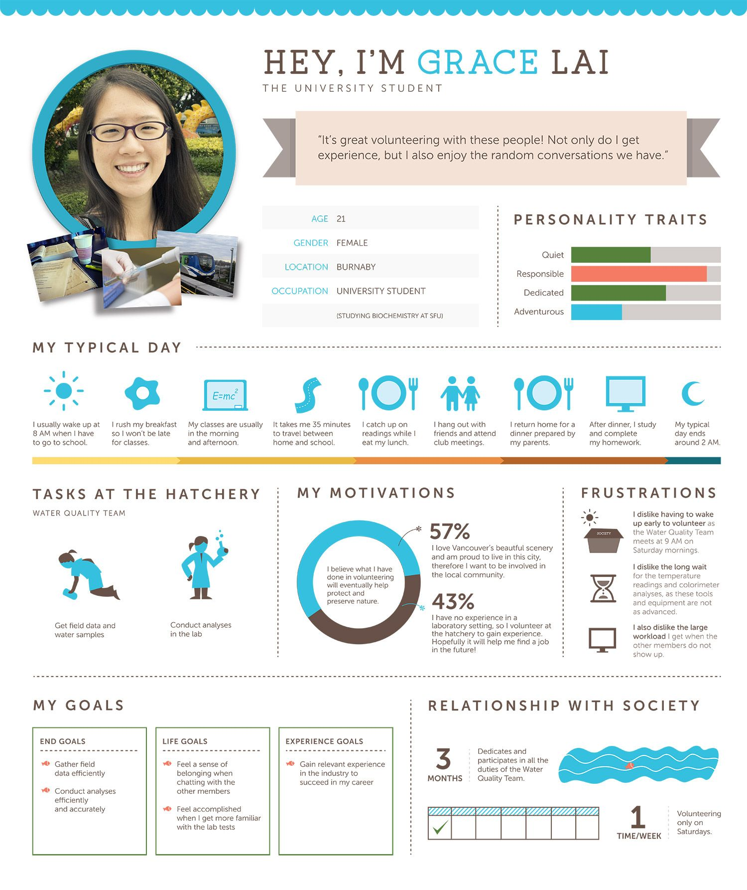
TOOL: PERSONA
FINANCIAL INNOVATION LAB | BOOTCAMP ONE

Slide 5
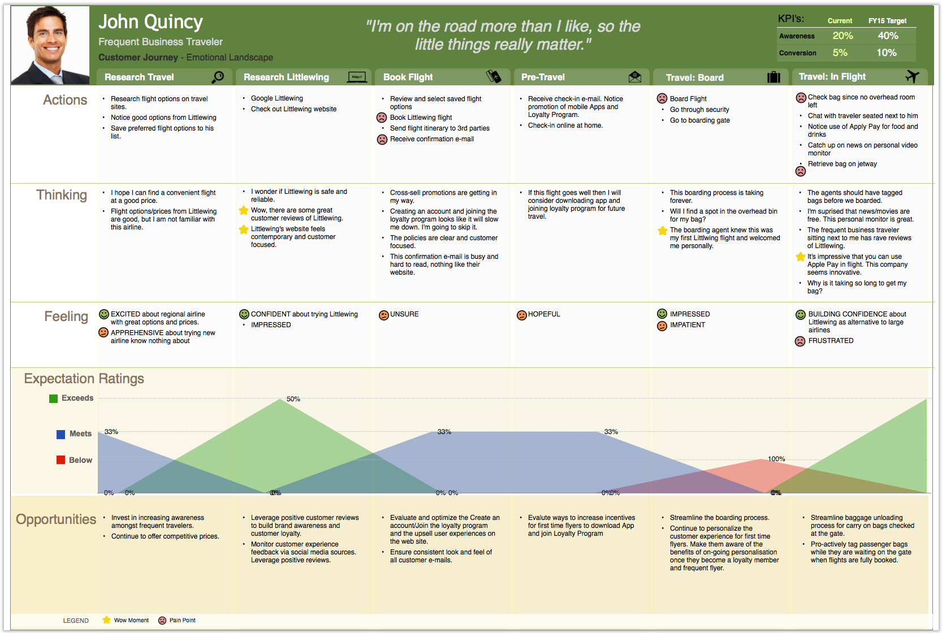
TOOL: PERSONA
FINANCIAL INNOVATION LAB | BOOTCAMP ONE

