Slide 1




PROTOTYPING TOOLS
HOW TO USE?
BOOTCAMP ONE | DAY THREE
HCD EXERCISE | PROTOTYPING
CONVERT IDEAS TO PROTOTYPES
Tool 1: Storyboards
Tool 2: Role Plays
1.
2.
3.
4.
Objective of Exercise
To bring ideas to life through quick representations that can help think through details. To create a testable asset for users to provide feedback on.
Tools
Storyboards, Role Plays, Wireframes, Physical Models
About ‘Storyboarding’
An end to end visualisation of a process or service with many parts. Inspired by film makers and comics, storyboards help see and react to the big picture before making a commitment to full production.
About ‘Wireframing’
Wireframing are basic sketches/mockups of website and mobile screens.
About ‘Role Plays’
Role plays are used to act out conversations and interactions between users and other people and objects.
About ‘Physical Models’
Physical representations of objects that form part of the solution, made usually with easily sourced materials.
Summary:
Summary:
Summary:
Summary:
5.
6.
7.
8.
Summary:
Summary:
Summary:
Summary:
1
1
End to End Journey / Service
Consider: If a storyboard is best used to represent the idea. Is the idea a process or service with many steps that need to be visualised?
Interactions
Consider: If a Role Play is best used to represent the idea. Is it an interaction or conversation between people that needs to be recreated?
2
The Steps / Frames
Break it down: Into the distinct stages/steps that you want to visualise. These steps could belong to a macro/high level journey or you may want to get into detail in one part. Each distinct step can be visualised and detailed as a frame.
2
The Setting & Roles
Break it down: The setting for the interaction and the key characters or roles that are playing a part.
3
Visualise
Draw it out: Draw the key frames out including people, interactions, conversations, messaging etc. out to summarise the end to end journey or service.
3
Script & Act
Play it out: The key steps, interactions, and conversations between people involved.
Not fine art
The visualisations on a storyboard do not need to be of a really high quality. They need to be functional and be able to communicate the essence of what is happening at each step.
*
FINANCIAL INNOVATION LAB | BOOTCAMP ONE
Notes:
Storyboards,
Wireframes,
Roles plays,
Paper Prototypes,
Prioritisation matrix (Desirable, Feasible, Viable)

Slide 2
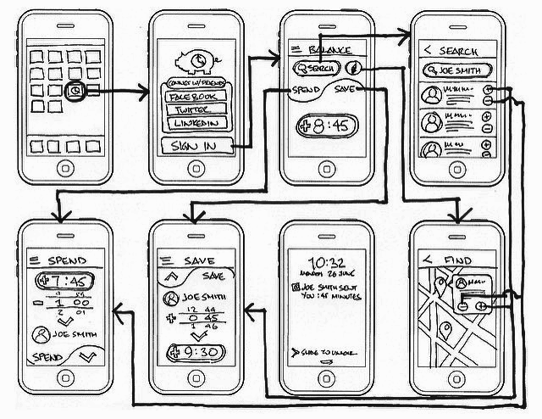

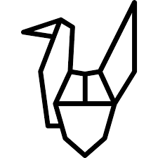

PROTOTYPING TOOLS
HOW TO USE?
HCD EXERCISE | PROTOTYPING
CONVERT IDEAS TO PROTOTYPES
Tool 3: Wireframes
Tool 4: Physical Models
1
Digital Interactions
Consider: If wireframes are the best way to represent the idea. Is it a digital product, screens or interaction that needs to be visualised?
1
Physical Objects
Consider: If physical objects are the best way to represent the idea. Is it a critical physical component (poster, form, machine, space etc.) of the service that needs to be modelled? Can the same job be done by a storyboard?
The Steps
Break it down: Into the distinct stages/steps that you want to visualise. These steps could belong to a macro/high level journey or you may want to get into detail in one part. Each distinct step can be visualised and detailed as a wireframe.
2
Form & Material
Choose: The form that the physical model needs to take. The level of construction that should be appropriate to communicate the concept to a fair degree of proximity. The material used to build the physical object in the simplest form.
2
3
Construct
Build: The physical object with the material available.
3
Visualise & Connect
Draw it out: Draw the key wireframes out including key interactive elements, messages, flows and connections between the screens.
Flows
App screens flow into each other. Therefore, it is important to establish connections between wireframe screens.
Physical Model Vs. Storyboard
There may be no need to build a physical model in case one is just trying to explain the journey. Storyboards should be enough for that. A physical model should be built for a part of the product or service experience of the user that a storyboard can’t quite do justice to. For example, physical models for a sign up form, or a physical booth, or a QR code poster - things that users will actually experience, can be made..
*
*
FINANCIAL INNOVATION LAB | BOOTCAMP ONE

Slide 3
BOOTCAMP ONE | DAY THREE
HCD EXERCISE | PROTOTYPING
CONVERT IDEAS TO PROTOTYPES
Notes
Session Flow
Sharing the Objective | 2 Min
Facilitators to share the objective of the session/exercise.
Walkthrough - Example | 10 Min
Facilitators to walk through 1-2 examples of the tool in use.
Walkthrough - ‘How To?’ | 10 Min
Facilitators to walk through the ‘How to?’ of the tool as per instructions on the toolsheet.
Clarifications | 8 Min
Facilitators to clarify doubts from participants.
Exercise | 45 Min
Participants to use tool with guidance from the facilitation team.
Discuss and Choose Prototype - 5 Min
Make Prototype - 40 Min
Points to Consider
The numbering provided in the How To? is a recommended path. Startups may still choose to fill the template as per their convenience.
The choice of prototype has to be such that it takes the idea a step further and makes it testable.
People often tend to create physical models to tell stories that storyboards can easily be used for - if the physical model is not adding value then just try and let it go.
Prototypes evolve through many rounds of iteration. The first prototypes are not expected to be high fidelity at all.
To try and explain an end to end journey, one can create multiple kinds of prototypes that can work together to explain the experience.
There is no perfect way or material to make prototypes. Try and make it happen with whatever material is easily accessible.
Tools
Storyboards, Role Plays, Wireframes, Physical Models
Material
Template, Chart Paper, Post-Its, Pens/ Sketch Pens
Time
75 Minutes
FINANCIAL INNOVATION LAB | BOOTCAMP ONE

Slide 4
PROTOTYPING TOOLS: STORYBOARD
1.
2.
3.
4.
Summary:
Summary:
Summary:
Summary:
5.
6.
7.
8.
Summary:
Summary:
Summary:
Summary:
FINANCIAL INNOVATION LAB | BOOTCAMP ONE

Slide 5
PROTOTYPING TOOLS: ROLE PLAY
Characters
The Setting
Props/Material
1.
2.
Key Steps
Actions / Interactions
Conversations
Characters Involved
3.
1.
4.
2.
5.
3.
4.
5.
FINANCIAL INNOVATION LAB | BOOTCAMP ONE

Slide 6
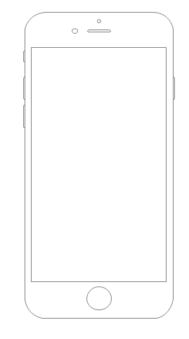
PROTOTYPING TOOLS: WIREFRAMES
FINANCIAL INNOVATION LAB | BOOTCAMP ONE

