Slide 1
Automation for GBS data processing?
Cecilia Deng, Bioinformatics, New Cultivar Innovation, PFR

Slide 2

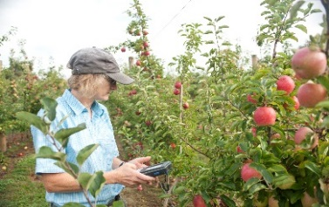

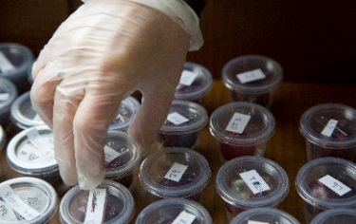
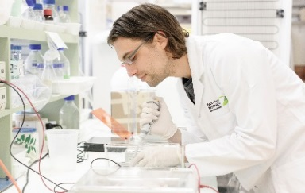
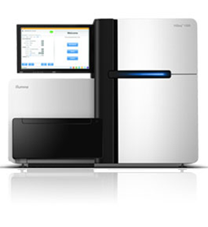
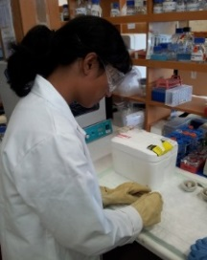
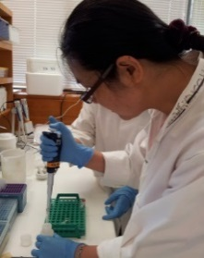
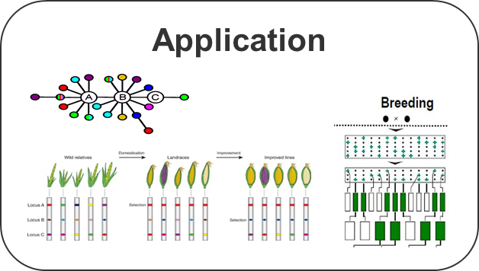
Genotyping-by-sequencing (GBS) in Breeding
Plant tracking
& phenotyping
Sample collection
gDNA extraction
Data analysing
Sequencing
Key file building
GBS lib preparation
Assess & Evolve
Result Sharing

Slide 3
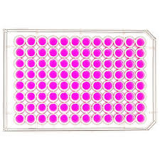
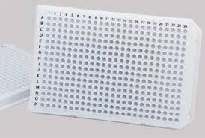
GBS Data Processing: Difficulties and Objectives
Data QC
De-multiplexing
Enzyme
Residue
Checking
Adapter Removal / Trimming
Mapping
Variant Calling
Filtering
Thousands of samples
Many analysis steps
Library construction and sequencing variations
96-well plate, 384-well plate
Same lot of barcodes (eg. 96x) re-used in multiple plates
Same plate being sequenced in multiple lanes
Same sample included in different plate
Same sample replicated in multiple cells with same or different barcode
Some plates sequenced in multiple lanes while the rest sequenced in single lane

Slide 4
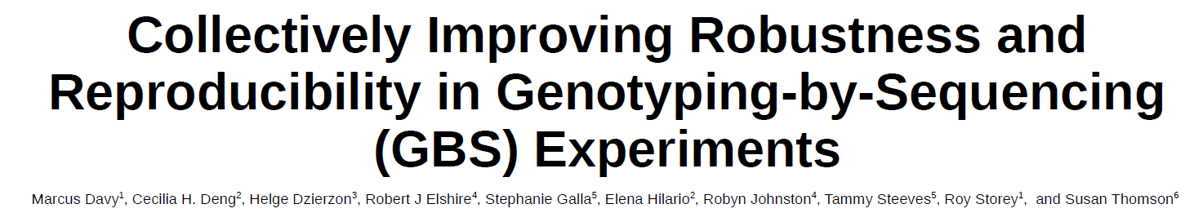
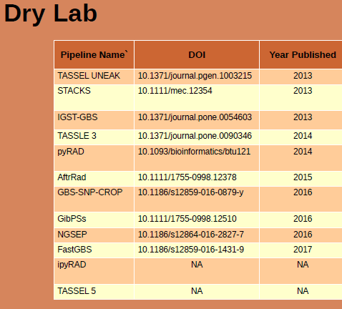
GBS Data Processing: Existing Pipelines
Not check enzyme(s) used
Hard-coded enzymes
Not deal with complicated experiment design
Not able to handle polyploid species
Many analysis steps
No efficient QC for steps in the workflow.

Slide 5

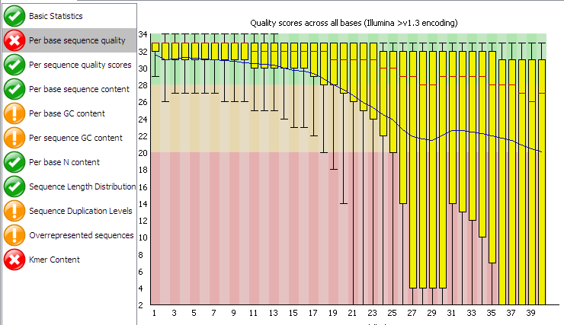
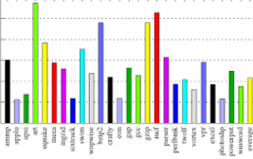
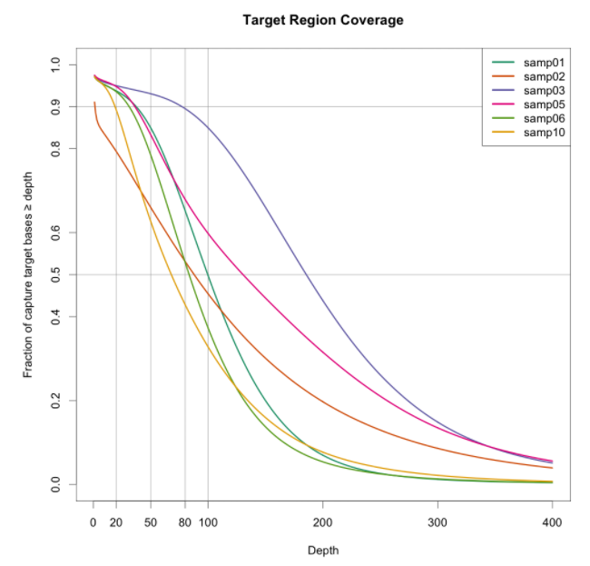
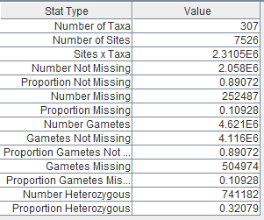
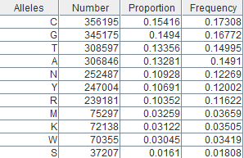
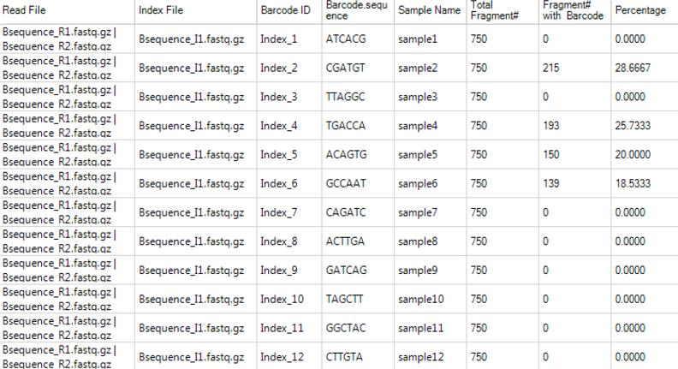
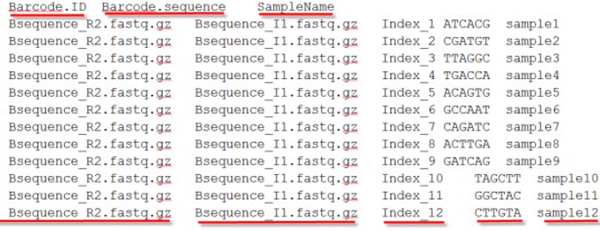
GBS Data Processing Automation: Usability
Configuration File(s)
Automatic or Semi-automatic GBS Data Analysis Pipeline
Data QC
De-multiplexing
Enzyme
Residue
Checking
Adapter Removal / Trimming
Mapping
Variant Calling
Filtering

Slide 6
GBS Data Processing Automation: Flexibility
Genomics Re-Sequencing Analysis Pipeline
Data QC
De-multiplexing
Enzyme
Residue
Checking
Adapter Removal / Trimming
Mapping
Variant Calling
Filtering

Slide 7
GBS Data Processing Automation: Flexibility
Metabarcode project
Data QC
De-multiplexing
Enzyme
Residue
Checking
Adapter Removal / Trimming
Mapping
Variant Calling
Filtering

Slide 8
GBS Data Processing Automation: Flexibility
Read Count
DEG Test
Total RNASeq Analysis Pipeline
Data QC
De-multiplexing
Enzyme
Residue
Checking
Adapter Removal / Trimming
Mapping
Variant Calling
Filtering

Slide 9

GBS Data Processing: Extensibility
Configuration File(s)
Automatic or Semi-automatic GBS Data Analysis Pipeline
Visualization
Phasing / Haplotyping
Genome Variations Database?

Slide 10
Aims
Minimizing human interaction
Standardizing the GBS analytical process
Standardizing result delivery
Increasing productivity
Expose the GBS pipeline to test driven development
More time for Bioinformatician to focus on interpretation our findings

Slide 11
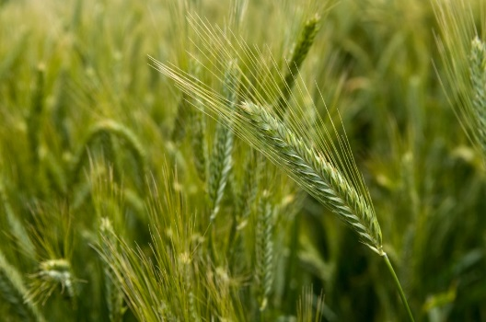
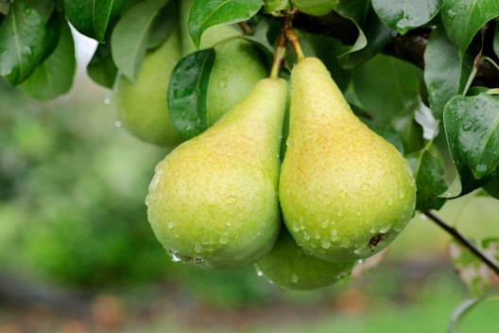

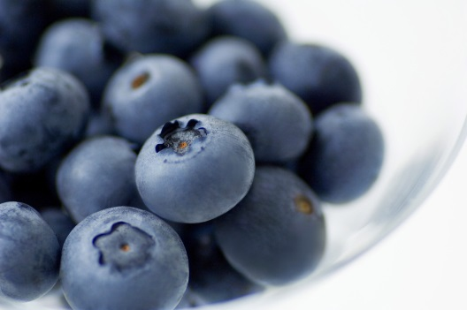
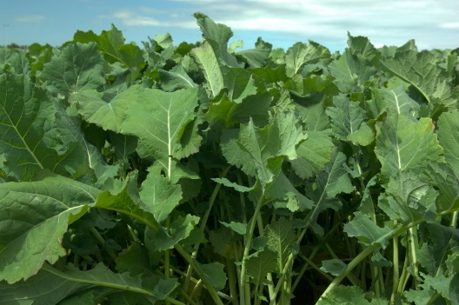
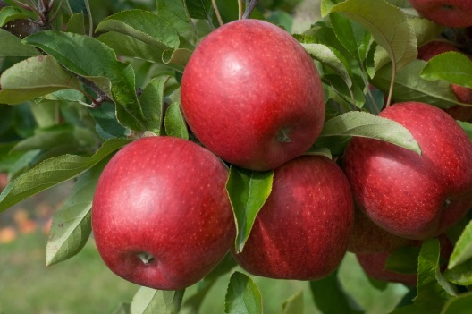
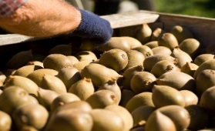
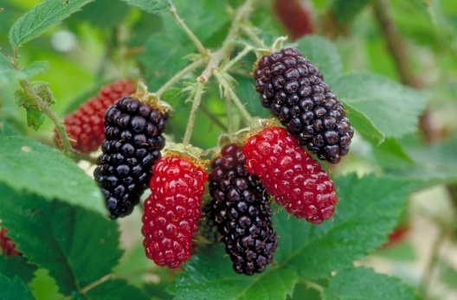
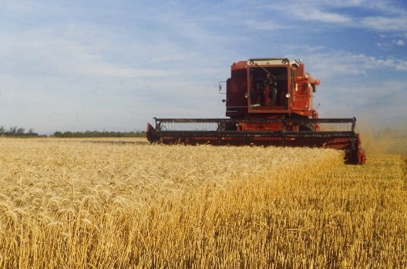
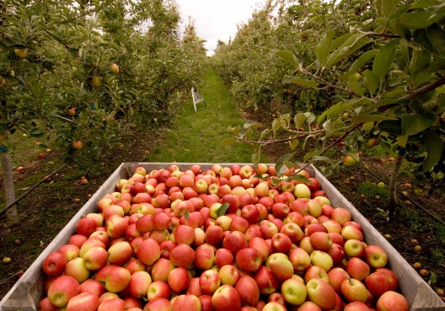

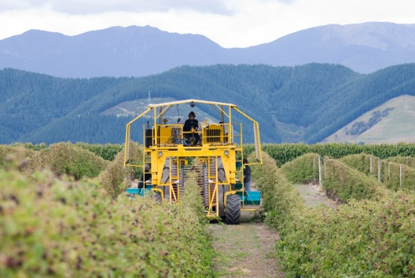
Thank you
Automation for NGS data analysis!

