Slide 1
Classifiers in Increasing Dimensions
Camille Porter

Slide 2
Data Generation
For this project, I generated 8 different datasets using the make classification function in scipy
I used 1 cluster per class, only informative features, non-repeated features, 3 different classes, and 200 samples
The clusters are drawn independently from N(0,1) and placed on the vertices of a hypercube.
The number of features increases from 3 to 1600.
Training data is 75% of the dataset

Slide 3
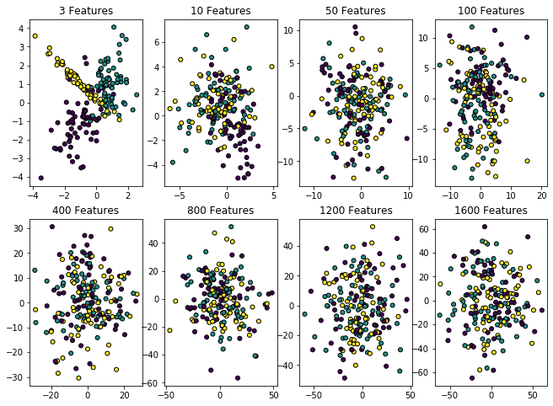
The axes for these plots are the first two features in the dataset. Colors are assigned by class.
It seems possible to visually separate the classes when the number of features is small, but as the number of features increases, it is difficult visually separate the classes.
As features are added, the dimensionality of the feature space grows and becomes more sparse

Slide 4
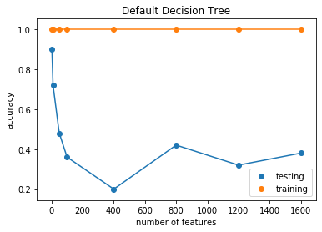
Decision Tree
The accuracy is good when the number of features is small
When the number of features is greater than the number of samples (150), the accuracy is very low
The models look very overfit. The training data has an almost perfect score, while the score of the testing data drops dramatically.
Perhaps restricting complexity will decrease the amount of over training

Slide 5
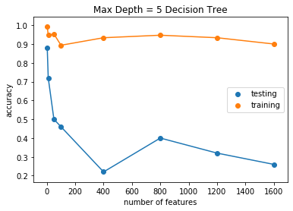
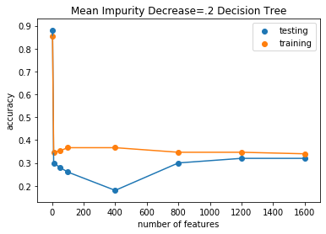
Decision Tree
Changing parameters that limit tree complexity (depth, mean impurity decrease) does not improve the accuracy.
Decision Tree does not generalize well and is prone to over-fitting, so it is not a good method for many dimensions.

Slide 6
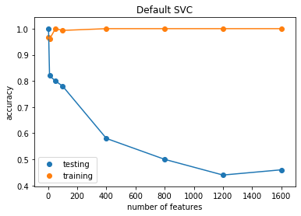
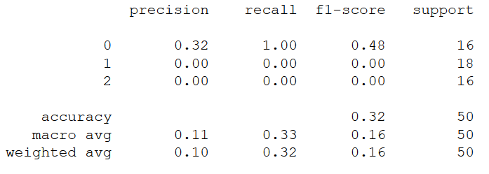
SVC
SVC is supposed to be resistant to overtraining, but it needs hyperparameter tuning.
The accuracy decreases as the number of features increases.
The 1200 and 1600 feature models are becoming baseline predictors, i.e. only predicting 1 class
This is the precision score for the 1600 feature model. The two worst performing models (1200 and 1600) are assigning all the samples to one class.
Perhaps we can improve this by tuning the parameters.

Slide 7
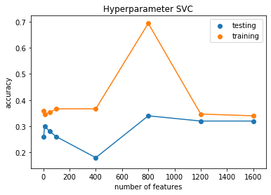
SVC
Each model has different optimal hyperparamters.
Even with optimizing hyperparameters, the two largest models only predict 1 class.
This is supposed to optimize the 1600 feature model ('C': 0.1, 'gamma': 0.0001, 'kernel': 'rbf’), but the accuracy for the model does not increase

Slide 8
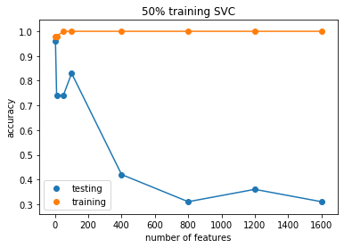
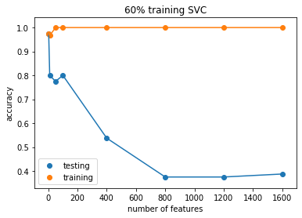
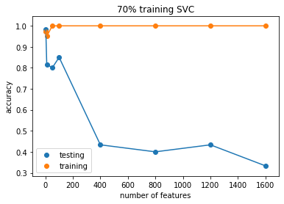
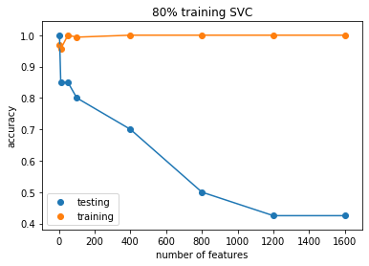
% Training Data
The accuracy is improved by including a larger number of samples in the dataset.
Even a small increase improves the accuracy.
50% - 100 samples
60% - 120 samples
70% - 140 samples
80% - 160 samples

Slide 9
Conclusions
Classifier accuracy decreases as the number of features increases. The models become over trained very quickly. It is not easy to fix.
The dataset becomes sparse as the number of features increases, and more training samples are needed
Including as many samples as possible should help. Using cross validation instead of accuracy should also help increase the amount of training data.
Genome studies often have millions of features and thousands of samples. They will have problems with this.

