Slide 1
Which job pays the most?
Lesson 1 · Ways of earning money
Year 10 · Financial mathematics
Notes:
Today we start a unit on money: how people earn it, how it grows, and what it costs to spend or borrow it. We start with one question.

Slide 2
Five jobs. Which one pays the most?
Vote with your hand up: A, B, C, D or E?
A
Café barista
B
Office assistant
C
Phone shop sales
$25 per hour
$58,500 p.a.
$400 per week + 5% commission on sales
D
T-shirt printer
E
Children's book author
$1.80 per shirt printed
10% royalty on every book sold
Notes:
These five job ads are made up for this lesson. Let's read them together. Point out any word you have not seen before, like p.a., commission or royalty. I will explain each one today. Now vote: hands up for A, B, C, D, E.

Slide 3
Can we actually tell which job pays the most?
Key question What would we need to know first?
Key question What would we need to do to compare the barista with the office assistant?
Think. Then tell the person next to you.
A $25 per hour
B $58,500 p.a.
C $400 per week + 5% commission on sales
D $1.80 per shirt printed
E 10% royalty on every book sold
Notes:
Expected: No, it depends. We need the barista's hours, how much the salesperson sells, how many shirts are printed and how many books are sold.
Expected: Find the barista's hours, then put both jobs over the same time, for example per week.

Slide 4
Where this unit goes
By the end of Lesson 3 you can answer "Which job pays the most?" properly
You are here
Lesson 1
Lesson 2
Lesson 3
Lessons 4–6
Lessons 7–9
Ways people are paid
Extra pay: overtime, weekends, public holidays
Weekly, monthly, yearly pay, tax and take-home pay
Earning interest on savings
Spending money and financial decisions
Notes:
This is the plan. Today: the different ways people are paid. Next lesson: extra pay for overtime, weekends and public holidays. Then weekly, monthly and yearly pay, tax and take-home pay. By the end of Lesson 3 you will be able to answer today's question properly.

Slide 5
Diagnostic quiz · 10 minutes
Open the quiz link on the class page
What the quiz checks
8 questions, on your own
Calculators allowed
Your result shows when you submit
Percentages
Multiplying and dividing money
Time and pay periods
The pay rule and timesheets
Notes:
Open the quiz link on the class page. Work on your own; calculators are allowed. You will see your result as soon as you submit.

Slide 6
Today
Learning intention We are learning to identify the different ways people are paid and to calculate earnings from a wage, commission, piecework and royalties.
Success criteria
I can describe the difference between a wage, a salary, commission, piecework and a royalty
I can calculate a wage from an hourly rate and the hours worked
I can calculate earnings from commission, piecework and royalties, and work backwards from total pay to find sales
Notes:
Here is what we are learning today, and how you will know you have it. We will come back to these three boxes at the end of the lesson.

Slide 7
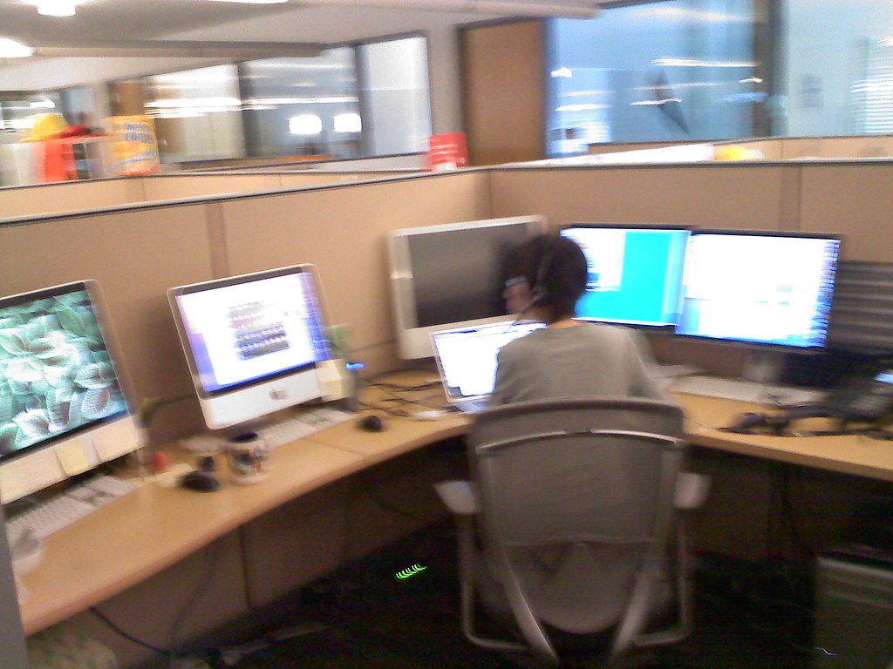
Wage or salary?
wage
salary
Pay worked out as hours worked × hourly rate
A set amount of pay for a year, paid in equal parts (for example weekly or monthly)
A. Café barista: $25 per hour
B. Office assistant: $58,500 p.a.
Key question Ella, the barista in ad A, works 20 hours this week at $25 per hour. What is her wage?
Key question If the office assistant works 5 extra hours this week, does their pay go up?
Notes:
Expected: $25 × 20 = $500.
Expected: Usually not. A salary is a set amount for the year, paid in equal parts, unless the contract says otherwise.
Start your vocabulary cards with wage and salary.

Slide 8
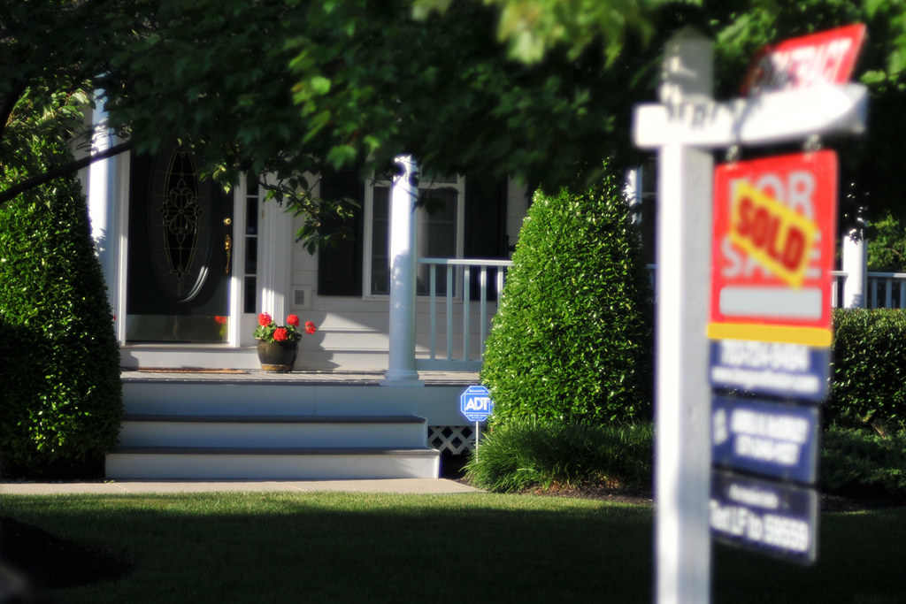
Worked example 1: commission
Jess sells phones. She is paid a retainer of $400 per week plus 5% commission on her sales. This week she sold $6,000 of phones. What is her pay?
Commission = 5% of $6,000
= 0.05 × $6,000 = $300
Total pay = $400 + $300 = $700
Key question Why do we write 5% as 0.05 and not 0.5?
Key question Is the 5% worked out on the $400 or on the $6,000?
Notes:
Watch every step. Commission is 5% of what she sells. 5% as a decimal is 0.05. 0.05 times 6000 is 300. Then add the retainer: 400 plus 300 is 700.
Expected: Per cent means out of 100, so 5% = 5 ÷ 100 = 0.05. 0.5 would be 50%.
Expected: On the $6,000. Commission is a percentage of what she sells, not of her retainer.

Slide 9
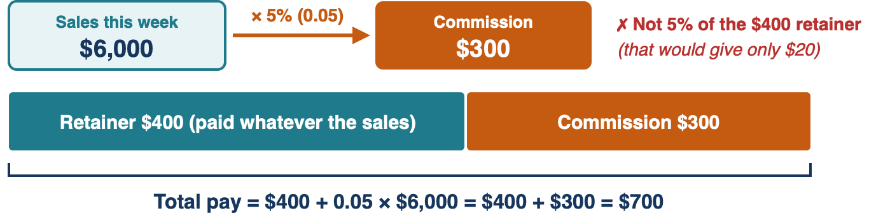
Where does the 5% come from?
Commission is worked out on the sales. The retainer is added afterwards.
Notes:
Look at the arrow. The 5% comes from the $6,000 of sales. The $400 retainer is paid whatever she sells, and it is added afterwards. 5% of the $400 would give only $20.

Slide 10
We do: your turn
Work it out in your book before we check
Jess sells $9,000 of phones next week. She still gets the $400 retainer plus 5% commission. What is her pay?
Notes:
Expected: 0.05 × $9,000 = $450. $400 + $450 = $850.

Slide 11
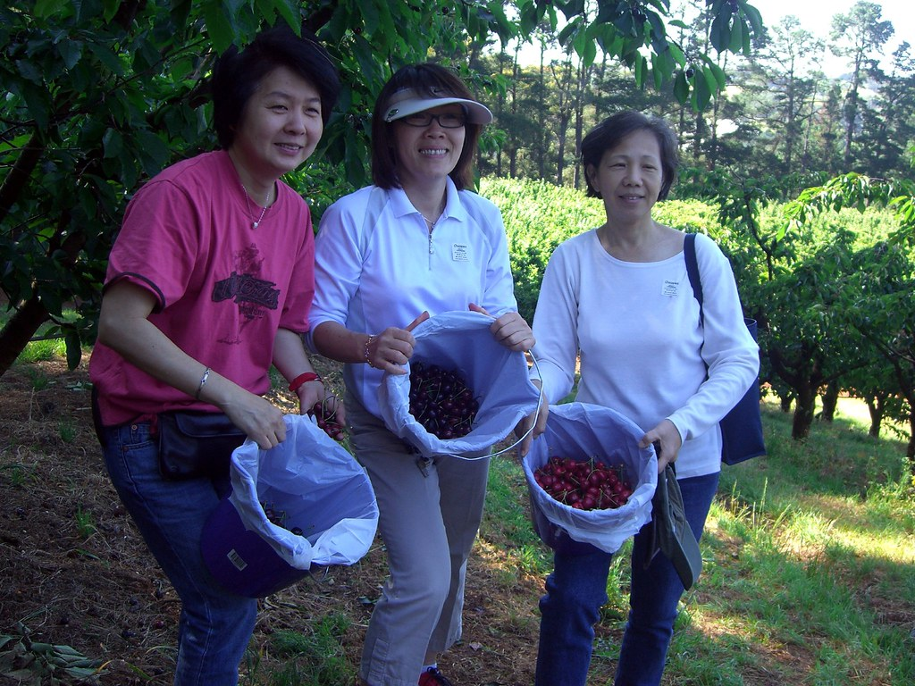
Worked example 2: piecework
Tom prints T-shirts and is paid $1.80 for each shirt. On Tuesday he printed 240 shirts. How much does he earn?
Pay = $1.80 × 240 = $432
Piecework: pay for each item produced or each task completed
Key question Is Tom paid for his time or for what he produces?
Notes:
Expected: For what he produces. The more shirts he prints, the more he earns. The photo shows fruit picking, which is often paid this way: so much per bucket.

Slide 12

Worked example 3: royalty
An author earns a 10% royalty on each book sold. The book sells for $25 and 3,000 copies are sold. How much does the author earn?
Royalty per book = 10% of $25
= 0.10 × $25 = $2.50
Total royalty = $2.50 × 3,000 = $7,500
Key question How is a royalty like commission?
Notes:
Expected: Both depend on sales. A royalty is paid to the person who created the work each time it is sold or used. It can be a percentage of the price, like this book, or a set amount each time, like a song being streamed.

Slide 13
You do
On your worksheet, on your own. Finished? Try the extension.
Q1 Leo works 15 hours at $23.50 per hour. What is his wage?
Q2 A car salesperson earns 3% commission. She sells a car for $28,000. How much commission does she earn?
Q3 A fruit picker is paid $3.20 for each bucket of fruit and picks 85 buckets. How much does she earn?
Q4 A musician earns a royalty of $0.004 each time her song is streamed. The song is streamed 250,000 times. How much does she earn?
Q5 Jess (from Worked example 1) earned $820 this week, made up of her $400 retainer plus 5% commission. What were her sales?
Extension An art centre sells a painting for $1,800 and keeps 25% commission. How much does the artist receive? Read the paragraph about art centres on your worksheet first.
Notes:
Work on your own. I will come round and check two things: that you change the percentage to a decimal, and that commission is worked out on the sales, not on the retainer. Use your vocabulary cards if you get stuck.

Slide 14
Back to the five jobs
Which way of being paid is each one?
A
Café barista
B
Office assistant
C
Phone shop sales
$25 per hour
$58,500 p.a.
$400 per week + 5% commission on sales
D
T-shirt printer
E
Children's book author
$1.80 per shirt printed
10% royalty on every book sold
Key question Which way of being paid would you choose for your first job, and why?
Notes:
Expected: A wage, B salary, C retainer plus commission, D piecework, E royalty.
Key question, any reasoned answer: a wage because the pay is the same each week; commission because good sales can earn more, though the pay changes; piecework because working faster earns more.

Slide 15
Exit ticket
Complete the exit ticket on your own.
Tick the success criteria you can now do.
For any you cannot tick, write the step that is still unclear.
Next lesson What happens to Ella's pay on a Sunday?
Notes:
Hand out the exit ticket and collect it before you leave. Next lesson: what happens to Ella's pay on a Sunday?

Slide 16
Image credits
wage: "Barista making coffee", rawpixel, CC0 1.0
salary: "Irene's office, across the asile [sic] from me" by wbaiv, CC BY-SA 2.0
commission: "House For Sale, Real Estate SOLD sign" by myguys.nova, CC BY 2.0
piecework: "Aunties Lay Leong, Susan and Julie with buckets of cherries" by avlxyz, CC BY-SA 2.0
royalty: "Books" by NeilGHamilton, CC BY 2.0
Job ads, names and figures are made up for this lesson.

