Slide 1

Android Event App
Front-End Team: - Aurora Gomez
- Jiwon Chae
Back-End Team: - Daniel Finn
- Gregory Aivaliotis

Slide 2
Group 7 Requirements

Slide 3
Group 4 Requirements

Slide 4
General Requirements
Use at least one design pattern
Use at least one AI based customer facing/development feature
App should be fully functional and running on the platform
Use versioning system (GitHub)
User SCURM board (Jira)

Slide 5
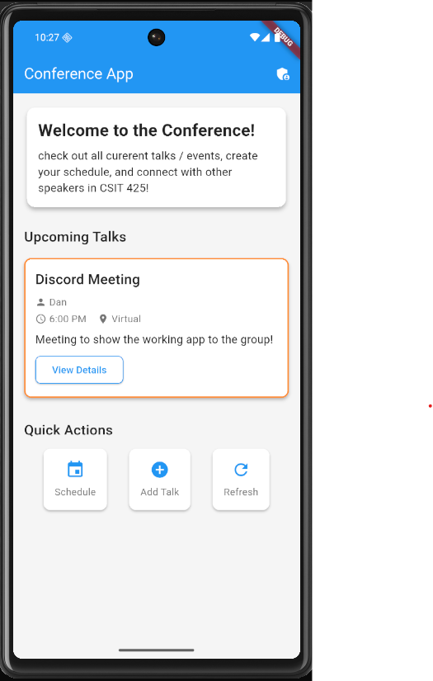
The Home Screen

Slide 6
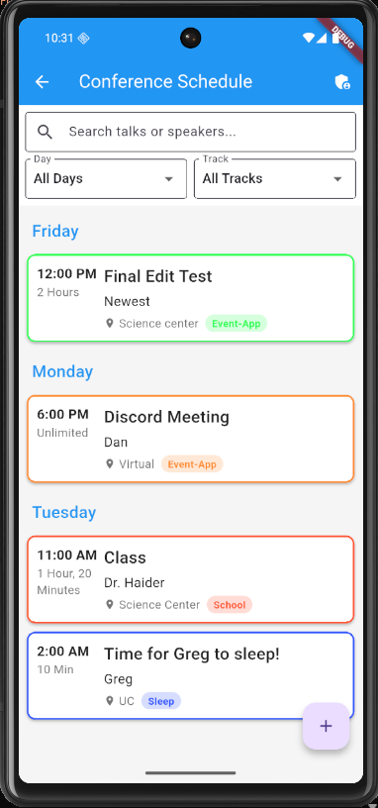

Slide 7
