Slide 1


England Storm Overflow API
COMP3011 Web Services and Web Data Coursework 1 Finn af Forselles

Slide 2
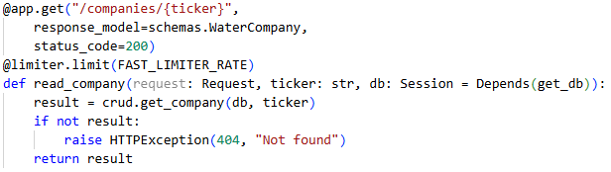




Pipeline
Request
Route
Database

Slide 3

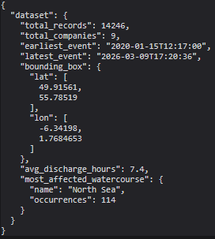

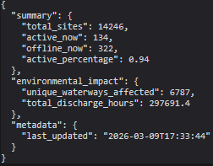

Key features
Geospatial filtering
Hashed API keys
Rate limiting
Statistical analysis

Slide 4
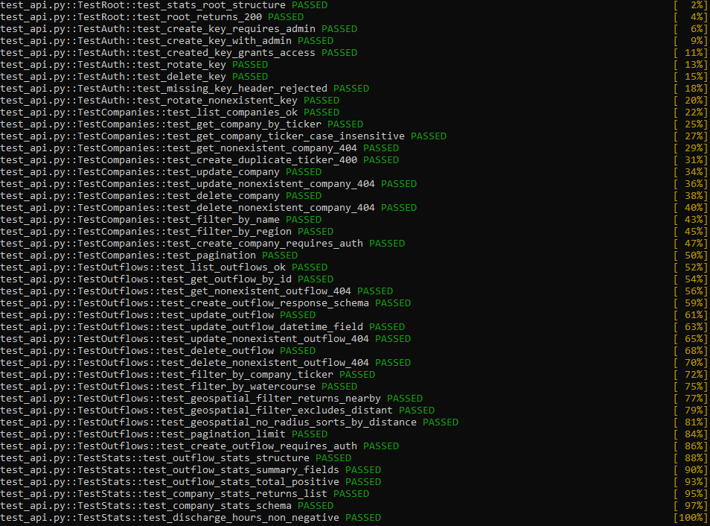

Testing

Slide 5
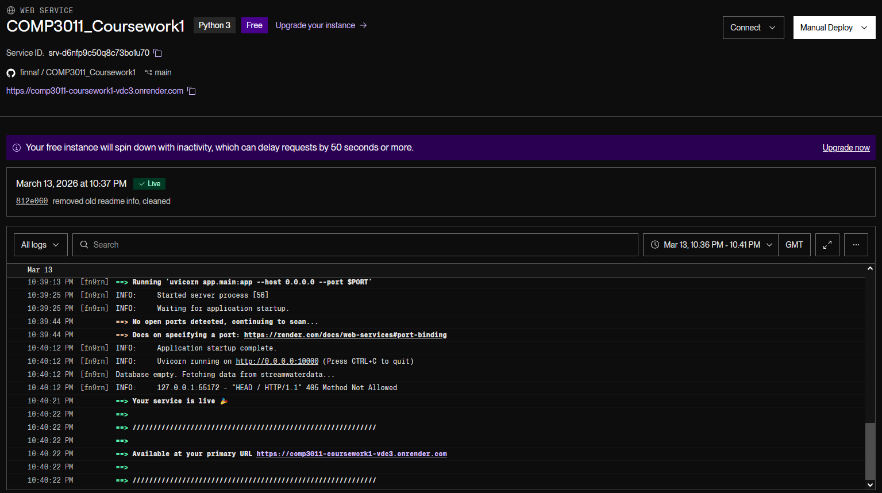
Deployment
https://comp3011-coursework1-vdc3.onrender.com/

Slide 6


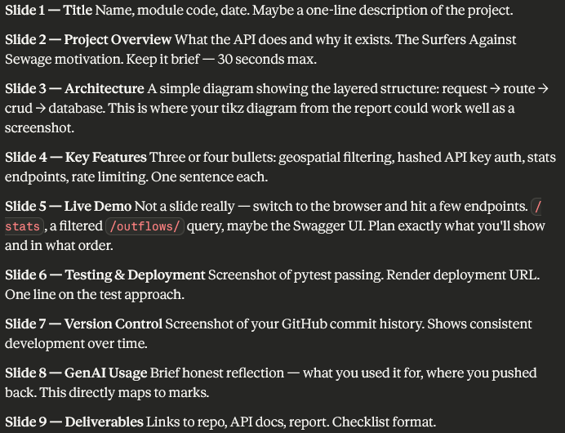
Generative AI
Used carefully throughout the project.
Even for this PowerPoint!
Importantly:
I learnt how to use new software.
I could do it even better next time.
It was a tool my brain used, not a new brain to get my degree for me.

Slide 7

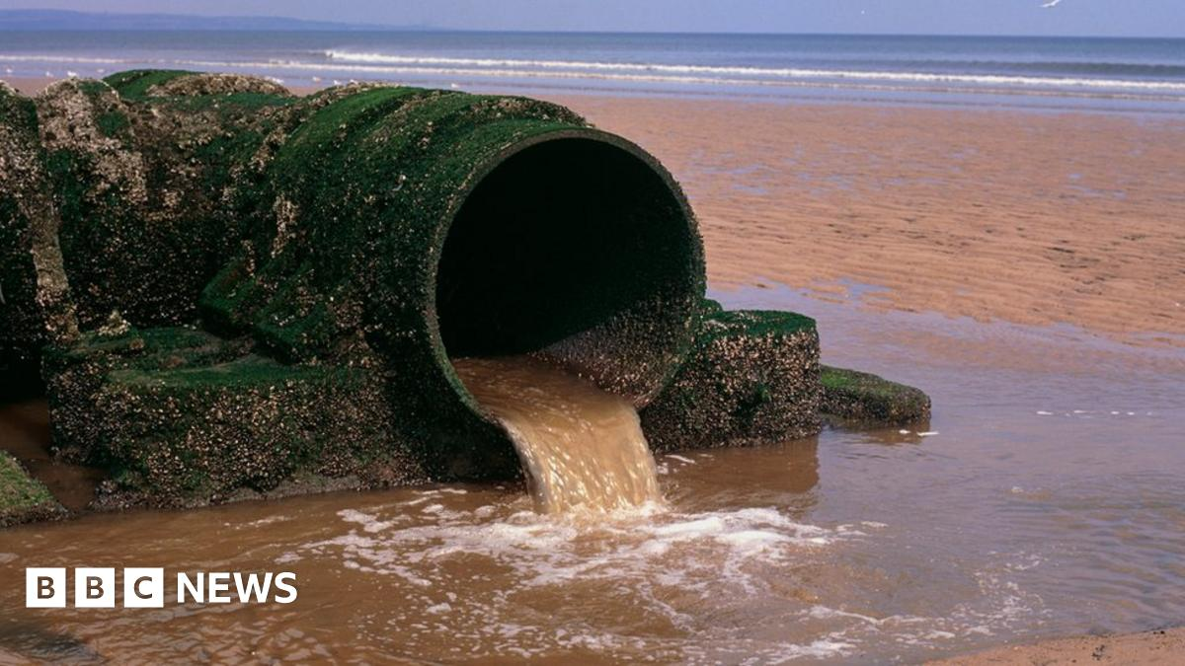
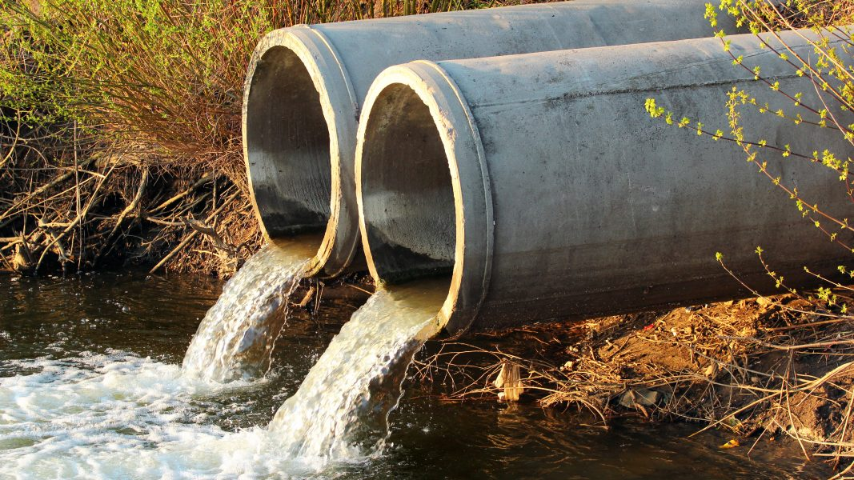
Links
https://github.com/finnaf/COMP3011_Coursework1
https://comp3011-coursework1-vdc3.onrender.com
https://www.streamwaterdata.co.uk/pages/storm-overflows-data
https://www.sas.org.uk/

