Slide 1

Event Maps

Slide 2
Problem
Companies have to print out confusing maps to hand to attendees at their events. Attendees would like to spend less time deciphering confusing maps and more time interacting with the tables at these events.
Navi-X seeks to provide an intuitive paperless solution to navigating such events.

Slide 3
Proposed Solution
Navi-X allows users to assert themselves as either an organizer, student/attendee, or company.
From the start page, they can search for an event and load its map to navigate tables of companies that are in attendance.
Organizers can use our platform from either a phone or our website to create maps for events.

Slide 4
Adaptability
Career Fairs
Conventions
Outdoor Festivals
Concerts
Trade Shows
Natural Disaster Relief Areas

Slide 5
General UI Features
Find events to attend
Download maps
Look up company info
Easily find companies with tables
  Logos on tables
Toggle between map and list view of companies attending event

Slide 6

Start Page

Slide 7

Events Page

Slide 8
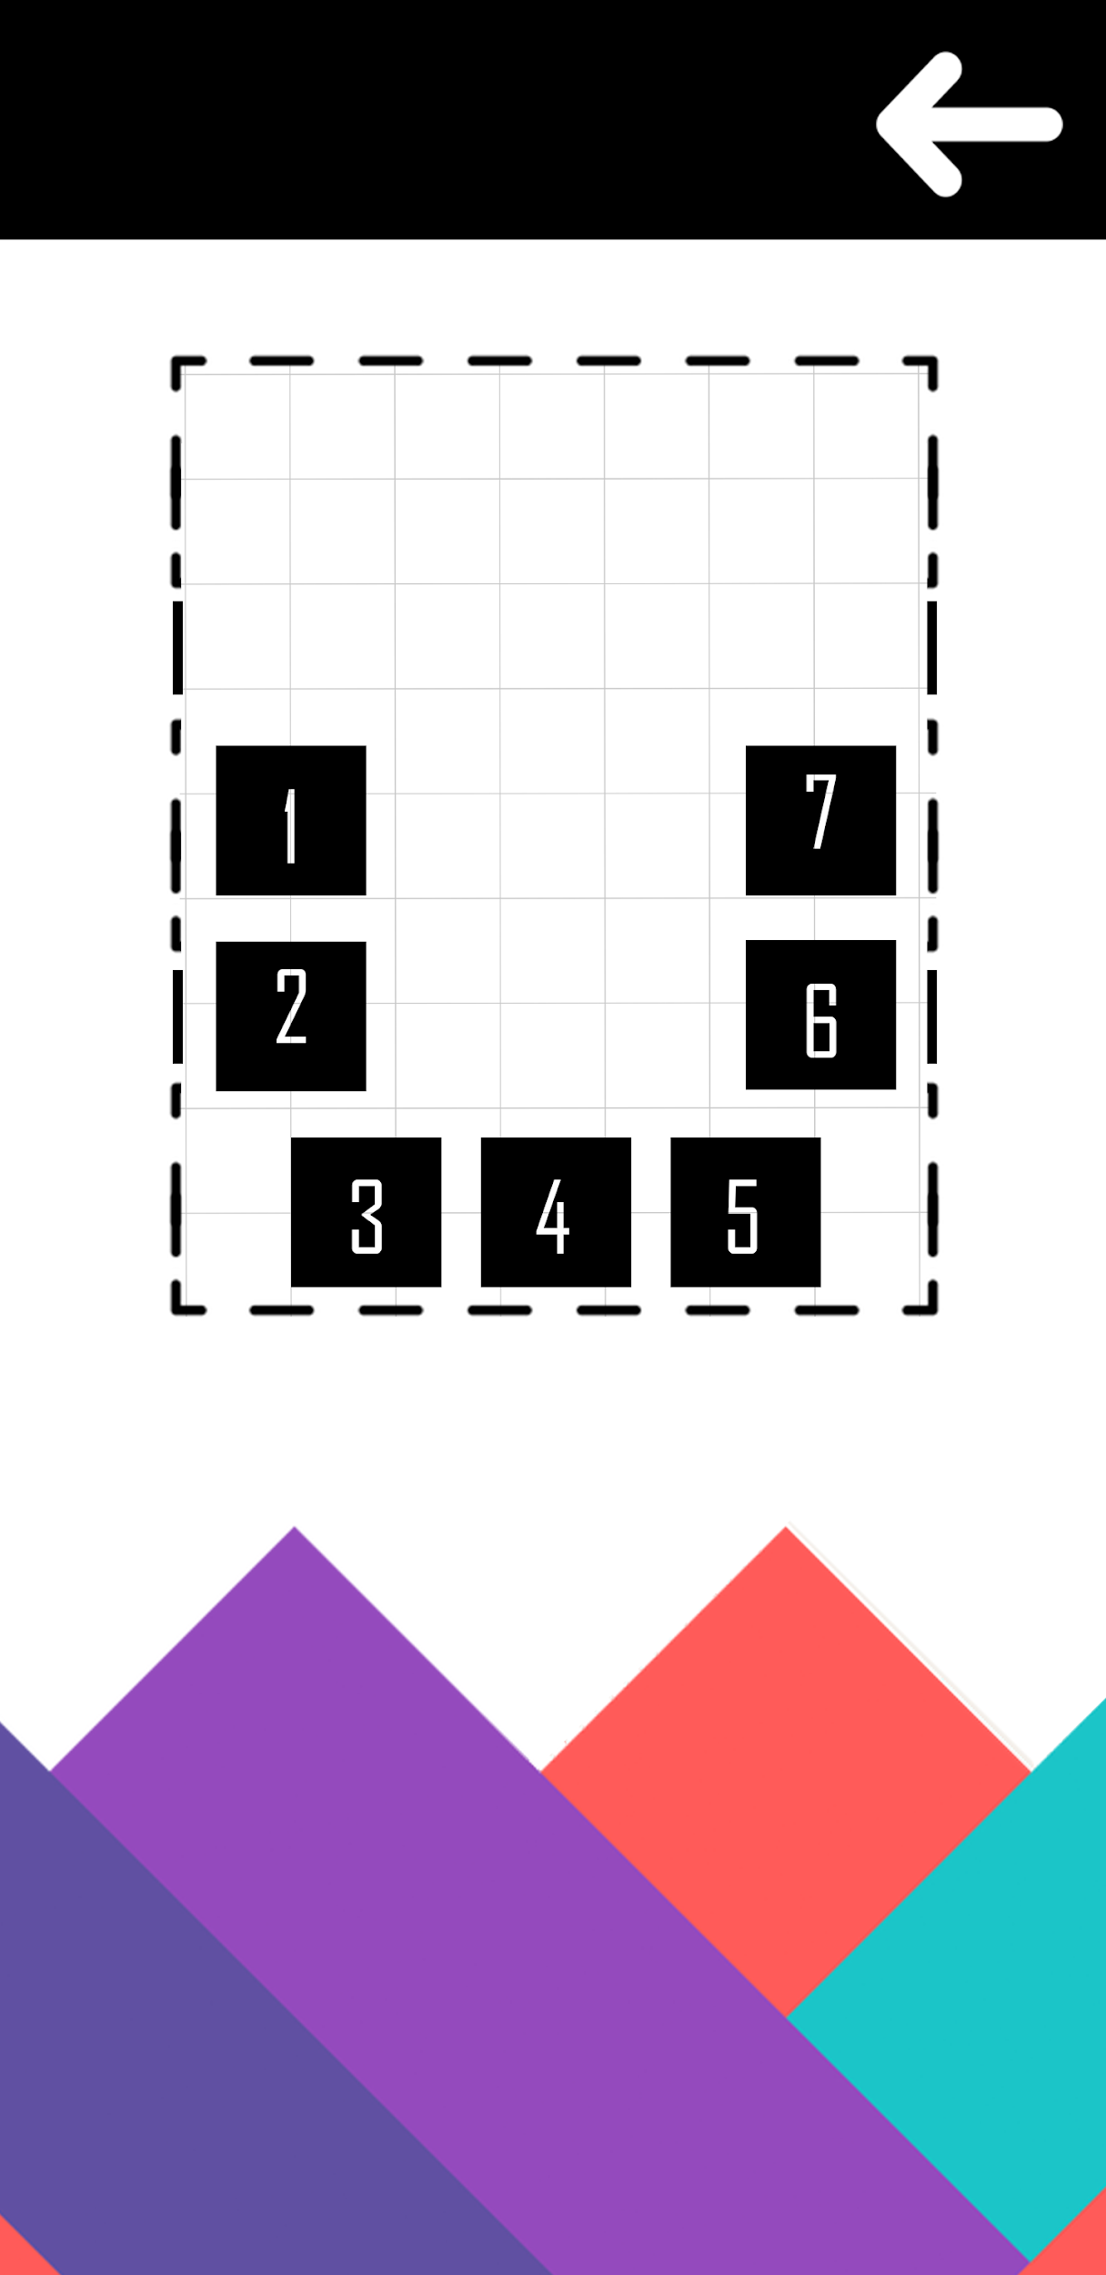
Map Navigation

Slide 9


Company Specific Pages

Slide 10
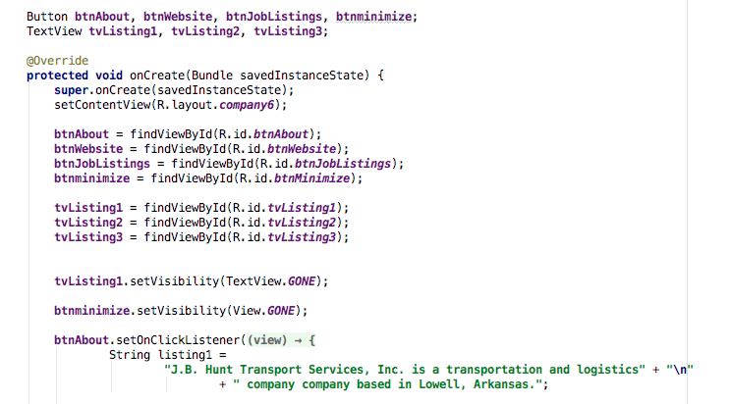
Driving Code

Slide 11
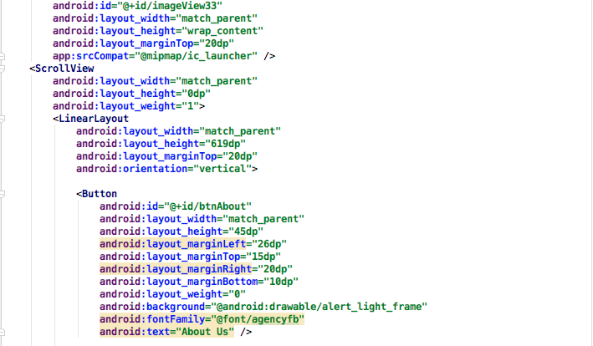
Graphics Code

Slide 12


Buttons

Slide 13
Bells and Whistles (Later Releases)
Real-time scheduling alerts for events happening at booths/tables
  Event starting soon and sudden changes
In-building walking directions from place to place with ETA
Attendee to company info sharing
  Brochures and coupons
Connect with LinkedIn

Slide 14
Concept: Organizer
Can edit on mobile or desktop
Invite and connect with companies
Create schedules for rotations
Create room layouts from existing template or draw custom
  Drag and drop, one-click arrays for table set up
Store and review future and previous events
Keep record of attendee count
Edit companies during current event in real time

Slide 15
Concept: Companies
Connect with attendees
Post job opportunities
Link to website
Request attendance to event
Display attendance to future events

Slide 16
Concept: Student
Look up events
Save events for future attendance
Send info to companies
Look up and filter job opportunities in app
Save companies for review

