Slide 1
Launch Strategy online video rental service
Data Analysis
Finn D. | Business Intelligence
Rockbuster steatlh

Slide 2
Status quo
Rockbuster Stealth as a movie rental company is currently facing stiff competition from new streaming services such as Netflix and Amazon Prime. To stay competitive the Rockbuster Stealth management team decided to leverage its existing film licenses and start an online video rental business. This presentation will give insights to the data to help with the launch of the new online video rental service.

Slide 3
Objective
ANSWERS
INSIGHTS
Provide data-driven answers to the posed business questions from the different departments
Deliver data-driven insights regarding the key topics for the upcoming launch of the new online video rental service
RECOMMENDATIONS
OVERVIEW
Present actionable recommendations for the upcoming launch of the new only video rental service
Give an overview of the current data situation of the needed data for this analysis the enable an optimal understanding of the findings

Slide 4

Key questions
revenue
Which movies contributed the most/least to revenue gain?
Product usage
What was the average rental duration for all videos?
customers
Which countries are Rockbuster customers based in?
Lifetime value
Where are customers with a high lifetime value based?
Sales
Do sales figures vary between geographic regions?

Slide 5
DATA OVERVIEW
DATA BASE
The data is stored in our local relational data base and contains information to all relevant business KPIs
LIMIT
The data only contains movies that were released in 2006
ACESS AND UPDATE
The data was accessed and last updated at 06/01/2022
LIMIT& SAMPLE
The data does not contain any sampled data

Slide 6
Top & Bad Sellers
Which movies contributed the most/least to revenue gain?
Top 10 movies by revenue
Rank | Movie | Rating | Genre | Revenue
1 | Telegraph Voyage | PG | Music | $215.75
2 | Zorro Ark | NC-17 | Comedy | $199.72
3 | Wife Turn | NC-17 | Documentary | $198.73
4 | Innocent Usual | PG-13 | Foreign | $191.74
5 | Hustler Party | NC-17 | Comedy | $190.78
6 | Saturday Lambs | G | Sports | $190.74
7 | Titans Jerk | PG | Sci-Fi | $186.73
8 | Harry Idaho | PG-13 | Drama | $177.73
9 | Torque Bound | G | Drama | $169.76
10 | Dogma Family | G | Animation | $168.72
Top 10 movies by revenue
Rank | Movie | Rating | Genre | Revenue
1 | Duffel Apocalypse | G | Documentary | $5.94
2 | Oklahoma Jumanji | PG | New | $5.94
3 | Texas Watch | NC-17 | Horror | $5.94
4 | Freedom Cleopatra | PG-13 | Comedy | $5.95
5 | Rebel Airport | G | Music | $6.93
6 | Young Language | G | Documentary | $6.93
7 | Cruelty Unforgiven | G | Classics | $6.94
8 | Treatment Jekyll | PG | Drama | $6.94
9 | Lights Deer | R | Classics | $7.93
10 | Japanese Run | G | Horror | $7.94

Slide 7
Current PRODUCT USAGE
What was the average rental duration for all videos?
Number of movies | Release Year | Language | Rating
1000 | 2006 | English | PG-13
 | Minimum | Maximum | Average
Rental Duration in days | 3 | 7 | 5
Rental Rate | $0.99 | $4.99 | $2.98
Movie Length | 46min | 185min | 115min
Replacement Cost | $9.99 | $29.99 | $19.99

Slide 8
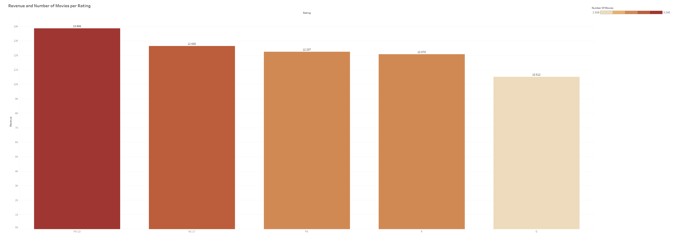
Revenue per RatinG
What was the average rental duration for all videos?

Slide 9
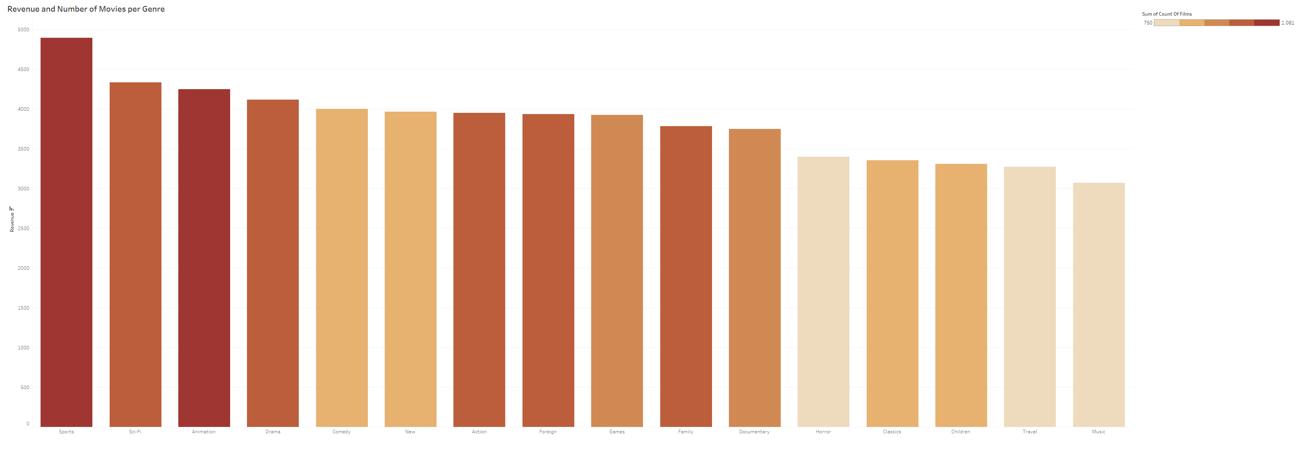
Revenue per Genre
What was the average rental duration for all videos?

Slide 10
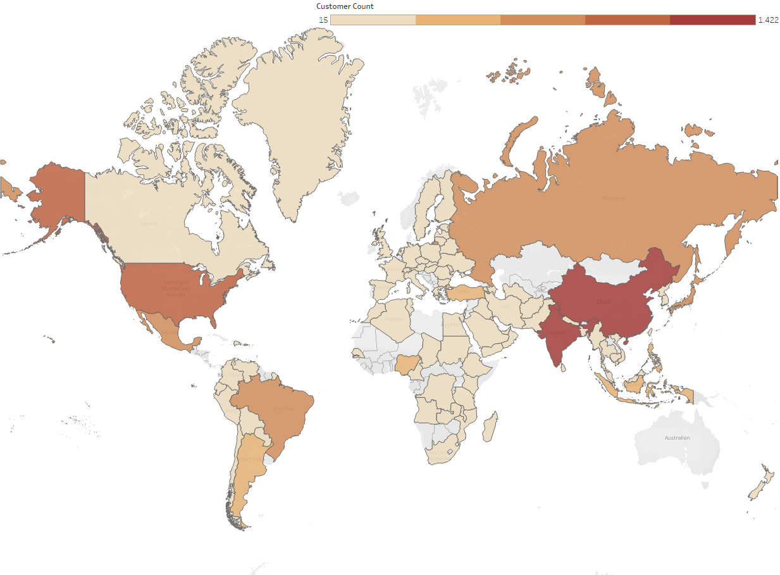
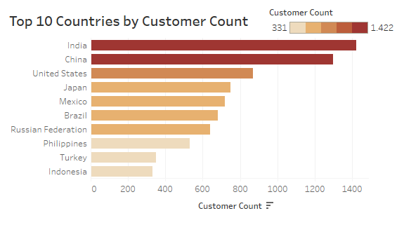
CUstomers
Which countries are Rockbuster customers based in?

Slide 11
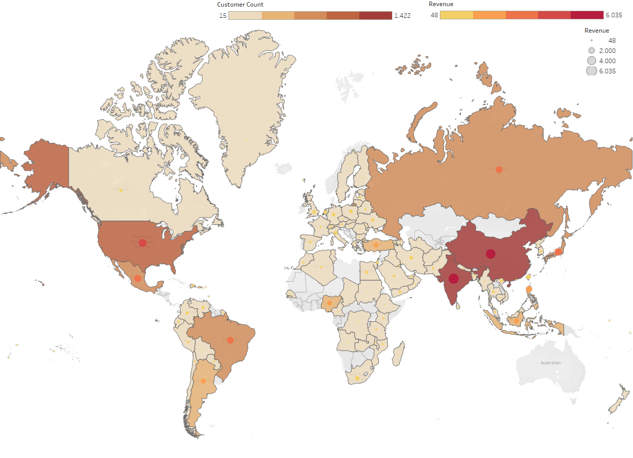
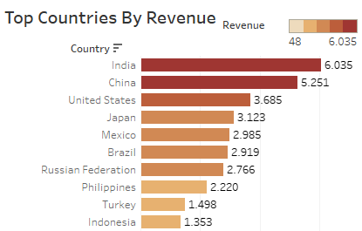
LIFetime value
Where are customers with a high lifetime value based?

Slide 12
Insights & Recommendations
REVENUE
CUSTOMERS
Average rental duration of 5 days
Most revenue gained from genre sports and PG-13
Least revenue gained from genre music and rating G
Top 3 countries by revenue: India, China, USA
Worldwide customer base
No customers in Australia
RECOMMENDATIONS
Focus
Start the streaming service in a mediocre performing country like turkey to test how well it‘s received by the customers, then expand to the other top countries descending in revenue
Movies from the genres with the best performance based on revenue like sports, sci-fi and animation and with PG-13 ratings should be prioritized, as they gain the most revenue

Slide 13
THANK YOU
Finn D.​
206-555-0146
finn@rockbusterstealthllc..com
www.rockbusterstealthllc.com

