Slide 1
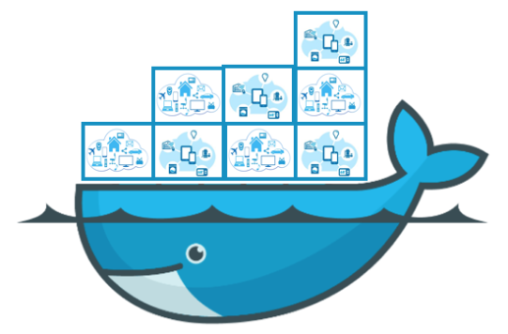
Docker

Slide 2
Agenda
What is Docker?
Docker vs. Virtual Machine
Run Platforms
Docker Engine
Hello-world
Images and Containers
Volume Mounting
Docker Use Cases

Slide 3
What is Docker?
Docker is an open-source project that automates the deployment of applications inside software containers, by providing an additional layer of abstraction and automation of operating system–level virtualization on Linux.

Slide 4
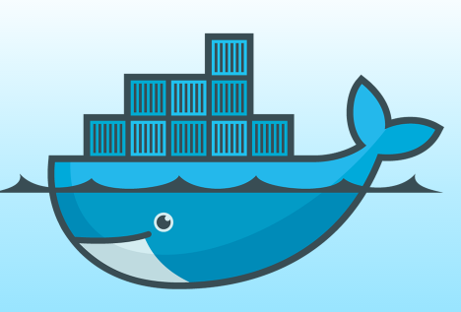
Docker
Provide a uniformed wrapper around a software package: «Build, Ship and Run Any App, Anywhere»
Similar to shipping containers: The container is always the same, regardless of the contents and thus fits on all trucks, cranes, ships, ...

Slide 5
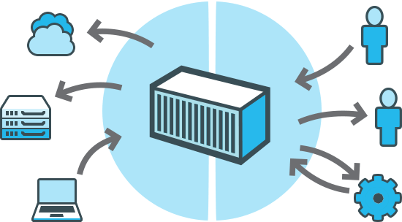
Docker
Build Once, Configure Once.
Deploy
Everything*
Everywhere*
Reliably & Consistently
Efficiently
Cheaply

Slide 6
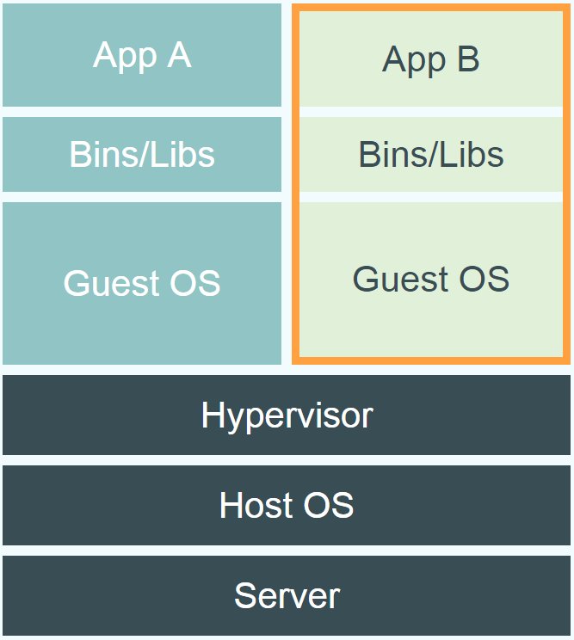
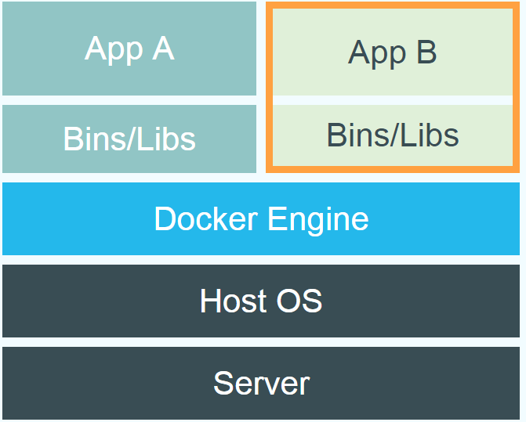
Docker vs. Virtual Machine
Notes:
Virtual Machines
Each virtualized application includes not only the application - which may be only 10s of MB - and the necessary binaries and libraries, but also an entire guest operating system - which may weigh 10s of GB.
Docker
The Docker Engine container comprises just the application and its dependencies. It runs as an isolated process in userspace on the host operating system, sharing the kernel with other containers. Thus, it enjoys the resource isolation and allocation benefits of VMs but is much more portable and efficient.
Docker provides base images that contain OS installations we can start from: The OS is not more than an application running on the Kernel...

Slide 7
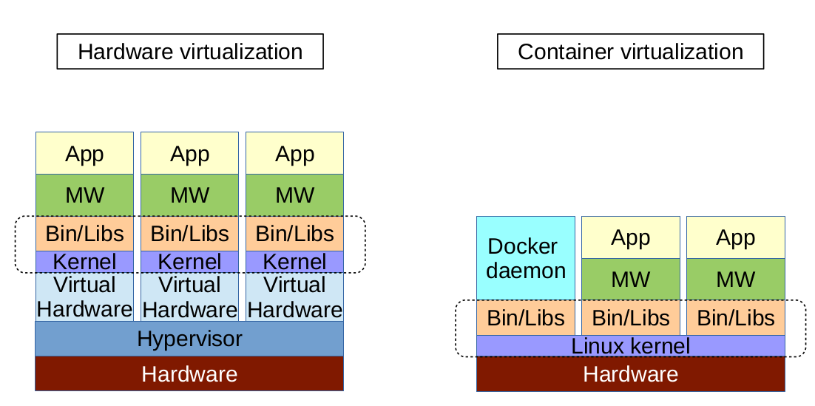
Docker vs. Virtual Machine
Notes:
Virtual Machines
Each virtualized application includes not only the application - which may be only 10s of MB - and the necessary binaries and libraries, but also an entire guest operating system - which may weigh 10s of GB.
Docker
The Docker Engine container comprises just the application and its dependencies. It runs as an isolated process in userspace on the host operating system, sharing the kernel with other containers. Thus, it enjoys the resource isolation and allocation benefits of VMs but is much more portable and efficient.
Docker provides base images that contain OS installations we can start from: The OS is not more than an application running on the Kernel...

Slide 8
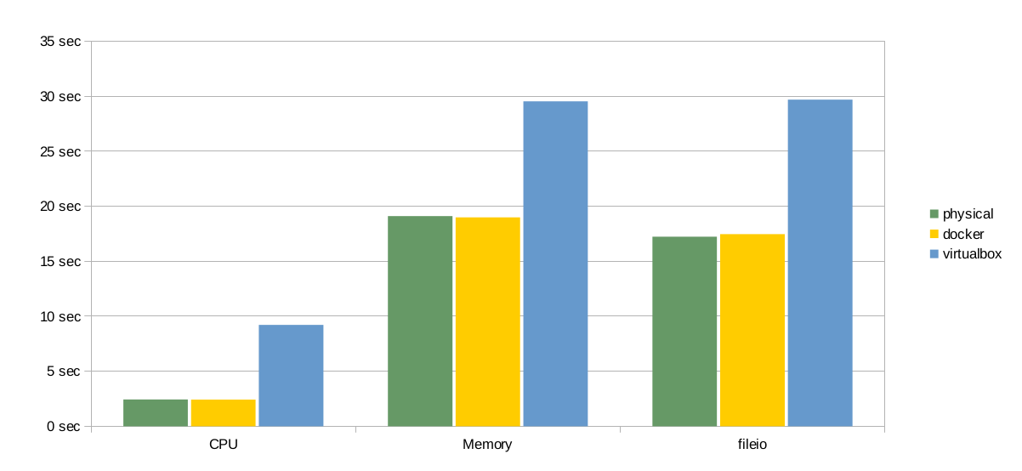
Docker vs. Virtual Machine
Notes:
Virtual Machines
Each virtualized application includes not only the application - which may be only 10s of MB - and the necessary binaries and libraries, but also an entire guest operating system - which may weigh 10s of GB.
Docker
The Docker Engine container comprises just the application and its dependencies. It runs as an isolated process in userspace on the host operating system, sharing the kernel with other containers. Thus, it enjoys the resource isolation and allocation benefits of VMs but is much more portable and efficient.
Docker provides base images that contain OS installations we can start from: The OS is not more than an application running on the Kernel...

Slide 9
Run Platforms
Various Linux distributions (Ubuntu, Fedora, RHEL, Centos, openSUSE, ...)
Cloud (Amazon EC2, Google Compute Engine, Rackspace)
2014-10: Microsoft announces plans to integrate Docker with next release of Windows Server
Notes:
Windows: http://www.zdnet.com/docker-cto-why-microsofts-docker-plans-for-windows-will-matter-to-you-7000035150/
"That's why the result of the Microsoft announcement will not allow a container that runs on Linux to run seamlessly on Windows or vice versa. But that's OK because in the context of distributed applications that's not what developers are asking for."

Slide 10
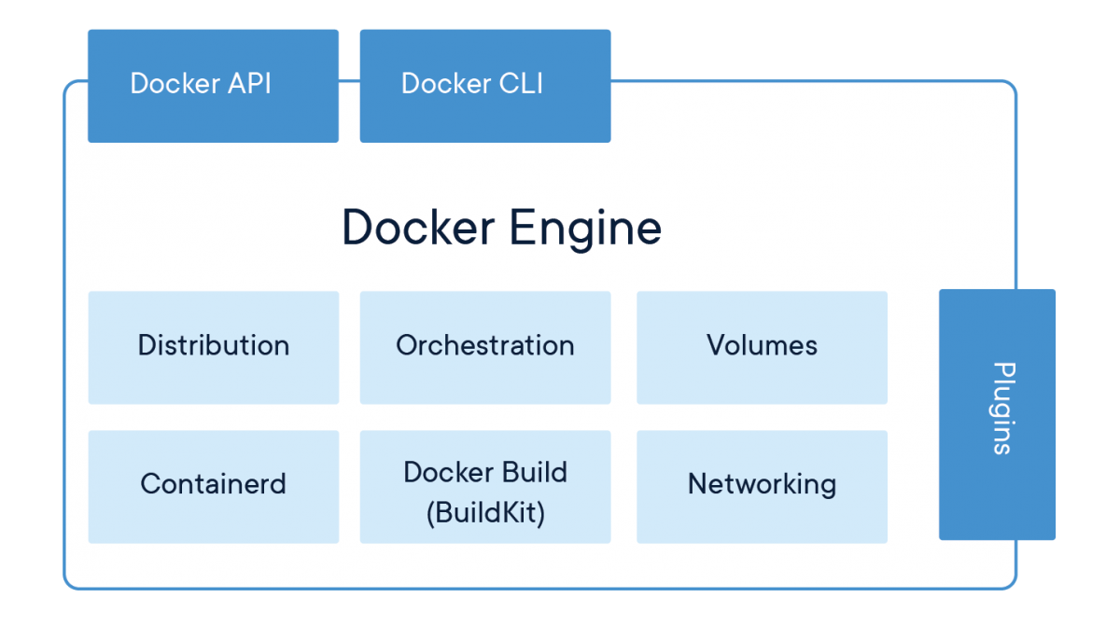
Docker Engine
Notes:
Docker Engine enables containerized applications to run anywhere consistently on any infrastructure, solving “dependency hell” for developers and operations teams, and eliminating the “it works on my laptop!” problem.

Slide 11
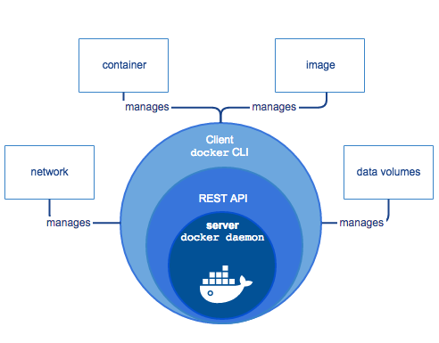
Docker Engine
Docker Engine is a client-server application with these major components:
A server which is a type of long-running program called a daemon process (the dockerd command).
A REST API which specifies interfaces that programs can use to talk to the daemon and instruct it what to do.
A command line interface (CLI) client (the docker command).
Notes:
https://docs.docker.com/engine/docker-overview/

Slide 12
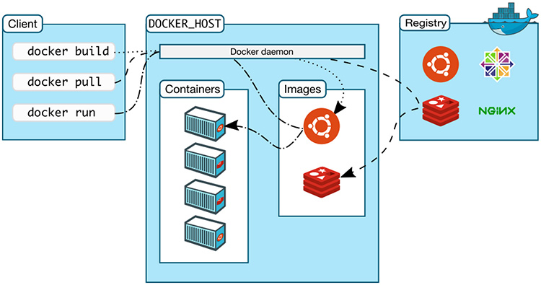
How the Client Talks to the Docker Host
The Docker client will honor the DOCKER_HOST env variable to set the -H flag for the client.
The Docker daemon can listen for Docker Engine API requests via three different types of Socket: unix, tcp, and fd.
a place to find and download Docker images
docker -H tcp://0.0.0.0:2375 ps
export DOCKER_HOST="tcp://0.0.0.0:2375"
docker ps
Notes:
# listen using the default unix socket, and on 2 specific IP addresses on this host.
$ sudo dockerd -H unix:///var/run/docker.sock -H tcp://192.168.59.106 -H tcp://10.10.10.2

Slide 13
Hello World (1/2)
Simple Command - Ad-Hoc Container
docker run hello-world
Notes:
Immediately exits
docker ps
docker ps –a
Re-attach: docker start –i stoic_wozniak
docker commit –m «message» containerId imageName(e.g. mytest/test1:1.0)
New Image
docker images

Slide 14
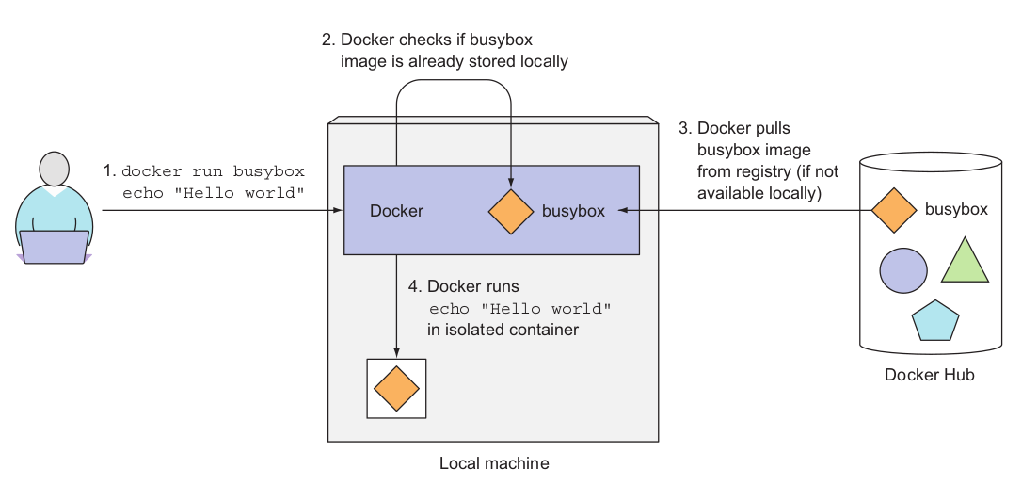
Hello World (2/2)
http://hub.docker.com

Slide 15
Terminology - Image
Persisted snapshot that can be run
images: List all local images
history <image>: view all the layers that make up the image
run: Create a container from an image and execute a command in it
tag: Tag an image
pull: Download image from repository
rmi: Delete a local image
This will also remove intermediate images if no longer used

Slide 16
Terminology - Container
Runnable instance of an image
ps: List all running containers
ps –a: List all containers (incl. stopped)
top: Display processes of a container
start: Start a stopped container
stop: Stop a running container
pause: Pause all processes within a container
rm: Delete a container
commit: Create an image from a container
Notes:
docker run --rm to remove container after termination

Slide 17
Image vs. Container
Base Image
ubuntu:latest
run
Container
cid1
base image
cmd → new state
New Image
iid1
commit
Container
cid1
run
Container
cid2
Container
cid3
Container
cid4

Slide 18
Dockerfile (1/2)
Create images automatically using a build script: «Dockerfile»
FROM node:7 ADD app.js /app.js ENTRYPOINT ["node", "app.js"]
Notes:
~: cat app.js
# starts up an HTTP server on port 8080
const http = require('http');
const os = require('os');
console.log("Kubia server starting...");
var handler = function(request, response) {
console.log("Received request from " + request.connection.remoteAddress);
response.writeHead(200);
response.end("You've hit " + os.hostname() + "\n");
};
var www = http.createServer(handler);
www.listen(8080);

Slide 19
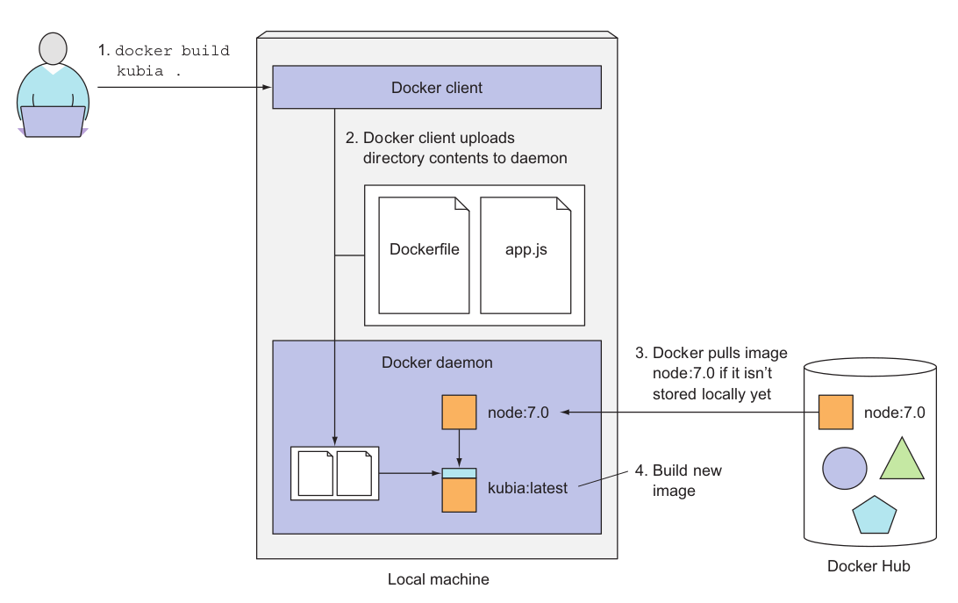
Dockerfile (1/2)
docker build -t myImage .
docker run --name myImage-container -p 8080:8080 -d myImage
curl localhost:8080

Slide 20
Mount Volumes
docker run –ti –v /hostLog:/log ubuntu
Run second container: Volume can be shared
docker run –ti --volumes-from firstContainerName ubuntu

Slide 21
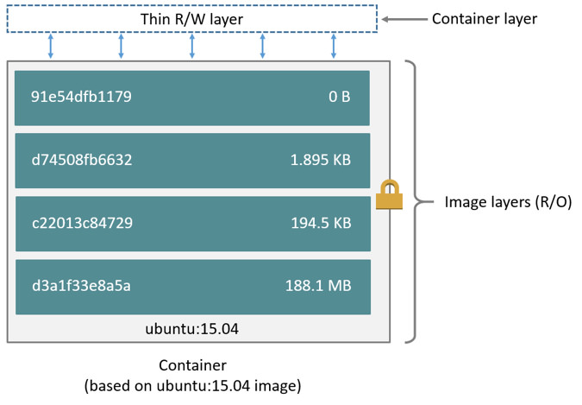
Images and layers
The major difference between a container and an image is the top writable layer

Slide 22
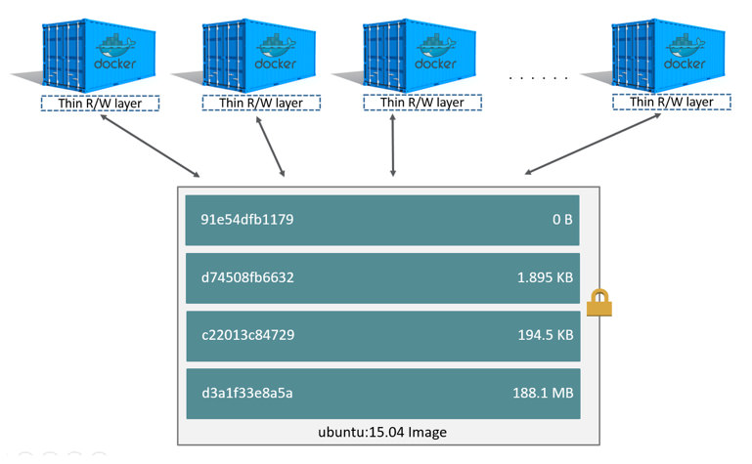
Container and layers
Multiple containers sharing the same Ubuntu 15.04 image

Slide 23
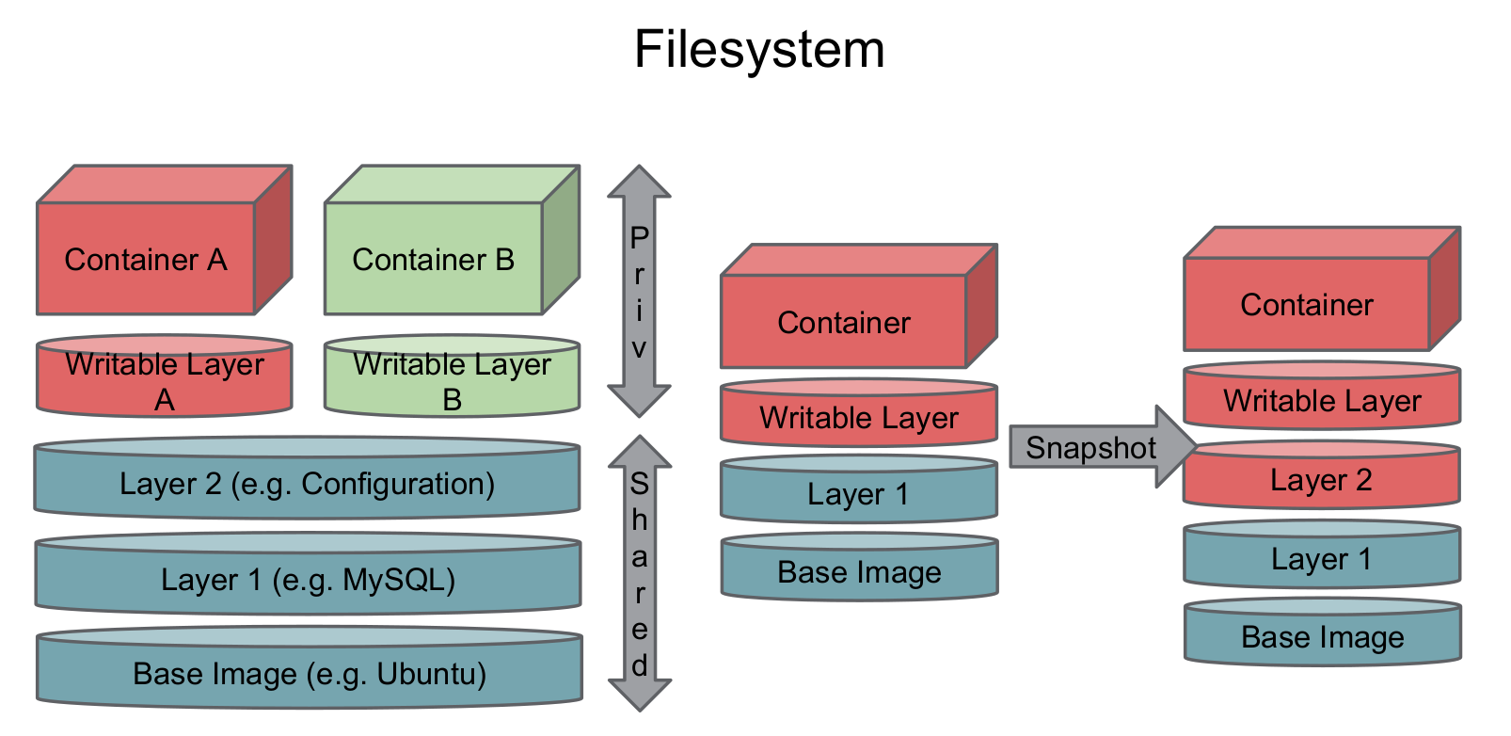
Filesystem
When we create a new container, we add a new & thin writable layer on top of the underlying stack of layers present in the base docker image.
All changes made to the running container, such as creating new files, modifying existing files or deleting files, are written to this thin writable container layer.

Slide 24
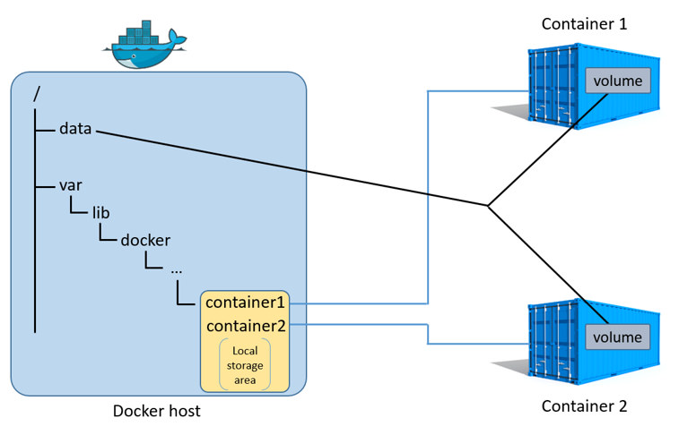
Data volumes
A data volume is a directory or file in the Docker host’s filesystem that is mounted directly into a container
Data volumes are not controlled by the storage driver. Reads and writes to data volumes bypass the storage driver and operate at native host speeds
You can mount any number of data volumes into a container. Multiple containers can also share one or more data volumes.

Slide 25
Docker Use Cases
Development Environment
Environments for Integration Tests
Quick evaluation of software
Microservices

Slide 26
Documentation
Docker homepage: https://www.docker.com/
Introduction: https://www.docker.com/whatisdocker/
Online tutorial: https://www.docker.com/tryit/
Installation and user guide: https://docs.docker.com/

