Slide 1
Master PostgreSQL Replication

Slide 2

Agenda
Introduction of the problem
Basics of aggregation / architecture components
Types of data aggregations
Aggregation system explained
„Poor man’s“ SQL Streaming
Examples of use cases / some facts about performance
Q&A

Slide 3
Write Ahead Log (WAL)
WALs are stored in pg_xlog, each file has default size of 16MB
wal_level set to hot_standby or replica for HA purpose
archive_mode = on (WAL archival), placeholder by setting archive_command = /bin/true (can be modified later)
checkpoint_segments, min_wal_size, max_wal_size, checkpoint_timeout = complex set based on performance of system disk.
max_wal_senders
wal_keep_segments = 3 * checkpoint_segments
Notes:
Fraudsters are working fast, we have to be faster.

Slide 4
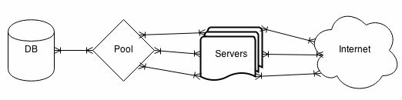
pgBouncer/pgPool
A connection pool in front of the database, hundreds of PostgreSQL server processes are reduced to dozens.
A database pool works by recycling database connections as soon as the client completes its current transaction or when its database work is complete.
Instead of hundreds of mostly idle database connections, we maintain a specific set of highly active connections.
pgbouncer database on port 6432 of the PostgreSQL server as the postgres user.
listen_addr monitor all IP addresses assigned to this server.
auth_type = md5 encrypted passwords
max_client_conn restricts PgBouncer clients.
default_pool_size and reserve_pool_size per-user and per-database.
Notes:
Fraudsters are working fast, we have to be faster.

Slide 5
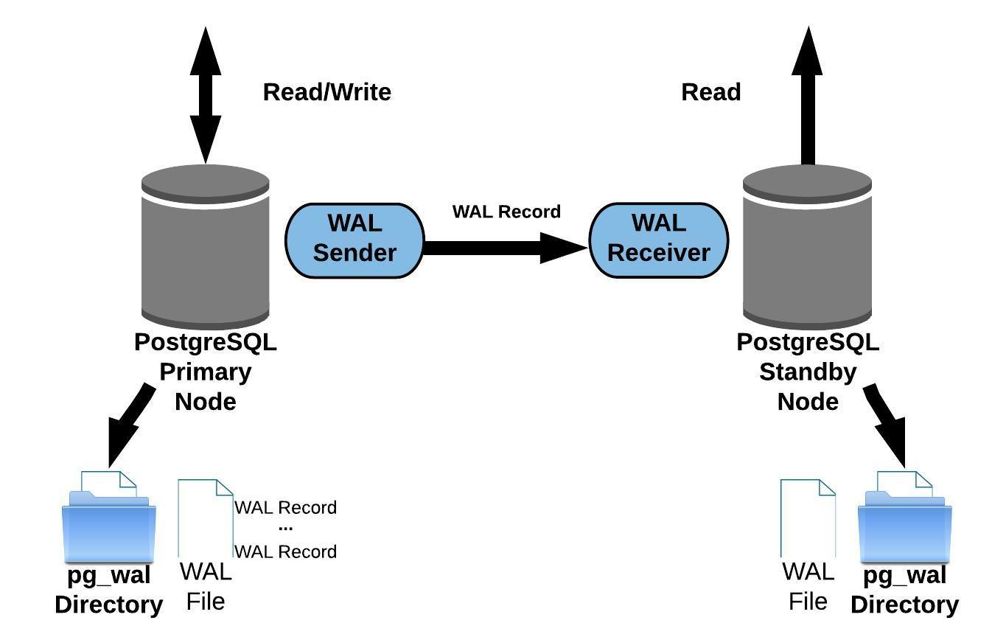
Replication
PostgreSQL file-based log shipping

Slide 6
Replication
PostgreSQL Streaming replication

Slide 7
Plain SQL vs aggregated data
SELECT
c.IP,
COUNT(1) as aggr_count,
SUM(c.call_price) as aggr_price,
SUM(c.call_duration) as aggr_duration,
MIN(c.call_start) as ev_time_first,
MAX(c.call_start) as ev_time_last,
COUNT(DISTINCT c.username) as aggr_users_count,
COUNT(b.username) as aggr_users_block_count
FROM calls c
LEFT JOIN blocked_users b
ON c.username = b.username
WHERE c.IP = ’10.166.205.32’
GROUP BY 1;
SELECT *
FROM aggr_ip_calls
WHERE aggr_object = ‘10.166.205.32’;
VS
Notes:
Fraudsters are working fast, we have to be faster.

Slide 8
Basics of PostgreSQL based architecture
Sharded PostgreSQL architecture
pl/proxy language for RPC calls
pgq for queueing
Python for scripting
Algorithm scalability
Shard 1
Shard 2
½ Data
½ Data
Notes:
Fraudsters are working fast, we have to be faster.

Slide 9
Basics of queueing (pgq component)
Insert
EVENT QUEUE
Event type (ins/upd/del)
Event data
PostgreSQL
Script
Update
Select
Delete
Notes:
Fraudsters are working fast, we have to be faster.

