Slide 1
Design Patterns
Template Method
Strategy

Slide 2
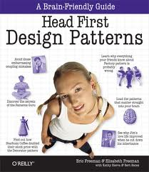
taken from
Head First Design Patterns

Slide 3
(some) Design Principals
Identify the aspects of your application that vary and separate them from what stays the same (page 9)
Program to an interface, not an implementation (page 11)

Slide 4
Template Method
Used to encapsulate algorithms
Example recipe-like (tea & coffe)

Slide 5
from page 276
Method for preparing Coffee (a recipe):
  1) boil water
  2) brew coffee in boiling water
  3) pour coffee in cup
  4) add sugar and milk

Slide 6
Method for preparing Tea (a recipe):
  1) boil water
  2) Steep tea in boiling water
  3) pour tea in cup
  4) add lemon

Slide 7
what does both methods have in common?
Method for preparing a drink (a recipe)
  1) boil water
  2) brew * different per drink
  3) pourInCup
  4) add condiments * different per drink

Slide 8
let’s code

Slide 9
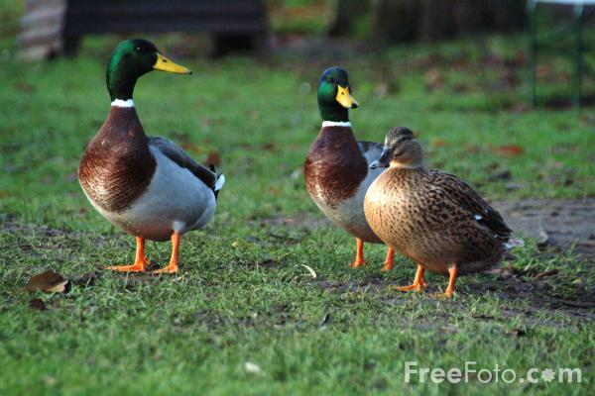
Strategy
Our example

Slide 10
A possible Duck architecture:
class Duck
swim() // same for all ducks, right?
quack() // all ducks quack, right?
display() // subclasses will have to override

Slide 11
class Mallard extends Duck
@Override
display() // "I'm a cute Mallard“
class ParkDuck extends Duck
@Override
display() // "I'm a happy park duck"

Slide 12
BUT say you want to add behaviour to Duck .. like fly()
We must implement fly() in the superclass and all subclasses will get it
Now we want a RubberDuck (his name is Declan)
This is problematic, Declan cannot fly or quack.

Slide 13
New Duck class with fly()
class Duck
fly() // all ducks fly, right?
swim() // same for all ducks, right?
quack() // all ducks quack, right?
display() // subclasses will have to override

Slide 14
class RubberDuck extends Duck
@Override
quack() // to say squeak
@Override
fly() // do nothing
@Override
display() // "Hi, my name is Declan!"

Slide 15
And now business wants…..
wooden decoy ducks

Slide 16
class WoodenDecoyDuck extends Duck
@Override
quack() // do nothing
@Override
fly() // do nothing
@Override
display() // "Please don't shoot!"

Slide 17
let’s code

