Slide 1
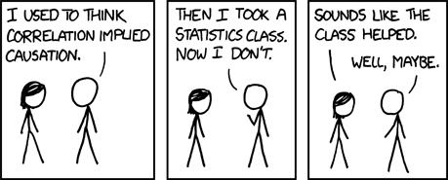
When is Correlation Causation?
Image Source: http://xkcd.com/552/
Notes:
Correlation does not imply causation - True and important. Please don't leave this talk with the notion that correlation is causality.
But if you are trained in classical statistics, you may believe correlation can tell us NOTHING about causality. This is less true. Its more complicated than that.

Slide 2

When is Correlation Causation?
Image source: www.tylervigen.com/
Notes:
When you think correlation is not causation you might have one of two possible pitfalls in mind.
1) The issue is that a unobserved (or latent variable) is causing both of the variables you are considering. The relationship is predictive. Collecting additional data does not help.
2) The issue is one of two many variables relative to the size of the data set. Some variables will be found to be similar by chance. This relationship would not be predictive. More data would help
I'm not considering the 2nd point in this talk. For the remainder of the talk, I assume that I have enough data that I can correctly infer (at a minimum) which variables are genuinely correlated.

Slide 3
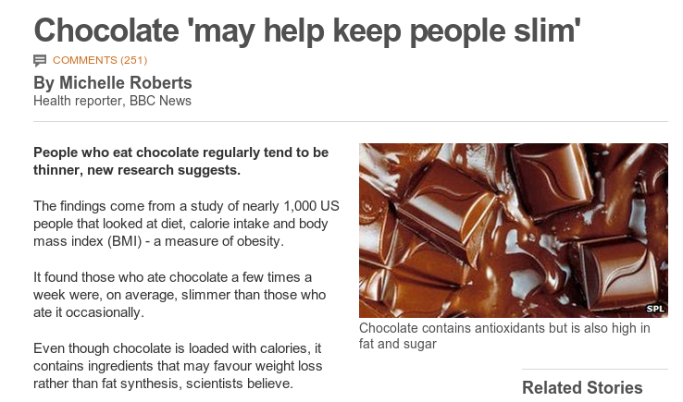
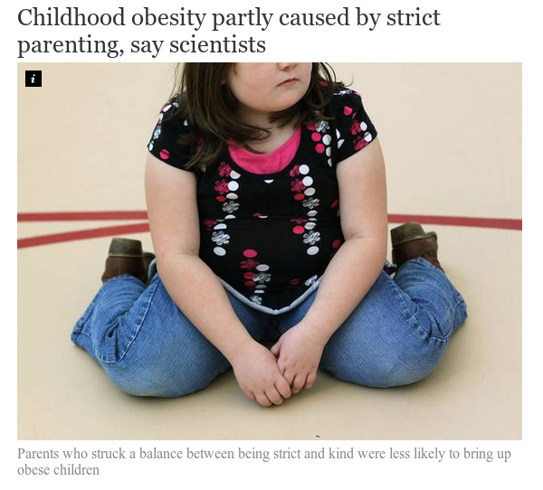
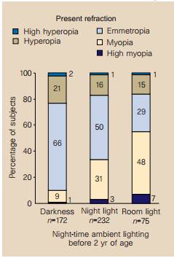
We care about causality
http://www.bbc.com/news/health-17511011
Sleeping with the light on is associated with short-sightedness in kids.
Quinn, Graham E., et al. "Myopia and ambient lighting at night." Nature 399.6732 (1999): 113-114
http://www.independent.co.uk/life-style/health-and-families/health-news/childhood-obesity-partly-caused-by-strict-parenting-say-scientists-9206147.html
Notes:
Chocolate study corrected for age, sex, other calories, mood
Obesity study Kakinami, Lisa, Tracie Barnett, and Gilles Paradis. "Abstract MP34: In Praise of Demanding Parenting: The Effects of Parenting Style and Poverty on Obesity Risk in Children: Evidence from a Nationally Representative Sample." Circulation 129.Suppl 1 (2014): AMP34-AMP34.
Corrected for poverty (but not education as far as I could tell)

Slide 4
Machine Learning
P
Infer some properties of P from the sample.
Supervised ML, given a set of training examples and features from an underlying distribution infer
Data sampled
from P
Notes:
Because so much of the time, we want to know what will happen if a system is changed by some external factor.
Does causation actually exist in the way we think about it. Probably not (Quantum mechanics suggests not) and what does the term external to the system really mean. What would causality look like to a system that could model every possible variable?
However, the concept of causality as generally perceived by humans is very useful, in that it allows us to break the world into manageable subsets of variables and to predict the outcome of manipulation of subsets of these variables.
This is the fundamental problem we want to solve with causal inference.

Slide 5
Causal inference
Do something
P
P'
Data sampled
from P
What does the data we have collected from the distribution P tell us about P'?
Notes:
Because so much of the time, we want to know what will happen if a system is changed by some external factor.
Does causation actually exist in the way we think about it. Probably not (Quantum mechanics suggests not) and what does the term external to the system really mean. What would causality look like to a system that could model every possible variable?
However, the concept of causality as generally perceived by humans is very useful, in that it allows us to break the world into manageable subsets of variables and to predict the outcome of manipulation of subsets of these variables.
This is the fundamental problem we want to solve with causal inference.

Slide 6
A framework for causal inference
Represent each variable as a deterministic function of its direct causes and noise
Noise terms must be mutually independent
where
Poverty
Smoking
Diet
Cancer
=> Variables are independent of their non-effects given their direct causes
=> The factorisation of the full distribution can be simplified
Notes:
This ties together the functional definition of causality with the Markov independence property

Slide 7
A framework for causal inference
Poverty
Smoking
Diet
Cancer
Poverty
Smoking
Diet
Cancer
Notes:
Without latent variables, it is now trivial to answer what happens if we do(X = x).
Simply delete edges going into the variable X and then condition on X = x
This differs from observing X=x, as in that case the link into X is still there

Slide 8
Conditional Independence
a conditionally independent of b given c, ,means:
Assuming you know c, learning the value of b tells you nothing about the value of a.
Graphically, influence can't flow from a to b through c.
a
c
a
b
c
a
b
c
b
Poverty
Poverty
Smoking
Diet
Smoking
Smoking
Diet
Cancer
Cancer
Notes:
The key to this approach to causal inference is conditional independence.
We can determine independence in observational data. - for example if we assume things are linear, then correlation coefficients measure independence.

Slide 9
Some intuition
A correlated with B
B correlated with C
C not correlated with A
A
C
B
B
A
C
Notes:
Can anyone come up with an example causal story for either of the two structures?

Slide 10
Some intuition
A correlated with B
B correlated with C
C not correlated with A
B | 0 | 1 | 2 | 3
P(B) | 0.25 | 0.25 | 0.25 | 0.25
A=Age
C=Sex
B in {0,1,2,3}
B =Reading level
A in {0,1}
A =1 if B in {0,1}
C in {0,1}
C=1 if B in {1,2}
B | 0 | 1 | 2 | 3
P(A=1) | 1 | 1 | 0 | 0
B | 0 | 1 | 2 | 3
P(C=1) | 0 | 1 | 1 | 0
Notes:
In the example on the left, the observed dependency is represented in the structure of the graph. This means that it holds in ALL distributions that factor over the graph. Ie if I wrote down the a conditional probability table for each node, perturbing the probabilities would not change the dependencies => it is stable.
In the graph on the left, the independence A indep of C is not represented by the graph and is not stable to perturbation of the parameters of the probability distribution.
The claim is that the structure on the left is preferable/more likely than the one on the right given the observed dependency structure.

Slide 11
When is correlation causation?
Can we infer causal structure from observed conditional independences?
Notes:
We saw before that a graph represents a set of conditional in-dependencies.
We can observe conditional independence in observational data.
So can we use the observed conditional independence structure to reconstruct the network
Not without assumptions !!!
Both of these graphs can represent any distribution over 5 variables.
So our first assumption, prefer structures that are minimally expressive in terms of distributions they can represent. Alternatively, as many as possible of the conditional independence assertions that hold in the distribution should be represented in the graph.

Slide 12
Faithfulness
We have some distribution P that was generated by some true (unknown) causal structure.
We assume that all the conditional independences in P are represented in the true causal structure
Finding the causal structure equates to finding the networks that encode exactly the dependencies we have observed in our data.

Slide 13
Sparsity and causal ordering
Can you have a network that represents a distribution, and is more sparse than the true causal model that generated that distribution?
True causal structure generating P
Bayesian network representing P
I | High | Low
P(I) | 0.5 | 0.5
Income
Income
Chocolate
Obesity
Chocolate
Obesity
I | H | L
P(C=Y) | .863 | .2
I | High |  | Low
C | Y | N | Y | N
P(O=Y) | .4 | .2 | .7 | .5
Notes:
Yes, when the distribution is not faithful to its true causal graph. In this case the dependency of obesity on chocolate consumption is exactly balanced by the dependency through income.
In this case, causation doesn't imply correlation!
But such distributions are not likely in general

Slide 14
The IC algorithm
1.
2.
3. Orient any undirected edges so as to avoid creating cycles or additional v-structures
True Causal Model
A
B
C
D
E
Notes:
Given our assumptions the search for causal structure comes down to finding the perfect I-Map(s) for the distribution P.
Does it exist? Not always but usually.
Is it unique? No, but certain links may be the same in all possible perfect I-Maps for P. That we can determine the causal direction of certain links purely from observational data.

Slide 15
The IC algorithm
1.
2.
3. Orient any undirected edges so as to avoid creating cycles or additional v-structures
True Causal Model
Inferred at step 1
A
A
B
C
B
C
D
D
E
E
Notes:
Variables that are directly causally linked cannot be conditionally independent given any other set of variables (assuming stability).

Slide 16
The IC algorithm
1.
2.
3. Orient any undirected edges so as to avoid creating cycles or additional v-structures
a
a
c
a
b
True Causal Model
Inferred at step 2
a
b
c
c
c
A
A
b
b
B
C
B
C
D
D
E
E
Notes:
Why step 2?
Consider all possible causal structures relating a and b through c. If a and b are not dependent given c, then only the option with a and b common causes of c matches the observed dependency structure.
If a and b are dependent given c then the direction of the arrows is ambiguous so we don't do anything.

Slide 17
The IC algorithm
1.
2.
3. Orient any undirected edges so as to avoid creating cycles or additional v-structures
a
a
c
a
b
True Causal Model
Inferred output
a
b
c
c
c
A
A
b
b
B
C
B
C
D
D
E
E
Notes:
We can't create cycles by assumption, but why can we be sure there should be no additional v-structures?
To create an additional v-structure, requires a structure of the form a → c – b. But such structures were checked at step 2 and found not to be a → c ← b
This is without latent variables

Slide 18
Latent variables
Theorem (Verma 1993):
for any latent structure there is an equivalent structure such that every latent variable is a root node with exactly 2 children.
A
A
L
L
C
D
C
D
Notes:
This allows us to narrow our all the set of latent structures that we consider as possibly accounting for the observed dependencies in the data.
Note we can't collapse the latent variable into its parent (unless the relationship was deterministic)
Mother Overweight
Gene expression
Poor eyesight
Heart disease

Slide 19
The IC* algorithm
1.
2.
3. Recursively add arrowheads/mark edges according to:
a
c
b
a
c
b
a
b
a
b
True Causal Model
Inferred output
A
A
B
C
B
C
D
D
E
E
Notes:
First two steps are the same as the IC algorithm
Need the theorem that any latent structure can be represented with latent variables as roots with exactly 2 children.

Slide 20
The IC* algorithm
2.
a
b
a
b
c
c
a
b
a
b
c
L
c
L
a
b
a
b
L
c
L
c
Notes:
First two steps are the same as the IC algorithm

Slide 21
The IC* algorithm
3. Add arrowheads/mark edges according to:
a
c
b
a
c
b
We know
and
a
a
a
c
c
c
L
b
b
b
a
a
a
L
L
L
c
c
c
L
b
b
b
Notes:
We know that conditioning on c breaks the dependency between a and b. This can only be explained by a direct cause, given that we already know that a causes c or a latent variable causes both.

Slide 22
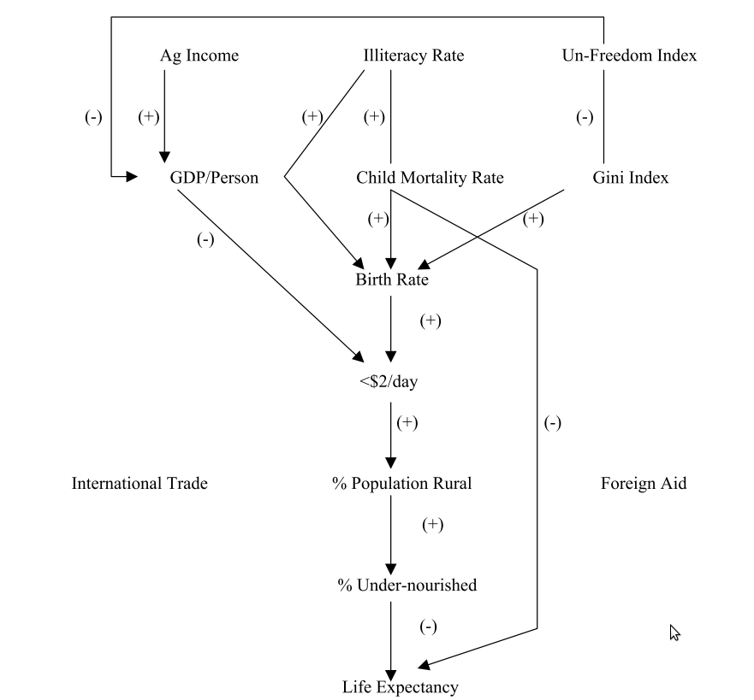
Causes of poverty
Bessler, David A. "On world poverty: Its causes and effects." Food and Agricultural Organization (FAO) of the United Nations, Research Bulletin, Rome(2003).

Slide 23
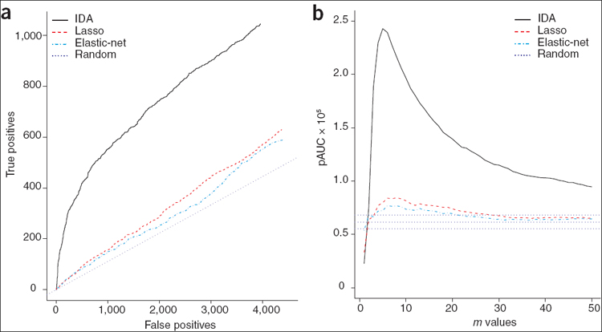
Uncovering causal links between genes and gene expression
Maathuis, Marloes H., et al. "Predicting causal effects in large-scale systems from observational data." Nature Methods 7.4 (2010): 247-248.
Notes:
(a) The number of true positives versus the number of false positives are plotted for the indicated methods, for the top 5,000 predicted effects from the observational data. The target set is the top 10% of the effects as computed from the interventional data. (b) The partial area under the receiver operating characteristic curve (pAUC) is plotted versus m values, when the target set is the top m percentage of the effects as computed from the interventional data. The pAUC was computed up to the false-positive rate determined by the top 5,000 effects from IDA for m = 10. The three horizontal lines for random guessing correspond to the 2.5th, 50th and 97.5th percentiles of a simulated distribution based on random orderings of effects.

Slide 24

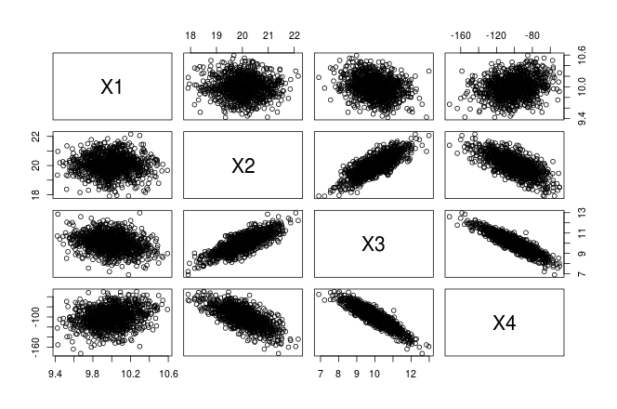
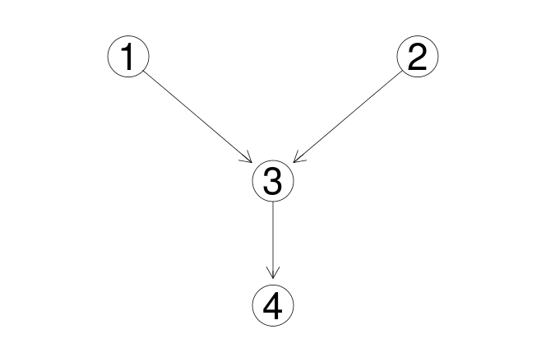
Causal structure learning in R (pcalg)

Slide 25
References
Pearl, J. (2000). Causality: models, reasoning and inference (particularly chapter 2)
Koller, D., & Friedman, N. (2009). Probabilistic graphical models: principles and techniques. (chapters 3 & 21)
Verma 1993 Graphical aspects of causal models Technical Report. UCLA
Spirtes, P., Glymour, C. N., & Scheines, R. (2000). Causation, prediction, and search.
Maathuis, Marloes H., et al. (2010) Predicting causal effects in large-scale systems from observational data. Nature Methods 7.4 : 247-248.
Kalisch, Markus, et al. (2012) Causal inference using graphical models with the R package pcalg. Journal of Statistical Software 47.11 : 1-26.
Bessler, David A. (2003) On world poverty: Its causes and effects. Food and Agricultural Organization (FAO) of the United Nations, Research Bulletin, Rome .

