Slide 1

Correlation is not causation
Notes:
Correlation does not imply causation - True and important. Please don't leave this talk with the notion that correlation is causality.
But if you are trained in classical statistics, you may believe correlation can tell us NOTHING about causality. This is less true. Its more complicated than that.

Slide 2

Ways things can go wrong
Image source: www.tylervigen.com/
Notes:
When you think correlation is not causation you might have one of two possible pitfalls in mind.
1) The issue is that a unobserved (or latent variable) is causing both of the variables you are considering. The relationship is predictive. Collecting additional data does not help.
2) The issue is one of two many variables relative to the size of the data set. Some variables will be found to be similar by chance. This relationship would not be predictive. More data would help
I'm not considering the 2nd point in this talk. For the remainder of the talk, I assume that I have enough data that I can correctly infer (at a minimum) which variables are genuinely correlated.

Slide 3
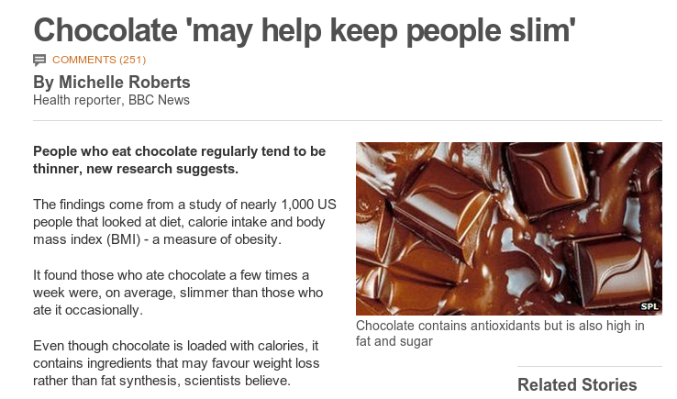
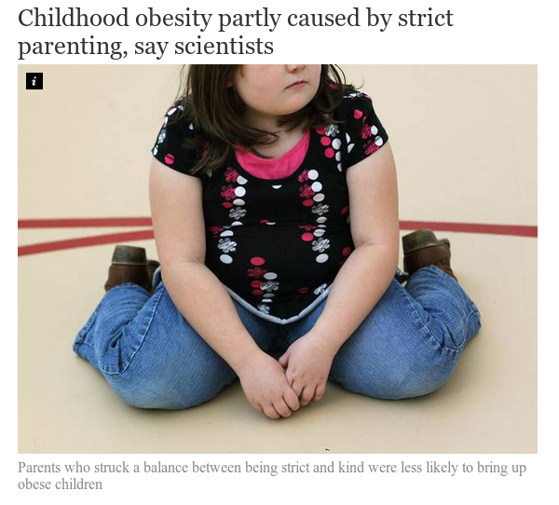
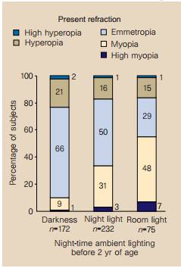
We care about causality
http://www.bbc.com/news/health-17511011
Sleeping with the light on is associated with short-sightedness in kids.
Quinn, Graham E., et al. "Myopia and ambient lighting at night." Nature 399.6732 (1999): 113-114
http://www.independent.co.uk/life-style/health-and-families/health-news/childhood-obesity-partly-caused-by-strict-parenting-say-scientists-9206147.html
Notes:
Chocolate study corrected for age, sex, other calories, mood
Obesity study Kakinami, Lisa, Tracie Barnett, and Gilles Paradis. "Abstract MP34: In Praise of Demanding Parenting: The Effects of Parenting Style and Poverty on Obesity Risk in Children: Evidence from a Nationally Representative Sample." Circulation 129.Suppl 1 (2014): AMP34-AMP34.
Corrected for poverty (but not education as far as I could tell)

Slide 4
Machine Learning/Statistics
P
What can we learn about the distribution P from a sample of data drawn from it?
Data sampled
from P
Notes:
Because so much of the time, we want to know what will happen if a system is changed by some external factor.
Does causation actually exist in the way we think about it. Probably not (Quantum mechanics suggests not) and what does the term external to the system really mean. What would causality look like to a system that could model every possible variable?
However, the concept of causality as generally perceived by humans is very useful, in that it allows us to break the world into manageable subsets of variables and to predict the outcome of manipulation of subsets of these variables.
This is the fundamental problem we want to solve with causal inference.

Slide 5
Causal inference
Do something
P
P'
What can a sample of data from the distribution P tell us about P'?
This is impossible to answer without some assumptions on how 'do something' changes P
Data sampled
from P
Notes:
Because so much of the time, we want to know what will happen if a system is changed by some external factor.
Does causation actually exist in the way we think about it. Probably not (Quantum mechanics suggests not) and what does the term external to the system really mean. What would causality look like to a system that could model every possible variable?
However, the concept of causality as generally perceived by humans is very useful, in that it allows us to break the world into manageable subsets of variables and to predict the outcome of manipulation of subsets of these variables.
This is the fundamental problem we want to solve with causal inference.

Slide 6
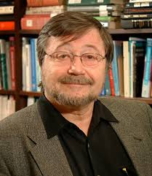
Causal bayesian networks
(causal DAGs)
A bayesian network where A → B is defined to mean A causes B
=> Variables are independent of their non-effects given their direct causes (Causal Markov Property)
Poverty
Smoking
Diet
Cancer
Absent links imply the factorisation of the full distribution can be simplified.
Notes:
This ties together the functional definition of causality with the Markov independence property

Slide 7
Intervention in Causal DAGs
Poverty
Truncated product formula
Drop from terms for intervened on variables from the factorization
Smoking
Diet
Cancer
A causal DAG represents the set of all possible interventional distributions over its variables
Poverty
Smoking=No
Diet
Cancer
Notes:
Without latent variables, it is now trivial to answer what happens if we do(X = x).
Simply delete edges going into the variable X and then condition on X = x
This differs from observing X=x, as in that case the link into X is still there

Slide 8
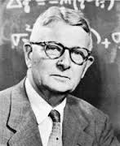
Structural equation models (SEMs)
Represent each variable as a deterministic function of its direct causes and noise
Noise terms must be mutually independent
where
Poverty
Smoking
Diet
Cancer
If the set of equations does not create a cycle then the Causal Markov property holds and the SEM is a causal bayesian network
Notes:
This ties together the functional definition of causality with the Markov independence property

Slide 9

Counterfactuals
Statements about what would have happened in some alternate reality where some specified thing were different.
A medical trial:
for an individual, i,
we only get to measure one of these.
Let be a random variable, is the distribution of outcome, that would occur if everyone was treated.
The causal effect is defined as
We can measure
&
Ignoreability assumption

Slide 10
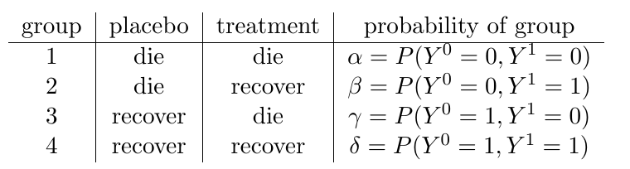


Counterfactuals
Counterfactural queries form a larger set than interventional queries
What is the probability that a patient, who was not treated and died, would have recovered if they had been treated? We know they are in either group 1 or 2 since they died without treatment, so the answer is
Can we identify that from

Slide 11
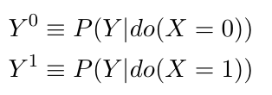
How do the models relate?
Do type queries can be phrased in terms of counterfactuals
For do type queries, the ignoreability assumption is true if the 'back door criterion' holds.
Causal bayesian networks don't support full counterfactuals as they only contain information on interventional distributions
SEMs do define counterfactuals
There is a subtle difference between the assumptions implied by the SEM models and what is actually needed for identification of do-queries (see Richardson & Robins 2013). This makes a difference for identifiability of non-interventional queries.

Slide 12
The Do Calculus: calculating causal effects in a (partially) known network
The do-calculus rules result from d-separation in a causal DAG
A causal effect is non-parametrically identifiable if and only if the interventional query can be reduced to an observational one via repeat application of the three rules (see Shpitser&Pearl 2012 for algorithm)

Slide 13
Rule 1: D-separation still applies
The graph that results from the intervention do(X=x) is still a bayesian network and d-separation applies.
W
U
W
U
X
Y
x
Y
Notes:
The process of intervening and setting the value of x to a given value changes the network in a specific way. X is no longer a function of its parents – so those links are removed, and x is set the value specified by the intervention.
The resulting network is still a (causal) bayesian network. D-separation still applies to that network.
The arguaments are clearer using the augmented network.

Slide 14
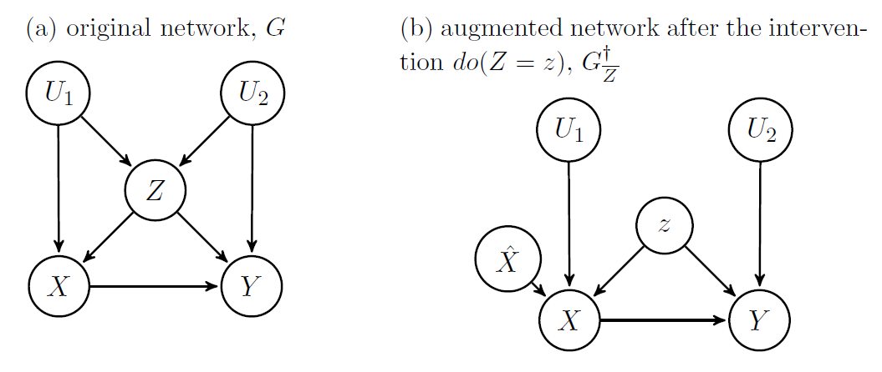
Rule 2: intervention and observation
If the target, y, is independent of how x is determined intervention is the same as observation.
Notes:
Explicitly model the possibility of intervention by adding a new variable S_x (think of as switch x) as a parent of the variable on which you will intervene.
Sx can be either off (in which case x is determined by its parents according to the original CPD) or some value, in which case x is set to that value. If y is d-sep from the switch, then do(x) = x

Slide 15
Rule 3: Sometimes intervention changes nothing
Smoking switch is d-separated from diet. There is no direct causal path from smoking to diet, so the intervention doesn't change anything.
Poverty
Switch
Smoking
Diet
Cancer
Notes:
Explicitly model the possibility of intervention by adding a new variable S_x (think of as switch x) as a parent of the variable on which you will intervene.
Sx can be either off (in which case x is determined by its parents according to the original CPD) or some value, in which case x is set to that value. If y is d-sep from the switch, then do(x) = x

Slide 16
The back door criterion
Just a special case of rule 2. If Z blocks all back door paths from X to Y then the causal effect of X on Y is obtained by adjusting for Z.
Poverty
Switch
Smoking
Diet
Cancer

Slide 17
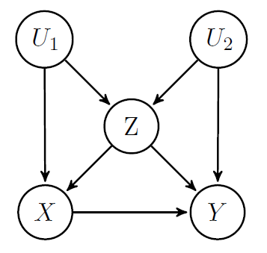
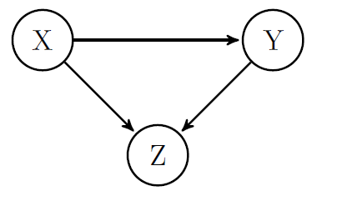
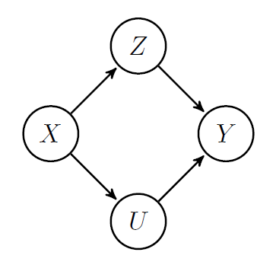
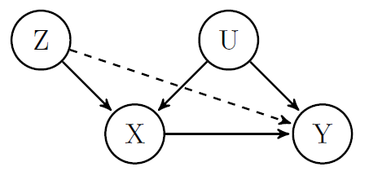
Causal estimation by 'adjusting'
Notes:
Examples of how things go badly by adjusting for the wrong things. (for IV variable case you can see you don't need to adjust graphically. Requires parametric arguaments to see what happens if you do anyway)
Propensity scores – where they fit.

Slide 18
Causal Discovery

Slide 19
Independence based methods
1) We assume our distribution P was generated by some (unknown) causal DAG over our observed variables (causal sufficiency)
2) We assume that all the conditional independences in P are implied by d-separation in the true causal network (faithfulness)
3) Finding the causal structure equates to finding perfect maps for P
True causal structure generating P
Perfect map for P
I | High | Low
P(I) | 0.5 | 0.5
Income
Income
Chocolate
Obesity
Chocolate
Obesity
I | High |  | Low
C | Y | N | Y | N
P(O=Y) | .4 | .2 | .7 | .5
Notes:
4) If 1) or 2) does not hold then a perfect map for P may not exist.

Slide 20
The IC (or SGS) algorithm
1.
2.
3. Orient any undirected edges so as to avoid creating cycles or additional v-structures
a
a
c
a
b
True Causal Model
Inferred output
a
b
c
c
c
A
A
b
b
B
C
B
C
D
D
E
E
Notes:
We can't create cycles by assumption, but why can we be sure there should be no additional v-structures?
To create an additional v-structure, requires a structure of the form a → c – b. But such structures were checked at step 2 and found not to be a → c ← b
This is without latent variables

Slide 21
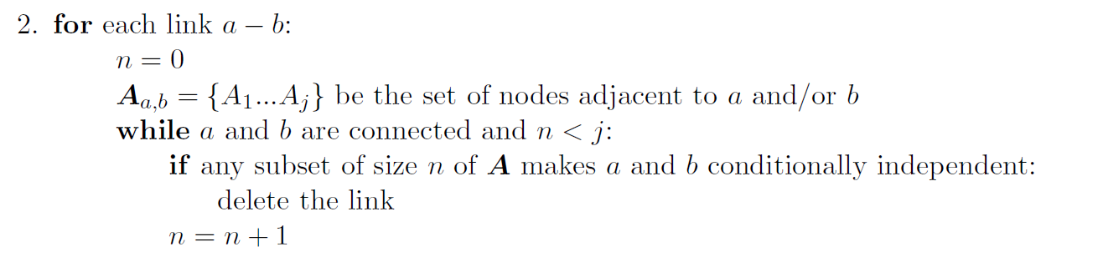
The PC algorithm
A more tractable version of the SGS algorithm

Slide 22
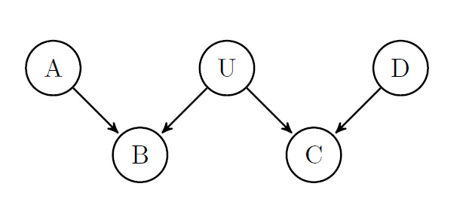
Latent variables
Problems:
  Infinite search space
  The space of causal DAGs is not closed under marginalization

Slide 23
Latent variables
Theorem (Verma 1993):
for any latent structure there is an equivalent structure such that every latent variable is a root node with exactly 2 children.
A
A
L
L
C
D
C
D
Notes:
This allows us to narrow our all the set of latent structures that we consider as possibly accounting for the observed dependencies in the data.
Note we can't collapse the latent variable into its parent (unless the relationship was deterministic)
Mother Overweight
Gene expression
Poor eyesight
Heart disease

Slide 24
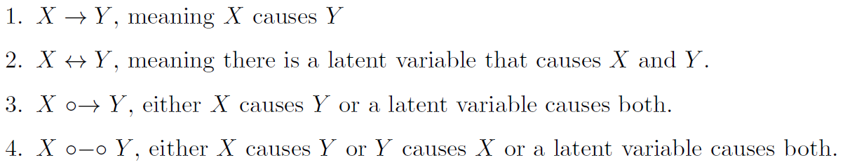
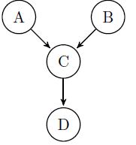
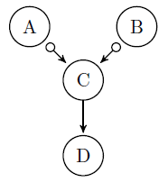
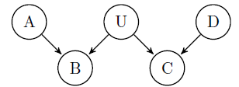
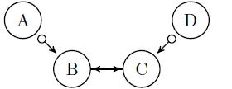
FCI algorithm
Outputs a Markov equivalence class of Maximal Ancestral Graphs
Discovers all aspects of causal structure identifiable from conditional independence relations (Zhang 2008)
Can be made to require a worst case polynomial (rather than exponential) number of conditional independence tests for sparse graphs (Claassen et al 2013).

Slide 25
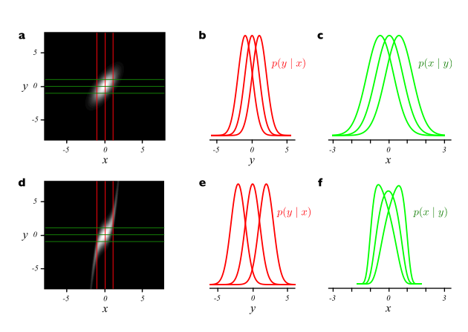
Beyond conditional independence
X
Y
Y
vs
X
Additive noise:
Figure 1, (Hoyer et al 2009)
Can be extended to post-non-linear additive noise
(Zhang et al 2009)
Notes:
In practice one does regression of y vs x to estimate the function f and then test to see if the residuals f-y are independent of x (then do it in reverse)

Slide 26
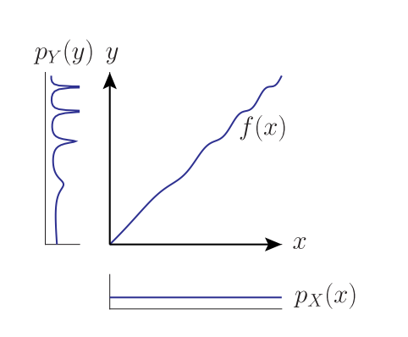
More asymmetries of cause and effect
X
Y
Y
vs
X
Figure 1: Daniusis et al 2012
Independence of function and input: If X → Y and we have a functional causal model y = f(x,e) then the input
distribution P(X) and function f represent independent mechanisms. Changing the input distribution does not modify the function itself.

Slide 27
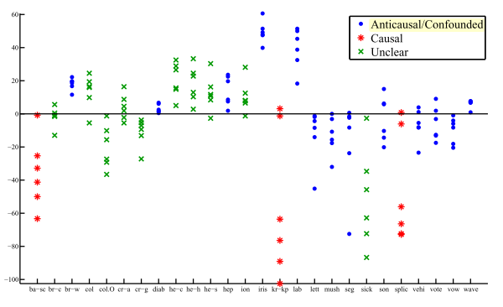
Causal-Anticausal
If X → Y, what is the relationship between P(X) and P(Y|X)?
What about P(Y) and P(X|Y)?
In semi supervised learning we are given training points from P(X,Y) and additional points sampled from P(X). The goal is to learn P(Y|X). The extra points from P(X) will not help if X → Y.
Figure 6, Janzing & Peters 2012

Slide 28
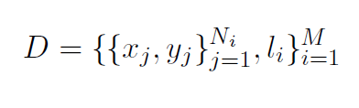


Learning what causality looks like
See Lopez-Paz et al 2014

Slide 29
Now with more than two variables!
Bi-variate additive noise model
If the triple: satisfies a certain condition then model is identifiable
To extend to multivariate case we need to satisfy the condition on the conditional distributions
For each variable j
Pick a single parent, i, and fix all the others
For each subset S that contains the remaining parents, and no descendants of j
The triple must satisfy the condition for at least one s.
If we can come up with a condition that guarantees identifiability for the bi-variate case, we can extend that result to get the conditions under which the multivariate case is identifiable.
See Peters et al 2014

Slide 30

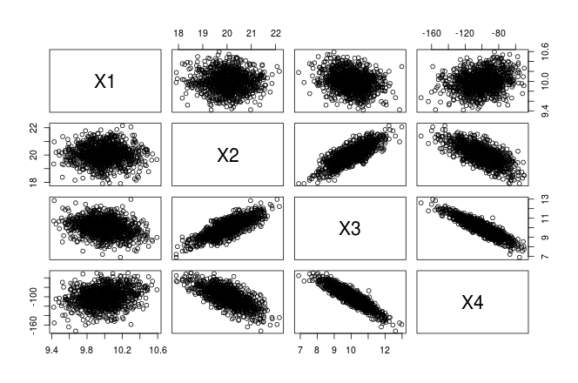
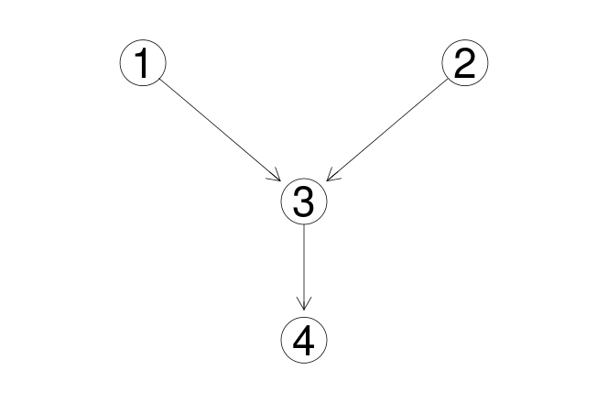
Causal structure learning in R (pcalg)

Slide 31
References
Pearl, J. (2000). Causality: models, reasoning and inference
Tom Claassen, J Mooij, and Tom Heskes. Learning sparse causal models is not NP-hard. arXiv Prepr. ArXiv1309.6824, 2013.
PO Hoyer, Dominik Janzing, and JM Mooij. Nonlinear causal discovery with additive noise models. Adv. Neural . . . , 2009.
Kun Zhang and A Hyvarinen. On the identiability of the post-nonlinear causal model.Proc. Twenty-Fifth Conf. . . . , 2009.
P Daniusis, Dominik Janzing, and Joris Mooij. Inferring deterministic causal relations.arXiv Prepr. arXiv . . . , pages 2-9, 2012.
Jiji Zhang. On the completeness of orientation rules for causal discovery in the presence of latent confounders and selection bias. Artif. Intell., 172(16-17):1873{1896, November 2008
Koller, D., & Friedman, N. (2009). Probabilistic graphical models: principles and techniques. (chapters 3 & 21)
Verma 1993 Graphical aspects of causal models Technical Report. UCLA
Spirtes, P., Glymour, C. N., & Scheines, R. (2000). Causation, prediction, and search.
Maathuis, Marloes H., et al. (2010) Predicting causal effects in large-scale systems from observational data. Nature Methods 7.4 : 247-248.
Kalisch, Markus, et al. (2012) Causal inference using graphical models with the R package pcalg. Journal of Statistical Software 47.11 : 1-26.
Shpitser, Ilya, and Judea Pearl. "Identification of conditional interventional distributions." arXiv preprint arXiv:1206.6876 (2012).
Dominik Janzing and Jonas Peters. On causal and anticausal learning JMLR. , 2012.
David Lopez-Paz, Krikamol Muandet, and Benjamin Recht. The Randomized Causation Coefficient. September 2014.
TS Richardson and JM Robins. Single world intervention graphs (SWIGs): a unication of the counterfactual and graphical approaches to causality. Cent. Stat. . . . , (128), 2013.
Jonas Peters, J Mooij, Dominik Janzing, and B Scholkopf. Causal discovery with continuous additive noise models. J. Mach. Learn. Res. 2014.

