Slide 1
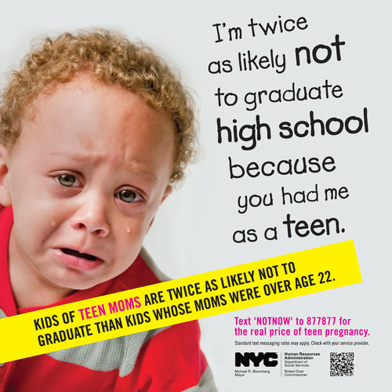
Notes:
43% of children of a teen mom (age 17 or under) fail to graduate high school by age 19
compared to 20% who fail if their mother was over age 22 when she gave birth.
Source: Manlove, Terry-Humen, Mincieli, and Moore (2008). Outcomes for Children of Teen
mothers from Kindergarten through Adolescence. In S. Hoffman and R. Maynard (Eds.) Kids
Having Kids: Economic and Social Consequences of Teen Pregnancy (pp. 161-196). Washington,
D.C. The Urban Institute Press.

