Slide 1

Correlation is not causation
Notes:
Correlation does not imply causation - True and important. Please don't leave this talk with the notion that correlation is causality.
But if you are trained in classical statistics, you may believe correlation can tell us NOTHING about causality. This is less true. Its more complicated than that.

Slide 2

Ways things can go wrong
Image source: www.tylervigen.com/
Notes:
When you think correlation is not causation you might have one of two possible pitfalls in mind.
1) The issue is that a unobserved (or latent variable) is causing both of the variables you are considering. The relationship is predictive. Collecting additional data does not help. Time is the counfounder in the first example.
2) The issue is one of two many variables relative to the size of the data set. Some variables will be found to be similar by chance. This relationship would not be predictive. More data would help
I'm not considering the 2nd point in this talk. For the remainder of the talk, I assume that I have enough data that I can correctly infer (at a minimum) which variables are genuinely correlated.

Slide 3
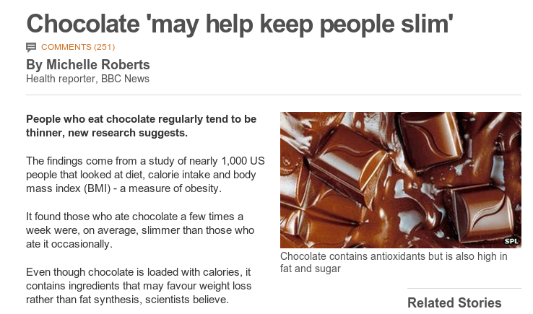
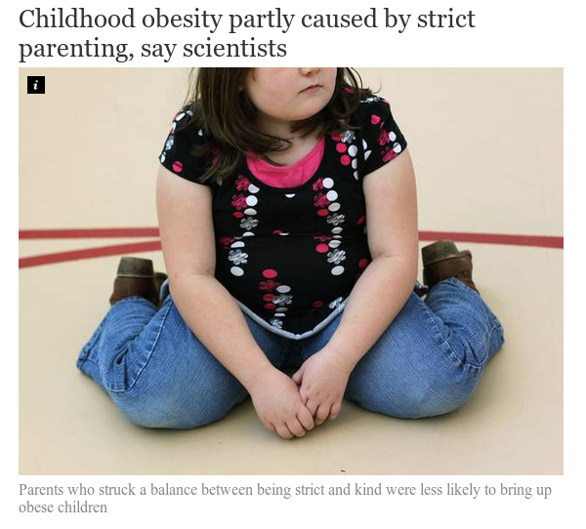
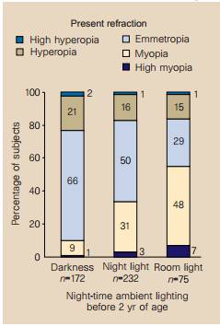
We care about causality
http://www.bbc.com/news/health-17511011
Sleeping with the light on is associated with short-sightedness in kids.
Quinn, Graham E., et al. "Myopia and ambient lighting at night." Nature 399.6732 (1999): 113-114
http://www.independent.co.uk/life-style/health-and-families/health-news/childhood-obesity-partly-caused-by-strict-parenting-say-scientists-9206147.html
Notes:
Chocolate study corrected for age, sex, other calories, mood
Obesity study Kakinami, Lisa, Tracie Barnett, and Gilles Paradis. "Abstract MP34: In Praise of Demanding Parenting: The Effects of Parenting Style and Poverty on Obesity Risk in Children: Evidence from a Nationally Representative Sample." Circulation 129.Suppl 1 (2014): AMP34-AMP34.
Corrected for poverty (but not education as far as I could tell)

Slide 4
Machine Learning/Statistics
P
What can we learn about the distribution P from a sample of data drawn from it?
Data sampled
from P
Notes:
Because so much of the time, we want to know what will happen if a system is changed by some external factor.
Does causation actually exist in the way we think about it. Probably not (Quantum mechanics suggests not) and what does the term external to the system really mean. What would causality look like to a system that could model every possible variable?
However, the concept of causality as generally perceived by humans is very useful, in that it allows us to break the world into manageable subsets of variables and to predict the outcome of manipulation of subsets of these variables.
This is the fundamental problem we want to solve with causal inference.

Slide 5
Causal inference
Do something
P
P'
What can a sample of data from the distribution P tell us about P'?
This is impossible to answer without some assumptions on how 'do something' changes P
Data sampled
from P
Notes:
Because so much of the time, we want to know what will happen if a system is changed by some external factor.
Does causation actually exist in the way we think about it. Probably not (Quantum mechanics suggests not) and what does the term external to the system really mean. What would causality look like to a system that could model every possible variable?
However, the concept of causality as generally perceived by humans is very useful, in that it allows us to break the world into manageable subsets of variables and to predict the outcome of manipulation of subsets of these variables.
This is the fundamental problem we want to solve with causal inference.

Slide 6
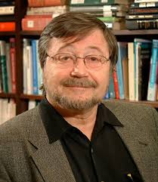
Causal bayesian networks
(causal DAGs)
A bayesian network where A → B is defined to mean A causes B
=> Variables are independent of their non-effects given their direct causes (Causal Markov Property)
Poverty
Smoking
Diet
Cancer
Absent links imply the factorisation of the full distribution can be simplified.
Notes:
This ties together the functional definition of causality with the Markov independence property

Slide 7
Intervention in Causal DAGs
Poverty
Smoking
Diet
A causal DAG represents the set of all possible interventional distributions over its variables
Cancer
Poverty
Smoking=No
Diet
Cancer
Notes:
Without latent variables, it is now trivial to answer what happens if we do(X = x).
Simply delete edges going into the variable X and then condition on X = x
This differs from observing X=x, as in that case the link into X is still there
If we know this graph (structure and CPD tables) then we can calculate any interventional distribution.

Slide 8
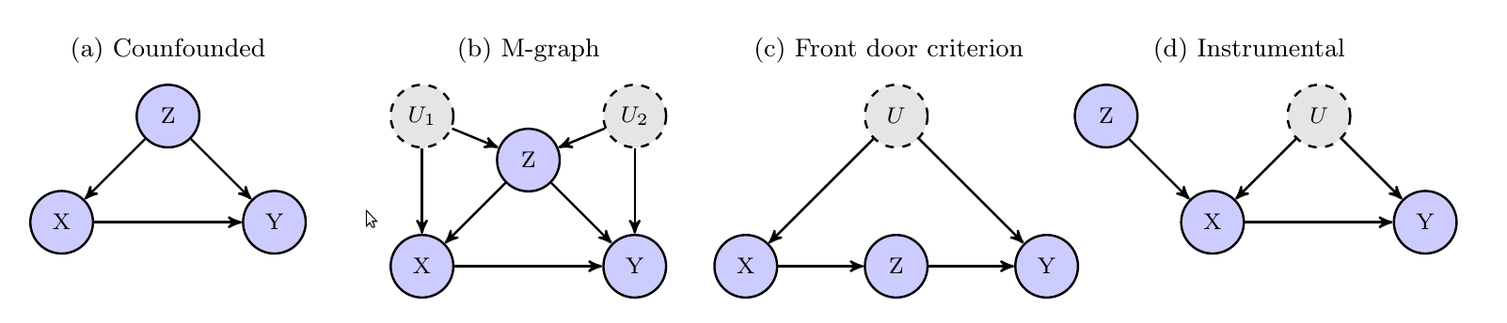
Calculating causal effects
If you can observe all the variables then you can estimate the effect of any intervention.
If there are some latent (unobservable) variables, use the do-calculus (see Pearl 2000)
Notes:
Most standard causal techniques are aimed at solving the causal inference problem - ie to estimate a causal effect where the structure of the problem is largly assumed to be known (although this assumption is frequently not explicitly stated).
For a large subset of graphs, finding the causal structure equates to identifying a subset of variables on which to condition so as to identify the causal effect. This is the standard practice of 'adjusting' used all the time. Propensity scores are simply a statistical tool to condition on large numbers of potentially continous variables with finite data. Graphical models and the do calculus provide a difinitive answer to the question – which variables should we condition on (and is the problem actually solvable)
Instrumental varialbes are a bit different – they provide bounds rather than point estimates – but still require causal structural assumptions.

Slide 9
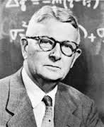
Structural equation models (SEMs)
Represent each variable as a deterministic function of its direct causes and noise
Noise terms must be mutually independent
where
Poverty
Smoking
Diet
Cancer
If the set of equations does not create a cycle then the Causal Markov property holds and the SEM is a causal bayesian network
Notes:
This ties together the functional definition of causality with the Markov independence property
Sewall Wright – a geneticist published on path analysis in 1918.

Slide 10
Causal Discovery what to do when you don't know the graph

Slide 11
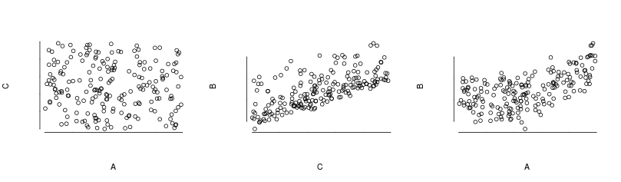
Independence based methods
1) We assume our distribution P was generated by some (unknown) causal directed acyclic graph
2) We assume that all the conditional independences in P are implied by d-separation in the true causal network (faithfulness).
3) Finding the causal structure equates to finding graphs that imply exactly the conditional independencies observed in our distribution.
Intuition
Suppose I tell you, A and C are indepependent variables both correlated with B.
Intuitively the graph must have the form A – B – C ,
Can you think of an real world example for A → B ← C,
What about A ← B → C?
Notes:
4) If 1) or 2) does not hold then a perfect map for P may not exist.
Conditional independence – A conditionally independent of C given B then once I know B, knowing C gives me no more information about A – so for example

Slide 12
Intuition
A and C are indepependent variables both correlated with B.
B | 0 | 1 | 2 | 3
P(B) | 0.25 | 0.25 | 0.25 | 0.25
A=Age
C=Sex
B
B =Reading level
A
C
B | 0 | 1 | 2 | 3
P(A=1) | 1 | 1 | 0 | 0
B | 0 | 1 | 2 | 3
P(C=1) | 0 | 1 | 1 | 0
Notes:
In the example on the left, the observed dependency is represented in the structure of the graph. This means that it holds in ALL distributions that factor over the graph. Ie if I wrote down the a conditional probability table for each node, perturbing the probabilities would not change the dependencies => it is stable.
In the graph on the left, the independence A indep of C is not represented by the graph and is not stable to perturbation of the parameters of the probability distribution.
The claim is that the structure on the left is preferable/more likely than the one on the right given the observed dependency structure.

Slide 13

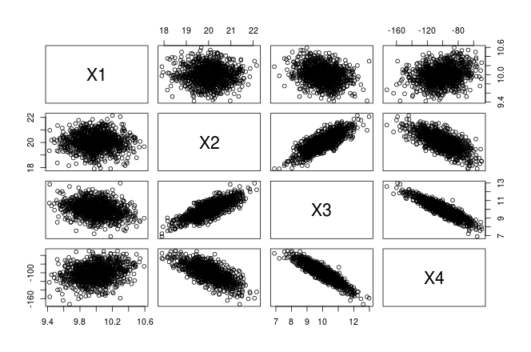
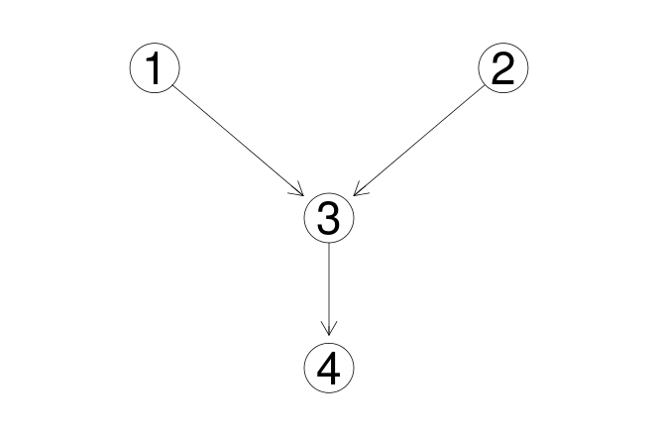
Practicalities
Algorithms: PC, FCI (Sprites 2000),GES (Chickering 2002),RFCI (Colombo, Diego, et al 2012)
Implementations:
Pcalc (R package)
Tedrad
Notes:
These algorithms require large numbers of sometimes high-dimensional conditional independece tests. This is ok if you assume linearity – but otherwise will require some form of kernalized conditional independence test ie HSIC.
Contraint based methods like PC, FCI, RFCI can be fragile in that if you mistakenly discard an edge early on (due to finite data) that error can propagate through cauing later errors.
Scoring algorithms like GES have super-exponential graph search space with increasing number of variables.
These methods return the a markov equivelence set of graphs (ie all those that exacty imply the observed contitional independencies). In general this set will contain more than one graph – so the direction of some eges is undetermined.

Slide 14
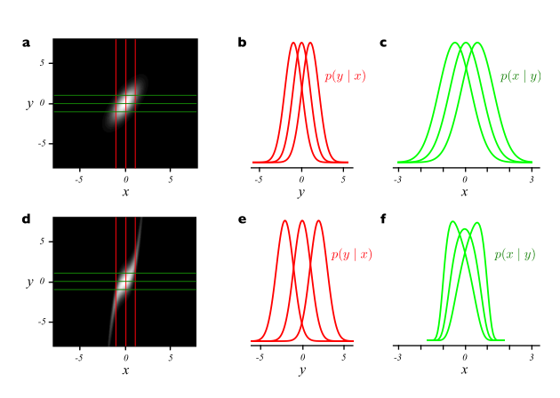
Beyond conditional independence
X
Y
Y
vs
X
Additive noise:
Figure 1, (Hoyer et al 2009)
Can be extended to post-non-linear additive noise
(Zhang et al 2009)
Notes:
If you assume noise is additive in causal direction, then in general, it will only be additive one way (linear guassian unforunate exception)
In practice one does regression of y vs x to estimate the function f and then test to see if the residuals f-y are independent of x (then do it in reverse)

Slide 15
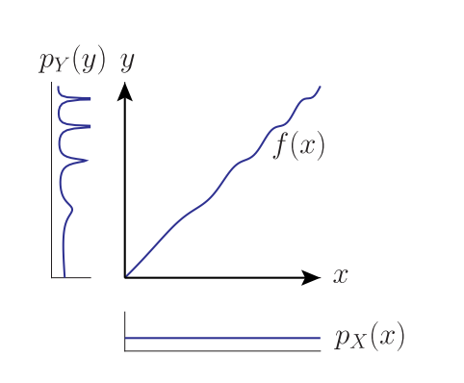
More asymmetries of cause and effect
X
Y
Y
vs
X
Figure 1: Daniusis et al 2012
Independence of function and input: If X → Y and we have a functional causal model y = f(x,e) then the input
distribution P(X) and function f represent independent mechanisms. Changing the input distribution does not modify the function itself.
Notes:
Let Y = f(X) <=> X = g(Y ). Ie deterministic invertible function
For most input distributions, P(X), the distribution P(Y) will be higher where f' is small and a larger region of X maps to similar values of Y . If X causes Y (but not if Y causes X) we would expect f and pX(x) to be independent and pY (y) should be correlated with f'.

Slide 16
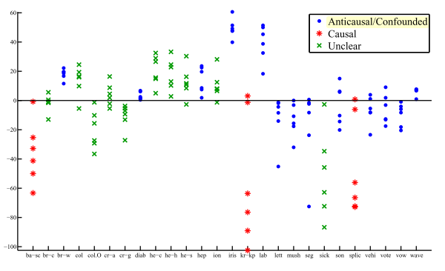
Causal-Anticausal
If X → Y, then assuming independence of input and mechanism we would expect P(X) and P(Y|X) should be independent.
P(Y) and P(X|Y) will generally not be independent.
In semi supervised learning we are given training points from P(X,Y) and additional points sampled from P(X). The goal is to learn P(Y|X). The extra points from P(X) will not help if X → Y.
Figure 6, Janzing & Peters 2012

Slide 17
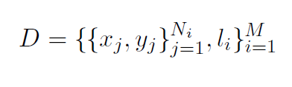


Learning what causality looks like
See Lopez-Paz et al 2014

Slide 18

Questions
I may not be able to stay and socialize after the talks (due to morning sickness) but I'm very happy to recieve questions/feedback via email: finnlattimore@gmail.com

Slide 19
References
Pearl, J. (2000). Causality: models, reasoning and inference
Tom Claassen, J Mooij, and Tom Heskes. Learning sparse causal models is not NP-hard. arXiv Prepr. ArXiv1309.6824, 2013.
PO Hoyer, Dominik Janzing, and JM Mooij. Nonlinear causal discovery with additive noise models. Adv. Neural . . . , 2009.
Kun Zhang and A Hyvarinen. On the identiability of the post-nonlinear causal model.Proc. Twenty-Fifth Conf. . . . , 2009.
P Daniusis, Dominik Janzing, and Joris Mooij. Inferring deterministic causal relations.arXiv Prepr. arXiv . . . , pages 2-9, 2012.
Jiji Zhang. On the completeness of orientation rules for causal discovery in the presence of latent confounders and selection bias. Artif. Intell., 172(16-17):1873{1896, November 2008
Koller, D., & Friedman, N. (2009). Probabilistic graphical models: principles and techniques. (chapters 3 & 21)
Verma 1993 Graphical aspects of causal models Technical Report. UCLA
Spirtes, P., Glymour, C. N., & Scheines, R. (2000). Causation, prediction, and search.
Maathuis, Marloes H., et al. (2010) Predicting causal effects in large-scale systems from observational data. Nature Methods 7.4 : 247-248.
Kalisch, Markus, et al. (2012) Causal inference using graphical models with the R package pcalg. Journal of Statistical Software 47.11 : 1-26.
Shpitser, Ilya, and Judea Pearl. "Identification of conditional interventional distributions." arXiv preprint arXiv:1206.6876 (2012).
Dominik Janzing and Jonas Peters. On causal and anticausal learning JMLR. , 2012.
David Lopez-Paz, Krikamol Muandet, and Benjamin Recht. The Randomized Causation Coefficient. September 2014.
TS Richardson and JM Robins. Single world intervention graphs (SWIGs): a unication of the counterfactual and graphical approaches to causality. Cent. Stat. . . . , (128), 2013.
Jonas Peters, J Mooij, Dominik Janzing, and B Scholkopf. Causal discovery with continuous additive noise models. J. Mach. Learn. Res. 2014.
Colombo, Diego, et al. "Learning high-dimensional directed acyclic graphs with latent and selection variables." The Annals of Statistics 40.1 (2012): 294-321.
Chickering DM (2002). “Optimal structure identification with greedy search.” Journal of Machine Learning Research, 3(3), 507–554.
TETRAD software http://www.phil.cmu.edu/tetrad/

Slide 20
Now with more than two variables!
Bi-variate additive noise model
If the triple: satisfies a certain condition then model is identifiable
To extend to multivariate case we need to satisfy the condition on the conditional distributions
For each variable j
Pick a single parent, i, and fix all the others
For each subset S that contains the remaining parents, and no descendants of j
The triple must satisfy the condition for at least one s.
If we can come up with a condition that guarantees identifiability for the bi-variate case, we can extend that result to get the conditions under which the multivariate case is identifiable.
See Peters et al 2014

Slide 21

Counterfactuals
Statements about what would have happened in some alternate reality where some specified thing were different.
A medical trial:
for an individual, i,
we only get to measure one of these.
Let be a random variable, is the distribution of outcome, that would occur if everyone was treated.
The causal effect is defined as
We can measure
&
Ignoreability assumption

Slide 22
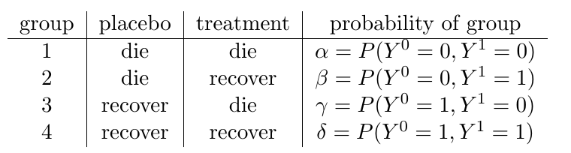


Counterfactuals
Counterfactural queries form a larger set than interventional queries
What is the probability that a patient, who was not treated and died, would have recovered if they had been treated? We know they are in either group 1 or 2 since they died without treatment, so the answer is
Can we identify that from

Slide 23
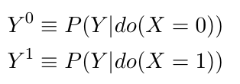
How do the models relate?
Do type queries can be phrased in terms of counterfactuals
For do type queries, the ignoreability assumption is true if the 'back door criterion' holds.
Causal bayesian networks don't support full counterfactuals as they only contain information on interventional distributions
SEMs do define counterfactuals
There is a subtle difference between the assumptions implied by the SEM models and what is actually needed for identification of do-queries (see Richardson & Robins 2013). This makes a difference for identifiability of non-interventional queries.

Slide 24
The Do Calculus: calculating causal effects in a (partially) known network
The do-calculus rules result from d-separation in a causal DAG
A causal effect is non-parametrically identifiable if and only if the interventional query can be reduced to an observational one via repeat application of the three rules (see Shpitser&Pearl 2012 for algorithm)

Slide 25
The Do Calculus: calculating causal effects in a (partially) known network
The do-calculus rules result from d-separation in a causal DAG
A causal effect is non-parametrically identifiable if and only if the interventional query can be reduced to an observational one via repeat application of the three rules (see Shpitser&Pearl 2012 for algorithm)

Slide 26
Rule 1: D-separation still applies
The graph that results from the intervention do(X=x) is still a bayesian network and d-separation applies.
W
U
W
U
X
Y
x
Y
Notes:
The process of intervening and setting the value of x to a given value changes the network in a specific way. X is no longer a function of its parents – so those links are removed, and x is set the value specified by the intervention.
The resulting network is still a (causal) bayesian network. D-separation still applies to that network.
The arguaments are clearer using the augmented network.

Slide 27
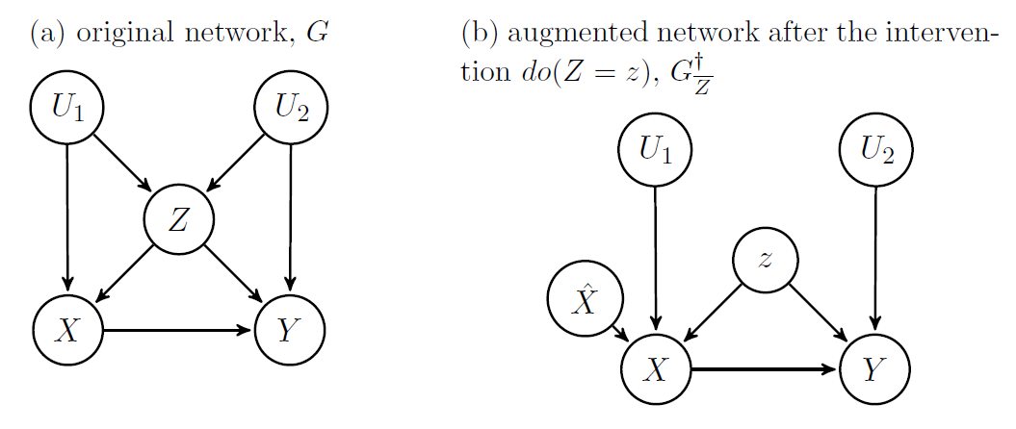
Rule 2: intervention and observation
If the target, y, is independent of how x is determined intervention is the same as observation.
Notes:
Explicitly model the possibility of intervention by adding a new variable S_x (think of as switch x) as a parent of the variable on which you will intervene.
Sx can be either off (in which case x is determined by its parents according to the original CPD) or some value, in which case x is set to that value. If y is d-sep from the switch, then do(x) = x

Slide 28
Rule 3: Sometimes intervention changes nothing
Smoking switch is d-separated from diet. There is no direct causal path from smoking to diet, so the intervention doesn't change anything.
Poverty
Switch
Smoking
Diet
Cancer
Notes:
Explicitly model the possibility of intervention by adding a new variable S_x (think of as switch x) as a parent of the variable on which you will intervene.
Sx can be either off (in which case x is determined by its parents according to the original CPD) or some value, in which case x is set to that value. If y is d-sep from the switch, then do(x) = x

Slide 29
The back door criterion
Just a special case of rule 2. If Z blocks all back door paths from X to Y then the causal effect of X on Y is obtained by adjusting for Z.
Poverty
Switch
Smoking
Diet
Cancer

Slide 30
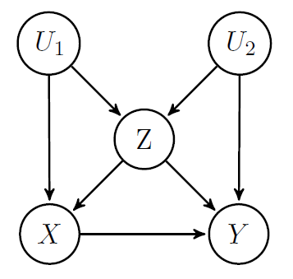
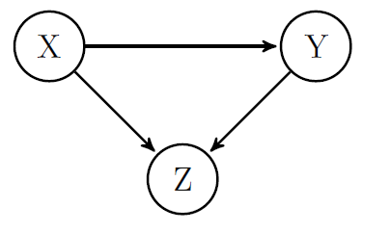
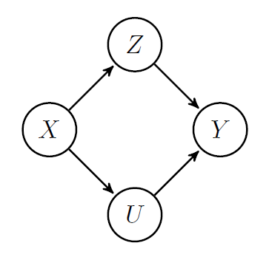
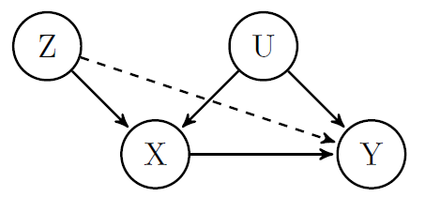
Causal estimation by 'adjusting'
Notes:
Examples of how things go badly by adjusting for the wrong things. (for IV variable case you can see you don't need to adjust graphically. Requires parametric arguaments to see what happens if you do anyway)
Propensity scores – where they fit.

Slide 31
The IC (or SGS) algorithm
1.
2.
3. Orient any undirected edges so as to avoid creating cycles or additional v-structures
a
a
c
a
b
True Causal Model
Inferred output
a
b
c
c
c
A
A
b
b
B
C
B
C
D
D
E
E
Notes:
We can't create cycles by assumption, but why can we be sure there should be no additional v-structures?
To create an additional v-structure, requires a structure of the form a → c – b. But such structures were checked at step 2 and found not to be a → c ← b
This is without latent variables

Slide 32
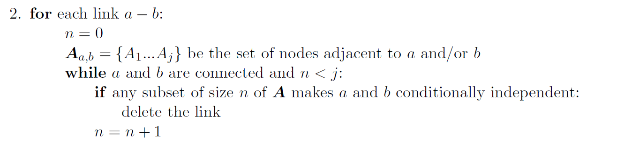
The PC algorithm
A more tractable version of the SGS algorithm

Slide 33
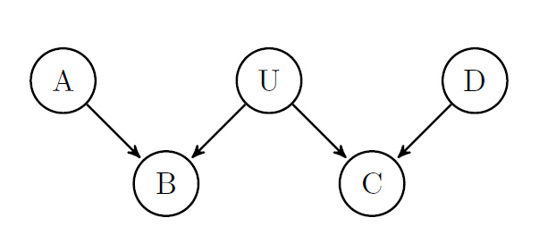
Latent variables
Problems:
  Infinite search space
  The space of causal DAGs is not closed under marginalization

Slide 34
Latent variables
Theorem (Verma 1993):
for any latent structure there is an equivalent structure such that every latent variable is a root node with exactly 2 children.
A
A
L
L
C
D
C
D
Notes:
This allows us to narrow our all the set of latent structures that we consider as possibly accounting for the observed dependencies in the data.
Note we can't collapse the latent variable into its parent (unless the relationship was deterministic)
Mother Overweight
Gene expression
Poor eyesight
Heart disease

