Slide 1
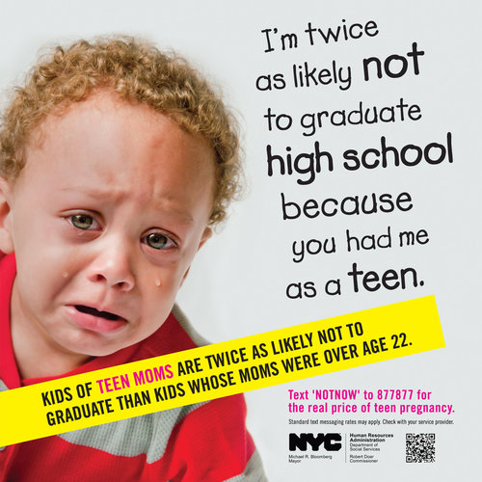
Causal Inference in Machine Learning
<number>
Notes:
<number>

Slide 2
What is causality
<number>
Notes:
<number>

Slide 3
Why do we care?
<number>
Notes:
<number>

Slide 4
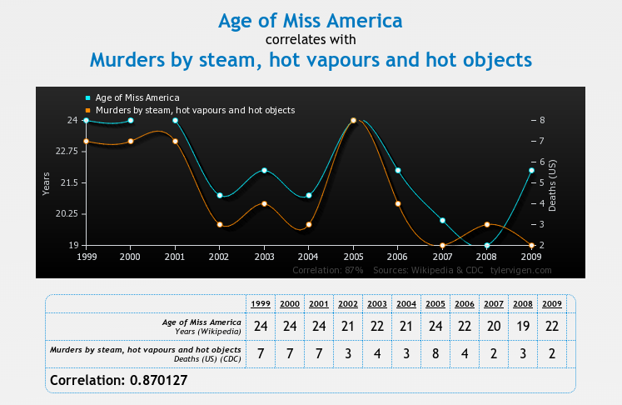
Correlation and Causation
Image source: www.tylervigen.com/
<number>
Notes:
<number>

Slide 5
Approaches to learning to act
Take control of the system and see what happens - Just do it!
Observational causal inference
<number>
Notes:
<number>

Slide 6
Observational causal inference
Mapping from one system to another
<number>
Notes:
<number>

Slide 7
Typical Machine Learning/Statistics
P
What can we learn about the distribution P from a sample of data drawn from it?
Data sampled
from P
Notes:
Because so much of the time, we want to know what will happen if a system is changed by some external factor.
Does causation actually exist in the way we think about it. Probably not (Quantum mechanics suggests not) and what does the term external to the system really mean. What would causality look like to a system that could model every possible variable?
However, the concept of causality as generally perceived by humans is very useful, in that it allows us to break the world into manageable subsets of variables and to predict the outcome of manipulation of subsets of these variables.
This is the fundamental problem we want to solve with causal inference.

Slide 8
Typical Machine Learning/Statistics
P
What can we learn about the distribution P from a sample of data drawn from it?
Data sampled
from P
Notes:
Because so much of the time, we want to know what will happen if a system is changed by some external factor.
Does causation actually exist in the way we think about it. Probably not (Quantum mechanics suggests not) and what does the term external to the system really mean. What would causality look like to a system that could model every possible variable?
However, the concept of causality as generally perceived by humans is very useful, in that it allows us to break the world into manageable subsets of variables and to predict the outcome of manipulation of subsets of these variables.
This is the fundamental problem we want to solve with causal inference.

Slide 9
Causal inference
Do something
P
P'
What can a sample of data from the distribution P tell us about P'?
This is impossible to answer without some assumptions on how 'do something' changes P
Data sampled
from P
Notes:
Because so much of the time, we want to know what will happen if a system is changed by some external factor.
Does causation actually exist in the way we think about it. Probably not (Quantum mechanics suggests not) and what does the term external to the system really mean. What would causality look like to a system that could model every possible variable?
However, the concept of causality as generally perceived by humans is very useful, in that it allows us to break the world into manageable subsets of variables and to predict the outcome of manipulation of subsets of these variables.
This is the fundamental problem we want to solve with causal inference.

Slide 10
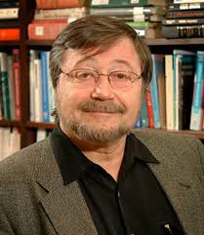
Causal bayesian networks (causal DAGs)
A bayesian network where A → B is defined to mean A causes B
=> Variables are independent of their non-effects given their direct causes (Causal Markov Property)
Poverty
Smoking
Diet
Cancer
Absent links imply the factorisation of the full distribution can be simplified.
$P\left(Po,S,D,C\right)=P\left(Po\right)P\left(S|Po\right)P\left(D|Po,S\right)P\left(C|Po,S,D\right)=P\left(Po\right)P\left(S|Po\right)P\left(D|Po\right)P\left(C|S,D\right)$
Notes:
This ties together the functional definition of causality with the Markov independence property

Slide 11
Causal Bayesian Networks
Mapping from one system to another
<number>
Notes:
<number>

Slide 12
Intervention in Causal DAGs
$P\left(Po,S,D,C\right)=P\left(Po\right)P\left(S|Po\right)P\left(D|Po\right)P\left(C|S,D\right)$
Poverty
Truncated product formula
Drop from terms for intervened on variables from the factorization
Smoking
Diet
Cancer
A causal DAG represents the set of all possible interventional distributions over its variables
$do\left(Smoking=No\right)$
Poverty
Smoking=No
Diet
Cancer
$P\left(Po,D,C|do\left(S=no\right)\right)=P\left(Po\right)P\left(D|Po\right)P\left(C|S=no,D\right)$
Notes:
Without latent variables, it is now trivial to answer what happens if we do(X = x).
Simply delete edges going into the variable X and then condition on X = x
This differs from observing X=x, as in that case the link into X is still there

Slide 13
Other causal frameworks
Counterfactuals
Structural equation models
Granger causality
<number>
Notes:
<number>

Slide 14
Causal Inference
Problem: Given a graph with known structure, predict the outcome of an intervention based on observational data.
Solution: Use the Do Calculus
The Do-calculus rules result from D-separation in a causal DAG
A causal effect is non-parametrically identifiable if and only if the interventional query can be reduced to an observational one via repeat application of the three rules (see Shpitser&Pearl 2012 for algorithm)
Notes:
Now we have a more specific definition of intervention, we can come up with a clearer type of causal query.
This is the query (in practice – it may not be made explicit) asked by the majority of observational studies in economics, social sciences, etc. Anywhere you hear 'after controlling for age, socio-economic status etc'
Non-parametrically identifiable means here we haven't assumed the functional form of the relationship between variables.
Identifiable means point identifiable at the infinite data limit.
You may still be able to get bounds on causal effects, or a point estimate if you are willing to make additional parametric assumptions.

Slide 15
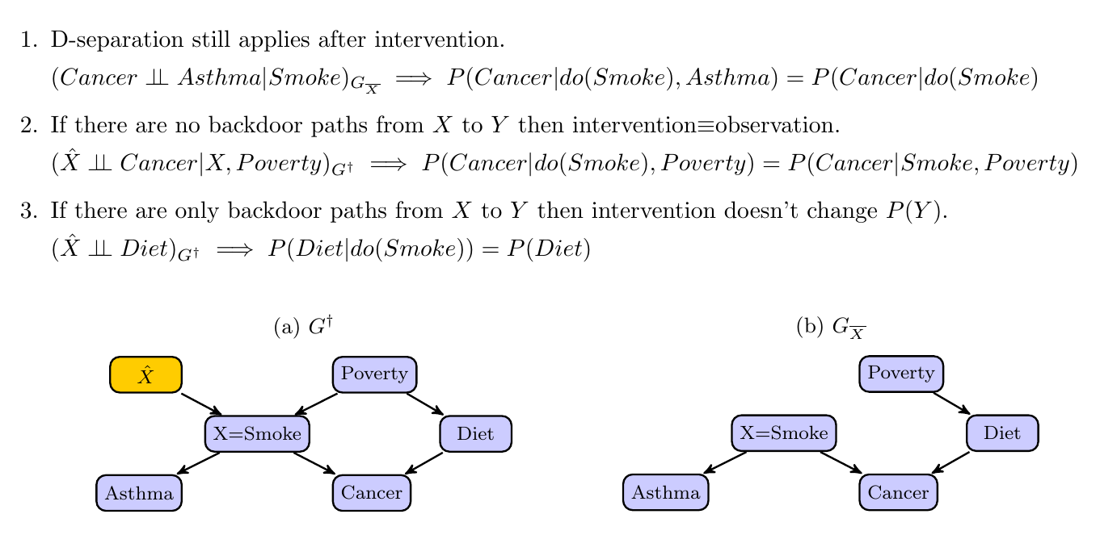
The Do Calculus (simplified)
Notes:
The key to what we are doing here is we are trying to map information we have collected in one graph (pre-intervention) to tell us what the distributions would look like were they generated by another graph (post-intervention).
Elias Barionboims work on transportability follows very similar logic – its about mapping data collected under randomized experiment to a different population (you again need some assumptions about the cuasal structure and how the population differs).

Slide 16
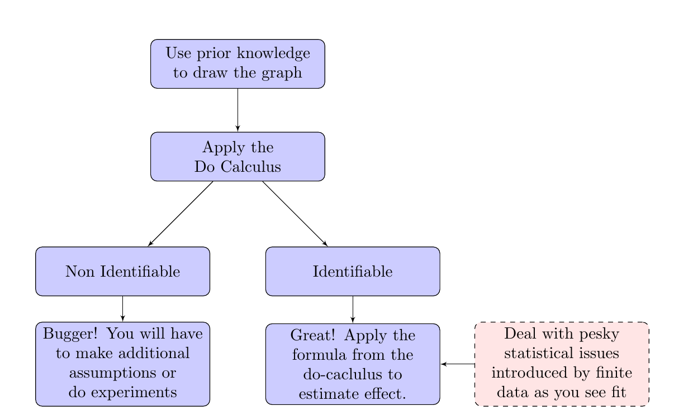
A recipe for causal inference from observational data

Slide 17
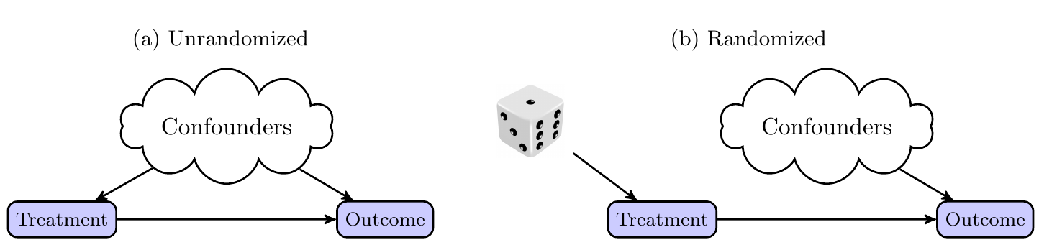
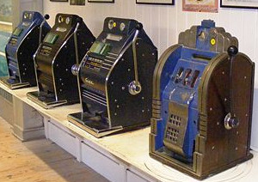
Causal Inference and Bandits
Randomized trials considered gold standard for determining causality
Bandits algorithms can be seen as an improvement on randomized trials that leverage the sequential nature of the decision process.
Can we incorporate ideas from causal inference into the bandit framework?
What problems would this be useful for?
Notes:
Make it clear that what I'm doing
Possibly add a slide after this for bandits. Define basic idea and what we mean by regret.
Sub-linear regret means we are learning.

Slide 18
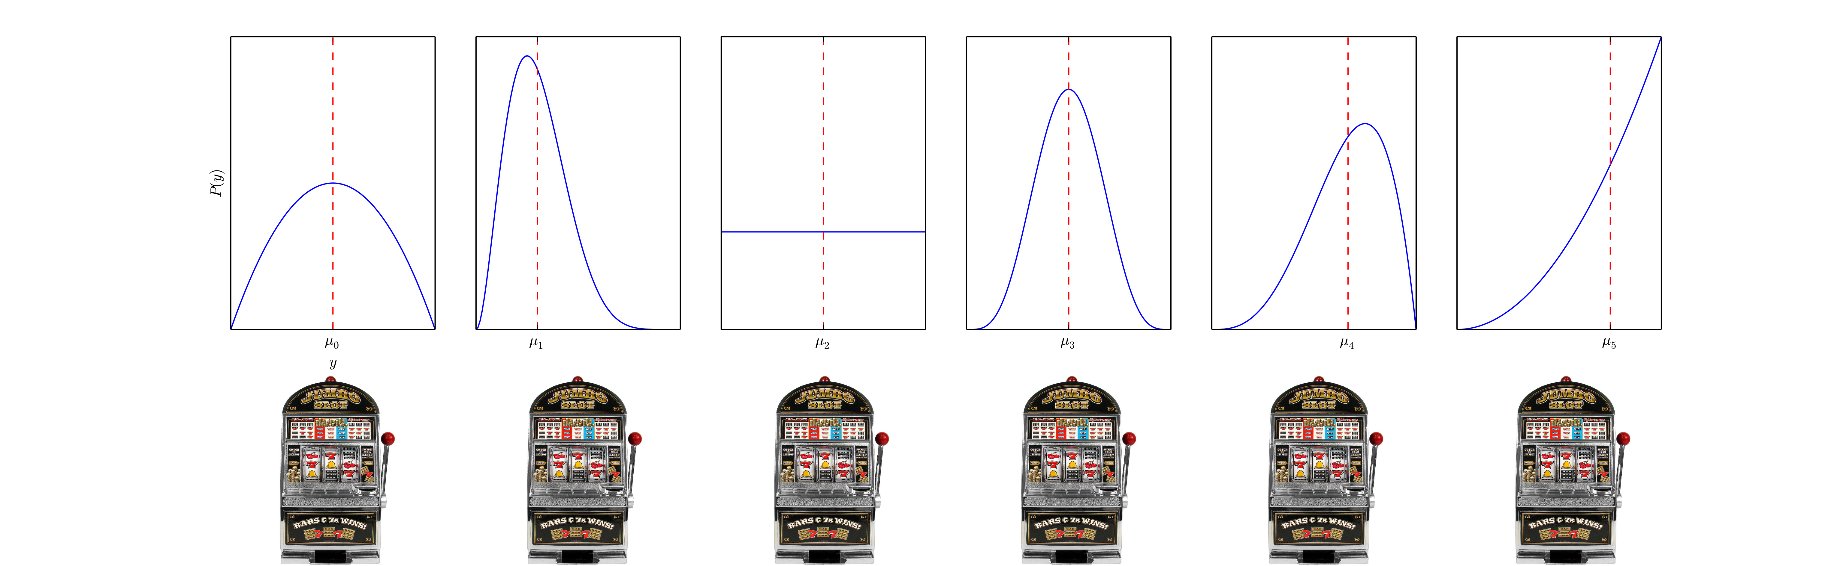
Classic Multi-armed Bandits
Multiple actions (arms). Each associated with an unknown but fixed distribution over reward, y.
Measure algorithm performance in terms of (psuedo)-regret.
We are learning if the regret is sublinear in T. Optimal algorithms get

Slide 19
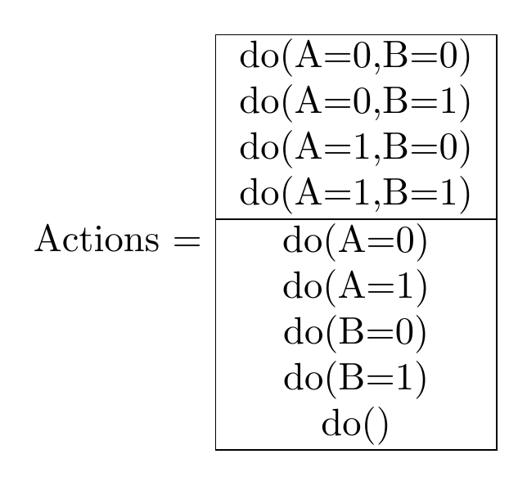

Establishing a link between causal graphs and bandits
Each possible assignment of variables to values that we can make is an action (or bandit arm)
Reward is value of a single specified node in the graph after the action is chosen – cost of actions.
Notes:
A more general formulation for reward would be some function of final state of actions selected and final state of graph.
Problem takes on characteristics of different bandit problems depending on what actions are permissible, what you get to see before you select an action what feedback you get afterward
Number of arms grows exponentially with the number of nodes in the graph.

Slide 20
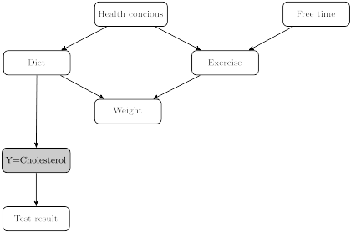
Feedback on reward node only
We can rule out some actions immediately based on the graph structure
Then run a standard bandit algorithm on remaining actions
Network adapted from Koller(2009)
Notes:
State why this is all we can do – probably.
So, in this case there is no point considering actions that set diet and any other variable (as Y is independent of everything else given do(Diet).
There is also never any point in directly intervening to change the cholesterol test result (ie by messing with the machine)

Slide 21
Feedback on additional nodes
Can give us some, but not always full, information on actions that were not selected.
Notes:
Non-full actions involve marginalizing out other variables and thus cannot be optimal unless they cost less. If a full action is optimal, then we can't learn about any of these actions from others – so same situation as previously.
If you can observe everything before you take the action then, you care about the reward for the full joint action action again (which are independent) so again same as before.
If we consider only acting on at most one variable, then we can get extra information on top of that immediately provided by the graph. This information could be built into a bandit algorithm.

Slide 22

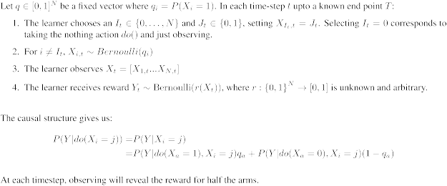
Bernoulli-bandit with causal structure
Assumed causal structure

Slide 23
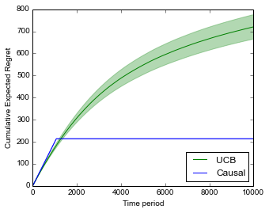
Balanced q,
We can use an explore-exploit style algorithm,
Observe for some number of timesteps, h
Then pick arm with highest estimated mean for remaining time-steps
Optimise h to minimise regret.
We expect to do better if
Comparison of the UCB and causal-explore-exploit for K=20 and T=10000. Note, K ~T^{1/3}.
Notes:
In this case, every time we observe all the arms are equally likely to occur. We get rapid convergence on all the arms by observing.
We get a bound that is practically independent of the number of arms.
If we considered the opposite scenario – where q_i was 0 (or 1) for all i, then we can only ever observe rewards for arms (i,1) by explicitly playing them. So we essentially have a standard bandit problem with K = N arms – and thus still order sqrt(KT) regret.

Slide 24
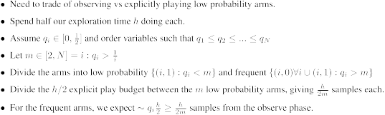
Arbitrary q
Goal, quantify how unbalanced an arbitrary q is and get a regret bound in terms of that.
Example: q = [ 0.03 0.12 0.32 0.33 0.33 0.35 0.41 0.45 0.49 0.49], m = 4
Notes:
The above sketch is for the case where we know the vector q (and thus m) in advance.
A more complex version of this algorithm lets us learn m and still achieves the same order regret.

Slide 25
Summary and future
Lower bounds (is the algorithm above roughly as good as it gets?)
Return to case where we get feedback only on reward node, but consider if the graph is not (fully) known. Can we learn it and use it to eliminate actions simultaneously.
Does NICTA have any data/problems where we should try out causal inference techniques?

Slide 26
References
Pearl, J. (2000). Causality: models, reasoning and inference
Tom Claassen, J Mooij, and Tom Heskes. Learning sparse causal models is not NP-hard. arXiv Prepr. ArXiv1309.6824, 2013.
PO Hoyer, Dominik Janzing, and JM Mooij. Nonlinear causal discovery with additive noise models. Adv. Neural . . . , 2009.
Kun Zhang and A Hyvarinen. On the identiability of the post-nonlinear causal model.Proc. Twenty-Fifth Conf. . . . , 2009.
P Daniusis, Dominik Janzing, and Joris Mooij. Inferring deterministic causal relations.arXiv Prepr. arXiv . . . , pages 2-9, 2012.
Jiji Zhang. On the completeness of orientation rules for causal discovery in the presence of latent confounders and selection bias. Artif. Intell., 172(16-17):1873{1896, November 2008
Koller, D., & Friedman, N. (2009). Probabilistic graphical models: principles and techniques. (chapters 3 & 21)
Verma 1993 Graphical aspects of causal models Technical Report. UCLA
Spirtes, P., Glymour, C. N., & Scheines, R. (2000). Causation, prediction, and search.
Maathuis, Marloes H., et al. (2010) Predicting causal effects in large-scale systems from observational data. Nature Methods 7.4 : 247-248.
Kalisch, Markus, et al. (2012) Causal inference using graphical models with the R package pcalg. Journal of Statistical Software 47.11 : 1-26.
Shpitser, Ilya, and Judea Pearl. "Identification of conditional interventional distributions." arXiv preprint arXiv:1206.6876 (2012).
Dominik Janzing and Jonas Peters. On causal and anticausal learning JMLR. , 2012.
David Lopez-Paz, Krikamol Muandet, and Benjamin Recht. The Randomized Causation Coefficient. September 2014.
TS Richardson and JM Robins. Single world intervention graphs (SWIGs): a unication of the counterfactual and graphical approaches to causality. Cent. Stat. . . . , (128), 2013.
Jonas Peters, J Mooij, Dominik Janzing, and B Scholkopf. Causal discovery with continuous additive noise models. J. Mach. Learn. Res. 2014.
Sachs, Karen, et al. "Causal protein-signaling networks derived from multiparameter single-cell data." Science 308.5721 (2005): 523-529.
Ebert‐Uphoff, Imme, and Yi Deng. "A new type of climate network based on probabilistic graphical models: Results of boreal winter versus summer." Geophysical Research Letters 39.19 (2012).
Taruttis, Franziska, Rainer Spang, and Julia C. Engelmann. "A statistical approach to virtual cellular experiments: improved causal discovery using accumulation IDA (aIDA)." Bioinformatics (2015): btv461.
Statnikov, Alexander, et al. "New methods for separating causes from effects in genomics data." BMC genomics 13.Suppl 8 (2012): S22.
Smith, Stephen M., et al. "Network modelling methods for FMRI." Neuroimage 54.2 (2011): 875-891.
Ramsey, Joseph D., et al. "Six problems for causal inference from fMRI." Neuroimage 49.2 (2010): 1545-1558
Iyer, Swathi P., et al. "Inferring functional connectivity in MRI using Bayesian network structure learning with a modified PC algorithm." Neuroimage 75 (2013): 165-175.
Ruzzano, Laura, Denny Borsboom, and Hilde M. Geurts. "Repetitive Behaviors in Autism and Obsessive–Compulsive Disorder: New Perspectives from a Network Analysis." Journal of autism and developmental disorders 45.1 (2015): 192-202.

Slide 27
Random thoughts
Causality, interpretability and ethics

Slide 28
Causal deep learning
This is finding a good representation. A way of breaking up the information available into variables in such a way as to allow a good model to be found. This is what deep networks are apparently doing. Is that right? Because they can effectively represent a very large number of different ways of combining whatever is initially chosen as a feature. So what is a good way to break up data into features for causal inference/discovery. We don't want to much entanglement. Come up with simple examples on generated data. How you take a feature and encode effects what space of models is explored. The 'variables' as they come in in the data are by no means the only description for that data. Do we encode something as a single variable with more levels or as two binary variables. Eg -

Slide 29
Adding power via causal assumptions
If you run a randomized trial where there are many uncontrolled confounders strongly effecting the outcome, the variance within treatment and control groups will be high – reducing the power of the study.
Adjusting for these variables increases the power of the study but at the risk of introducing bias.

Slide 30
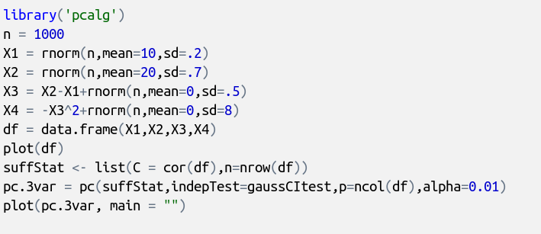
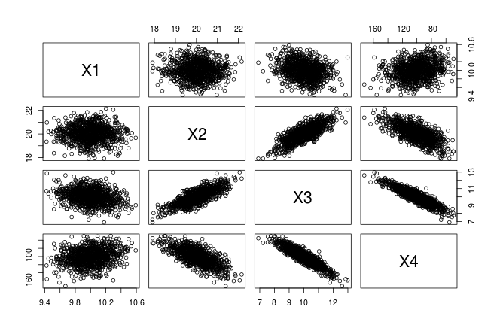
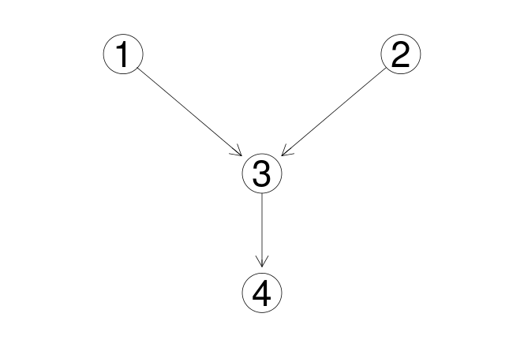
Causal structure learning in R (pcalg)

Slide 31
Causal Inference in Machine Learning
Abstract
Inferring causal relationships is central to many problems involving decision making or predicting the outcome of an intervention. The past two decades has seen substantial progress formalising frameworks and developing algorithms for causal inference, particularly utilising graphical models.
Bandit algorithms, an example of reinforcement learning, present an alternative approach to decision making that takes account of the sequential nature of many such problems.
I will present a review of the key ideas in causal inference and discovery, discuss how we might start to merge them with the bandit framework and present some preliminary results demonstrating that we can incorporate causal assumptions to improve the performance of bandit algorithms.

