Slide 1

Causal Inference in Machine Learning
Finnian Lattimore (finnlattimore@gmail.com)
Notes:
Correlation does not imply causation - True and important. Please don't leave this talk with the notion that correlation is causality.
But if you are trained in classical statistics, you may believe correlation can tell us NOTHING about causality. This is less true. Its more complicated than that.

Slide 2

Ways things can go wrong
Image source: www.tylervigen.com/
Notes:
Two ways of things going wrong in causal inference.

Slide 3
Machine Learning/Statistics
P
What can we learn about the distribution P from a sample of data drawn from it?
Data sampled
from P
Notes:
Because so much of the time, we want to know what will happen if a system is changed by some external factor.
Does causation actually exist in the way we think about it. Probably not (Quantum mechanics suggests not) and what does the term external to the system really mean. What would causality look like to a system that could model every possible variable?
However, the concept of causality as generally perceived by humans is very useful, in that it allows us to break the world into manageable subsets of variables and to predict the outcome of manipulation of subsets of these variables.
This is the fundamental problem we want to solve with causal inference.

Slide 4
Causal inference
Do something
P
P'
What can a sample of data from the distribution P tell us about P'?
This is impossible to answer without some assumptions on how 'do something' changes P
Data sampled
from P
Notes:
Because so much of the time, we want to know what will happen if a system is changed by some external factor.
Does causation actually exist in the way we think about it. Probably not (Quantum mechanics suggests not) and what does the term external to the system really mean. What would causality look like to a system that could model every possible variable?
However, the concept of causality as generally perceived by humans is very useful, in that it allows us to break the world into manageable subsets of variables and to predict the outcome of manipulation of subsets of these variables.
This is the fundamental problem we want to solve with causal inference.

Slide 5
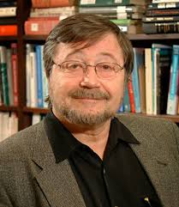
Causal bayesian networks
(causal DAGs)
A bayesian network where A → B is defined to mean A causes B
=> Variables are independent of their non-effects given their direct causes (Causal Markov Property)
Poverty
Smoking
Diet
Cancer
Absent links imply the factorisation of the full distribution can be simplified.
Notes:
This ties together the functional definition of causality with the Markov independence property

Slide 6
Intervention in Causal DAGs
Poverty
Truncated product formula
Drop from terms for intervened on variables from the factorization
Smoking
Diet
Cancer
A causal DAG represents the set of all possible interventional distributions over its variables
Poverty
Smoking=No
Diet
Cancer
Notes:
Without latent variables, it is now trivial to answer what happens if we do(X = x).
Simply delete edges going into the variable X and then condition on X = x
This differs from observing X=x, as in that case the link into X is still there

Slide 7
Causal Inference
Problem: Given a graph with known structure, predict the outcome of an intervention based on observational data.
Solution: Use the Do Calculus
  The Do-calculus rules result from D-separation in a causal DAG
  A causal effect is non-parametrically identifiable if and only if the interventional query can be reduced to an observational one via repeat application of the three rules (see Shpitser&Pearl 2012 for algorithm)
Notes:
Now we have a more specific definition of intervention, we can come up with a clearer type of causal query.
This is the query (in practice – it may not be made explicit) asked by the majority of observational studies in economics, social sciences, etc. Anywhere you hear 'after controlling for age, socio-economic status etc'
Non-parametrically identifiable means here we haven't assumed the functional form of the relationship between variables.
Identifiable means point identifiable at the infinite data limit.
You may still be able to get bounds on causal effects, or a point estimate if you are willing to make additional parametric assumptions.

Slide 8
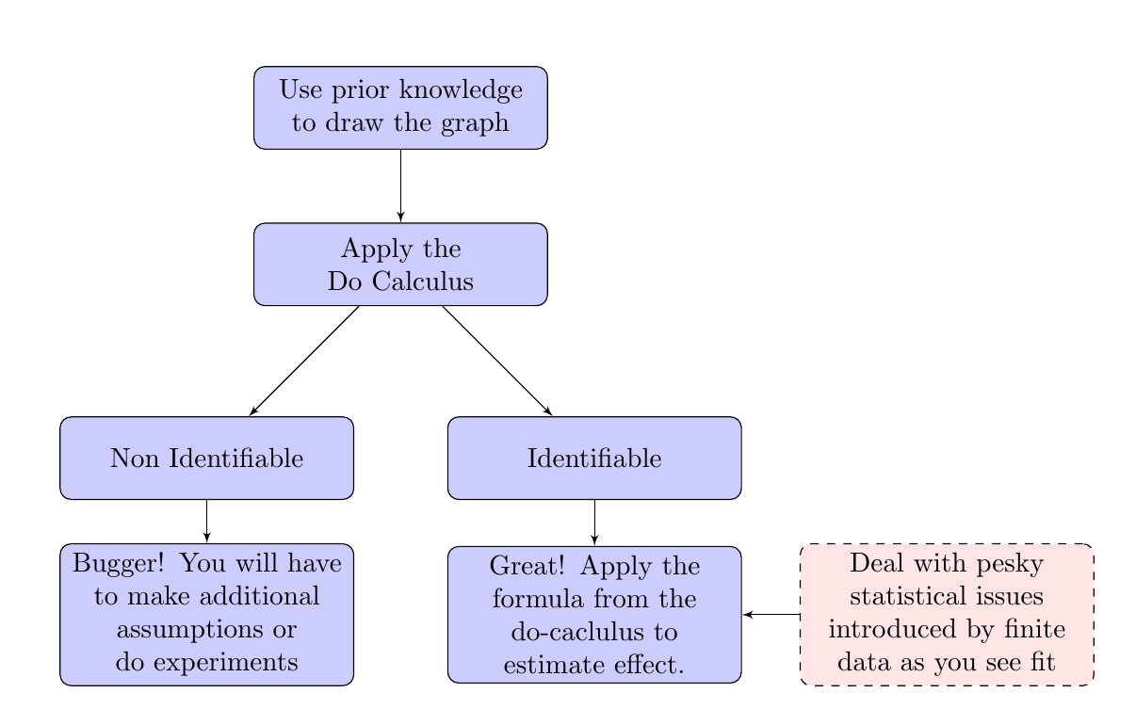
A recipe for causal inference from observational data

Slide 9
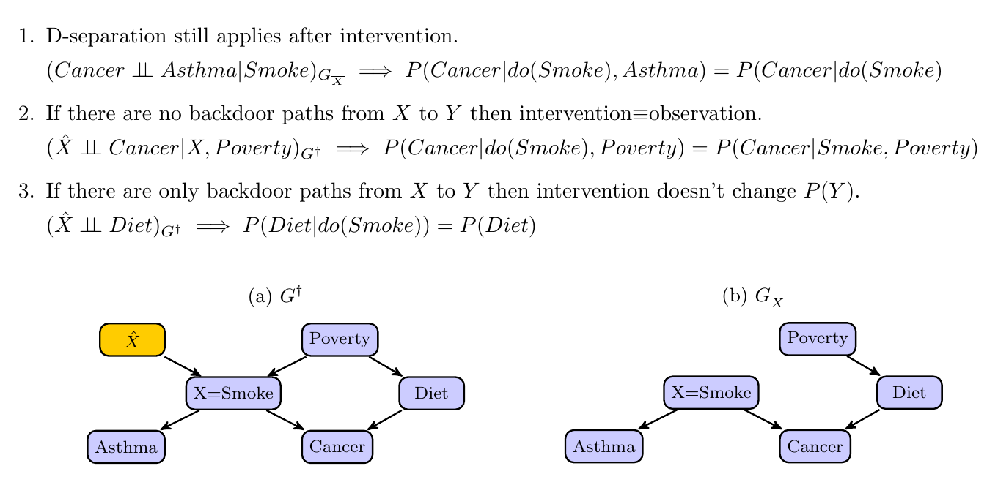
The Do Calculus (simplified)
Notes:
The key to what we are doing here is we are trying to map information we have collected in one graph (pre-intervention) to tell us what the distributions would look like were they generated by another graph (post-intervention).
Elias Barionboims work on transportability follows very similar logic – its about mapping data collected under randomized experiment to a different population (you again need some assumptions about the cuasal structure and how the population differs).

Slide 10
Causal Discovery when you don't know the graph

Slide 11
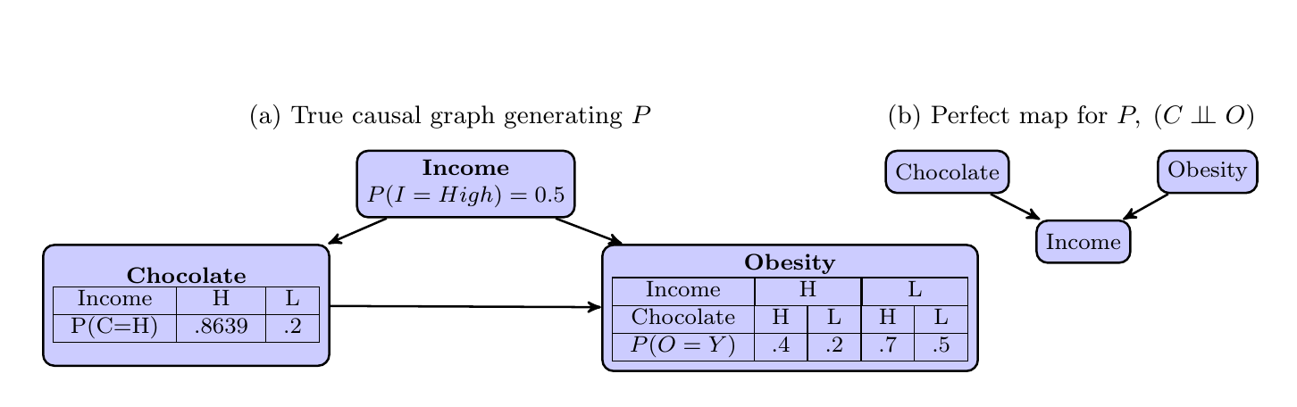
Independence based methods
1) We assume our distribution P was generated by some (unknown) causal DAG over our observed variables (causal sufficiency)
2) We assume that all the conditional independences in P are implied by d-separation in the true causal network (faithfulness)
3) Finding the causal structure equates to finding the graph(s) that imply exactly the set of conditional independence relations as are observed in P.
An example violating faithfulness
Notes:
4) If 1) or 2) does not hold then a perfect map for P may not exist.

Slide 12
Independence based Algorithms
Constraint based
  IC/SGS algorithm Sprites 2000/Pearl 2000
  PC
  FCI
  RFCI
Search and Score
  GES
Notes:
Constraint based methods are based on conditional independence tests. Errors early can propagate. Non-parametric conditional independence tests are not so straightforward. (Kernel based methods).
Assuming everything is linear and guassian makes things much easier.
Note which support latent variables. (not GES?)
Read up and understand exactly how GES scores each proposal graph and how it generates new proposals and what guarentees there are for convergence …
Also would be nice to know roughly what sized graphs each can handle (current implementations/research)

Slide 13
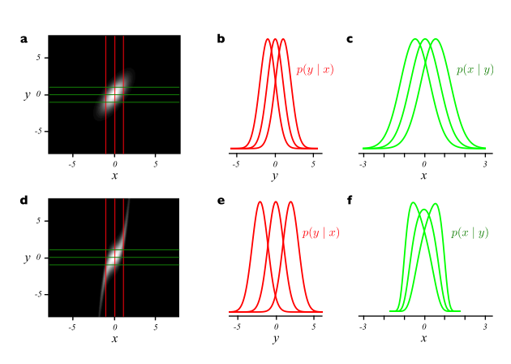
Beyond conditional independence
X
Y
Y
vs
X
Additive noise:
Figure 1, (Hoyer et al 2009)
Can be extended to post-non-linear additive noise, , (Zhang et al 2009)
Can be extended beyond bi-variate graphs. (Peters et al 2014)
Notes:
In practice one does regression of y vs x to estimate the function f and then test to see if the residuals f-y are independent of x (then do it in reverse)

Slide 14
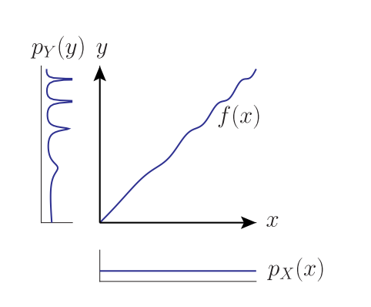
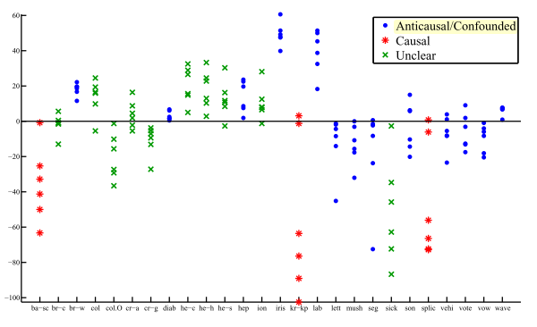
More asymmetries of cause and effect
X
Y
Y
vs
X
Figure 1: Daniusis et al 2012
Independence of function and input: If X → Y and we have a functional causal model y = f(x) then the input
distribution P(X) and function f represent independent mechanisms. Changing the input distribution does not modify the function itself.
We expect P(Y|X) to be related to P(Y) but not to P(X)
Semi-supervised learning supplements data sampled from P(X,Y) with additional points from P(X) with the goal of learning P(Y|X). If X → Y the additional data should not help.
Figure 6, Janzing & Peters 2012

Slide 15
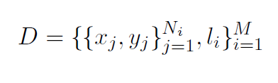


Learning what causality looks like
See Lopez-Paz et al 2014

Slide 16
Applications
Some links to research that have applied some of these methods...A first place to look would be follow up papers from that symposium on causal inference.

Slide 17
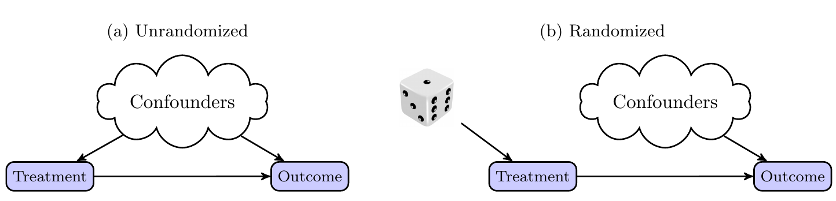
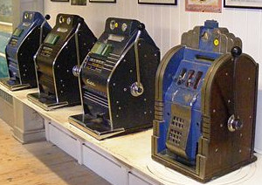
Causal Inference and Bandits
Randomized trials considered gold standard for determining causality
Bandits algorithms can be seen as an improvement on randomized trials that leverges the sequential nature of the decision process
Can we incorporate ideas from causal inference into the bandit framework?
What problems would this be useful for?
Causal inference techniques let you infer outcomes of an intervention from data collected under a different scenario – this suggests we might be able to combine causal inference with bandit algorithms.

Slide 18
Establishing a link between causal graphs and bandits
Each possible assignment of variables to values that we can make is an action (or bandit arm)
Reward is value of a single specified node in the graph after the action is chosen – cost of actions.
Problem takes on characteristics of different bandit problems depending on what you get to see before you select an action what feedback you get afterward
Notes:
A more general formulation for reward would be some function of final state of actions selected and final state of graph.

Slide 19
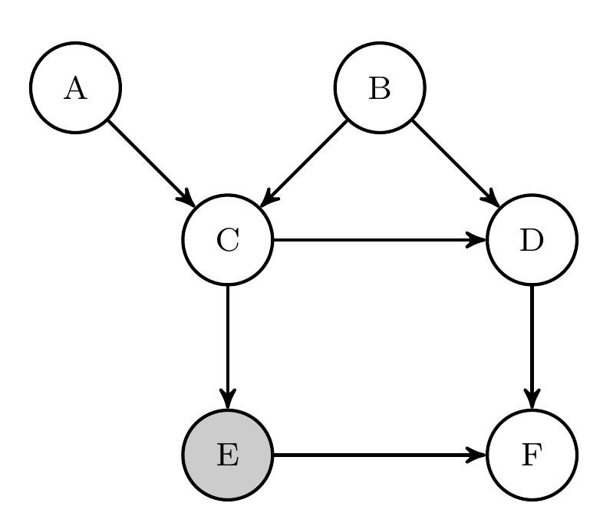
Feedback on reward node only
We can rule out some actions immediately based on the graph structure
Then run a standard bandit algorithm on remaining actions

Slide 20
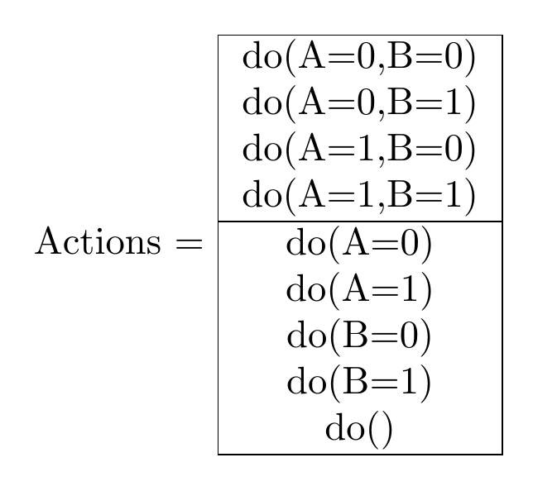
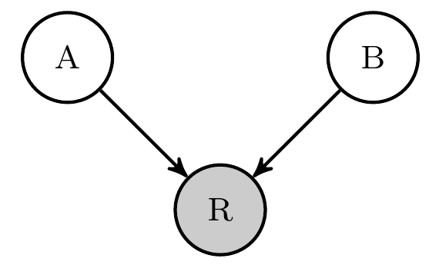
Feedback on additional nodes
Can give us some, but not always full, information on actions that were not selected.
Notes:
Non-full actions involve marginalizing out other variables and thus cannot be optimal unless they cost less. If a full action is optimal, then we can't learn about any of these actions from others – so same situation as previously.
If we consider only acting on at most one variable, then we can get extra information on top of that immediately provided by the graph. This information could be built into a bandit algorithm.

Slide 21
References
Pearl, J. (2000). Causality: models, reasoning and inference
Tom Claassen, J Mooij, and Tom Heskes. Learning sparse causal models is not NP-hard. arXiv Prepr. ArXiv1309.6824, 2013.
PO Hoyer, Dominik Janzing, and JM Mooij. Nonlinear causal discovery with additive noise models. Adv. Neural . . . , 2009.
Kun Zhang and A Hyvarinen. On the identiability of the post-nonlinear causal model.Proc. Twenty-Fifth Conf. . . . , 2009.
P Daniusis, Dominik Janzing, and Joris Mooij. Inferring deterministic causal relations.arXiv Prepr. arXiv . . . , pages 2-9, 2012.
Jiji Zhang. On the completeness of orientation rules for causal discovery in the presence of latent confounders and selection bias. Artif. Intell., 172(16-17):1873{1896, November 2008
Koller, D., & Friedman, N. (2009). Probabilistic graphical models: principles and techniques. (chapters 3 & 21)
Verma 1993 Graphical aspects of causal models Technical Report. UCLA
Spirtes, P., Glymour, C. N., & Scheines, R. (2000). Causation, prediction, and search.
Maathuis, Marloes H., et al. (2010) Predicting causal effects in large-scale systems from observational data. Nature Methods 7.4 : 247-248.
Kalisch, Markus, et al. (2012) Causal inference using graphical models with the R package pcalg. Journal of Statistical Software 47.11 : 1-26.
Shpitser, Ilya, and Judea Pearl. "Identification of conditional interventional distributions." arXiv preprint arXiv:1206.6876 (2012).
Dominik Janzing and Jonas Peters. On causal and anticausal learning JMLR. , 2012.
David Lopez-Paz, Krikamol Muandet, and Benjamin Recht. The Randomized Causation Coefficient. September 2014.
TS Richardson and JM Robins. Single world intervention graphs (SWIGs): a unication of the counterfactual and graphical approaches to causality. Cent. Stat. . . . , (128), 2013.
Jonas Peters, J Mooij, Dominik Janzing, and B Scholkopf. Causal discovery with continuous additive noise models. J. Mach. Learn. Res. 2014.

Slide 22

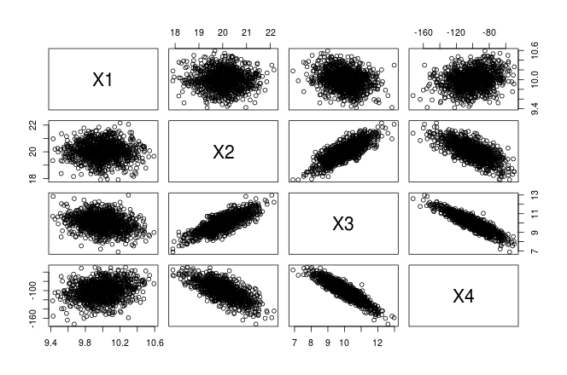
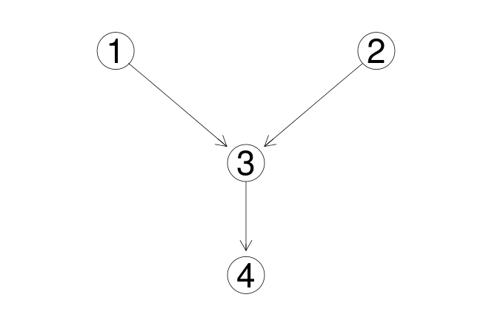
Causal structure learning in R (pcalg)

