Slide 1
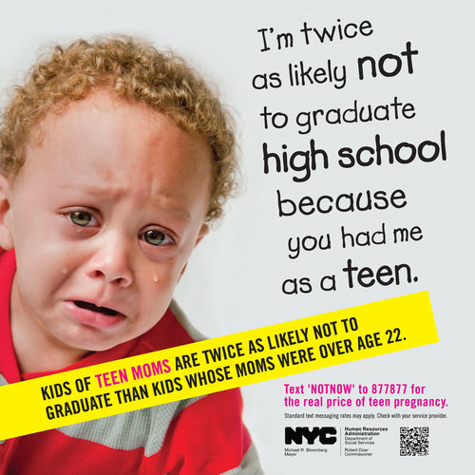
Correlation is not causation
Notes:
Correlation does not imply causation - True and important. Please don't leave this talk with the notion that correlation is causality.
But if you are trained in classical statistics, you may believe correlation can tell us NOTHING about causality. This is less true. Its more complicated than that.

Slide 2
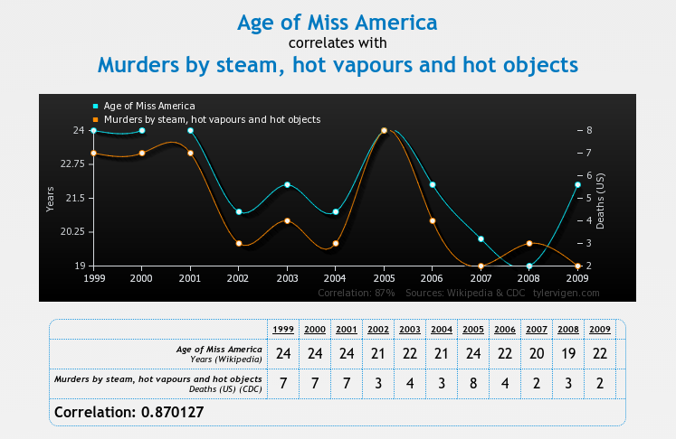
Ways things can go wrong
Image source: www.tylervigen.com/
Notes:
When you think correlation is not causation you might have one of two possible pitfalls in mind.
1) The issue is that a unobserved (or latent variable) is causing both of the variables you are considering. The relationship is predictive. Collecting additional data does not help.
2) The issue is one of two many variables relative to the size of the data set. Some variables will be found to be similar by chance. This relationship would not be predictive. More data would help
I'm not considering the 2nd point in this talk. For the remainder of the talk, I assume that I have enough data that I can correctly infer (at a minimum) which variables are genuinely correlated.

Slide 3
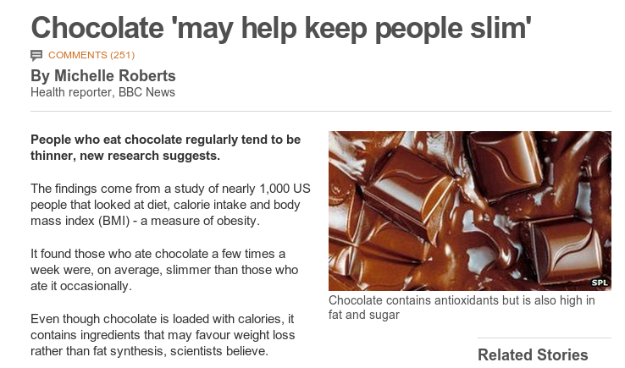
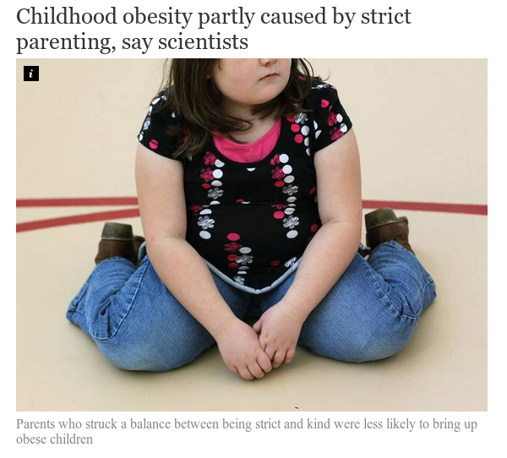
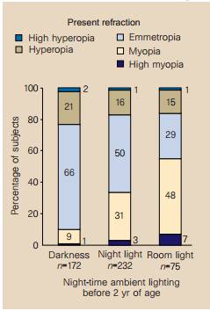
We care about causality
http://www.bbc.com/news/health-17511011
Sleeping with the light on is associated with short-sightedness in kids.
Quinn, Graham E., et al. "Myopia and ambient lighting at night." Nature 399.6732 (1999): 113-114
http://www.independent.co.uk/life-style/health-and-families/health-news/childhood-obesity-partly-caused-by-strict-parenting-say-scientists-9206147.html
Notes:
Chocolate study corrected for age, sex, other calories, mood
Obesity study Kakinami, Lisa, Tracie Barnett, and Gilles Paradis. "Abstract MP34: In Praise of Demanding Parenting: The Effects of Parenting Style and Poverty on Obesity Risk in Children: Evidence from a Nationally Representative Sample." Circulation 129.Suppl 1 (2014): AMP34-AMP34.
Corrected for poverty (but not education as far as I could tell)

Slide 4
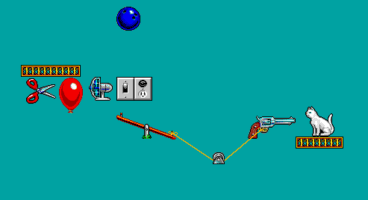




Machine Learning
P
Use data generated by a process P to make a model that can predict some variable(s) in terms of others
Data sampled from P
?
Notes:
Though experiments with unfortunate outcomes for cats are traditional in physics...
Note, the machine learning algorithm has not learned any physics here. It is just noting a pattern between what happens to the balloon and what happens to the cat.

Slide 5

Causal inference
P
P’
Do something
?
Data sampled from P
?
What can the data from P tell us about P'?
Notes:
What will happen if a system is changed by some external factor?
Inference is impossible unless we say something about how the system has been changed.
We need a way to describe how the variables in the system are related in a way that lets us map knowledge of the distributions of variables sampled from P to the distribution of variables sampled from P’.
The concept of causality as generally perceived by humans is very useful, in that it allows us to break the world into manageable subsets of variables and to predict the outcome of manipulation of subsets of these variables.

Slide 6
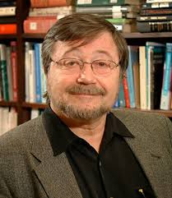
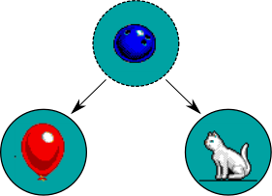
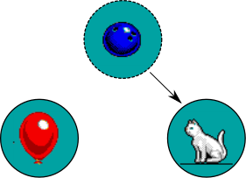
Causal bayesian networks
Just consider changes to P that fix the value of some variable(s)
A causes B if changing the system such that A is forced to some value, do(A=a), can change the distribution of B.
A directly causes B, (A → B) if changing A still changes B, after holding constant all other variables that are causes of B and consequences of A.
P
P’
Causal network for original system
Causal network after do(Balloon = ?)
Notes:
This ties together the functional definition of causality with the Markov independence property

Slide 7
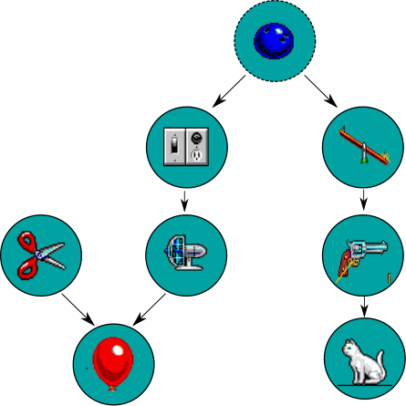
Causal bayesian networks
A directly causes B, (A → B) if changing A still changes B, after holding constant all other variables that are causes of B and consequences of A. (This depends on what variables we consider)
Notes:
This ties together the functional definition of causality with the Markov independence property

Slide 8
Causal bayesian networks
Causal bayesian networks have same factorisation properties as regular bayesian networks.
The key extra thing they give you is a way to go from the original network, to the network given an intervention on any variable (just delete all the links into the set variable).
Notes:
This ties together the functional definition of causality with the Markov independence property

Slide 9
Interlude: what happened to the cat?
Notes:
This ties together the functional definition of causality with the Markov independence property

Slide 10
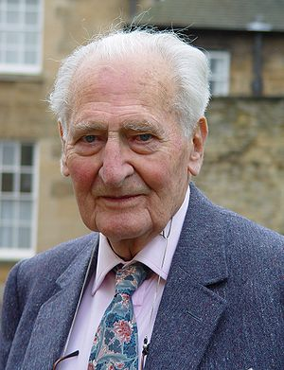
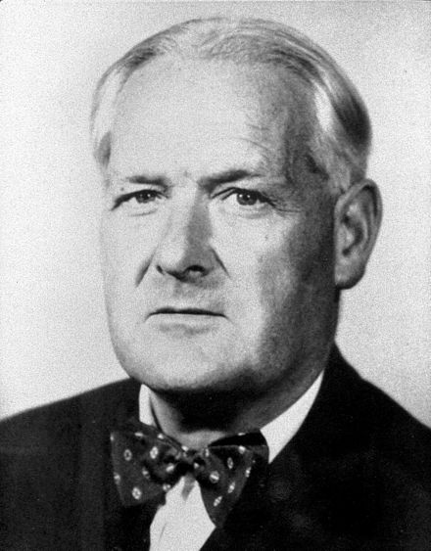
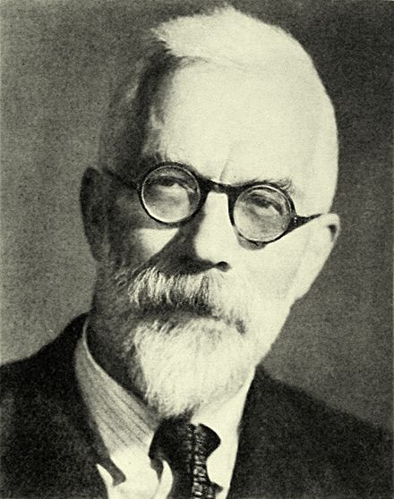
A real life example
Genetics
Smoking
Cancer
Smoking
Cancer
Genetics
Smoking
Cancer
heavy smokers 30 times more likely to die of lung cancer than non-smokers, but does smoking cause lung cancer?
Notes:
Richard Doll
Austin Bradford Hill
Epidemiologists found a very strong association between smoking and lung cancer. Heavy cigarette smokers were 30 times more likely to die from lung cancer.
Fisher thought this was due to genetics that made some people more likely to smoke and also more likely to get cancer.
Ronald Fisher – famous statistician and biologist. Invented ANOVA, many key statistical tests,

Slide 11


The do calculus
When can we estimate the effect of intervening on X on Y (from observational data)?
Z
X
Y
X
Y
X
Y
X
Y
Z
X
Z
Y
X
Y
X
Z
Y
X
X
Z
Y
X
Z
Y
Notes:
An algorithm, that determines if you can identify the causal effect of X on Y from observational data.
Here are some examples.

Slide 12
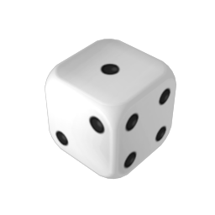
Estimating causal effects
Genetics
How can we solve this smoking problem?
Smoking
Cancer
Genetics
Genetics
Smoking
Cancer
Smoking
Cancer
Observational (adjust for genetics)
Randomised experiment
Notes:
Experiments work by breaking the link between the intervention variable and everything else.
Here’s some problems with experiments
- the experiment is not ethical or feasible
- the intervention is not random (or people non randomly ignore it)
- the intervention spills over to the control group
- the experiment is only feasible in some contrived setting, not one representative of the real world.
- the noise is too high.
Here’s some ways observational inference can fail
- there is an unobserved confounder that has not been included.
- the noise is too high.

Slide 13
Estimating causal effects
Genetics
How can we solve this smoking problem?
Smoking
Cancer
Genetics
Genetics
Smoking
Cancer
Smoking
Cancer
Observational (adjust for genetics)
Randomised experiment
Notes:
Experiments work by breaking the link between the intervention variable and everything else.
Here’s some problems with experiments
- the experiment is not ethical or feasible
- the intervention is not random (or people non randomly ignore it)
- the intervention spills over to the control group
- the experiment is only feasible in some contrived setting, not one representative of the real world.
- the noise is too high.
Here’s some ways observational inference can fail
- there is an unobserved confounder that has not been included.
- the noise is too high.

Slide 14
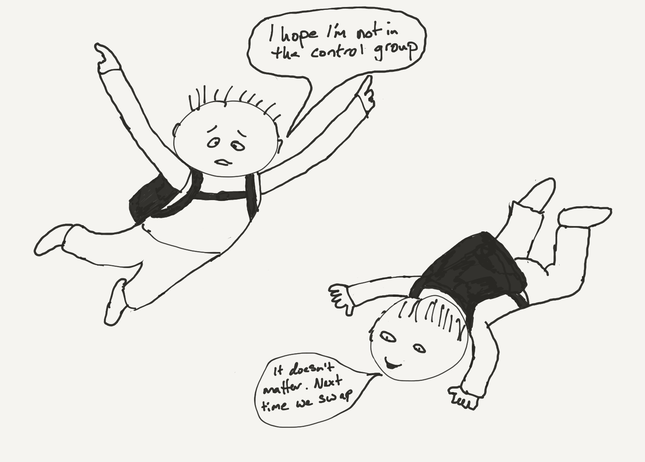
Experiments
Parachute use to prevent death and major trauma related to gravitational challenge: systematic review of randomised controlled trials
“We think that everyone might benefit if the most radical protagonists of evidence based medicine organised and participated in a double blind, randomised, placebo controlled, crossover trial of the parachute.”
Notes:
Experiments work by breaking the link between the intervention variable and everything else.
Here’s some problems with experiments
- the experiment is not ethical or feasible
- the intervention is not random (or people non randomly ignore it)
- the intervention spills over to the control group
- the experiment is only feasible in some contrived setting, not one representative of the real world.
- the noise is too high.
Here’s some ways observational inference can fail
- there is an unobserved confounder that has not been included.
- the noise is too high.

Slide 15
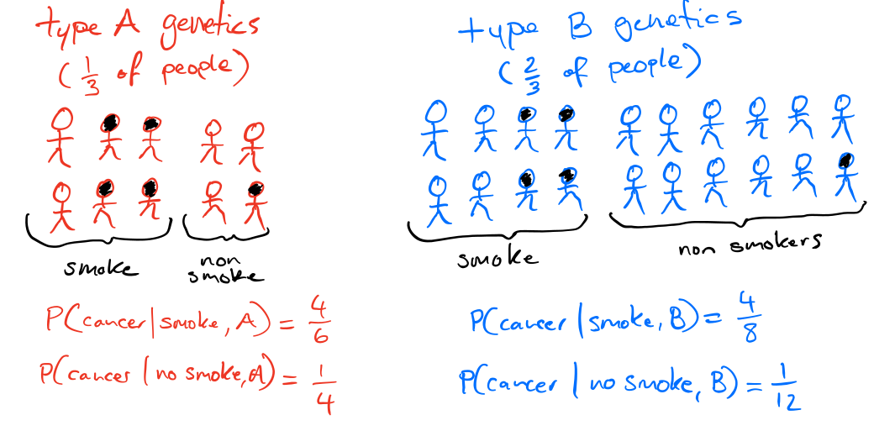
Adjusting for confounding
Genetics
Smoking
Cancer
Notes:
Experiments work by breaking the link between the intervention variable and everything else.
Here’s some problems with experiments
- the experiment is not ethical or feasible
- the intervention is not random (or people non randomly ignore it)
- the intervention spills over to the control group
- the experiment is only feasible in some contrived setting, not one representative of the real world.
- the noise is too high.
Here’s some ways observational inference can fail
- there is an unobserved confounder that has not been included.
- the noise is too high.

Slide 16
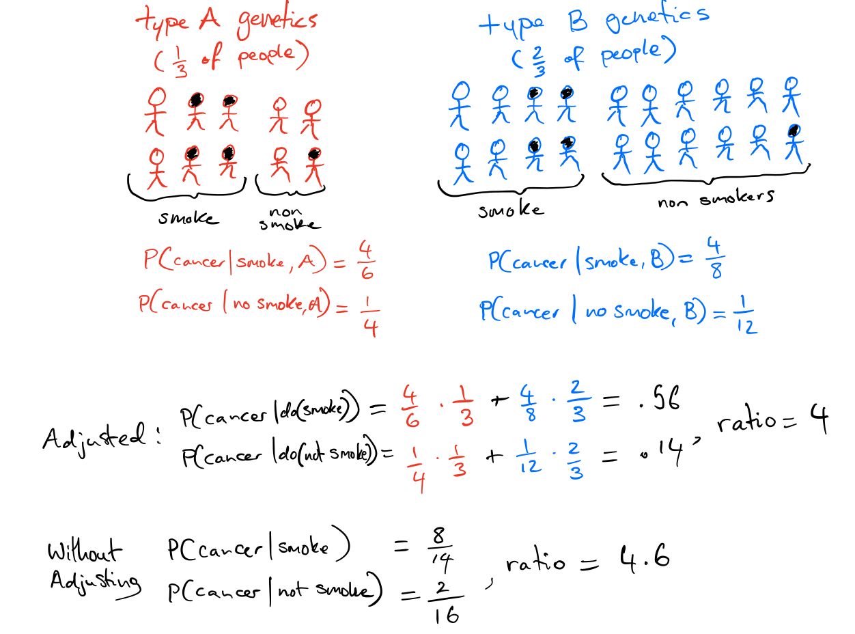
Adjusting for confounding variables
Notes:
Experiments work by breaking the link between the intervention variable and everything else.
Here’s some problems with experiments
- the experiment is not ethical or feasible
- the intervention is not random (or people non randomly ignore it)
- the intervention spills over to the control group
- the experiment is only feasible in some contrived setting, not one representative of the real world.
- the noise is too high.
Here’s some ways observational inference can fail
- there is an unobserved confounder that has not been included.
- the noise is too high.

Slide 17
Which variables do you adjust for?
Should you adjust?
Yes definitely
Probably
Probably not
Definitely not
D
F
E
X
G
Y
H
Notes:
The key is the position of the variable in the causal graph matters.
It comes down to d-seperation, to identify which variables should be conditioned on to remove confounding bias (in asymptotic regime)
Conditioning on variables like E helps reduce noise
Conditioning on variables like F can increase noise (if you look at adjustment as a covariate shift problem)

Slide 18
Marketing mixed model example
?
Media spend $
(excl. branded search)
Competitor spend $
Tarps, GRPs,
impressions,...
people exposed to ads
Creative
quality
peoples awareness
& attitude to brand
Brand metrics
Unemployment
etc,
people
considering buy
Consideration
metrics
Consideration
metrics
Branded
Search $
People quoting
Relative pricing
Sales
Notes:
The real world is complicated …

Slide 19
Regression is causal inference?
The coefficient says how much increases when increases by 1, holding all the other variables fixed.
If the causal graph is such that the all the other variables is a valid set to adjust for, the regression coefficient(s) have a causal interpretation.
Notes:
This holding fixed is equivalent to ‘adjusting’ for all the other X variables.

Slide 20
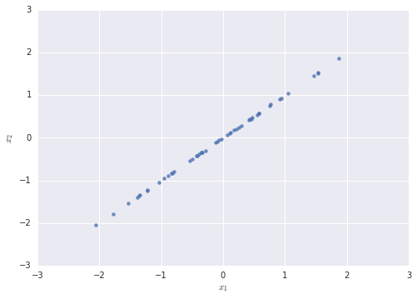


Co-linearity
You are building a model, and two columns are highly correlated. Does that matter?
Machine learner
Yes, it can be a
huge problem
Economist
No
Notes:
It depends who you ask ...

Slide 21
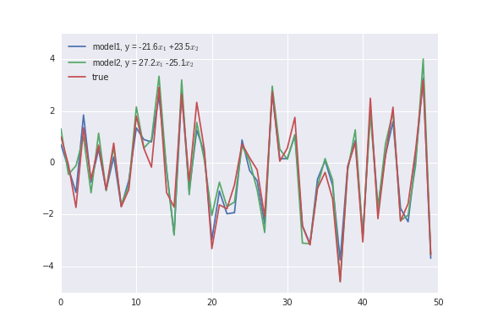
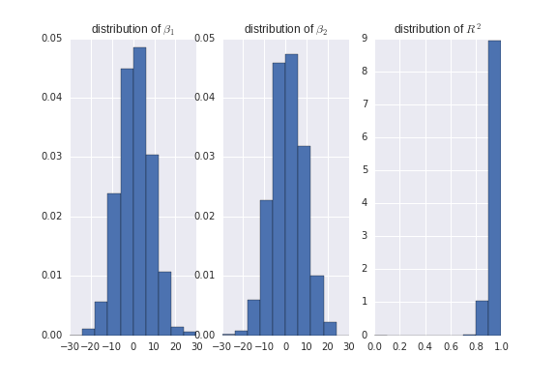
Co-linearity
You are building a model, and two columns are highly correlated. Does that matter?
Yes, it can be a
huge problem
Machine learner
Economist
No
Notes:
It depends who you ask ...

Slide 22
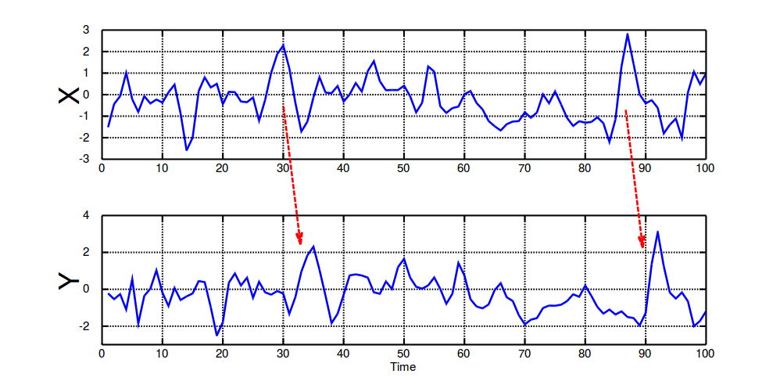
A couple of economist’s tricks
Z
Instrumental variables
X
Y
Granger causality
Notes:
Experiments work by breaking the link between the intervention variable and everything else.
Here’s some problems with experiments
- the experiment is not ethical or feasible
- the intervention is not random (or people non randomly ignore it)
- the intervention spills over to the control group
- the experiment is only feasible in some contrived setting, not one representative of the real world.
- the noise is too high.
Here’s some ways observational inference can fail
- there is an unobserved confounder that has not been included.
- the noise is too high.

Slide 23
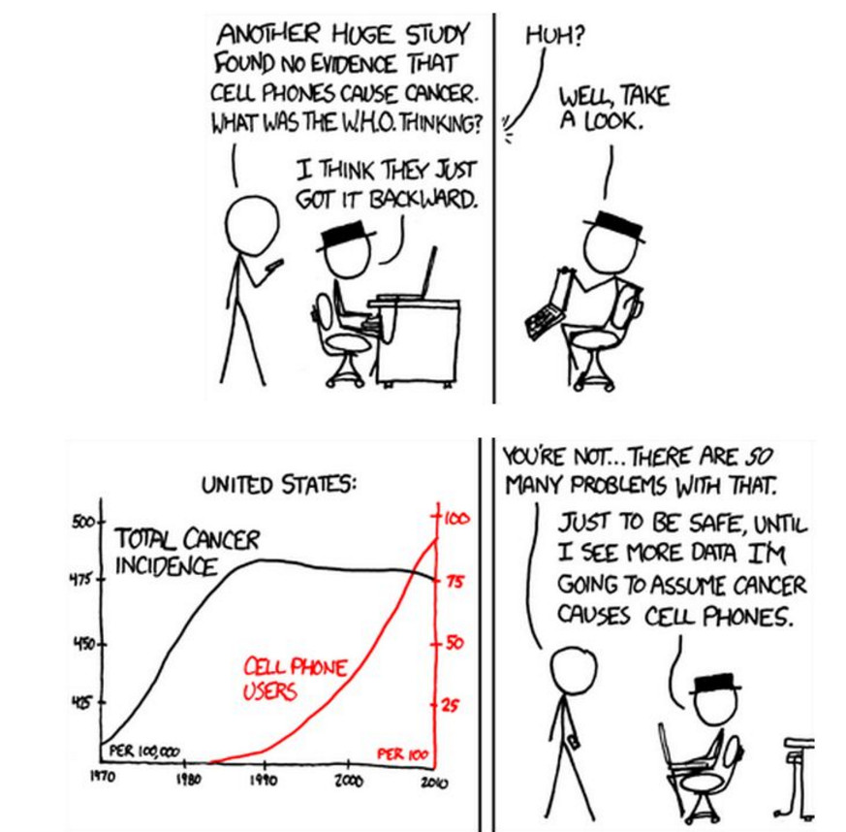
Granger causality
Notes:
Experiments work by breaking the link between the intervention variable and everything else.
Here’s some problems with experiments
- the experiment is not ethical or feasible
- the intervention is not random (or people non randomly ignore it)
- the intervention spills over to the control group
- the experiment is only feasible in some contrived setting, not one representative of the real world.
- the noise is too high.
Here’s some ways observational inference can fail
- there is an unobserved confounder that has not been included.
- the noise is too high.

Slide 24
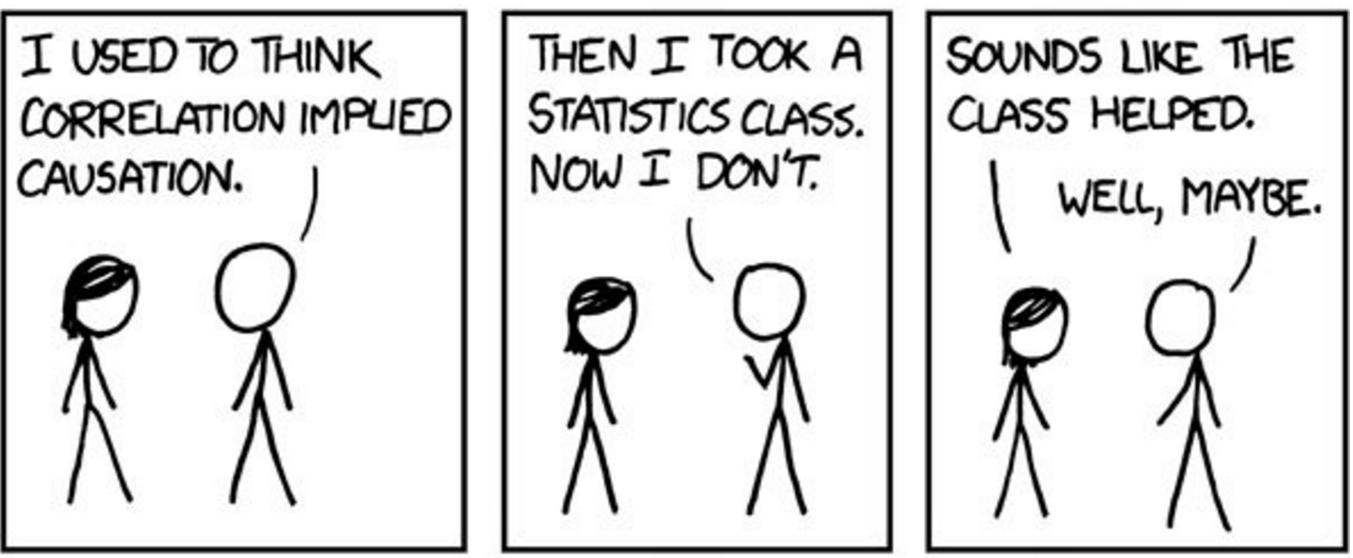
To conclude ...
Notes:
Experiments work by breaking the link between the intervention variable and everything else.
Here’s some problems with experiments
- the experiment is not ethical or feasible
- the intervention is not random (or people non randomly ignore it)
- the intervention spills over to the control group
- the experiment is only feasible in some contrived setting, not one representative of the real world.
- the noise is too high.
Here’s some ways observational inference can fail
- there is an unobserved confounder that has not been included.
- the noise is too high.

Slide 25
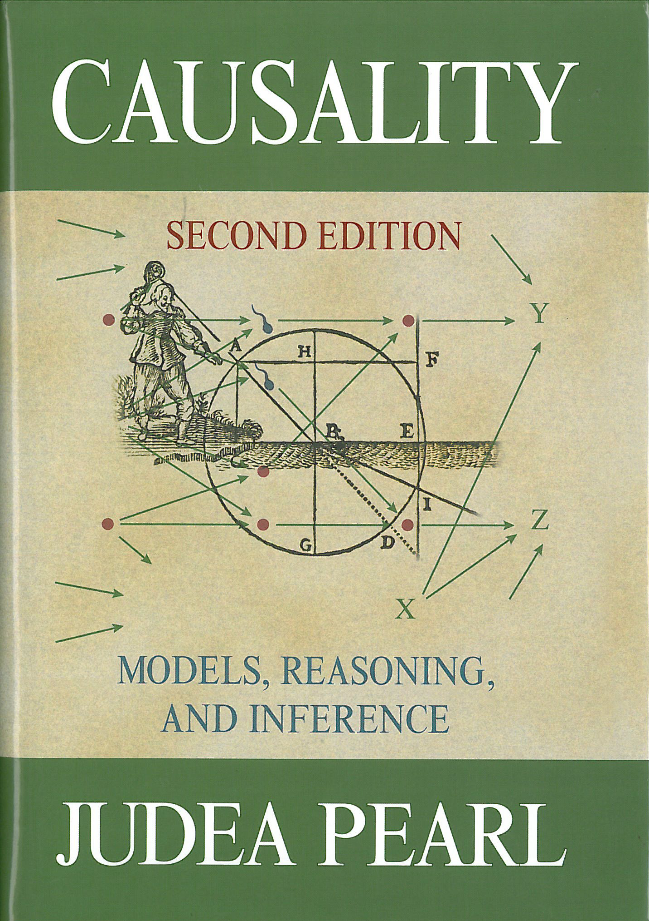
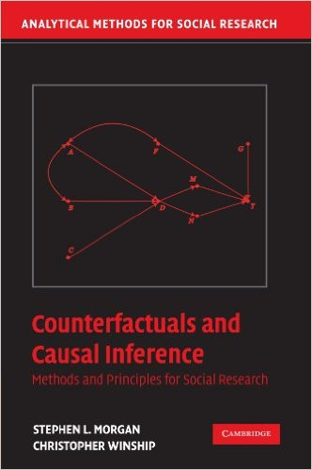

That wasn’t enough?
Notes:
Experiments work by breaking the link between the intervention variable and everything else.
Here’s some problems with experiments
- the experiment is not ethical or feasible
- the intervention is not random (or people non randomly ignore it)
- the intervention spills over to the control group
- the experiment is only feasible in some contrived setting, not one representative of the real world.
- the noise is too high.
Here’s some ways observational inference can fail
- there is an unobserved confounder that has not been included.
- the noise is too high.

Slide 26
What if you don’t know the graph?
This is called causal discovery. Amazingly, you can still do something. There are two key approaches
1) Finding graphs that have the imply the same conditional independences that you observe in the distribution of your data
2) Looking for structures such that the residuals are consistent with independence of mechanism and input.
It is really, really hard to get good results (or know if you have got good results)
Notes:
Experiments work by breaking the link between the intervention variable and everything else.
Here’s some problems with experiments
- the experiment is not ethical or feasible
- the intervention is not random (or people non randomly ignore it)
- the intervention spills over to the control group
- the experiment is only feasible in some contrived setting, not one representative of the real world.
- the noise is too high.
Here’s some ways observational inference can fail
- there is an unobserved confounder that has not been included.
- the noise is too high.

Slide 27
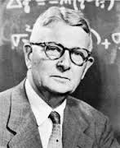
Structural equation models (SEMs)
Represent each variable as a deterministic function of its direct causes and noise
Noise terms must be mutually independent
where
Poverty
Smoking
Diet
Cancer
If the set of equations does not create a cycle then the Causal Markov property holds and the SEM is a causal bayesian network
Notes:
This ties together the functional definition of causality with the Markov independence property

Slide 28

Counterfactuals
Statements about what would have happened in some alternate reality where some specified thing were different.
A medical trial:
for an individual, i,
we only get to measure one of these.
Let be a random variable, is the distribution of outcome, that would occur if everyone was treated.
The causal effect is defined as
We can measure
&
Ignoreability assumption

Slide 29
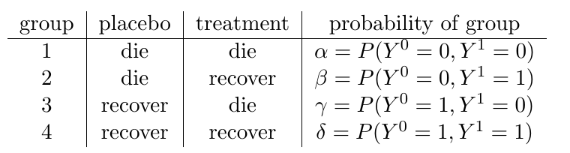


Counterfactuals
Counterfactural queries form a larger set than interventional queries
What is the probability that a patient, who was not treated and died, would have recovered if they had been treated? We know they are in either group 1 or 2 since they died without treatment, so the answer is
Can we identify that from

Slide 30
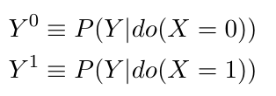
How do the models relate?
Do type queries can be phrased in terms of counterfactuals
For do type queries, the ignoreability assumption is true if the 'back door criterion' holds.
Causal bayesian networks don't support full counterfactuals as they only contain information on interventional distributions
SEMs do define counterfactuals
There is a subtle difference between the assumptions implied by the SEM models and what is actually needed for identification of do-queries (see Richardson & Robins 2013). This makes a difference for identifiability of non-interventional queries.

Slide 31
The Do Calculus: calculating causal effects in a (partially) known network
The do-calculus rules result from d-separation in a causal DAG
A causal effect is non-parametrically identifiable if and only if the interventional query can be reduced to an observational one via repeat application of the three rules (see Shpitser&Pearl 2012 for algorithm)

Slide 32
Rule 1: D-separation still applies
The graph that results from the intervention do(X=x) is still a bayesian network and d-separation applies.
W
U
W
U
X
Y
x
Y
Notes:
The process of intervening and setting the value of x to a given value changes the network in a specific way. X is no longer a function of its parents – so those links are removed, and x is set the value specified by the intervention.
The resulting network is still a (causal) bayesian network. D-separation still applies to that network.
The arguaments are clearer using the augmented network.

Slide 33
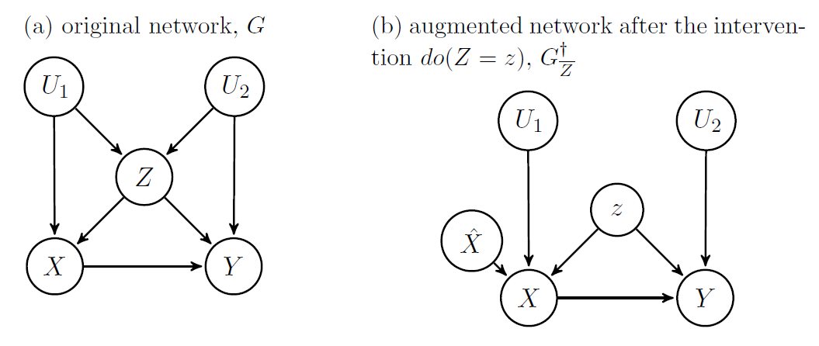
Rule 2: intervention and observation
If the target, y, is independent of how x is determined intervention is the same as observation.
Notes:
Explicitly model the possibility of intervention by adding a new variable S_x (think of as switch x) as a parent of the variable on which you will intervene.
Sx can be either off (in which case x is determined by its parents according to the original CPD) or some value, in which case x is set to that value. If y is d-sep from the switch, then do(x) = x

Slide 34
Rule 3: Sometimes intervention changes nothing
Smoking switch is d-separated from diet. There is no direct causal path from smoking to diet, so the intervention doesn't change anything.
Poverty
Switch
Smoking
Diet
Cancer
Notes:
Explicitly model the possibility of intervention by adding a new variable S_x (think of as switch x) as a parent of the variable on which you will intervene.
Sx can be either off (in which case x is determined by its parents according to the original CPD) or some value, in which case x is set to that value. If y is d-sep from the switch, then do(x) = x

Slide 35
The back door criterion
Just a special case of rule 2. If Z blocks all back door paths from X to Y then the causal effect of X on Y is obtained by adjusting for Z.
Poverty
Switch
Smoking
Diet
Cancer

Slide 36
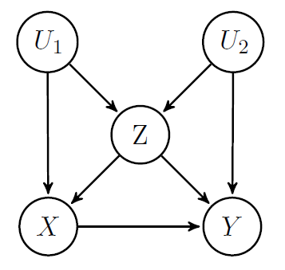
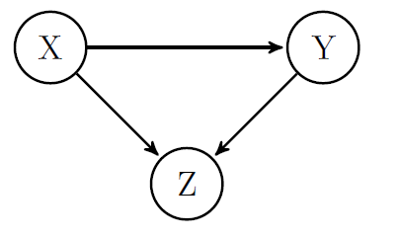
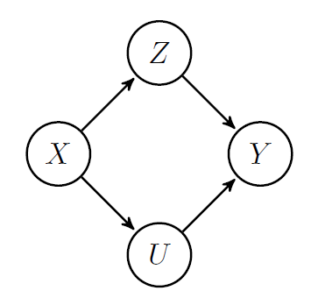
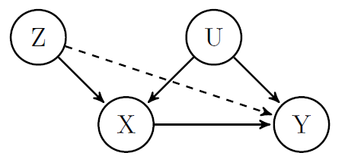
Causal estimation by 'adjusting'
Notes:
Examples of how things go badly by adjusting for the wrong things. (for IV variable case you can see you don't need to adjust graphically. Requires parametric arguaments to see what happens if you do anyway)
Propensity scores – where they fit.

Slide 37
Causal Discovery

Slide 38
Independence based methods
1) We assume our distribution P was generated by some (unknown) causal DAG over our observed variables (causal sufficiency)
2) We assume that all the conditional independences in P are implied by d-separation in the true causal network (faithfulness)
3) Finding the causal structure equates to finding perfect maps for P
True causal structure generating P
Perfect map for P
I | High | Low
P(I) | 0.5 | 0.5
Income
Income
Chocolate
Obesity
Chocolate
Obesity
I | High |  | Low
C | Y | N | Y | N
P(O=Y) | .4 | .2 | .7 | .5
Notes:
4) If 1) or 2) does not hold then a perfect map for P may not exist.

Slide 39
The IC (or SGS) algorithm
1.
2.
3. Orient any undirected edges so as to avoid creating cycles or additional v-structures
a
a
c
a
b
True Causal Model
Inferred output
a
b
c
c
c
A
A
b
b
B
C
B
C
D
D
E
E
Notes:
We can't create cycles by assumption, but why can we be sure there should be no additional v-structures?
To create an additional v-structure, requires a structure of the form a → c – b. But such structures were checked at step 2 and found not to be a → c ← b
This is without latent variables

Slide 40
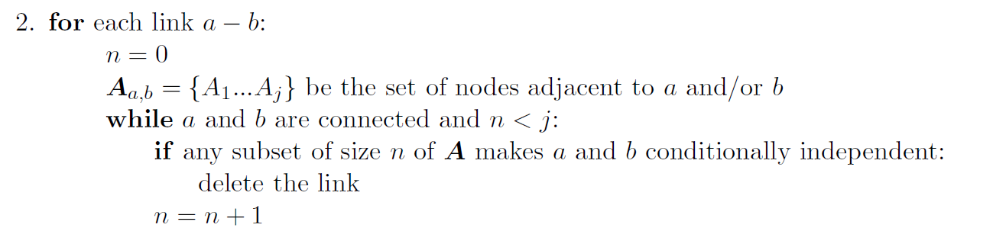
The PC algorithm
A more tractable version of the SGS algorithm

Slide 41
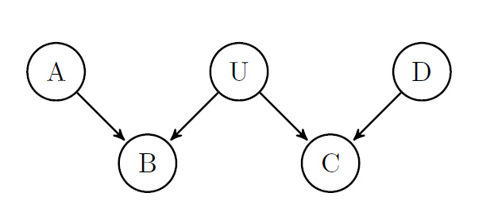
Latent variables
Problems:
  Infinite search space
  The space of causal DAGs is not closed under marginalization

Slide 42
Latent variables
Theorem (Verma 1993):
for any latent structure there is an equivalent structure such that every latent variable is a root node with exactly 2 children.
A
A
L
L
C
D
C
D
Notes:
This allows us to narrow our all the set of latent structures that we consider as possibly accounting for the observed dependencies in the data.
Note we can't collapse the latent variable into its parent (unless the relationship was deterministic)
Mother Overweight
Gene expression
Poor eyesight
Heart disease

Slide 43
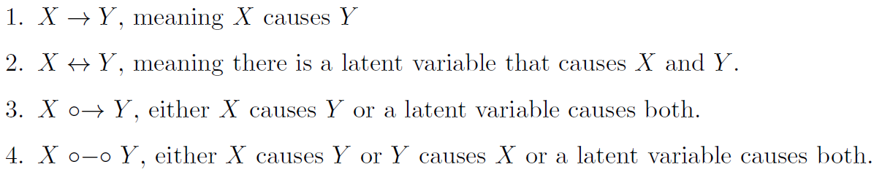
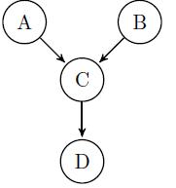
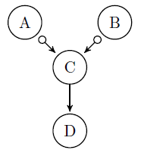
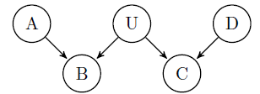
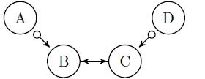
FCI algorithm
Outputs a Markov equivalence class of Maximal Ancestral Graphs
Discovers all aspects of causal structure identifiable from conditional independence relations (Zhang 2008)
Can be made to require a worst case polynomial (rather than exponential) number of conditional independence tests for sparse graphs (Claassen et al 2013).

Slide 44
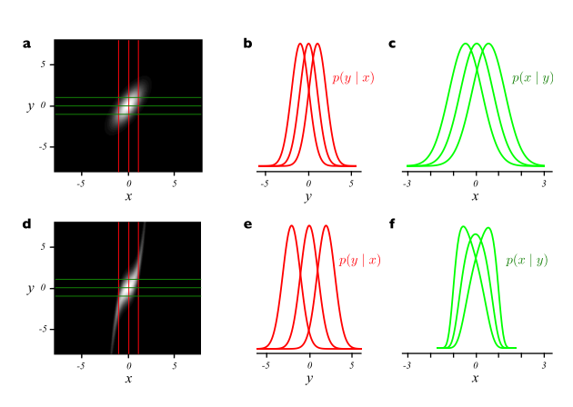
Beyond conditional independence
X
Y
Y
vs
X
Additive noise:
Figure 1, (Hoyer et al 2009)
Can be extended to post-non-linear additive noise
(Zhang et al 2009)
Notes:
In practice one does regression of y vs x to estimate the function f and then test to see if the residuals f-y are independent of x (then do it in reverse)

Slide 45
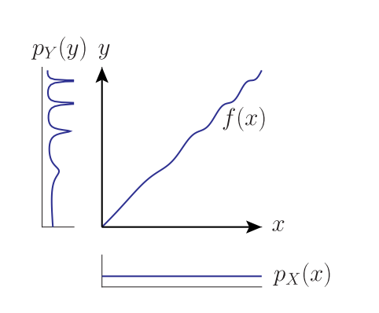
More asymmetries of cause and effect
X
Y
Y
vs
X
Figure 1: Daniusis et al 2012
Independence of function and input: If X → Y and we have a functional causal model y = f(x,e) then the input
distribution P(X) and function f represent independent mechanisms. Changing the input distribution does not modify the function itself.

Slide 46
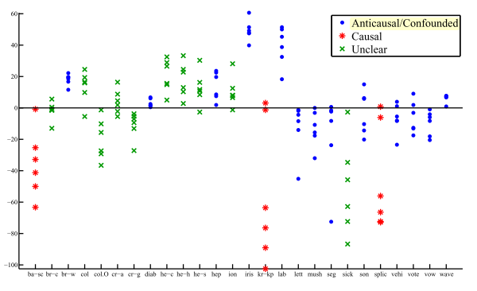
Causal-Anticausal
If X → Y, what is the relationship between P(X) and P(Y|X)?
What about P(Y) and P(X|Y)?
In semi supervised learning we are given training points from P(X,Y) and additional points sampled from P(X). The goal is to learn P(Y|X). The extra points from P(X) will not help if X → Y.
Figure 6, Janzing & Peters 2012

Slide 47
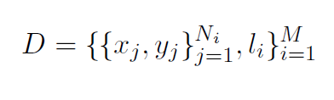


Learning what causality looks like
See Lopez-Paz et al 2014

Slide 48
Now with more than two variables!
Bi-variate additive noise model
If the triple: satisfies a certain condition then model is identifiable
To extend to multivariate case we need to satisfy the condition on the conditional distributions
For each variable j
Pick a single parent, i, and fix all the others
For each subset S that contains the remaining parents, and no descendants of j
The triple must satisfy the condition for at least one s.
If we can come up with a condition that guarantees identifiability for the bi-variate case, we can extend that result to get the conditions under which the multivariate case is identifiable.
See Peters et al 2014

Slide 49
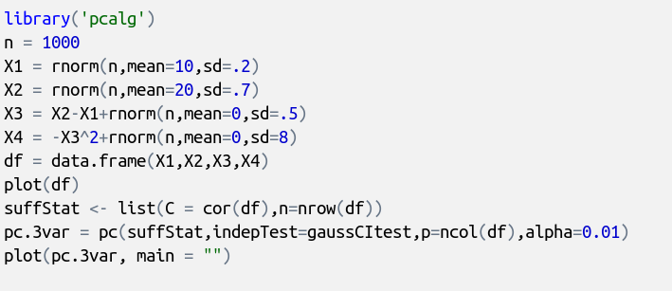
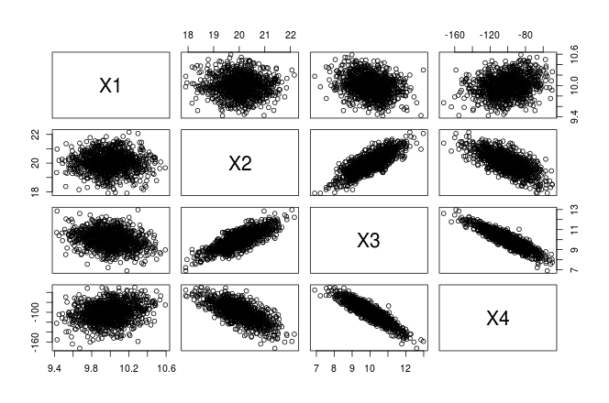
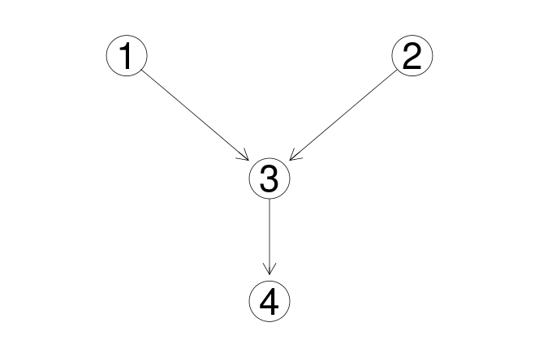
Causal structure learning in R (pcalg)

Slide 50
References
Pearl, J. (2000). Causality: models, reasoning and inference
Tom Claassen, J Mooij, and Tom Heskes. Learning sparse causal models is not NP-hard. arXiv Prepr. ArXiv1309.6824, 2013.
PO Hoyer, Dominik Janzing, and JM Mooij. Nonlinear causal discovery with additive noise models. Adv. Neural . . . , 2009.
Kun Zhang and A Hyvarinen. On the identiability of the post-nonlinear causal model.Proc. Twenty-Fifth Conf. . . . , 2009.
P Daniusis, Dominik Janzing, and Joris Mooij. Inferring deterministic causal relations.arXiv Prepr. arXiv . . . , pages 2-9, 2012.
Jiji Zhang. On the completeness of orientation rules for causal discovery in the presence of latent confounders and selection bias. Artif. Intell., 172(16-17):1873{1896, November 2008
Koller, D., & Friedman, N. (2009). Probabilistic graphical models: principles and techniques. (chapters 3 & 21)
Verma 1993 Graphical aspects of causal models Technical Report. UCLA
Spirtes, P., Glymour, C. N., & Scheines, R. (2000). Causation, prediction, and search.
Maathuis, Marloes H., et al. (2010) Predicting causal effects in large-scale systems from observational data. Nature Methods 7.4 : 247-248.
Kalisch, Markus, et al. (2012) Causal inference using graphical models with the R package pcalg. Journal of Statistical Software 47.11 : 1-26.
Shpitser, Ilya, and Judea Pearl. "Identification of conditional interventional distributions." arXiv preprint arXiv:1206.6876 (2012).
Dominik Janzing and Jonas Peters. On causal and anticausal learning JMLR. , 2012.
David Lopez-Paz, Krikamol Muandet, and Benjamin Recht. The Randomized Causation Coefficient. September 2014.
TS Richardson and JM Robins. Single world intervention graphs (SWIGs): a unication of the counterfactual and graphical approaches to causality. Cent. Stat. . . . , (128), 2013.
Jonas Peters, J Mooij, Dominik Janzing, and B Scholkopf. Causal discovery with continuous additive noise models. J. Mach. Learn. Res. 2014.

