Slide 1
VibeThinker-3B
Core message
What a 3B reasoning model teaches us about benchmarks, pattern matching, and post-training
The result is impressive but narrow.
“Pattern matching” here means learning reusable solution templates, not rote memorising answers.
The interesting part is the training recipe: many candidate paths, verification, reward, compression.
Data science team briefing
3B dense model
Verifiable math + code
Post-training heavy
Source: VibeThinker-3B technical report, arXiv:2606.16140

Slide 2
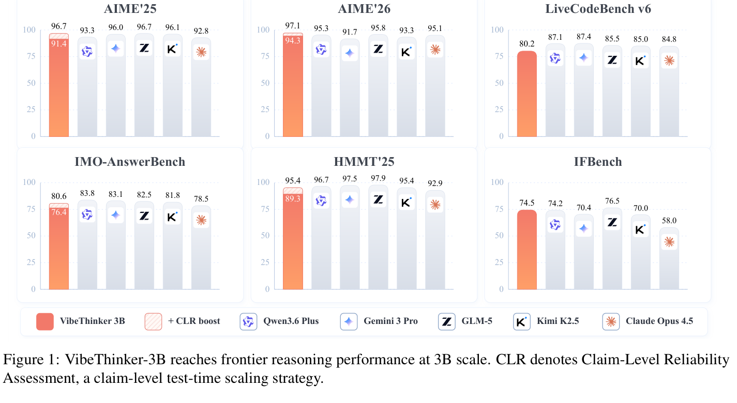
Benchmark performance: striking for 3B, but read the fine print
Reported scores place VibeThinker-3B in the band of much larger reasoning models on verifiable tasks.
Reported headline numbers
AIME26: 94.3; 97.1 with CLR.
LiveCodeBench v6: 80.2 Pass@1.
Unseen LeetCode contests: 123/128 first-attempt Python submissions.
GPQA-Diamond remains weaker than large models.
Interpretation: these are mostly tasks with crisp external checking - exact answer, test suite, or rule verifier.
Figure cropped from Xu et al. (2026), Figure 1. CLR = claim-level reliability assessment.

Slide 3
Public reaction: “is this reasoning, or just pattern matching?”
A useful criticism - but the phrase needs unpacking.
“Push it into deeper, unfamiliar, or messy questions, and it COLLAPSES because it only knows how to match the nearest pattern...”
- Reddit / r/LocalLLaMA discussion
Narrow domain match
Messy prompts fail
Benchmark debate
Quote from public discussion; used here as the starting point for unpacking what “pattern matching” means.

Slide 4
Pattern matching is not memorising benchmark answers
In this context, it means mapping a new problem onto a learned family of solution procedures.
Bad interpretation
Better interpretation
Why it matters
“It saw this exact problem.”
Leakage, memorisation, contamination.
Possible in any benchmark, but not the whole story.
“This looks like a known template.”
Choose variables, invariants, proof move, algorithm pattern.
Then execute and verify.
Verifiable benchmarks reward template recognition plus careful execution.
Real work punishes brittle template choice and hidden assumptions.
Same idea as human contest prep: learn problem families, not answer keys.

Slide 5
Example: math benchmarks often reward “recognise the move”
Representative toy examples, not copied benchmark questions.
Prompt shape
Likely learned template
“Given integers satisfying a modular constraint, find the number of possible residues / arrangements / triples.”
Translate words to constraints
Find invariant / symmetry
Counting
Modular arithmetic
Invariants
Count cases; check boundary
Return exact answer
The “pattern” is a reusable problem-solving scaffold: parse constraints, select invariant, enumerate safely.

Slide 6
Example: coding benchmarks reward algorithm-template selection
The model does not need to remember the contest problem if it recognises the skeleton.
Prompt shape
Template recognition loop
“You are given an array and many queries. Each query asks for the best value over a changing interval under constraints.”
Read constraints
Infer complexity target
Choose known pattern
Generate implementation
Range queries
Greedy / DP
Data structures
Self-check on samples
LiveCodeBench-style tasks have an executable verifier. That strongly favours models trained to iterate toward code that passes tests.

Slide 7
Where benchmarks differ from real coding and math work
Benchmarks are clean, closed, and verifiable. Work is often ambiguous, open, and socially constrained.
Benchmark problem
Real task
Complete statement.
Hidden tests or exact answer.
Few required facts outside the problem.
One-shot success metric.
Failure is easy to score.
Messy requirements and missing context.
Partial, shifting, or no oracle.
Needs repo, domain, stakeholder knowledge.
Iterative debugging and trade-offs.
Failure can look plausible.
Evaluation gap: a model can be frontier on verifiable reasoning and still brittle as an autonomous analyst or engineer.

Slide 8
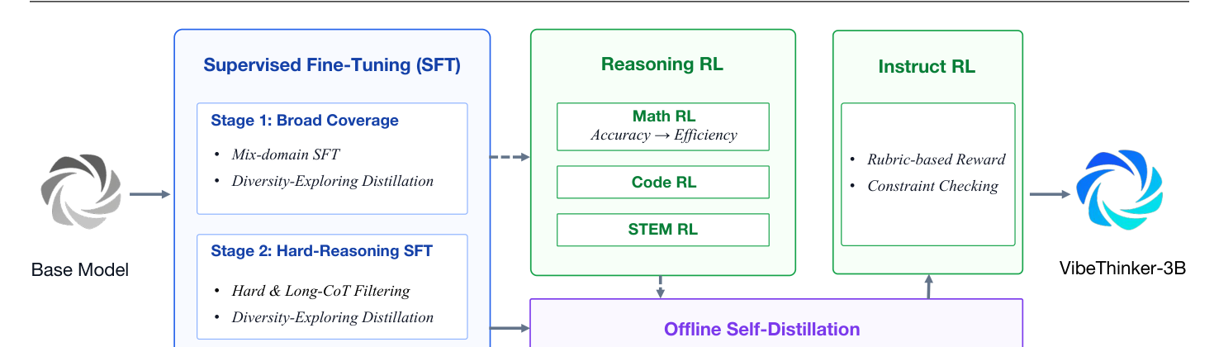
Training intuition: turn a base coder into a reasoning specialist
The paper is mostly a post-training story, not a new pretraining story.
Base coder
3B
Show many
worked paths
Reward correct
verifiable outputs
Compress best
behaviours
Follow instructions
reliably
Original pipeline figure shown at top. The rest of the deck translates the stages into intuition.

Slide 9
Stage 1: build a broad library of problem-solving routes
Start with high-confidence seeds, expand them, then keep only traces that survive checks.
Seed tasks with
known answers/tests
Rewrite across
concepts & constraints
Teacher models
propose many paths
Filter: answer,
execution, overlap
Intuition
Do not teach one canonical solution. Teach a cloud of valid routes so later reinforcement learning has somewhere useful to explore.
Paper details: query expansion, multi-path reasoning distillation, n-gram contamination filtering, LLM filtering, answer/execution checks.

Slide 10
Stage 2: curriculum - easy breadth first, then long hard reasoning
The model first learns the map, then practices the mountains.
Broad coverage cold start
Hard-reasoning focus
Math, code, STEM, chat, instruction following.
Diverse chain lengths and domains.
Goal: stable behaviour and many solution families.
Keep long traces and difficult problems.
Drop problems the smaller reference model usually solves.
Goal: long-horizon derivation and constraint handling.

Slide 11
Stage 3: practice with a judge - reward what can be verified
This is why verifiable tasks matter: you can grade lots of attempts cheaply and consistently.
Sample multiple
solutions
Run verifier
answer/tests/rubric
Increase likelihood
of good attempts
Repeat by domain:
math → code → STEM
Many attempts create variation
Verifier creates signal
Training amplifies signal
Key intuition: the model is shaped by the distribution of problems and the verifier. Strong benchmark results can follow when the deployment task looks like that training loop.

Slide 12
Stages 4-5: compress, shorten, and align the specialist
Final stages make the behaviour cheaper, more consistent, and easier to prompt.
Self-distil
Shorten
Instruction-align
Keep high-quality RL trajectories.
Train the final model to internalise them.
Unify math, code, and STEM behaviour.
Reward correct but less wasteful reasoning.
Avoid long meandering traces.
Improve latency and usability.
Use rule checks and rubrics.
Handle constraint-heavy prompts.
Reduce loss of controllability.
Practical takeaway for us: evaluate on our own messy-but-verifiable tasks before assuming benchmark reasoning transfers.

