Slide 1
Support/Normal (720N)
Weight
(720N)

Slide 2
5N
5N
+
=
5N
5N
+
=
5N
10N
+
=
5N
10N
+
=
10N
+
5N
+
5N
=

Slide 3
100N Drag
Weight
(720N)

Slide 4
1kg
Ground

Slide 5
Support/Normal Force 9.8N
1kg
Ground
Weight Force 9.8N

Slide 6
Support/Normal Force 8.22N
30°
Weight Force 9.8N

Slide 7
Support/Normal Force 8.5N
Weight force perpendicular to the surface
30°
Weight Force 9.8N

Slide 8
Support/Normal Force 8.5N
Weight force perpendicular to the surface
30°
Weight Force 9.8N

Slide 9
Support/Normal 8.5N
Friction
Draw a vector diagram
Friction
Weight 9.8N
30°
Put the vectors head to tail
Support/Normal 8.5N
Weight 9.8N

Slide 10
F_{n} Normal Force

Slide 11
F_{n} Normal Force
Experienced Weight Force
F_{w} Weight Force

Slide 12
Support
Friction
Weight

Slide 13
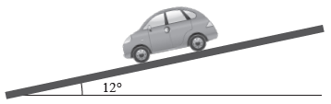
Support
Friction
Weight

Slide 14
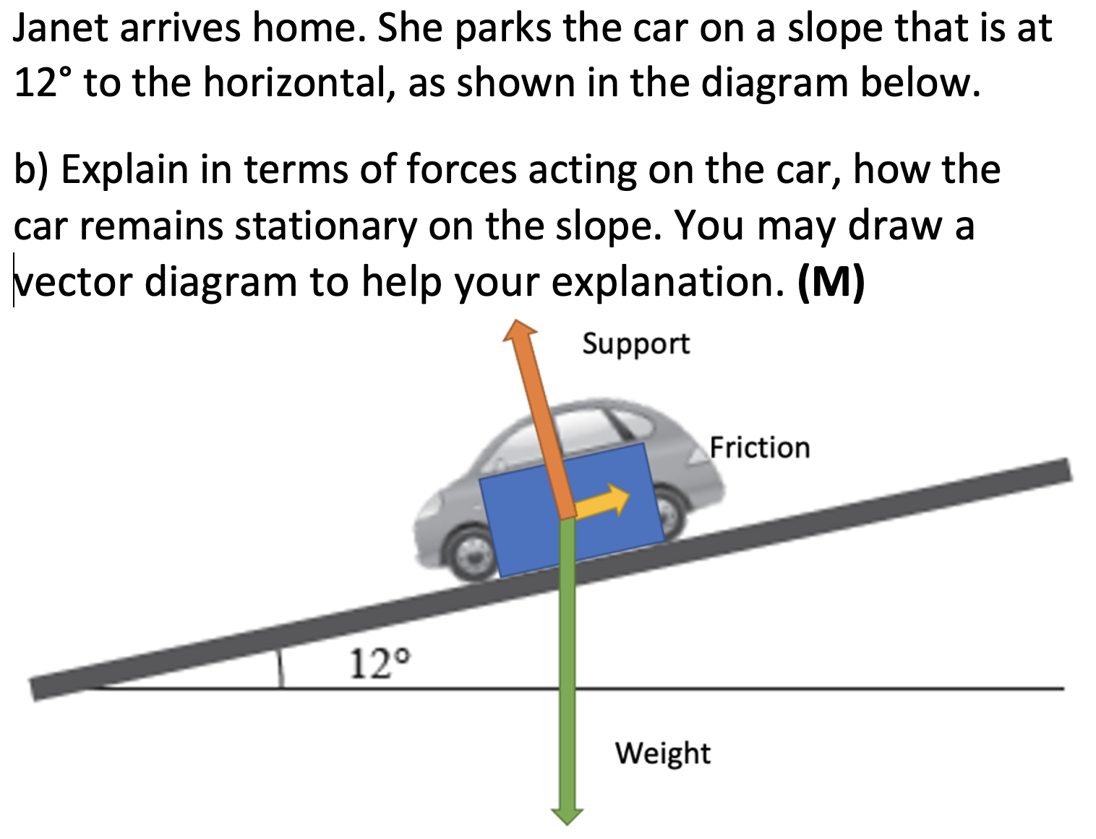
Weight
Support
Friction

Slide 15
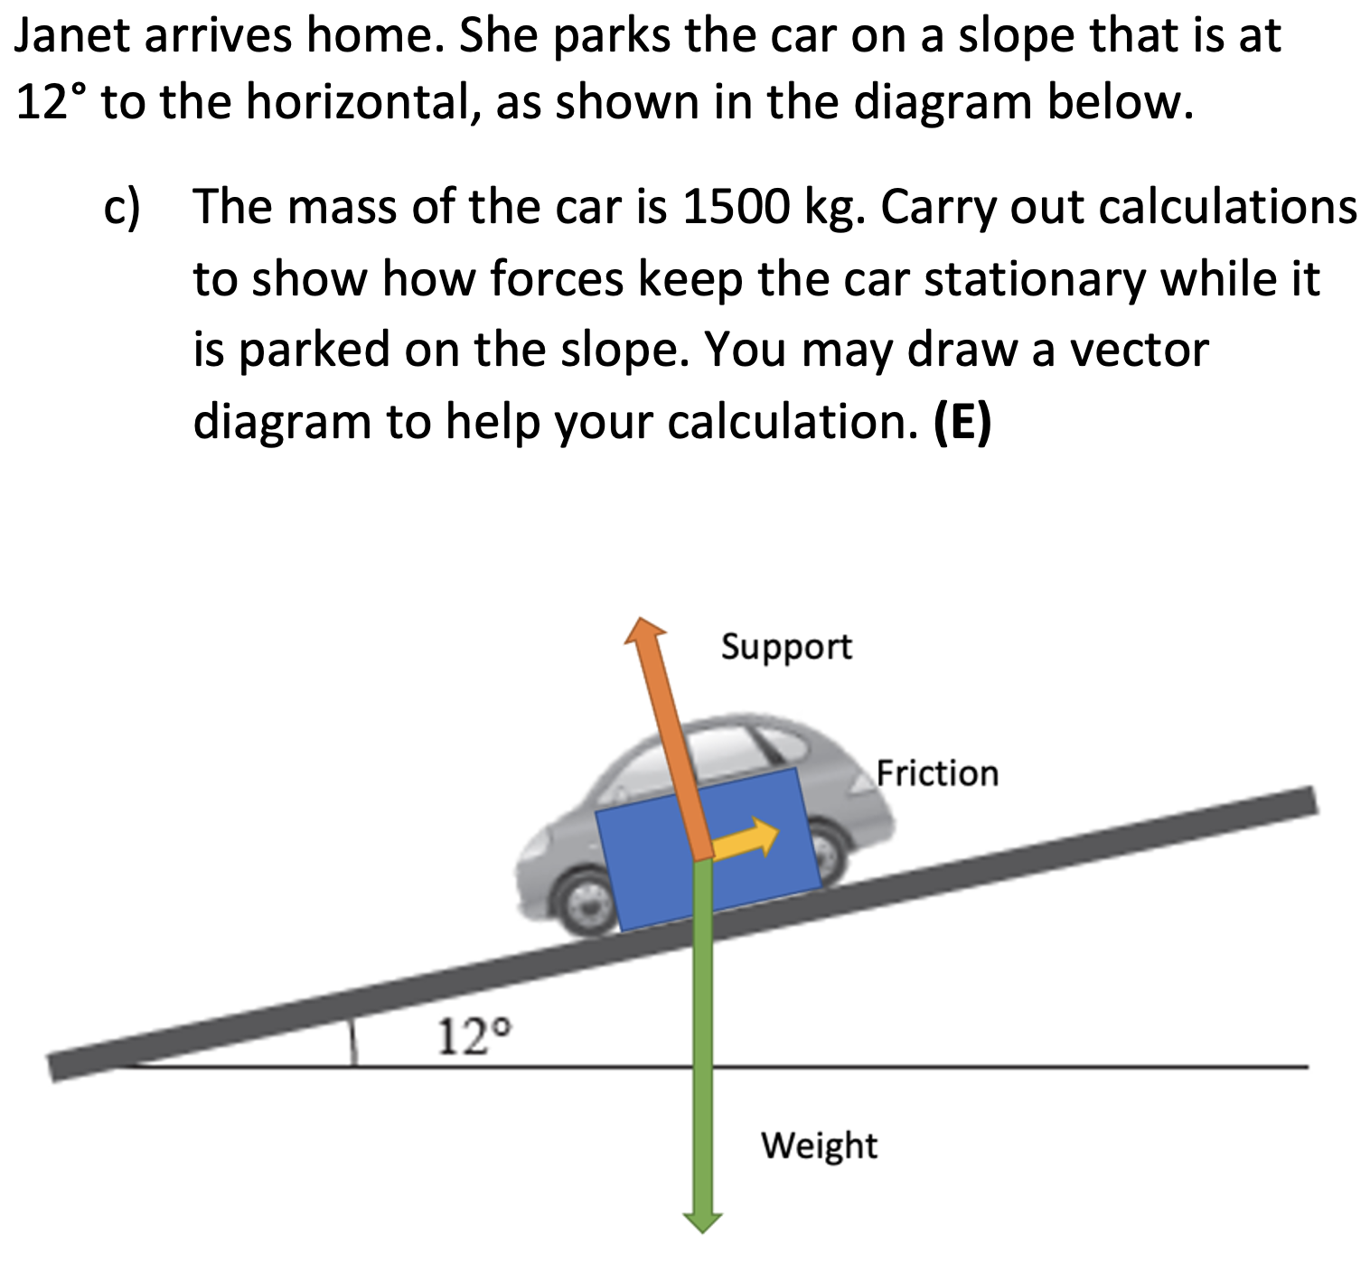
Weight 14700N
Support 14387N
Friction
3056N

Slide 16
3m
4kg
1.5m
F_{p}
T_{ACW}

Slide 17
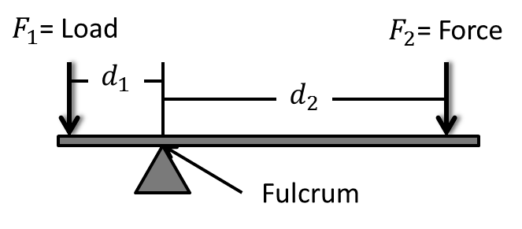
F_{p}

Slide 18
50m
F_{A}
10m
F_{B}
1000kg
B
A

Slide 19
Finding A.
Rotate around B.
All distances relative to B.
50m
40m
F_{A}
25m
1000kg
B
A
F_{CAR}
F_{P}

Slide 20
Finding B.
Rotate around A.
All distances relative to A.
50m
25m
F_{B}
10m
1000kg
B
A
F_{CAR}
F_{P}

Slide 21
50m
F_{A}=56,840N
10m
F_{B} = 50,960N
1000kg
B
A

Slide 22

$$4{ms}^{−1}$$
1m
8kg

Slide 23

$$10{ms}^{−1}$$
2m
← 305N

Slide 24

C = 1.885m
$$2.826{ms}^{−1}$$
0.3m
T = 0.667s

