Slide 1
Finn Le Sueur lsf@cashmere.school.nz https://putaiao.nz/12phy/as91172/

Slide 2
Atoms and Isotopes
2-7 | Protons | Electrons | Neutrons | Nucleons
#
#
Oxygen
Sodium
Aluminium
Copper
Learning Outcomes
Define the terms proton, neutron, electron, nucleon, atomic mass, atomic number and isotope.
r0.25
image
Aristotle and the Greeks in 450BC hypothesised that everything was made of water, earth, air and fire. Some years later, another Greek philosopher Democritus came up with the idea of an indivisible piece of matter - a fundamental building block. He did not know what it was, but theorised that one should exist. He called these pieces of matter atomos (indivisible).
In the modern day we have a different theory that is testable and that allows us to make predictions. Our theory predicts that everything is made up of 119 different elements.
Atoms and Elements
r0.5
image
Pātai: What makes the elements different from each other?
Ngohe: Draw a labelled diagram of a lithium atom
The Rutherford Model
r0.3 image
What you have drawn is the Rutherford Model of the atom. This model is the most common one we see in school today because it has very strong predictive powers. It is also very valuable because it allows to easily visualise things like ions and isotopes and how some chemical bonding works.
The central region is called the . It is made of and which are strongly bound together by the . Together we call protons and neutrons , as they exist in the nucleus.
Electrons are constantly moving around the nucleus in a probabilistic way. This means that they do not have fixed orbits like the planets, but instead exist in a . The size of the nucleus compared to the whole atom is very small, but it contains $>99.95\%$ of the mass because electrons are very light.
Protons have a charge, electrons have a charge, and neutrons have charge. Protons and electrons have an equal but opposite sized charge despite their very different masses.
Atomic and Mass Numbers
The number of protons in an atom (i.e. the atomic number) defines which type of atom it is. For example, and atom that has six protons MUST be a atom, and cannot be any other.
Atomic number:
Mass number:
Ngohe: Reading the Periodic Table

Slide 3
2-7 | Protons | Electrons | Neutrons | Nucleons
#
#
Carbon-12
Carbon-13
Carbon-14
Ions
r0.5
image
An atom is a neutral particle, having equal number of protons and electrons (recall: they have opposite but equal size electric charges). However, an atom may lose or gain one or more electrons during a reaction. This causes them to gain a net charge. When an atom has a charge it is called an . Positively charged ions are called and negatively charged ions are called .
Isotopes
l0.4
image
An isotope is an atom with the same number of protons (same element), but with a different number of neutrons. This means that the atomic number is the same, but that the mass number is different.
This is why some periodic tables show a mass number with lots of decimal places, it is an average of the different isotopes.
Some isotopes are stable, while others like Carbon-14 is radioactive and will decay over time. Carbon-14 can be used to find the age of organic matter. They do this by looking at the ratio of Carbon-14 compared to the other isotopes.
Ngohe: Carbon Isotopes
For Carbon-12, Carbon-13 and Carbon-14, complete the table below.

Slide 4
Whakawai: Atomic Structure
Atoms are made of a central dense part called the surrounded by a moving cloud of . The particles in the central region are called nucleons and are either protons or . The charge on protons is .
The nucleons are attracted strongly to each other by a force called the force. The protons however, repel each other, because they have similar charges. This repulsion force between the protons is an force. As a result of these forces in the nucleus, most nuclei are stable. However, if nuclei are disrupted by nuclear reactions enormous amounts of may be released. The reason for this is that the in the nucleus are very strong.
The atomic number is the number of in the nucleus of an atom. The mass number is the number of and in the nucleus of an atom. Isotopes of an element will always have the same number but different numbers.

Slide 5
Atomic Structure
image image
Observation 1: Most alpha particles were found to go straight through the foil. Conclusion:
Observation 2: Some alpha particles experienced a small angle of deflection. Conclusion:
Observation 3: Very few alpha particles were deflected. Conclusion:
Observation 4: Some particles were deflected at a very large angle. Conclusion:
Explain why the gold foil experiment had to be carried out in a vacuum.
Explain why it was necessary for the gold foil to be a few atoms thick.
Describe one way in which Thomson’s and Rutherford’s models of the atom were similar.
Describe the key difference between Thomson’s and Rutherford’s model of the atom.
In front of the alpha emitter is a lead screen with a narrow slit cut in it. What function does this lead screen serve?
What would Rutherford have seen if Thomson’s model of the atom was correct?
What would have been observed if Rutherford used a beta emitter instead of an alpha emitter?
Learning Outcomes
Understand the history and process of how we formulated the current atomic model
Introductory Video: https://youtu.be/xazQRcSCRaY
The Greeks
As mentioned earlier, Aristotle and the Greeks in 450BC thought that everything was made of water, earth, air and fire. Some years later, another Greek philosopher Democritus came up with the idea of some indivisible piece of matter - a fundamental building block. He did not know what it was, but theorised that one should exist. He called these pieces of matter atomos (Latin: indivisible).
John Dalton (1766 - 1844)
r0.25
image
John Dalton was an English chemist who introduced atomic theory into chemistry. There is some debate about where he got his theory, but the main points he developed were:
Elements are made of extremely small particles called atoms
Atoms of a given element are , , and other properties
Atoms cannot be .
Atoms of different elements combine in simple whole-number ratios to form chemical compounds. E.g. $MgCl_{c}$.
In chemical reactions, atoms are combined, separated or rearranged.
He was not able to ascertain the weight of any elements, but did attempt to order them by relative weight. It was with John Dalton when atomos from the Greeks became atoms.
Joseph Thomson (1856–1940)
r0.25
image
Joseph Thomson was a British physicist who did a lot of work with cathode rays ( ) and who was awarded the Nobel Laureate in Physics for discovering the electron. This was the first subatomic particle to be discovered! He is also credited with finding the first scientific evidence of .
At the time of his research he was not originally aware that cathode rays were streams of "electrons". He only knew that they were negatively charged and had . He hypothesised that the electrons were emitted from the atoms inside the cathode ray tube, and thus concluded .
If the electrons were inside the atoms, and an atom was neutral, the electrons would have to be evenly distributed throughout, and the atom itself made of some positive material.
Ernest Rutherford (1871-1937)
r0.2
image
Ernest Rutherford is a New Zealand-born British Physicist credited as the father of nuclear physics. He was the discoverer of the concept of , and was awarded the Nobel Prize in Chemistry for his work into the disintegration of the elements ( ).
His work on the atom revolved around something called where he fired alpha particles ( ) at a sheet of thin gold foil. By analysing the scatter pattern of the alpha particles he was able to determine that there is a positive nucleus in the centre of the atom, and that the electrons should orbit around the outside. Notice that at this point we still have not discovered the neutron.
The Gold Foil Experiment
Introductory Video: https://youtu.be/sG6QoLxwIw4

Slide 6
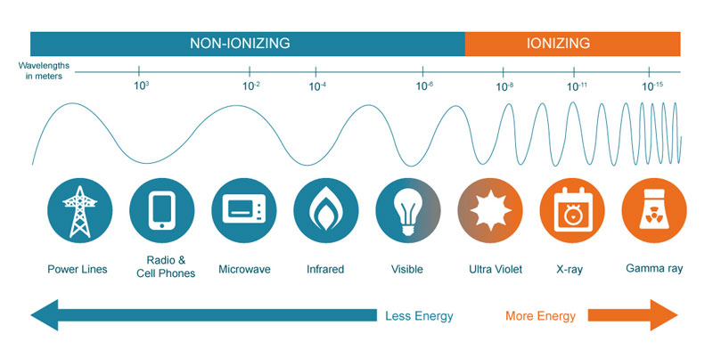
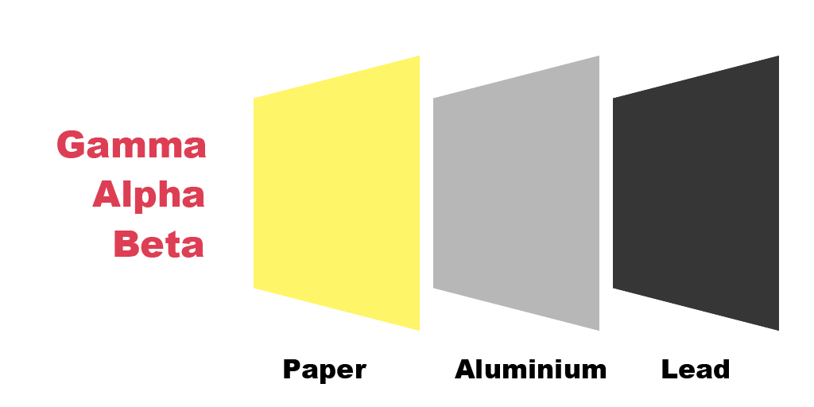
Nuclear Decay
Alpha Decay
r0.3 image
During alpha ($α$) decay a particle is emitted from the nucleus. This particle is a , also known as an alpha particle . It is positively charged because it contains just two neutrons and two protons. It is slow moving (up to 10% the speed of light) due to its relatively large mass. Its large mass means it can only move through the atmosphere before being absorbed or redirected. It also means that it is . Conversely, the large mass (high momentum) means that it will do a lot of damage if it impacts organic matter like DNA. It is said to have
The majority of alpha emitters are the elements with atomic number greater than 83, although some other smaller nuclei also undergoing alpha emission.
Beta Decay
l0.5 image
During beta ($β^{−1}$) decay a neutron inside the nucleus changes (decays) into a proton and a high energy electron is emitted. This changing of a neutron to a proton increases the atomic number of the atom by one, and therefore changes the element!
The emitted high-energy electron can travel up due to its very small mass, and has a medium range in the atmosphere ( ). It is able to pass through a sheet of paper but will be stopped by a more dense material e.g. 5mm of aluminium. It is said to have and can disrupt chemical bonding on impact.
Notice how there are two options for beta decay in the diagram to the right. In both cases electric charge is conserved.
Gamma Decay
r0.4 image
Gamma ($γ$) radiation is a form of high-energy electromagnetic radiation, and is not a particle at all. It is instead an electromagnetic wave with an . This kind of radiation occurs when a nucleus is left in an excited state after undergoing alpha or beta decay. It is a way for the nucleus to release energy.
Due to being electromagnetic radiation, it travels at and will travel through large volumes of atmosphere. It requires several centimetres of dense metal (e.g. lead) to block gamma radiation, and due to its lack of mass, .
Ngohe: Radiation Protection
Draw an arrow from each type of radiation, stopping the arrow at the material that is capable of blocking it.
Whakawai: Types of Radiation
Learning Outcomes
Describe alpha radioactive decay
Describe beta radioactive decay
Describe gamma radioactive decay
Introductory Video: https://youtu.be/UtZw9jfIxXM
Pātai: What is a nuclear reaction?
It is not a physical reaction (e.g. changing state)
It is not a chemical reaction (e.g. forming ionic compounds)
It is a reaction where:
There are three types of nuclear reactions that we are interested in for this topic:
Why Nuclear Decay Occurs
r0.5 image
Inside the nucleus are the protons and neutrons. The neutrons do not carry an electric charge, so do not interact electrically. The protons, however, carry a positive charge. We know that like charges repel, so why does the nucleus not fall apart?
It turns out that when nucleons get close enough another force comes into effect: the . This force glues the nucleons together. Nuclear decay occurs when the nucleus gets very large; either by having a large atomic number, or by being an isotope with a large number of neutrons.
Adding nucleons increases the volume of the nucleus, and thereby "diluting" the strong nuclear force. When the strong nuclear force is "diluted" such that the electrostatic force is now larger, the nucleus . This is called radioactive decay!
Do you recall the Law of Conservation of Energy? Similar laws apply to nuclear equations and these four properties are also conserved:
Video: https://www.youtube.com/watch?v=TJgc28csgV0
Ionizing Radiation
Ionising means to have the ability to strip electrons from an atom/molecule. In some circumstances this can cause bonds to break - this can be bad in regards to cells and DNA. Heavy atoms like $α$ particles may also simply break a molecule on impact ( ).
The ability to ionize is also characterised by having an electric charge. Neutral particles are less ionising. Low energy electromagnetic radiation is also not ionising. This is why your phone or microwave cannot harm you, but repeated x-rays can.

Slide 7
2-5 | Mass # | Charge | Speed | Ionising Ability
Alpha Particle
Beta Minus Particle
Gamma Ray

Slide 8
State which elements tend to be naturally radioactive and explain why.
Identify which of the three types of radiation is being described below.
It can only travel a few cm in air.
It will pass through aluminium sheet but is stopped by a few mm of lead.
It is stopped by a sheet of paper.
It will pass through less than a few mm of lead.
It is highly ionising.
It is not deflected by a magnetic field.
When the three types of radiation are passed through a magnetic field they separate into three beams as shown. Identify which beam is which.
Describe what happens to the atomic number and mass number of a nucleus which emits a beta minus particle.
Whakamātau: Background Radiation
All around us in the crust of Earth are a wide variety of elements. Some are even radioactive! These elements decay over time and give off a low level of radiation. Some radiation comes from interstellar space, although the majority is deflected by the Van Allen Belt.
Thankfully we are evolved to live with this level of radiation – our cells incorporate mechanisms to fix small mutations in our DNA. A device used to measure the amount of activity of radiation is called a Geiger Counter. It emits a sound when it detects either alpha, beta or gamma radiation.
Turn the geiger counter on
Count the number of ticks over a period of four minutes
Find the activity per minute.
Use paper and a sheet of metal to try and figure out the main type of radiation being detected.
Why do you think it is this type?

Slide 9
Nuclear Equations
 | Before | After
Atom | Thallium-214
Number of Protons
Number of Neutrons
Atomic Number
Mass Number
Introductory Video: https://youtu.be/CaYoDxWxww8
Learning Outcomes
Balance nuclear equations using the knowledge of the conservation of atomic and mass numbers.
An equation for a nuclear reaction looks a lot like a regular chemical reaction. The reactants go on the left, and the products (daughter products) go on the right. We also use an arrow in the middle. The main change is that we indicate the mass an atomic numbers to the left of each atom. $M$ represents the , $A$ represents the and $X$ represents .
$$\begin{matrix}​_{A}^{M}X\end{matrix}$$
Pātai: In the space provided write the nuclear symbols for Thorium, Plutonium, Americium and Gold.
State the number of protons and neutrons in the following nuclides.
$​_{86}^{222}Rn$:
$​_{92}^{238}U$:
$​_{29}^{63}Cu$:
$​_{13}^{27}Al$:
Write the following nuclides in their symbol form.
A nucleus of carbon with 6 protons and 8 neutrons.
A nucleus of sulfur with 16 protons and 17 neutrons.
A nucleus of helium with 2 neutrons.
A nucleus of hydrogen with no neutrons.
A nucleus of nitrogen with a mass number of 16.
A nucleus of potassium with 20 neutrons.
A nucleus of an atom with 56 protons and 84 neutrons.
Alpha Decay
In alpha ($α$) decay a helium nucleus is emitted from the parent atom. This means that the atom loses two protons and two neutrons. This means that the atomic number by , and the mass number by .
Pātai: Write the nuclear symbol for an alpha particle (two options):
Pātai: Use your knowledge of alpha decay to predict what atom would be produced.

Slide 10
 | Before | After
Atom | Polonium-218
Number of Protons
Number of Neutrons
Atomic Number
Mass Number
Pātai: Next, we should attempt to write this decay as a nuclear equation where Thallium-214 is the reactant, and the daughter atom and alpha particle are the products.
Beta Decay
In beta ($β^{−1},e^{−1}$) decay a neutron turns into a proton and a is emitted from the nucleus. This means that the atomic number by , and the mass number .
Pātai: Write the nuclear symbol for a beta particle (two options):
Pātai: Use your knowledge of beta decay to predict what atom would be produced:

Slide 11
 | Before | After
Atom | Magnesium-23
Number of Protons
Number of Neutrons
Atomic Number
Mass Number
Pātai: Next we should attempt to write this decay as a nuclear equation where Polonium-218 is the reactant, and the daughter atom and beta particle are the products.
Positron Emission
Due to the symmetrical nature of Physics, each particle has an antiparticle. In this case, this means that electrical charge can be conserved if the opposite of beta decay occurs. This means that a single proton turns into a neutron and emits a positron (think: a positive electron). This means that the atomic number by , and the mass number .
Pātai: Write the nuclear symbol for a positron (two options):
Pātai: An example atom that undergoes positron decay is Magnesium-23. Use your knowledge of beta decay to predict what atom would be produced:

Slide 12
 | Before | After
Atom | Nickel-60
Number of Protons
Number of Neutrons
Atomic Number
Mass Number
Pātai: Next we should attempt to write this decay as a nuclear equation where Magnesium-23 is the reactant, and the daughter atom and positron are the products.
Gamma Decay
In gamma ($γ$) decay an excited nucleus emits high-energy electromagnetic waves in the form of gamma radiation. The nucleus does not emit any particles - it only becomes more relaxed. This means that the atomic and mass numbers .
Pātai: Write the nuclear symbol for a gamma ray (one option):
Pātai: An example of gamma decay is after Cobolt-60 has decayed to Nickel-60 via beta decay. The Nickel-60 atom is in an excited (high energy state) and needs to emit some energy. Use your knowledge of gamma decay to predict what atom would be produced:

Slide 13
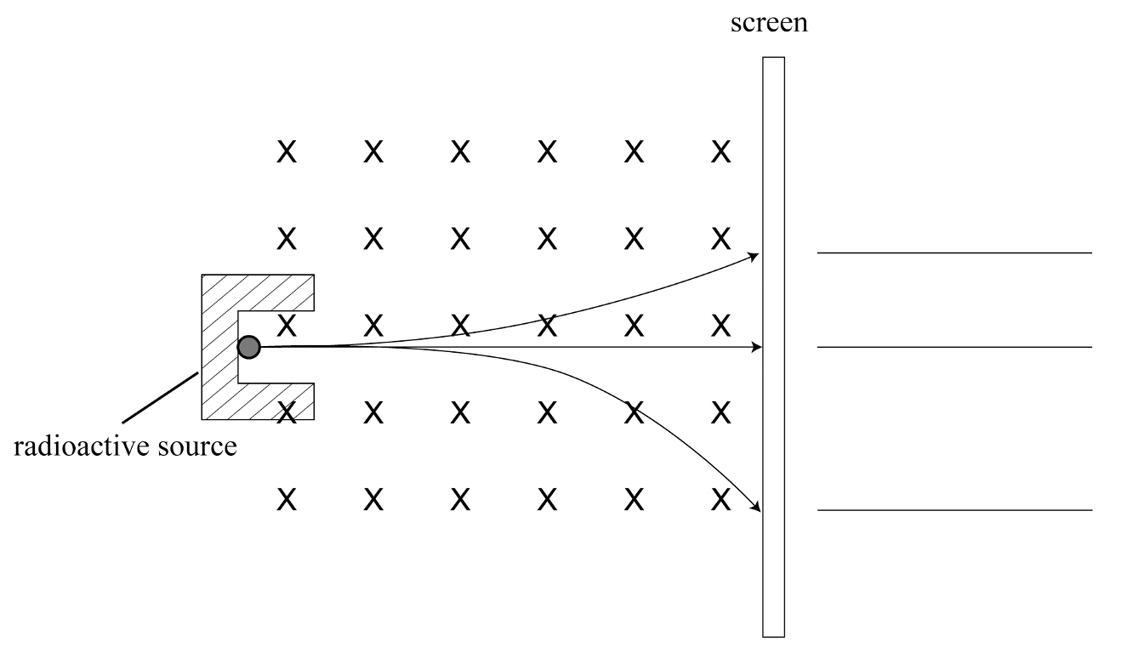
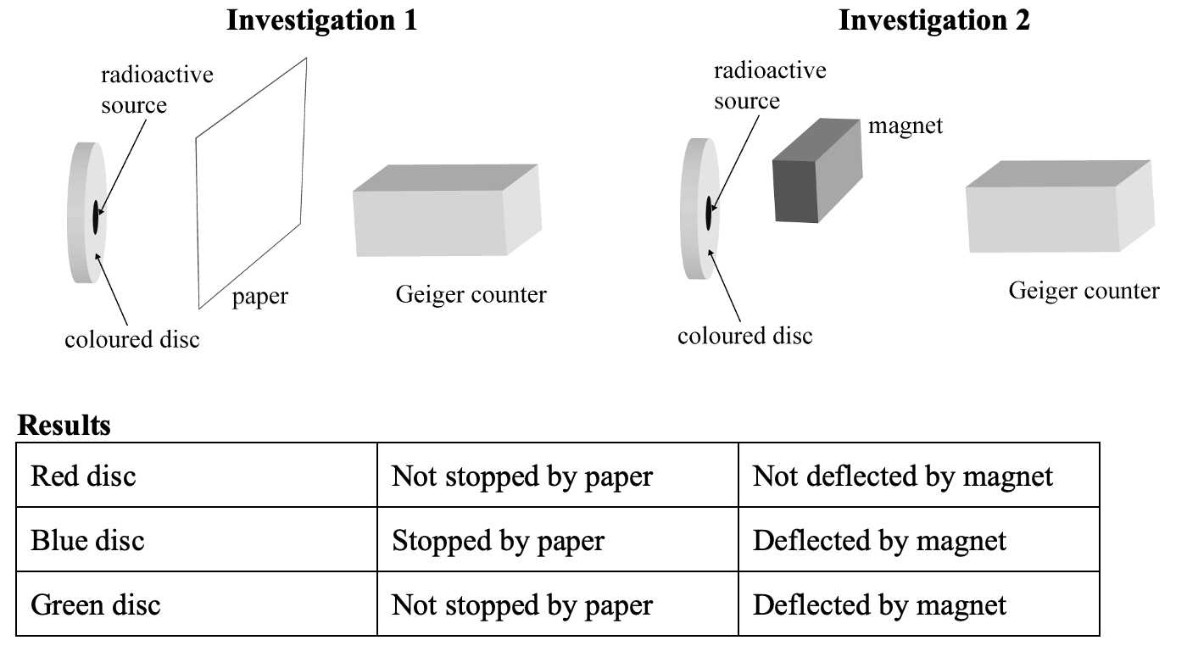
Name each emission form on the appropriate line to the right of the screen.
Explain the path of the top particle by explaining the relevant RH rule and relate the amount of deflection to the force experienced ($F=Bqv$) and the properties of the particle.
Explain the path of the middle particle by explaining the relevant RH rule and relate the amount of deflection to the force experienced ($F=Bqv$) and the properties of the particle.
Explain the path of the bottom particle by explaining the relevant RH rule and relate the amount of deflection to the force experienced ($F=Bqv$) and the properties of the particle.
Pātai: Geiger Counter Investigation
A student wanted to identify the type of radiation emitted from three unknown radioactive sources. She had a piece of paper, a strong magnet and a Geiger counter. The radioactive sources were attached to discs coloured red, blue and green. In the investigations, she placed each radioactive source in the position shown, and measured the radiation received by the Geiger counter.
Deduce the type of radiation emitted from each radioactive source, giving a brief explanation in each case.
Radioactive source on red disc emits: Explanation:
Radioactive source on blue disc emits: Explanation:
Radioactive source on green disc emits: Explanation:
Pātai: Platinum
Platinum-195 ($​_{78}^{195}Pt$) and platinum-192 ($​_{78}^{192}Pt$) are both isotopes of the same element.
State the difference between the nuclei of platinum-192 and platinum-195.
What do the numbers 78 and 195 represent in the symbol?
Write an equation for the decay of iridium-192 to platinum and name the particle emitted.
What Physics principles did you use to write the above nuclear equation?
Technetium-99 is sometimes injected into hospital patients. Technetium-99 decays by emitting gamma rays and low energy electrons. Technetium-99 has a half life of 6 hours. Give TWO reasons why is it important for doctors to use a radioactive isotope that has a half-life of a few hours in patients.
Explain why it is safer to inject radioisotopes that emit gamma rays rather than those that emit alpha particles.
Describe and explain the changes which occur in the nucleus of a radioactive isotope, including changes of its atomic number and mass number when it decays by emitting:
An alpha particle
A beta particle
Pātai: Classroom Sources
Here we have three radioactive sources: Polonium-210 (alpha), Strontium-90 (beta) and Cobalt-60 (gamma). When the Geiger counter emits a "beep", a single nucleus has transformed via radioactive decay.
Describe why (if) the Polonium-210 source can be detected using a Geiger counter.
Write a nuclear equation describing the decay of a Polonium-210 nucleus.
Describe why (if) the Strontium-90 source can be detected using a Geiger counter.
Write a nuclear equation describing the decay of a Strontium-90 nucleus.
Describe why (if) the Cobalt-60 source can be detected using a Geiger counter.
Write a nuclear equation describing the decay of a Cobalt-60 nucleus.
Pātai: Next we should attempt to write this decay as a nuclear equation where Nickel-60 is the reactant, and the daughter atom and gamma ray are the products.
Whakawai: Decay Equations
Write the nuclear equations for these reactions. For double decays, write two equations and then combine them into a single equation.
An alpha decay of Polonium-218
A beta decay of Hydrogen-3
A gamma decay of Carbon-14
An absorption of a neutron by Carbon-13 ($C−13+n$)
A double alpha decay of Uranium-234
A double beta decay of Thorium-234
Whakawai: Types of Radiation
Complete the two nuclear equations below with appropriate symbols and numbers to identify the type of radiation emitted.
$​_{38}^{90}Sr→​_{39}^{90}Y+...$ Name of Radiation:
$​_{27}^{60}Co→​_{27}^{60}Co+...$ Name of Radiation:
Uranium-238 decays to thorium (Th) by emitting an alpha particle. Complete the equation for this reaction using appropriate symbols and numbers. $​_{92}^{238}U→$
What is meant by the term ionising?
Which type of radiation is most strongly ionising?
An electron can be emitted from a radioactive nucleus even though it cannot exist inside the nucleus. Where does that electron come from?
As part of an experiment, Rutherford placed an alpha particle emitter into a jar. When the jar was later tested it contained the gas helium that was not previously present. Explain how the helium was formed.
The isotope Radon-222 ($​_{86}^{222}Rn$) undergoes two consecutive radioactive decays and turns into the isotope Polonium-218 ($​_{84}^{218}Po$). Write equations to determine the TWO separate emissions. Name the emissions.
Pātai: Radiation in a Magnetic Field
Radioactivity can occur in three distinct forms. The following diagram shows a radioactive source whose emission comprises all three forms. The three emission forms are being separated as they pass through a uniform magnetic field directed into the page, as indicated by the crosses.

Slide 14
Half-Life
2-4 | Remaining
Half-Lives Elapsed | Fraction | Percentage | Particles
1
2
3
4
5
6
7
Learning Outcomes
Be able to make half-life graphs
Be able to interpret half-life graphs
Introductory Video: https://www.youtube.com/watch?v=zXw2cOSBB8E
Whakamātau: Dice
In pairs, collect a container of dice from the front.
Count and record the total number of dice.
Roll all the dice in one go. Discard aside the dice with dots facing up, count the dice without dots and record that value (number of dice remaining).
Roll all the dice in one go that did did not land with dots facing up. Discard those with dots facing up, count, record and repeat until no dice remain.
Create a line graph showing the number of dice rolled (y-axis) vs the roll number (x-axis).
Interpret your graph to find out how many rolls it took for your original number of dice to halve. Confirm this by checking subsequent halvings.
r0.4 image
What you have hopefully discovered is an exponential decay curve! This type of curve can be observed in a multitude of places in nature, but in Nuclear Physics it shows the half-life of a particular radioactive atom.
It is important to note that for any section of a decay curve, it is steeper on the left and more gentle on the right. This means that the mass/number of atoms is changing more rapidly on the left.
What is Half-Life?
Definition: The time taken for half of a radioactive sample to undergo decay (half the nuclei to transform into their daughter-type)
Many things in the universe are deterministic - calculations can be performed to make accurate and specific predictions, however we are unable to predict when exactly a particular radioactive nuclei will decay. It turns out that decay is probabilistic and it is impossible to make a prediction for a single nuclei.
It is, however, possible to make predictions about groups of atoms using statistics (exponential decay curves).
We should also note that each different radioactive nuclei has a different half-life. Tellurium-128 is believed to have a half-life of over 128 trillion years, while Hydrogen-7 has a half-life of $23×{10}^{−24}s$.
Pātai: If there were initially 1200 particles in a sample, fill out the number of particles left after each half life has elapsed.

Slide 15
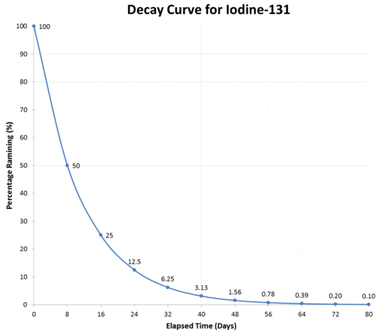
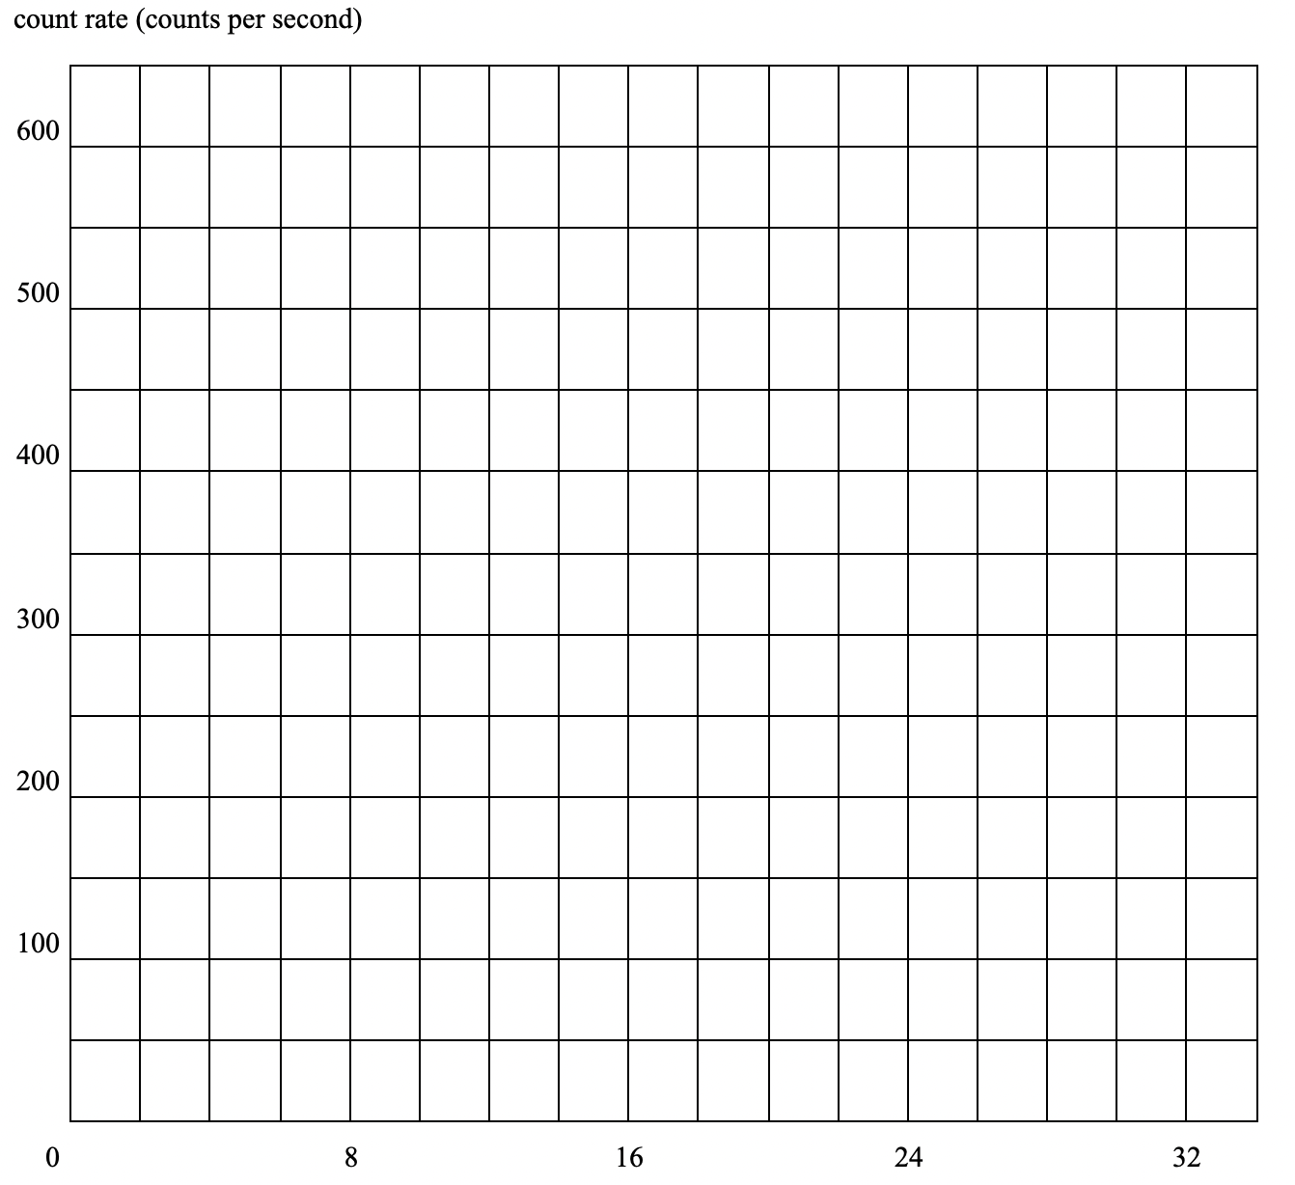
Whakawai: Carbon-Dating
Radio-carbon dating is used to estimate the age of objects that were once living. All living things contain a small amount of radioactive Carbon-14 ($​_{6}^{14}C$). Radioactive C-14 is created through the impact of cosimic rays with carbon in the atmosphere. This carbon is then used by plants in photosynthesis, and these plants eaten by animals.
Organisms have a relatively constant ratio of C-14 in them over their lifetime due to them continually consuming it through food. Once they die they are no long acquiring C-14 and it starts to decay away.
Carbon-14, which has a half-life of 5700 years, decays to Carbon-12. By measuring the activity of a sample of dead tissue, its approximate age can be determined. Activity is measured in counts per minute ($\frac{counts}{min}$ or $\frac{decays}{minute}$).
Calculate the number of neutrons present in a carbon 14 nucleus.
State what is meant by the term half-life.
A sample of living wood has an activity of $16counts/min$ per gram. Calculate the activity of a $20g$ sample of living wood.
Hence calculate the activity of a $20g$ sample of wood from a tree that died 17,100 years ago. State the correct unit for your answer.
A $5.0g$ sample of wood from an archaeological site has an activity of $20counts/min$. Calculate the activity of the sample when the wood was living, and hence calculate how long ago the tree died.
Whakawai: Cobalt-60
Cobalt 60 is a beta emitter used in medicine. It is created in a nuclear reactor, and decays with a half-life of 5.2 years. It is stored in a lead container until it is used.
State why the container is made of lead.
In 2001, the contents of a sealed lead container were 2.0 g of radioactive Cobalt 60. Determine the approximate mass of the contents five years later. Explain your answer.
In what year will the rate of decay of the Cobalt 60 be one-quarter of what it was in 2001?
Whakawai: Iodine-131
A sample of pure iodine-131 has a decay rate of $600s^{−1}$ (counts per second). 16 days later the decay rate has dropped to $150s^{−1}$. Use a graph to determine the decay rate after 28 days. You must show your working.
Half-Life Calculations
Those of who are confident with their math skills will have noticed that you can formulate an equation to help you make precise predictions about the number of particles left for any given time. In Year 12 Physics we do not use a formula, rather we make more approximate predictions by creating and reading graphs. Equation use is something you may see in Year 13 and into tertiary education. We can also perform predictions simply by dividing by two (as above) and using this to help us make estimates.
Method 1: Dividing
This method is slightly less accurate in some cases than the graphical method. The half-life of Hydrogen-3 (Tritium) is approximately 12.25 years. If you found a small sample of Tritium containing 5,000,000 un-decayed nuclei.
How many nuclei will be left after 12.25 years?
How many nuclei will be left after 24.5 years?
How many nuclei will be left after 49 years?
How many nuclei will be left after 196 years?
How long until there is less than 2500 un-decayed nuclei left?
Method 2: Graphs
This method can help us gain a better view when we want to know about non-integer half-lives e.g. the number of particles after 4.5 half-lives.
Pātai: You found a $50g$ sample of Cobalt-60 which has a half-life of 5 years.
Sketch a mass vs. time graph of the Cobalt-60 sample over a 30-year period. Use the graph to answer the following questions:
How long it would take for the mass of the $50g$ sample to fall just below $1.17g$.
Estimate the mass of Cobalt-60 left after 12.5 years.
Estimate the number of Cobalt-60 particles after 20 years.
Whakawai: Iodine-131
Predict the amount of time until there is 37.5% of the original sample of Iodine-131 left.

Slide 16
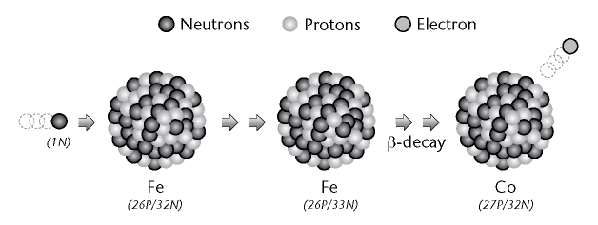
Fission and Fusion
By colliding high-speed neutrons with an already large nucleus, the neutron can sometimes be incorporated into the nucleus via the . This in turn causes the electrostatic force to now become larger than the strong nuclear force and the nuclei to break apart in nuclear fission. This is the process through which nuclear reactors produce energy here on Earth.
Pātai: Fission of Uranium
Uranium-235 is bombarded with a high speed neutron. The resulting nucleus becomes radioactive and decays into two daughter nuclei: Krypton-92 and Barium-141.
Write a nuclear equation describing the bombardment and fission of U-235
What is the third product? How did you determine it - what was conserved?
Nuclear Fusion
r0.4 image
Unlike Nuclear Fission, with fusion we can add whole nuclei together! This is the process through which stars produce energy. Fusion typically requires very high temperatures and pressures in order to get the nuclei close enough to combine. It is for this reason that we struggle to create self-sustaining fusion reactions here on Earth - it is hard to create and maintain these conditions.
However, it is important to note that fusing nuclei smaller than iron produces energy, while trying to fuse nuclei larger than iron requires more energy than is produced. We will see this concept again later!
Pātai: Fusion of Hydrogen
In the Sun deuterium (H-2) and tritium (H-3) are fused together to create helium (He-4) and one other product.
Write a nuclear equation describing the fusion of H-2 and H-3
What is the second product? How did you determine it - what was conserved?
Mass-Energy Equivalence
You probably know Einstein’s most famous formula were $E$ is energy, $m$ is mass and $c$ is the speed of light:
$$\begin{matrix}E=mc^{2}\end{matrix}$$
Because the speed of light is so large, this implies that a small amount of mass can be converted into a large amount of energy.
Pātai: Antimatter
Let’s pretend $2g$ of material is converted directly into energy (this would be a matter-antimatter collision). Calculate the amount of energy generated by this reaction, given $c≈3×{10}^{8}ms^{−1}$.
Knowns:
Unknowns:
Formula:
Substitute:
Solve + Unit:
Introductory Video: https://www.youtube.com/watch?v=HEYbgyL5n1g
How Fission and Fusion Produce Energy
It turns out that if you measure the mass of the reactants and products of a nuclear reaction, mass is not (exactly) conserved. Instead, the products have slightly less total mass than the reactants. This means that some mass was lost. Where did it go? It turned into energy via mass-energy equivalence.
Pātai: Fusion of Deuterium
Introductory Video: https://www.youtube.com/watch?v=mZsaaturR6E
$$\begin{aligned}&​_{1}^{3}H+​_{1}^{2}H→​_{2}^{4}He+​_{0}^{1}n\end{aligned}$$
Tritium ($​_{1}^{3}H$) $=5.00641×{10}^{−27}kg$
Deuterium ($​_{1}^{2}H$) $=3.3436×{10}^{−27}kg$
Helium ($​_{2}^{4}He$) $=6.64466×{10}^{−27}kg$
Neutron ($​_{0}^{1}n$) $=1.67493×{10}^{−27}kg$
Use these data to answer the following questions.
Calculate the total mass of the reactants.
Calculate the total mass of the products.
Calculate the amount of mass lost during the reaction.
Calculate the energy produced during this reaction.
Calculate the power output of this reaction if it took $0.0001s$ to occur ($P=\frac{E}{t}$).
Pātai: Fission of U-235
A nuclear power plant in the US can produce $1GW$ of power through neutron bombardment of U-235 and consequently, its fission. This fission produces Ba-141, Kr-92 and three neutrons.
$U−235=390.2480×{10}^{−27}kg$
$Ba−141=233.9616×{10}^{−27}kg$
$Kr−92=152.5794×{10}^{−27}kg$
$Neutron=1.67493×{10}^{−27}kg$
Use these data to answer the following questions.
Write an equation describing this nuclear reaction.
Calculate the total mass of the reactants.
Calculate the total mass of the products.
Calculate the amount of mass lost during the reaction.
Calculate the energy produced during this reaction.
If the plant is running for one year, calculate the mass of U-235 required. Start by calculating the amount of mass needed to produce $1GW$ of power, and then scale that up to the length of one year.
Pātai: Smoke Alarm
One particular type of smoke detector used in homes contains a radioactive material called americium. When a nucleus of americium decays it emits an alpha particle. The emitted alpha particles ionise the air inside the smoke detector. These ions travel between positive and negative plates inside the detector - thus creating a current and completing the circuit! This is what causes the alarm to sound.
$$\begin{matrix}​_{95}^{241}Am→​_{2}^{4}He+​_{93}^{237}Np+energy\end{matrix}$$
Helium $=6.64476×{10}^{−27}kg$
Neptunium $=393.54874×{10}^{−27}kg$
Americium $=400.20350×{10}^{−27}kg$
Given the above data, calculate the quantity of energy released in the alpha decay of a nucleus of americium.
Learning Outcomes
Understand the difference between nuclear fission and fusion
Use $E=mc^{2}$
Use $P=\frac{E}{t}$
Introductory Video: https://www.youtube.com/watch?v=rcOFV4y5z8c
Nuclear Fission
Recall from earlier that nuclei are generally stable because the is greater than the . This means that even though the protons repel each other, the nucleus does not break apart. Also recall that atoms with a nucleus that is too large in volume can be unstable (radioactive). This is because the electrostatic force is greater than the strong nuclear force, and the atom can then break down (decay) via alpha or beta/position emission.

