Slide 1
5N
5N
5N
5N

Slide 2


$$\tilde{A}$$
$$\tilde{B}$$

Slide 3
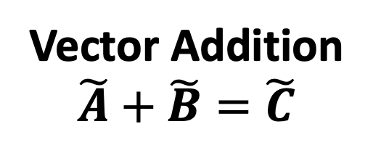



Vector Addition
$$\tilde{A}+\tilde{B}=\tilde{C}$$
$$\tilde{A}$$
$$\tilde{A}$$
$$\tilde{B}$$
$$\tilde{C}$$
$$\tilde{B}$$

Slide 4
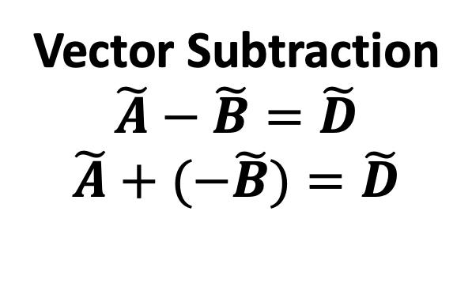

Vector Subtraction
$$\tilde{A}−\tilde{B}=\tilde{D}$$
$$\tilde{A}+(−\tilde{B})=\tilde{D}$$
Vector Addition
$$\tilde{A}+\tilde{B}=\tilde{C}$$
$$\tilde{A}$$
$$\tilde{A}$$
$$\tilde{B}$$
$$\tilde{B}$$
$$\tilde{D}$$
$$\tilde{C}$$
$$\tilde{B}$$
$$\tilde{A}$$

Slide 5
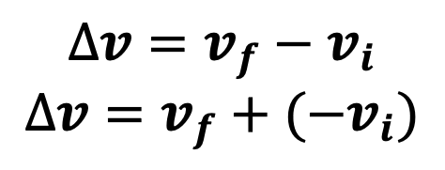



$$∆v=v_{f}−v_{i}$$
$$∆v=v_{f}+{(−v}_{i})$$
$$v_{f}={15ms}^{−1}$$
$$∆v$$
$${−v}_{i}={5ms}^{−1}$$

Slide 6
Support/Normal (720N)
Weight
(720N)

Slide 7
5N
5N
+
=
5N
5N
+
=
5N
10N
+
=
5N
10N
+
=
10N
+
5N
+
5N
=

Slide 8
100N Drag
Weight
(720N)

Slide 9
1kg
Ground

Slide 10
Support/Normal Force 9.8N
1kg
Ground
Weight Force 9.8N

Slide 11
Support/Normal Force 8.22N
30°
Weight Force 9.8N

Slide 12
Support/Normal Force 8.5N
Weight force perpendicular to the surface
30°
Weight Force 9.8N

Slide 13
Support/Normal Force 8.5N
Weight force perpendicular to the surface
30°
Weight Force 9.8N

Slide 14
Support/Normal 8.5N
Friction
Draw a vector diagram
Friction
Weight 9.8N
30°
Put the vectors head to tail
Support/Normal 8.5N
Weight 9.8N

Slide 15
F_{n} Normal Force

Slide 16
F_{n} Normal Force
Experienced Weight Force
F_{w} Weight Force

Slide 17
Support
Friction
Weight

Slide 18
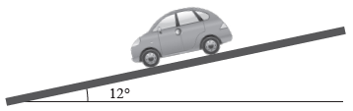
Support
Friction
Weight

Slide 19
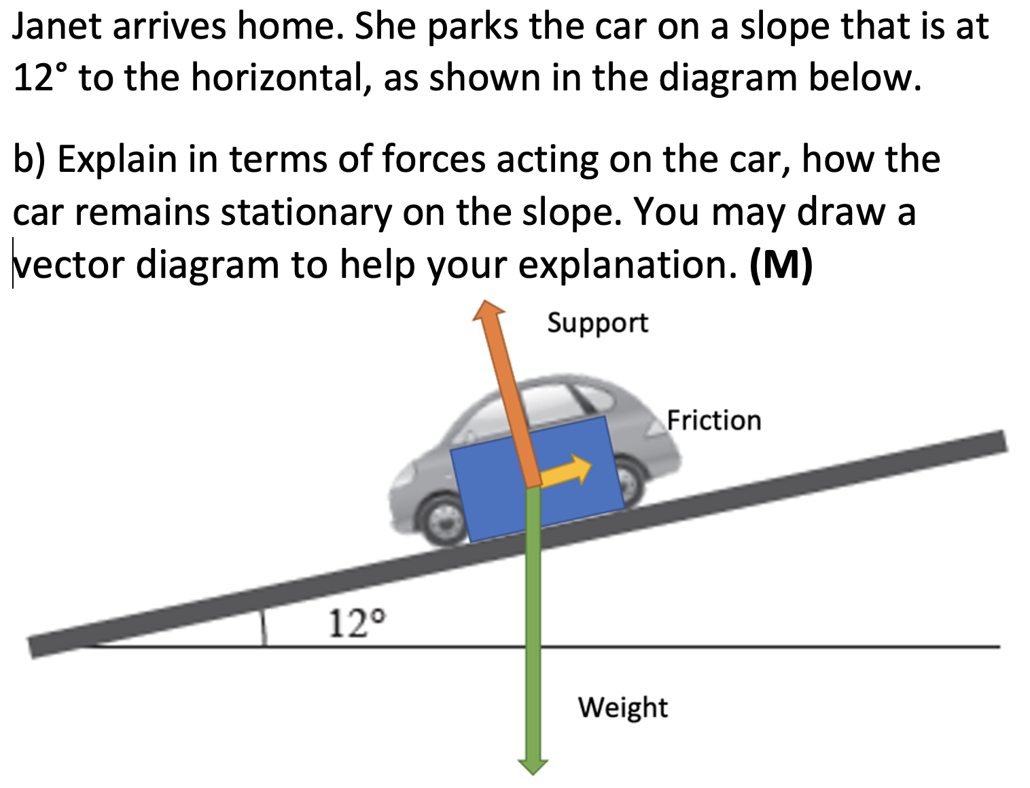
Weight
Support
Friction

Slide 20
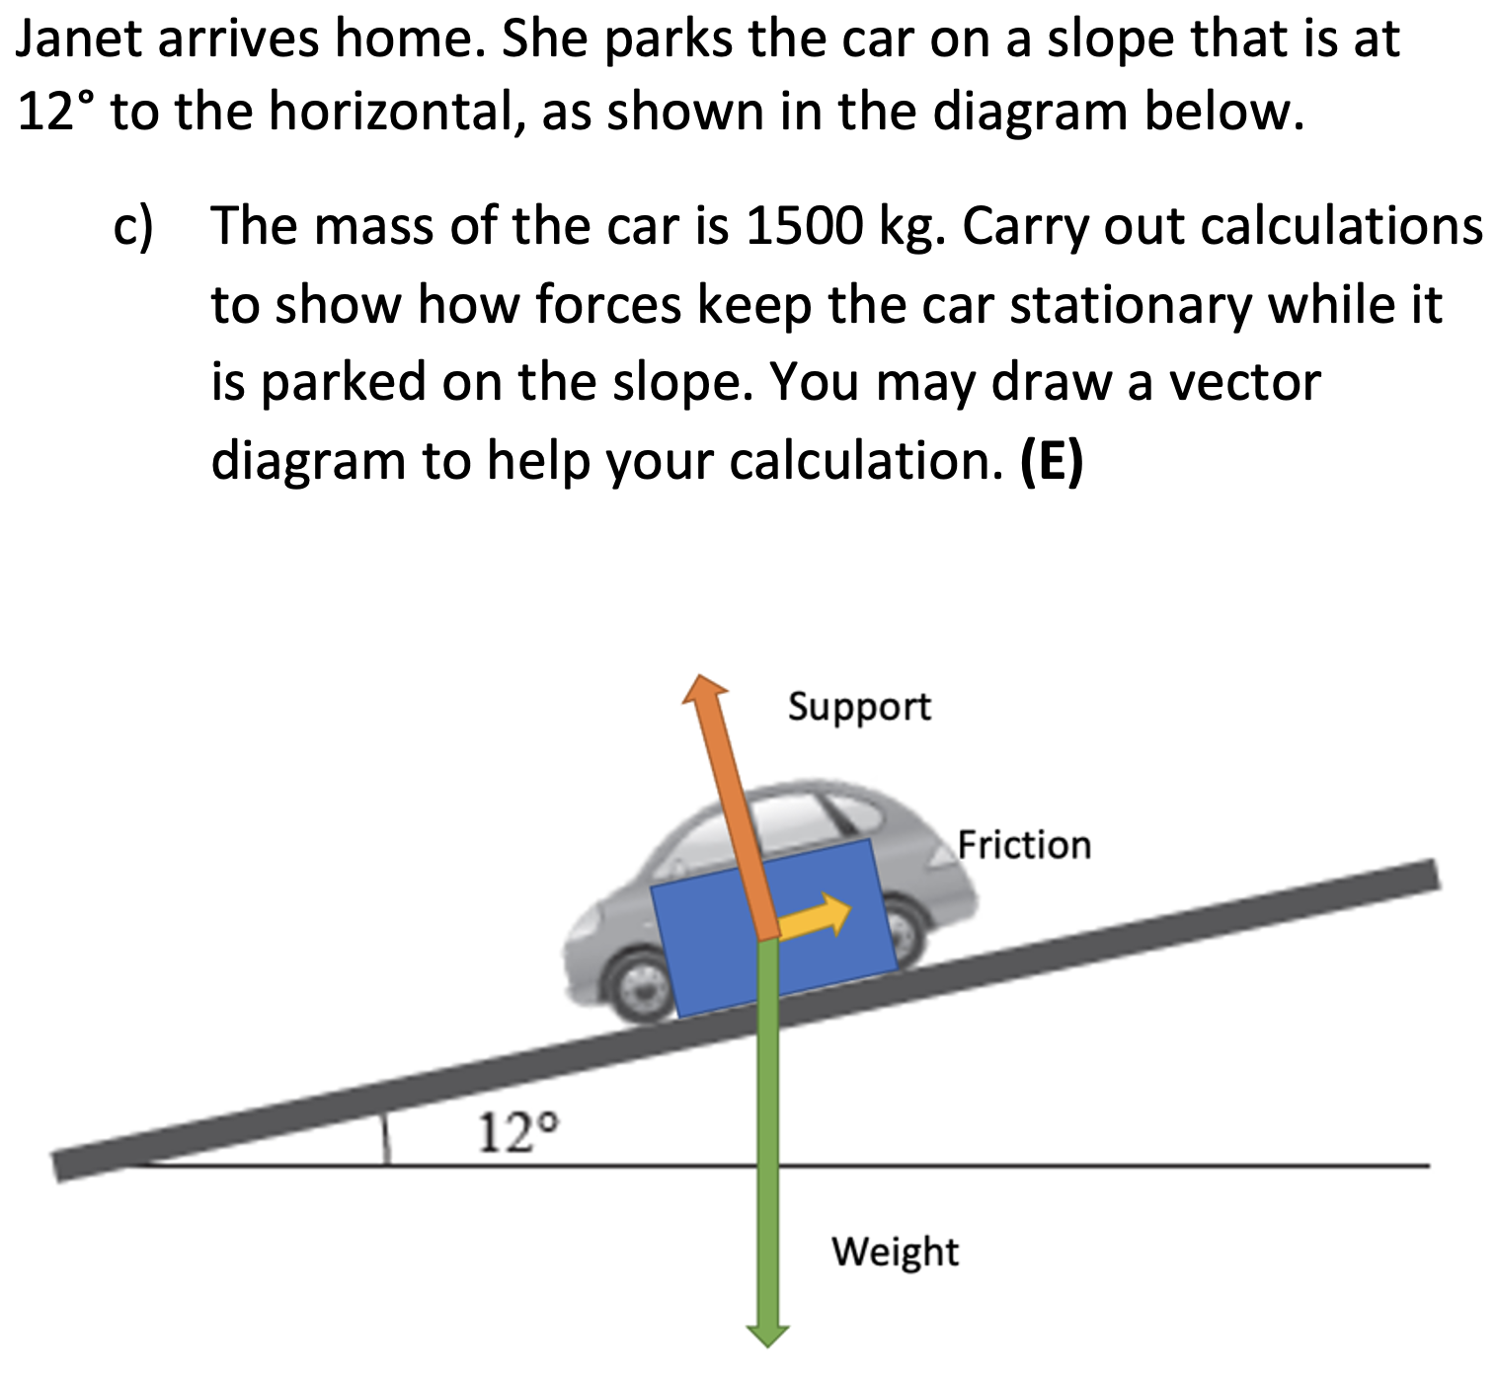
Weight 14700N
Support 14387N
Friction
3056N

Slide 21
3m
4kg
1.5m
F_{p}
T_{ACW}

Slide 22
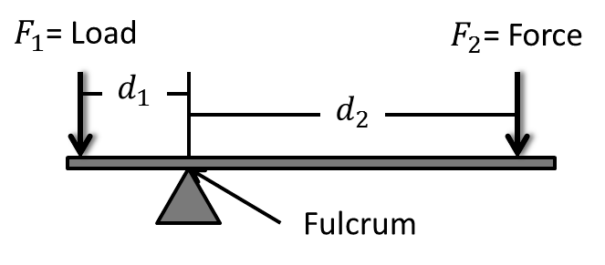
F_{p}

Slide 23
50m
F_{A}
10m
F_{B}
1000kg
B
A

Slide 24
Finding A.
Rotate around B.
All distances relative to B.
50m
40m
F_{A}
25m
1000kg
B
A
F_{CAR}
F_{P}

Slide 25
Finding B.
Rotate around A.
All distances relative to A.
50m
25m
F_{B}
10m
1000kg
B
A
F_{CAR}
F_{P}

Slide 26
50m
F_{A}=56,840N
10m
F_{B} = 50,960N
1000kg
B
A

Slide 27

$$4{ms}^{−1}$$
1m
8kg

Slide 28

$$10{ms}^{−1}$$
2m
← 305N

Slide 29

C = 1.885m
$$2.826{ms}^{−1}$$
0.3m
T = 0.667s

Slide 30
Three Types of Projectile Motion Questions
Half Parabola Homework Booklet: C4 | Full Parabola Homework Booklet: C2, C9 | Three-Quarter Parabola Homework Booklet: C3, C8 (hard)

