Slide 1
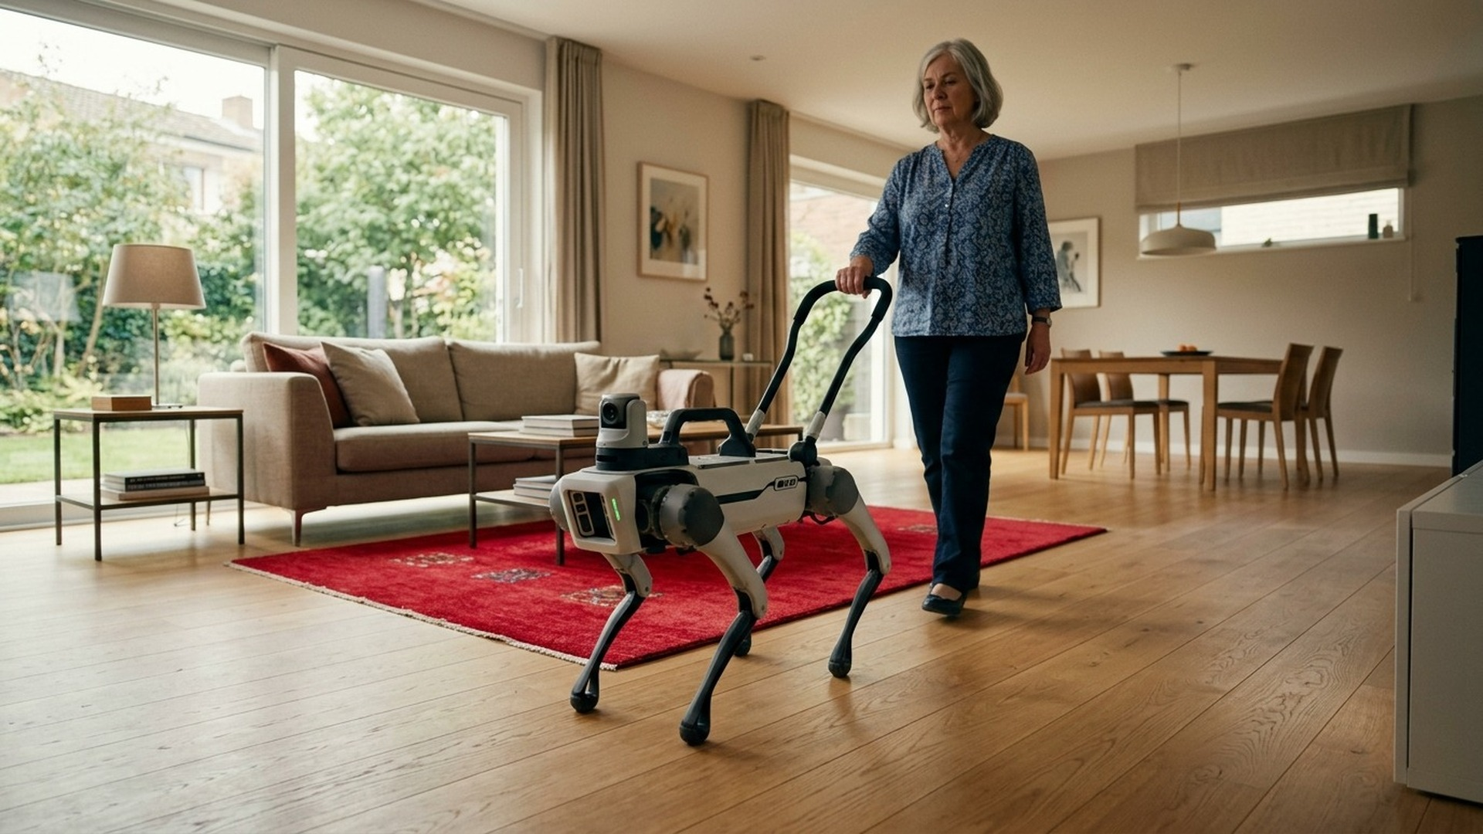

Nudge
A local-AI assistance dog for deaf, blind and deafblind people
Safety always on.
Local Gemma for the unknown.
Eden · Finn · Matteo · Ricktho · Sean
Agentverse 2026 · Robotics track
CONCEPT RENDER
Notes:
Hi, we're team Nudge. Nudge is a robot assistance dog for people who are deaf, blind or deafblind. It hears the house for its owner, finds them, nudges them, and guides them by a handle: to the door, to the kitchen, or out of the house in a fire. Everything runs locally on one laptop, with Google's Gemma 4 as its brain. (This picture is a concept render; everything after this is our working simulation.)

Slide 2
Independence shouldn’t depend on a wait
2M+
18M
450k+
16–18
people in the UK live with sight loss
adults are deaf or have hearing loss
deafblind people, rising to 610,000+ by 2035
months: the average wait for a guide dog
RNIB
RNID
Sense
A guide dog can cost over £55,000.
Someone who can’t hear the smoke alarm can’t wait two years.
Notes:
The need is big and immediate. Over two million people in the UK live with sight loss, 18 million adults are deaf or have hearing loss, and over 450,000 are deafblind, rising to over 610,000 by 2035. A trained assistance dog changes their life, but the average wait for a guide dog is 16 to 18 months, and a guide dog can cost over £55,000. Someone who can't hear the smoke alarm can't wait two years.

Slide 3
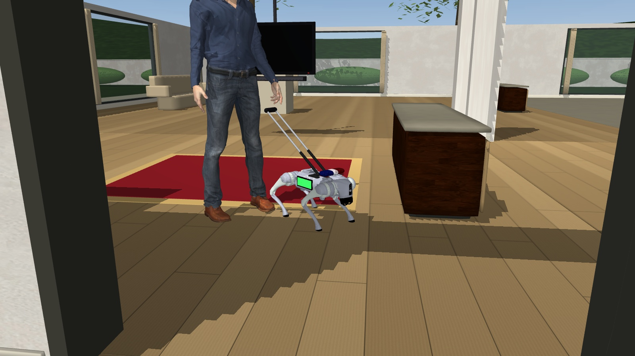
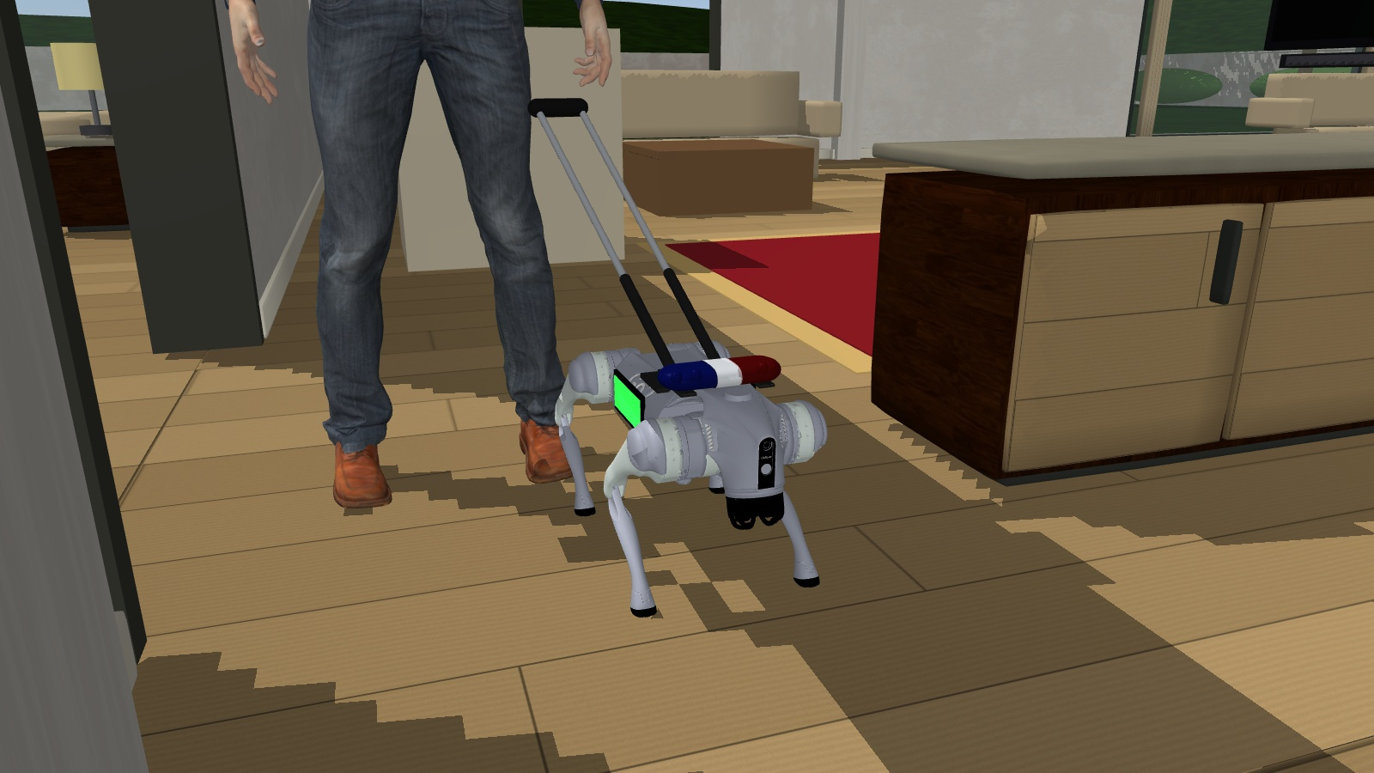
From sound to support
1
Hear
2
Find
3
Alert
4
Guide
5
Evacuate
Stereo ears: what the sound is and where it came from
Camera and the owner’s voice lead it to them
Handle pulses, screen and speech
Leads the owner by a rigid handle
In a fire, out by the safest exit
IN OUR SIMULATION
HANDLE CLOSE-UP
Notes:
The loop is simple. Nudge hears a sound with stereo ears and works out what and where it is. It finds the owner with its camera, or by their voice. It alerts them the way they need: handle pulses, a screen, speech. Like a real guide dog it walks on the owner's left, so the rigid handle comes up on their side at hand height. Then it leads them to the source, or out of the house by the safest exit in a fire.

Slide 4
Built to react. Designed to reason.
Reflex layer
Thinking layer
Plain code · milliseconds · always on
Local Gemma 4 · woken only by events
A smoke alarm pre-empts everything
Speed capped near the owner
4 s watchdog on every LLM call
Obstacle stops from the LiDAR
Picks one option from a menu of legal actions built from live perception
Explains every decision on screen
Turns the owner’s words into rules – e.g. don’t step on the new carpet
5 local models · 1 machine · no cloud calls
Gemma 4 · YOLOv8n · YAMNet · Whisper · Piper
Notes:
Two layers. The reflex layer is plain code that runs in milliseconds and can't be switched off: a smoke alarm pre-empts everything, speed is capped near the owner, and if the AI is slow, a 4-second watchdog hands over to rules. The thinking layer is Google's Gemma 4, running locally. It only wakes when something happens. Code builds a menu of legal options from what the robot senses, and Gemma picks one and explains why, so it can't invent an unsafe action. It also turns the owner's words, like 'don't step on my new carpet', into rules. All five models run on one laptop with no cloud calls.

Slide 5
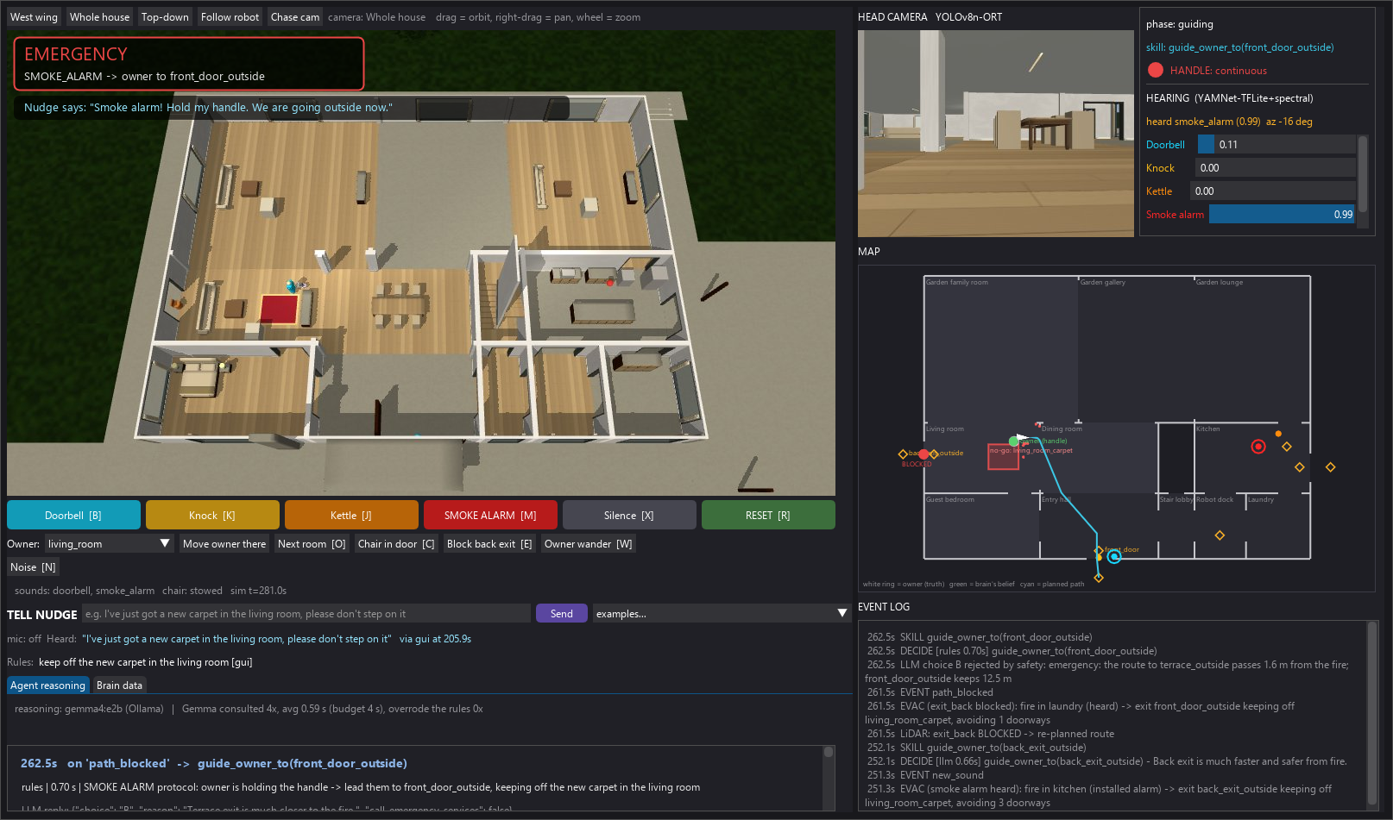
When the scene changes, Nudge adapts
0.6 s
A smoke alarm pre-empts the mission mid-way
Re-routed
Back exit blocked: LiDAR sees it and leads the owner to the front door
Overruled
Gemma’s exit choice near the fire is rejected by safety code
IN OUR SIMULATION
Notes:
This is the critical failure we designed for: a fire while Nudge is busy with something else. The smoke alarm pre-empts the current mission in 0.6 seconds. Here a chair has fallen into the back exit: the LiDAR sees it, and Nudge re-routes to the front door. And if Gemma ever picks an exit that passes near the fire, plain safety code rejects it. It also asks 'Shall I call 999?' while still leading the owner out.

Slide 6
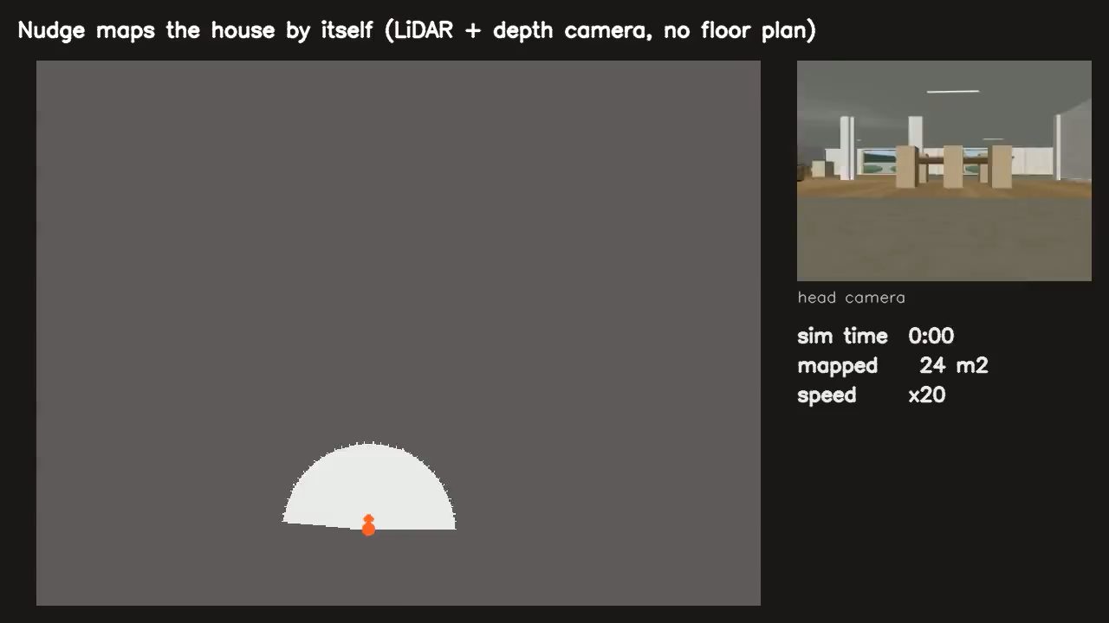
It learns a new home
99.8 %
of the floor mapped by itself, from LiDAR + depth camera
Exits
found from its own scan
~8 cm
position estimate from LiDAR
2nd home
IN OUR SIMULATION
the same brain works there too
Notes:
A real owner won't hand us a floor plan. So Nudge can explore a home by itself: from the LiDAR and its depth camera it mapped 99.8 % of the floor, and it finds the exits from its own scan. It can also estimate where it is from LiDAR, to about 8 cm in simulation. And the same brain runs unchanged in a second home, an apartment. These are built and tested in simulation, switched off in the recorded demo.

Slide 7
Measured, not imagined
0.19 s
96 %
0 %
per Gemma decision; 93 % right on real decisions
of sounds detected; smoke alarm never missed
false alerts from background noise
9 / 12
97–98 %
~8 cm
unseen, randomised situations solved
of camera views find the owner
self-localisation error from LiDAR
Simulation and evaluation results, 8 November 2026. Hearing: 1,000 random trials. Gemma timed on an RTX 5060 laptop.
Notes:
Everything here is measured, not claimed. Gemma decides in 0.19 seconds on the laptop and was right on 93 % of real logged decisions. In 1,000 random hearing trials, 96 % of sounds were detected and the smoke alarm was never missed, with zero false alerts from background noise. In 12 randomised situations it had never seen, it solved 9. The camera finds the owner in 97 to 98 % of views, and LiDAR localisation stays within about 8 cm.

Slide 8
Honest about where we are
Today
Next, on a real Go2
Simulated body and sensors
Synthesized demo sounds; real recordings are weaker (smoke 96 %, doorbell 64 %)
Room names come from a hand-written floor plan
Localisation on real sensors
Hearing tuned in real rooms
Build the haptic guide handle
Test with deafblind users
Everything shown runs today, in simulation, on one laptop.
No cloud calls in the loop: Gemma 4, YOLOv8n, YAMNet, Whisper and Piper all run locally.
Notes:
We want to be clear about what this is. Today the robot's body and sensors are simulated, the demo uses synthesized sounds, real recordings are weaker, and room names come from a floor plan we wrote. The next steps to a real Go2 are localisation on real sensors, hearing tuned in real rooms, building the haptic handle, and above all testing with deafblind people.

Slide 9
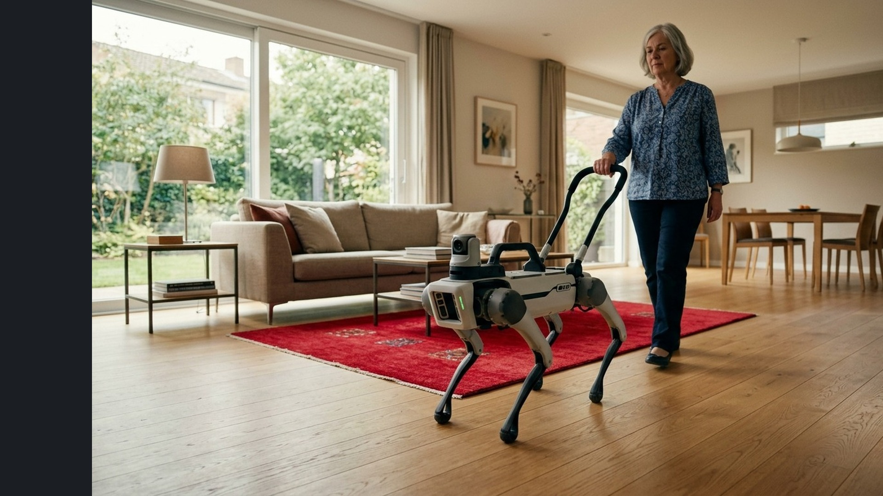

More awareness.
More independence.
Safety always on.
Local Gemma for the unknown.
Nudge: help that doesn’t make you wait two years.
Eden · Finn · Matteo · Ricktho · Sean
CONCEPT RENDER
Notes:
To close: Nudge gives deaf, blind and deafblind people more awareness of their home and more independence in it. Safety is always on, and local Gemma handles the rest. Help that doesn't make you wait two years. Thank you.

