Slide 1
Scala
The good, the bad and the very ugly

Slide 2
Vanity slide
Senior software engineer @ TomTom
Using scala for more than a year
Stackoverflow (couldn’t miss that)
http://techblog.bozho.net
@bozhobg
(Yes, I’m making presentations about programming languages in PowerPoint with screenshots of code)

Slide 3
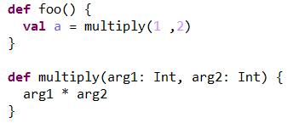
The good
functional and object-oriented
JVM-based
val, type inference
expressive
DSL-friendly

Slide 4
The good
case classes - immutable, value classes
embrace immutability - immutable collections by default
automatic conversion from and to Java collections

Slide 5

The good
no null - Option[Foo]
Reusing java instruments (e.g. guava, slf4j, even spring and hibernate)
goodies – e.g. instantiating collections without unnecessary brackets or type declarations

Slide 6
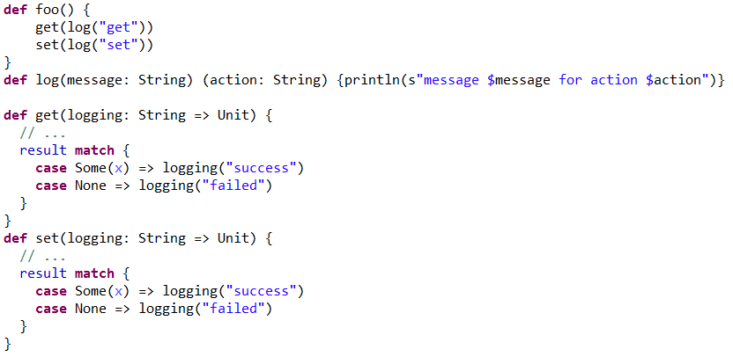
Partially applied functions

Slide 7
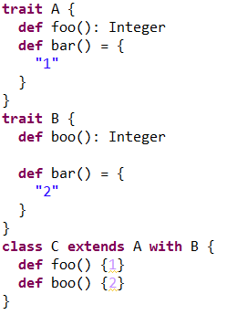
Traits
Multiple inheritance done right

Slide 8
The bad
tools
The compiler is too slow
IDE-s (Eclipse and IntelliJ) break
sbt (build tool) is buggy
ecosystem
Many java libraries cannot/should not be used
Most frameworks and libraries and in early phase
binary incompatible => one artifact for each scala version
lambdas are slower than in Java 8

Slide 9
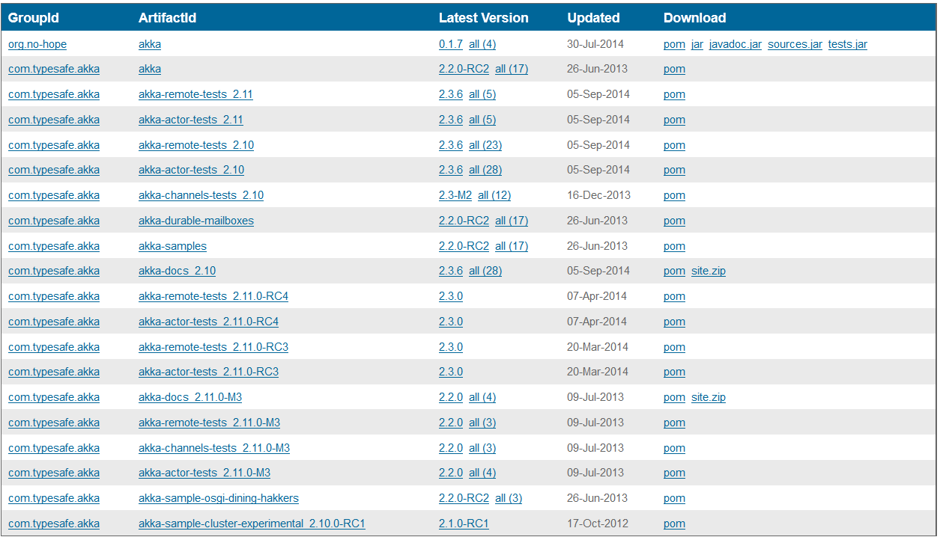

Slide 10
The bad
Heavy in terms of concepts and keywords: implicits, for comprehensions, lazy, case class, case object, currying, partially applied functions vs partial functions =>
Steep learning curve
Syntactic diabetes

Slide 11
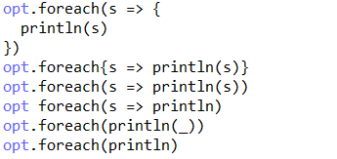
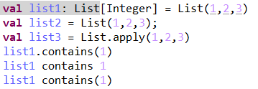
Syntactic diabetes

Slide 12
Implicits
implicit val, implicit def, implicitly, (implicit argument)
If anywhere in the execution context there is an implicit definition, any function can read it with(implicit foo: String) => the horror!
Saves initialization (e.g. of some tool)

Slide 13
The bad
One thing can be written in many ways and there is no “right” way.

Slide 14
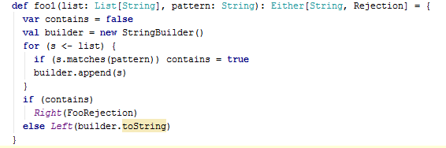
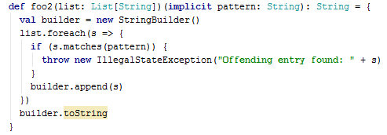


Slide 15
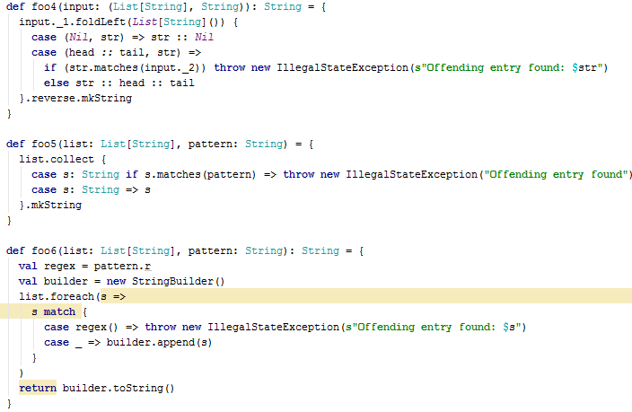

Slide 16
The bad
“Concise” doesn’t necessarily mean fast to write or easy to read

Slide 17
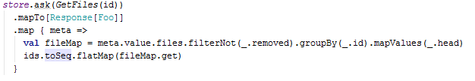

Slide 18
The bad
Productivity – do we gain or lose?

Slide 19
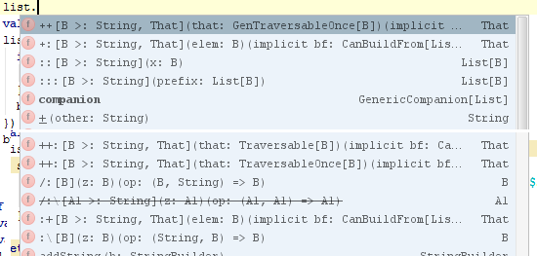
The very ugly
cryptic

Slide 20
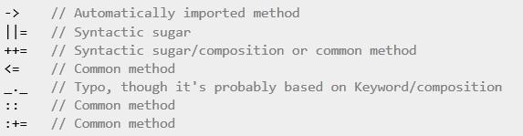
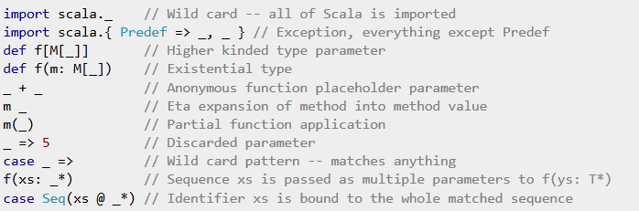
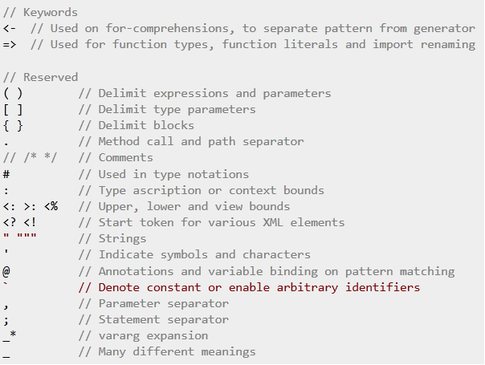


Slide 21
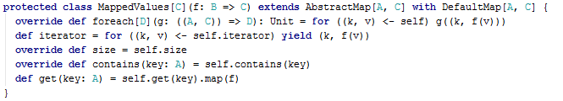

Slide 22
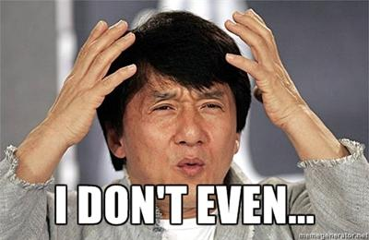

Slide 23


Slide 24
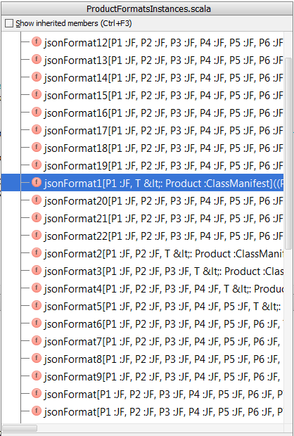

Slide 25
scala> List(1,2,3).toSet()

Slide 26
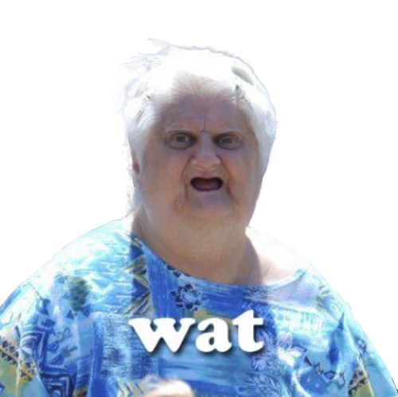
res0: Boolean = false
List(1,2,3).toSet
res0: s.c.immutable.Set[Int] = Set(1, 2, 3)

Slide 27
Philosophy
Should the language stop us from shooting ourselves in the foot?
Should this be at the expense of its expressiveness?
Where is the balance?
Who is scala suitable for?

Slide 28
Optimistic
IDEs are getting better
Frameworks are getting mature
Twitter and the language author are releasing guidelines and best practices (scala – the good parts)
invokeDynamic (SI-8359)

Slide 29
Conclusion
I wouldn’t recommend scala for a general-purpose new project
In an actual project most of the defficiencies are relatively easy to overcome
I would recommend scala for a small, side module
It’s interesting to work with, due to the functional aspect
Don’t give the users of your language, API or product all of the possible options – they will misuse them.

Slide 30
Questions?
def ? = ???

