Slide 1
Joule Dynamic Power Envelope Management for Compute Clusters
Finn Wicks
March 2026

Slide 2
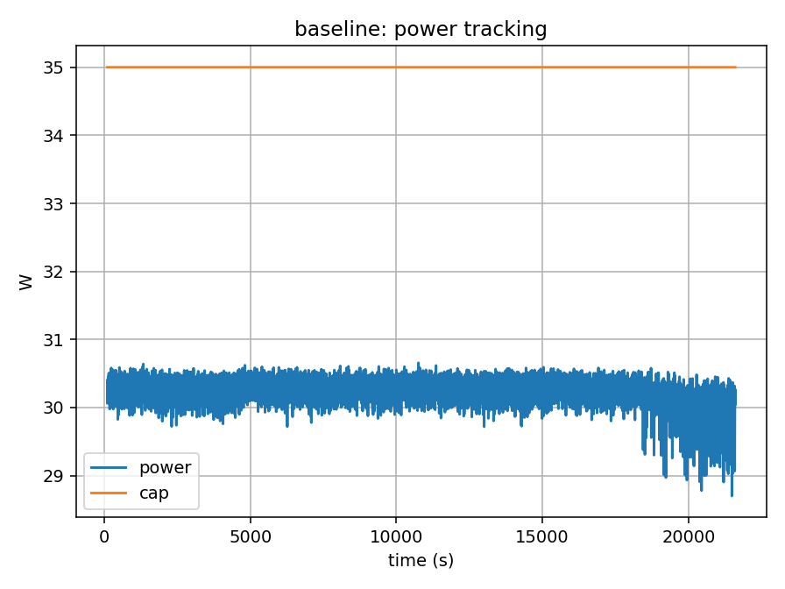
Static Power Limits Waste Compute Capacity
Real workloads fluctuate significantly
Static limits leave ~10-20% power unused
10% unused power => ~10% lost compute

Slide 3
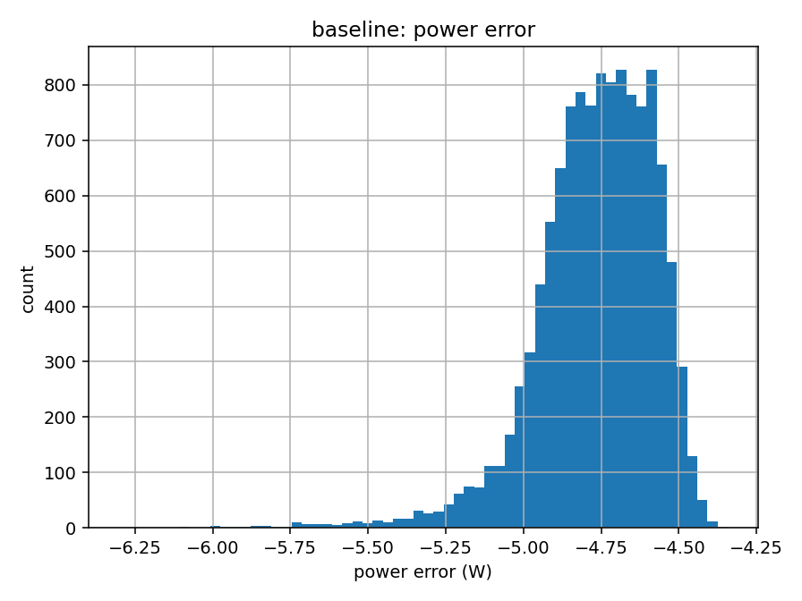
Unused Power Limits Compute Throughput
Real workloads fluctuate significantly
Static limits leave 10-20% of power unused
Power-constrained clusters lose potential compute
10% unused power = huge lost capacity

Slide 4
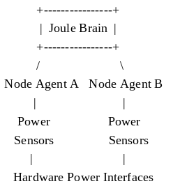
Joule Dynamically Allocates Power
Treats power as a shared cluster resource
Continuously adjusts node power limits
Maintains strict compliance with a global power cap

Slide 5
Controlled Evaluation
Multi-node compute cluster
Mixed compute workloads
Multiple power-cap levels
Six-hour runs per configuration
Same Hardware
Same Workloads
Same Power Cap
|
--------------------------
| |
Baseline Run Joule Run
Static Power Caps Dynamic Control
| |
----------- Compare ----------
Utilisation & Throughput

Slide 6
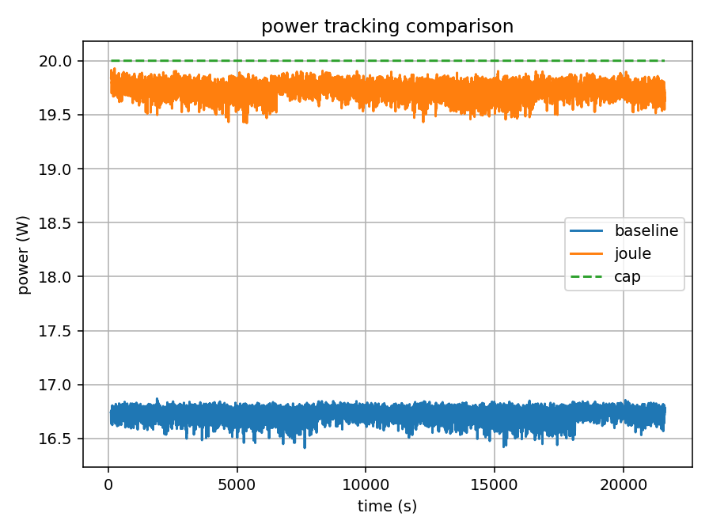
Joule Tracks the Power Cap with Near-Perfect Precision
Joule dynamically adjusts node power limits to keep cluster power near the configured envelope.
Baseline leaves significant power headroom
Joule tracks the envelope with <1W error
Zero cap violations

Slide 7
Dynamic Power Allocation Increases Throughput
Dynamic power control converts unused headroom into 5–12% more compute.
Cap | Baseline Utilisation (%) | Joule Utilisation (%)
20 | 83 | 99
25 | 79 | 99
30 | 79 | 98
35 | 86 | 97

Slide 8
Power Is the Limiting Resource
Power Is the Primary Constraint
Datacentres increasingly limited by electrical capacity
Example:
100 MW datacentre
10% utilization improvement
= 10 MW additional compute capacity
Joule increases usable compute under fixed power limits

Slide 9
Roadmap
Current:
Prototype validation (v0.96)
Next:
Cluster-scale deployment
GPU power interfaces
Scheduler integration
Future:
Rack-level envelopes
Datacentre-scale power management
Expand node scaling
GPU power interfaces
Integration with cluster scheduleres

Slide 10
Next Step
Deploy Joule on GPU clusters
Seeking:
Funding for cluster-scale evaluation
• Industry partners for pilot deployments

