Slide 1
CACFAR

Slide 2
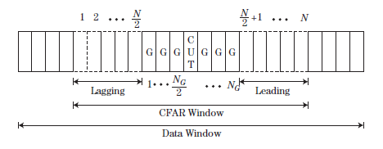
Parameters
Data window = 64
CFAR window = 12
Guard cells = 4
Alpha = 5
Data width = 16

Slide 3
Step by step
Write sample in the WRITE ADDRESS position of the BRAM
If WRITE ADDRESS is lower to 12, or memory is not filled, do nothing. If one of both is true, then read the value of the corresponding cell under test.
Make the average of the window around cut
Make the product by alpha
Compare with cut and make a decision
Incremental CUT ADDRESS and WRITE ADDRESS

Slide 4
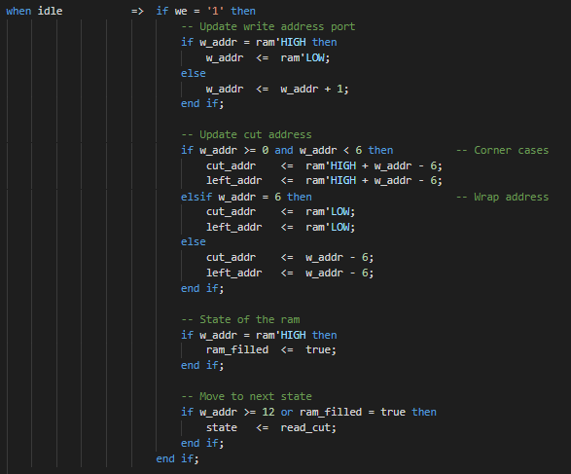
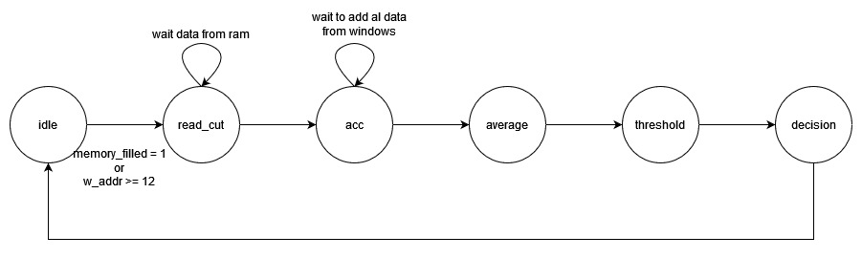
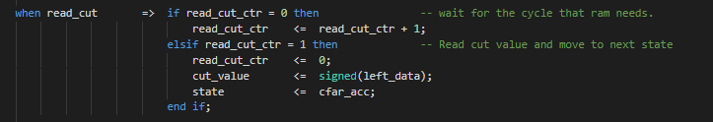
FLOW CHART

Slide 5
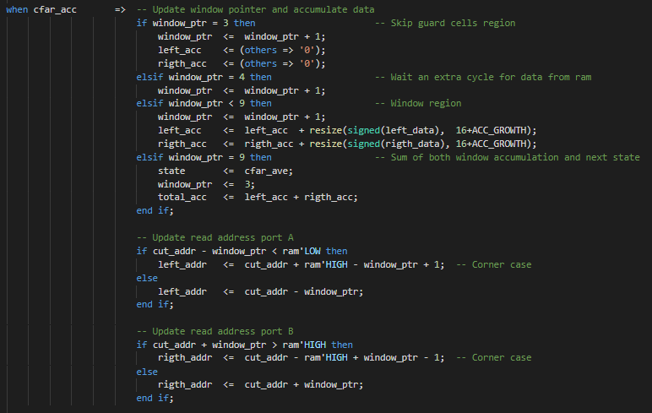
FLOW CHART

Slide 6
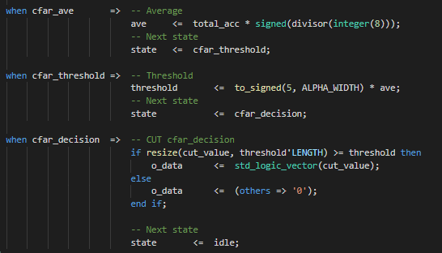
FLOW CHART
There is not división operation in HW
A multiplication by 1/x is synthetized instead
A set of values 1/x, where x is from 1 to 128, is load into LUTs
Values are quantized as signed [10 9]
In example, if the address pointer to the LUT is 8, the result will be 1/8 = 0,125

Slide 7
FLOW CHART

Slide 8
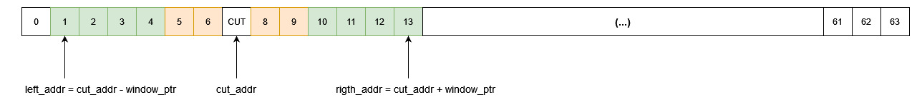
POINTERS
cut_addr is the index of the current cell under test
right_addr and left_addr are the pointers to the cells within left and rigth window
Window pointer is incremented until it reaches the higher position

Slide 9
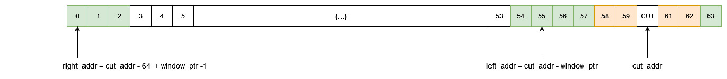
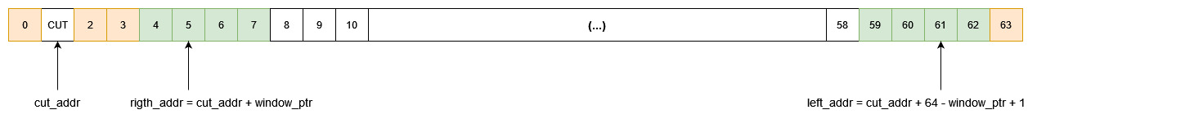
POINTERS – CORNER CASES
There are 2 corner cases: lower bound and upper bound of ram
Both cases are solved by wrapping the address

Slide 10
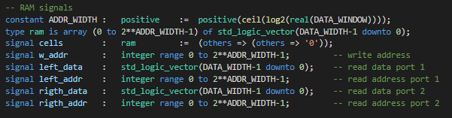
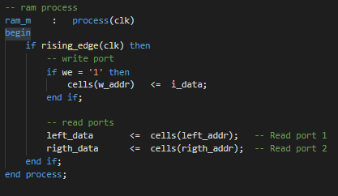
INFERRED BRAM
Signals declaration
RAM process

Slide 11
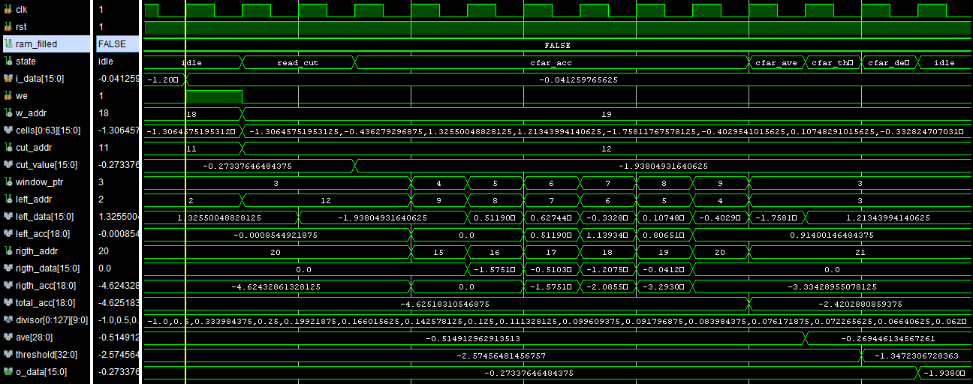
SIMULATION RESULTS

Slide 12
SIMULATION RESULTS

Slide 13
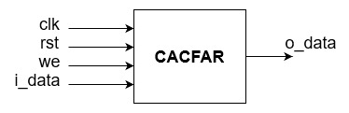

BLOCK DIAGRAM AND UTILIZATION REPORT

Slide 14
Thanks!

