Slide 1
Archi – The Architect and Multipurpose AI Copilot Framework
IT Architecture DTCC
PRESENTER:
Laura Monica Poca, Allan Valloran, Sundeep Mohanty
DATE:
2025-02-07
DEPARTMENT:
DTCC ITA

Slide 2
AGENDA
Archi – Architecture Copilot Solution
Archi – Video Demo

Slide 3
Problem Statement
IT Architecture teams within financial organizations are operating vertically and horizontally across the different lines of business and departments.
Architecture documents encompass many categories and types: policies, standards, guidance documents, architecture patterns, logical and technical architecture documents, application, platform, data, security, performance, testing specific documentation , audit, control and assessment documentation, etc.
Architecture document storage and repositories are diverse and constantly evolving. The shear volume and quantity of information is vast and thus challenging to access and correlate.
Unification, standardization and modernization of architecture artifacts is time consuming and requires domain specific and technology specific information
Compliance audits are complex and require answers from several architecture artifacts

Slide 4
Solution Overview
Solution:
Create an AI copilot framework that can be leveraged for solving Architectural engagement concerns also to define an open AI copilot framework that can be used for various other use cases.
Archi, the Architecture Co-Pilot application, enables Architecture Teams to onboard all relevant Architecture documents and allow different personas within the organization to leverage their content, to be able to search for ITA specific information, diagrams, key concepts and ask questions in real time to get insights into different areas of Architecture.
It is an interactive UI/backend application that enables text, image, audio and video responses to leverage GEN AI technologies
It is an application that facilitates easy access to information and aims to increase productivity within different teams in the organization.
Solution Approach: Multi-modal document embedding and RAG generation for document Knowledge base , Leverage Bedrock and Polly AWS GEN AI technologies and several multi-modal LLMs like Anthropic sonnet, Titan embedding

Slide 5
Solution Overview
Key Features:
Onboard of specific documents to create a multimodal RAG (document knowledge Base).
UI Co-pilot to enable easy interaction with all GEN AI tools
Ability to ask questions and get streaming response in real time.
Ability to get DTCC specific responses based on DTCC artifacts
Return text and diagrams from knowledge base
Ability to render text to audio and video
Ability to select voice and avatar
Capability to store dialogue history with diagrams
Session memory for text
Industry impact
Increase productivity by leveraging Gen AI capabilities
Facilitate Modernized Architecture Design
Empower regulatory compliance by design
Monitoring governance compliance
Facilitate AI-Powered decision making
Enable AI-Powered Risk Assessments
Plug and Play AI framework for productivity gain

Slide 6
Technical Implementation
Tech Stack Overview:
Front end developed in Java Script
Backend developed in Python
Solution developed for AWS cloud
AWS services used: ec2, lambda, API gateway, Aurora Postgres + PG Vector, Bedrock, Polly, IAM, Secret Manager, S3 storage
FastAPI and API Gateway
Data Usage: for the hackathon we uploaded some Kafka Confluent documentation available from the internet
Model Performance and Results:
response text is streaming to simulate real-time
Backend is developed and deployed on ec2 which can be scaled up in a production deployment
Aurora Postgres can be scaled up as necessary in a production environment

Slide 7
Architecture Diagram: Logical Design

Slide 8
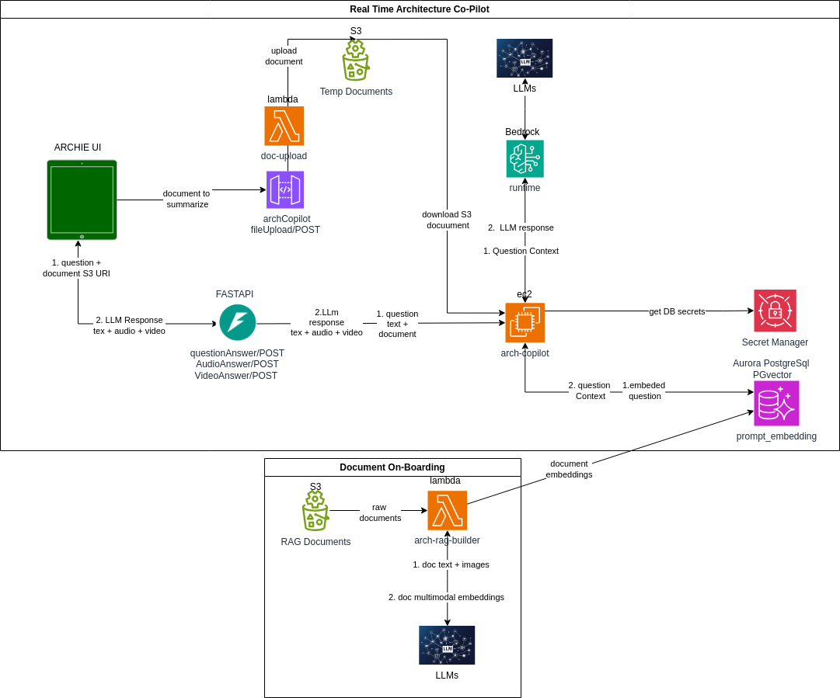
Architecture Diagram: Technical Design

Slide 9
Industry Impact, Collaboration and Production Viability
Path to Production:
Solution has multiple implementation for production
Ec2 can be deployed in different cluster technologies to enable elastic scalability
NLBs (Network Load Balancer) can be used to distribute traffic to backend targets across multiple AZs within a region and enable cross-zone load balancing for DR
Scalability
Solution can be deployed on a cluster to enable scalability

Slide 10
Conclusion
In today’s fast-paced digital landscape, architects face complex, evolving technologies and ever-changing business demands
Traditional methods of designing, validating and optimizing architectures are time-consuming, error-prone and costly
Enter Archie – the Architecture Co-pilot powered by Generative AI
A game-changing AI-driven assistant that empowers architects to design in an optimized fashion with speed, accuracy and compliance

Slide 11



Judging Criteria and Scoring
Maximum Score
Metric
Title
Technical Innovation
Innovation and Originality of Solution Design
Does the solution have a creative approach to solve the problem? Was AI used effectively to derive the solution? Judges will evaluate the uniqueness of the solution, the creative approach to solving the use case.
15
Technical Implementation
The quality and sophistication of the solution's architecture, design, tech stack, industry frameworks and efficiency of the solution.
10
Solution Viability
Solution’s potential for operationalization and enterprise use.
10
Data Usage and Management
The effective use of provided datasets or external data sources, data preprocessing and feature engineering techniques, and handling of data privacy and security concerns will be evaluated.
10
Ease of Use
Does it have a user-friendly interface? Can a user use the product with minimum instructions.
5
Value Proposition
Industry Impact and Viability
Potential value to the Capital Markets industry broadly, market scalability, and revenue generation or cost-saving potential of the solution.
20
Industry Collaboration
(Bonus for "super teams")
Does the implementation (or future phases of the implementation) facilitate/require collaboration across at least 2 or more industry participants? (e.g., through data sharing or other methodologies).
15
Final Presentation and Demo
Clear Presentation of Problem and Solution
Effective handling of Q&A
A clear explanation of the problem and solution, the quality of the pitch or demo, and technical design documentation of the project will be important factors.
15
Technical Design Documentation
Bonus- visual appeal of presentation material

