Slide 1
Sentiment Analysis
-LiquidityGuard
TEAM NAME: Blue Devils TEAM MEMBERS/ORGS: Mingyang Li, Renjie Wang, Chen Xu, Yiwei Yan, Shirley Zhu
DATE:
February 7th, 2025
DEPARTMENT:
Duke University

Slide 2
AGENDA
Problem & Solution Approach
Technical Implementation
Results

Slide 3
Problem Statement
Background: current risk management systems in financial markets rely heavily on historical trading data and real-time intraday monitoring, but are unable to anticipate in advance the impact of pre-opening news on trading volumes.
Reason: information vacuum during non-trading hours, pre-opening news (e.g., earnings, policy, breaking news) is not entirely quantitative analyzed, resulting in a “black box” of liquidity fluctuations at the beginning of the trading day.
Results: financial institutions may face reduced clearing efficiency, settlement delays and increased counterparty default risk due to misallocation of resources.

Slide 4
Solution Approach
“Extracting signals from emotional noise: quantitative modeling of multidimensional news.”
Sentiment score calculation using RoBERTa NLP machine learning model. Scores were calculated by weighting their positive/negative effects on the news headline recognition results represented.
Three dimensions of our news impact model:
1. Emotional intensity (absolute value of score): measures the “impact” of the news on the market.
2. Information density (number of news items): reflects market interest.
3. Divergence of views (scored variance): capturing market hesitation or consensus.
future first-hour trading volume = constant + β₁abs_sentiment_score + β₂news_num + β₃score_var + other control variables

Slide 5
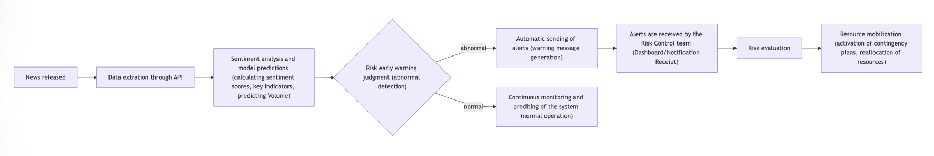
Solution
LiquidityGuard——Opening Liquidity Risk Early Warning Platform
Product components:
Real-time API: Integration with DTCC clearing system to push predicted trading volume before the market opens.
Dashboard: historical prediction accuracy, fitted model selection.
Core values:
Helps DTCC dynamically adjust margin requirements and clearing resources, e.g., allocates additional clearing bandwidth in advance if the forecasted volume is above a threshold; warns of liquidity crises due to the “herd effect” if the news divergence is extremely low.
User Journey：

Slide 6
Key Features
Real-time forecasting: Automatically collects multi-source financial news during the pre-market non-trading session, generate forecasts 30 minutes before the market opens, complementing traditional intraday monitoring.
Sentiment Scoring and Metrics Construction:Quantifying the sentiment of news (positive and negative scoring), calculating absolute sentiment value, number of news and sentiment variance, capturing multiple dimensions of market sentiment.
Intuitive dashboard and early warning system: Real-time display of forecasts and risk indicators, with thresholds set to trigger automatic warnings, facilitating rapid response by decision makers.
Historical Data Retrospective and Model Iteration: Storing historical data supports continuous model calibration and optimization to adapt to different market environment changes.

Slide 7
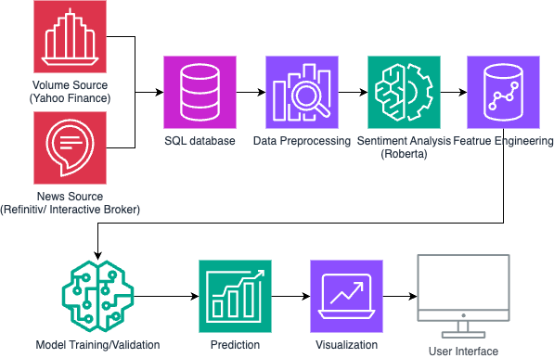
Architecture Diagram

Slide 8
Technical Implementation
Tech Stack Overview: Python for the backend, Streamlit for the frontend, APIs include Refinitiv Eikon and Interactive Brokers, Yahoo Finance, SQL database
Data Usage:
Details: next slide
Responsible AI considerations:
Fairness: Audit for biases in sentiment analysis and predictions.
Transparency: Use interpretable models and document the process.

Slide 9
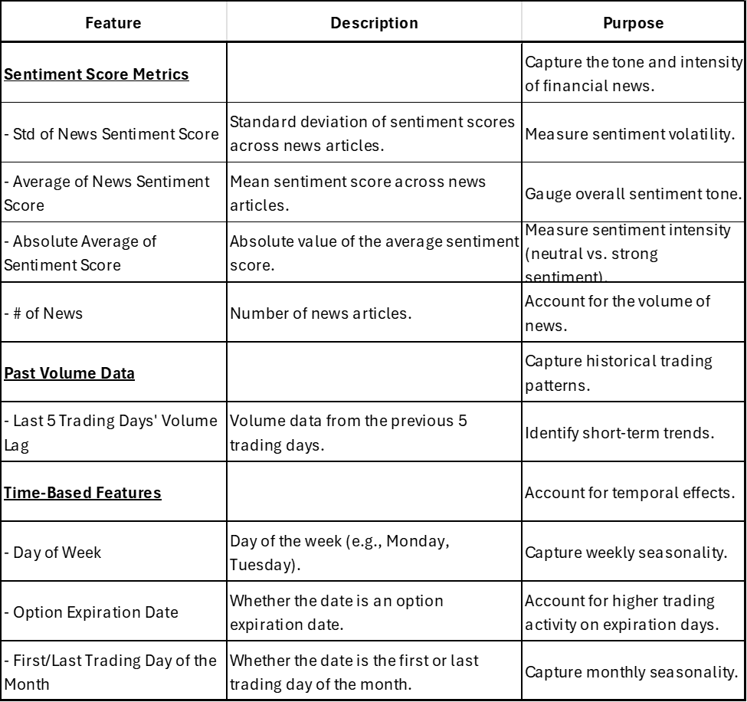
Data Usage
after-hour financial news
volume data
date
next trading day 9.30-10.30 trading volume

Slide 10
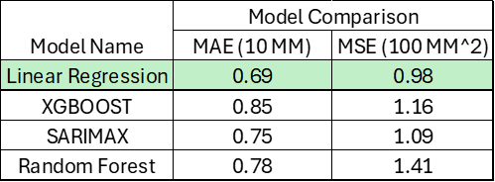
Model Comparison
Linear Regression has the lowest errors in MAE and MSE
MAE (Mean Absolute Error) measures the average absolute difference between predicted and actual values, while MSE (Mean Squared Error) measures the average of the squared differences, giving more weight to larger errors
What we found:
News sentiment is a strong market indicator. Higher sentiment variability and more news suggest increased stock activity and market events.

Slide 11
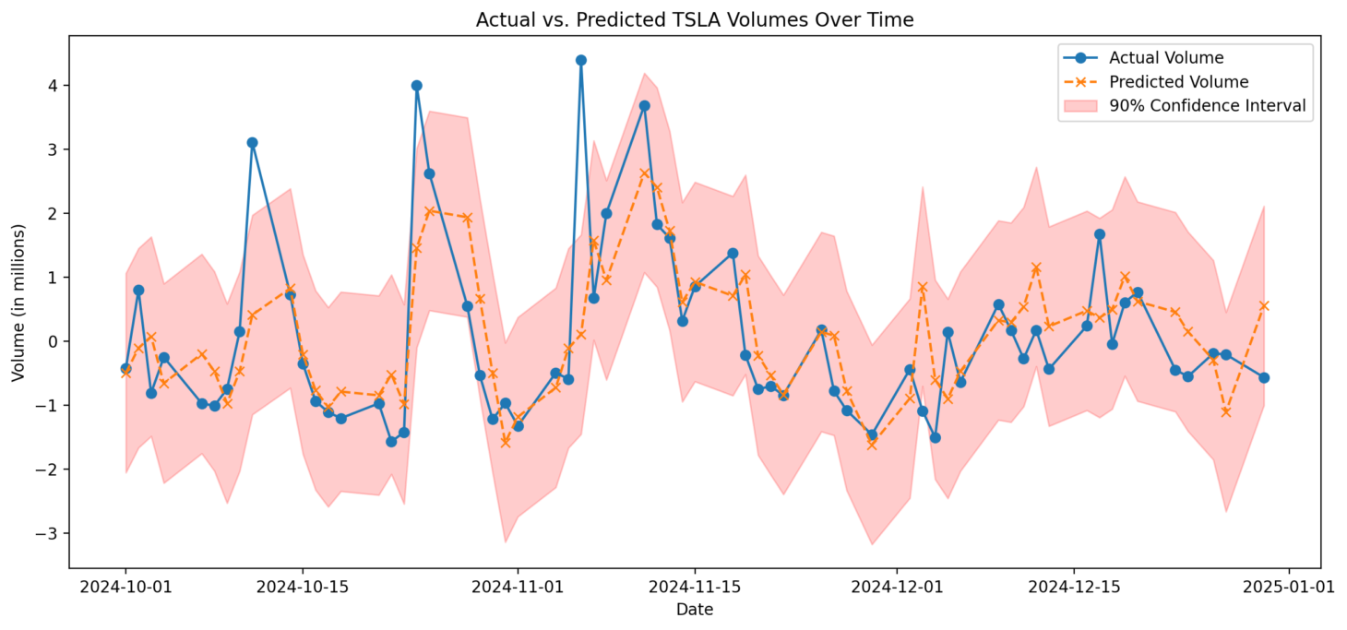
Model Performance
Be aware of large trading volume ahead of time
Mean Squared Error: 0.9845
R-squared: 0.4489

Slide 12
Scalability
Efficient Sentiment Analysis: RoBERTa processes 100,000+ news in ~30 minutes, demonstrating strong scalability for large datasets.
Fast Model Execution: Linear regression ensures real-time inference, making the system highly scalable with minimal computational overhead.
Cloud & Parallel Processing Ready: Can further scale with distributed computing for even faster processing.

Slide 13
Industry impact
Impact to individual Financial Institutions:
Risk reduction: Reduce settlement failures due to volume spikes.
Optimize resource allocation:Help organizations adjust system resources and risk control measures in advance to improve the efficiency of responding to sudden market fluctuations.
Revenue Growth: Sell predictive data as a value-added service to hedge funds, market makers
Impact to the industry:
Market stability: Identify trading volume anomalies in advance, provide early warning for clearing and settlement sessions, and reduce system risks and potential operational risks, prevent “flash crashes” (e.g., the 2010 flash crash in U.S. stocks).
Regulatory Enablement: Provide early warning system for SEC to identify systemic risks.

Slide 14
Challenges and Limitation
Model Performance Trade-off: More complex ML models could improve accuracy, but linear regression performs better given the current dataset.
Limited Data Availability: Only 1 year of news data, restricting long-term trend analysis.
Headline-Only Sentiment: Lack of full article text reduces RoBERTa’s accuracy, as context is missing.
Scalability vs. Accuracy: Need to balance processing speed and model complexity for optimal performance.

Slide 15
Demo
https://liquidityguards-bluedevils.streamlit.app/

Slide 16
Conclusion
LiquidityGuard is an innovative early-warning platform that fills this critical gap by leveraging NLP-driven sentiment analysis to forecast first-hour trading volume with high accuracy. It enhances clearing efficiency, mitigates risk, and ensures market stability from the opening bell for DTCC.

Slide 17
Thank you for your time!

Slide 18
Appendix

Slide 19
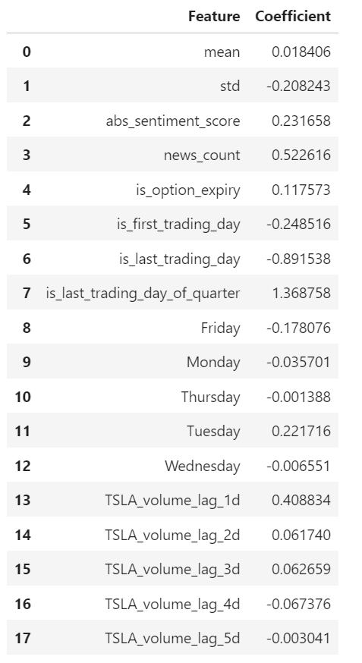
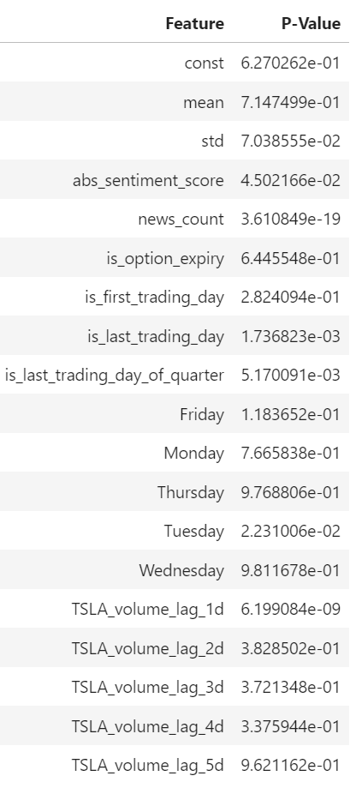
Model Performance
Significant Variable Coefficient
std
abs_sentiment_score
news_count
is_last_trading_day
tuesday
TSLA_volume_lag_1d
Intuition
News sentiment is a strong market indicator. Higher sentiment variability and more news suggest increased stock activity and market events.

Slide 20



Judging Criteria and Scoring
Maximum Score
Metric
Title
Technical Innovation
Innovation and Originality of Solution Design
Does the solution have a creative approach to solve the problem? Was AI used effectively to derive the solution? Judges will evaluate the uniqueness of the solution, the creative approach to solving the use case.
15
Technical Implementation
The quality and sophistication of the solution's architecture, design, tech stack, industry frameworks and efficiency of the solution.
10
Solution Viability
Solution’s potential for operationalization and enterprise use.
10
Data Usage and Management
The effective use of provided datasets or external data sources, data preprocessing and feature engineering techniques, and handling of data privacy and security concerns will be evaluated.
10
Ease of Use
Does it have a user-friendly interface? Can a user use the product with minimum instructions.
5
Value Proposition
Industry Impact and Viability
Potential value to the Capital Markets industry broadly, market scalability, and revenue generation or cost-saving potential of the solution.
20
Industry Collaboration
(Bonus for "super teams")
Does the implementation (or future phases of the implementation) facilitate/require collaboration across at least 2 or more industry participants? (e.g., through data sharing or other methodologies).
15
Final Presentation and Demo
Clear Presentation of Problem and Solution
Effective handling of Q&A
A clear explanation of the problem and solution, the quality of the pitch or demo, and technical design documentation of the project will be important factors.
15
Technical Design Documentation
Bonus- visual appeal of presentation material

Slide 21
Technical Implementation
Tech Stack Overview: What technologies (programming languages, frameworks, APIs, etc.) did you use?
Architecture Diagram If relevant, show the architecture of your solution
Data Usage: Explain how you effectively used data (e.g. sources, preprocessing, feature engineering), any responsible AI considerations
Model Performance and Results: Key performance metrics, comparisons against baselines or benchmarks, Visualizations to illustrate results

