Slide 1

KYC Agent: Leveraging AI for Enhanced Efficiency and Security
The financial industry is increasingly reliant on Know Your Customer (KYC) processes to mitigate risk and comply with regulations. However, traditional KYC methods are often manual, time-consuming, and prone to errors especially for rapidly changing regulatory requirements and compliance standards. We propose an innovative AI-powered KYC agent that streamlines KYC processes, makes it cost-efficient, and always stays up to date with regulatory requirements.
DB Team, DTCC AI Hackathon, Feb 2025

Slide 2










Team
Maxim Romanovsky
Haydn Griffith-Jones
Elena Podgornova
Somnath Pailwan
Team Lead
Product Owner
Fullstack Engineer
Fullstack Engineer
Nikolay Tolstokulakov
Valeria Bladinieres
Matthew Barley
Pulkit Khera
Fullstack Engineer
ML Engineer
ML Engineer
ML Engineer
Alessio Sordo
Meeka Lenisa
ML Engineer
Data Scientist

Slide 3
Problem statement
KYC is very expensive and low-efficient
Current KYC processes are mostly manual (30-60%), slow and expensive, making client onboarding inefficient.
Businesses struggle to stay compliant with evolving global regulations.
Difficult verification steps frustrate users and increase drop-off rates.
Existing solutions fail to detect sophisticated fraud, such as deepfakes and synthetic identities.
There is a need for an AI-driven KYC solution that is fast, secure, cost-effective, and user-friendly.

Slide 4
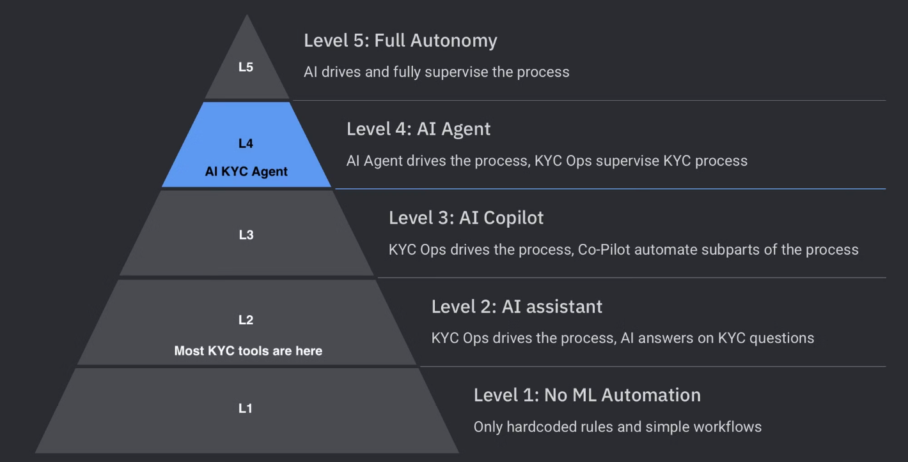
AI KYC Agent: high level of autonomy
KYC AI Agent targets to achieve Level 4 autonomy, demonstrating high automation capabilities. It will handle complex KYC processes with minimal human intervention, significantly enhancing efficiency and accuracy.

Slide 5

Key features
Perform E2E KYC for a client
Request information from a client
Extract information from client messages and documents
Perform risk assessment
Provide summarisation of the client risk and risk matrix
Support 4-eyes review
Escalate risk to AFC
Upload policy to change the process and reasses risks for all clients affected by changed policy
Transparency and explainability on every step, fully audit-friendly

Slide 6
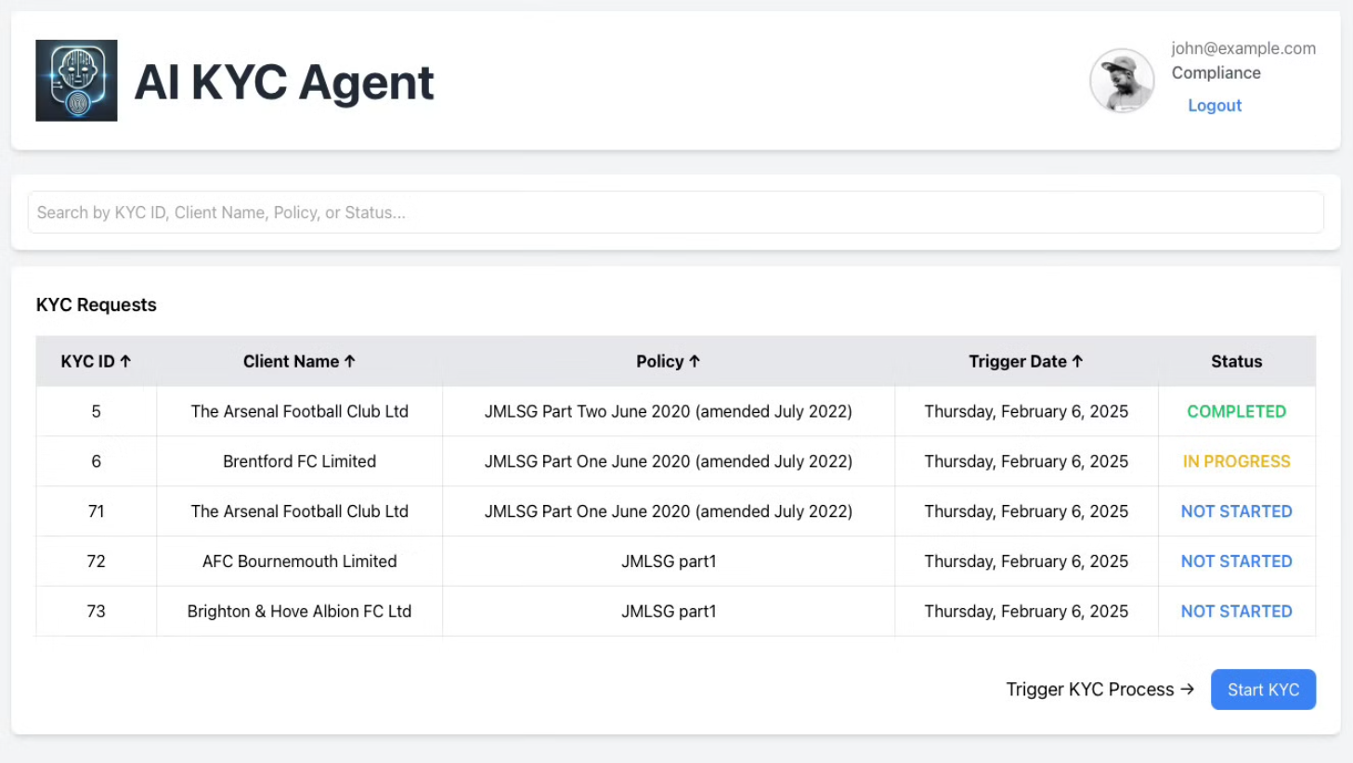
DEMO

Slide 7
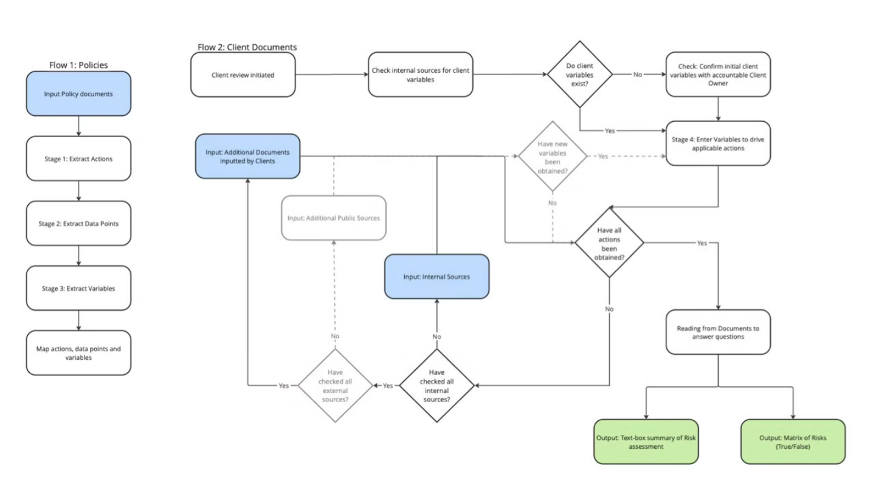
Workflow

Slide 8
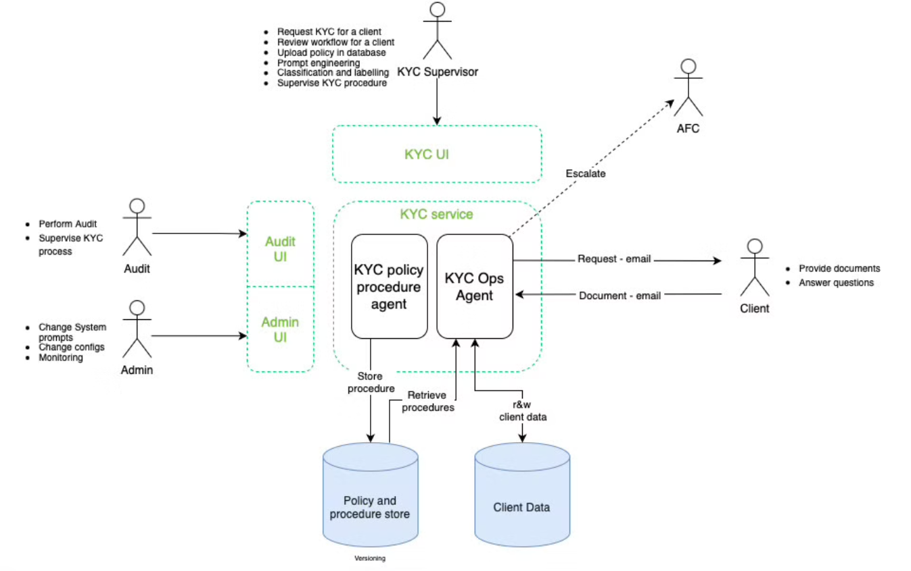
Architecture Diagram

Slide 9







Tech stack
Python
React.JS
Core language for AI model development and data processing.
Used for building the user-friendly interface of our solution.
Postgres SQL
Agent framework
Provides a robust and secure database for storing and managing KYC data.
Self written implementation of core Agent concepts.
Claude Sonnet 3.5
AWS Bedrock
Fast, capable SOTA LLM model by Anthropic, optimized for reasoning, coding, and conversation.
Cloud solution enables developers to build and scale generative AI apps using foundation models.

Slide 10
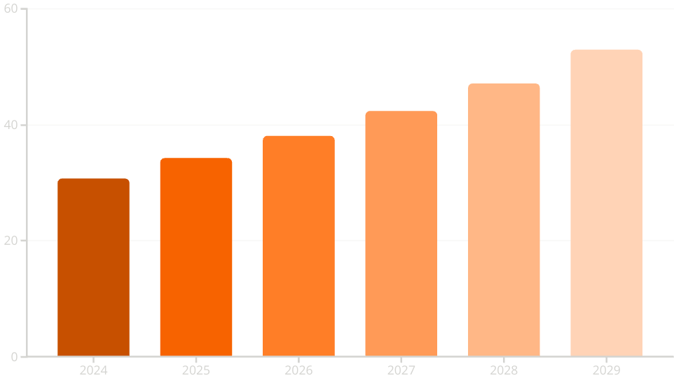
KYC Market size
KYC Market size, $Bn
KYC market size, 2024
$30.8bn
KYC market size, 2029 (estimated)
$52.9bn

Slide 11

Transforming the KYC Landscape
Industry Impact
Collaboration
AI KYC Agent will drastically decrease costs for KYC processes, make it more robust, accurate and efficient. It will increase transparency for regulators and customers satisfaction.
Our solution fosters collaboration between financial institutions and regulators by providing transparent and auditable KYC processes.

Slide 12




Roadmap
Finish current functionality, make it stable and easy to deploy
Examinate responsible AI practices and compliance (GDPR, EU AI Act, etc)
Introduce AI KYC Agent for re-evaluation of risks scores for existed clients
Apply for all KYC requests within organization
Evaluate quality of KYC checks
Enhanced functionality: versioning of policies and KYC procedures, interaction with KYC process on every step (human in the loop), receiving of information from external sources
Use AI KYC Agent for 1% of KYC requests
Implement supervisory and audit functionality

Slide 13
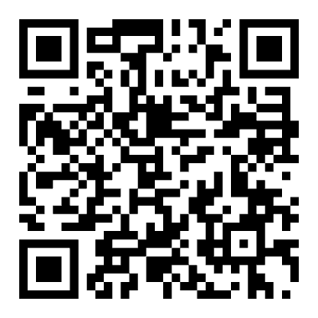
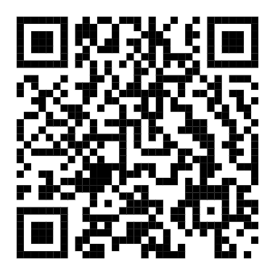
Appendix 1. Links
GitHub repo
Application
GitHub repo: https://github.com/finos-labs/dtcch-2025-db
Application: https://dtcch-2025-db.sibnick.men
Get started guide: link
Documentation: link

Slide 14
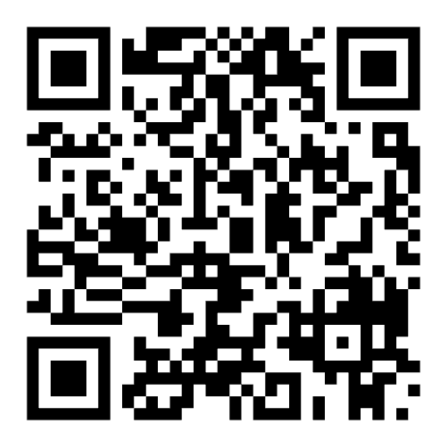
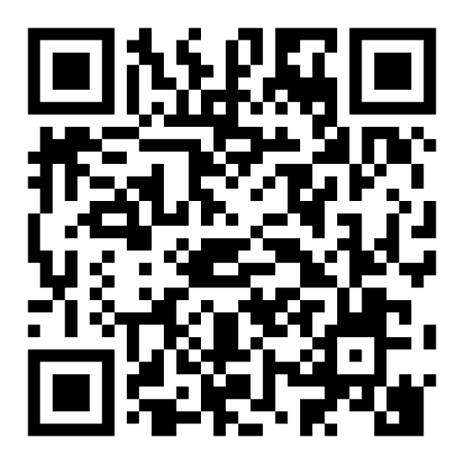
Appendix 2. Want to use, invest or contribute?
Contact Maxim Romanovsky via LinkedIn or email
LinkedIn
Email

