Slide 1

Sentinova – Sentiment Analysis
Team Members
Krishna Prabha
Sandhya
Pavithra
Arun Prasanna
Sivagama Sundari
Mahendran
Vignesh
Gayathri Sivakumar
Jayasree
Arun Prasanna
Team Name: predicta citi corp
Presenters:
Krishna Prabha, Sandhya & Pavithra
DATE:
07 Feb 2025
DEPARTMENT:
Citi Global Wealth & Partnership

Slide 2
AGENDA
Problem Statement, Solution & Impact
Solution Overview
Technical Implementation
Demo
Industry Impact, Collaboration and Production Viability
Q&A

Slide 3
Problem Statement, Solution & Impact
Problem: Traditional market prediction struggles to capture real-time sentiment shifts. News, social media, and other text data hold valuable insights, but are unstructured and difficult to analyze.
Solution: Leverage Natural Language Processing (NLP) to analyze this textual data, gauge market sentiment (positive/negative/neutral), and build predictive models for more accurate and timely market forecasts.
Impact: Improved investment decisions, risk management, and understanding of market dynamics.

Slide 4
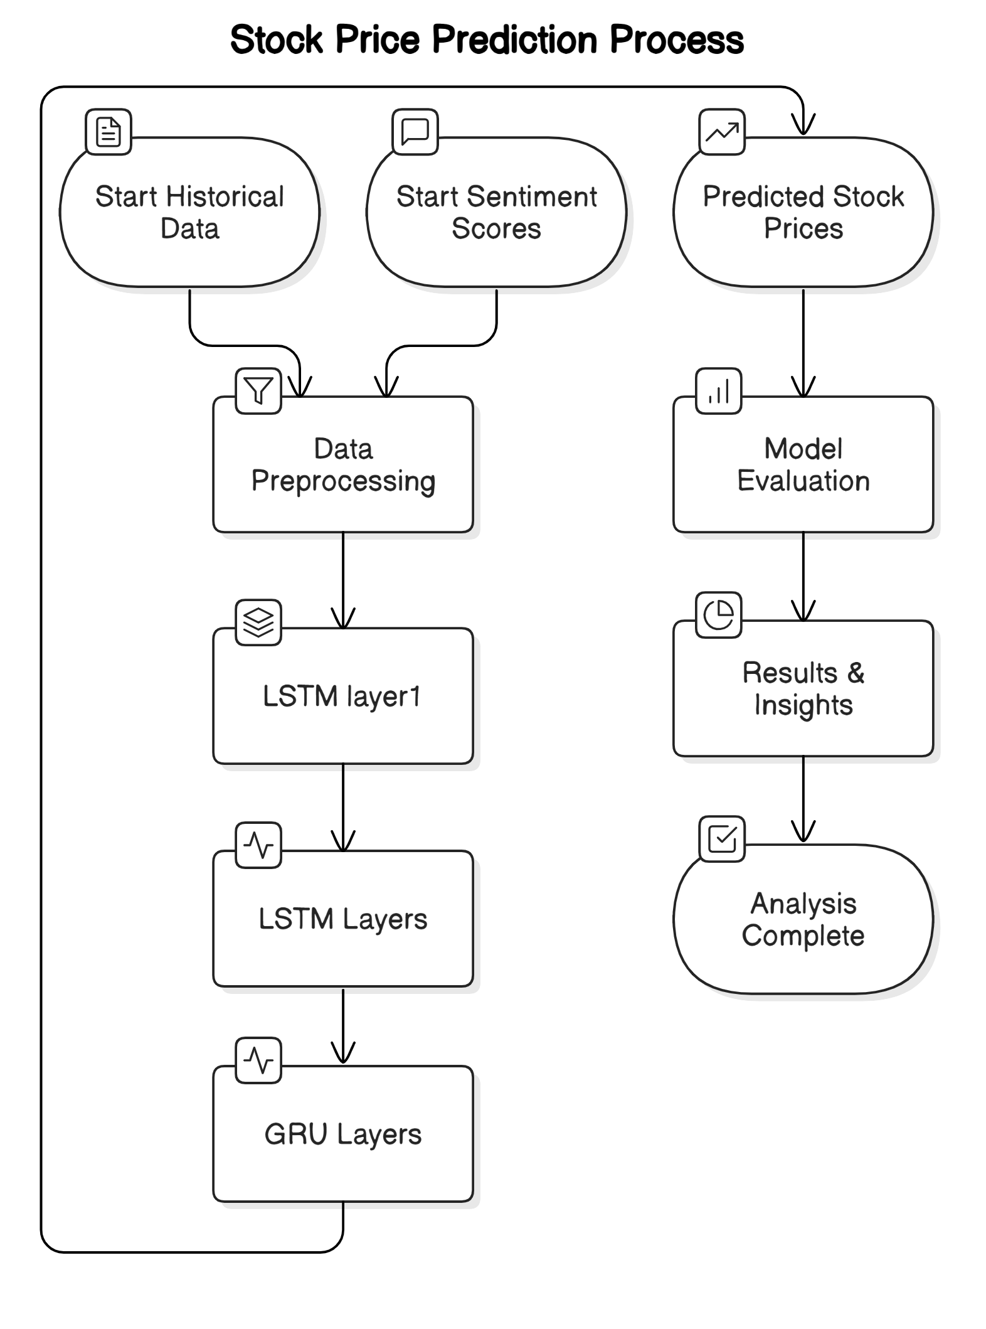
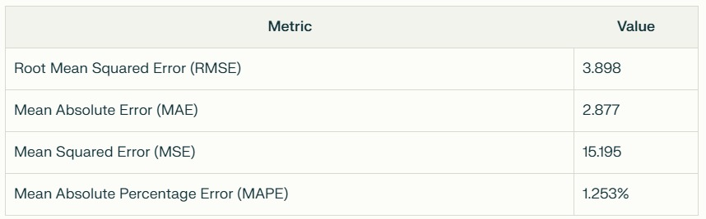
Solution Overview
Input Data
Data Preprocessing (Not explicitly detailed in the diagram for brevity)
APIs used – Yfinance, AlphaVantage, Reddit
Sentiment Models – NLTK VADER
Model : LSTM
Output: Predicted Stock Prices
Model Evaluation & Comparison
Performance metrics: Mean Squared Error (MSE), Root Mean Squared Error (RMSE), Mean Absolute Error (MAE), Mean Absolute Percentage Error (MAPE)
Results & Insights
Analyze predictions vs. actual market data
Identify factors influencing stock price movements
Visualize predictions to gain insights

Slide 5

Technical Implementation
Tech Stack Overview
Frontend - A user interface built using SCSS, HTML, Flask & Java Script for data interaction and visualization.
Backend - API layer for processing requests and serving ML predictions.
Machine Learning Model - Python-based model for training and inference
Dataset - Excel files used for training and inference.
ML Engine
(Python, LSTM, GRU models)
Data Sets
Excel/CSV
HTML, SCSS, Javascript Web Application
End User

Slide 6
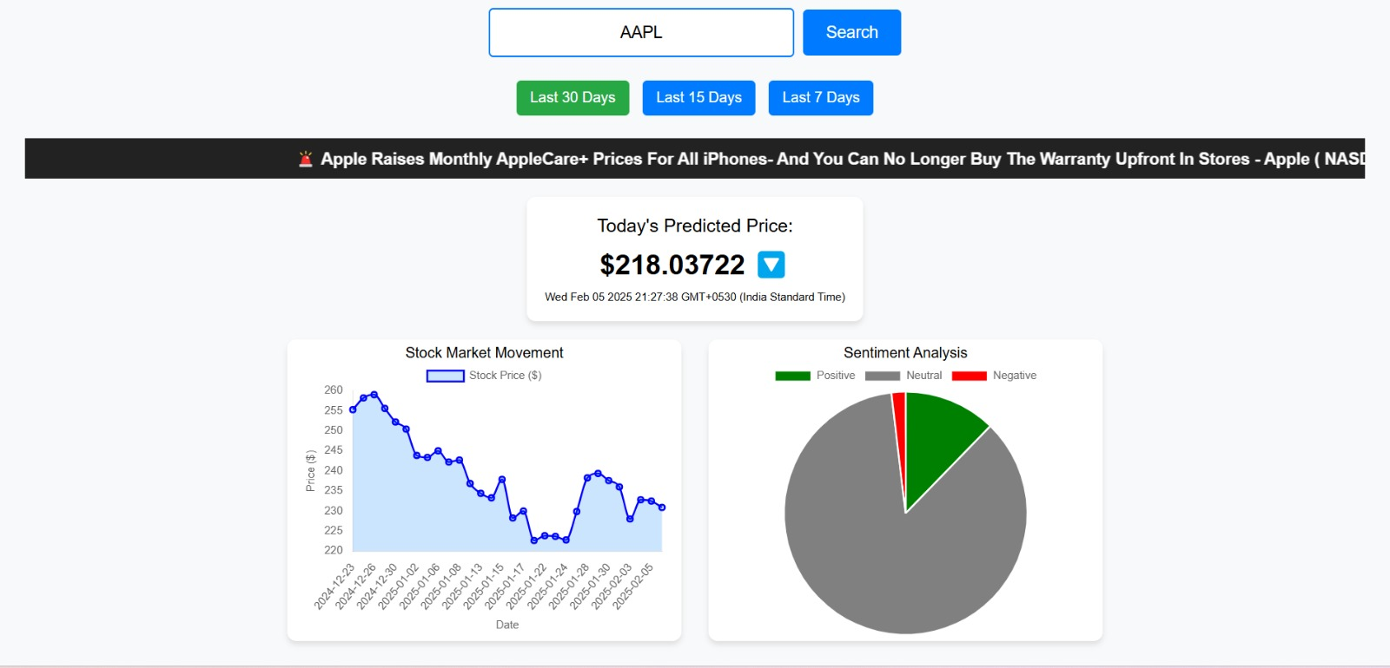
Demo

Slide 7
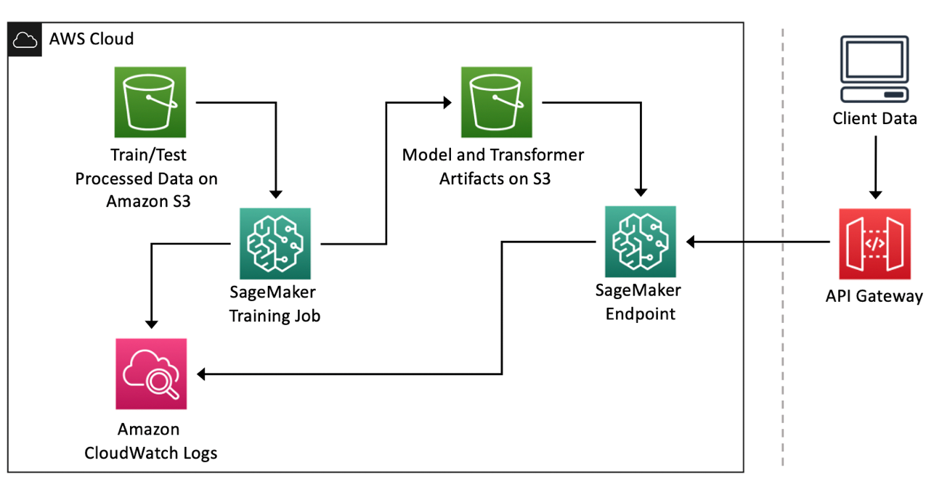
Industry Impact, Collaboration and Production Viability
Potential Path to Production
Deploy to AWS, Addition of Oauth
Automatic training of model using automatic jobs Jenkins CI/CD
Scalability
Integrate with more data providers to fetch more real-time datasets to train the model

Slide 8
Q&A

