Slide 1
Info-Navigator for Capital Market Research
Tech geniuses Kavita, dinesh, Madhava, varun, Krishnan, siddesh, Harmandeep, rugma, ganga, vineeth
PRESENTER:
Dinesh
DATE:
Feb 7, 2025
DEPARTMENT:
TCS Innovation

Slide 2
AGENDA
Problem Statement
Solution Overview
Value Enablers
Demo

Slide 3


Problem Statement
Evolving Data Sources and dynamic research needs make Manual Research sub-optimal
Manual Research
Challenges
Evolving Data
Huge data including financial reports, market trends, news, sentiments
Explosion of unstructured data across modalities and alternative data
Cycle Time
Choosing sources & validating contextual relevance delays analysis
Routine extracts & artefacts generation take up disproportionate time
Analysis Quality
Human errors & Inconsistencies due to verification issues
Limited investigation opportunities for SMEs to do complex research
Costs & Overheads
Expensive SME time lost in repetitive tasks
Missed opportunities for downstream decisions

Slide 4
Solution Overview
LLM based App using Agentic flows to navigate diverse data sources for a spectrum of Research needs
Description
Solution harnessing Generative AI & Agentic flows for efficient Capital Market Research for automated insights and decision support in enterprises
Approach & Highlights
Modular agents to dynamically accomplish multiple research tasks and orchestration to manage the flow of tasks. This is enabled thru a chat interface which navigates the user progressively thru Discovery, Extraction, Reasoning, Analysis & Reporting on enterprise-wide and web-based data sources varying in their content and format.
Interface – Easy conversational interface to accomplish a variety of research goals and queries answered
Modular Agentic Flow – Orchestration agent dynamically allocates tasks to multiple task agents
Discovery – Know most relevant content for the research from enterprise sources and alternative web-based sources for the user scenarios alongside summaries, key topics of the artefact explain the relevance
Extract – Automated Key Metric extraction from multiple relevant sources
Analyze – Ask deeper questions on extracted metrices in a conversational mode
Report – Dynamic dashboard to visualize extracted metrics thru charts, summaries and downloaded reports
Configuration – Define data sources and workflows to establish boundaries for research
Key Features
Impact
Assisted, affordable and quality research to enable fast investment decisions
More SME time available for strategic work

Slide 5


















Tech Stack
Data Sources
User Experience
Application UI | Chatbot
Security & Access Control
PDFs
API Gateway
Application Integration
Web Pages
Orchestration
Agent Orchestration | Lambda Services
Audio
Model Hub
Claude Sonnet | AWS Titan
Images
Custom Components
Data Processing | Context Curation | Configuration | Evaluation
External API
DB & Vector Store
S3 | DynamoDB | AWS Kendra | AWS OpenSearch
Enterprise Data

Slide 6
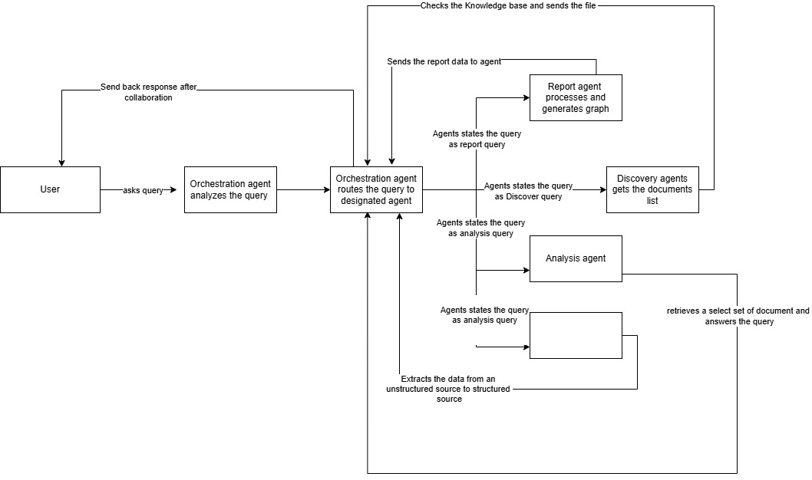
Architecture

Slide 7
Industry Impact, Collaboration and Production Viability
Potential Path to Production: Pilot the solution for limited user base with larger data and variety, fine-tune the application for production rollout
Scalability of your solution at an enterprise level: Modular design that can adapt to varied research goals, accommodate multiple data modalities, volumes while maintaining quality levels
Highlight collaboration with industry partners (if any): NA
Potential challenges and limitations: Might require more configuration efforts for other domains

Slide 8
Demo
Product Walkthrough: Show a live demo or screenshots of your product in action.
Key Functionalities: Demonstrate how your solution works to solve the problem. Highlight key features
User Experience: Highlight the ease of use, interface design, or any innovative aspects that improve user experience

Slide 9
Conclusion
Unique solution that can help a variety of research needs and quick decision support in Capital Markets to manage risks, grow assets and improve compliance

Slide 10
Thank You

