Slide 1
DESIGN

Slide 2
Proposed Flow

Slide 3
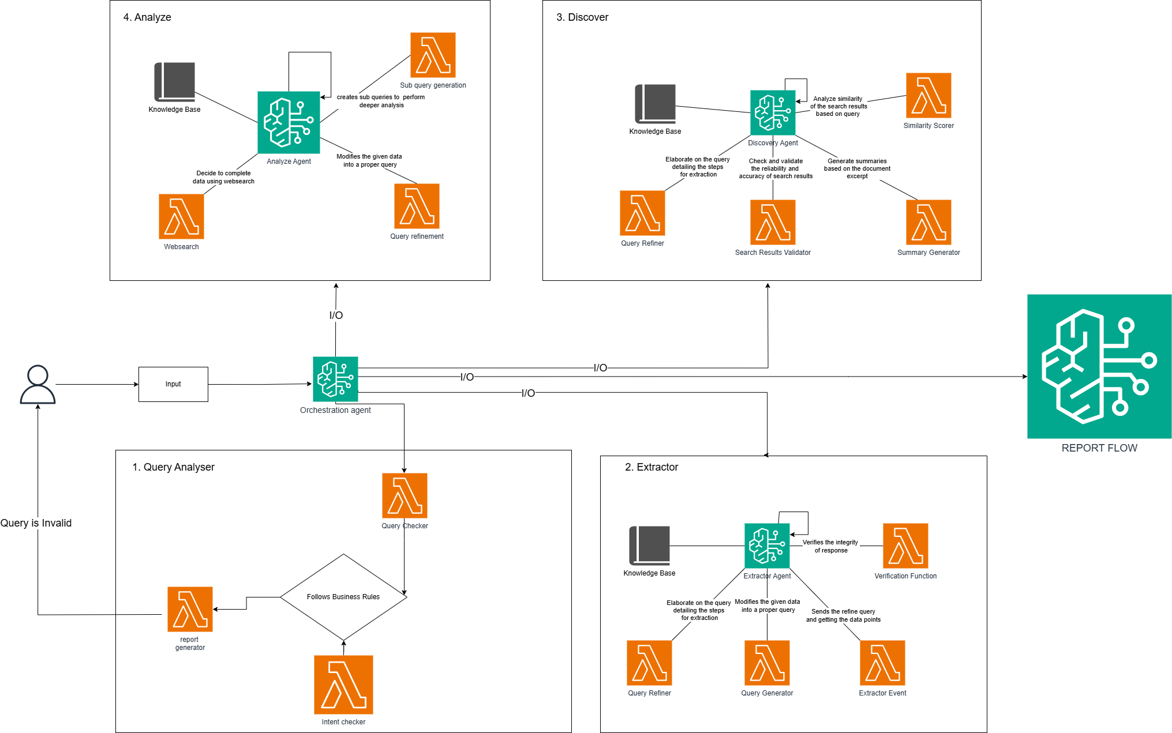
AGENTIC FLOW

Slide 4
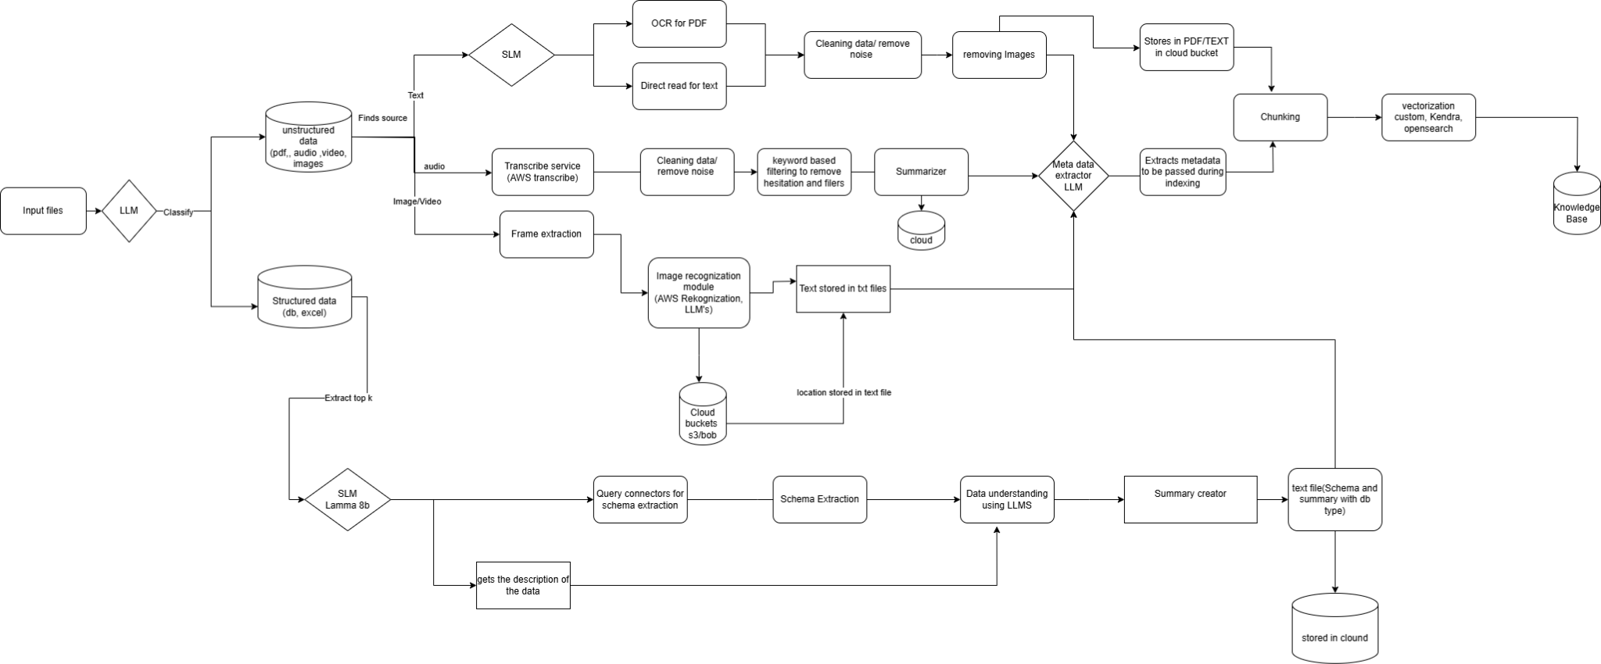
KNOWLEDGE BASE

Slide 5
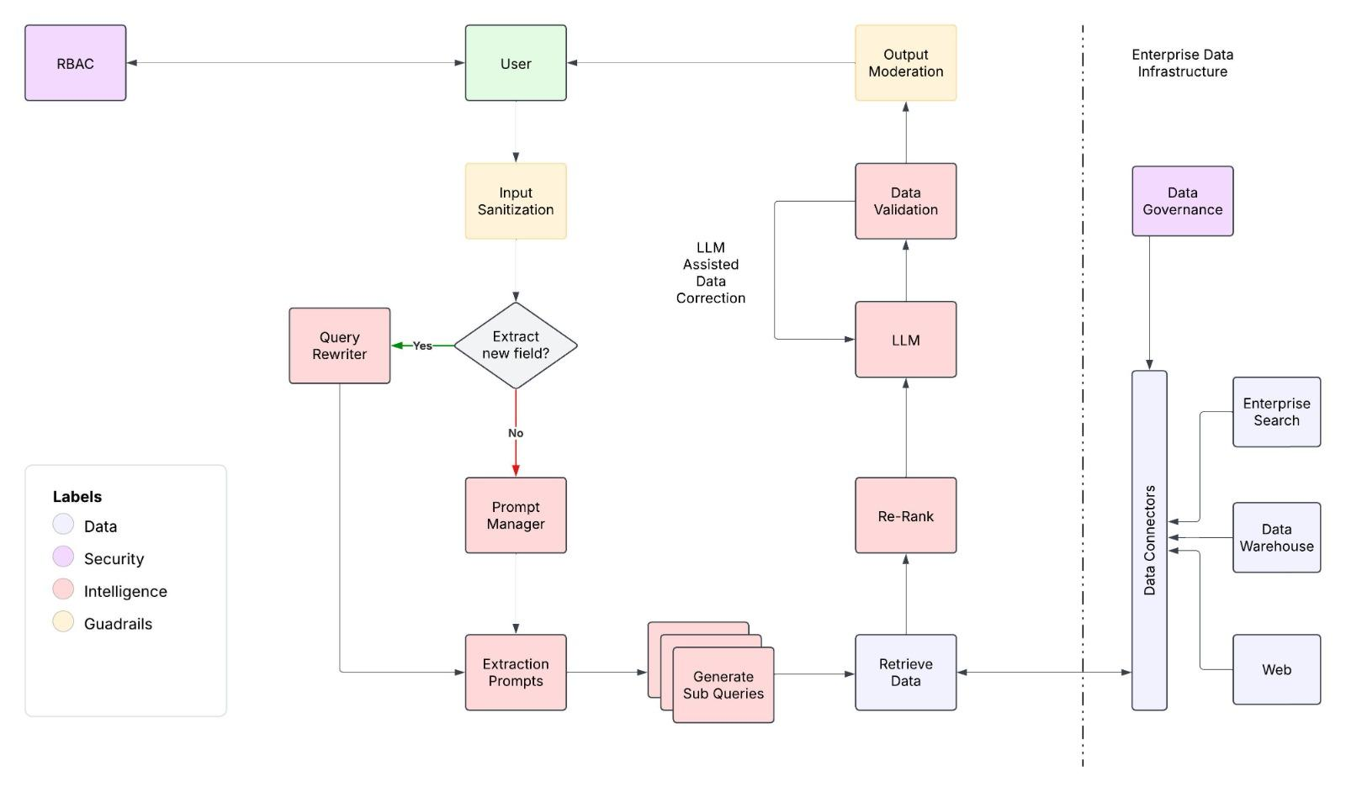
EXTRACT MODULE

Slide 6
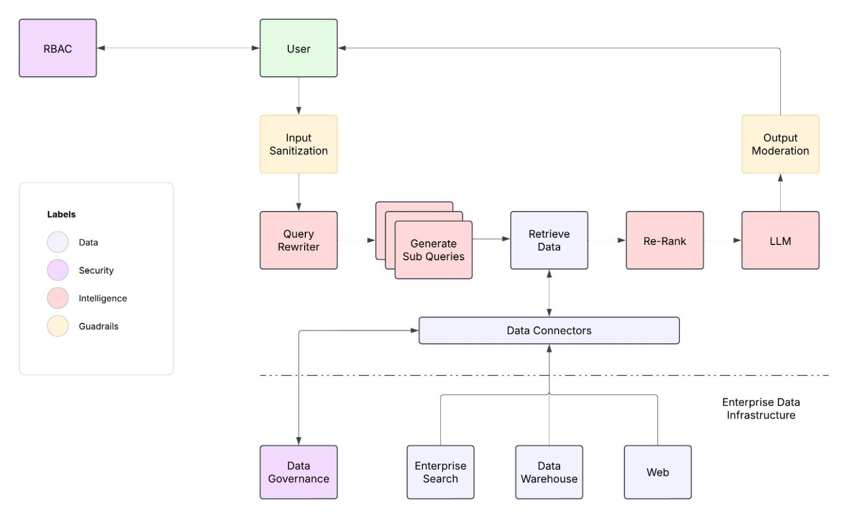
ANALYZE MODULE

Slide 7
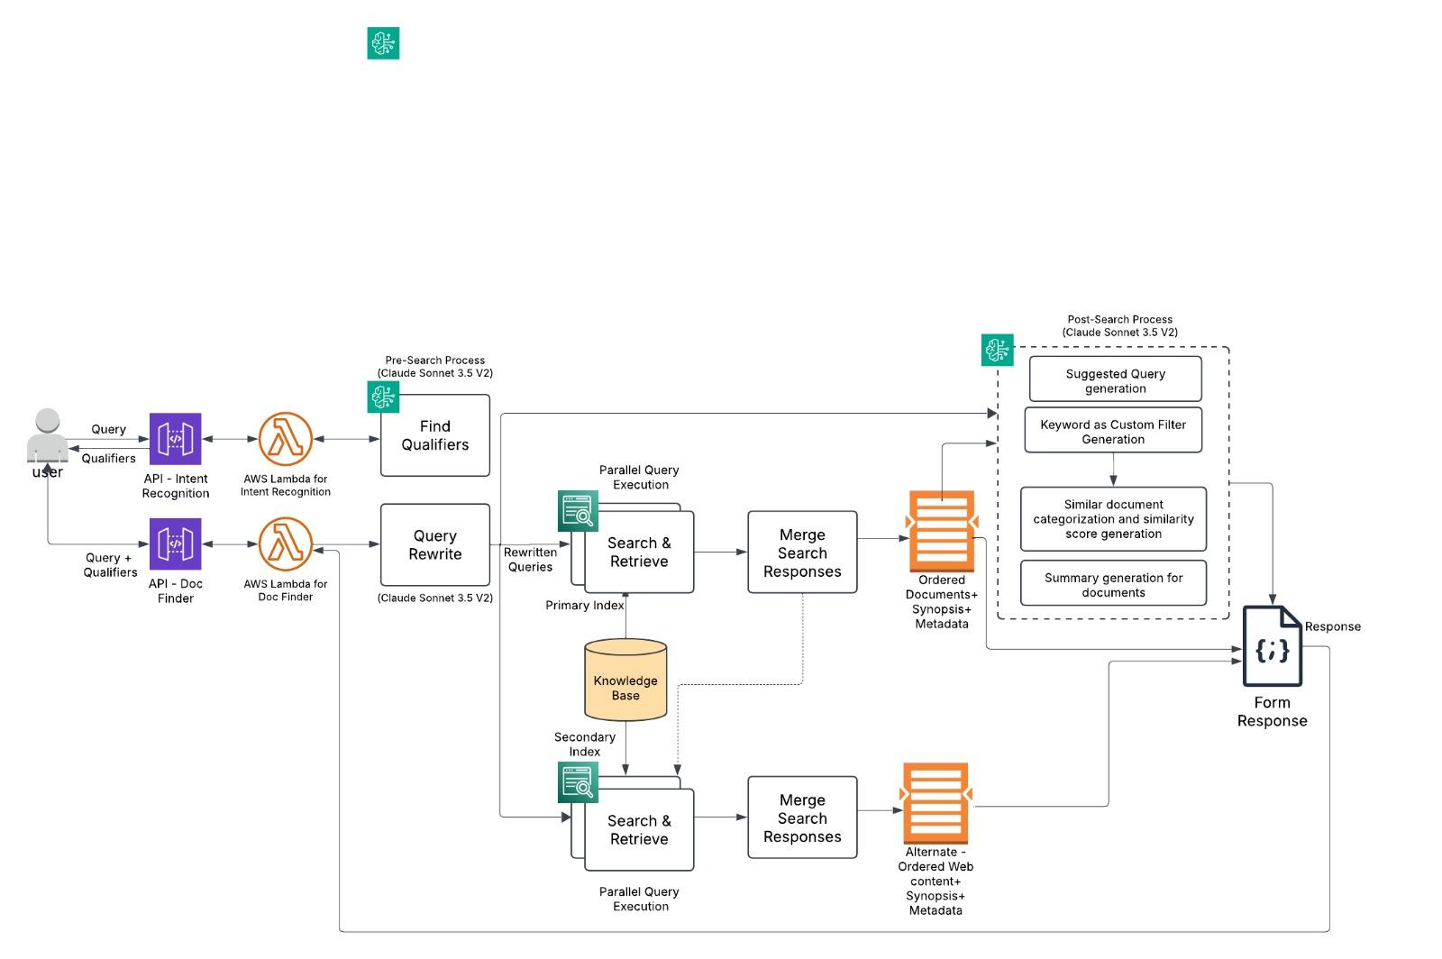
Discover Module

Slide 8
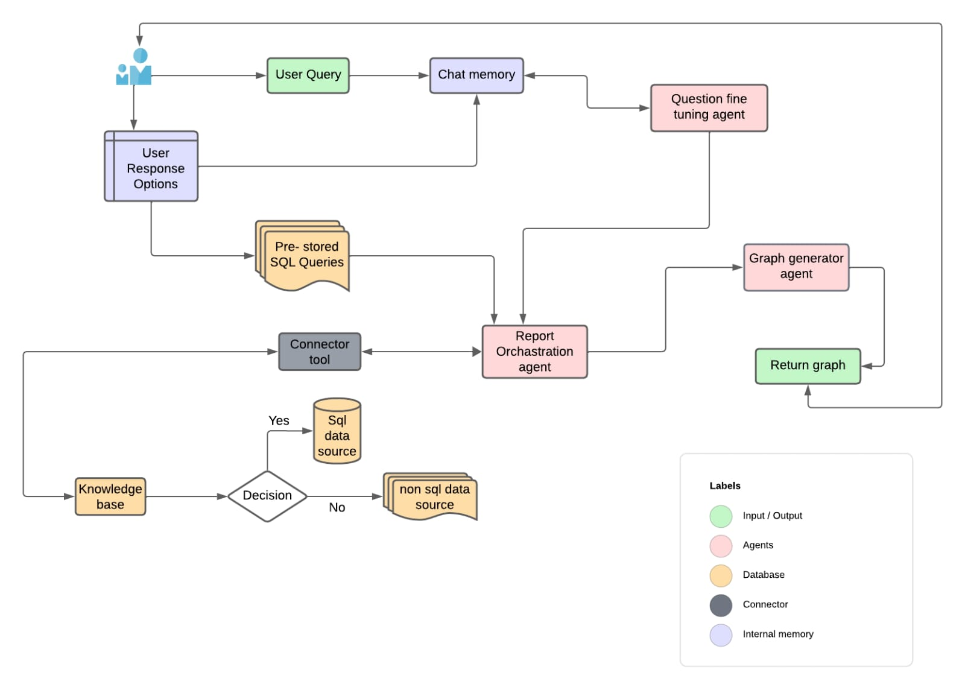
Report Module

Slide 9
Current Flow:
Scoped down as version 1

Slide 10
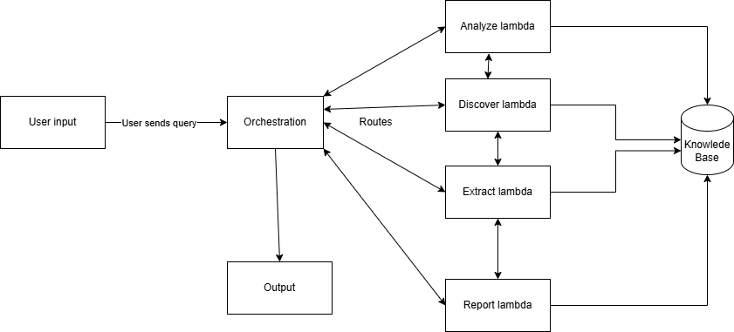
AGENTIC FLOW

Slide 11
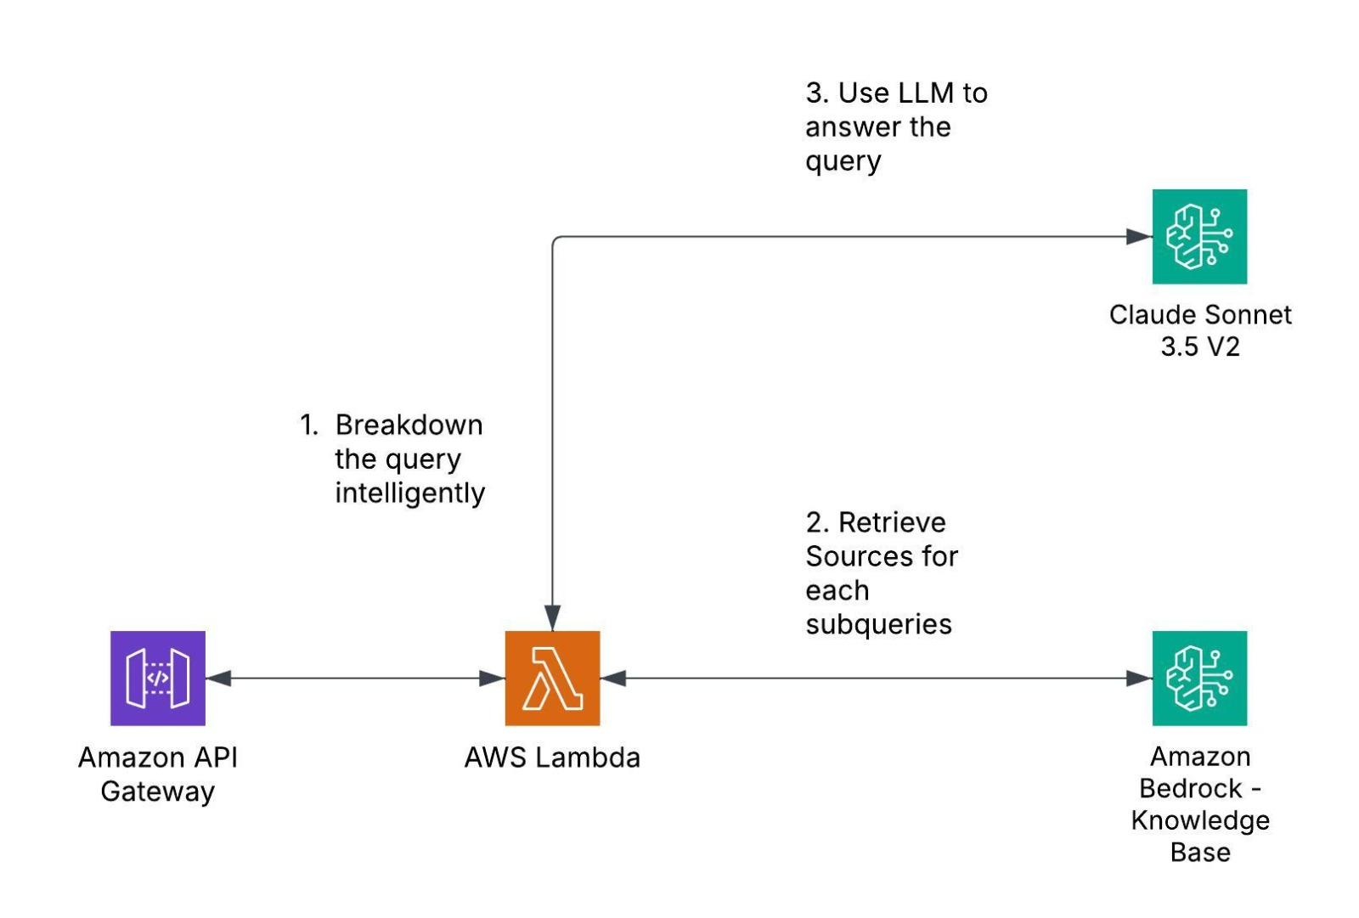
ANALYZE MODULE

Slide 12
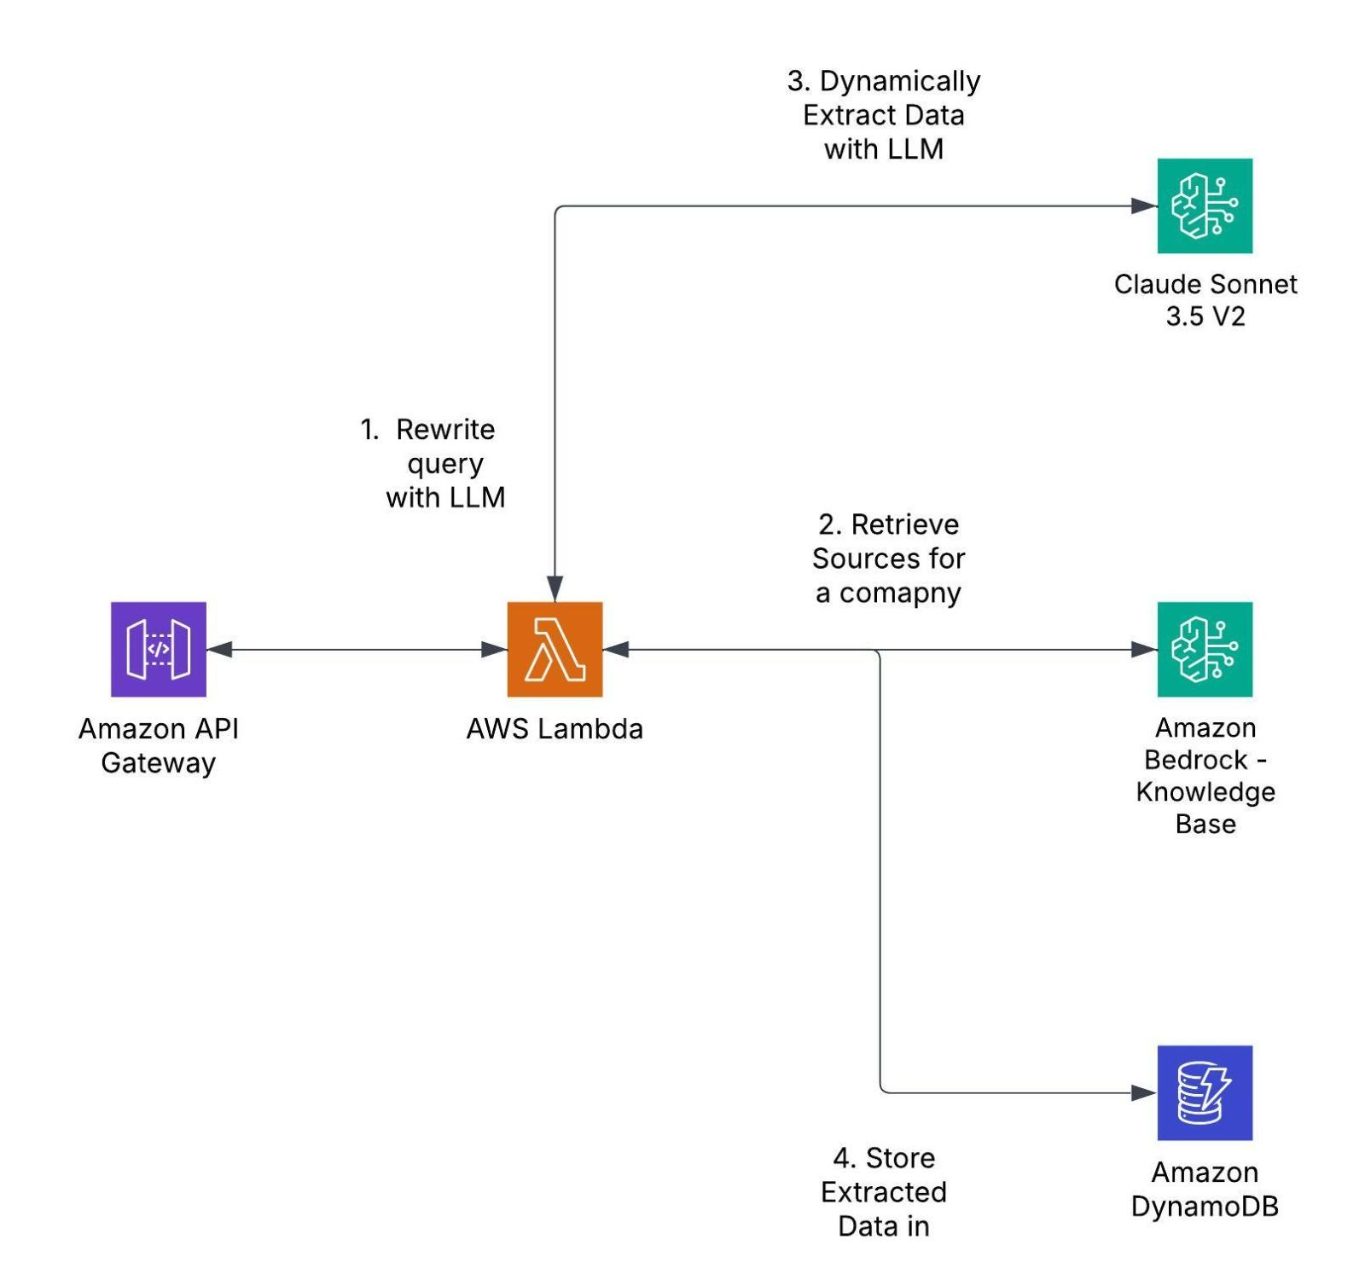
EXTRACT MODULE

Slide 13
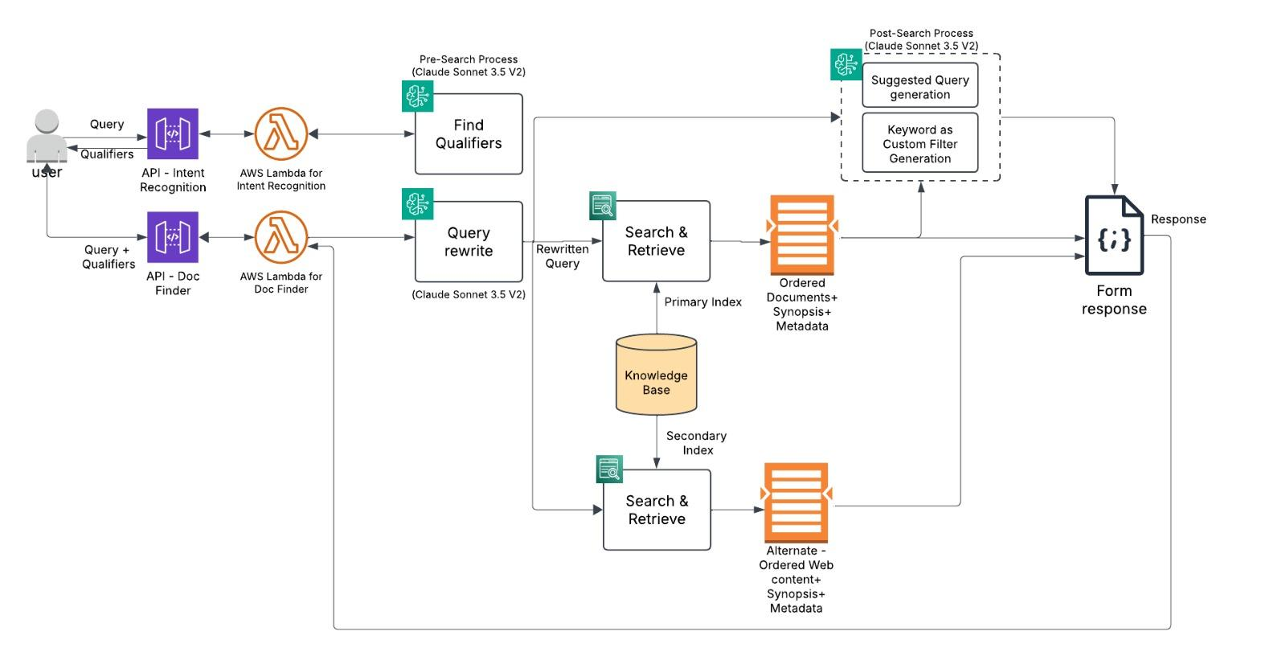
DISCOVER MODULE

Slide 14
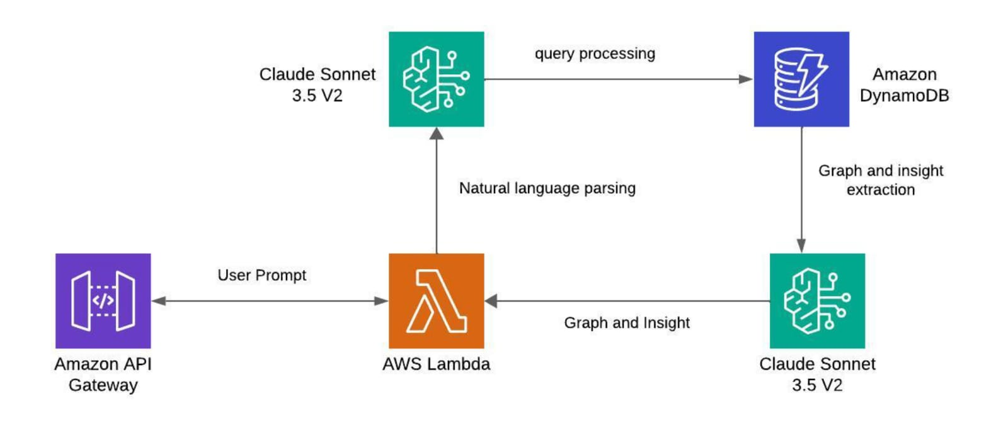
REPORT MODULE

Slide 15
Conclusion
We have our proposed design which is the end goal in the first half of the deck.
We have our implemented design which is a scoped down version of the proposed Design.

