Slide 1
Proof-Based Settlement Enforcement for Tokenized Markets
Final Presentation – DTCC Hackathon
Maranda Harris – Founder, CompliLedger

Slide 2
Team
Team Name: CompliLedger
Team Members: Maranda Harris & Satyam Singhal
Track: Regulatory Compliance & Governance
Project Title: Proof-Based Settlement Enforcement

Slide 3
Problem Compliance Lags Behind Settlement
1. Compliance Happens After Finality
Tokenized assets settle instantly.
Compliance is validated post-trade.
2. Evidence Is Trust-Based
Audit reports and legal memos
are not machine-verifiable proof.
3. Reserve & Custody Checks Are Periodic
Monthly attestations do not enforce
No transaction-level enforcement
4. No Deterministic Pre-Settlement Gate
Clearing systems finalize transactions
Without programmable compliance logic.

Slide 4
Solution Deterministic Pre-Finality Enforcement
1. Enforce Before Settlement Completes
Every settlement intent runs through a canonical proof chain.
2. Replace Trust Based Evidence
Each validation step produces a hash.
A signed attestation bundle is generated.
3. Validate Reserves & Custody in Real Time
Backing and custody conditions are enforced per transaction.
4. Insert a Programmable Settlement Gate
ALLOW or DENY is derived
from deterministic rule logic.

Slide 5
SettlementGuard Deterministic Pre-Finality Enforcement Infrastructure
Canonical Proof Chain Engine
Issuer → Classification → Custody → Reserve Deterministic validation sequence per settlement
Cryptographic Attestation Bundle
bundle_root_hash
decision_hash
Ed25519 signature
Tamper-detectable settlement proof.
Canton On-Chain Anchoring
Append-only commitment
Independent verification
Portable, regulator-verifiable evidence
AI Explanation Layer
Natural-language reasoning
Deterministic decision transparency
AI explains decisions-it does not determine them.

Slide 6
Industry Impact & Regulation-Driven Path
Deploy adjacent to stablecoin and tokenized fund infrastructure
• Integrate via settlement APIs and issuer data feeds
Regulation-Driven (GENIUS / CLARITY)
• Enforce transaction-level reserve and custody validation
• Replace periodic attestations with real-time proof
• Provide portable, regulator-verifiable settlement evidence
• Scale via stateless enforcement nodes

Slide 7
Industry Collaboration
• Stablecoin issuers — real-time reserve & disclosure feeds
• Tokenized money-market platforms — eligibility & compliance rules
• Custodians — custody condition attestations
• Clearinghouses — deterministic ALLOW/DENY before finality
• Auditors & Regulators — independent verification API + anchor validation
Designed to integrate — not replace — settlement infrastructure.

Slide 8
Challenges, Limitations & Future Work
• Standardizing cross-issuer attestation schemas
• Production-grade integration with reserve & custody feeds
• Governance framework for expanding proof checks
• Future: Portfolio-level proof bundles
• Future: Expanded asset coverage (repos, MMFs, structured products)

Slide 9
Technical Implementation – Tech Stack
• Backend: Python (FastAPI) — Canonical Proof Chain engine
• Database: PostgreSQL — rule sets & configuration state
• Cryptography: SHA-256 hashing + Ed25519 signatures
• Blockchain: Canton — append-only proof anchoring
• Integration: REST / gRPC APIs for settlement intents & verification
Deterministic enforcement logic isolated from explanation layer.

Slide 10
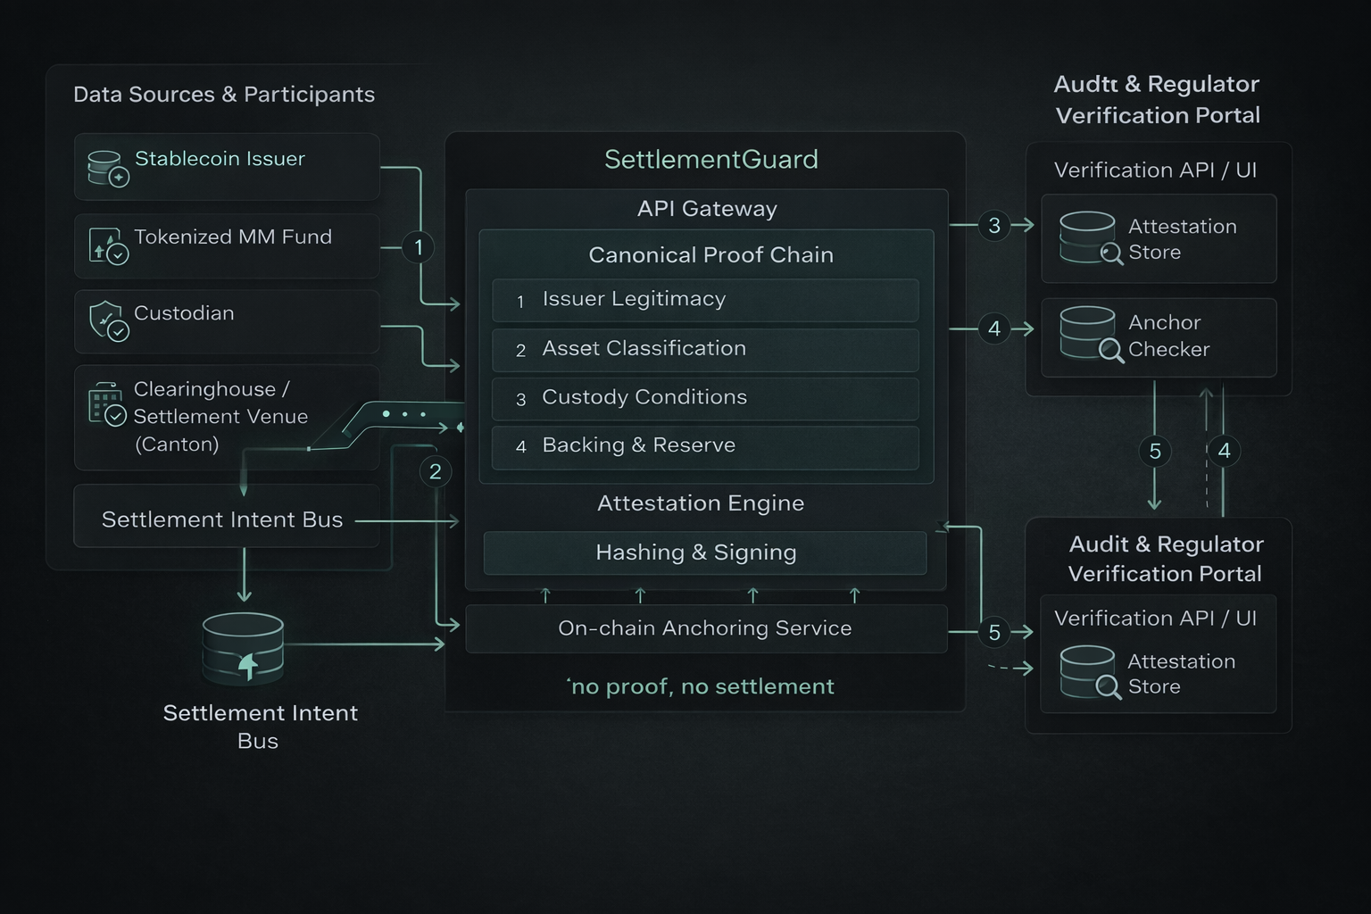
Canonical Proof Chain
Designed to integrate — not replace — settlement infrastructure.

Slide 11
Architecture – Deterministic Enforcement Flow
SettlementGuard
Canonical Proof Chain
1. Issuer
2. Classification
3. Custody
4. Reserve
Deterministic ALLOW / DENY Decision
Settlement Venue
(Canton-Based Rail)
Attestation +
On-Chain Anchor
(Hash Only)
Verification Clients
(Auditors / Regulators)
No proof → No settlement.

Slide 12
Data Usage & Responsible Design
• Ingest issuer reserve reports
• Custodian position attestations
• Asset eligibility & classification rules
• Only cryptographic hashes anchored on-chain
• Deterministic logic — inspectable & replayable
Sensitive financial data never written to public ledger.

Slide 13
Prototype Metrics
Performance
• Avg evaluation time: 22 ms
• P95 latency: 35 ms
• Enforcement completes before settlement finality thresholds
Determinism
• 100% reproducible ALLOW/DENY decisions
• Identical bundle_root_hash under replay
• Zero nondeterministic variance observed
Integrity
• Ed25519 signature verification enforced
• Tamper detection via hash mismatch
• Independent anchor verification supported
Enforcement Flow
Intent → Validate → Seal → Anchor → Verify

Slide 14
Demo: PASS & FAIL Scenarios
Submit Settlement Intent
Canonical Proof Chain executes
PASS → ALLOW + Attestation issued
FAIL → DENY pre-finality
Attestation sealed & anchored
Independent verification

Slide 15
Why SettlementGuard Matters
• Stablecoin issuers — transaction-level reserve enforcement
• Tokenized funds — deterministic eligibility validation
• Custodians — cryptographic custody verification
• Clearinghouses — block non-compliant settlement pre-finality

Slide 16
Conclusion & Q&A
• Compliance must match tokenized settlement speed
• Enforcement must occur before finality
• Proof must be portable and independently verifiable
Maranda Harris – maranda@compliledger.com
www.CompliLedger.com
SettlementGuard enforces deterministic, proof-based compliance at the final gate.

