Slide 1
Undirected Models: Markov Networks
David Page, Fall 2009
CS 731: Advanced Methods in Artificial Intelligence, with Biomedical Applications

Slide 2
Markov networks
Undirected graphs (cf. Bayesian networks, which are directed)
A Markov network represents the joint probability distribution over events which are represented by variables
Nodes in the network represent variables

Slide 3
Markov network structure
A table (also called a potential or a factor) could potentially be associated with each complete subgraph in the network graph.
Table values are typically nonnegative
Table values have no other restrictions
  Not necessarily probabilities
  Not necessarily < 1

Slide 4
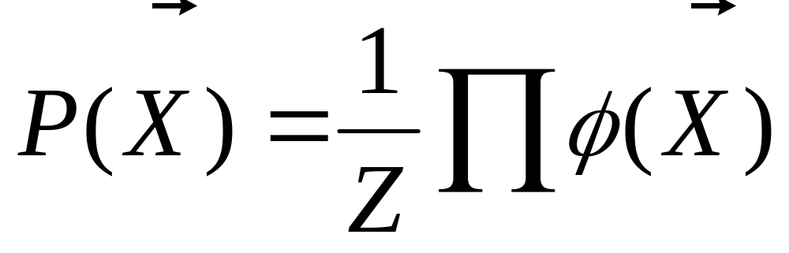
Obtaining the full joint distribution
i
i
You may also see the formula written with D_{i} replacing X_{i} .
The full joint distribution of the event probabilities is the product of all of the potentials, normalized.
Notation: ϕ indicates one of the potentials.

Slide 5
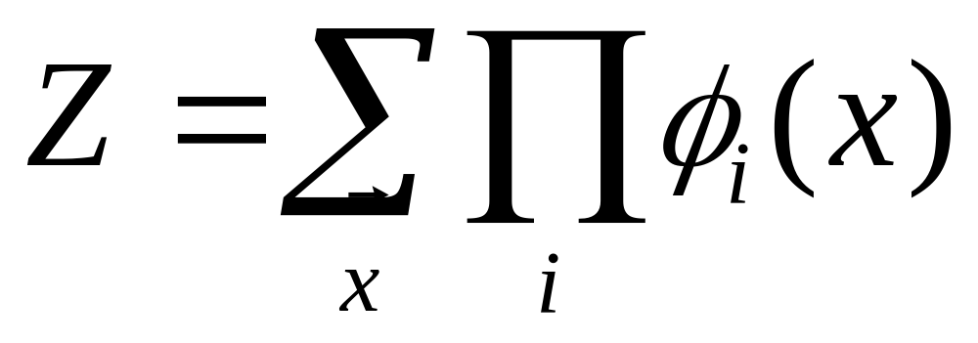
Normalization constant
Z = normalization constant (similar to α in Bayesian inference)
Also called the partition function

Slide 6
Steps for calculating the probability distribution
Method is similar to Bayesian Network
Multiply the distribution of factors (potentials) together to get joint distribution.
Normalize table to sum to 1.

Slide 7
Topics for remainder of lecture
Relationship between Markov network and Bayesian network conditional dependencies
Inference in Markov networks
Variations of Markov networks

Slide 8
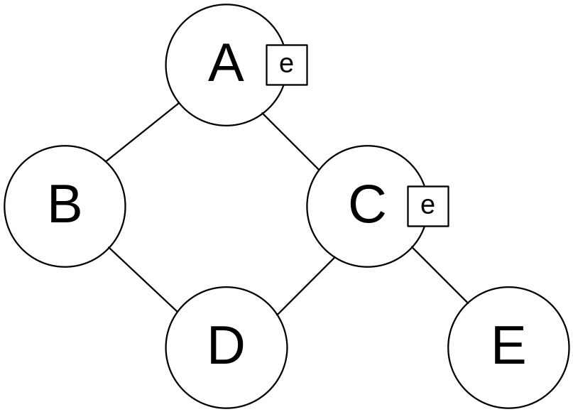
Independence in Markov networks
Two nodes in a Markov network are independent if and only if every path between them is cut off by evidence
Nodes B and D are independent or separated from node E

Slide 9
Markov blanket
In a Markov network, the Markov blanket of a node consists of that node and its neighbors

Slide 10
Converting between a Bayesian network and a Markov network
Same data flow must be maintained in the conversion
Sometimes new dependencies must be introduced to maintain data flow
When converting to a Markov net, the dependencies of Markov net must be a superset of the Bayes net dependencies.
  I(Bayes) ⊆ I(Markov)
When converting to a Bayes net the dependencies of Bayes net must be a superset of the Markov net dependencies.
  I(Markov) ⊆ I(Bayes)

Slide 11
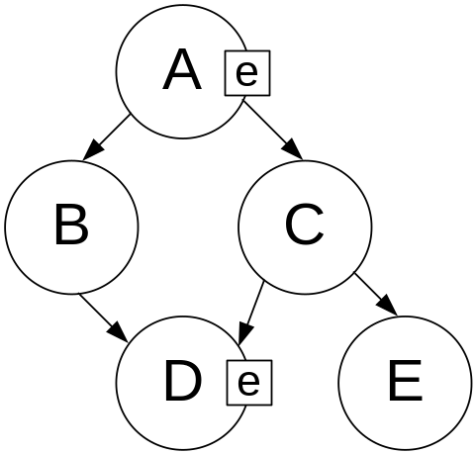
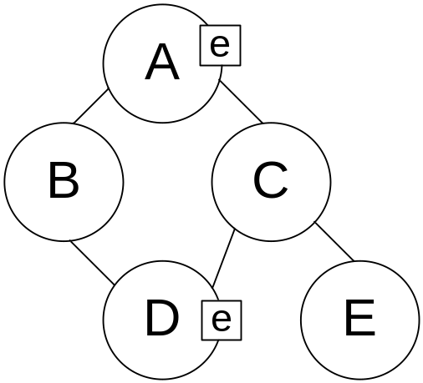
Convert Bayesian network to Markov network
Maintain I(Bayes) ⊆ I(Markov)
Structure must be able to handle any evidence.
Address data flow issue:
  With evidence at D
    Data flows between B and C in Bayesian network
    Data does not flow between B and C in Markov network
Diverging and linear connections are same for Bayes and Markov
Problem exists only for converging connections

Slide 12
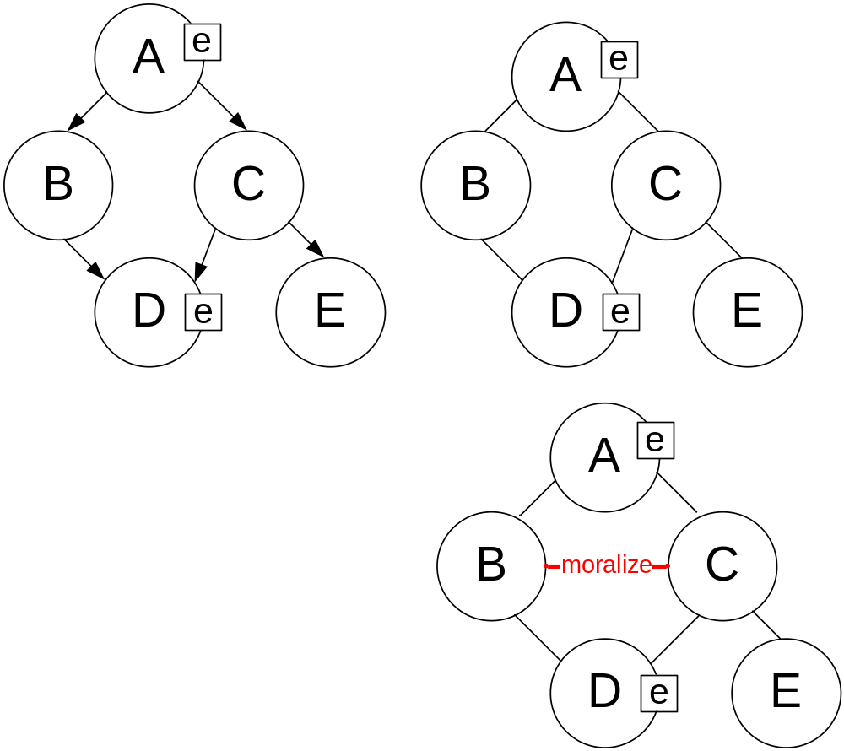
Convert Bayesian network to Markov network
Maintain structure of the Bayes Net
Eliminate directionality
Moralize

Slide 13
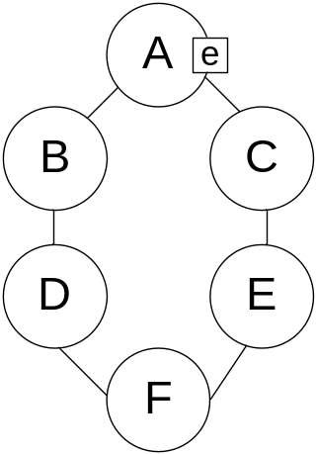
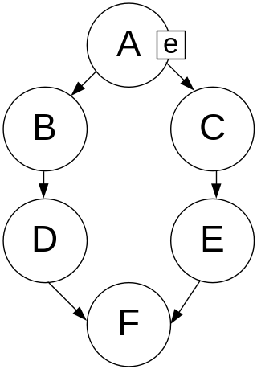
Convert Markov network to Bayesian network
Maintain I(Markov) ⊆ I(Bayes)
Address data flow issues
  If evidence exists at A
    Data can flow from B to C in Bayesian net
    Data cannot flow from B to C in Markov net
Problem exists for diverging connections

Slide 14
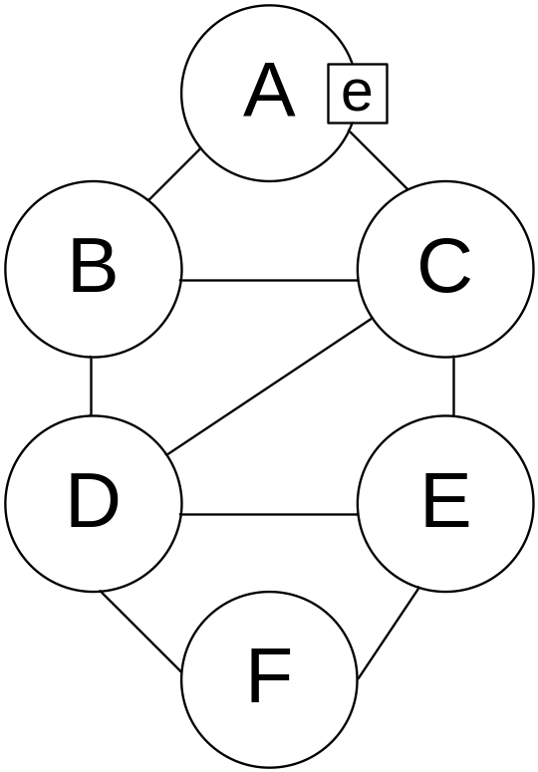
Convert Bayesian network to Markov network
Triangulate graph
  This guarantees representation of all independencies

Slide 15
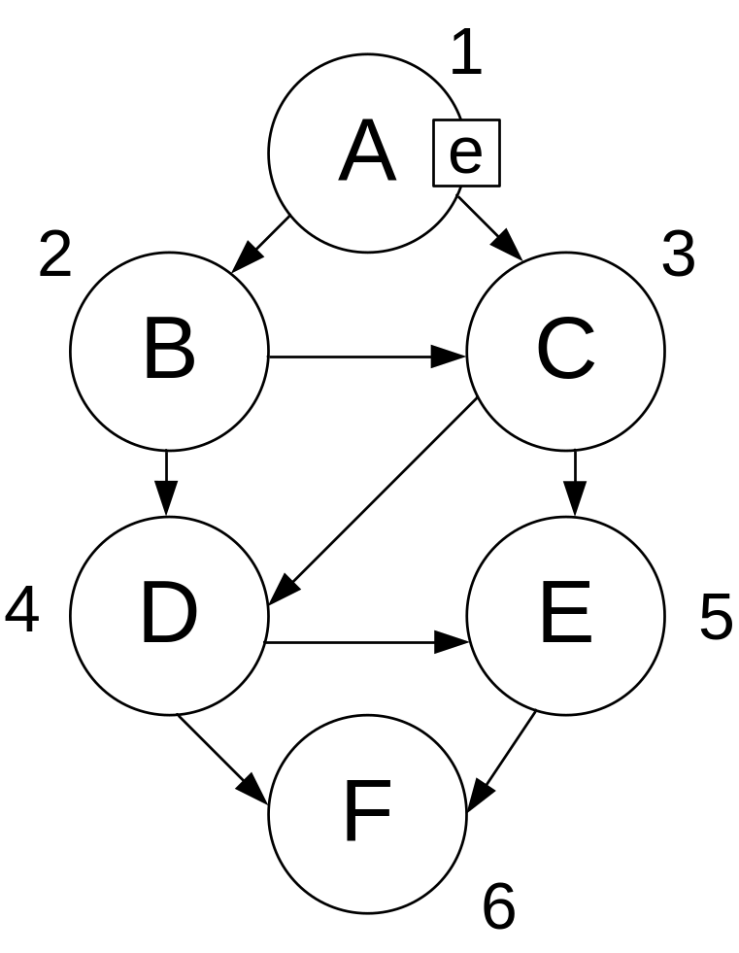
Convert Bayesian network to Markov network
Add directionality
  Do topological sort of nodes and number as you go.
  Add directionality in direction of sort

Slide 16
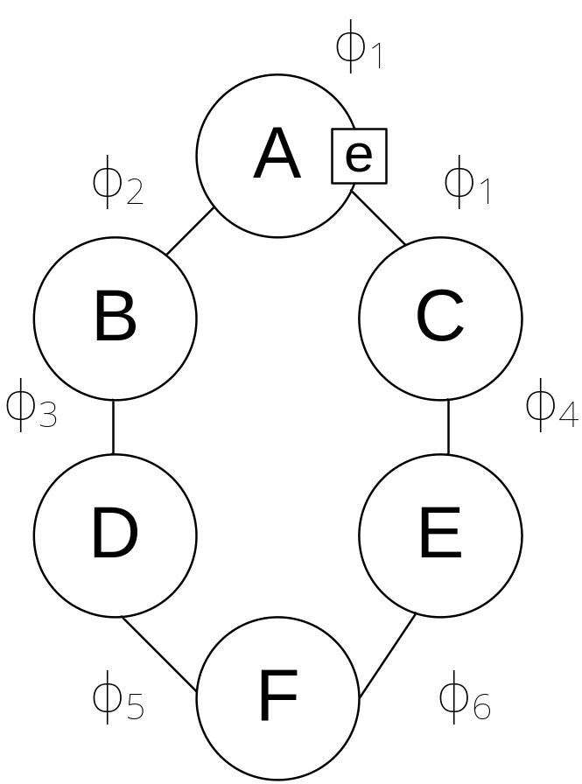
Variable elimination in Markov networks
ϕ represents a potential
Potential tables must be over complete subgraphs in a Markov network

Slide 17
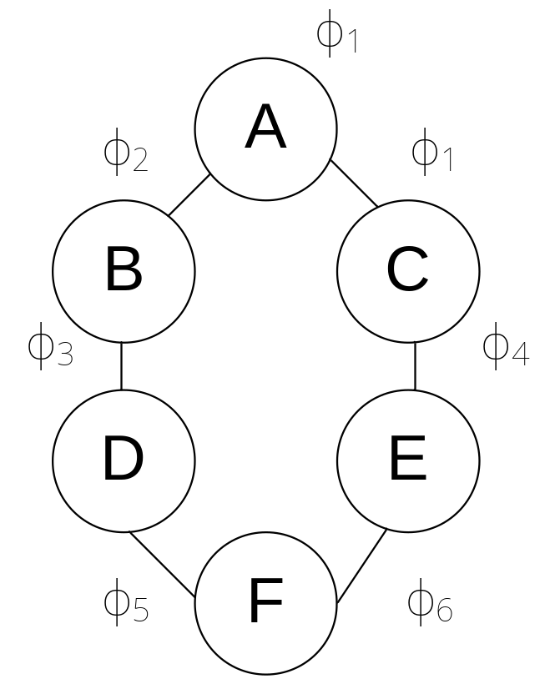
Variable elimination in Markov networks
Example: P(D | ¬c)
At any table which mentions c, set entries which contradict evidence (¬c) to 0
Combine and marginalize potentials same as for Bayesian network variable elimination

Slide 18
Junction trees for Markov networks
Don’t moralize
Must triangulate
Rest of algorithm is the same as for Bayesian networks

Slide 19
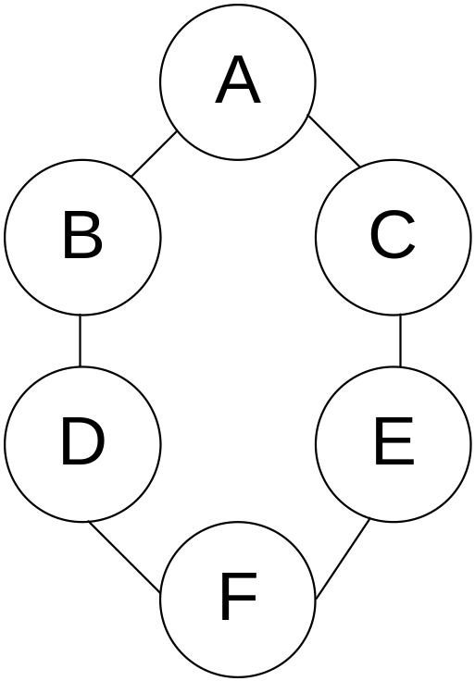
Gibbs sampling for Markov networks
Example: P(D | ¬c)
Resample non-evidence variables in a pre-defined order or a random order
Suppose we begin with A
  B and C are Markov blanket of A
  Calculate P(A | B,C)
  Use current Gibbs sampling value for B & C
  Note: never change (evidence).
A | B | C | D | E | F
1 | 0 | 0 | 1 | 1 | 0

Slide 20
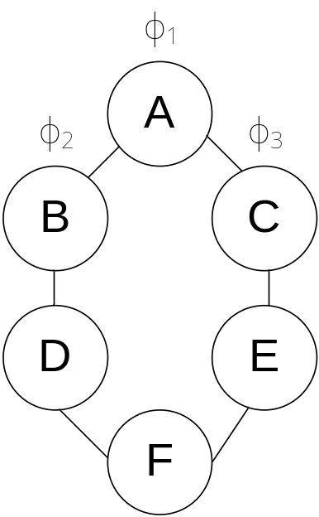
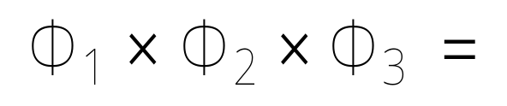
Example: Gibbs sampling
Resample probability distribution of A
a | ¬a
2 | 1
 | a | ¬a
b | 1 | 5
¬b | 4.3 | 0.2
 | a | ¬a
c | 1 | 2
¬c | 3 | 4
A | B | C | D | E | F
1 | 0 | 0 | 1 | 1 | 0
? | 0 | 0 | 1 | 1 | 0
a | ¬a
25.8 | 0.8
Normalized result =
a | ¬a
0.97 | 0.03

Slide 21
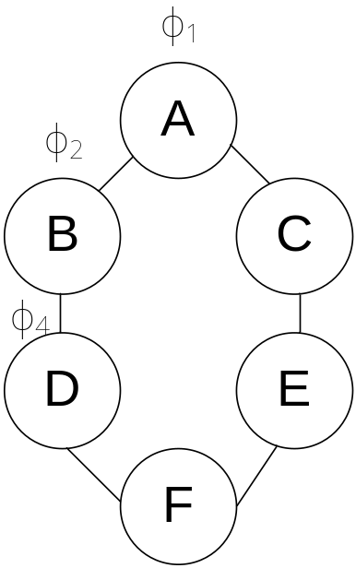
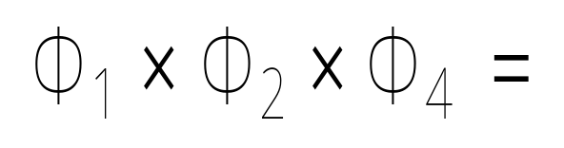
Example: Gibbs sampling
Resample probability distribution of B
 | a | ¬a
b | 1 | 5
¬b | 4.3 | 0.2
A | B | C | D | E | F
1 | 0 | 0 | 1 | 1 | 0
1 | 0 | 0 | 1 | 1 | 0
1 | ? | 0 | 1 | 1 | 0
 | d | ¬d
b | 1 | 2
¬b | 2 | 1
b | ¬b
1 | 8.6
Normalized result =
b | ¬b
0.11 | 0.89

Slide 22
Loopy Belief Propagation
Cluster graphs with undirected cycles are “loopy”
Algorithm not guaranteed to converge
In practice, the algorithm is very effective

Slide 23
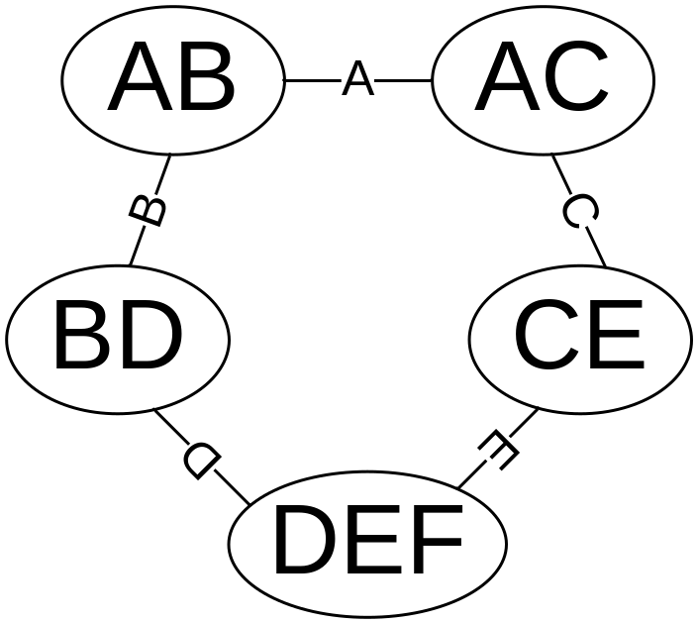
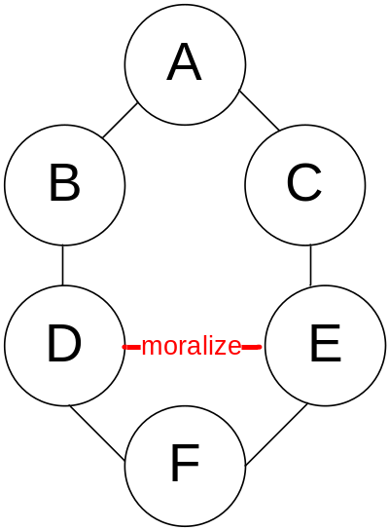
Loopy Belief Propagation
We want one node for every potential:
Moralize the original graph
Do not triangulate
One node for every clique
Markov
Network

Slide 24
Running intersection property
Every variable in the intersection between two nodes must be carried through every node along exactly one path between the two nodes.
Similar to junction tree property (weaker)
See also K&F p 347

Slide 25
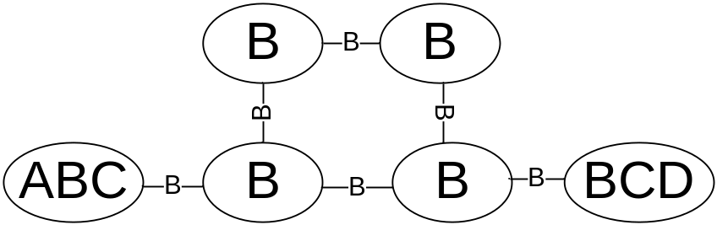
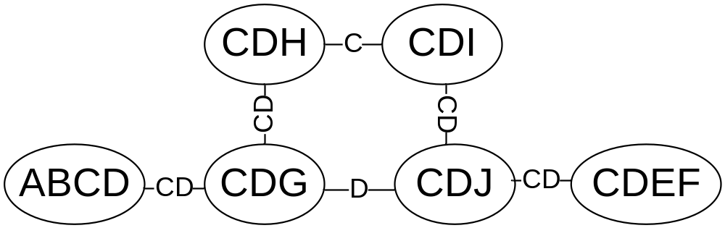
Running intersection property
Variables may be eliminated from edges so that clique graph does not violate running intersection property
This may result in a loss of information in the graph

Slide 26
Special cases of Markov Networks
Log linear models
Conditional random fields (CRF)

Slide 27
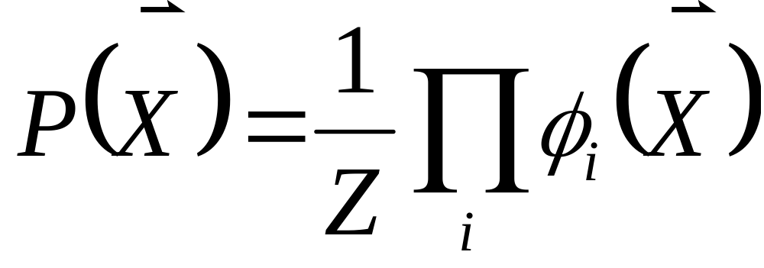
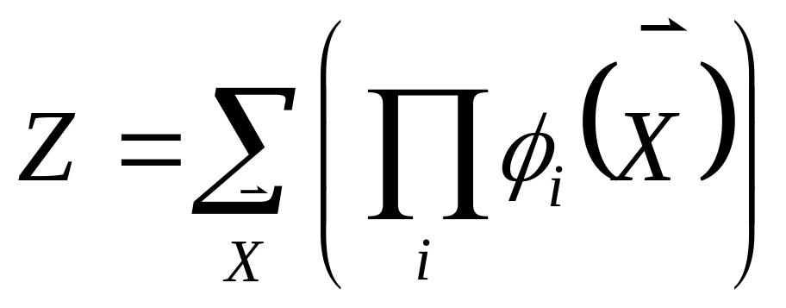
Log linear model
Normalization:

Slide 28
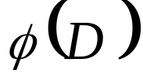
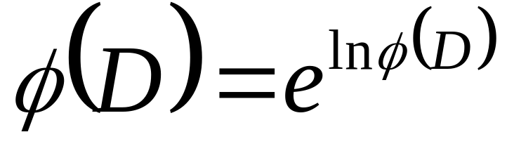
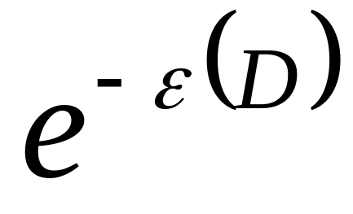
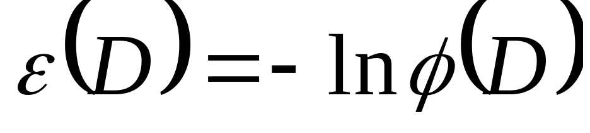
Log linear model
Rewrite each potential as:
For every entry V in
Replace V with ln_{V}
OR
Where

Slide 29
Log linear models
Use negative natural log of each number in a potential
Allows us to replace potential table with one or more features
Each potential is represented by a set of features with associated weights
Anything that can be represented in a log linear model can also be represented in a Markov model

Slide 30
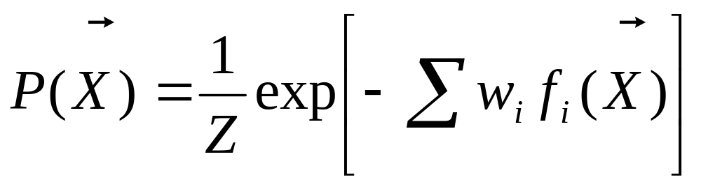
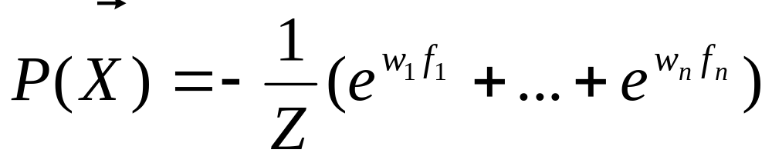
Log linear model probability distribution

Slide 31
Log linear model
Example feature f_{i} : b → a
When the feature is violated, then weight = e^{-w}, otherwise weight = 1
 | a | ¬a
b | e⁰ = 1 | e^{-w}
¬b | e⁰ = 1 | e⁰ = 1
α
 | a | ¬a
b | e^{w} | 1
¬b | e^{w} | e^{w}
Is
proportional
to..

Slide 32
Trivial Example
f₁: a ∧ b, -ln V₁
f₂: ¬a ∧ b, -ln V₂
f₃: a ∧ ¬b, -ln V₃
f₄: ¬a ∧ ¬b, -ln V₄
Features are not necessarily mutually exclusive as they are in this example
In a complete setting, only one feature is true.
Features are binary: true or false
 | a | ¬a
b | V₁ | V₂
¬b | V₃ | V₄

Slide 33
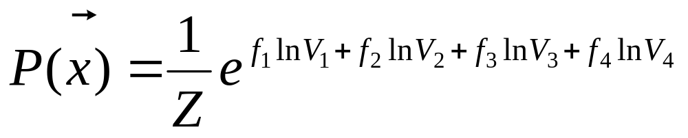
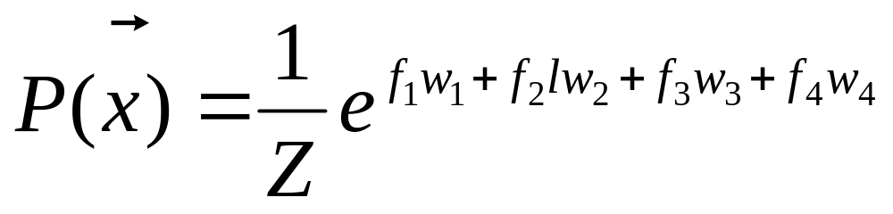
Trivial Example (cont)

Slide 34
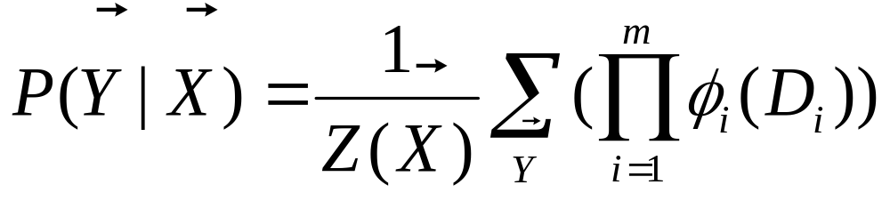
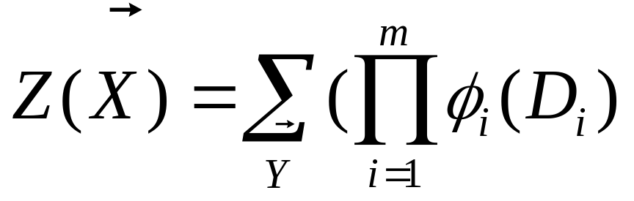
Markov Conditional Random Field (CRF)
Focuses on the conditional distribution of a subset of variables.
ϕ₁(D₁)… ϕ_{m}(D_{m}) represent the factors which annotate the network.
Normalization constant is only difference between this and standard Markov definition

