Slide 1
FinTech Sector Portfolio Analysis
By: The Quagga Group
Ethan Silvas, Naomy Velasco, Karim Bouzina, and Jeff Crabill

Slide 2
Mission Statement
Portfolio analysis of different sectors within Fintech to better understand the growth, correlations, and profitability of Fintech companies.

Slide 3
Goals
How does each Fintech sector, and the individual stocks within them, perform over time?
Which sectors and individual stocks are the best potential investments?
What are the relationships or correlations between each sector?
Based on what we learned about the sectors and stocks, if we were to come up with a Fintech portfolio what stocks would we choose?

Slide 4
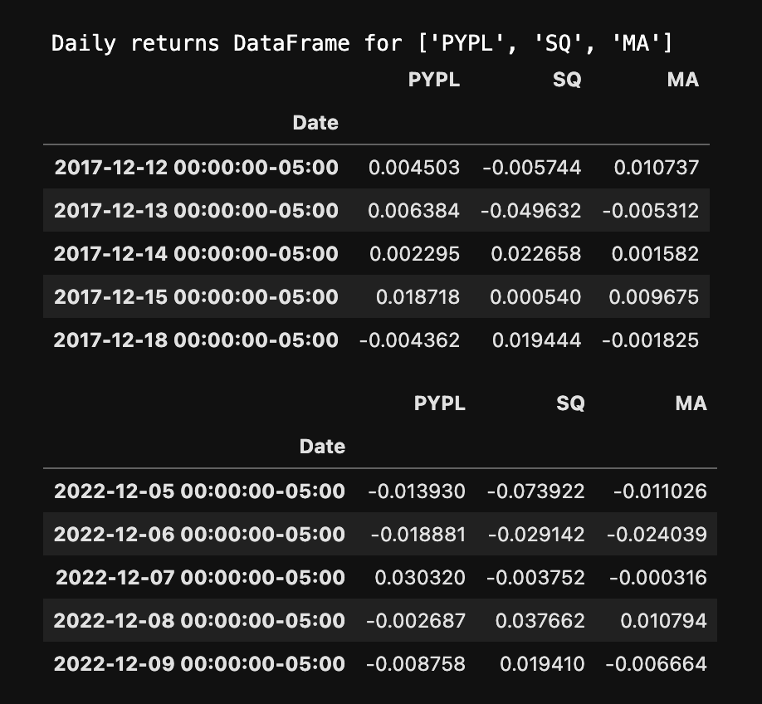
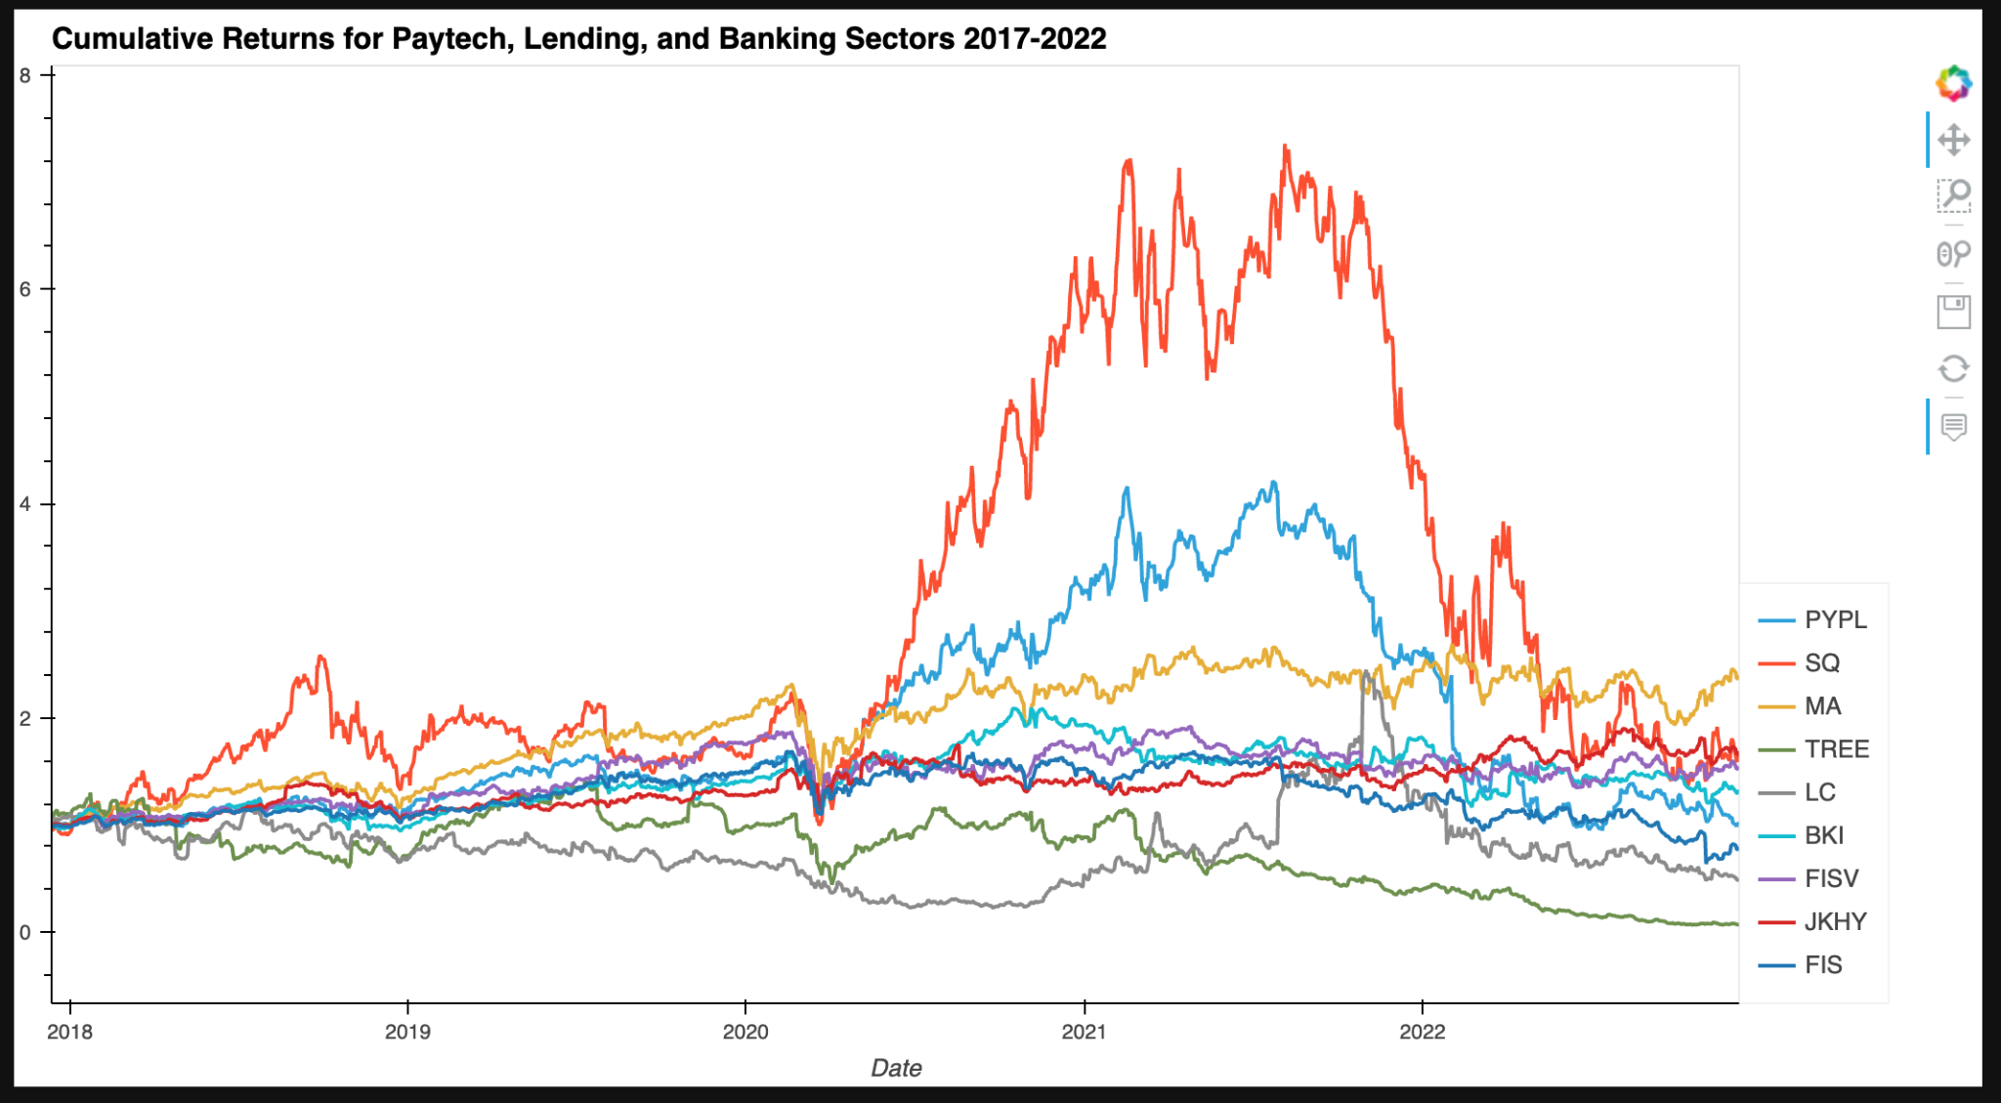
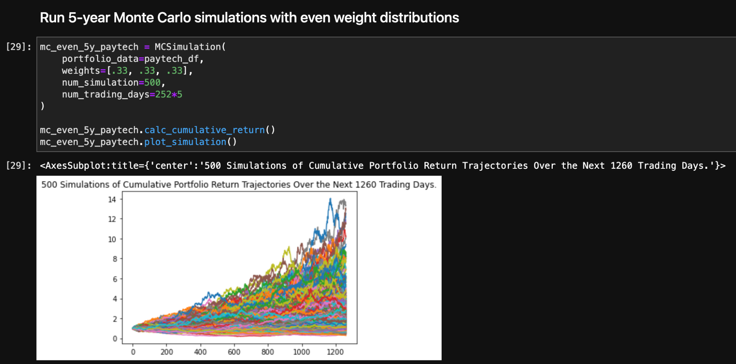
Summary
Collect
Analyze
Predict

Slide 5
Sectors
Paytech
PayPal
Square
MasterCard
Lending
LendingTree
LendingClub
Black Knight
Banking
Fiserv
Jack Henry and Associates
FIS (Fidelity National Information Services)

Slide 6

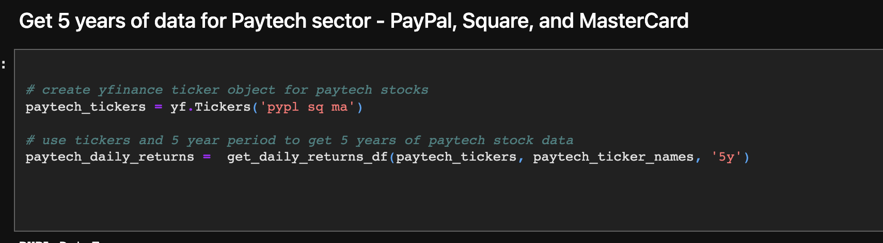
Data Collection
Notes:
Describe the source of your data and why you chose it for your project.
Describe the collection, exploration, and cleanup process.

Slide 7
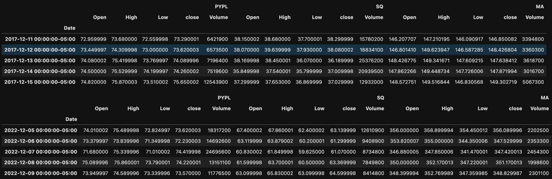

Slide 8
Understanding Our Data
Volatility - box plot
Cumulative returns
Rolling 21-day averages and standard deviations

Slide 9
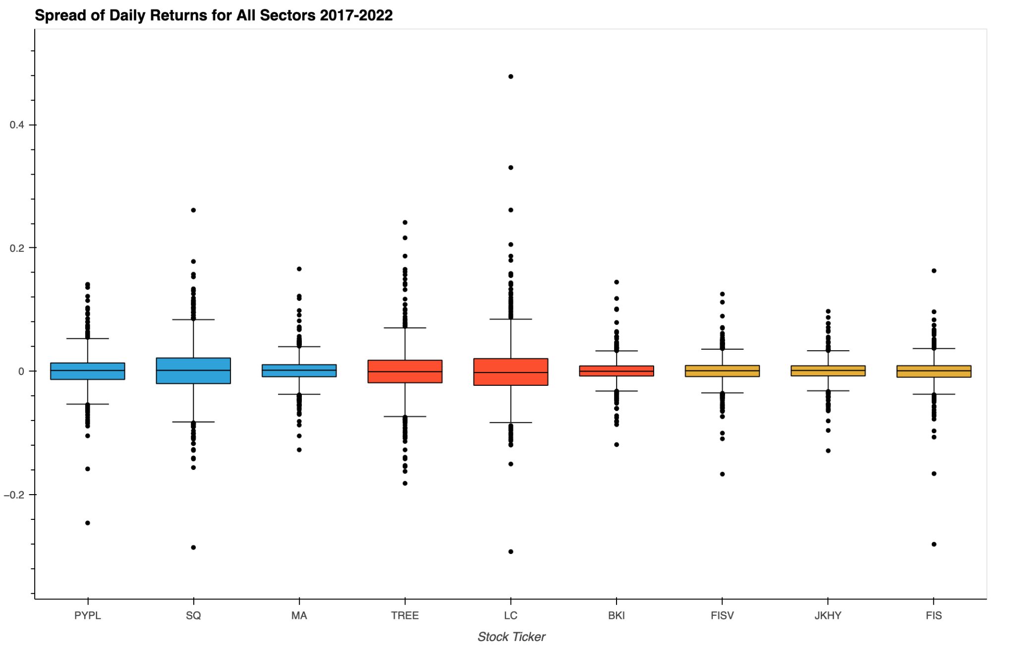

Slide 10
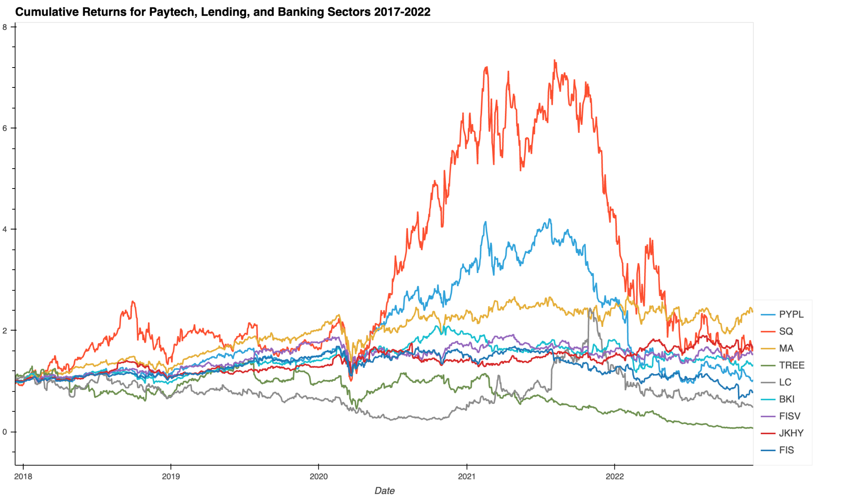

Slide 11
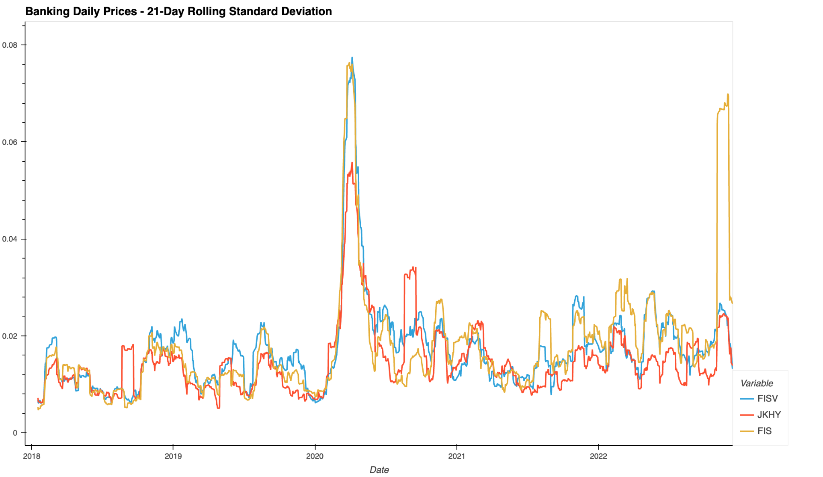

Slide 12
Insights
Betas for Banking->Paytech and Lending->Paytech
Risk-return profile - Sharpe ratios

Slide 13
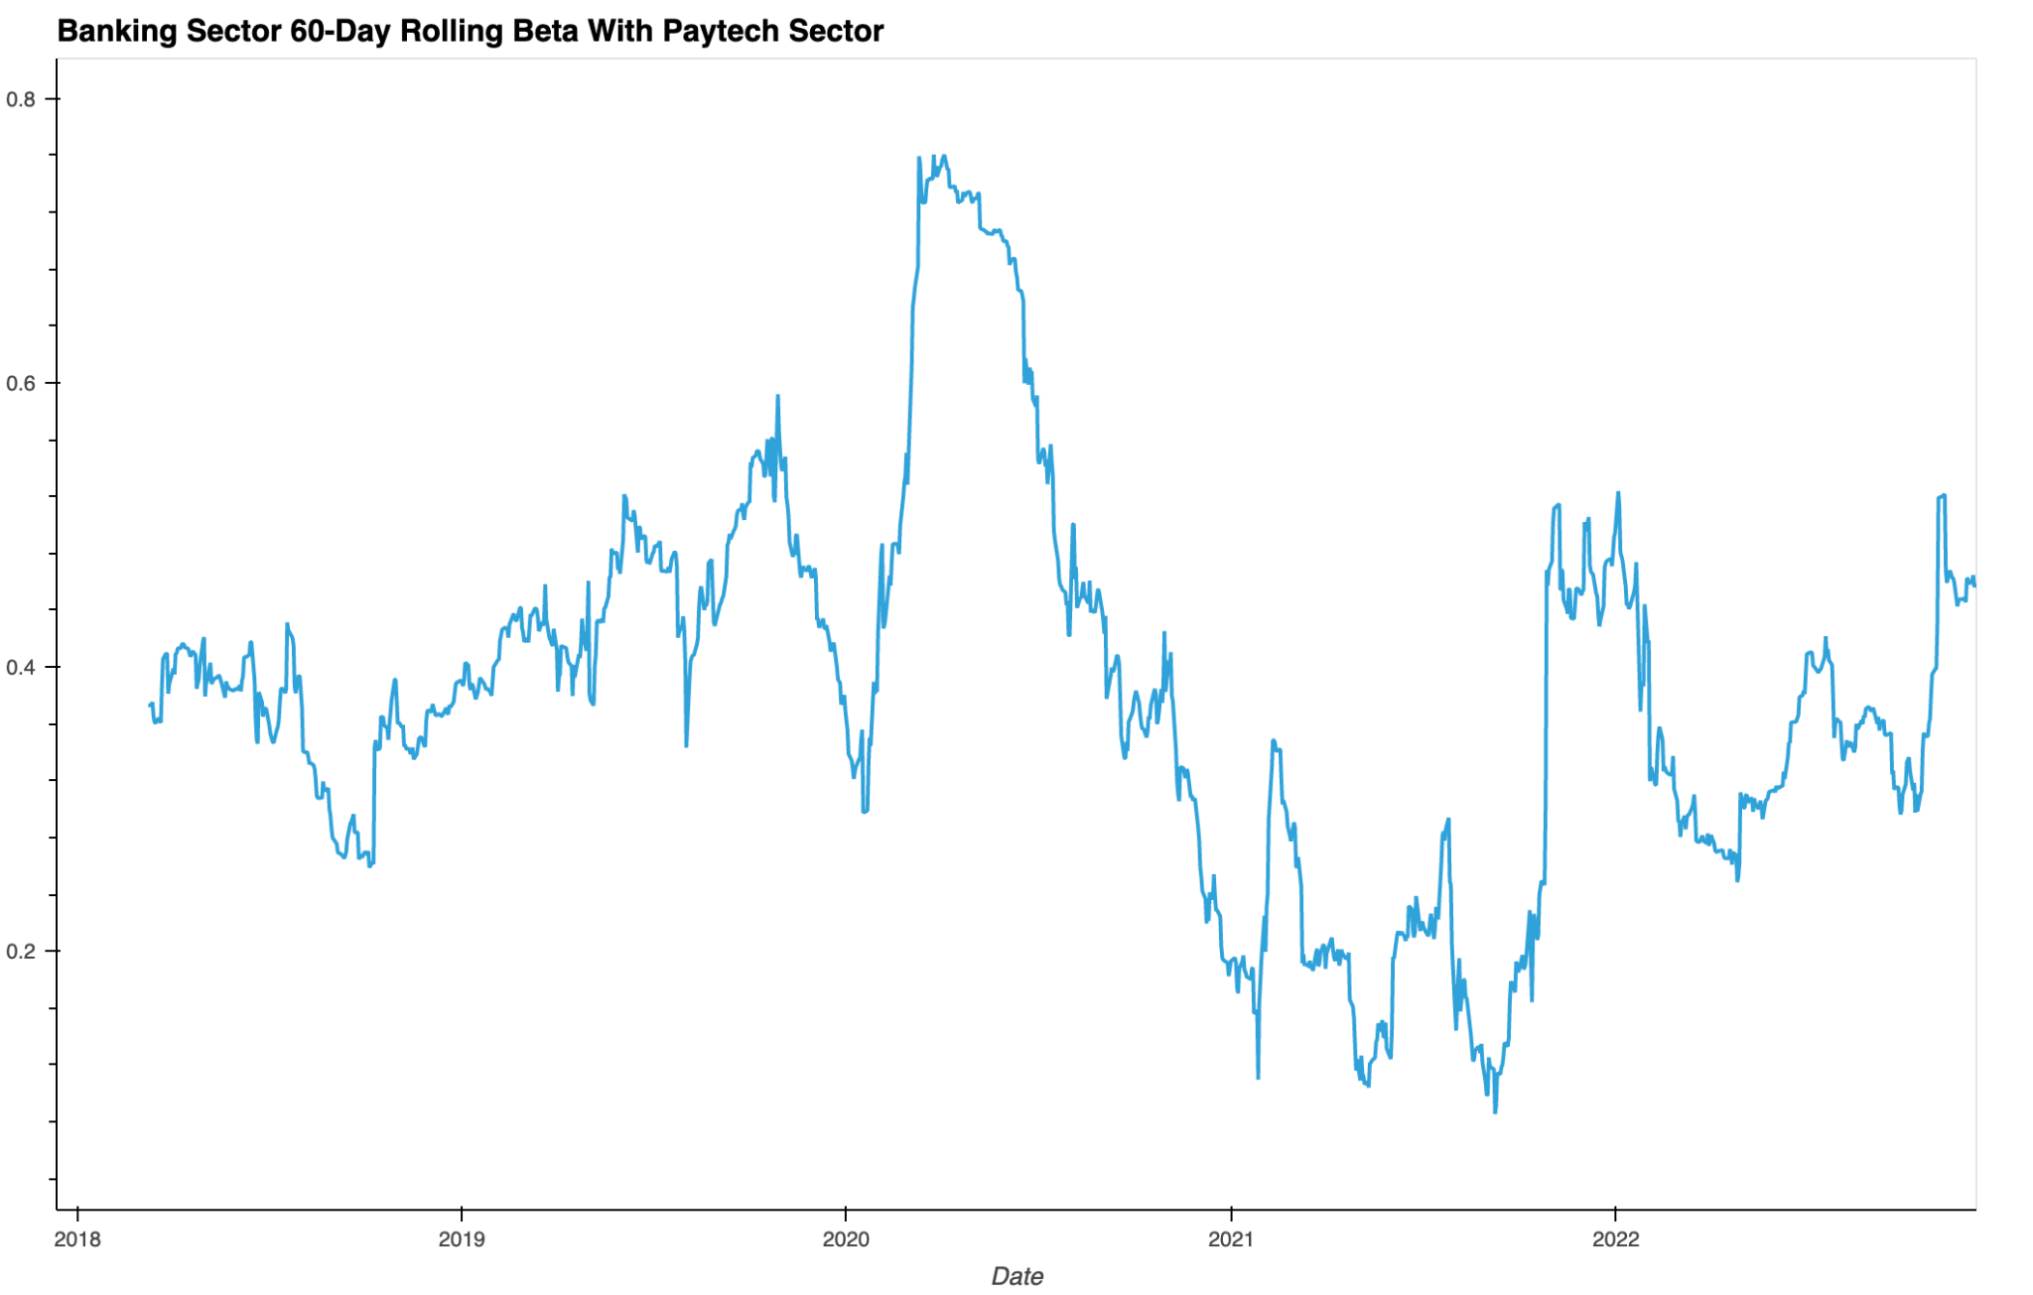

Slide 14
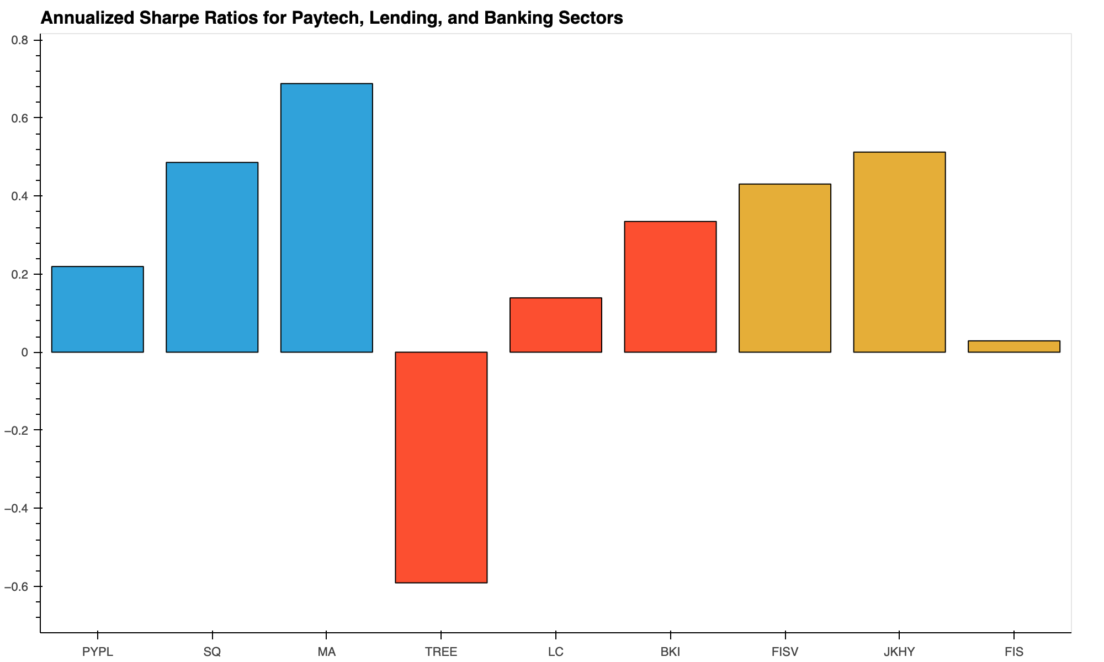

Slide 15
Results and Conclusions: Monte Carlo Simulations
1-year and 5-year predictions using 5 years of data
Even weights and uneven weights based on higher Sharpe ratios
Notes:
Be sure to include relevant images or examples to support your work.
If the project goal was not achieved, talk about the issues and what was attempted to resolve the issues.

Slide 16
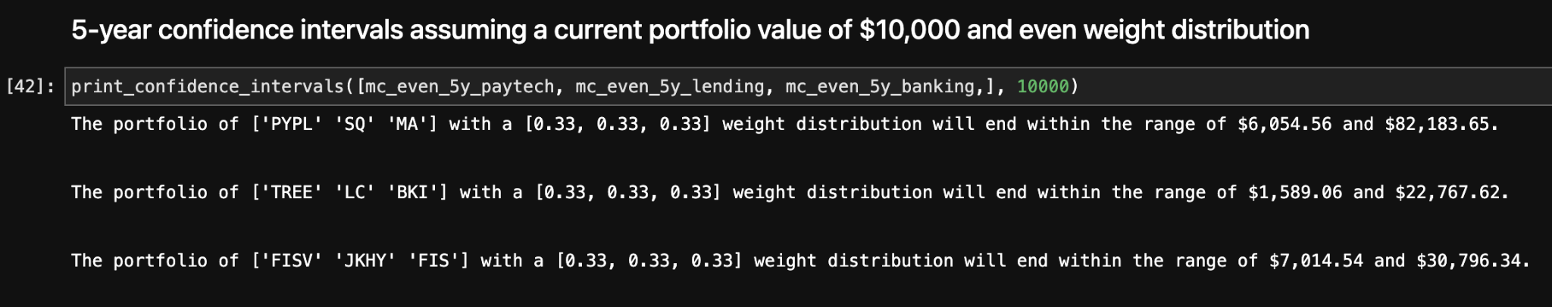
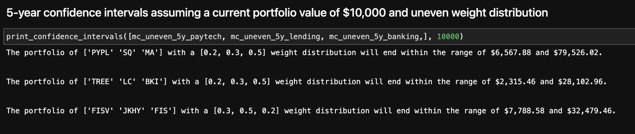

Slide 17
Creating a Custom Portfolio
MasterCard, Square, Black Knight, Fiserv, and Jack Henry
Annualized average return = 18.01
Cumulative return = 2.00

Slide 18
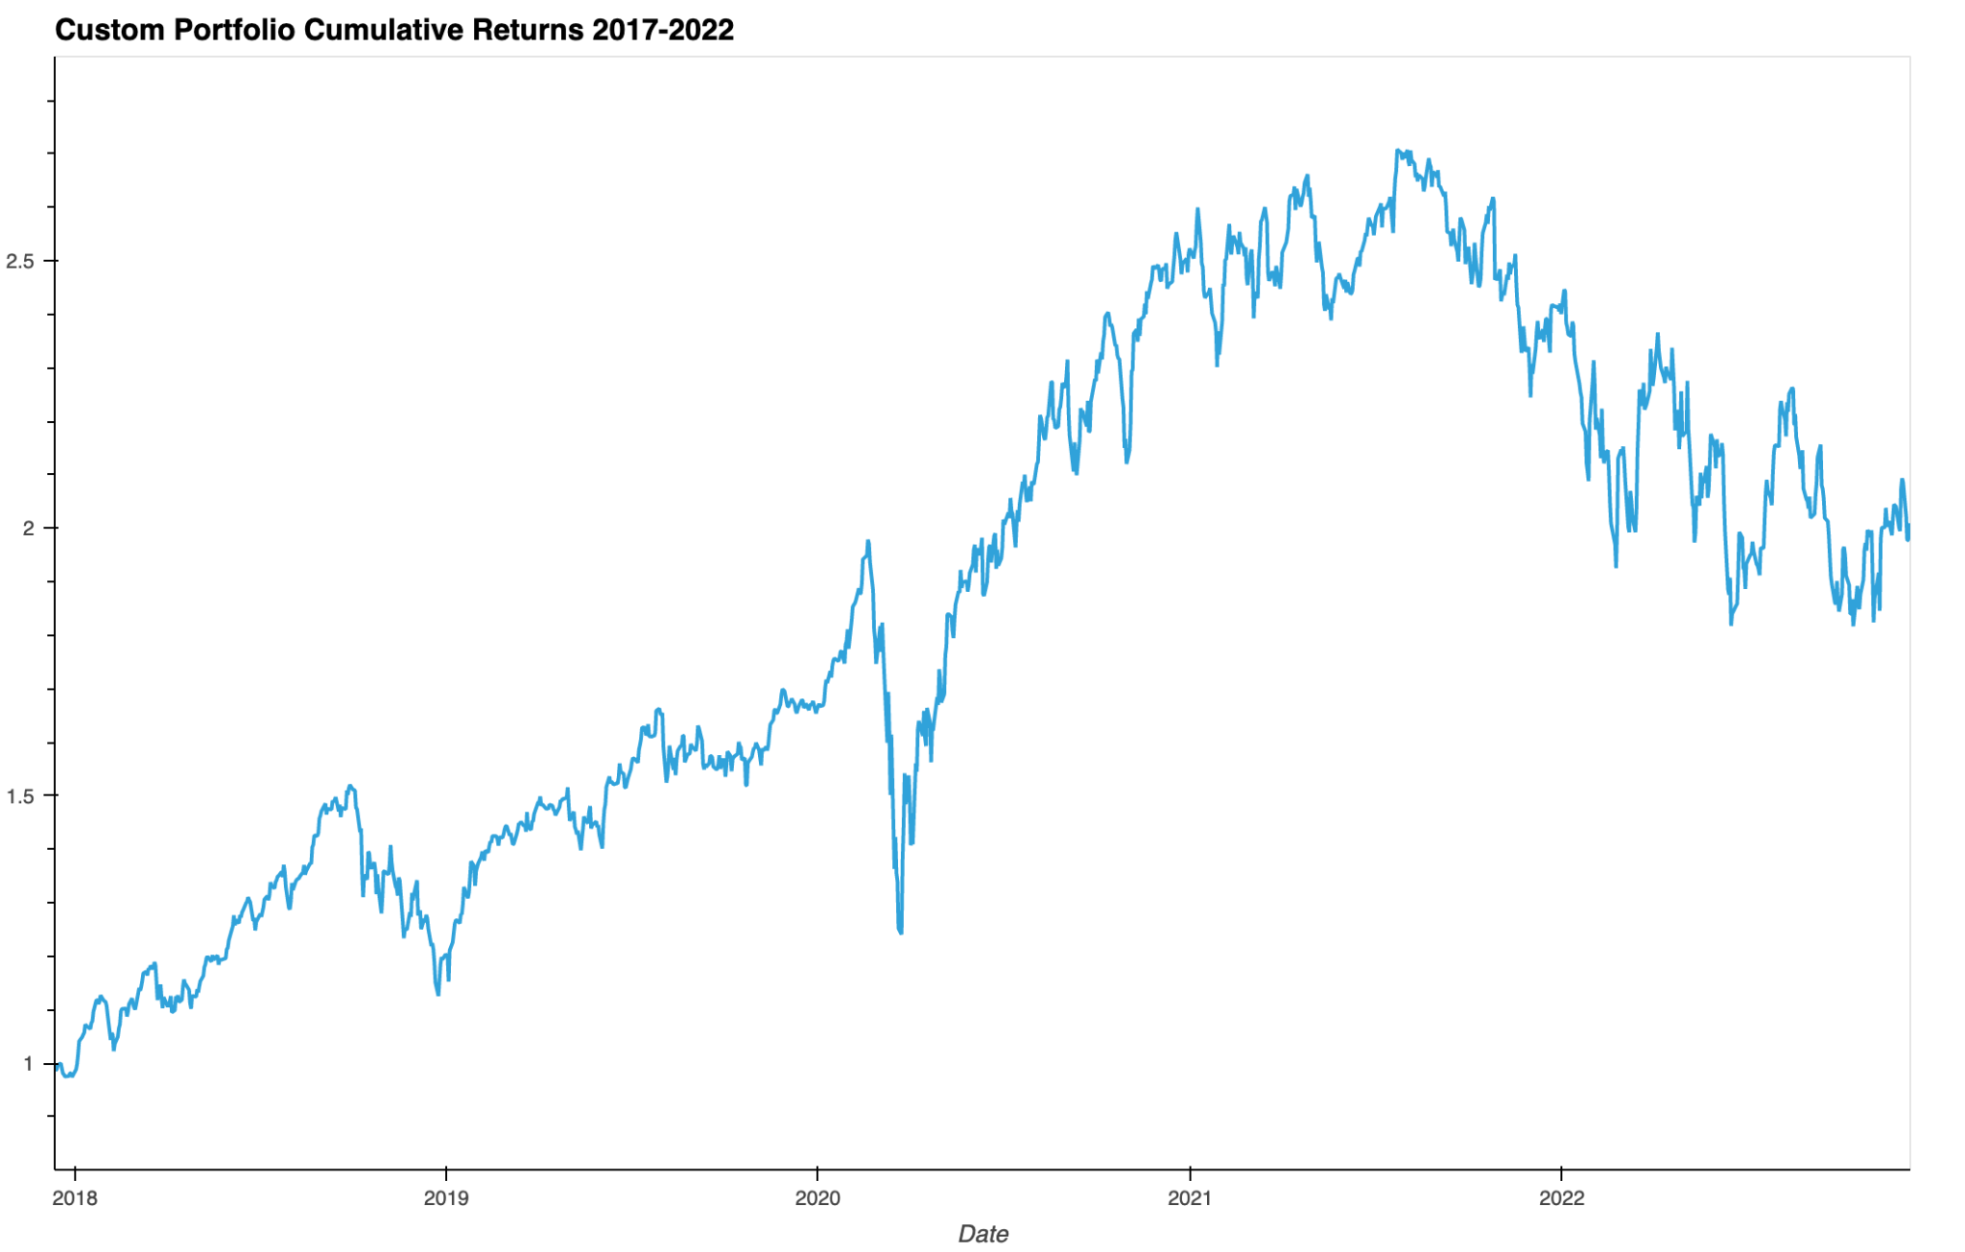

Slide 19
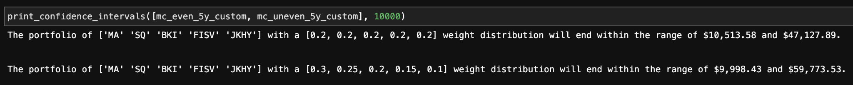
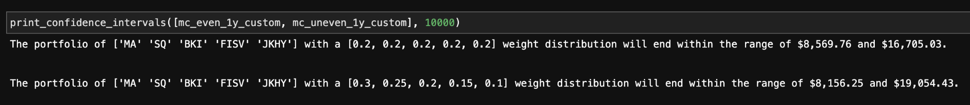

Slide 20
Custom Portfolio Findings
Performs well long-term
Drawback is lots of positive data (2021)
Weight distributions don’t have a clear winner
All sectors have at least one stock that is a good potential investment

Slide 21
Goals Achieved
Paytech and Banking are best sectors
Most stocks are fairly low volatility and have good risk-return profile
Only 3 of the 9 stocks are currently below 1.0 cumulative returns
Best stocks and custom portfolio
MasterCard, Square, Black Knight, Fiserv, Jack Henry and Associates

Slide 22
Issues
New industry; short time length of data
Popular companies recently went public (2020, 2021, etc.)
Companies cover multiple sectors
Jupyter notebook caused lots of merge conflicts with Git

Slide 23
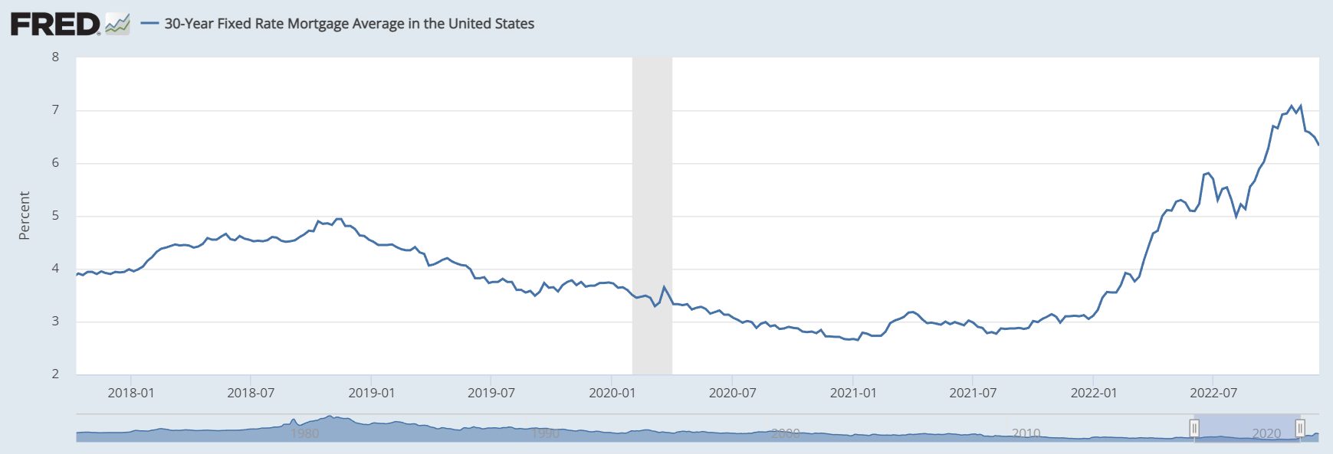
Next Steps
Look into more sectors and the same sectors with more stocks
How each sector perform v.s. each other in varying market conditions
Analyze popular companies that recently went public
Robinhood, Sofi, Coinbase, Affirm
Finding better weight distributions for Monte Carlo simulations
Notes:
Take a moment to discuss potential next steps for the project.
Discuss any additional questions that came up that you didn't have time to answer: if you had more weeks to work on your project, what would you research next?

Slide 24
Thank you!

